Slide 1
Context Middleware
MCP Dev Summit New York 2026

Slide 2


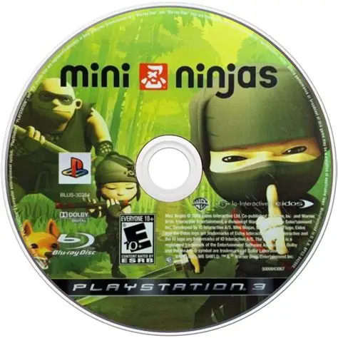

Who am I?
Peder Holdgaard Pedersen
Principal Developer at Saxo Bank (AI Engineering)
MCP Maintainer (FSIG) and Community Moderator
Microsoft .NET MVP (2025)
Background in Game Development and FinTech
Writing a book: MCP Engineering Handbook (Packt)
Who is Saxo?
Online investment bank and trading platform
1.5+ million clients
Systemically Important Financial Institution (SIFI)

Slide 3



Remember when RAG was cool?
Similarity
”Tell me about product X”
<injected_context> Lots of information about product X </injected_context> ”Tell me about product X”
Embedding
Re-rank
”Let me tell you lots of information about product X”

Slide 4

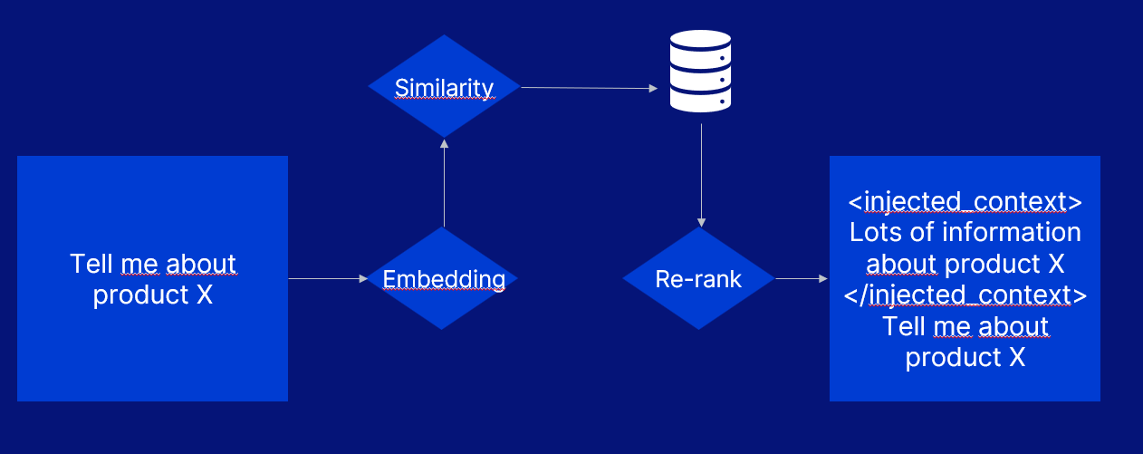
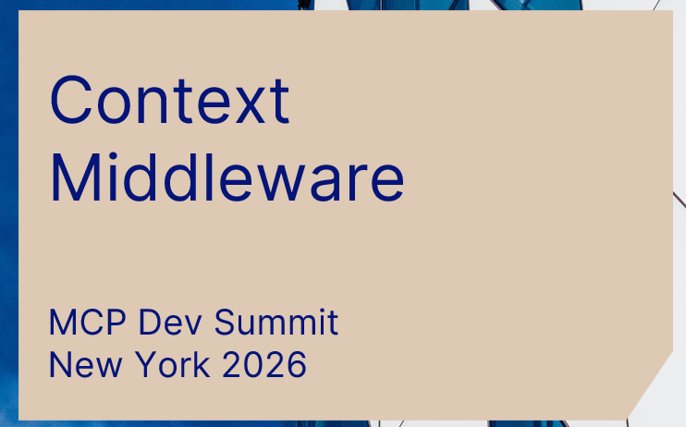
RAG was the original
context middleware!!!
Before MCP
Before agentic search
Before context engineering
… RAG mutated context before it reached the model

Slide 5
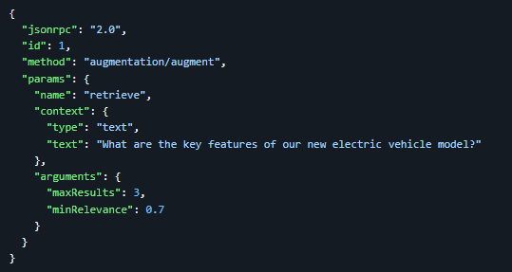

Augmentations – an early proposal
~1 year ago (ancient history)
Server capability
Similar to tools: arbitrary context in, arbitrary context out
Mutations, redactions, augmentations, validation, auditing, etc. Non-portable RAG was really annoying
”Tell me about product X”
(injected context) ”Tell me about product X”
MCP Server

Slide 6
The model Q2 was released in August 2025
The model Q-Plus was released in Spring 2025
RAG is not really that cool
Depends on vector similarity:
Structure can dominate:
”What is your latest EV car model?”
The model W is the newest car as of May 2024
<preface> This collection of Danish fairytales…. </preface> <contents> …
</contents>
<query> Tell me about me about myths from my home country? </query> <user_info> Peder H Pedersen, Copenhagen, Denmark </user_info>
Saxo Grammaticus writes that Denmark was founded by…

Slide 7
Augmentations – a confession
~1 year ago (ancient history)
CONFESSION…
I wanted this for reasons other than RAG… but lots of other people thought RAG was cool!
However… augmentations still didn’t fly with the maintainers or the community…
Use resource templates
Is this really a great idea?
Sending context through a third party? Security? Privacy? Isn’t RAG something that client implementer should know about?
What kind of crazy people use MCP if they control both client host and server?

Slide 8

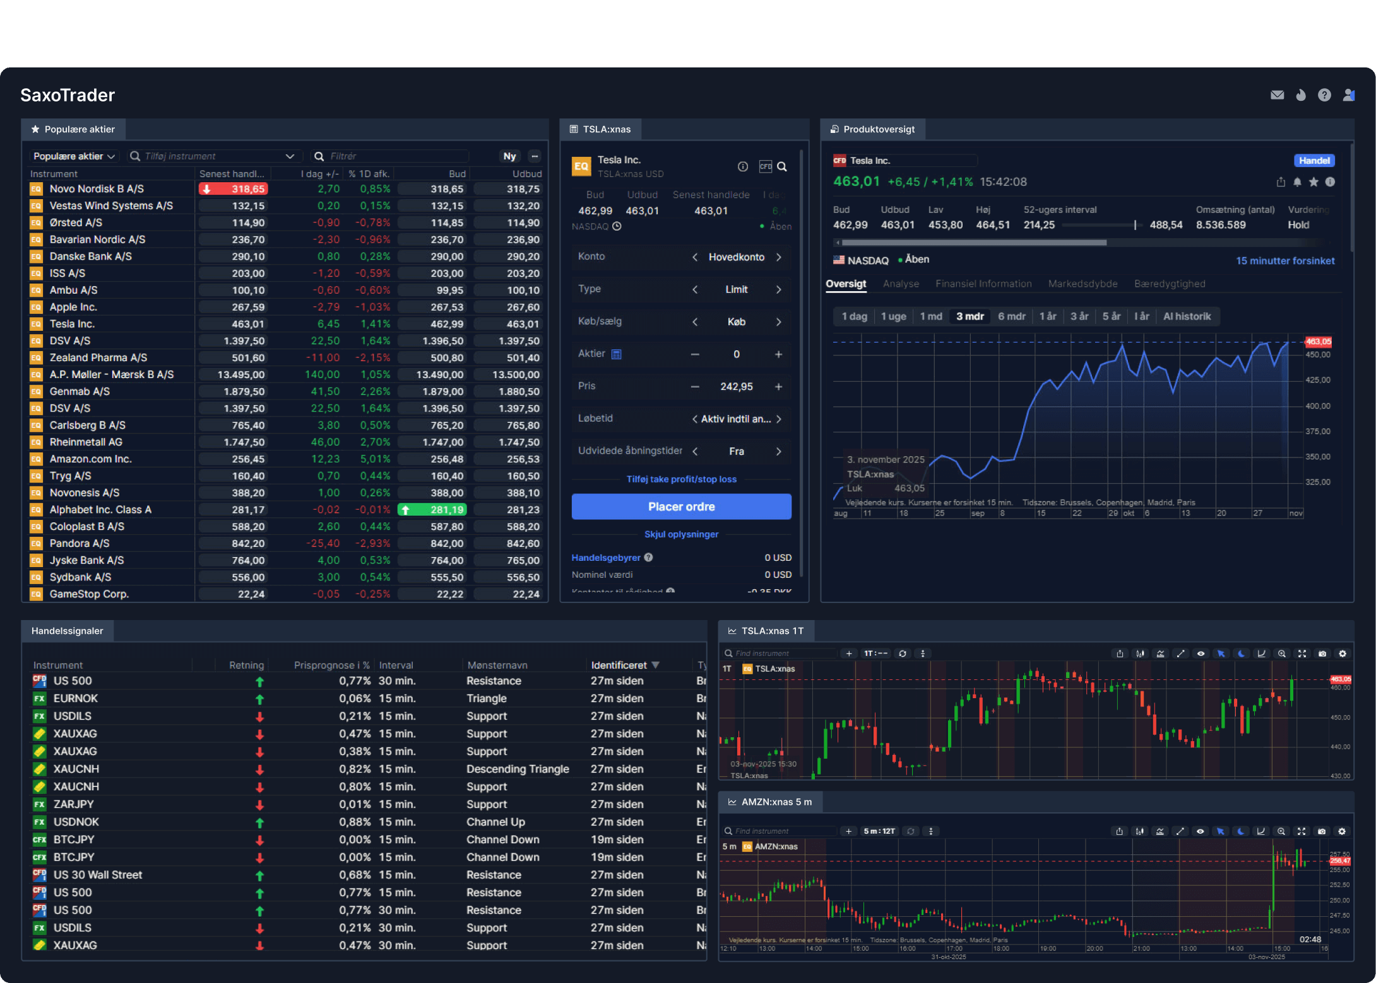

Once Upon a Chatbot…
A story from the real-world from when assistant were still chatbots
Question
Answer Citation
MCP Server
??? HALLUCINATION ???

Slide 9
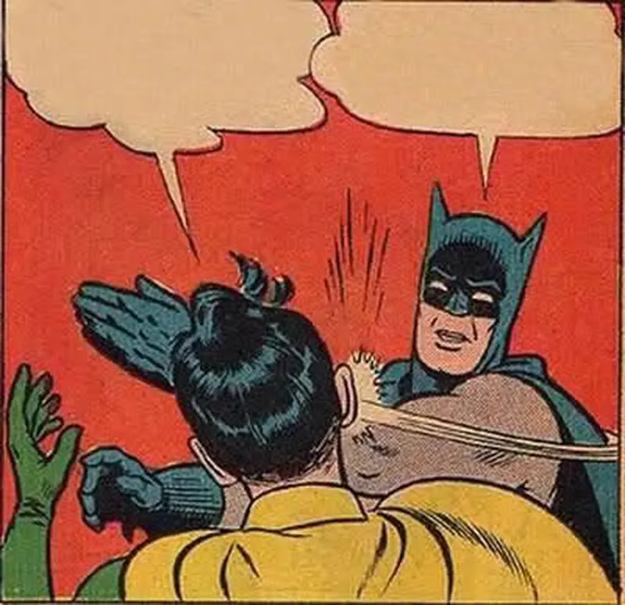
Once Upon a Chatbot…
Hallucinations are unaccaptable – even when rare!
The first insight:
- Hallucinations almost always accompanied by a hallucinated citation!
The second insight:
- Retry beats corrective extra turn
But I believe that…
RUN YOUR EVALUATIONS!
Answer Citation
Hallucination
Detection
Service
Finding
Action

Slide 10
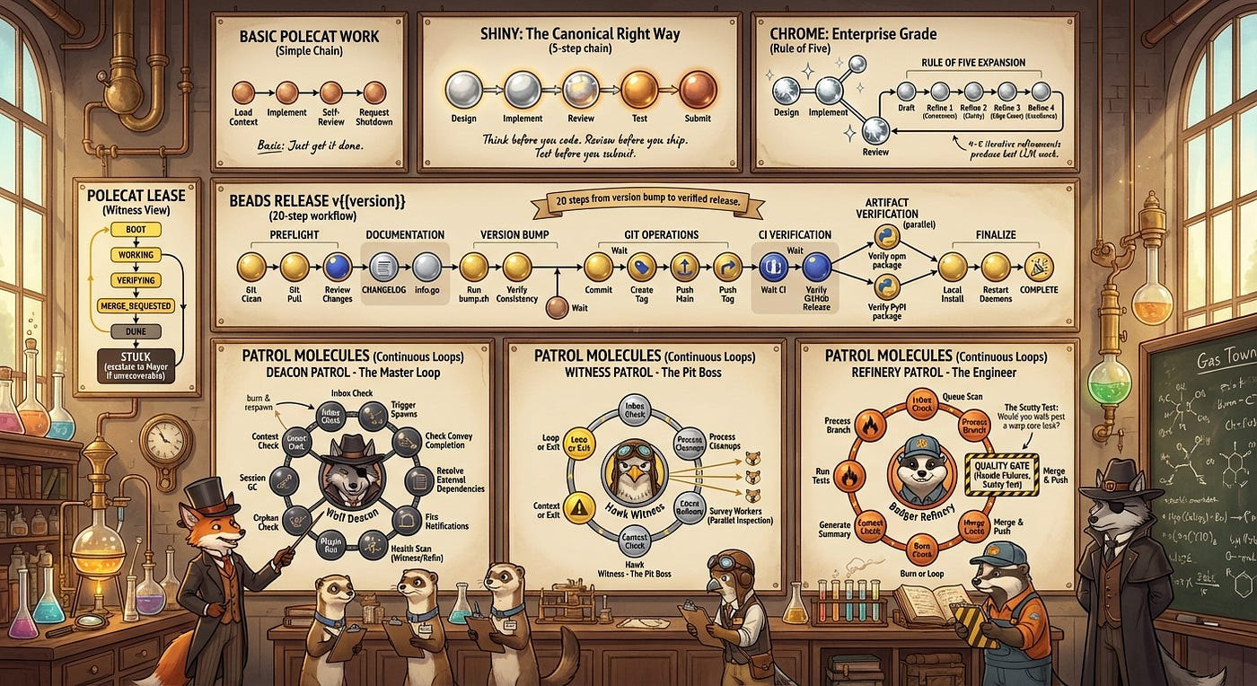
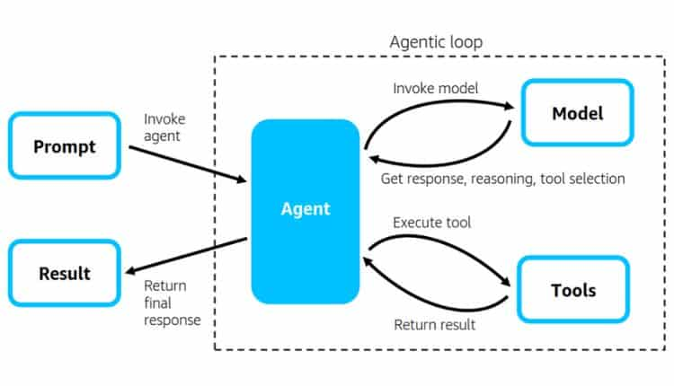

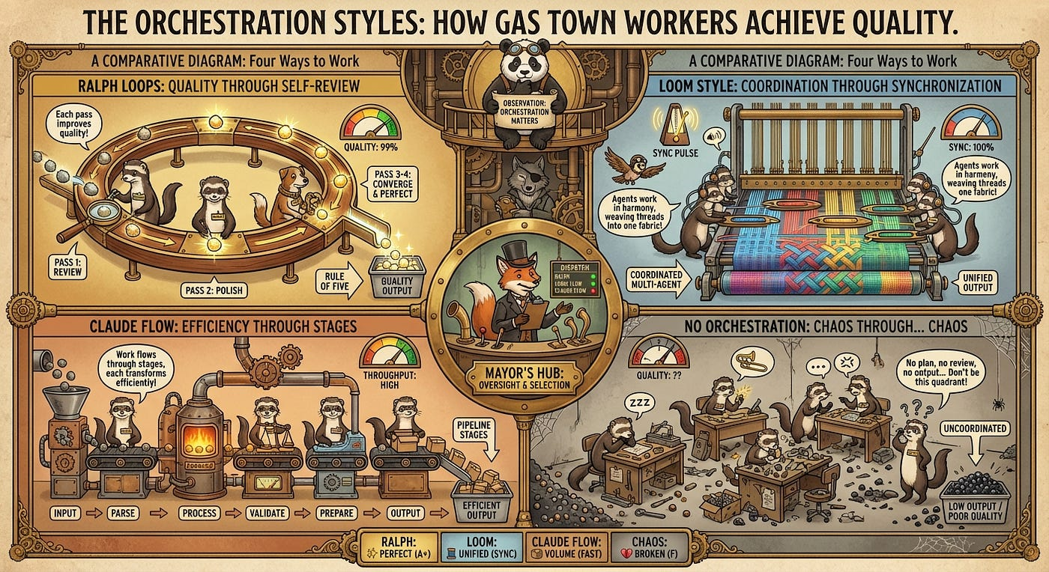
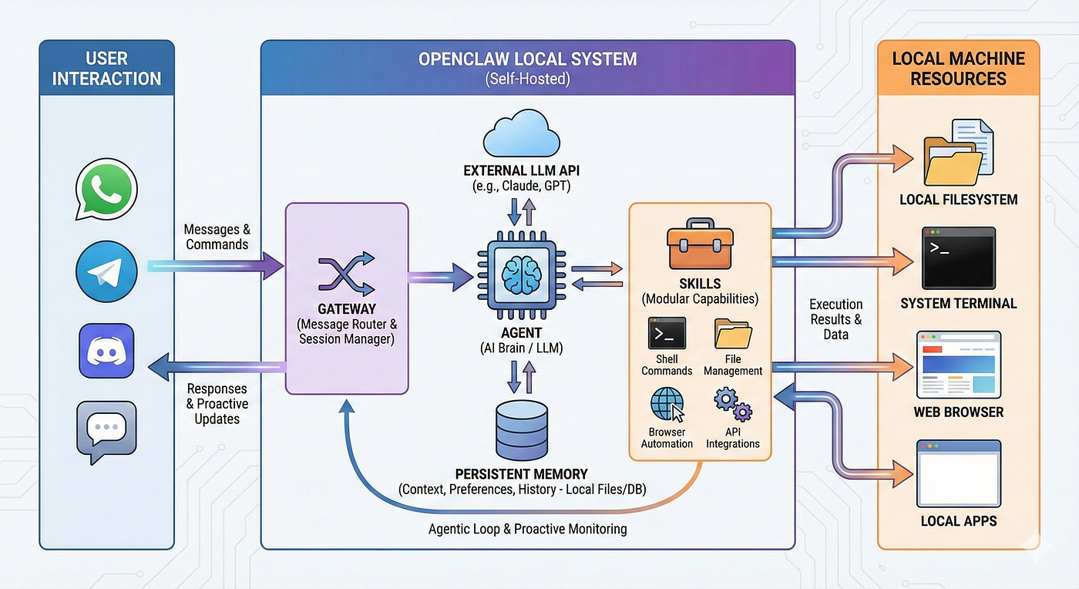

Autonomy and complexity keeps increasing

Slide 11
Autonomy and complexity keeps increasing
Stage | Description | Middleware
Dumb chatbot | No tools, static context, maybe some RAG | What’s middleware?
Conversational assistant | Tools, agentic RAG, integrations | RAG, guardrails
Long-running agent | Agentic models, advanced harnesses | Hooks, Ralph loops
Autonomous agent | Communicates through side-channels, high-risk access, unobserved | …needs middleware everywhere!

Slide 12
Context Middleware – what is it good for?
Security & Compliance | Platform & Ops | Product & Risk
PII redaction | Auditing | LLM guardrails
Data sensitivity handling | Tool filtering | Progressive disclosure
Trust boundaries | Tool call/result validator | Hallucination detection
Data attribution | Caching | Context enrichment

Slide 13
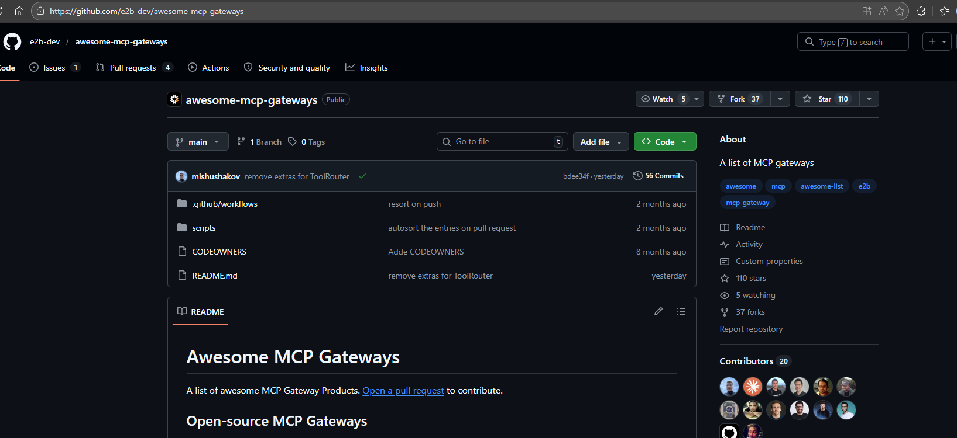
The Middleware Landscape today
20+ major gateways Launched in 2025
Inconsistency in SDK middleware/
Filtering features
In-Process:
FastMCP and C# SDK, not many others
Naming hell…
Hooks, policies, filters, plugins, interceptors, middleware, guardrails, mutators, mesh, access control
https://github.com/e2b-dev/awesome-mcp-gateways

Slide 14
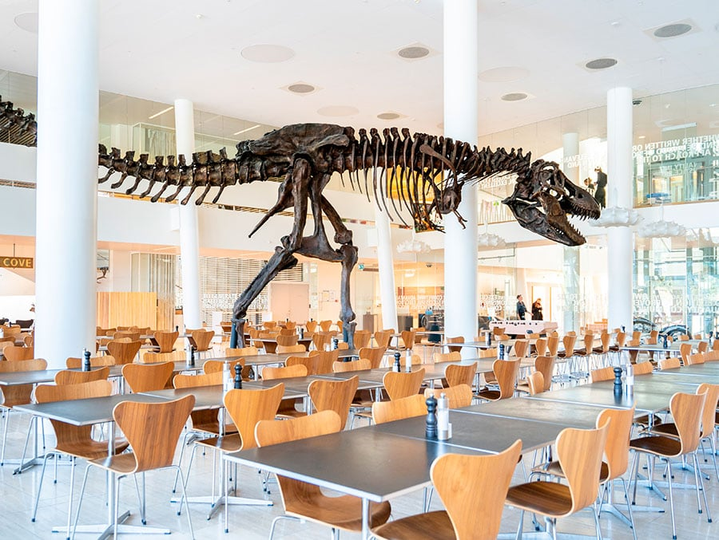
The Middleware Landscape today
M x N is back with a vengeance!!!
Ecosystem is trying to fill a gap in the protocol, but there is no standard, no portability

Slide 15


Enter the Middleware Interceptor SEP!
Author: Sambhav Kothari
https://github.com/modelcontextprotocol/modelcontextprotocol/issues/1763 https://github.com/modelcontextprotocol/experimental-ext-interceptors
Enter the Middleware SEP!

Slide 16
Not covering client / server bounded middleware
But it is also part of the discussion
NOTE!
SEP-1763: Interceptors
Protocol-level interception points across the MCP message flow. Retrieved using interceptors/list,called using interceptor/invoke
Validation
Parallel, pass/fail gates (compliance, security, contracts
Mutation
Sequential, transforms payloads (PII redaction, encryption, format conversion, injection, progressive disclosure)
Observability
Parallel, fire-and-forget (logging, metrics, audit, sidecars)
Targets
Existing methods (tool/call, resources/list, etc) and llm/completion

Slide 17
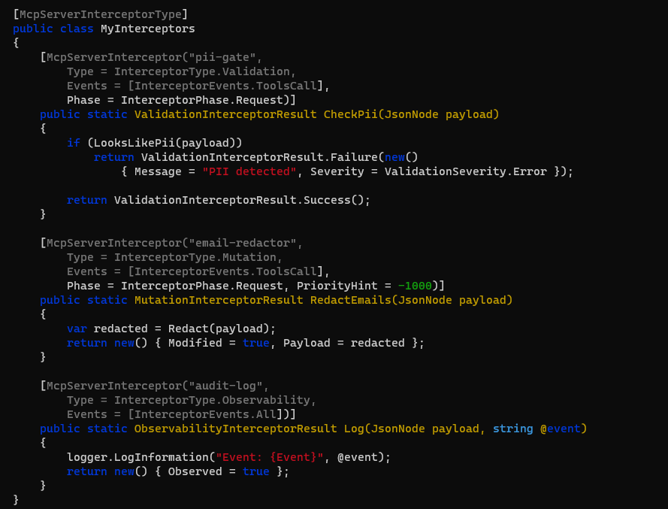
SEP-1763: Interceptors

Slide 18
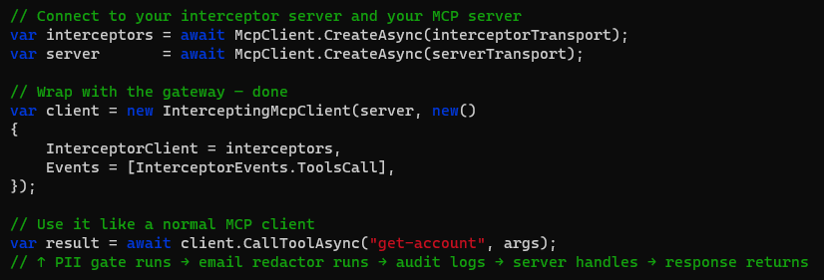
SEP-1763: Interceptors
Note: Simple case that runs full chain of a given gateway server.
interceptors/list allow client-side discovery and configuration of which specific interceptors to invoke.

Slide 19
SEP-1763: Interceptors
MCP Client
MCP Server
MCP Server (interceptor)
Mutations (sequential)
Validations (parallel)
Observability (parallel, fire-and-forget)

Slide 20
SEP-1763: Interceptors
Chain execution model
Requests
Responses
Orderable
Composable

Slide 21
SEP-1763: Interceptors
Chain execution model
#3B
Auditing
Request
#1
#2
Response
Enrichment
PII Redaction
#3A
MCP Server
PII Restoration

Slide 22

Validation
Parallel – but blocking!
Example – detect API keys and credentials
Target tool/call
Scans calls
Pass – tool call passes on as if nothing had happened
Fail – tool call is blocked and never reaches the server
Other example: compliance gates, content guardrails, input contract enforcement, policy enforcement, rate-limiting

Slide 23
Mutation
Sequential – ordering matters!
Example – inject time and date
Target llm/completion
Injects current time and date
Other example: email redaction, RAG, format normalization, enrichment, tool list filtering, tool description optimization, response substitution

Slide 24
Observability
Parallel – but fire-and-forget!
Example – live alerting
Target tool/call
Scans calls
Detection of a suspicious patterns – alert a human operator
Other example: logging, audit trails, metrics collection, sidecar content, distributed tracing

Slide 25


The Hallucination Detector Reimagined
Answer Citation
Runs validator
MCP Server (interceptor)

Slide 26

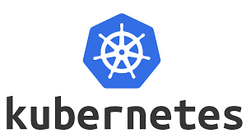
Ecosystem Impact
This isn’t about replacing middleware vendors – but about creating portability and standardization.
Standardized guardrail and safety services
Portability & composability

Slide 27
Enterprise Impact
Who | What
Security teams | Portable visibility and control
Compliance | Auditable interceptions at the protocol level
Platform teams | Reusable infrastructure
AI engineers | Composable and orderable hooks

Slide 28
What was this new method?
Maybe this was the sampling we needed along?
Maybe model invocation doesn’t need to be a client capability?
We could make this a ”real” method?
Would be really useful for the hallucination example…
Maybe it is an overreach – but we keep getting signals…
llm/completions

Slide 29

Middleware is here to stay
The question is whether we want to solve M x N for middleware too
And maybe we can soon say….
Remember when we couldn’t do RAG with MCP?

