Slide 1
If You Can Secure It Here,
You Can Secure It Anywhere
MCP Dev Summit | NYC
April 2026

Slide 2


Katrina
Liu
About Us
Milan
Williams
Software Engineer,
Semgrep
Product Manager,
Semgrep
Notes:
"I'm Milan, I'm a product manager at Semgrep.
Katrina is a software engineer on the team who built a lot of what we're going to show you today.
Semgrep is an Application Security platform. We help hundreds of security and engineering teams find software vulnerabilities, before they ship to production. Our customers include some of the largest and most security-conscious companies in the world.
So when the AI coding agent wave hit, and it became clear that our security tooling needed to adapt to this new wave of agent engineering. But we also knew we couldn't build it the way most people were building MCP servers. We needed to build it the way our customers would build it. Which meant starting somewhere most people don't start: with a real threat model."

Slide 3


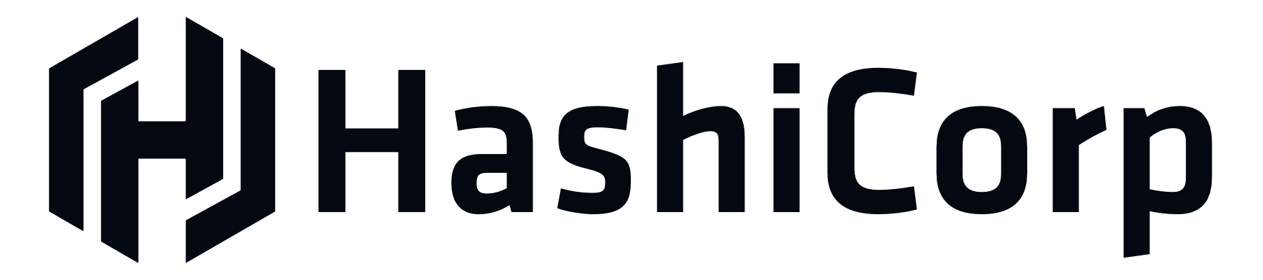
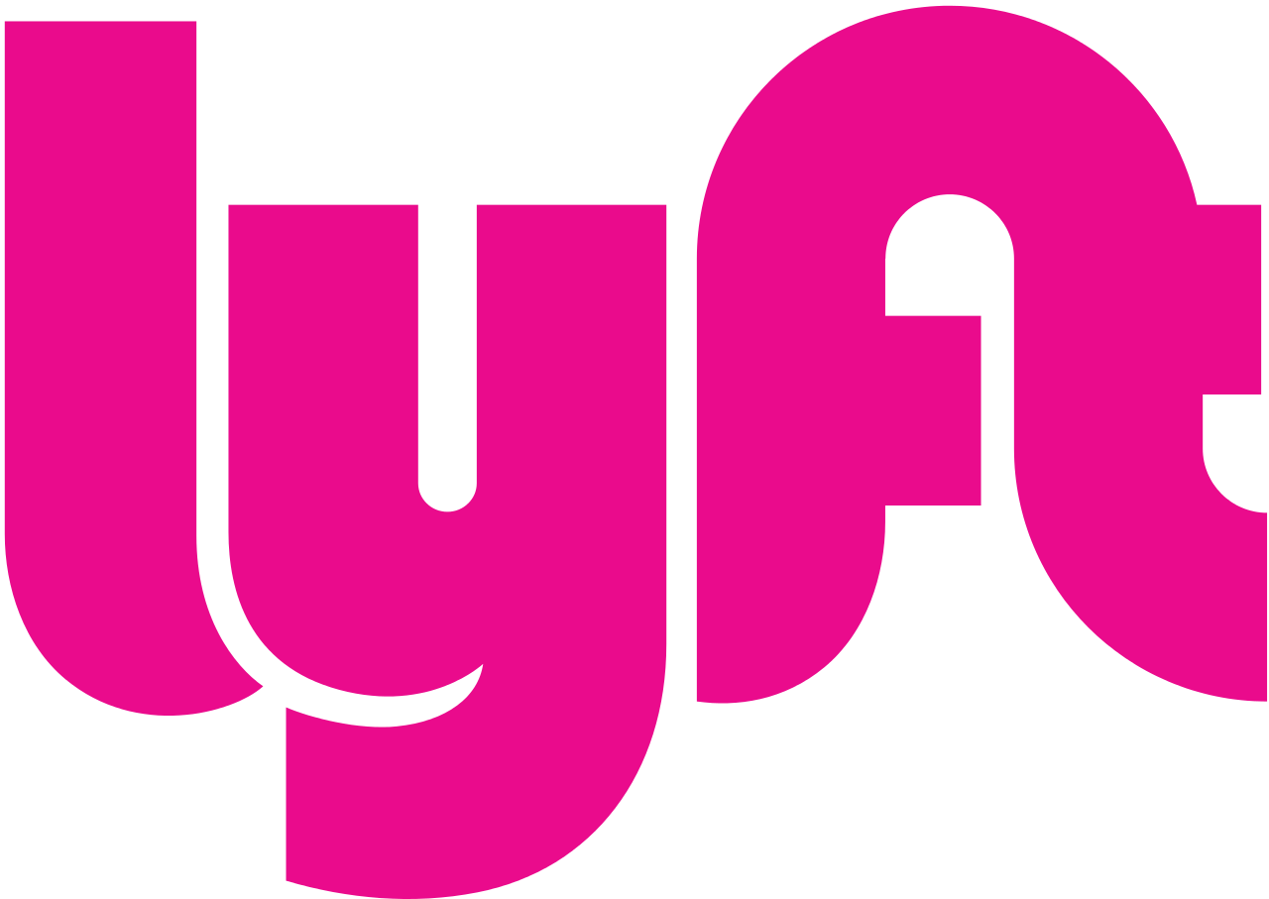
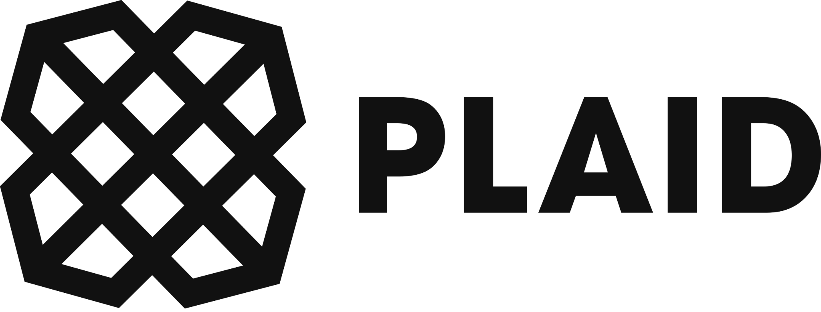
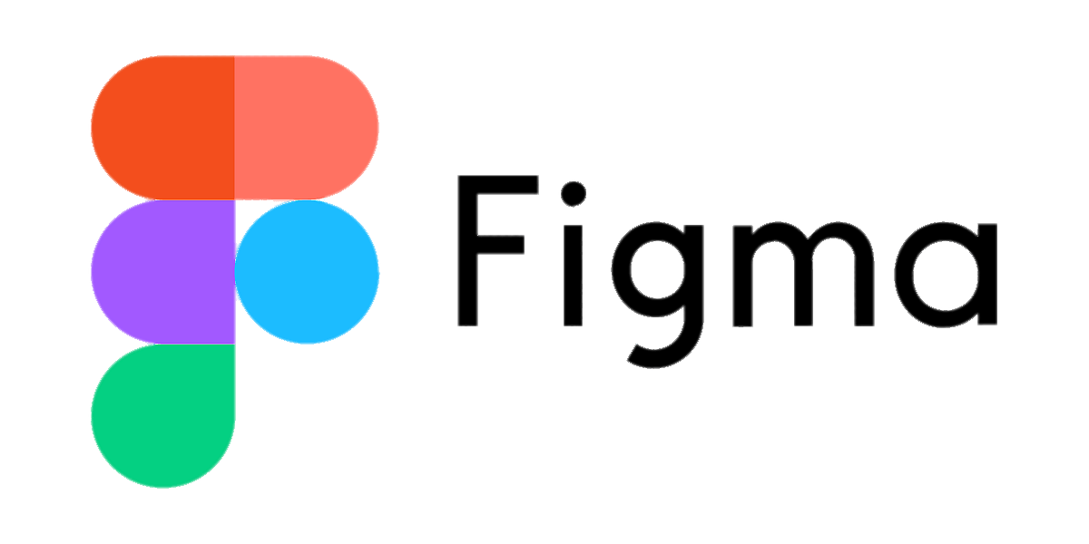
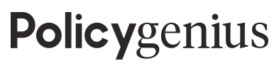



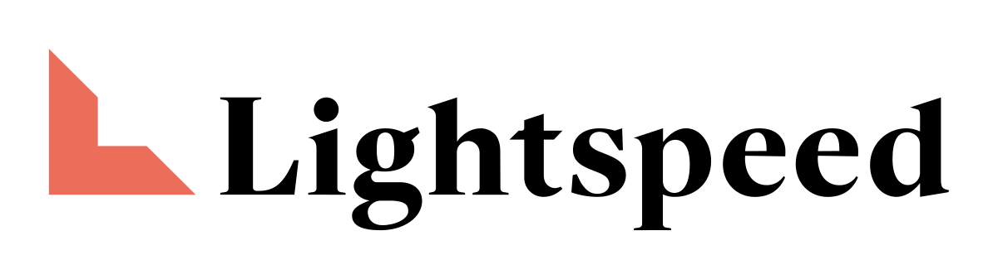


About Semgrep
Innovative Organizations Depend on Semgrep
The AppSec platform for secure guardrails
Multi-modal SAST: deterministic + AI
SCA: Codebase-Aware Reachability
Secrets: Protecting your keys, credentials
and tokens
Assistant and Assistant Memories: your AI security engineer that reduces backlogs
by 20% out of the box
Semgrep powers over 10M scans per month
Top Tier Investors
Top Tier Investors

Slide 4
Agenda
1. Why we built it
2. Real MCP attacks
3. Challenges
- Non-determinism
- Hallucinations
- Authentication
4. How to secure your MCP server
Notes:
Take a step back
What can an MCP server actually expose?
Store / send sensitive information (code)
Tools that can expose Semgrep’s APIs
…
Rough outline
Introductions
About us
Agenda
Why did we build an MCP server in the first place?
About Semgrep - we build security tooling for enterprises…code security for builders
AI agents are generating >majority of software. One customer said 90% of PRs should come from Cursor by the end of the year. At the same time, agents are generating software that is less secure than humans, and at a much higher rate. Need a solution to protect against the explosion of vulnerabilities. Enter Semgrep’s MCP server!
Security implication:
The MCP protocol is still early / untested. Not a lot of threat models / hardening standards yet.
Other companies could iterate in public but not us.
Soon, there started to be high profile incidents that targeted MCP users.
mcp-remote had a RCE that affected over 400,00 developers. Needed a different approach.
On top of that, we have threat actors that run targeted campaigns against Semgrep / other security companies. Under a higher scrutiny than most.
Challenges we faced & how we resolved them [Katrina]
Remote vs. local
Authentication (Oauth vs. semgrep tokens)
Lack of determinism
Takeaways [Milan]
We bundled all of our learnings into this security engineering checklist - hope it can be useful for you / your teams who are hardening your own MCP servers!
The point isn't that everyone has our threat model. The point is that we’re all in this together, the ecosystem will get stronger when builders hold themselves to a higher security standard.

Slide 5
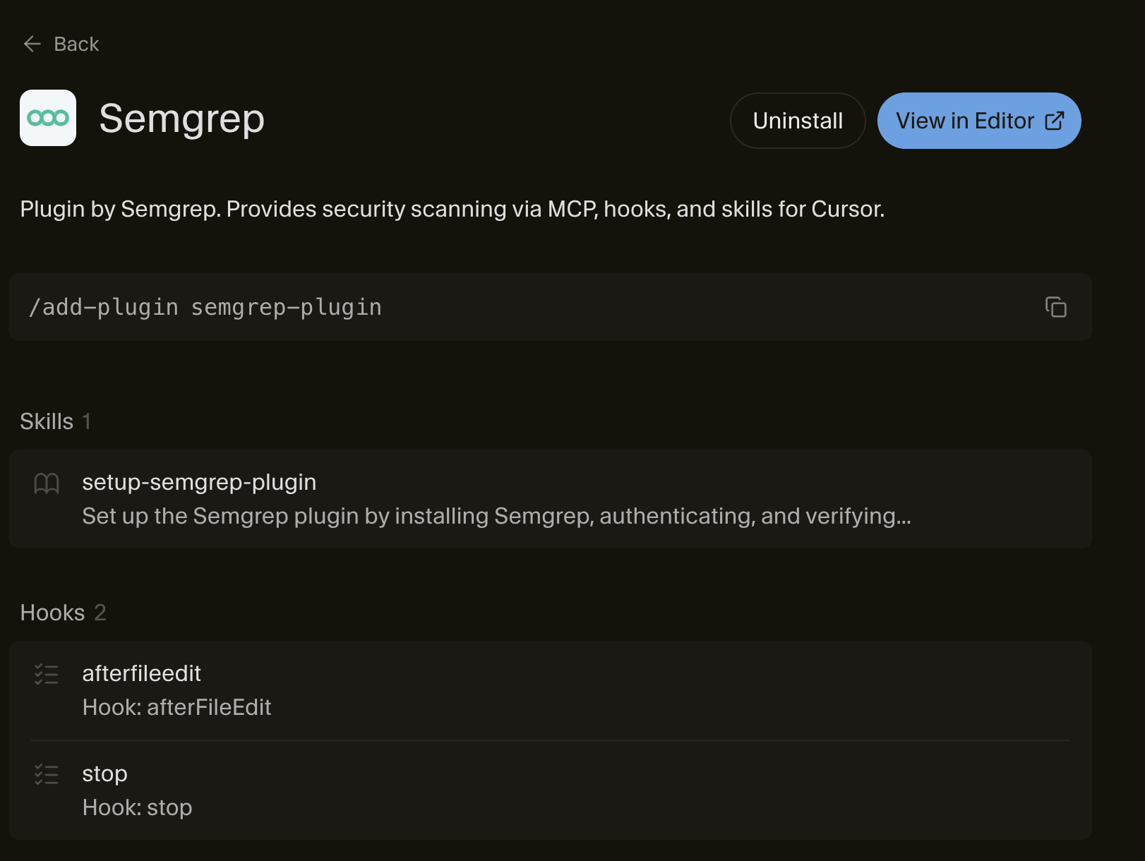
Why we built
an MCP server
More vulnerabilities than ever
Fastest time to exploit in history
Security teams are overwhelmed & understaffed
Notes:
It’s clear to everyone in this room that agents are generating >majority of software. One of our customers has an explicit engineering mandate that 90% of PRs should come from Cursor by the end of the year. While I want to debate the merits of those kinds of KPIs, I do understand what drives them. It’s undeniable that engineering (alongside almost every industry) has fundamentally changed with the introduction of AI.
At the same time, research shows that agents generate software that is less secure than humans, (up to 3x more vulnerabilities), and of course write software at a much higher rate. For security teams, that leads to an explosion in vulnerabilities that they’ve never seen before. At the same time, attackers have the advantage. With AI tools, they can go from detection to exploit faster than ever before. Now, all of the sudden the “low severity” vuln in the backlog that would never get fixed, becomes incredibly cheap for an attacker to spin an exploit for. All while this is going on, security teams are still tasked to do more with less. Budgets and headcount have stayed largely stagnant – so they need a solution (now) to protect themselves that’s built at the speed of how attackers are using it.

Slide 6
Semgrep’s Threat Model

Slide 7
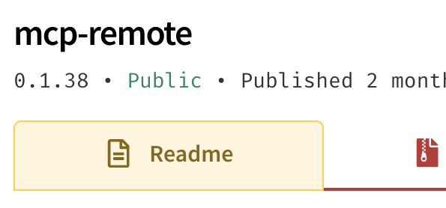
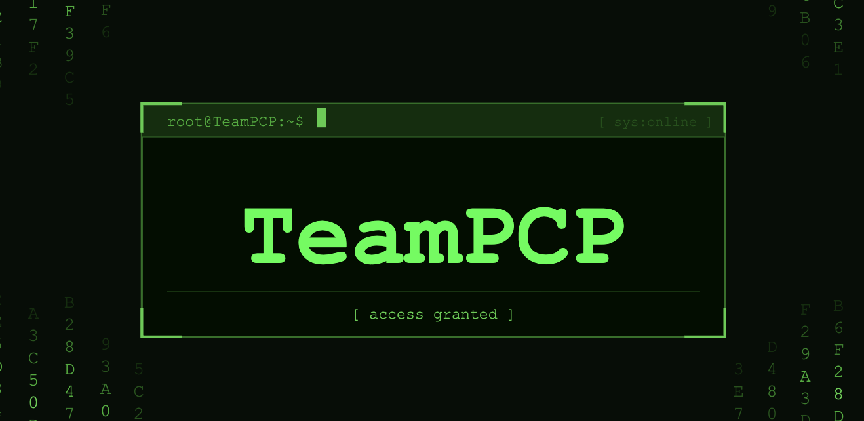
What are we really up against?
alt. why we have trouble sleeping
Industry-wide attacks in MCP tool chain: mcp-remote
Dedicated threat actors, targeting Semgrep:
teamPCP
Notes:
When we were building the MCP server, there were a couple key assumptions that went into our decision making, that not every company has to think about at the offset.
June 2025 - first documented case of system compromise through MCP infrastructure
Knew of industry wide attacks in the MCP tool chain
Dedicated threat actors that explicitly target Semgrep

Slide 8



Our non-negotiables
Protect customer environments
Reliable,
repeatable results
Worst case,
minimize blast radius
Build a trusted deployment model that works for startups and Fortune 500s
Deterministic outputs to codify security standards at scale
Well-scoped authentication so that a compromise is less-likely to impact multiple customers
Notes:
This threat model lead to three things had to be true before we could ship:
We need the deployment model had to protect our customers' environments,
We needed determinism (even if the protocol didn’t always guarantee it)
And our authentication model had to be airtight, to limit the blast radius in the (worst case) something is compromised.

Slide 9
Challenges

Slide 10
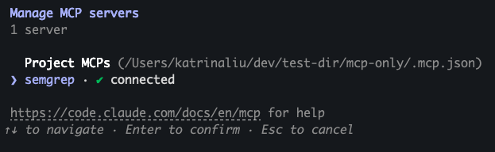
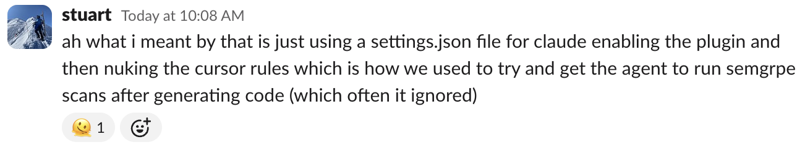
Challenge 1: Non-determinism
Never gets called!
Even with CLAUDE.md/ Cursor rules…

Slide 11
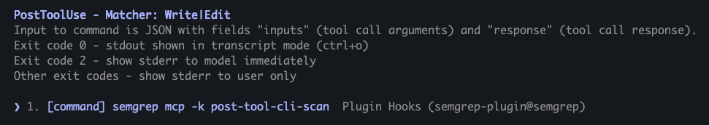
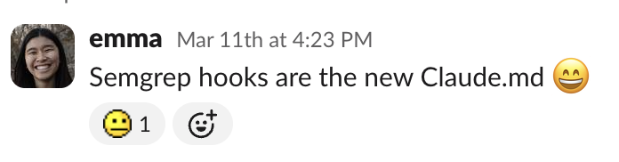
Challenge 1: Non-determinism
Hooks!
Code gets scanned!

Slide 12
Challenge 2: File content hallucination
{
path: ”test.py”,
content: “...”
}
Tools
semgrep_scan
semgrep_findings
Client
⋮
test.py
Remote MCP Server

Slide 13
Challenge 2: File content hallucination
{
path: ”test.py”,
content: “...”
}
Tools
semgrep_scan
Does NOT match the actual file contents
semgrep_findings
Client
⋮
test.py
Especially common with lockfiles…
Remote MCP Server

Slide 14
Challenge 2: File content hallucination
{
path: ”test.py”,
content: “...”
}
Tools
semgrep_scan
semgrep_findings
Client
reads
⋮
test.py
Remote Local MCP Server
Alternatively,

Slide 15
Challenge 3: Authentication
Tools
Fragment scanner
semgrep_scan
DB with user configs, findings, etc
semgrep_findings
Client
Authentication
⋮
MCP Server

Slide 16
Challenge 3: Authentication
Tools
Fragment scanner
semgrep_scan
DB with user configs, findings, etc
semgrep_findings
Client
Semgrep App token
⋮
Local MCP Server

Slide 17
Challenge 3: Authentication
Hooks
Tools
Fragment scanner
semgrep_scan
DB with user configs, findings, etc
semgrep_findings
Client
Semgrep App token
⋮
Local MCP Server

Slide 18
Challenge 3: Authentication
Tools
Fragment scanner
semgrep_scan
DB with user configs, findings, etc
semgrep_findings
Client
OAuth
⋮
Remote MCP Server
Notes:
We haven’t given up on making a remote MCP that scans code, since it is much easier to support, a better setup flow (no Semgrep installation), etc… We implemented OAuth for our beta remote MCP server, and it also provides us with more accurate user metrics than when we use the app tokens.

Slide 19
Challenge 3: Authentication
Authentication
Hooks
Tools
Fragment scanner
semgrep_scan
DB with user configs, findings, etc
semgrep_findings
Client
⋮
Remote MCP Server
This is something we are still trying to figure out, it is our current blocker for remote hooks…

Slide 20

Demo!

Slide 21
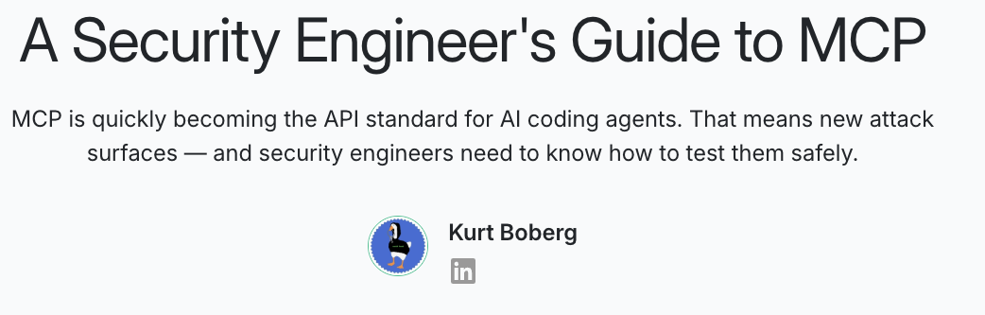
Key Takeaways

Slide 22
Resources
Try the Semgrep Plugin today: semgrep.dev/docs/mcp
Secure your MCP server: semgrep.dev/blog/2025/a-security-engineers-guide-to-mcp

