Slide 1
From One MCP Server to an Ecosystem
When MCP Stops Being a Server and Becomes a Platform
Vaibhav Tupe | Principal Engineer, Equinix | MCP Dev Summit 2026
Notes:
“Alright… last session of the day.”
(pause, smile)
“Which means… you’ve either learned a lot…”
“…or you’re just waiting for the after party.”
(light laugh)
“I’ll try to make sure this is worth staying for.”
(pause)
“This talk… is not about how to build an MCP server.”
“It’s about what happens… after you succeed.”

Slide 2
Show of hands.
Who here has built an MCP server?
Who here is running multiple MCP servers in production?
That gap between building a server and
running an ecosystem is where the real architecture begins
Notes:
“Quick pulse check…”
“How many of you have built an MCP server?”
(pause)
“Nice.”
“How many are running multiple MCP servers in production?”
(pause, react)
“And… how many are just here for the after party?”
(raise your hand slightly → smile → pause for laugh)
“That gap…”
“between building a server… and running an ecosystem…”
(pause)
“that’s where the real architecture begins.”

Slide 3
Vaibhav Tupe
Principal Engineer — Equinix
Architecture lead for Fabric Intelligence, an AI platform initiative at Equinix.
Leading development of:
• Fabric AI agent for infrastructure operations
• MCP server ecosystem for infrastructure automation
Contributing to open source and Agentic AI Foundation work groups
Focus areas • AI infrastructure • Agentic systems • Network automation
Notes:
“I’m Vaibhav.”
“I lead Fabric Intelligence at Equinix.”
“We’re building AI agents that operate infrastructure— networks, interconnections, multi-cloud systems.”
“And MCP… is the backbone of that system.”

Slide 4
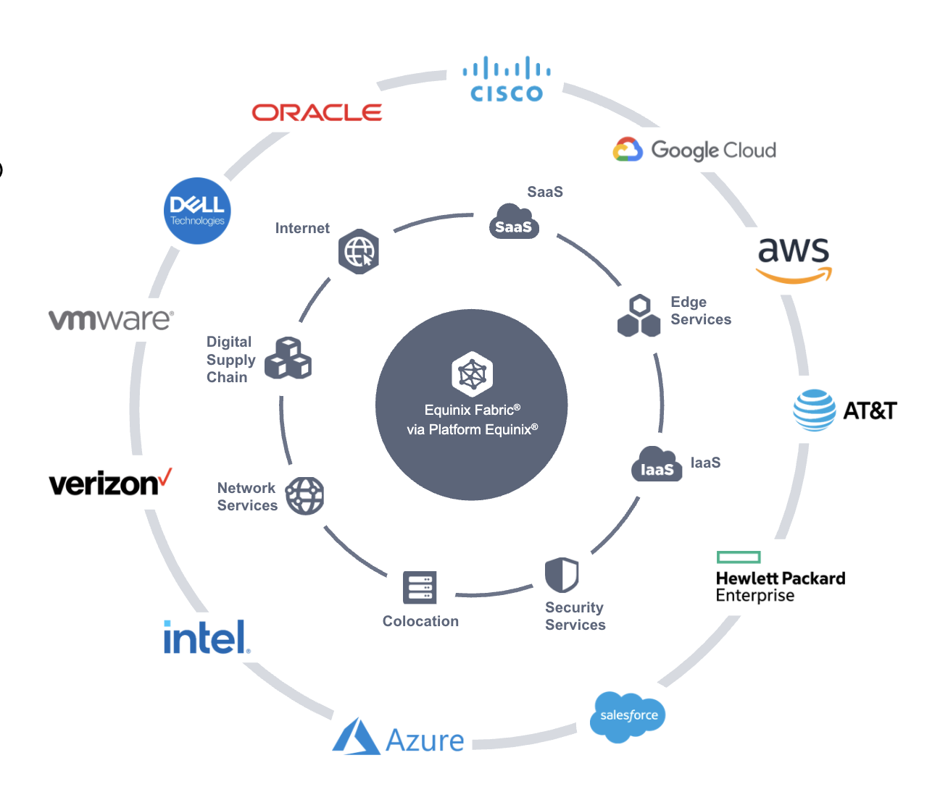
Equinix context
Diverse global ecosystem ​ Access the largest and most dynamic global ecosystem ​ with 500,000+ interconnections.​
Enterprises and service providers​ Select from ~2,000 networks, 4,800+ enterprises ​ and ~3,000+ cloud and IT service providers.​
Interconnection opportunities​ Discover and transact with customers, suppliers ​ and partners to create and consume new value.​
Digital capabilities​ Unlock new capabilities with software-defined ​ connectivity to thousands of partners and providers.
Notes:
“For those not familiar— Equinix is where networks, clouds, and enterprises meet.”
“Thousands of providers… hundreds of thousands of interconnections…”
(pause)
“Now imagine…”
“AI agents operating inside this ecosystem.”
“Not dashboards… not humans clicking buttons…”
“Agents making decisions… at machine speed.”

Slide 5
How Our MCP Journey Started
Act I
Notes:
“So let me take you back…”
“April 2025.”
“Our first MCP server.”

Slide 6
April 2025 — First MCP Server
Goal:
Allow AI agents to retrieve and provision network interconnections.
Initial design:
Single Fabric MCP server, single domain, small set of tools.
Tools built on top of existing public APIs
Reused existing authentication and authorization layers
Example Fabric MCP tools:
search_connections
search_ports
search_routers
create_connection
create_router
Notes:
“The goal was simple.”
“Let AI agents… search and provision network connections.”
“That’s it.”
(pause)
“Single server.”
“Single domain.”
“Small set of tools.”
“We didn’t reinvent anything.”
“We wrapped existing APIs…”
“reused authentication…”
“kept it simple.”
“And it worked.”
(pause)
“Honestly… this is the phase where everything feels easy.”
(light smile)
“You start thinking— ‘This MCP thing is straightforward.’”

Slide 7
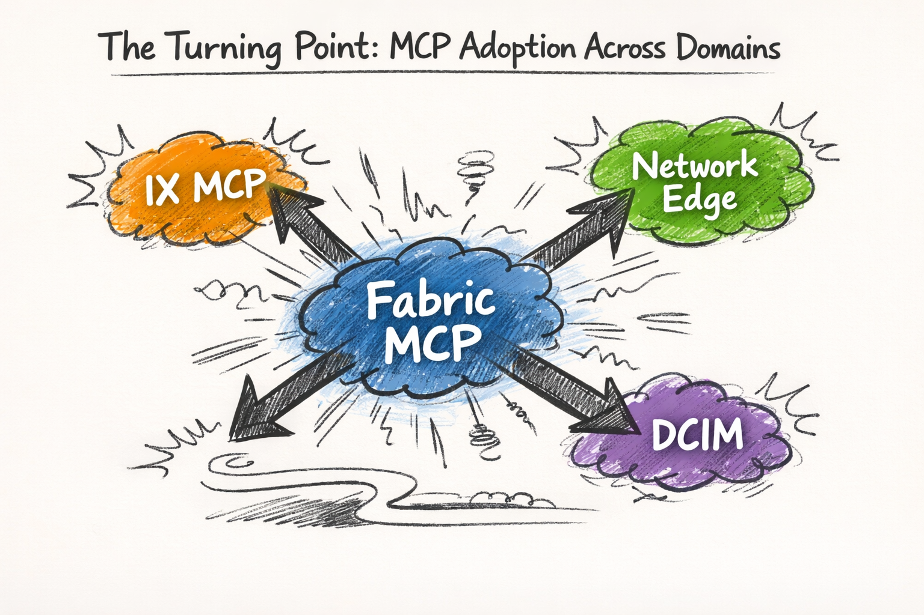
Then Adoption Started
Once the Fabric MCP server worked, other teams asked:
“Can we expose our APIs through MCP?”
Internet Exchange
Network Edge
Data center Infrastructure Management
What started as one server quickly became
a multi-domain challenge.
Notes:
“And then…”
(smile)
“other teams showed up.”
“They said— ‘Can we expose our APIs through MCP?’”
“Then another team…”
“Then another…”
“And suddenly…”
(pause)
“we didn’t have one MCP server anymore.”
💡 Laugh line #1 (natural, relatable)
“We basically went from one clean server…”
“…to a group project.”
(pause for laugh)

Slide 8
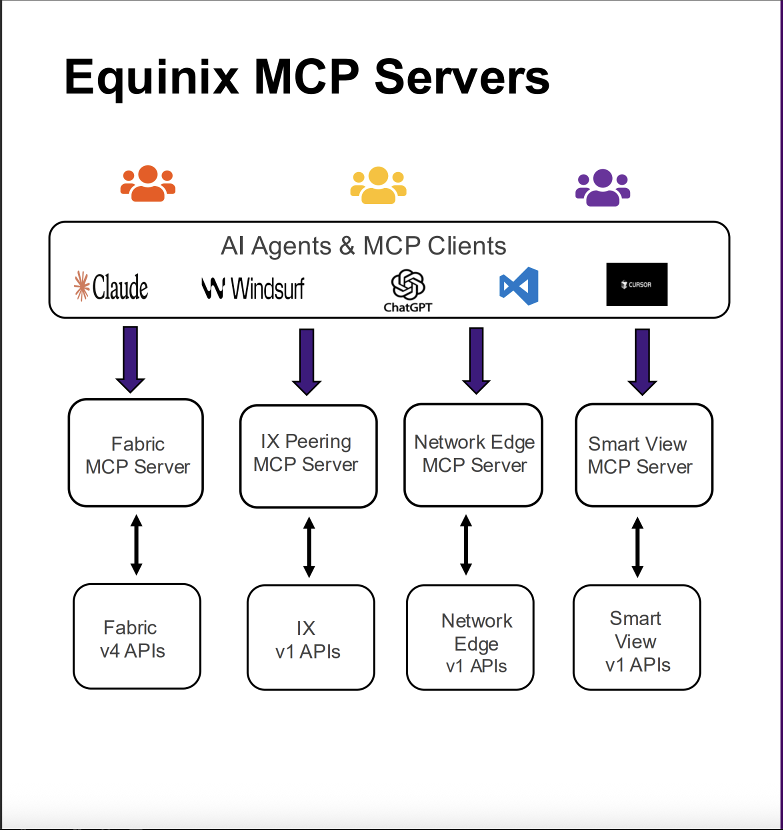
Our MCP Ecosystem Today
4 public MCP servers
Fabric MCP alone: 80+ tools
Ecosystem total: 150+ tools
Numerous internal MCP server’s power agentic workflows across teams.
Clients consuming the ecosystem:
Internal AI agents
External MCP clients (Claude Desktop, Cursor)
MCP is no longer a server. It is a platform.
Notes:
“Today…”
“multiple public MCP servers…”
“150+ tools…”
“internal agents…”
“external clients like Claude and Cursor…”
“At this point…”
(pause)
“MCP stopped being a server.”
“It became platform infrastructure.”

Slide 9
MCP is no longer just a server.
It is a platform capability across teams.
Notes:
“And this is where things change.”
“Because scaling MCP…”
(pause)
“is not about adding more tools.”
“It’s about controlling what the agent sees.”

Slide 10
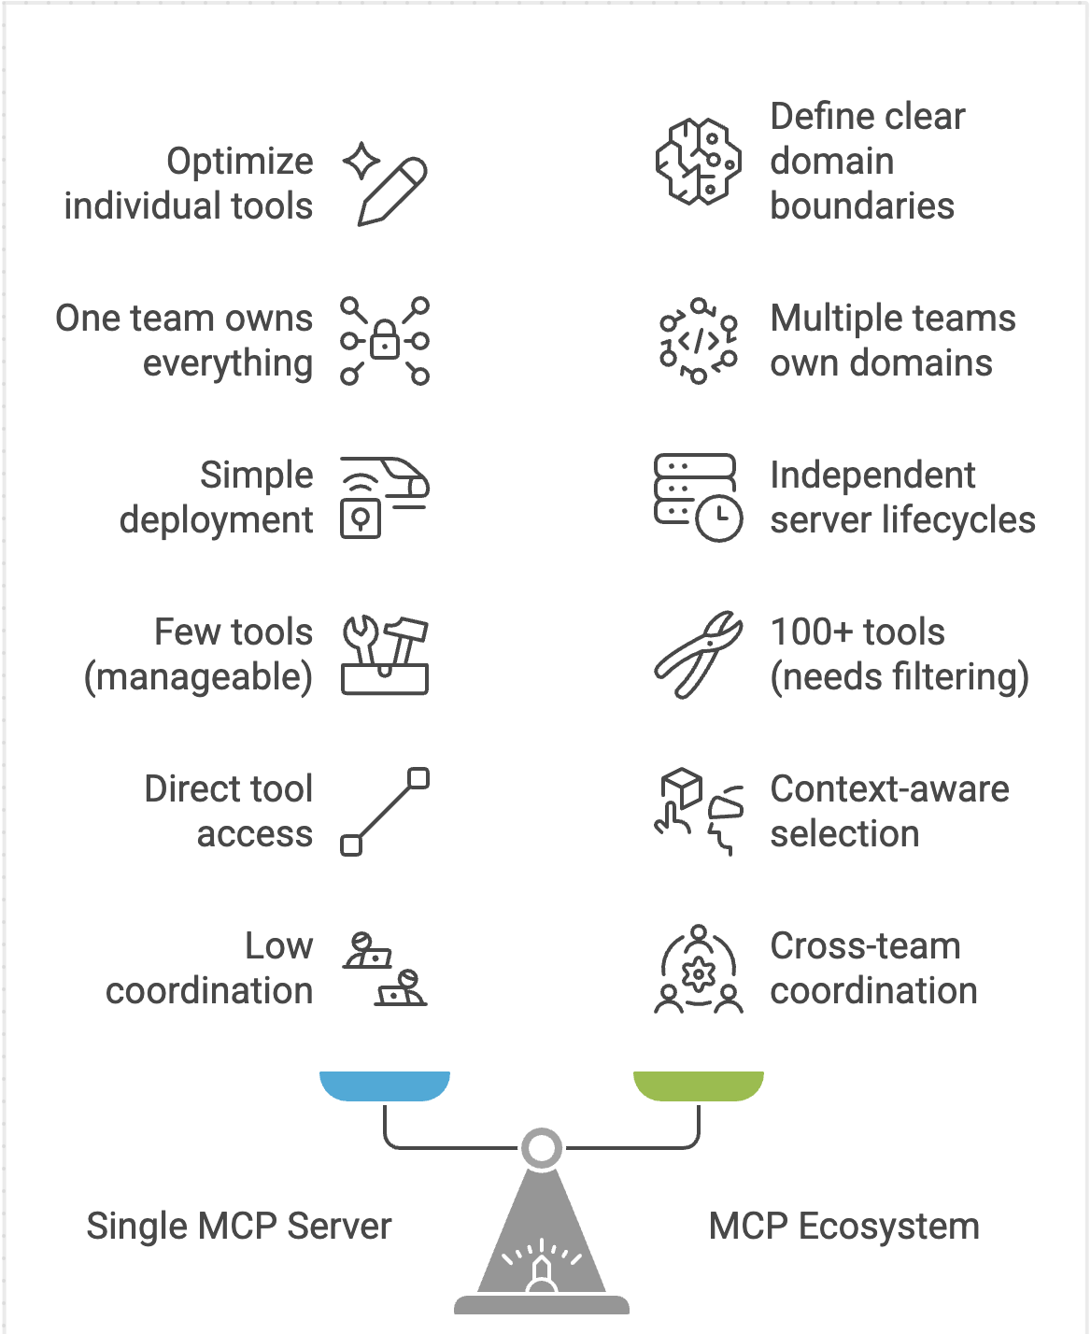
What Changes at Ecosystem Scale
Scaling MCP is not about adding more tools -
it’s about managing boundaries and context.
Notes:
“So… what actually changes… when you move from one MCP server…”
“to an ecosystem?”
“At first, it looks like growth—more servers, more tools.”
“But at ecosystem scale, the problem changes completely.”
2️⃣ The shift: capability → coordination
“At small scale, the problem is building capability.”
“At large scale, the problem becomes coordination across teams and systems.”
3️⃣ Boundaries become critical
“Multiple teams, multiple domains—each with their own MCP servers.”
“Without clear boundaries, everything starts interfering with everything.”
4️⃣ Context becomes the bottleneck
“Hundreds of tools are no longer useful if the agent can’t choose correctly.”
“The real challenge becomes controlling what the agent sees.”
“At ecosystem scale, the problem is no longer capability—it’s coordination, boundaries, and context.”

Slide 11
Design Patterns
Act II
Notes:
[TIMING: 16 min | Transition beat]
"Let's get into the specific patterns."
[Keep it brief and move quickly to the content slides.]

Slide 12
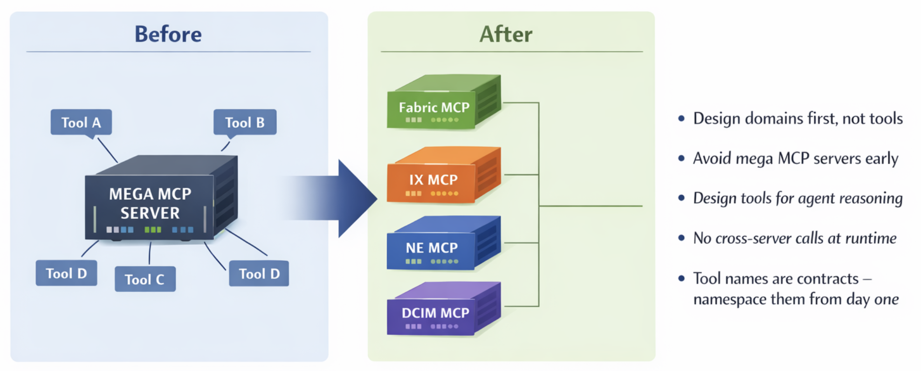
Design Patterns That Worked
At scale, structure matters more than features.
Notes:
🔹 1. Design domains first — not tools
“The biggest shift we made — we stopped thinking in terms of tools… and started thinking in terms of domains.”
“Fabric. IX. Network Edge. DCIM. Each became its own bounded MCP surface.”
“Because tools change. APIs evolve. But domains — those are stable.”
(small pause) 👉 “This one decision prevented long-term chaos.”
🔹 2. Avoid mega MCP servers
“It’s very tempting to build one giant MCP server — we almost did.”
(light smile)
“But mega servers don’t scale — they collapse.”
“Too many tools. Too much context. Agents start guessing instead of reasoning.”
👉 “So we forced separation early.”
🔹 3. Design for agent reasoning — not human APIs
“This was subtle but critical.”
“Our APIs were originally designed for humans — dashboards, filters, workflows.”
“Agents don’t think like that.”
“They need:
clear intent
predictable outputs
minimal ambiguity”
👉 “So we redesigned interfaces for how agents reason — not how humans browse.”
🔹 4. No cross-server calls at runtime
“Another hard rule we enforced — no MCP server calling another MCP server.”
“Because the moment you allow that… you introduce hidden dependencies.”
“Now debugging becomes impossible, latency explodes, and failures cascade.”
👉 “Instead — orchestration happens at the agent layer. Servers stay clean and independent.”
🔹 5. Tool names are contracts
“And this one sounds small… but it’s not.”
“Tool names are not just labels — they are how the agent understands capability.”
“If naming is inconsistent, the agent gets confused.”
👉 “So we treated naming like API contracts — namespaced, consistent, intentional from day one.”
🔻 Close Slide 12 (strong line)
“And if I had to summarize all of this…”
(pause)
“At scale — structure matters more than features.”

Slide 13
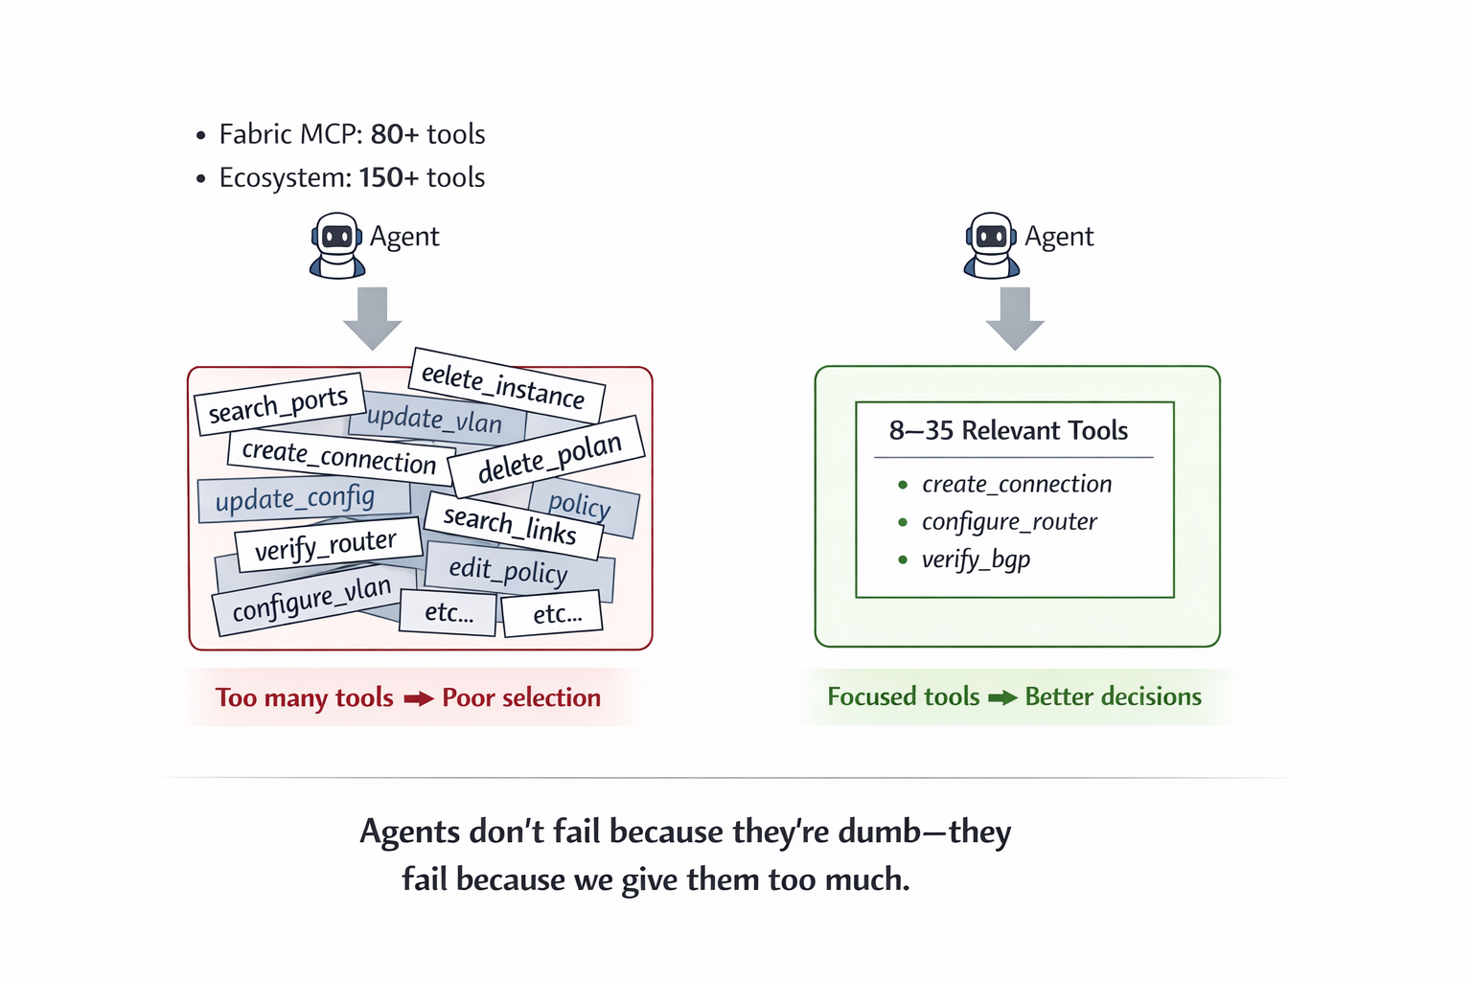
The Context Explosion Problem
Notes:
“Our first real problem…”
(pause)
“was context explosion.”
“We exposed too many tools.”
“We thought— more tools… smarter agents.”
(shake head slightly)
“That’s not what happened.”
💡 Key moment (pause after this)
“We gave the agent 150 tools…”
“and expected it to behave like a senior engineer.”
(pause)
“It behaved like an intern on day one.”
(hold 1–2 sec)
“It slowed down.”
“Got confused.”
“Picked the wrong tools.”
“More tools… does not mean better agents.”
“At scale… context becomes the problem, not capability.”

Slide 14
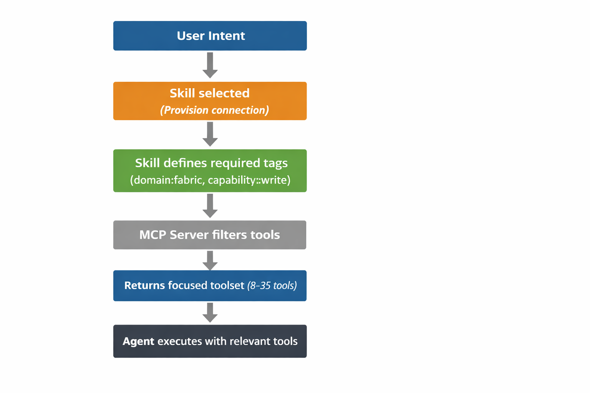
Skill + Tool Filtering Using MCP Tags
Solution: Skill + tag-based tool filtering.
Example MCP tool tags:
domain: connection | domain: port | domain: router
capability:read | capability:write
We don’t let agents see all tools—we guide them using
skills and MCP tool tags.
Notes:
“So we changed the model.”
“We stopped showing all tools.”
(pause)
“And started showing… only the right tools.”
“User says— ‘Create a connection between AWS and Azure.’”
“The planner selects a skill.”
“That skill maps to MCP tags.”
“And instead of 150 tools…”
(pause)
“the agent sees maybe 10.”
“Now it’s faster.”
“More accurate.”
“And safer.”
“Tags control context.”
(pause)
“Skills guide reasoning.”
“We don’t give agents freedom…”
“We give them focus.”

Slide 15
Security & Agent Integration
Act III
Notes:
“Now… security.”
“Because these agents…”
“are not generating text.”
“They are acting on infrastructure.”

Slide 16
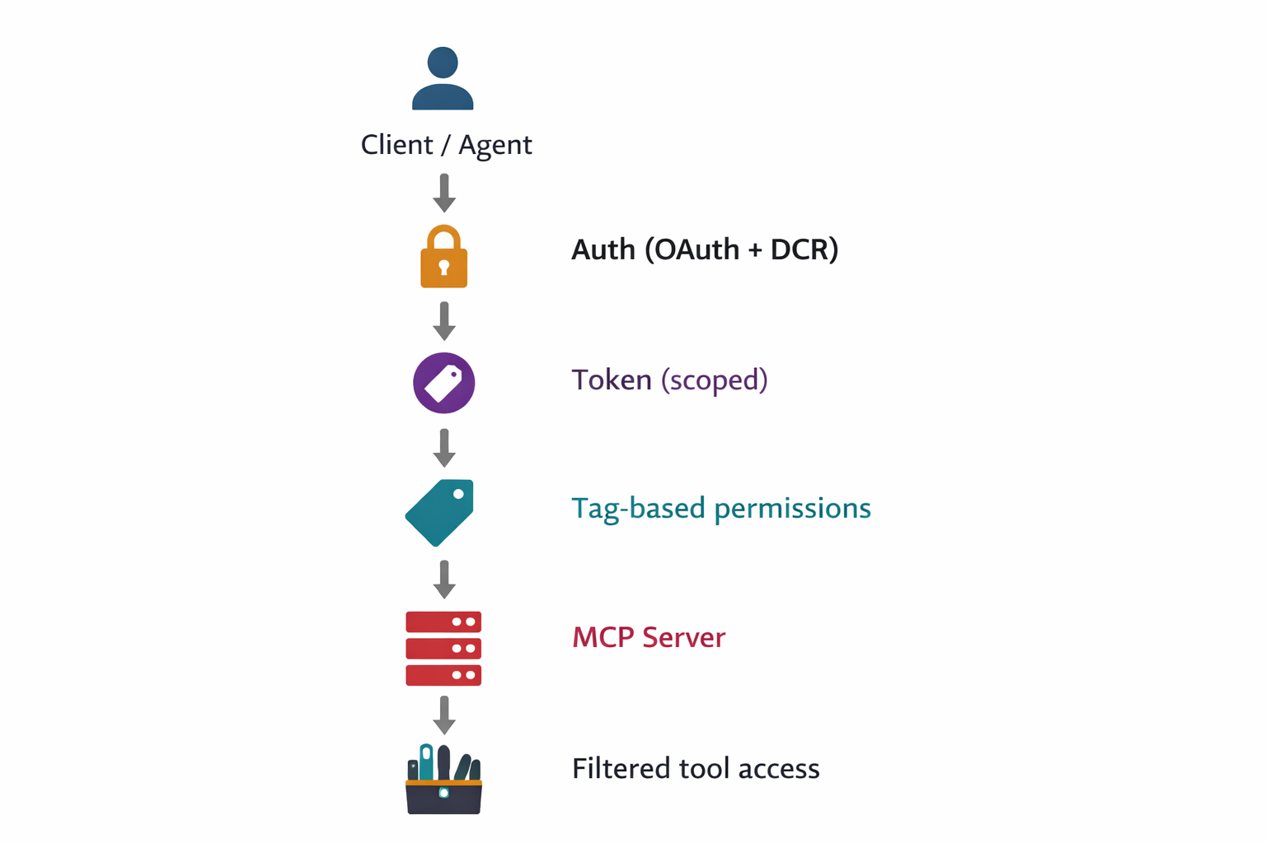
Security at Platform Scale
MCP servers are secure API endpoints
Built with auth, rate limiting,
audit logging
Identity + scopes → control tool access
Auth defines identity.
Tags define what the agent can do.
Notes:
“Once MCP becomes a platform… security is no longer optional — it becomes foundational.”
(pause)
“Because now you're not exposing tools… you’re exposing real infrastructure actions to AI agents.”
🔹 1. MCP servers are secure API endpoints
“The first mindset shift we made — an MCP server is not a helper service.”
“It is a production-grade API surface.”
“Which means — everything you expect from APIs applies here:
authentication
authorization
rate limiting
audit logging”
👉 “We didn’t reinvent security — we built MCP on top of existing enterprise controls.”
🔹 2. Identity defines who
“At the core — everything starts with identity.”
“Every MCP request is tied to:
a user
or a system identity”
“And that identity carries scopes and permissions — just like any API system.”
👉 “So first question is always — who is calling this tool?”
🔹 3. Tags define what the agent can do
“But identity alone is not enough.”
(pause)
“Because agents don’t operate like humans — they explore, they reason, they choose tools.”
“So we added another control layer — MCP tool tags.”
“Tags define:
domain (connection, router, port)
capability (read, write, provision)”
👉 “So now we control not just who… but also what the agent is allowed to even see and use.”
🔹 4. Security = Identity + Tags
“And this is the key idea…”
(slow down)
“Auth defines identity. Tags define capability.”
“Together — they create a controlled tool surface for the agent.”
“The agent never sees the entire system — only the part it is allowed to operate on.”
🔹 5. Why this matters (bring it home)
“Because without this…”
“An agent could:
discover unintended tools
take unsafe actions
or operate across domains it shouldn’t”
“With this model — we keep agents powerful, but bounded.”
🔻 Closing line (strong)
“At platform scale — security is not just about protection…”
(pause)
“It’s about controlled autonomy.”

Slide 17
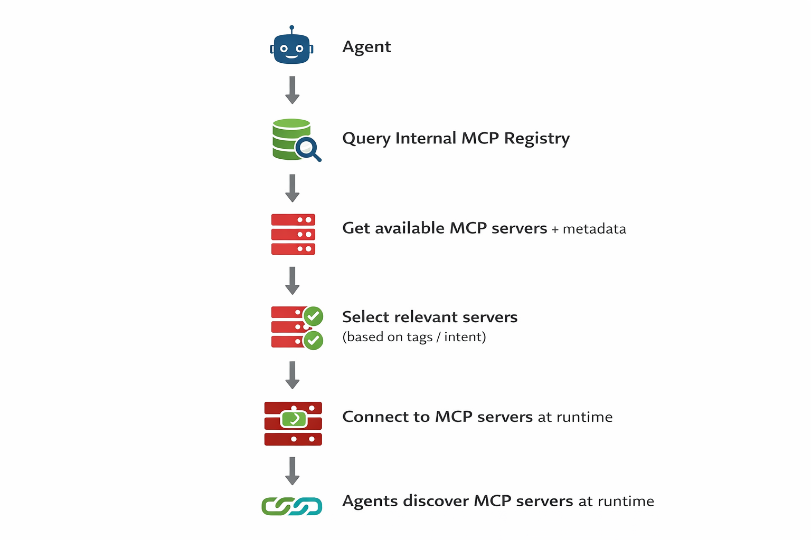
MCP Server Discovery
Central internal registry of MCP servers
Includes tool metadata + tag taxonomy
No hardcoded server endpoints
Agents discover MCP servers dynamically—
nothing is hardcoded.
Notes:
[TIMING: 22-23 min]
"One piece that doesn't get talked about enough: how do agents actually find the right servers in a large ecosystem?"
"We built an internal MCP registry — a central catalog of all our MCP servers, their endpoints, tool metadata, and tag taxonomy."
"Agents query the registry rather than having server endpoints hardcoded. This means as we add new MCP servers, agents automatically discover them."
"It's a small thing but it has a big operational impact — adding a new domain MCP server means registering it, not modifying every agent that might need it."
[Gesture to the diagram placeholder]

Slide 18
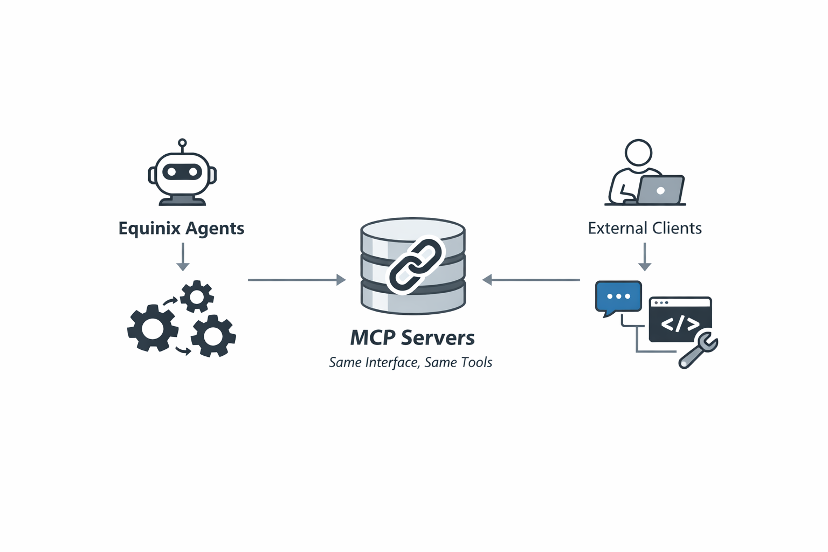
Internal and External Agent Integration
MCP provides a consistent interface:
Internal agents running at machine speed
External developer tools for human engineers
Same MCP server.
Two different consumers.
One consistent tool contract.
Notes:
“And something interesting happens here.”
“The same MCP server…”
(pause)
“serves two very different worlds.”
“Internal agents—autonomous, machine speed.”
“External developers—human-driven tools.”
“Same server.”
“Same tools.”
“Same contract.”
👉 Optional line:
“This is where MCP becomes a platform interface.”

Slide 19
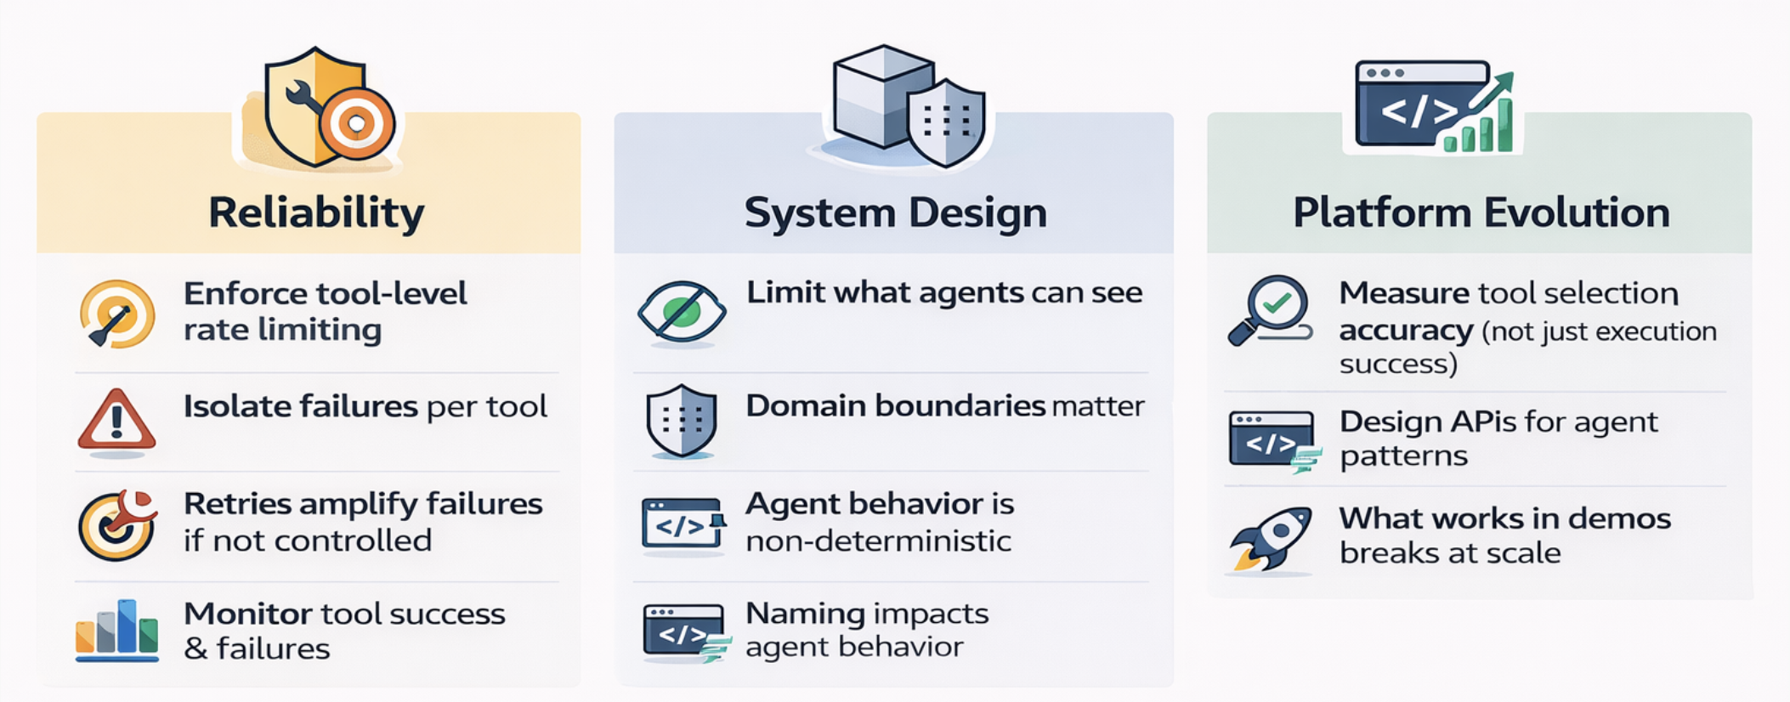
Operational Lessons
MCP servers become production infra. Treat them like it from day one.
Notes:
Say (slightly slower, serious tone):
“Now… this is where most systems break.”
“What works in demos…”
(pause)
“breaks at scale.”
“MCP servers are production infrastructure.”
“Tool names become contracts.”
“You don’t casually change them anymore.”
“And observability…”
(pause)
“is not optional.”
👉 Optional light line:
“If you don’t have observability…”
“the agent is doing something…”
(pause)
“you just don’t know what.”

Slide 20
Key Takeaways
1. Bounded domains beat mega-servers.
2. Tags solve context explosion at scale.
3. Auth + tags create secure, focused tool surfaces.
4. Design MCP for ecosystems, not single servers.
The internet connected machines.
APIs connected applications.
MCP connecting AI agents to the real world.
Notes:
“And if you’re building in this space…”
“or struggling with scale…”
“come find me at the after party.”
(smile)
“That’s where the real architecture discussions happen.”

