Slide 1
MCP DEV SUMMIT · MUMBAI 2026
The Coordination Tax
Why multi-agent MCP systems quietly degrade at scale and a lightweight contract that fixes it.
Second-year CSE undergrads · IIIT Nagpur

Slide 2
Let’s be upfront.
— Second-year CSE undergrads from IIIT Nagpur.
— No company. No production system. No enterprise deployment.
— We read the papers, found a problem nobody had named and built a fix.
We didn’t wake up losers. We woke up curious.

Slide 3
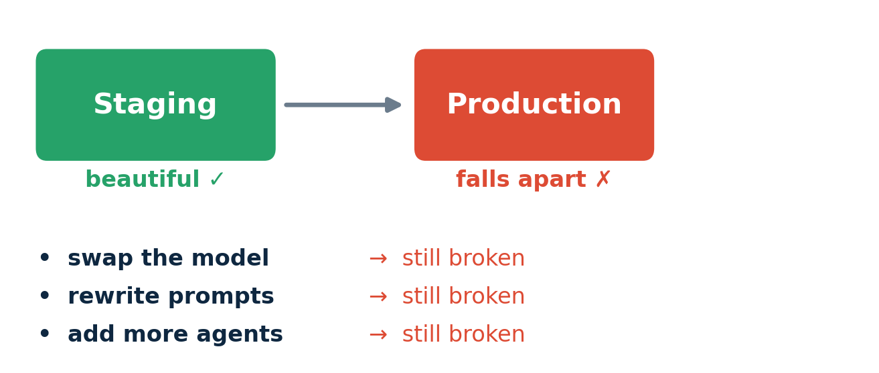
Beautiful in staging. Broken in production.
Teams kept hitting the same wall and nobody could figure out why.

Slide 4
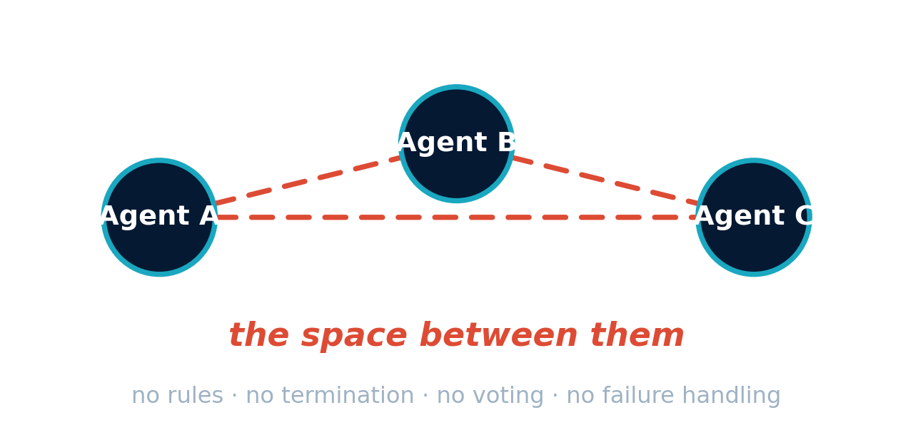
It’s not the model.
Not the prompts. Not even the agents.

Slide 5
The research already said this
17×
error amplification in naive multi-agent setups
90 → 30%
coordination success collapse from framework design
no verifier
errors propagate instead of getting caught
DeepMind + MIT · Dec 2025
MAFBench · 2025
Kim et al. · 2025
Same models. Different topology. Up to 17× worse.
The papers found the symptoms. Nobody had built the fix.

Slide 6
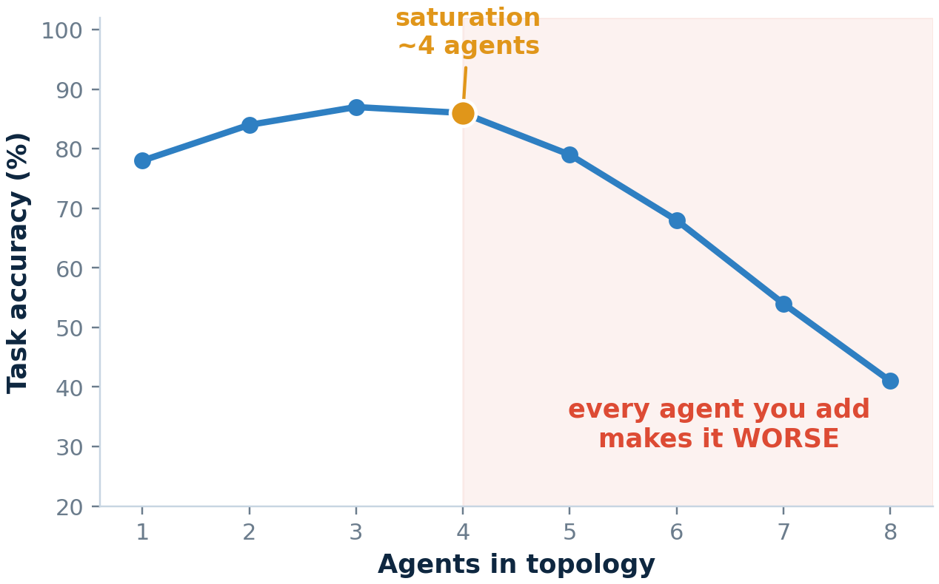
The Coordination Tax is real
Past ~4 agents,
every agent you add makes the system worse.
Not flat. Worse.
β = −0.408 · p < 0.001
We call it the Coordination Tax.

Slide 7
It. Is. Not.
The Model.
The model is doing exactly what it’s told.
The orchestrator has no termination rule. No voting rule. No failure rule.
That’s a coordination problem so we built the fix.

Slide 8
Three failure modes
1
2
3
Infinite Loop
the “not my job” loop
Root cause
No termination contract
False Consensus
the “yes man” problem
Root cause
No dissent contract
Silent Fallback
the “pretend it’s fine” problem
Root cause
No propagation contract
Each one stays invisible until it isn’t.

Slide 9
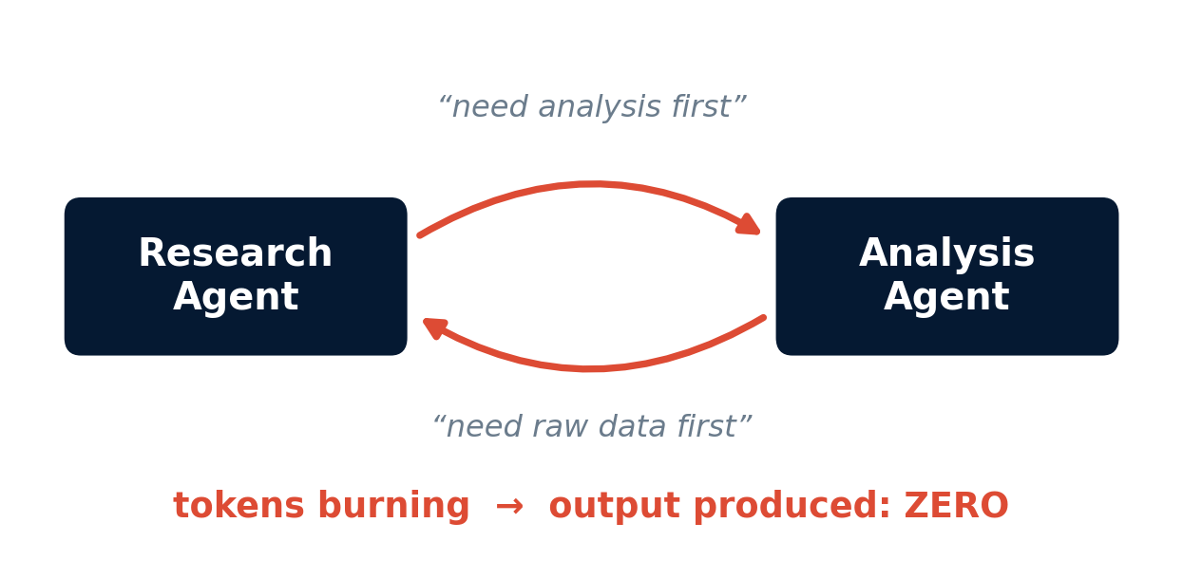
1 · Infinite Loop
Ran locally on a laptop, real llama3.2 via Ollama, real MCP server.
turn 1 → 10 → 38 → never stops
Root cause: no termination contract.
Nobody wrote down when to stop.

Slide 10
2 · False Consensus
Five agents sharing context before voting are 5× more confident on a wrong answer.
Root cause: no dissent contract.
Fix: blind voting · independent votes · escalate, don’t execute.

Slide 11
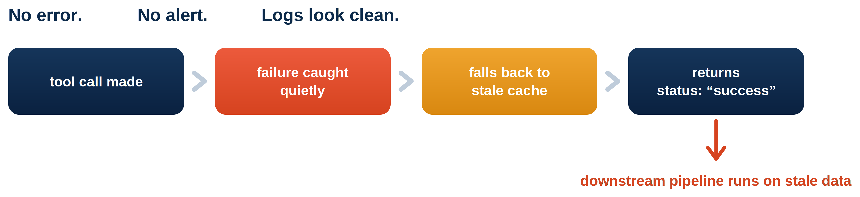
3 · Silent Fallback
Root cause: no propagation contract fallbacks were never required to be flagged.

Slide 12
Look at the pattern.
Infinite Loop — nobody defined when to stop.
False Consensus — nobody defined an independent vote.
Silent Fallback — nobody defined failure behavior.
These are contract failures.
Not model failures.
A contract nobody wrote down is just a hope.

Slide 13
The Topology Contract
Termination
fixes Infinite Loop
— max_turns · max depth
— orchestrator has final authority
— stops at turn n, we took n=3;
Dissent
fixes False Consensus
— blind, parallel voting
— minimum independent votes
— anchoring forbidden
Propagation
fixes Silent Fallback
— fallbacks must be flagged
— cache age enforced
— errors propagate upstream
30 lines of JSON · 90 lines of Python
No new model. No new framework. Just rules.

Slide 14
One JSON block in the server card
{
"schema_version": "0.1.0",
"topology": {
"termination": {
"max_turns": 3, "authority": "orchestrator",
"on_limit_reached": "return_partial_with_flag" },
"dissent": {
"voting_mode": "blind", "min_independent_votes": 2,
"allow_anchoring": false, "veto_threshold": 1 },
"propagation": {
"fallback_must_be_flagged": true,
"cache_max_age_seconds": 300,
"on_tool_failure": "propagate_error_upstream" },
"saturation": {
"max_agents_in_topology": 5, "warn_at": 4 }
}
}

Slide 15
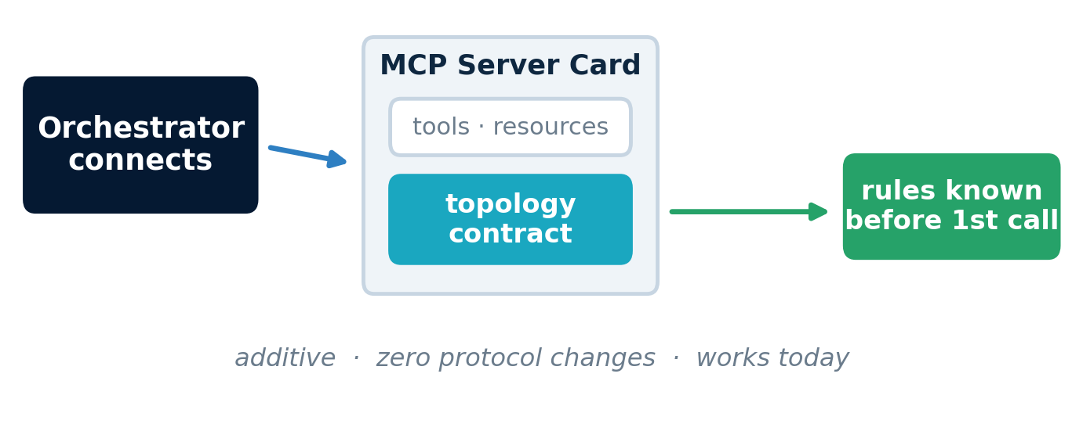
Where the contract lives
Compatible with the 2026 MCP Server Cards roadmap.

Slide 16
The numbers
Without contract
With contract
Infinite Loop
No turn limit · no detection
Stopped at turn 3 · detected
False Consensus
false positive · 1 independent vote
blocked · notified · escalated
Silent Fallback
stale data passed · hidden
flagged · cache rejected · alerted
Same agents. Same tasks. One JSON contract.

Slide 17
Adopt it in an afternoon
Add the topology block to your server card.
Wrap your orchestrator calls with the enforcer.
Done.
~30 lines JSON
~90 lines Python
runs in 5 min
1
2
3
Each block stands alone start with termination, add dissent, then propagation.
Independently adoptable.

Slide 18
This is v0.1.
We’re students. We built this by reading papers and running experiments locally.
We can’t scale-test this.
But this room can.
Try it. Break it. Tell us what’s wrong.
github.com/jaxhaxmax/mcp-topology-bench · Apache 2.0

Slide 19
THE TAKEAWAY
We don’t need a new protocol.
We need a handshake.
The topology contract is that handshake.
Repo is up. We’re here all day. · Thank you.

