Slide 1
Your Agents Don't Like to talk to APIs
Building Multi-Agent Systems with MCP
"My AI travel agent booked a flight to Tokyo... on the wrong date, to the wrong airport, using an API it wasn't supposed to call."
Anannya Roy Chowdhury
Gen AI Developer Advocate
Amazon Web Services

Slide 2


Slide 3
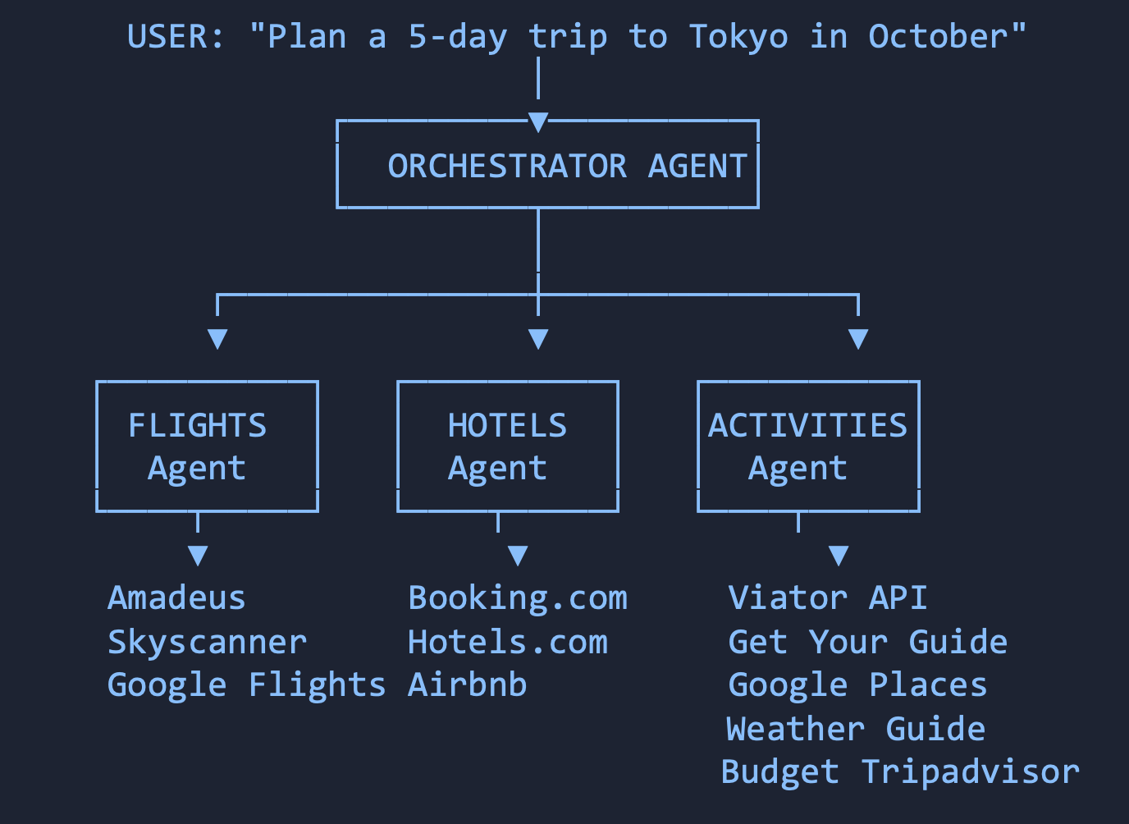
The Use Case: A Travel Planner Agent
A multi-agent system that plans trips end-to-end
3
specialized agents
9+
external APIs
4
steps per tool call

Slide 4
The Disaster: What Actually Happens
Failure | What Happened | Root Cause
Wrong tool selected | Flight agent called hotel search API | Ambiguous function names
Invalid parameters | check_in: "October" instead of "2026-10-15" | No schema enforcement
Redundant calls | 3 agents each called weather API | No shared resource layer
Silent failures | Agent got 401, retried 5x, hallucinated | No structured error contract
Context explosion | All 9 API schemas = 4,000+ tokens | M×N integration bloat
15-20%
$$$
60%
retry rate from tool failures
wasted tokens per retry
tool name mismatches
"The agent doesn't fail because it can't reason. It fails because APIs were designed for HUMANS, not models."

Slide 5
The M×N Problem: Why This Doesn't Scale
BEFORE MCP: M×N integrations
AFTER MCP: M+N
┌──────────┐ ┌──────────┐
│ Agent A │────▶│ API 1 │ Custom connector
│ Agent A │────▶│ API 2 │ Custom connector
│ Agent A │────▶│ API 3 │ Custom connector
│ Agent B │────▶│ API 1 │ ANOTHER custom
│ Agent B │────▶│ API 2 │ ANOTHER custom
│ Agent B │────▶│ API 3 │ ANOTHER custom
└──────────┘ └──────────┘
3 agents × 3 APIs = 9 custom integrations
┌──────────┐ ┌──────────┐ ┌──────────┐
│ Agent A │─┐ │MCP Client│ ┌─│MCP Server│──▶ API 1
│ Agent B │─┤ │(standard)│ ├─│MCP Server│──▶ API 2
│ Agent C │─┘ └──────────┘ └─│MCP Server│──▶ API 3
└──────────┘ └──────────┘
3 agents + 3 servers = 6 components (not 9)
At Scale:
10 agents × 30 APIs = 300 custom integrations vs 40 components with MCP
"MCP is USB-C for AI — one universal connector that eliminates bespoke integrations"

Slide 6
MCP Architecture
The protocol in 60 seconds
97M
HOST → MCP CLIENT
JSON-RPC 2.0 • Stateful • Bidirectional
monthly SDK downloads
▼
stdio | Streamable HTTP
3
MCP SERVER
primitives. That's it.
📦 RESOURCES — Data to READ
AAIF
🔧 TOOLS — Functions to CALL
📝 PROMPTS — Reusable templates
Linux Foundation governed

Slide 7
The Fix: Schema-Based Contracts
BEFORE — Ambiguous REST
AFTER — MCP Schema (typed, validated)
Available functions:
- search(query, params) → searches for items
- book(id, details) → books something
- check(location, date) → checks availability
// Agent thinks: "search" = flight? hotel?
// activity? ALL of them?
{
"name": "search_flights",
"description": "Search flights",
"inputSchema": {
"type": "object",
"properties": {
"origin": {
"type": "string",
"pattern": "^[A-Z]{3}$",
"description": "IATA code"
},
"departure_date": {
"type": "string",
"format": "date"
},
"passengers": {
"type": "integer",
"minimum": 1, "maximum": 9
}
},
"required": ["origin",
"destination", "departure_date"]
}
}
✓ Schema IS the contract
✓ Names ARE unambiguous
✓ Validation IS deterministic

Slide 8
Resources vs Tools: Fixing Redundancy
The key architectural insight most people miss
BEFORE: Every agent fetches independently
AFTER: MCP Resources = shared read-only layer
Flight Agent → GET /weather/tokyo (500 tokens)
Hotel Agent → GET /weather/tokyo (500 tokens, SAME)
Activity Agent→ GET /weather/tokyo (500 tokens, SAME)
Total: 1,500 tokens for ONE piece of information
MCP Server exposes:
resource://weather/tokyo/october → READ ONCE
All 3 agents READ same resource = 500 tokens TOTAL
No duplication. No I/O contention. No stale reads.
📦 RESOURCES
🔧 TOOLS
READ • Cacheable • Shared
Always idempotent
CALL • Mutating • Per-agent
May have side effects

Slide 9
Deterministic Execution: Validate Before You Call
The constraint pruning pattern, now protocol-native
Traditional: Hope it works
MCP: Validate → Reject invalid → Execute only valid
# Agent generates → Hope → Retry on failure
response = llm.generate(prompt_with_all_tools)
result = call_api(response) # 🙏 hope valid
if result.error:
retry_with_more_tokens() # 💸 expensive
# Schema validates → Reject → Execute valid only
tool_call = llm.generate(prompt_with_mcp_schemas)
validation = mcp_client.validate(tool_call)
if not validation.valid: # ⚡ <1ms, $0
return validation.error # self-correct
result = mcp_client.call_tool(tool_call) # ✅ valid
⚡ Validation is FREE — happens client-side against JSON Schema
🚫 Invalid calls never reach the server → no wasted compute
📉 Retry rate drops from 15-20% to <3%
💡 "Fail fast, fail free" — now it's protocol-native
LLM Generate → Schema Validate (<1ms, $0) → ✅ Execute OR ❌ Self-Correct (no API call)

Slide 10
Before vs After
TRADITIONAL API
MCP-BASED
9,000 tok schemas loaded
3× weather fetches
2+ retries per request
Hallucinated on timeout
8.5s latency
$0.032/request
1,200 tok (relevant only)
1× shared resource read
0 retries (validated)
All params typed & checked
3.2s latency
$0.008/request

Slide 11
Production: Containerized MCP Servers
How to deploy MCP at scale — the infrastructure view
┌──────────────────────────────────────────────────────┐
│ Your Agent Application (ECS / Lambda / EKS) │
│ ┌────────────────────────────────────────────────┐ │
│ │ MCP Client (Strands SDK / your SDK) │ │
│ └───────────────┬────────────────────────────────┘ │
└──────────────────┼───────────────────────────────────┘
│ Streamable HTTP (remote)
▼
┌──────────────────────────────────────────────────────┐
│ API Gateway / ALB (auth, rate limiting, routing) │
└──────────────────┬───────────────────────────────────┘
│
┌──────────────┼──────────────┐
▼ ▼ ▼
┌────────┐ ┌────────┐ ┌────────┐
│Flight │ │Hotel │ │Activity│
│MCP Srvr│ │MCP Srvr│ │MCP Srvr│
│(ECS) │ │(ECS) │ │(ECS) │
└───┬────┘ └───┬────┘ └───┬────┘
▼ ▼ ▼
Amadeus Booking.com Viator
One container,
one responsibility
Each MCP server wraps exactly one service domain
Dynamic discovery
Servers register capabilities on startup — clients discover
Independent scaling
Flights 10× traffic in holidays? Scale THAT container
Crash isolation
Hotel server down ≠ flight agent down

Slide 12
Production: Security & Governance
Transport
mTLS / OAuth 2.0 Data In Transit
⚠️
Auth
Token-based per server Who can call
Never expose MCP
servers directly.
Always behind
ALB / API Gateway
with host validation.
AuthZ
Scoped capabilities What they can do
Validation
JSON Schema on every call Data Integrity
Rate Limit
Per-client, per-tool quotas Cost Control
Audit
Trace ID on every call Compliance

Slide 13
Observability
TRACE: user_request_12345
Track These
├─ orchestrator.plan
200ms
✅
● Tool selection accuracy
├─ validate.flights
2ms
✅
● Validation rejection rate
├─ tool.search_flights
1.2s
✅
├─ validate.activities
1ms
❌
● Per-tool P50/P99 latency
│ └─ self_correct
0ms
✅
● Resource cache hit rate
└─ orchestrator.compose
300ms
✅
Total: 3.7s | Retries: 0 | Cost: $0.004
● Cost per request
Graceful degradation • Circuit breakers • Self-correction

Slide 14
Results: Measurable Improvements
Travel Planner Agent — Traditional API vs MCP-based
Metric | Traditional API | MCP-Based | Improvement
Tool selection accuracy | ~60% first-attempt | ~95% first-attempt | +35pp
Schema tokens in context | 9,000 (all APIs loaded) | 1,200 (relevant only) | -87%
Retries per request | 2.3 avg | 0.2 avg | -91%
Latency (end-to-end) | 8.5s | 3.2s | -62%
Redundant API calls | 3× weather fetch | 1× shared resource | -67%
Cost per request | $0.032 | $0.008 | -75%
New API integration time | 2-3 days (custom SDK) | 2-4 hours (MCP server) | -90%
At Scale (10K requests/day)
Traditional: $320/day → $9,600/month | MCP-based: $80/day → $2,400/month | Annual savings: ~$86,400
"Same agents. Same APIs. Structured contracts between them."

Slide 15
The Final Decision Framework
1
2
3
Agents fail at tool interaction,
not reasoning.
MCP turns M×N into M+N.
Schema contracts eliminate ambiguity.
Validate before execute.
The cheapest failure is the one you prevent.
✅ USE MCP WHEN
⚠️ DIRECT APIs WHEN
Multiple agents share tools
Schemas change frequently
Dynamic capability discovery
Building a platform
Single agent, 1-2 tools
Stable, well-documented APIs
Fixed, known tool set
One-off integrations
Notes:
"Your agents don't hate APIs. They hate ambiguity.
Give them contracts. Give them schemas. Give them MCP.
Stop building custom connectors. Start building MCP servers."

Slide 16

The future is for Agents that talk efficiently !
Notes:
The future is here and it is happening now.
Today Agents are empowering developers to reimagine user experiences and are transforming how companies operate across virtually every industry, every geography, and every size of company.
In order for developers to be able to use agents with confidence, they need the right foundational set of tools to put agents into production.

Slide 17
Appendix A: MCP SDK Code Examples
Python — Server setup, tool registration, client connection
# MCP Server — Flight Search
from mcp.server import Server
from mcp.types import Tool, TextContent
server = Server("flight-search")
@server.tool()
async def search_flights(
origin: str, # IATA code e.g. "BLR"
destination: str, # IATA code e.g. "NRT"
departure_date: str, # ISO date
passengers: int = 1
) -> list[TextContent]:
"""Search available flights between airports"""
# Schema auto-generated from type hints
results = await amadeus.search(
origin=origin,
destination=destination,
date=departure_date,
pax=passengers
)
return [TextContent(
type="text",
text=json.dumps(results)
)]
# MCP Client — Connecting to server
from mcp.client import ClientSession
from mcp.client.streamable_http import (
streamablehttp_client
)
async with streamablehttp_client(
url="https://api.myapp.com/mcp/flights"
) as (read, write, _):
async with ClientSession(
read, write
) as session:
await session.initialize()
# Discover available tools
tools = await session.list_tools()
# Call with validated params
result = await session.call_tool(
"search_flights",
arguments={
"origin": "BLR",
"destination": "NRT",
"departure_date": "2026-10-15"
}
)

Slide 18
Appendix B: Streamable HTTP vs stdio Transport
Dimension | stdio | Streamable HTTP
Deployment | Local subprocess | Remote/cloud service
Latency | <1ms (IPC) | 10-100ms (network)
Scalability | Single machine | Horizontally scalable
Auth | OS-level (process) | OAuth 2.0 / mTLS
Use case | Dev/local tools, IDE plugins | Production APIs, multi-tenant
Streaming | Native (stdin/stdout) | SSE (Server-Sent Events)
Session management | Process lifetime | Mcp-Session-Id header
Best for | Desktop apps, CLI tools | Cloud services, microservices
Recommendation: Use stdio for local development & testing. Switch to Streamable HTTP for production deployments. The protocol is transport-agnostic — your server code stays the same.

Slide 19
Appendix C: Security Deep-Dive
OAuth flows, host header protection, production hardening
┌─────────────────────────────────────────────────┐
│ MCP OAuth 2.0 Flow (RFC 6749) │
│ │
│ Client ──▶ GET /.well-known/oauth-meta │
│ ◀── authorization_endpoint, token_ep │
│ │
│ Client ──▶ POST /token (client_credentials) │
│ ◀── { access_token, expires_in } │
│ │
│ Client ──▶ POST /mcp │
│ Authorization: Bearer <token> │
│ ◀── JSON-RPC response │
└─────────────────────────────────────────────────┘
Production Security Checklist
☑ Reverse proxy (ALB/nginx)
☑ Host header validation
☑ OAuth token rotation
☑ Per-tool rate limits
☑ Request signing (HMAC)
☑ Input sanitization
☑ Audit logging (CloudTrail)
☑ Secrets in Secrets Manager
☑ VPC isolation for servers
☑ mTLS between services
⚠️ Lesson: The "BadHost" Vulnerability (May 2026)
Starlette (325M weekly downloads) exposed MCP servers to Host header injection.
Impact: OAuth token theft via crafted Host headers.
Fix: Always put MCP servers behind a reverse proxy that validates Host headers.
Never expose MCP servers directly to the internet.

Slide 20
Appendix D: The AgentInterface Pattern
Protocol-based tool swapping — how MCP enables hot-swappable agent tools
# The AgentInterface Pattern
# Agents don't bind to implementations — they bind to CONTRACTS
class FlightToolInterface(Protocol):
"""Contract that any flight MCP server must satisfy"""
async def search_flights(
self,
origin: str, # ^[A-Z]{3}$
destination: str, # ^[A-Z]{3}$
departure_date: str, # format: date
passengers: int = 1 # min: 1, max: 9
) -> FlightResults: ...
async def book_flight(
self,
flight_id: str,
passenger_details: list[Passenger]
) -> BookingConfirmation: ...
# Swap implementations without changing agent code:
flight_tool = MCPClient("amadeus-mcp-server") # Production
flight_tool = MCPClient("mock-flights-server") # Testing
flight_tool = MCPClient("budget-flights-server") # A/B test
Why This Matters
Testability
Mock MCP servers for unit tests — zero API calls
A/B Testing
Route 10% traffic to new provider, compare
Gradual Migration
Swap from REST SDK to MCP server one tool at a time
Vendor Freedom
Switch Amadeus → Skyscanner without agent changes
Environment Parity
Same agent code in dev/staging/prod

Slide 21
Appendix E: MCP Ecosystem & Adoption
97M downloads, 10K+ servers, AAIF governance
97M
10K+
6
Monthly SDK
Downloads
Public MCP
Servers
Major Backers
(AAIF)
AAIF Governing Members
Anthropic
OpenAI
Google
Microsoft
AWS
Meta
Adoption Timeline
Nov 2024
MCP announced by Anthropic
Jan 2025
OpenAI, Google adopt
Mar 2025
Streamable HTTP transport added
Apr 2025
Linux Foundation AAIF formed
May 2025
97M monthly downloads milestone
Jun 2025
Enterprise governance features

