Slide 1

TECH SESSION
From Legacy to
Agentic AI
OpenAPI 명세를 MCP로, 그리고 Agent까지
OpenAPI × MCP × Agent
OpenAPI
→
MCP
→
Agent
MCP Dev Summit Seoul · 2026.08.13–14 · Seoul, Korea

Slide 2



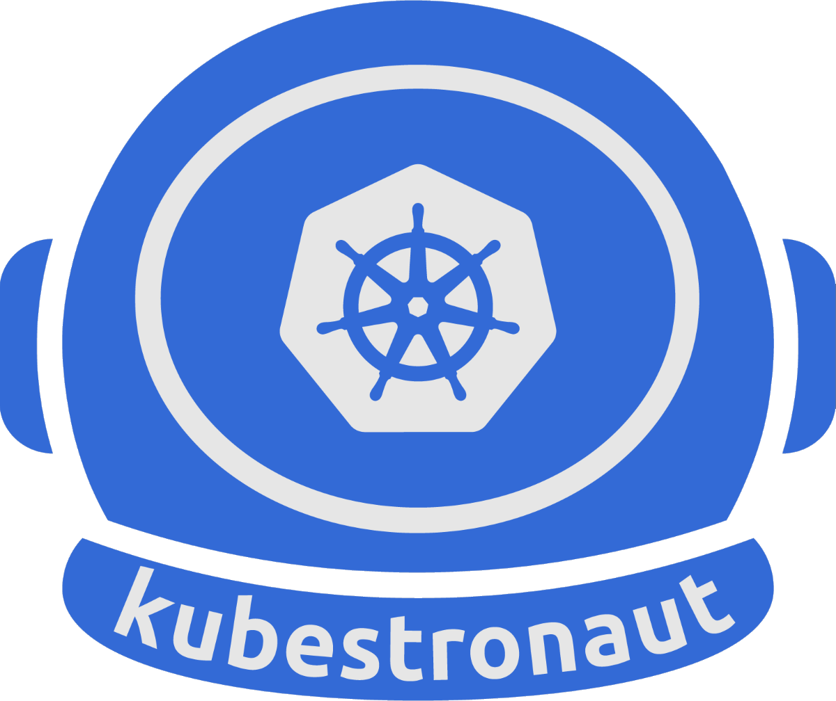



SPEAKER
Who am I
AI Platform Engineer
Seoyul Yoon
An engineer bridging legacy systems into the Agentic AI era
Focused on agent infrastructure connecting OpenAPI, MCP, and Agents
Organizer, Agentic AI Foundation Community Seoul
Seo-yul
Seoyul Yoon
Yul (Seoyul Yoon)
00 · intro
02 / 25

Slide 3
THE PROBLEM
AI Transformation = Redevelopment?
We are rebuilding servers just to adopt AI
A familiar scene in enterprise AI adoption: right next to a perfectly working system, yet another server is built just
for AI to call.
REALITY
PRACTICE
COST
Specs weren't written for AI
So we build it again
Grows with every backend
An LLM can call a decades-old REST
API, but not reliably in one shot.
Human-oriented specs push it into trial
and error.
Teams redevelop: new AI-friendly
servers or MCP servers, with tool
functions hand-written for
every backend.
Development and maintenance costs
grow with the number of backends.
The same feature gets built twice.
The question: The APIs and their specs already exist. Why build them again? “Don't reinvent the wheel” applies here, too.
00 · intro
03 / 25

Slide 4
BUILDING BLOCKS
Don't reinvent the wheel
Automate instead of redevelop, reusing the wheels that already exist
Layer | Library | Role in this pipeline
Protocol | mcp (Python SDK) | The standard protocol for LLM tool calls (tools/list · tools/call, JSON-RPC)
Framework | FastMCP | High-level MCP server framework with OpenAPI auto-conversion (OpenAPIProvider) and extension hooks
Adapter | langchain-mcp-adapters | Exposes multiple MCP servers as a single LangChain tool collection, regardless of transport
Agent | LangGraph + deepagents | Stateful graph workflows plus a standardized SubAgent orchestration pattern
Convert | spec2openapi | Converts Swagger 2.0 specs into FastMCP-ready OpenAPI 3.x (built in-house, released as open source)
00 · intro
04 / 25

Slide 5
THE BIG PICTURE
The Pipeline in One Line
“A single OpenAPI spec spins up an MCP server, and a LangGraph Agent runs on top.”
→
→
01
02
03
OpenAPI spec
MCP server
Agent
Legacy specs lifted to OpenAPI 3.x
The standard tool interface
Stateful orchestration
spec2openapi
FastMCP · mcp SDK
LangGraph · deepagents
Two standards combined: OpenAPI owns the spec, MCP owns the tool interface. Our own code is only the converter
between them (spec2openapi) and a thin layer on FastMCP hooks, so the pipeline evolves as the standards do.
00 · intro
05 / 25

Slide 6




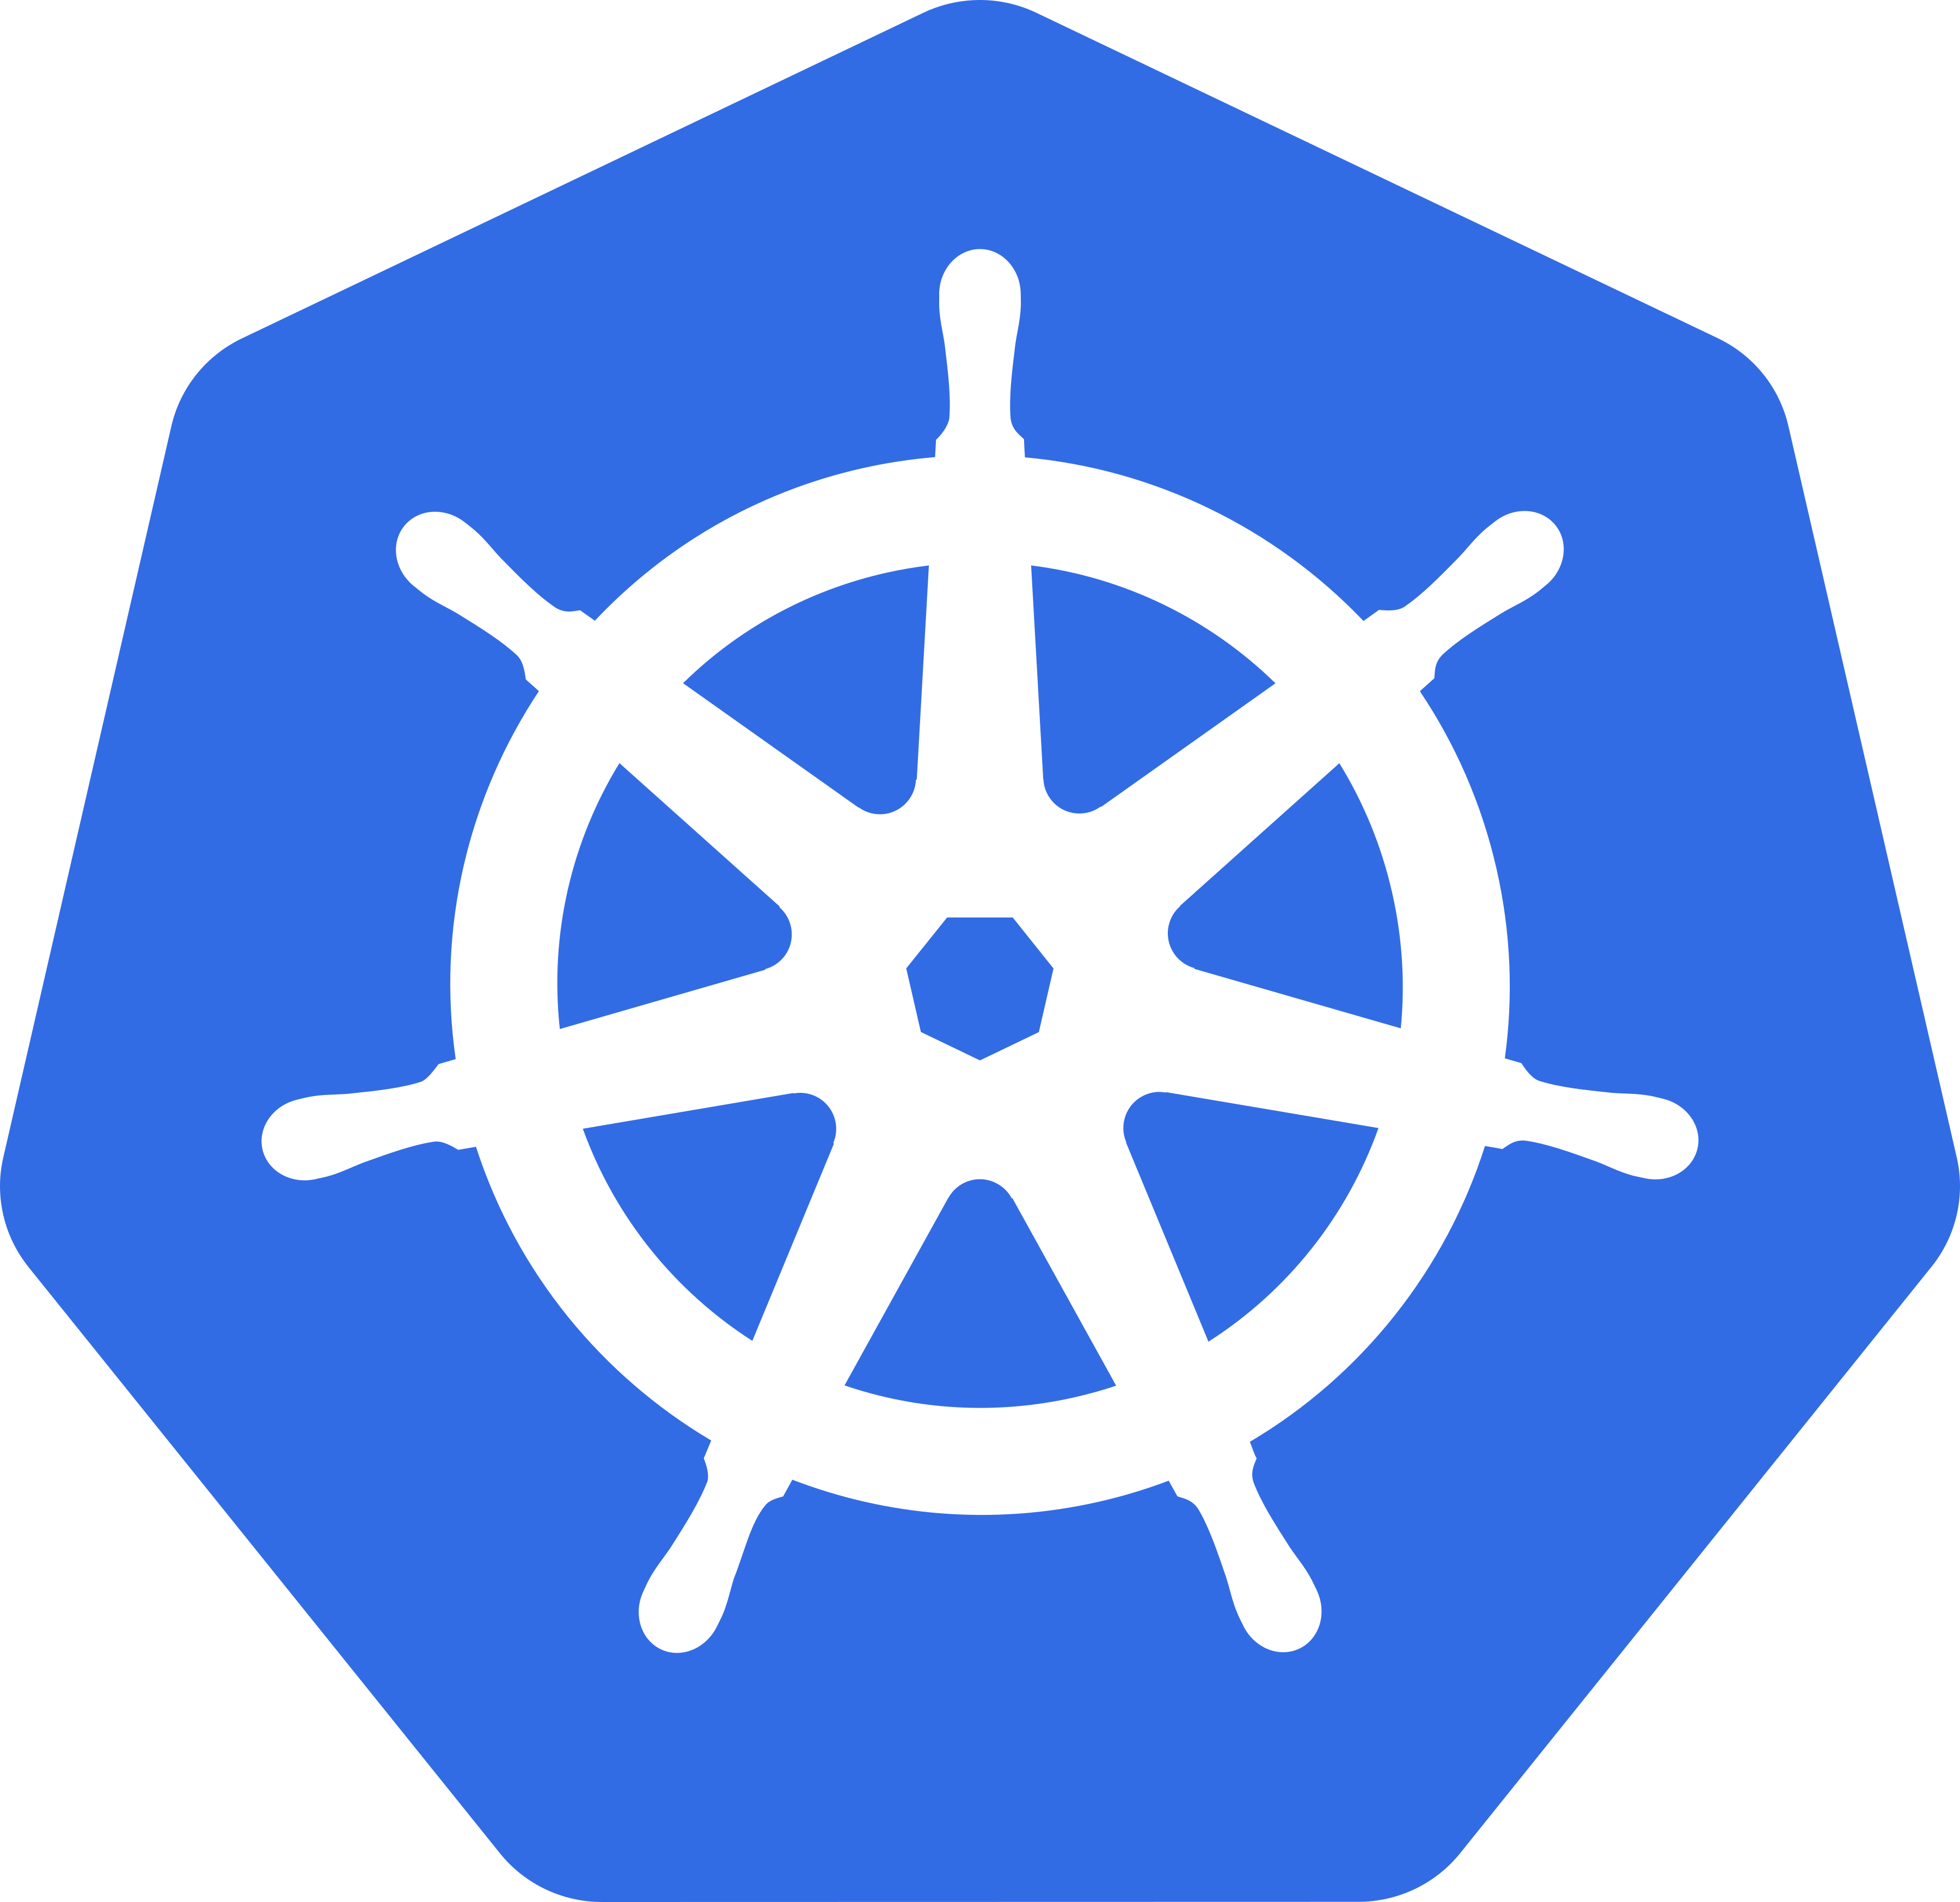
THE PLATFORM
The Platform at a Glance
One flow from a legacy spec to a conversation
spec2openapi
mcp-adapters
chat
Legacy System
MCP Server
AI Agent
User
REST API
Swagger 2.0 spec
FastMCP · OAuth proxy
tools from the spec
LangGraph · deepagents
main + SubAgents
chat · triggers
Kubernetes
provisioned by our Operator · McpServer / AiAgent CRDs
One pipeline: the spec is converted, served as MCP tools, wired into an agent, and delivered as chat. The runtime underneath
is provisioned declaratively.
00 · intro
06 / 25

Slide 7

PART 1
OpenAPI → MCP
Turning legacy specs into a standard tool interface
OpenAPI
→
MCP
→
Agent

Slide 8
LIBRARY
FastMCP
The go-to library for building MCP servers agents can call
If the mcp SDK is the protocol itself, FastMCP is the framework for building servers on top of it quickly.
Think FastAPI, but for MCP.
DECORATORS
TRANSPORTS
KEY FEATURE
@mcp.tool
stdio · http
OpenAPI integration
Add a decorator and the function
becomes an MCP tool. Argument
schemas are generated from
type hints.
stdio for local and CLI use, Streamable
HTTP for production. Same code,
different transport.
Reads an OpenAPI spec and converts
it into tools automatically. This is
where redevelopment-free
transformation starts.
Three reasons we chose it
① OpenAPI auto-conversion ② RouteMap exposure control ③ hooks to override auth and descriptions
01 · OpenAPI→MCP
08 / 25

Slide 9
THE CORE MOVE
OpenAPI → Tool, Automatically
From spec to tools: the hand-written step disappears
Normally, 100 APIs mean 100 hand-written tool functions. FastMCP needs just the spec.
python
Single Source of Truth (SSoT)
The backend team maintains only the OpenAPI
spec; the tool catalog stays in sync automatically.
Even definitions tangled with $ref and allOf are
flattened into clean argument schemas
by OpenAPIProvider.
When the API changes, the spec changes, and
the tools follow.
from fastmcp import FastMCP
from fastmcp.server.providers.openapi import OpenAPIProvider
import httpx
client = httpx.AsyncClient(base_url=BACKEND_URL)
provider = OpenAPIProvider(
openapi_spec=spec, # OpenAPI 3.x spec
client=client, # how tools call upstream
route_maps=ROUTE_MAPS, # what to expose
mcp_names=names, # operationId -> tool name
)
mcp = FastMCP(providers=[provider])
mcp.run(transport="http")
01 · OpenAPI→MCP
09 / 25

Slide 10
REALITY CHECK
Two Walls on the Way
Then we hit two walls in the field
Wall ① Input format
Wall ② Spec quality
FastMCP accepts only OpenAPI 3.x. Most legacy specs in
the field are still Swagger 2.0, so the pipeline cannot
even start.
If the spec is unclear, the agent cannot call the tools
correctly. Human-oriented descriptions and rule-breaking
operationIds are not enough.
01 · OpenAPI→MCP
10 / 25

Slide 11
IN-HOUSE · OSS
spec2openapi
We built and open-sourced a converter that clears both walls
Not just a converter
Spec upgraders already exist, but none guarantee FastMCP-ready output. That guarantee is why we built our own.
FastMCP-ready guarantee
Enforces the tool name == operationId rules (allowed characters, 64-char limit, uniqueness) at conversion time.
Upgrade to the standard
The output is a standard OpenAPI 3.x document that runs on any OpenAPI runtime. This is our production path today.
python
from spec2openapi import (
load_spec, convert_swagger, check_fastmcp_ready)
spec = load_spec("swagger2.json") # file or URL
doc = convert_swagger(spec) # -> OpenAPI 3.x
check_fastmcp_ready(doc) # [] means MCP-ready
Open source · Apache-2.0 · PyPI · github.com/Seo-yul/spec2openapi · CLI (upgrade · validate · serve) wraps the
same API
01 · OpenAPI→MCP
11 / 25

Slide 12
DESIGN PRINCIPLE
Convert Honestly, Verify Really
A library that never guesses silently
Legacy specs have holes: consumes, operationId, host.
When the library meets one, it answers in one of three ways — all visible in the result.
doc["x-s2o"]
x- extensions
strict=True
Fill it — and say so
Can't map it? Keep it
Or refuse to guess
Safe defaults fill the holes, and every
default is written into the output
document. Nothing is hidden.
What OpenAPI 3 cannot express is
preserved as x- extensions instead of
being dropped.
One argument makes conversion fail
the moment a guess would be needed —
with the full list of what it wanted
to assume.
python
doc = convert_swagger(spec) # assumptions recorded in doc["x-s2o"]
doc = convert_swagger(spec, strict=True) # raises ConversionError instead of guessing
# verified on 975 real-world Swagger 2.0 specs (APIs.guru) · known failures: 0
01 · OpenAPI→MCP
12 / 25

Slide 13
SPEC QUALITY
Curate What the Agent Sees
Show the agent only what it needs, in words it understands
Too many tools hurt selection accuracy, and human-oriented descriptions break calls.
python
RouteMap as a whitelist: only defined endpoints
open as TOOL, and the final catch-all EXCLUDE
rule blocks everything else.
Descriptions replaced via ToolTransform:
OpenAPI descriptions are written for humans.
Tool descriptions are overridden with
LLM-friendly ones.
This becomes the basis for isolating each agent's
tool scope per profile.
ROUTE_MAPS = [
# open only endpoints defined in the profile
RouteMap(methods=["GET"],
pattern=r"^/v1/alerts$",
mcp_type=MCPType.TOOL),
RouteMap(methods=["POST"],
pattern=r"^/v1/alerts/ack$",
mcp_type=MCPType.TOOL),
# block everything else (catch-all)
RouteMap(mcp_type=MCPType.EXCLUDE),
]
01 · OpenAPI→MCP
13 / 25

Slide 14
WHEN DEFAULTS FALL SHORT
Enterprise Auth, on Extension Hooks
Enterprise auth sits on FastMCP extension hooks
Production immediately demands per-user auth and per-backend headers.
This is where choosing an OSS with well-exposed hooks pays off.
PER-REQUEST INJECTION
CUSTOM VERIFICATION
SEEN AS ONE ROLE
httpx event hook
TokenVerifier
OAuth proxy
Injects per-user tokens and headers
right before every request. Optional
parameters that some models fill with
empty strings are filtered in the
same place.
Keycloak introspection verification
implemented in-house, with results
cached. Five IdPs supported:
Keycloak, Google, GitHub,
Azure, Okta.
Verifies tokens on the way in, injects
tokens on the way out: the MCP server
becomes an auth relay. All thin code
on top of the hooks.
python
async def inject_headers(req): req.headers["Authorization"] = f"Bearer {await store.get(user_id)}"
client = httpx.AsyncClient(base_url=BACKEND_URL, event_hooks={"request": [inject_headers]})
01 · OpenAPI→MCP
14 / 25

Slide 15
PROVISIONING
Provisioned by an Operator
Declare one resource; the Operator runs it and keeps it running
Actually running and operating the MCP servers is the Kubernetes Operator's job.
Two CRDs: McpServer and AiAgent.
yaml
One declaration: declare a single McpServer
and the Deployment, Service, Ingress, and HPA
are created automatically.
One image: a generic runtime image; only the
per-service config and spec ConfigMaps
get swapped.
Self-managing: dead Pods are recreated, and
spec changes trigger automatic rolling restarts.
Bad specs stop at the door: the CRD schema
blocks them instead of controller branches. The
agent-side CRD comes at the end of Part 2.
apiVersion: platform.example.com/v1
kind: McpServer
metadata:
name: alert-mcp
spec:
image: registry/mcp-runtime:2.3 # generic runtime
profileConfigMapRef: alert-profile
swaggerConfigMapRef: alert-swagger
envSecretRef: alert-oauth-secret
port: 8080
replicas: 2
# optional: service, ingress,
# scaling(HPA), podOverrides ...
01 · OpenAPI→MCP
15 / 25

Slide 16
PAYOFF
What Developers Don't Do Anymore
What existing system developers no longer worry about
This is the front half of the automated AI transformation pipeline. Here is how the developers' workload shrinks.
→
→
1
AI interface work
2
Deployment
3
Rolling out changes
no redevelopment
no ops burden
no rework
No tool functions to write. Maintain the
OpenAPI spec and the tool
catalog follows.
Running and keeping servers is the
Operator's job. One declaration
is enough.
When the spec changes, tools update
and servers restart automatically.
Nothing is redeveloped for AI transformation. A pipeline built with open source, from a legacy spec to the MCP
server, does it instead.
01 · OpenAPI→MCP
16 / 25

Slide 17

PART 2
MCP → Agent
Stateful orchestration that wires tools into execution
OpenAPI
→
MCP
→
Agent

Slide 18
LIBRARY
langchain-mcp-adapters
The bridge that turns MCP servers into LangChain tools
What it is: a single MultiServerMCPClient connects multiple
MCP servers at once.
From the agent's view: no need to know which server or
transport anything comes from. It is simply one bundle
of Tools.
On top of that: plumbing such as OAuth metadata discovery
and Dynamic Client Registration (RFC 7591) is handled
automatically. The only human step left is browser consent.
Naming chaos is absorbed here too: the ecosystem calls the
same transport http, streamable-http, and streamable_http. We
normalize to one internal enum and translate only at
this boundary.
python
from langchain_mcp_adapters.client import (
MultiServerMCPClient)
client = MultiServerMCPClient({
"alert": {"transport": "streamable_http",
"url": ALERT_URL},
"logging": {"transport": "streamable_http",
"url": LOG_URL},
"github": {"transport": "stdio",
"command": "npx", "args": [...]},
})
tools = await client.get_tools() # list[BaseTool]
stdio or HTTP, in-house or third-party: this library absorbs the differences at the boundary.
02 · MCP→Agent
18 / 25

Slide 19
LIBRARY
deepagents
Compose SubAgents by purpose and role; the main agent orchestrates
What it is: a library that standardizes the SubAgent
orchestration pattern on top of LangGraph.
Structure: users compose SubAgents by purpose and role, and
the main agent plans and orchestrates them. Tool selection and
context stay far cleaner than with one giant prompt.
Built on LangGraph: runs on StateGraph, persists conversation
state with a PostgreSQL checkpointer, and supports
human-in-the-loop via interrupt() as a standard.
Default safety rails: ToolRetry (retries transient failures) ·
Human-in-the-loop (risky tools gated by interrupt_on) · PII
masking. All are langchain-provided middlewares, a few lines of
config each.
Trigger
↓
main agent
↓
SubAgent
↓
MCP Tool
02 · MCP→Agent
19 / 25

Slide 20
OUR GLUE
Two Pieces of Glue
Two pieces of our own code join the parts: assembly and connection
The gaps between the open-source parts are joined by two pieces of our own code, one role each.
DeepAgentWrapper — assembly: reads a profile (trigger,
LLM, and tool nodes) and builds an executable graph.
Middlewares are attached here as well.
UserMCPClientFactory — connection: pools MCP clients per
user and manages OAuth tokens in Redis with TTLs. When
servers change, invalidate() rebuilds the tool catalog.
Agent code never knows how many servers or which
transports. It sees a single Tool collection.
python
factory = UserMCPClientFactory(...) #
per-user pool
wrapper = DeepAgentWrapper(
agent_spec=profile, # node-based spec
mcp_client_factory=factory, # tools per user
checkpointer=postgres_saver, # resumable convo
)
graph = await wrapper.build_deepagent(
user_id="user-123")
The third piece is deployment. The AiAgent CRD on the next slide handles it.
02 · MCP→Agent
20 / 25

Slide 21
AGENT PROVISIONING
AiAgent — Agent as a Resource
Declare the intent; triggers decide the workload
The agent runtime is handled by the same Operator.
The CR declares only intent; what gets deployed is decided by its triggers.
yaml
Intent only: the CR carries just an image, an
agent definition reference, and triggers.
Triggers shape the workload: chatbot and
webhook unfold into a Deployment; scheduler
unfolds into a CronJob.
Rollout = version bump: raising
agentProfile.version is the redeploy.
apiVersion: platform.example.com/v1
kind: AiAgent
metadata:
name: sre-agent
spec:
image: registry/agent-runtime:2.3
agentProfile: { id: "6863...", version: 4 }
profileConfigMapRef: sre-agent-profile
envSecretRef: sre-agent-secret
triggers:
- type: chatbot # -> Deploy/Svc/Ing
tokenValidation: { type: jwt, issuer: ... }
- type: scheduler # -> CronJob
schedule: "0 9 * * MON"
02 · MCP→Agent
21 / 25

Slide 22
PUTTING IT TOGETHER
End-to-End
The full path of a single request
From one chat request to a legacy REST API call, everything flows as a single unbroken chain.
Chat
→
FastAPI
Router
→
DeepAgent
+ LLM
→
MCP Tool
→
Legacy
REST API
The profile decides the agent's tool scope
Maintain the OpenAPI spec and the tool catalog generates itself
Any MCP-capable host reuses the same catalog as-is
MCP servers and agents alike start and stay up from one declaration
03 · wrap-up
22 / 25

Slide 23
KEEPING IT HONEST
Not Solved Yet
Four things to know before you try this
WSDL: ready, not applied
Interactive OAuth
Today's production path is Swagger 2.0. spec2openapi's
WSDL conversion and SOAP bridge are implemented and
verified, but production adoption is still in preparation.
MCP OAuth assumes browser redirects and user consent.
Headless triggers such as webhooks leave an auth gap,
which we are closing with PATs and per-trigger
token validation.
Non-standard LLM schemas
Description = behavior
Response structures differ by provider, so parsing logic
needs attention on every model switch.
Tool description quality drives agent behavior.
Auto-conversion is not the end: spec management becomes
a new, ongoing cost.
03 · wrap-up
23 / 25

Slide 24


COMMUNITY
Agentic AI Foundation Community Seoul
이 서밋을 주최하는 재단의 서울 커뮤니티가 문을 열었습니다
오늘 이 서밋을 주최하는 곳이 MCP와 AGENTS.md의 집인 Agentic AI Foundation입니다.
그 서울 커뮤니티가 막 시작됐고, 오늘 같은 이야기가 바로 이 커뮤니티에서 진행됩니다.
WHAT
WHO
JOIN
AAIF, 서울에서
한국의 빌더들
오늘, 여기서 시작
이 서밋을 주최하는 재단의 서울 챕터. MCP, goose, AGENTS.md와 agentic AI의 오픈 표준을 초급 세션부터 딥다이브까지 다룹니다.
에이전트, MCP 서버, 도구를 만드는 한국의 엔지니어들. 서울에서 커뮤니티 행사, 발표 세션, 핸즈온을 준비하고 있습니다.
Agentic AI를 만드는 사람들과 연결되는 가장 빠른 자리입니다. 이미 딱 맞는 행사에 와 계시니, 세션 끝나고 편하게 말 걸어주세요.
오거나이저: Seoyul Yoon (linkedin.com/in/yoon-seoyul) · Junghwan Park (PyTorchKR)
서울에서 만나요 — See you in Seoul
03 · wrap-up
24 / 25

Slide 25

Thank you
Rebuild nothing. Automate everything.
github.com/Seo-yul · #MCPDevSummit

