Slide 1
Artificial Intelligence in Evidence Synthesis
Andrea Kepsel
Jessica Sender

Slide 2
Today…
Overview of Evidence Synthesis and Process
AI in Evidence Synthesis
AI Tools in the Evidence Synthesis Process

Slide 3
Overview of Evidence Synthesis and Process
Systematic reviews developed in the medical literature to collate all randomized controlled trials for interventions into one recommendation
Many different types of reviews
Systematic review, scoping review, integrative review, mapping review
Process
From initial research question to publication
question → search strategy → title and abstract review → full text review → quality assessment → manuscript development → publication

Slide 4
Expansion Beyond Medicine
Seeing proliferation of these projects in non-medicine/health disciplines -not just in medicine/health sciences anymore
A systematic review of human-wildlife conflicts in the context of ecological change: Insights from geospatial applications
International Higher Education Students' Self-Esteem: A Systematic Review
Towards safer public spaces: A systematic literature review on CPTED strategies in park design

Slide 5
AI in Evidence Synthesis
Proliferation of AI tools that purport to support evidence synthesis (particularly systematic reviews) process
Predictive AI vs. Generative AI
Generative AI
This is the “new” AI tools that we’re seeing
Developed by existing companies and newer start ups
Predictive AI
Already in use in a number of tools (Covidence, etc.)
Generative AI tools is where we want to focus the scope of this presentation

Slide 6
Using AI In the Evidence Synthesis Process
Research Question Formation/Initial Scan of Literature
PerplexityAI
Consensus
Search Strategy Development
PerplexityAI
Consensus
ChatGPT-for synonym/keyword idea and development - but really bad at subject headings and more specialized, database specific syntax

Slide 7
More AI In the Evidence Synthesis Process
Title/Abstract and Full Text Review
Covidence and EndNote
Data Extraction
Elicit
Synthesis
Elicit
PerplexityAI
Consensus

Slide 8
Questions and Concerns
Do you know where the tool is pulling their data from?
Is it legal?
Copyright concerns
Anthropic settles with authors in first-of-its-kind AI copyright infringement lawsuit
How can you report using AI for publications?
Will the journal allow for AI support? If so, what capacity?
Results are often not reproducible (foundational for research)
Incorrect information
Lots of citations that are simply incorrect-even with DOIs

Slide 9
Future Directions
Is there a return on investment for time dedicated to learning these tools?
Development of disciplinary guidelines for using AI
RAISE Guidelines
Disciplinary guidelines/recommendations
JBI, Campbell, Cochrane, and Collaboration for Environmental Evidence
Still an unclear/shifting landscape
Products, companies, reliability, development

Slide 10
Best Practices
Be clear in reporting
PRISMA (reporting tool for health sciences) has built in AI
JBI, other disciplinary guidelines for AI
Be intentional - use what makes sense and is reputable
Time spent on evaluation and understanding development
Understand publishing process and landscape
Do journals you publish in allow for AI as a tool, author, etc.
Norms in your discipline
Identify ways to keep up with what’s being developed and how it can be leveraged (or not)
Does it actually support your search and review process?
Or are you having to go back and redo work because of incorrect or missed results

Slide 11


Questions and Discussion

Slide 12
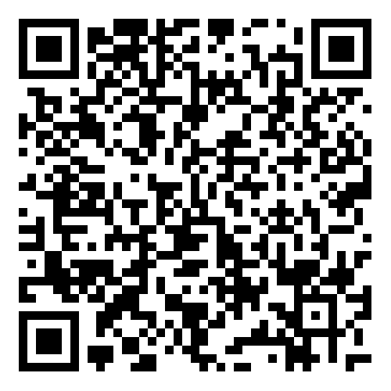
Thanks!
Please fill out the session Feedback Survey:

