Slide 1
Reflecting Your Campus
Using Diversity Audits to Inform Collection Development

Slide 2
What we’re covering
Background
Our library/collection and diversity audits
Initial audit findings
Collection development changes
Outcomes
Updated data
Lessons learned

Slide 3
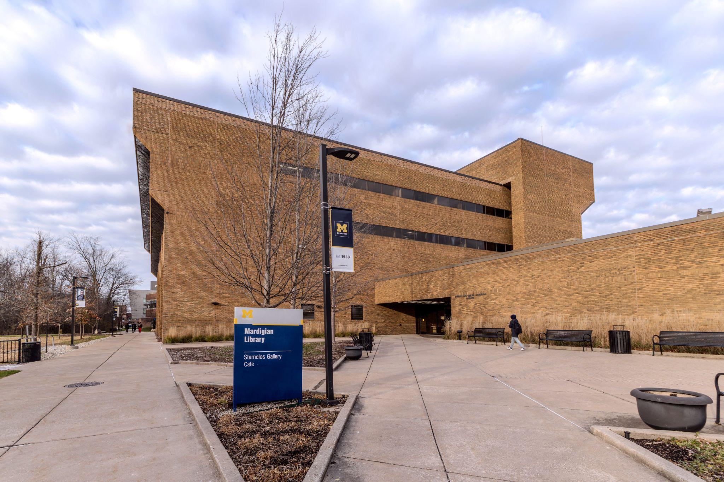
Background
Who We Are
Mardigian Library
Recreational Collection
Image: Mardigian Library
Notes:
To get started, we’ll briefly go over some details about us, our library, and the specific collection which was the subject of our diversity audit.

Slide 4
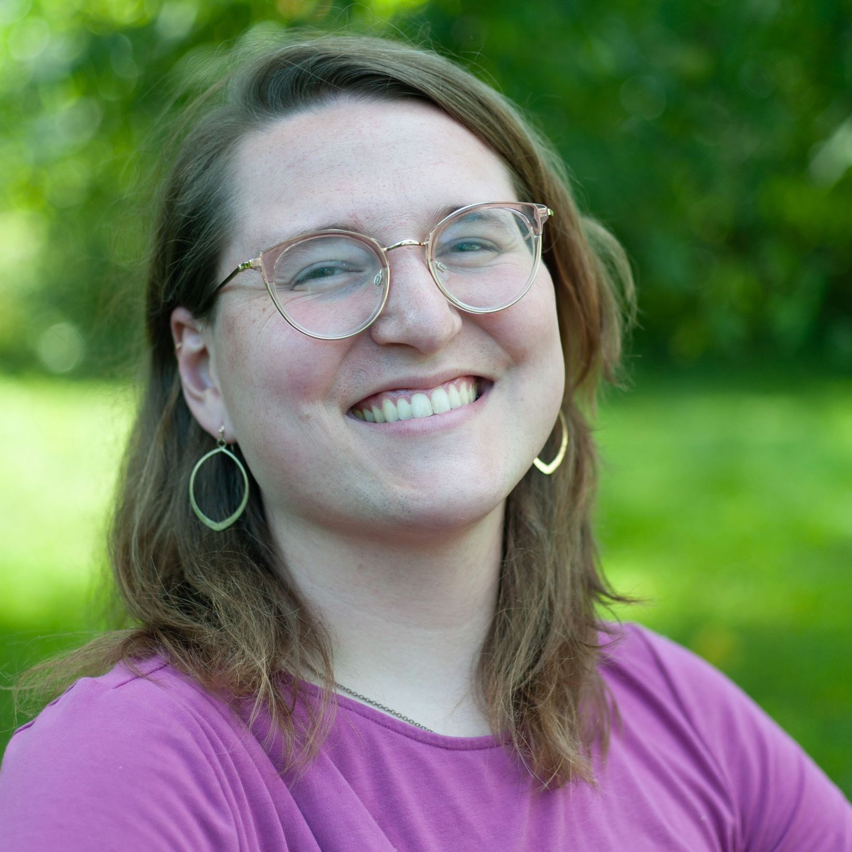
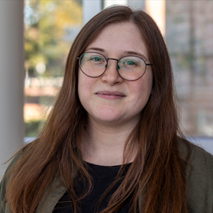
Presenters
Josie Columbus
(she/her)
Access Services Associate
Natalie Hagopian
(she/her)
Business Librarian
Notes:
Josie Columbus (she/her) is an Access Services Associate and a member of he Recreational Collection Committee. Natalie Hagopian is a Business Librarian and the chair of the Recreational Collection Committee

Slide 5
THANK YOU COMMITTEE!
Entire committee supported development and implementation of the audit
Extra thanks to Heidi Keppen-Palmer, who designed our automated spreadsheets
Notes:
This project included an incredible effort from all of our committee members, and it truly could not have been done without their time and expertise. In addition, we’d like to give a special shout out to Heidi Keppen-Palmer, a Technical Services Librarian at the Mardigian Library, who aggregated and parsed a lot of the data that we use in this presentation.

Slide 6
Mardigian Library at UM-Dearborn
The only library at the Dearborn Campus of the University of Michigan
Staff of 23, 6 of whom are on the Recreational Collection Committee
Mid-size commuter campus
High proportion of transfer, first-generation, and/or international students
Location in Dearborn, MI gives us a unique student body and patron population
Notes:
The Mardigian Libary is the only library at UM-Dearborn. We have a full-time staff of 23, not including our student assistants. 6 full-time staff members serve on the Recreational Collection Committee. We are a mid-sized commuter campus with a high proportion of transfer, first-generation, and/or international students. In particular, our location in Dearborn, Michigan gives us a unique patron population, with a large proportion of Middle Eastern, North African, and/or Arab American students.

Slide 7
Recreational Collection
Charge: The purpose of the Recreational Collection Committee is to encourage the use of recreational materials by students, faculty, and staff. Committee members select materials outside of the curriculum, including titles that are culturally relevant, for entertainment purposes, current topics, or local interest, etc.
Size: Approximately 500 items including books, board games, periodicals, and DVDs.
Budget: Endowed fund independent from overall collection budget, and have received multiple annual increases. ($500 when we did the audit, $1500 this year!)
Goals: Create a relaxing environment for destress and casual reading.
Notes:
The Recreational Collection comprises the “fun books” in the Mardigian Library. The purpose of the collection is to provide recreational materials – including popular novels and nonfiction, periodicals, DVDs, and board games. The collection has its own endowed fund which has been increased several times since the audit and which is independent from the rest of the collection budget. The committee’s goal is to create a relaxing environment and encourage casual reading for patrons.

Slide 8
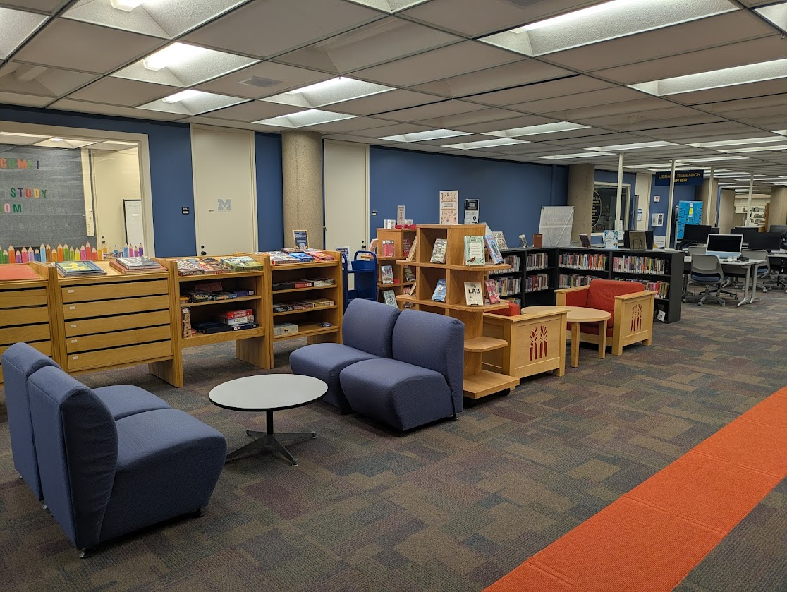
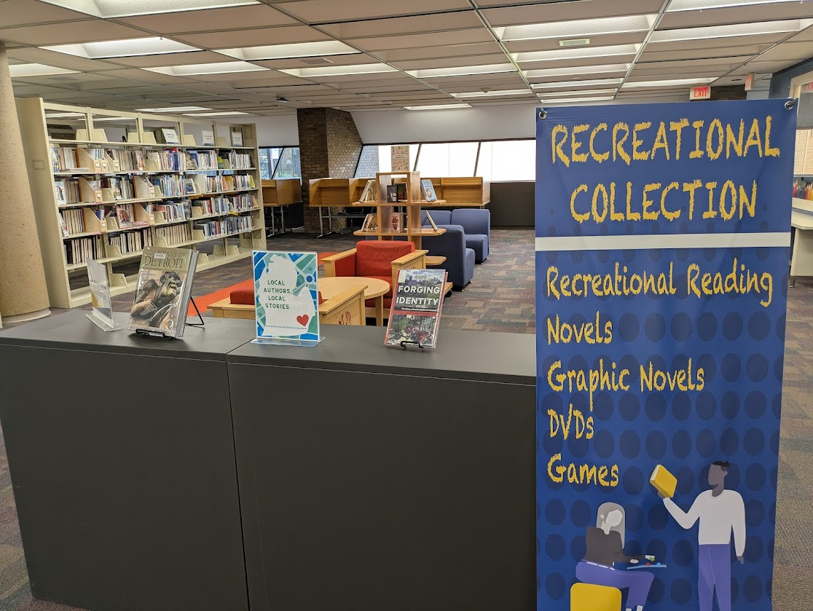
Recreational Collection
Notes:
Photos of the recreational collection

Slide 9
What is a diversity audit?
A data-based evaluation of a collection for specific, pre-defined diversity factors
Notes:
A diversity audit is a data-based evaluation of a collection for specific, pre-defined diversity factors.

Slide 10
Why we needed a diversity audit
Insufficient titles for an Arab American Heritage Month display
Past committee members felt that diverse books had lower circulation numbers and were weeded at a higher rate
Interested in re-evaluating collection development and weeding practices, but needed good data to start
Notes:
The main catalyst for us to begin talking about conducting a diversity audit of the collection was the realization that we lacked sufficient titles in the collection to fill out an Arab American heritage month display. This was particularly concerning for our campus, since so many of our students are Arab American. As we began talking a bit more within the committee about the demographics of our collection, we learned that past committee members felt diverse books had lower circulation numbers and were therefore shifted out of the collection at a higher rate. We wanted to take these anecdotes and pair them with actual data, to see if there were major holes in the collection and be able to take a data-based approach to addressing them. Further, all librarians with collection development responsibilities had completed a course on diversifying collections, and our small Recreational Collection seemed like an ideal place to pilot some of the ideas we were introduced to in that course.

Slide 11
Our approach
Entire (small) collection was audited
Looked at both author identity and content
Iterative process, with two rounds of data collection
For analysis, we used campus demographics as benchmark comparisons
Factors we reviewed:
Race and ethnicity
Neurodiversity and disability
Sexuality and gender
Notes:
For our audit, we decided to review the entire Recreational Collection. This was feasible due to the small size of the collection, although even around 400 titles requires considerable time to evaluate! We also decided to review both author identity and content, which added an additional layer of complexity. In the audit, we reviewed race and ethnicity, neurodiversity and disability, and sexuality and gender. Our audit unintentionally became an interative process, as our find round failed to produce any usable data. In an effort to most accurately reflect self-identity in our review, we initially used open fields to record our findings. In our second round, we used a controlled vocabulary to create workable, easily sortable data.

Slide 12
Challenges
Structure
Balancing the complexity of identity with creating usable data
Relying on self identification whenever possible
Notes:
As I eluded to in the last slide, we ran into some major challenges throughout the audit process. Our initial structure for the audit failed to give us useful data, which we addressed through introducing a controlled vocabulary. We also found that a continuous point of tension was balancing the complexity of identity with creating usable data. It was uncomfortable placing individuals into broad categories, and much of how we define race and ethnicity on a broad scale gets wonky when applied to individuals. Similarly, we ran into some unexpected challenges when relying exclusively on self-identification. We found that white authors were less likely to share information about their race and identity, which meant many white authors ended up in an “unknown” category, which made it seem like they were a smaller percent of our collection than they actually were. In hindsight, this issue was not too surprising, since white cultural hegemony treats whiteness as a norm that others are deviating from, and is therefore less likely to be noted or addressed directly. Our desire to reflect peoples’ identity perfectly initially got in the way of us being able to find the information we needed to make actionable decisions about the collection.

Slide 13
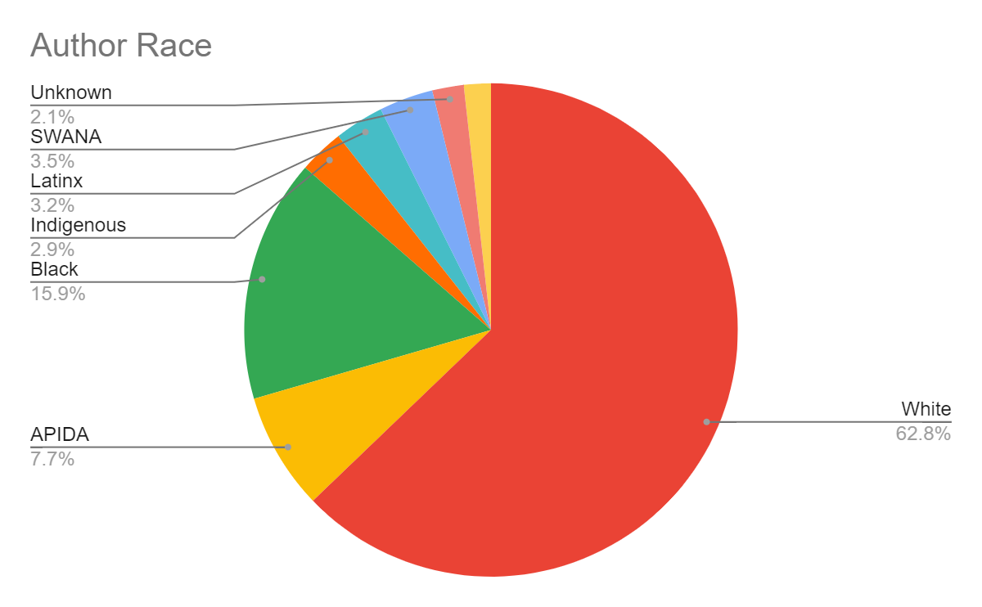
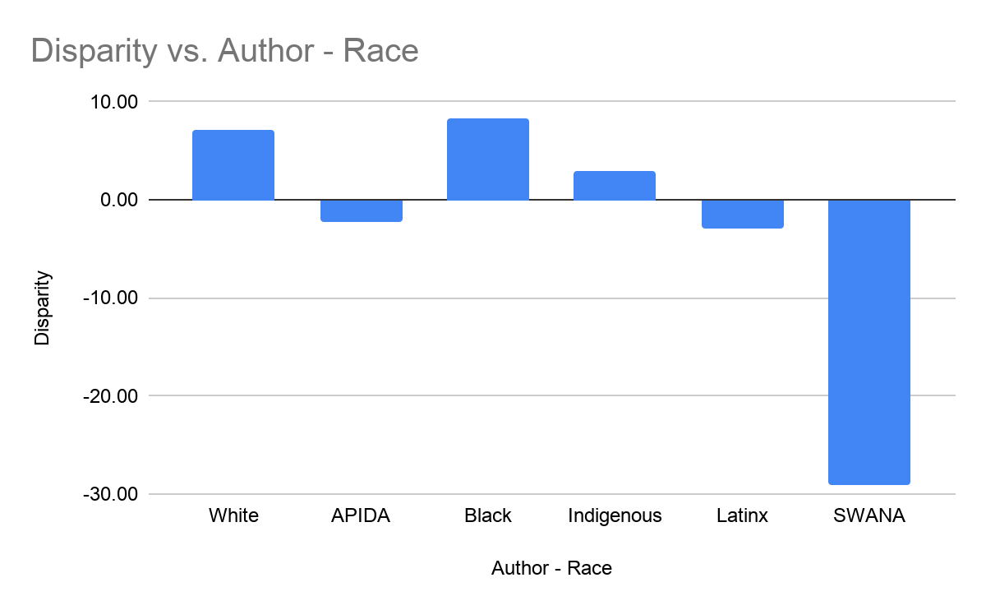
Findings
Notes:
The chart on the left illustrates the author identities in the collection in 2023, as a percentage of the overall collection. 62.8% of books were written by white authors, 7.7% by Asian, Pacific Islander, Desi American (APIDA) authors, 15.9% by black authors, 2.9% by Indigenous authors, 3.2% by Latinx authors, and 3.5% by Southwest Asian/North African authors, with 2.1% of authors having unknown racial identity. The bar chart on the right demonstrates the disparities this represents between our student population and the makeup of the collection. White and Black authors are overrepresented by about 8%, and Indigenous authors are overrepresented by about 3%. APIDA and Latinx materials are unerrepresentated by about 5% each, and SWANA patrons are vastly underrepresented compared to our demographic estimates of our patron population, at a nearly 30% disparity.
Note some quirks in the data. The IPEDS estimate for our Indigenous population on campus is less than 1%, leading to the disparity noted above, but this is likely not reflective of the Indigenous student population on campus. Likewise, SWANA is not an identity measured in IPEDS, and many of these patrons may sort themselves into other categories, such as white, in official census data. .

Slide 14
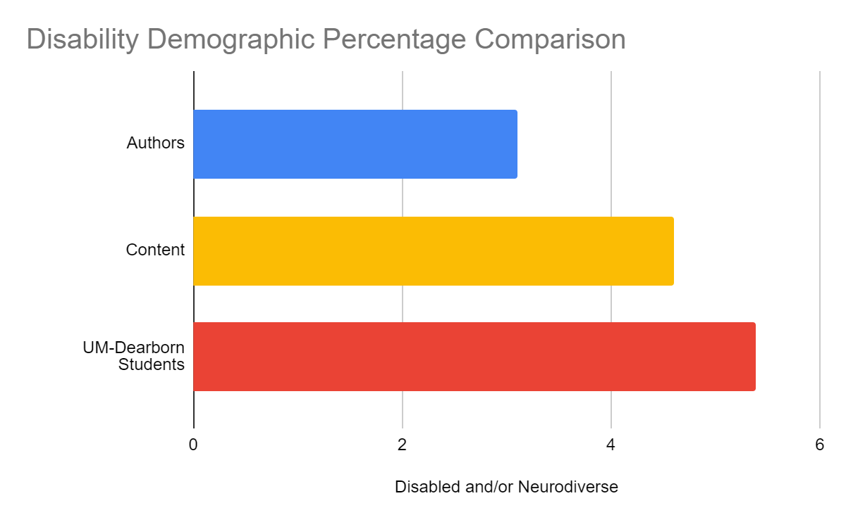
Audit v. UM-Dearborn Demographics Comparison - Disability
Note: The percentage of students with disabilities at UM-Dearborn is likely higher in reality; this 5.38% only includes students who are formally registered with the Office of Disability Services
Notes:
Here we explore another dimension of the findings, comparing the percentage of books either by or about disabled and/or neurodiverse people to the percentage of UM-Dearborn students registered with the Office of disability Services. Roughyl 3% of the authors in the Recreational Collection were written by disabled and/or neurodiverse authors, while just a little under 5% of the books featured content related to disability and/or neurodiversity. This is compared to the roughly 5.5% of students registered with Disability Services. However, as many students may identify as being disabled or neurodiverse without formally registering, this is most likely an undercount of the actual population on campus. Still, the collection in 2023 failed to meet even this underestimate.

Slide 15
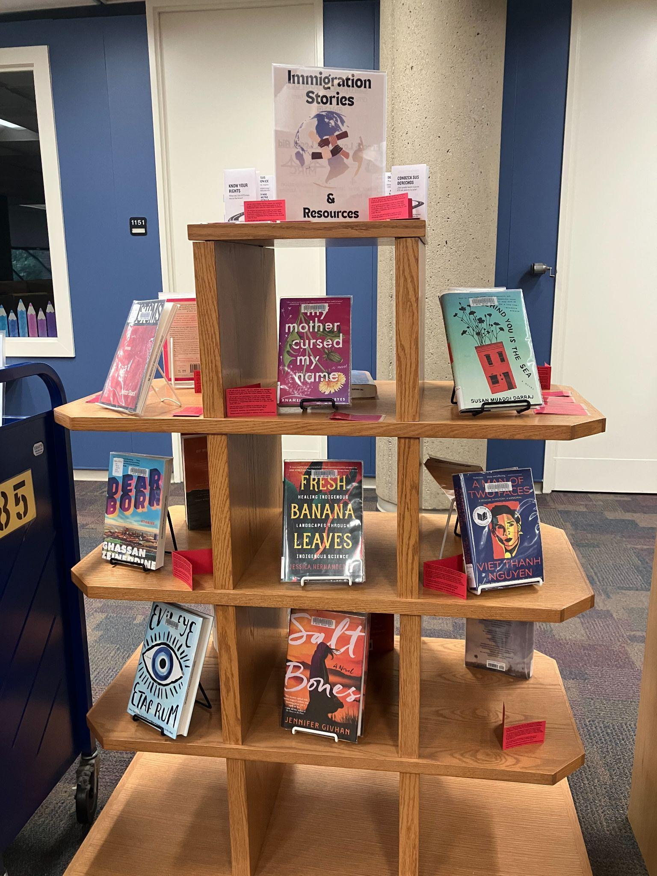
Policy Changes - Collection Development
2 hours per semester focusing on semesterly collection development goal
Example: Latinx authors
Use controlled vocabulary to record relevant demographic information when selecting a title for purchase
Identity-based displays: plan in advance in order to add titles to collection if needed to fill out display
Notes:
Following our data analysis, we had a much better sense of where we were at with the collection. However, just knowing the collection gaps alone wouldn’t magically fix them! We spent time as a committee creating a plan to address our audit findings. This took the form of re-writing our collection-specific collection development policy. First, we decided to identify a semesterly collection development goal where each committee member would commit at least two hours during that semester looking for titles based on that goal. As an example, one of our first focus areas was Latinx authors. We felt that approaching this as a time goal rather than a quota allowed us more freedom with our selections while still keeping diversity as a major focus. We also continued using our controlled vocabulary that we implemented for the audit. We work off of a spreadsheet where we add possible collection additions, and part of entering a purchase suggestion now includes entering any relevant demographic information. This allows us to evaluate the collection diversity with far less effort, since now all our data funnels automatically into a single spreadsheet. This allows us to “spot check” our diversity data whenever we would like, and respond more quickly to any issues we’re seeing. We also adjusted how we plan our displays.Our displays rotate on roughly a monthly basis, and we moved toward mapping out display plans for the entire year over the summer. This allows us more time to plan for our displays, and particularly for identity-based displays, we’re able to order more books if we find we lack sufficient titles to make a display.

Slide 16
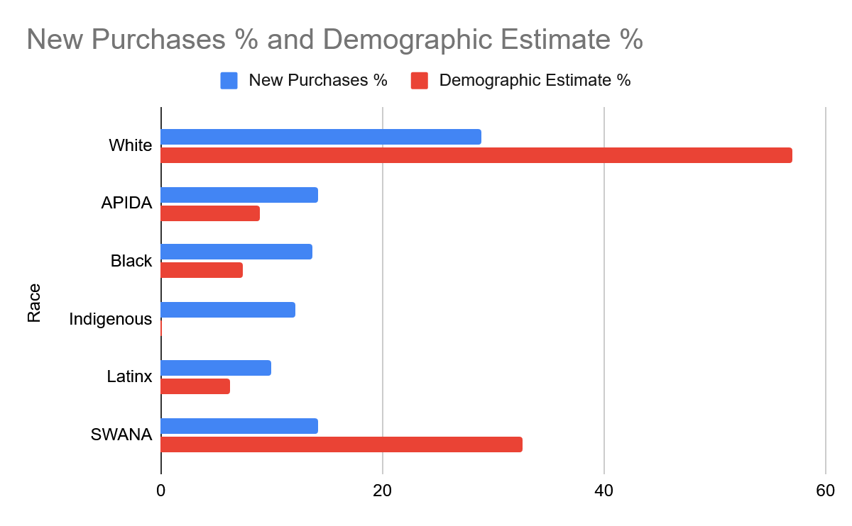
Changes to the Collection
Notes:
Now we’re going to take a look at our progress following the implementation of our changes in approach to collection development. The chart on this slide compares our new purchases in the last three years to our campus demographic estimates. For APIDA, Black, Indigenous, and Latinx authors, our new editions surpass our demographic estimates, while our white and SWANA authors fall below. Since white authors were so overrepresented in our audit, this drop is by design. Our disparity with SWANA demographics is not by design, but is partially a reflection of how large this particular segment is of our campus. We are of course limited somewhat by what gets published and the scope of this particular collection, but we would like to see this disparity continue to shrink.

Slide 17
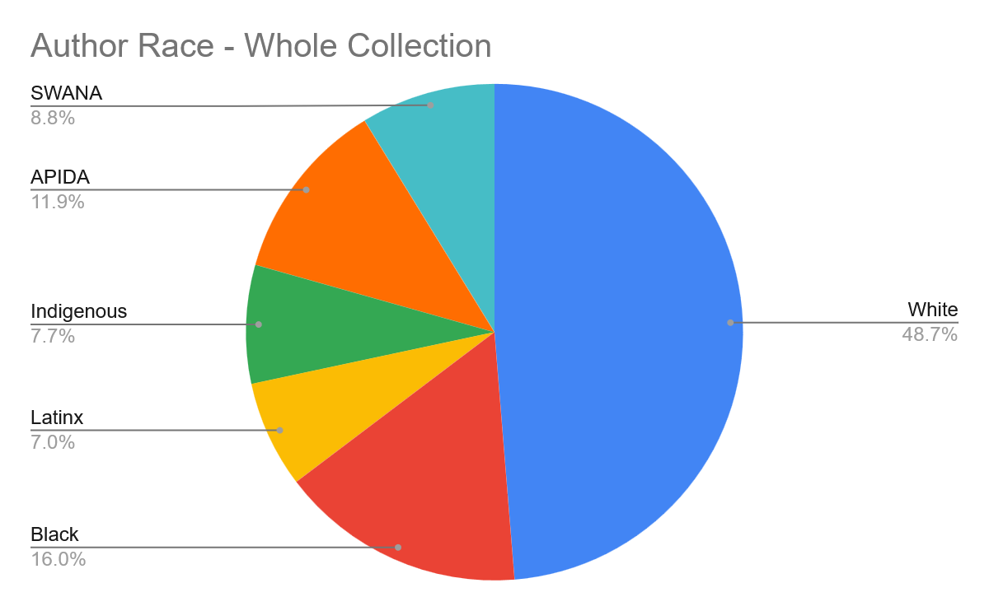
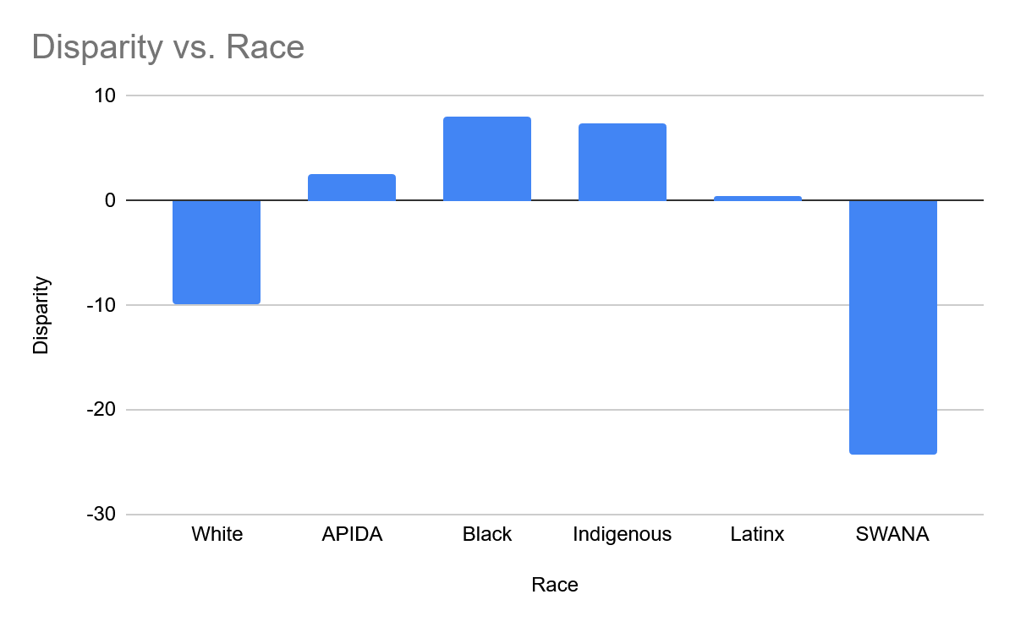
Updated Data
Notes:
Now around three years out from the original audit, we’ve pulled together updated data. These charts reflect the entirety of our collection - this is not looking exclusively at our new additions. We found that our collection development process changes seem to have had a significant impact. Overall, these charts both reflect positive movement. We’re getting closer to our minimum demographic benchmarks, and exceeding it in many areas. The chart on the left shows our updated data for the entire collection. So this includes all the titles that were in the collection pre-audit, along with the items we’ve added since the audit. The pie chart shows our collection currently stands at about 49 percent white authors, 9 percent SWANA, 12 percent APIDA, 8 percent Indigenous, 7 percent Latinx, and 16 percent Black. Particular changes we see here from our previous data: the share of white authors is down from about 63 percent, SWANA authors grew from a previous 3.5 percent, and Latinx, APIDA, and Indigenous authors all nearly doubled in percentage of collection. This second graph indicates our current collection’s disparity with our comparison campus demographic data. The graph shows our disparity for white authors is roughly around -10, APIDA +2, Black and Indigenous around +7, Latinx about zero, and SWANA at -25. In comparison to our original audit data, the major shifts include white authors dropping from an overrepresentation of around +8, SWANA’s disparity dropping from around -28, and all other racial groups at least reaching parity with demographic estimates. We see improvement accross the board, which is great news, although the SWANA representation still lags far below parity with campus demographics.

Slide 18
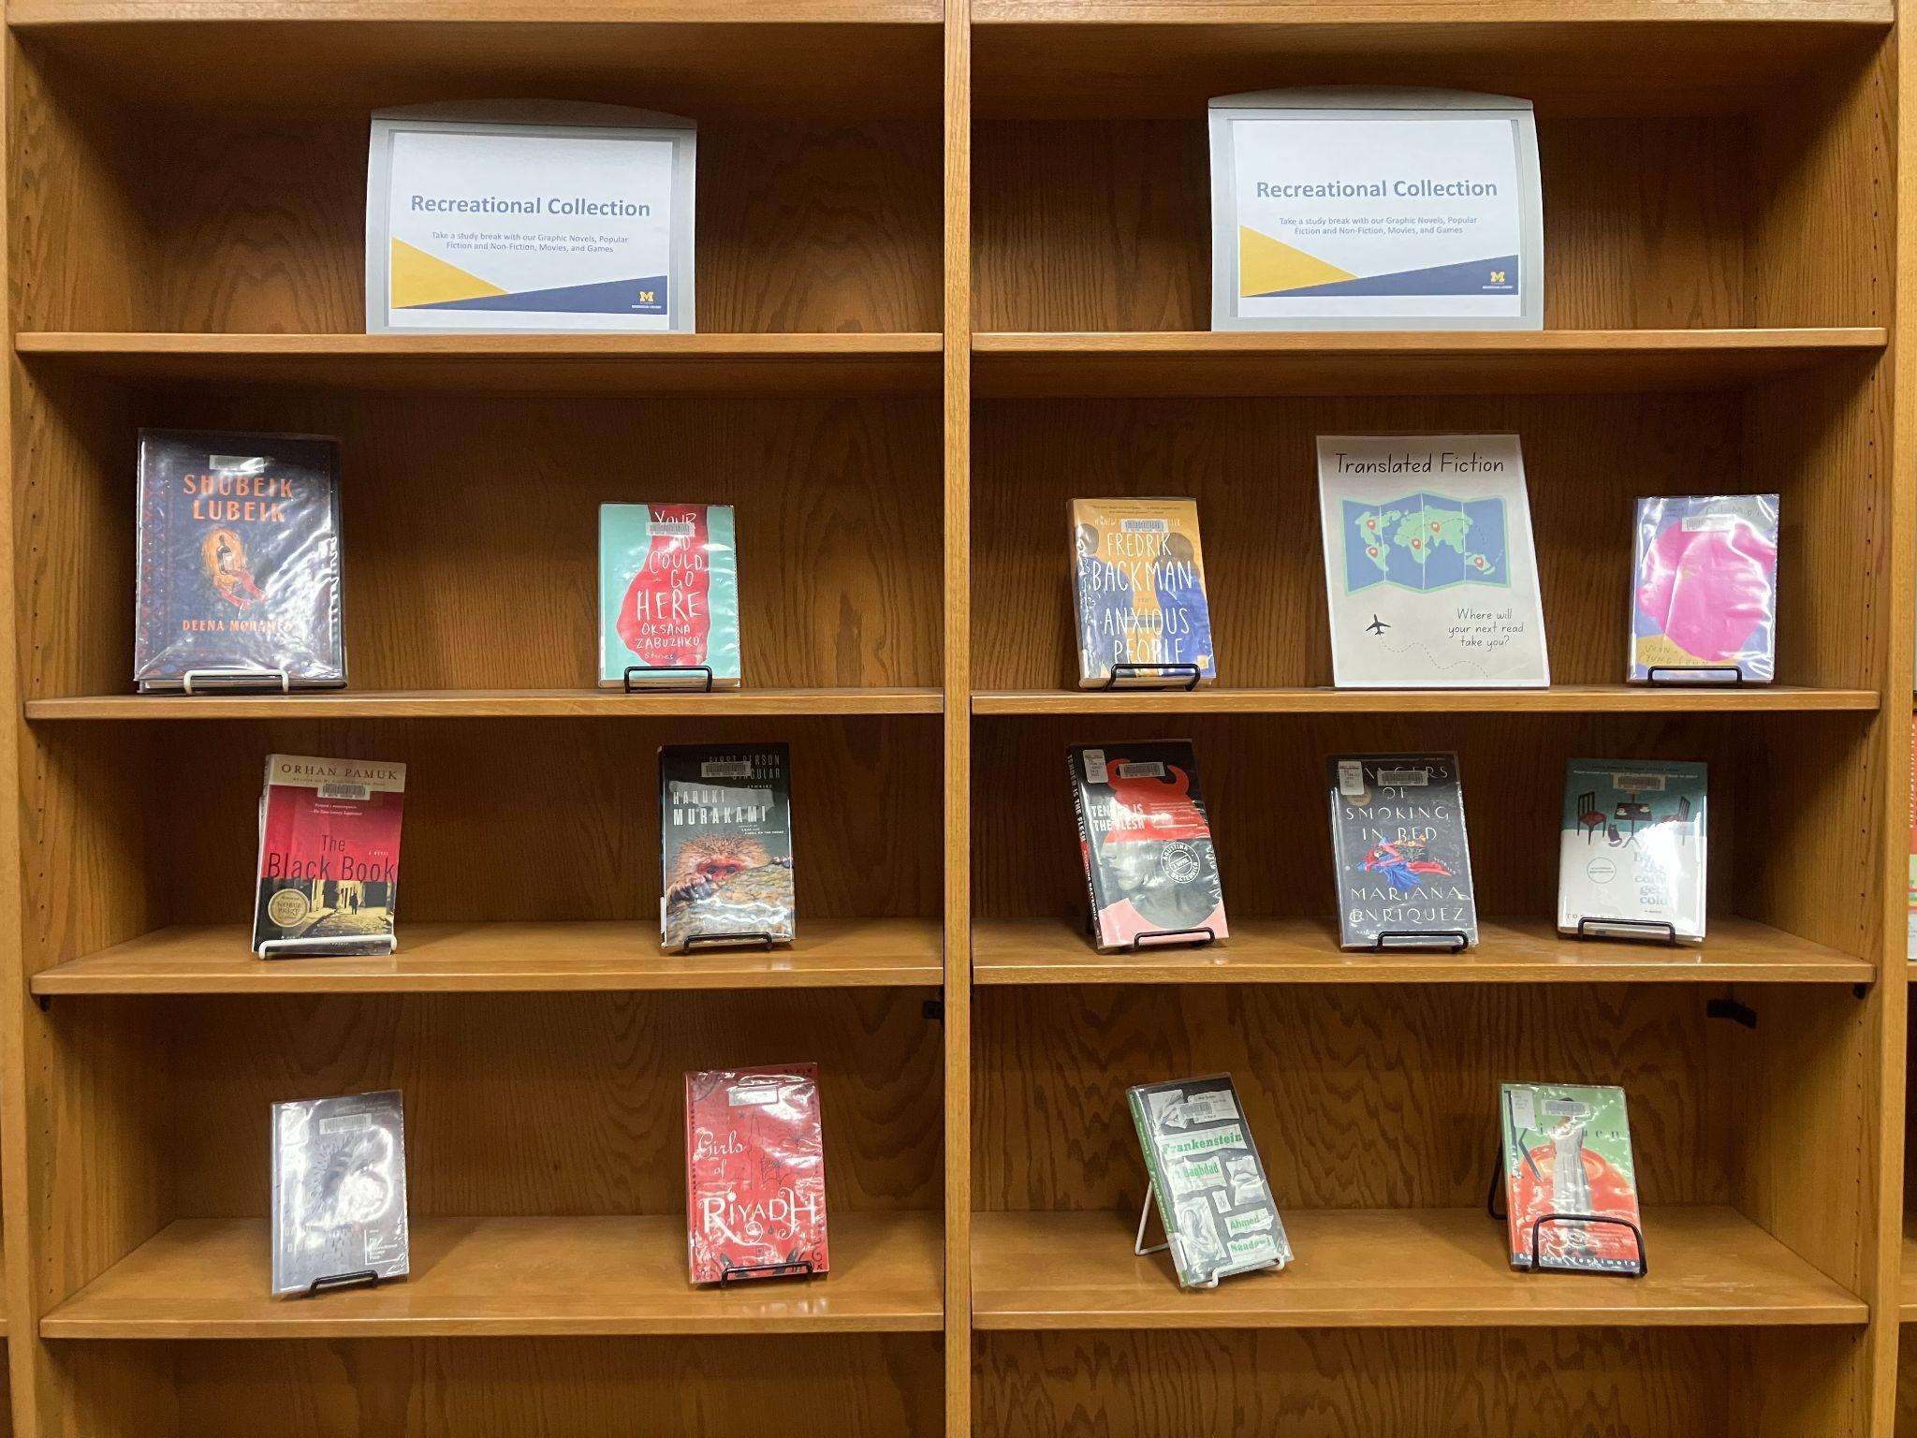
Outcomes
Hard, but possible (& worth it!)
Campus benchmarks helped set a simple baseline goal to diversify our collection
Recommendations and displays are more diverse
Small but concerted effort toward increasing diversity in collections is doable and impactful
Notes:
Diversity Audits are hard, but they are possible and definitely worth it! Campus demographic benchmarks helped us set a simple baseline goal for diversification. With the lessons learned and the changes to our collection development policy, we have been able to offer more diverse recommendations and displays. These small but concerted efforts toward increasing collection diversity are doable and impactful!

Slide 19
Recommendations
Utilize tools like NoveList and Diverse BookFinder in audits and in collection development
Start small: a narrow focus or a “shelfie” approach
Non quota-based collection development goals may make diversifying academic-focused collections more feasible
When possible, use technology to help streamline audits and collection spot-checks

Slide 20
Questions?

Slide 21
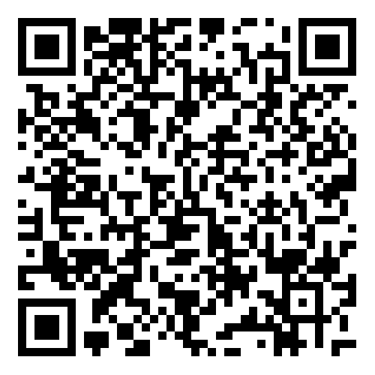
Share your Feedback!

