Slide 1
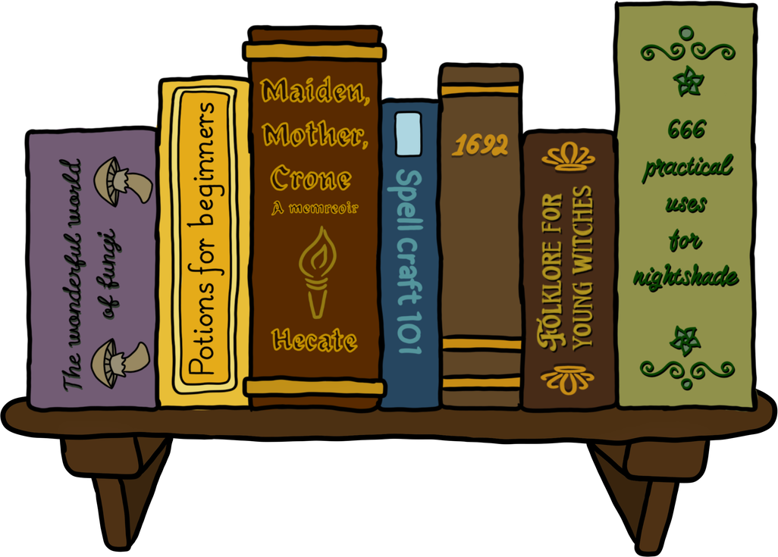


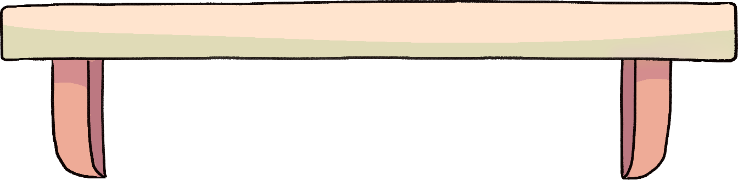
THE PATCHWORK QUILT OF REPARATIVE DESCRIPTION: SHORT HISTORY AND MODERN PROJECTS
Rebecca R. Daly, MLIS
Metadata and Cataloging Librarian
Notes:
Welcome Lake Superior area Librarians! I'm Rebecca Daly, from NMU in Marquette Michigan. I was formally the head librarian of Finlandia University for over 12 years and after it's closing, I joined NMU as the Metadata and Cataloging Librarian, which is truly my dream job.
I've moved from working as a generalist, solo professional academic librarian at a small private religious university to a specialized position working with a team of librarians and staff at a medium-sized public liberal arts university.
I'm excited to be here today and meet some of my fellow lake superior area librarians. And I thank you for attending my presentation.

Slide 2




PRESENTATION OUTLINE
INTRODUCTION
HISTORY
MODERN PROJECTS
GETTING STARTED
Notes:
My new position has allowed me to delve deeper into an area of cataloging that I'm interested in: repartitive description.
Today I'll share information about Reparative description for GLAMS, galleries, libraries, archives, museums and special libraries.

Slide 3

TERMINOLOGY
REPARATIVE DESCRIPTION- FIXING OUT OF DATE TERMS, SUBJECTS, CALL NUMBERS
ENRICHING RECORDS- ADDING IN MISSING SECTIONS OF A BIB RECORD, PARTICULARLY SUBJECT TERMS AND OTHER ACCESS POINTS, ADDING IN NON-LIBRARY OF CONGRESS VOCABULARIES
CONSCIOUS OR CONSCIENTIOUS CATALOGING- PAYING ATTENTION TO AND DELIBERATELY FIXING OLD RECORDS AND ENRICHING RECORDS ACCORDING TO CURRENT BEST PRACTICE
DECOLONIZING- CREATING A NEW SYSTEM/STRUCTURE BASED ON INDIGENOUS WORLDVIEW
HARMFUL LANGUAGE- WORDS THAT ARE NO LONGER ACCEPTABLE, LIKE DEROGATORY TERMS. CREATE A NOTICE THAT MATERIALS CONTAIN HARMFUL LANGUAGE.
CONTENT WARNING/NOTICE/STATEMENT- DESCRIPTION OF MATERIALS THAT CONTAIN HARMFUL LANGUAGE AND/OR PICTURES/IMAGES THAT ARE OFFENSIVE, GRAPHIC, VIOLENT OR OTHERWISE DISTURBING TO SOME PATRONS.
Notes:
This will be an introduction to the wide variety of work that falls under the umbrella of reparative description in cataloging or supports the goals of reparative description.
There's a variety of terms that all relate to reparative description, we'll look at how these concepts were used in the past and today.

Slide 4

POWER OF LANGUAGE
“CLASSIFICATION, HOWEVER, ALTHOUGH NECESSARY IN SYSTEMS OF LANGUAGE, CONTRIBUTES to hierarchies of power.” Vaughan, C. (2018, The language of cataloguing: Deconstructing and decolonizing systems of organization in libraries).
“IF METADATA AND CATALOGING ARE “THE POWER TO NAME”, THEN IT IS WORTH ASKING: WHO IS DOING THAT NAMING?’”
WATSON, BRIAN M. 2019. “BIAS AND INCLUSIVITY IN METADATA.”
Notes:
read quote--
as librarians, we are creating the policies and procedures that inform and guide cataloging. Creating bib records is not only providing patrons with descriptions of items but also access points like subject terms to find materials. We want the data and information we provide to be both accurate and reflective of the diverse communities we serve.

Slide 5
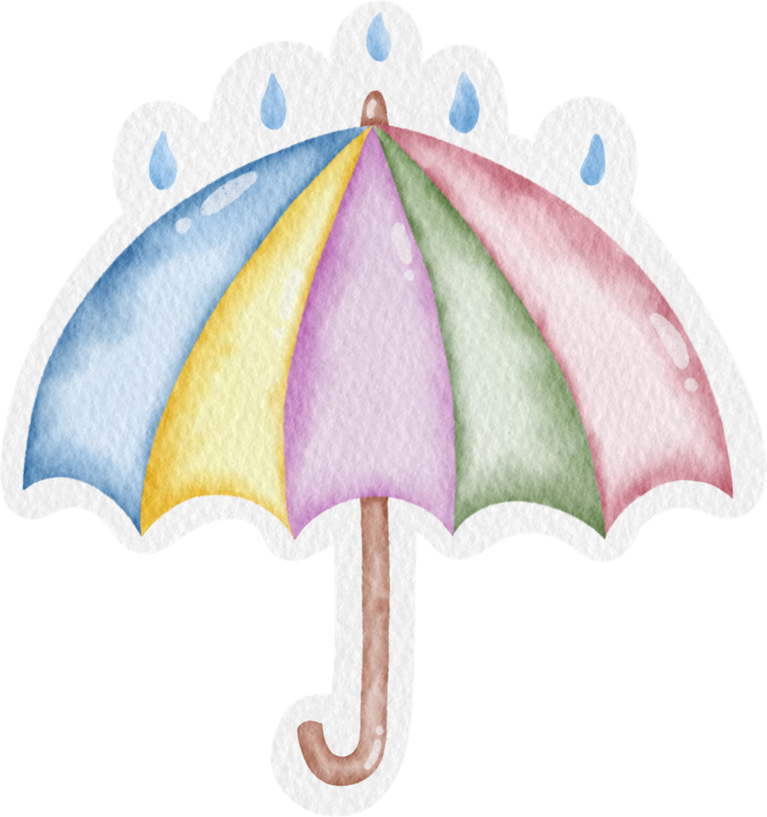


REPARATIVE DESCRIPTION IN CATALOGING & ARCHIVES
acknowledging women as individuals
Pre-Colonial Place Names
Putting harmful language in context
Accurate terminology= Dignity for all people
Slave =Enslaved Person
Illegal Immigrant=Undocumented Immigrant/noncitizen
Updating Call and Cutter Numbers - DDC
Using Tribe names from the tribe instead of name given by colonizers and other tribes
Notes:
There's a variety of projects, small and large that fall under reparative description.

Slide 6


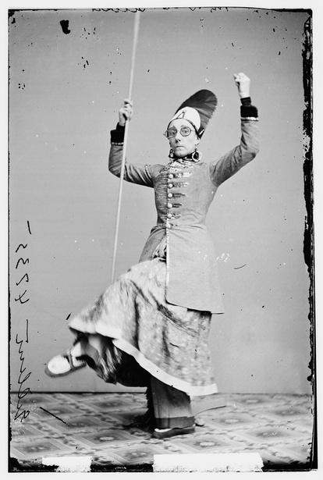
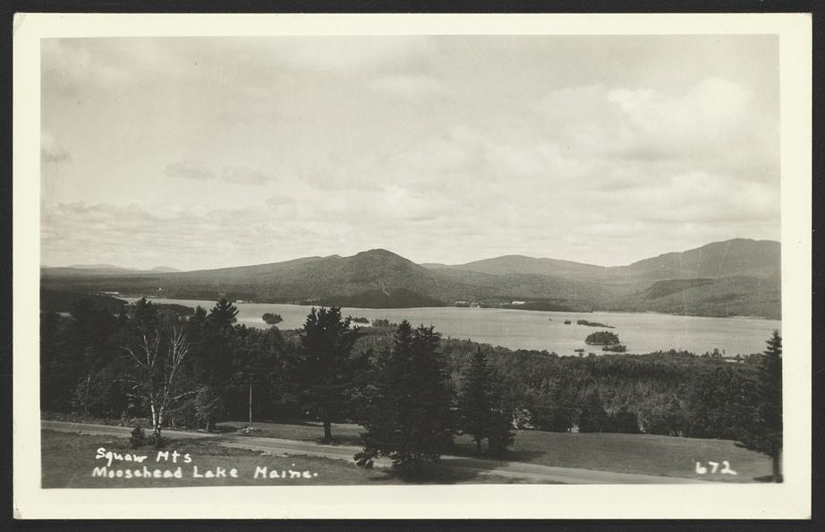

EXAMPLES
Rug money : how a group of Maya women changed their lives through art and innovation
Mrs. Geo. H. Gilbert, 1855-1865
Mrs. Geo. H. Gilbert. , None. [Between 1855 and 1865] Photograph. https://www.loc.gov/item/2017897285/.
Colonial Place Names
Squaw Mountain from Blair's Hill, Moosehead Lake, Greenville, Maine. Maine Greenville United States, None. [Between 1900 and 1940] Photograph. https://www.loc.gov/item/2024688292/.
Notes:
Let's look at a few examples of records that could use repartive work.
Acknowledging women as individuals. Mrs. George H. Gilbert had a first name and maiden name. It would take some research into wedding records to find out women's full names and biographic information like birth or death dates. She was an actress, so it might not be as hard to identify her through newspaper and theatre ephemera.
Colonial Place names, the name given to this mountain range in Maine is extremely offensive and derogatory. The mountain has already been renamed Big Moose Mountain, the name change was initiated by a state law in 2000 to change all place names that included 'Squaw'.
Other name changes in Maine include Baxter mountain, which is the highest point, to Katahdin, from Abenaki or Penobscot languages. If we look at the LOC record for this postcard, there is no additional place name reflecting the change or a note saying that the term is derogatory.
Rug Money-- Female artists last names are included in the book, can add them as personal names, also add the local communites as 651/geographical. Adding in local subject fields for the place names and adding in womens' last name, provides more accurate description and access points, while also providing dignity to the subjects of the work.

Slide 7





HISTORY
Notes:
Now that we have a basic understanding of what reparative description is.
Let's look at it's history in American and Canadian libraries next and see how this type of work has always been a part of library science.

Slide 8


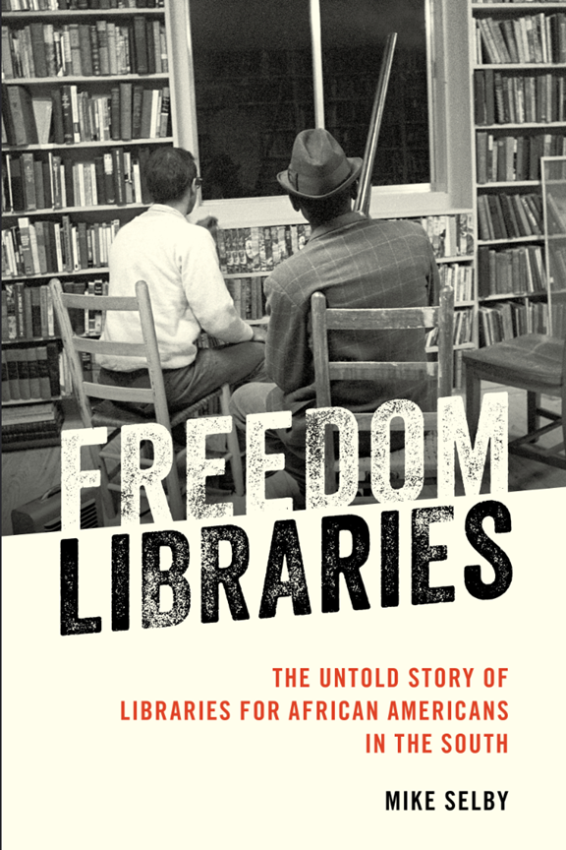
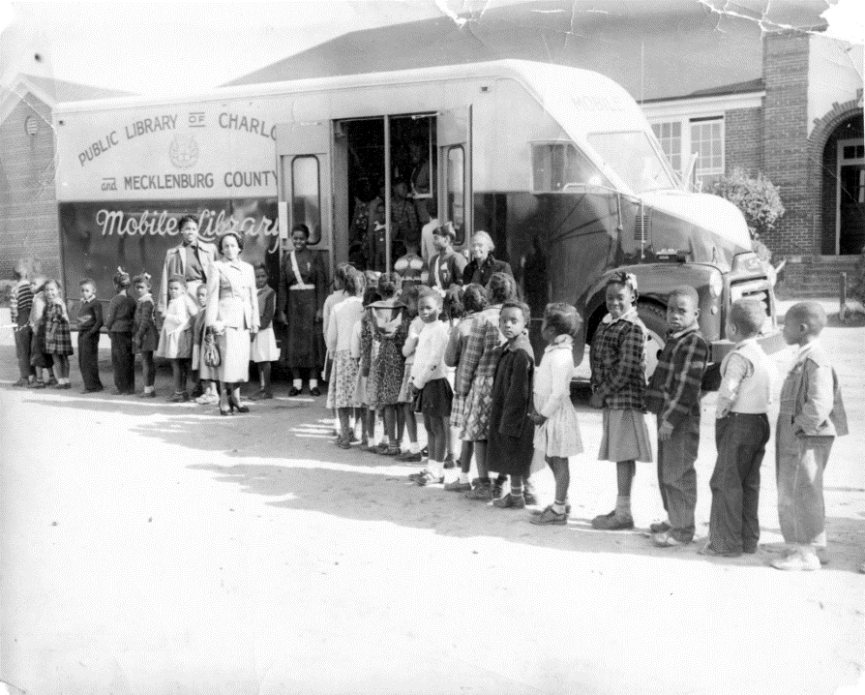



PIONEER BLACK LIBRARIANS
TITLE: FEMALE LIBRARIANS ASSISTING CHILDREN ON THE BOOKMOBILE, 1966
CHARLOTTE MECKLENBURG LIBRARY, NORTH CAROLINA
HTTPS://WWW.CMLIBRARY.ORG/BLOG/PIONEERING-WOMAN-HISTORY-ALLEGRA-WESTBROOKS
Rodney Freeman, UNC Charlotte Librarian and Documentary Film Maker
“Are You a Librarian: The Untold Story of Black Librarians”
Go FundMe: https://www.gofundme.com/f/help-us-highlight-the-stories-of-black-librarians
Go Fund Me for Doc
Notes:
Due to segregation, a parallel library system was created by african americans for their communities, Freedom Libraries were a part of the Freedom Schools movement.
These libraries were outside the formal library systems.
Quick plug here for Rodney Freeman's documentary about the history and modern experience of black librarians. I learned about his work at the last ALA LearnLibX conference.

Slide 9

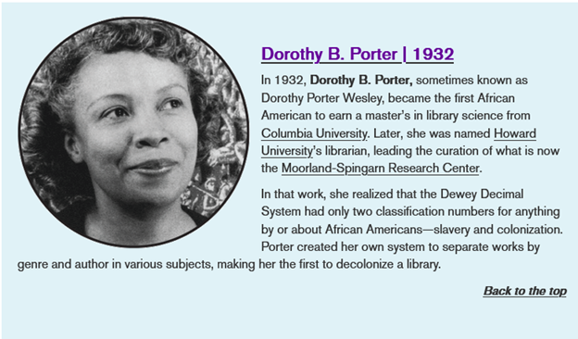
DOROTHY B. PORTER
https://www.slj.com/story/five-trailblazers-in-black-librarianship
February 2nd, 2023
Notes:
One of the best known AA librarians was Dorothy B. Porter-Wesley.
Note that this blurb about her from the SLJ came out for Black History Month, it would be ideal to have this history integrated into library history and not a 'special subject'.

Slide 10

1930-1975 DEWEY DECIMAL SYSTEM
PORTER’S SYSTEM AT HOWARD
Moorland-Spingarn Research Center
Pan-African diaspora/global perspective
Organized by Genre /Subject & Author
Native languages - example Liberian Bassa language, British colonizers forbade
World Literature beyond European languages
325-- Colonization--
All African American literature and works classed here
Poetry, Fiction, Speeches
326--Slavery
Notes:
When Porter started with the Moorland-Spingarn Research Center at Howard University- she greatly expanded and diversified Howard's collection beyond african american history, to include the larger black diaspora and a greater diversity of works by black americans.
Howard is one of the first Historically Black Colleges and Universities, again due to segregation black people were forced to create their own institutions of higher learning.
She realized that DDC was treating blacks as 'other' and greatly modified the DDC classification system for Howard's collection.
This allowed for self-representation , inclusion and resistance against the fracturing of black diaspora works.
She included POC and minority viewpoints within subject area instead of the segregated locations of 325 & 326
Porter promoted a Global viewpoint instead of the traditional western white Christian male centered view.
Porter also questioned her western worldview during this process to ensure that she was giving non-Western materials equal treatment.

Slide 11


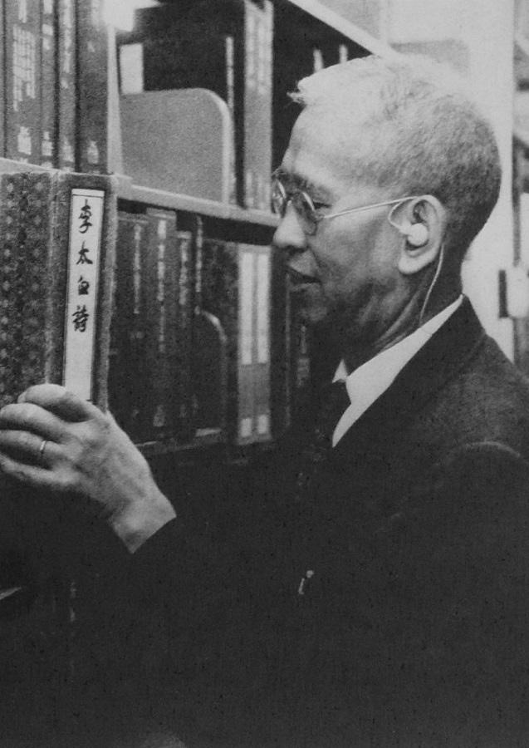

ALFRED KAIMING CHIU
Harvard-Yenching Library
Chinese and Japanese Scripts
Hard to alphabetize non-roman languages
Chinese classification system lacked flexibility
DDC was confined to Western Perspective/segregating Eastern knowledge (like Black knowledge)
Subject, Author or title, format displayed in traditional Chinese classification number of 4 characters , was adapted internationally
Harvard-Yenching Classification System is still used today
THE FIRST UNIVERSITY LIBRARIAN DR. ALFRED CHIU KAIMING TOOK UP OFFICE IN SEPTEMBER 1966.
PICTURE FROM CHINESE UNIVERSITY OF HONG KONG LIBRARY
Notes:
When AKC started at the Harvard library in the 1930s, he ran into many of the same issues as Porter but for Chinese and Japanese materials. Like Porter he wanted Asian materials to be fully integrated in the classification system and not 'othered'.
LOC updated Chinese topics in the 70's and 80's
It took 4 or 5 decades for LC to catch up to the useful changes Chiu suggested. This is a good example of why a library would want to add local subject terms instead of waiting for LOC.
Picture from Chinese University Hong Kong Library, from 1960. Chiu was their first librarian.

Slide 12
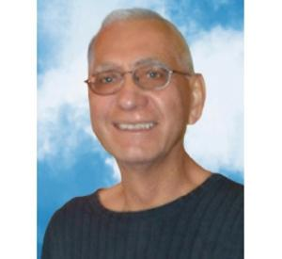
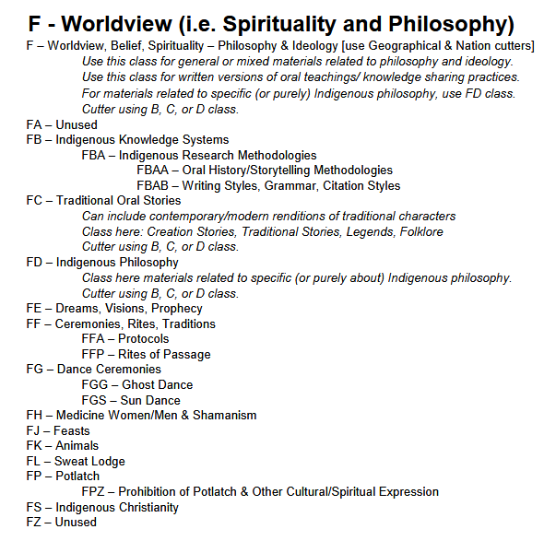
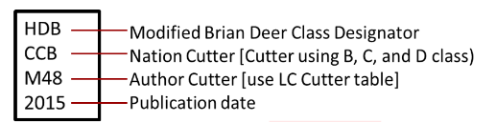
A. BRIAN DEER
Indigenous, First Nations
Canadian Perspective
Created in 1970's
Geographical
True Decolonization of a classification system
Still used today, often in a modified version, example Kwantlen Polytechnic University, BC
Notes:
Brian Deer Classification system has been around since the 1970's, it's main focus is on Canadian tribes. It's based on geographic location, making it easier to explore tribes from the same area.
One disadvantage of this system is that the call and cutter numbers are based on only one tribal name, where there could be several names for a single tribe.
This is a true decolonization project. Instead of manipulating the DDC or LC system, it was a new classification system based on the Canadian indigenous worldview.
Look at another indigenous decolonized classification system later
LINK TO KPU-- so many great resources

Slide 13
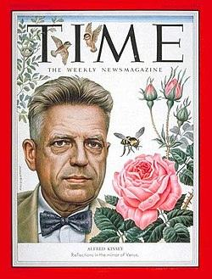
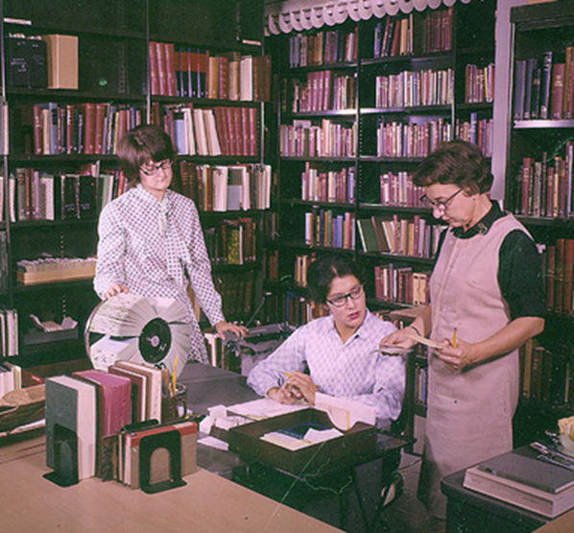
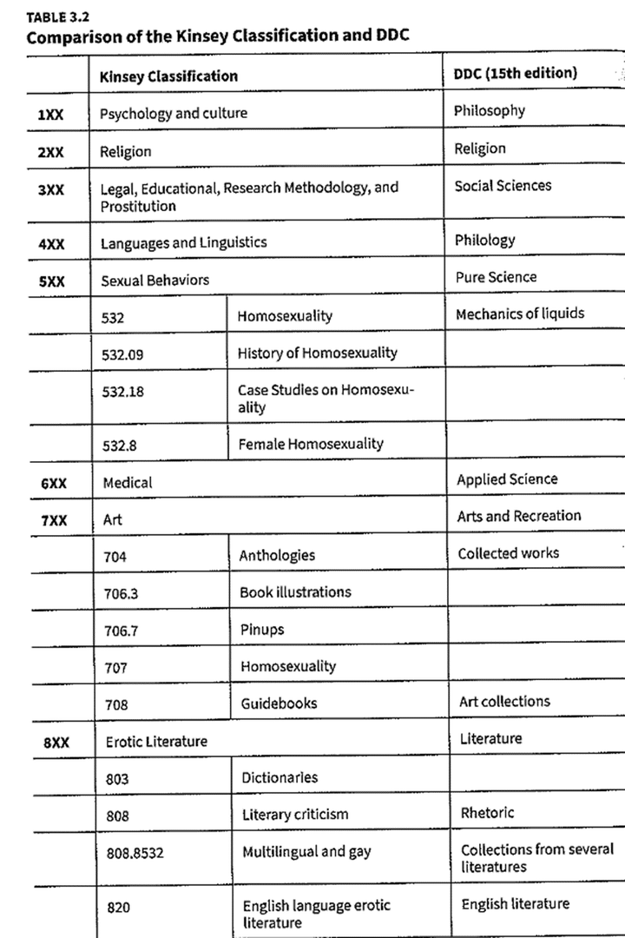
ALFRED KINSEY-INSTITUTE FOR SEX RESEARCH
PICTURE OF ALFRED KINSEY ON TIME MAGAZINE’S AUGUST 24, 1953 ISSUE
ELIZABETH EGAN AND TWO ASSISTANTS, FROM THE KINSEY INSTITUTE HISTORY PHOTOGRAPH COLLECTION
HTTPS://MONROEHISTORY.ORG/2019/02/25/KINSEY-VS-THE-LIBRARIAN/
Notes:
Alfred Kinsey is considered the pioneer of human sexuality studies. He was a Biology professor at Indiana University, and students petitioned for classes on marriage and the family. Kinsey taught as part of a team and focused on sexuality. The class was immensely popular and through funding for research from non-profit organizations, Indiana allowed him to create the Institute on Sex Research in 1947. Kinsey set up the library for the Institute Kinsey himself, creating a new classification system because DDC did not allow for a spectrum of topics on sexuality and instead demeaned and marginalized topics like homosexuality by defining it as a mental derangement. In the early 60s, Elizabeth Egan became the head librarian, and she decided to reclassify everything under Dewey Decimal, but used a modified version that included hundreds of subject terms that hadn’t been adopted by DDC yet. I tried visiting the Kinsey Institute website and it is not currently up. The State of Indiana stopped funding the Institute and has been heavily pressuring Indiana Univ to offload the institute and make it a non-profit not related to the university. It is currently a political prisoner. The last blog post I could find was from 2024.

Slide 14



MODERN PROJECTS
Notes:
Let's look at some more modern project

Slide 15

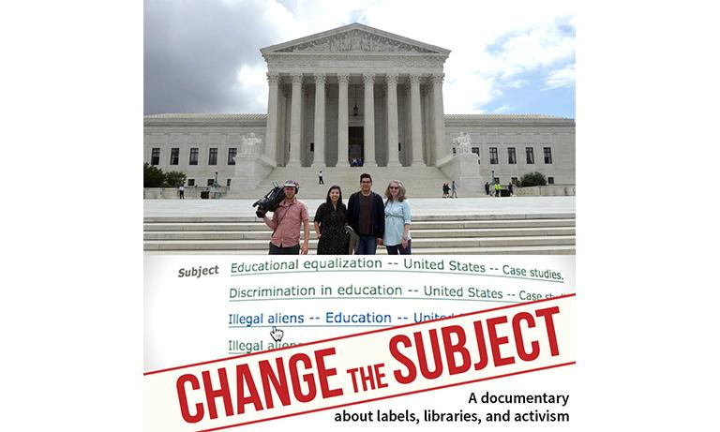
MODERN PROJECTS
LC Subject Terms
Slaves-- enslaved people
Illegal aliens-- undocumented people, noncitizens
Insane-- mentally ill
Sexual deviance, sexual perversion--homosexuality
Correcting Tribal Names- LC has a working group of tribal librarians
LC Geographical Subject Terms
Mt. McKinley--Denali--back to Mt. McKinley
Gulf of Mexico-- Gulf of America
Librarians can add local subject fields and create/modify Authority Records
ALA guidance empowers & encourages local cataloger(s) to add local subject and authority record fields
Notes:
Subject headings became a national debate in 2018 when congress members rallied against the recommendation from librarians to change the term 'illegal aliens' to undocumented people. The latest controversies surround the changing of the geographical subject terms for Mt. Denali and Gulf of Mexico.
Library of congress is not a national library, it is for the government and while it provides support for libraries in the US and around the world, it is political by design and creates 'politically correct' terminology by what subject terms it approves.
In most libraries, LC provides guidance but as the saying goes 'you follow the rules until you don't or your mileage may vary'. We are always walking the edge between what the guiding rules are and what our local rules are, including consortiums or state library systems.
Luckily the ALA empowers and encourages Librarians to enrich records and MARC21 provides the means to add local subject terms and fields, to bib and authority records.
REMEMBER old terms are still included in the authority records, allowing access when using old subject terms. patrons can become familiar with new terms by looking at the bib record's subject terms

Slide 16
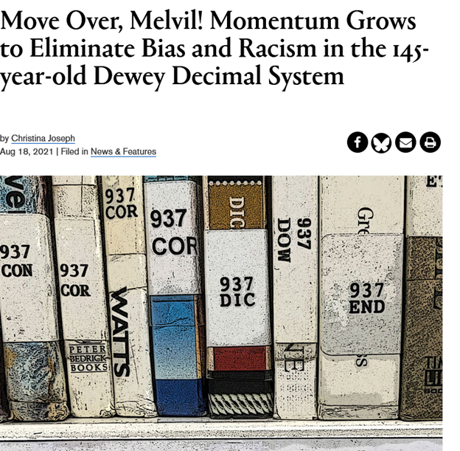

MODERN PROJECTS- DEWEY DECIMAL CLASSIFICATION SYSTEM
Goals:
Eliminate Bias
More inclusive/global- give more space to non-Western Christian topics
Increase accessibility
Reflect modern knowledge
Advantage in DDC: room to create new classification numbers
Notes:
The DDC system also has its fair share of controversy.
Quote from this article--"But a growing number of school and youth librarians are moving to dismantle the Dewey Decimal Classification system...Not only is the Dewey Decimal System outdated, they say, but many of Dewey’s approaches to categorizing books were racist and sexist. For instance, Black history is not part of American history; “women’s work” is a separate category from jobs; non-Christian religious holidays are situated with mythology and religion; and LGBTQ+ works were once shelved under “perversion” or “neurological disorders” before landing in the “sexual orientation” category."
The ALA has a resolution about Melvil Dewey
"citing a history of racism, anti-Semitism, and sexual harassment. “Whereas Melvil Dewey did not permit Jewish people, African Americans, or other minorities admittance to the resort owned by Dewey and his wife,” reads the resolution approved by ALA.
“Whereas the behavior demonstrated for decades by Dewey does not represent the stated fundamental values of ALA in equity, diversity, and inclusion,” the statement continues after listing several other Dewey offenses."

Slide 17
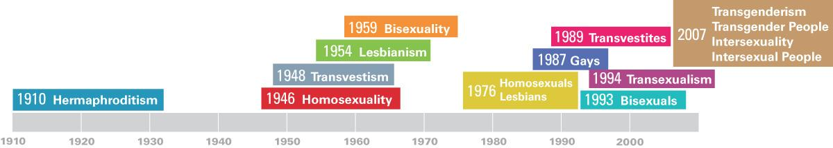
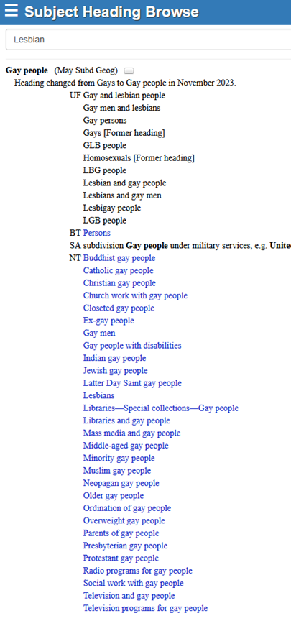
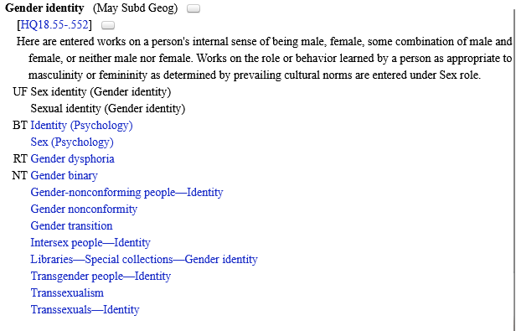

PROGRESSION OF QUEER TERMINOLOGY
ELLEN GREENBLATT’S STUDY "THE TREATMENT OF LGBTIQ CONCEPTS IN THE LIBRARY OF CONGRESS SUBJECT HEADINGS" IN SERVING LGBTIQ LIBRARY AND ARCHIVES USERS: ESSAYS ON OUTREACH, SERVICE, COLLECTIONS AND ACCESS (MCFARLAND, 2010).
LGBTQ PUBLISHING: FILE UNDER QUEER
A look at how readers have found LGBTQ literature, from the 1950s to today
By Jason Baumann |
PUBLISHERS WEEKLY, May 22, 2015
Notes:
Here's a look at the progression of subject terms used that relate to a specific minority group, queer people. Although the subject term was changed to 'Gay People', it seems like Queer is considered more 'inclusive' these days.
on your where to get started handout, you can see a list of call numbers in DDC that are no longer appropriate.

Slide 18


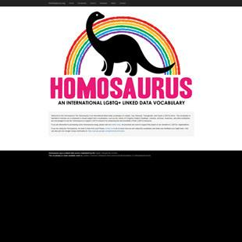
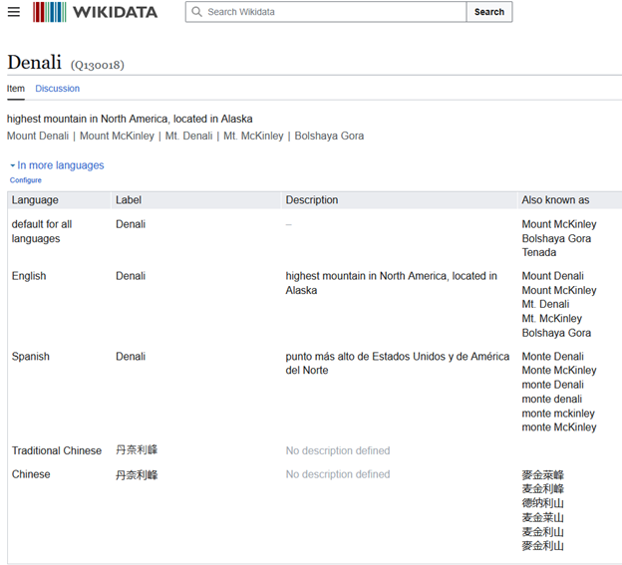
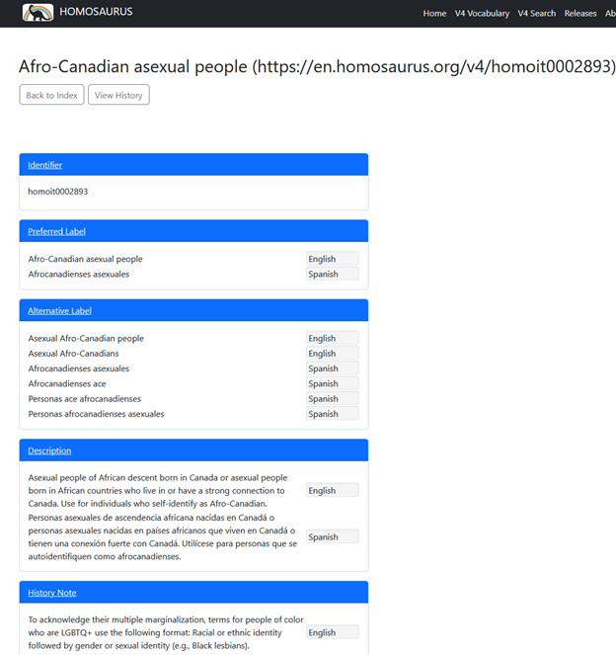
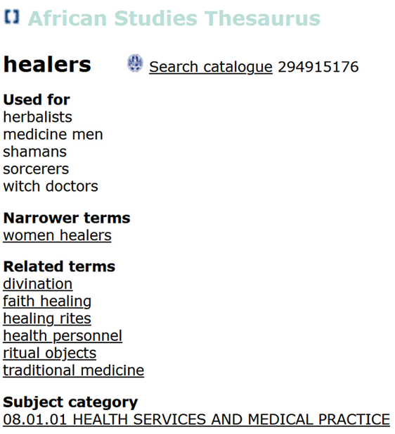
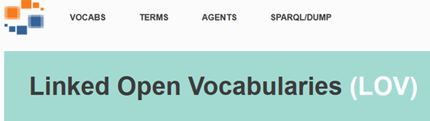
ALTERNATIVE VOCABULARIES & DATA SOURCES
With the African Studies Thesaurus the ASC Leiden aims to facilitate the identification of relevant indexing terminology, provide a tool for the indexing and retrieval of African Studies information resources, and promote easy national and international subject access to its own resources.
Notes:
You can also enrich your records with terms from alternative vocabularies.
Wikidata- here's the info for Mt. Denali. it provides names from different languages and also context. For example it provides cyrlic spelling of Denali and gives subject change information, ie, that the name change was approved by the current administration and also that it's being disputed by the state of Alaska, along with indigenous spelling/name of the mountain.
African Studies Thesaurus-- Shamans is used by LC but the AST perfers the term 'healers'.
Look at handout- Examples of adding a local field. One for Homosaurus
Linked Open Vocabs- lists links to websites of hundreds of specialized vocabs. It includes resources you may already be familiar with like the Art & Architecture Thesaurus and the Cochrane Library, which organizes evidence-based medical practice articles and intervention practices. And there are lots of other specialized scientific, industry and ethnic thesauri available.
So, if you have a specialized academic program or collection, you might consider using more technical subject terms.

Slide 19
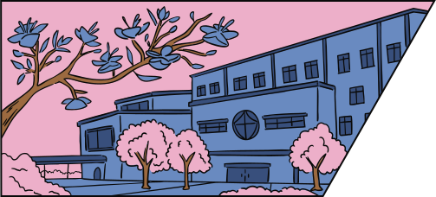
EXAMPLES OF REPARATIVE DDC PROJECTS - PUBLIC SCHOOLS
Leslie Howard, Fairhill Elementary School, Fairfax VA
Christian Holidays have distinct DDC numbers while other holidays are under mythology or 290's – created a separate location for all holiday books
Jess deCourcy Hinds, Bard High School Early College, Queens, NY
Integrating Black History into American History subject areas, example speeches by President Obama were in two spots: civil rights and American History
Notes:
Start Small and choose projects on what is most important to your patrons, in these examples, public school students.

Slide 20



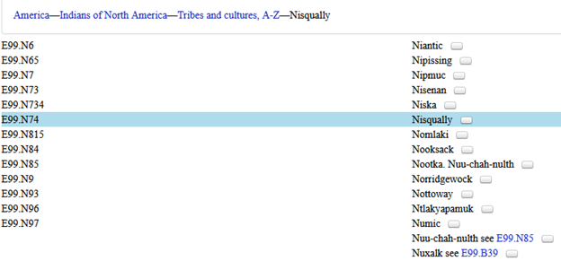
Look at Folklore & Mythology in Juvenile Literature
mel.org
Samples of Call Numbers via mel.org
Library of Congress Call Numbers
E99.N77 America—Indians of North America—Tribes and cultures, A-Z—N
E78.N77 M33 1993 – America—Indians of North America—By state, province, or region, A-Z—Northwest (Pacific)
PZ8.1.M159-- Fiction and juvenile belles lettres—Juvenile belles lettres—American and English—Folklore, legends, romance
Dewey Decimal Classification System
Majority under 398.208
J 290 MCDER-- Non-Christian Religions
Other Scheme
E McD Native American
Notes:
In Michigan we have MeL, which is a state catalog for copy cataloging and interlibrary loan. you can see what libraries have a title and see their call numbers. So, I thought it would be interesting to see who stuck with the given call number from the bib record and what other call numbers were assigned.
Bib record from MeL
Added their own subject terms,
note the 7 in 2nd indicator letting us know the source for the term is in subfield $2
Call no. designated by LC, includes .N77 cutter, which is not in the schedule and most likely represents the region for the Pacific Northwest. You can create cutters for regions that are larger than states or countries.
We see that another library decided to assign a different LC call number of E78.N77 by region instead of by tribe/culture, this appears to be more accurate.
PZ8.1- there is also a fables area
Looking at the DDC libraries, one library classed it in
290- In the religion class area, all of the other 200 ranges are for Christianity, all the non-Christian religions are in the 290's, with 299 for any religion not assigned a number. There are no call numbers assigned to North or South American indigenous groups or any African religions.

Slide 21
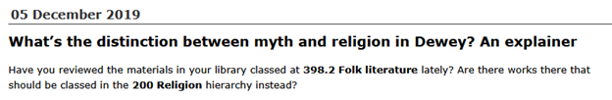
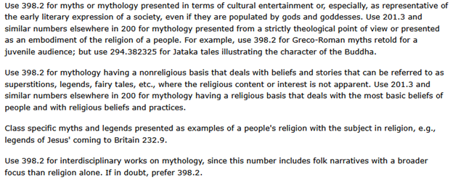
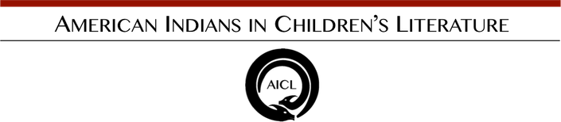
Look at Folklore & Mythology in Juvenile Literature
DDC instructions ask: How is the item presented? Is it presented as religious? Is it sacred or a ritual? Is it meant to be entertaining? Is it a retelling for Juvenile audiences?
Joseph Campbell is quoted as saying mythology is “other people’s religion.”
Below is from DDC 22, notes section for 398.2
Established in 2006 by Dr. Debbie Reese of Nambé Pueblo, American Indians in Children's Literature (AICL) provides critical analysis of Indigenous peoples in children's and young adult books. Dr. Jean Mendoza joined AICL as a co-editor in 2016. (Site redesign on January 8, 2025)
Notes:
McDermott has written many children's books about folktales and myths from around the world. He worked with Joseph Campbell.
The issue here is: are we placing non-Christian religious stories into the mythology section? Which would be disrespectful and inaccurate.
Article in the Dewey Blog is by Violet Fox.
Clearest example of bias: christian creation stories and biblical stories are not classified as 'folklore', instead DDC has call numbers for 'biblical teaching', 'testament', 'bible stories'. Native stories have been placed with 'legends', 'folk tales'.

Slide 22
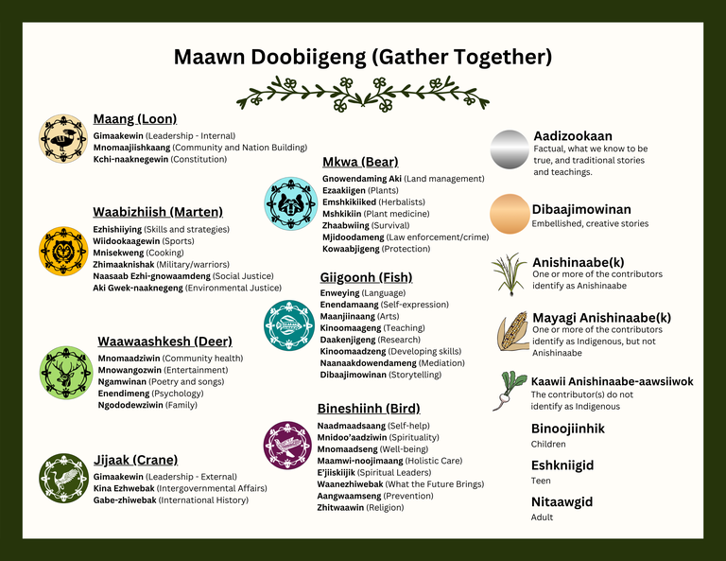
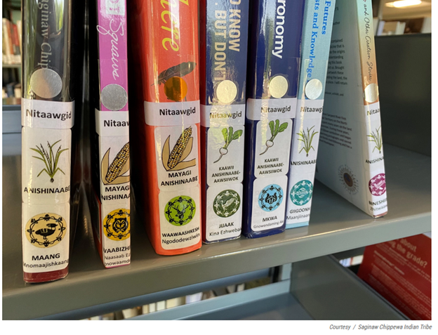
DECOLONIZING THE STACKS
Saginaw Chippewa Tribal Libraries, Mount Pleasant, MI
Notes:
Another true decolonization project--
The Chippewa Tribe is Anishinaabe and there are 7 clans that make up the tribe.
Their classification system is based on the 7 clans and their primary services or responsibilities to the other clans. These clans' responsibilities were then mapped or corresponded to subject areas.
For example, the Giigoonh (fish) clan represented intellectualism & Philosophy and would mediate between the Chief clans to settle disputes.
After the main subject area, there's fiction and non-fiction, the background of the author and the reading age.
Took long term planning, a working group of community members, along with the librarians, some of which are not indigenous.

Slide 23
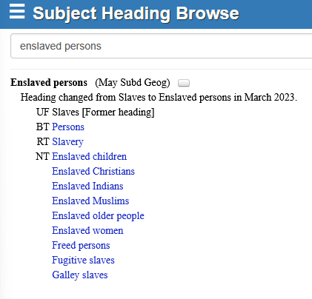
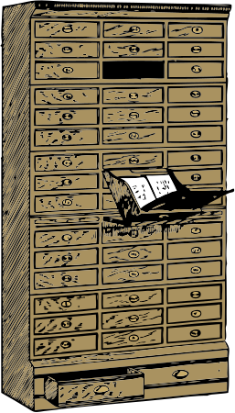
Description in Archival Works
This is America: Creating Anti-racist Metadata for Digital Collections, University of Houston
Bill of sale for Susan, an enslaved person, from E. Bellinger to E.H. Simmins, 1849 December 21 : autograph manuscript
Notes:
Let's look at some examples from the archival world.
The first one is the Handout for This is America from the University of Houston.
I think this is an exemplary handout, really shows how to select key data points and add them in as local subject terms
Hispanola
village or geographical names
they are also using subject terms regarding colonization
Also shows how to put the original title of the work into context.
Bill of Sale from Duke Univ.
Enslaved Persons UF Slaves, changed in March 2023

Slide 24
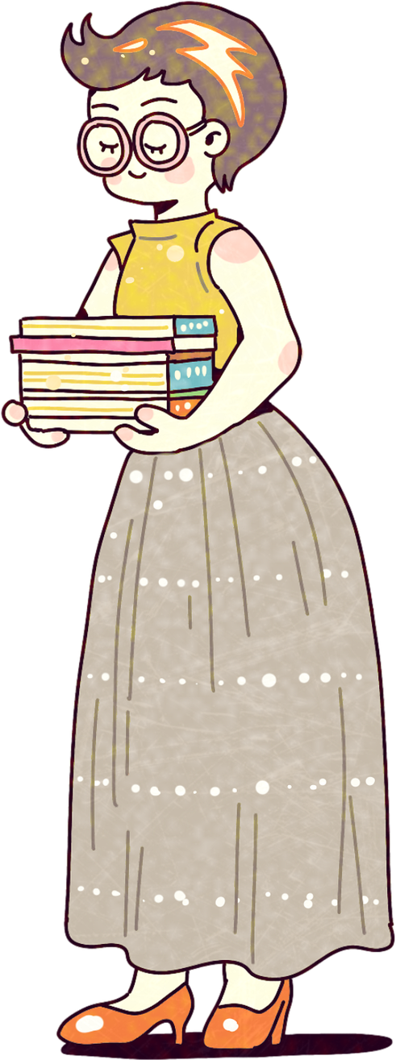



GETTING STARTED
Notes:
Lastly, let's look at some ways you can get started implementing some of these practices into your library.

Slide 25

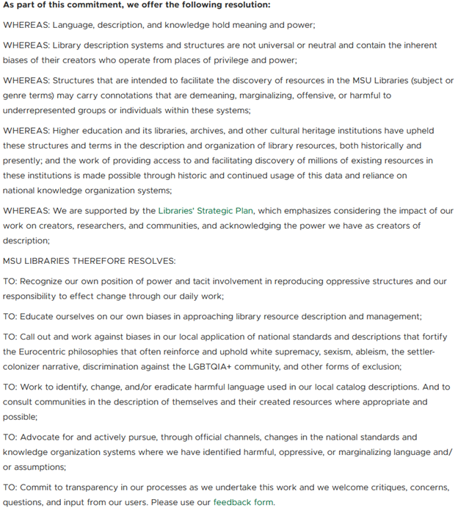
Harmful Language Resolution from Michigan State University
Cataloguing Code of Ethics
Society of American Archivist Core Values Statement and Code of Ethics
RISING ACTION
Create Inclusive Metadata Statement, guide from ShareOK in Resources
Harmful Language Statement
GUIDING DOCUMENTS
Notes:
You can consider adopting the cataloging code of ethics.
An inclusive metadata statement provides guidance to catalogers and also shows the library or institution's commitment to considering all patrons, including minority groups, when creating access points and descriptions to records.
Finally, a harmful language statement, let's look at MSU's

Slide 26
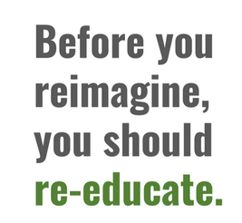
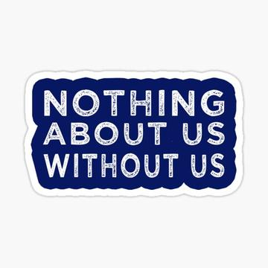
Quote is from Rachel Chong Reimagining Library Space and Classification: Indigenous Collection at KPU Library
Attend webinars, read LibGuides, articles, ALA professional books
Conscientious cataloging NOW
Look for smaller, less complicated projects
Replace Transsexual with Transgender – Homosaurus
D810.N4 – World War II Black Americans, replace .N4 with .A4 (African Am) or .B5 (Black Am.)-- MSU Harmful Language LibGuide
Putting ALL cookbooks in TX642 to TX840 (Home economics -- Cooking.)-- MSU Harmful Language LibGuide
Add local subject terms and names, for example Aionwatha in addition to Hiawatha-- look at Indians.org for links to official tribe websites (also book recommendations and reviews) and Association of Tribal Archives, Libraries & Museums
Holiday book shelf example
Adding full names of known women
Updating Linked Data/Authority records as part of cataloging procedure
larger reclassifying projects
labeling projects
updating record sets
mass/bulk/global linked data updates
projects requiring committees/working groups
INCREASINGLY COMPLICATED
SIMPLE(R) PROJECTS
Notes:
You can consider adopting the cataloging code of ethics.
An inclusive metadata statement provides guidance to catalogers and also shows the library or institution's commitment to considering all patrons, including minority groups, when creating access points and descriptions to records.
Finally, a harmful language statement, let's look at MSU's

Slide 27


GLAMS’ WORK IS IMPORTANT
“memory workers’…theories, practices and institutions have been deeply complicit in creating and replicating…inequities based on systems of white supremacy, hetero- patriarchy, capitalism and other oppressions for centuries…We have the power to interrupt these systems of oppression, to dismantle memory structures designed around them and in service to them, and to build new liberatory systems, if we have the courage’”
“...archival holdings and activities…[have come]…to reflect society more directly, in all its pluralism, diversity, and contingent nature. There was no ‘‘Truth’’ to be found or protected in archives, but many truths, many voices, many perspectives, many stories...undefined.” (Cook, 2013)
Terry Cook, Evidence, memory, identity, and community: four shifting archival paradigms (2013), Archival Science Journal
Michelle Caswell, Revisiting Feminist Standpoint Appraisal: Centering Oppressed Positions in Times of Crisis (2020) iPres2020

Slide 28
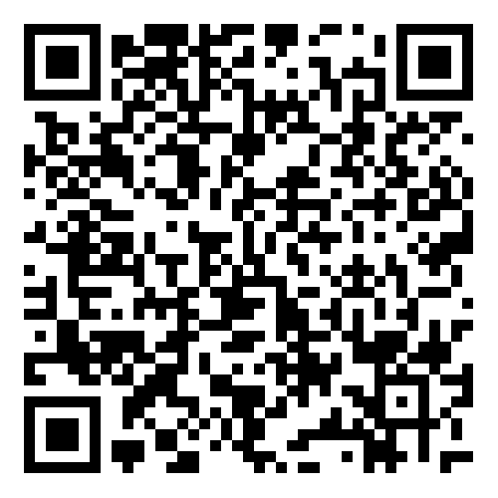
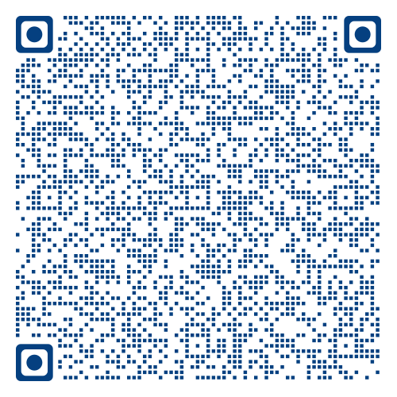

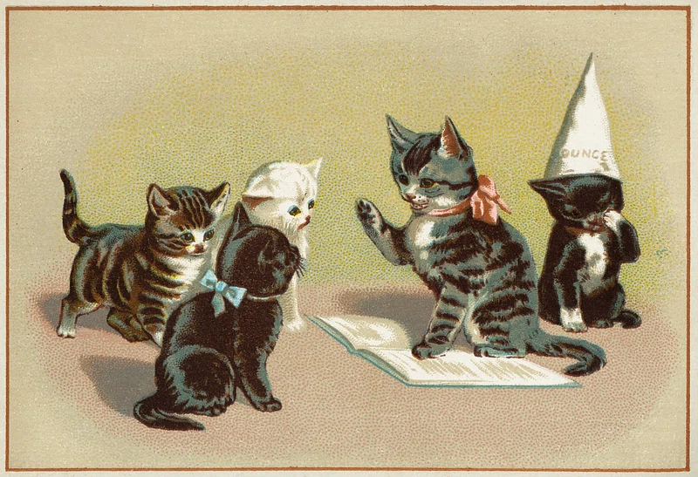
THANK YOU !
Rebecca R. Daly, MLIS
redaly@nmu.edu
Scan for Feedback Survey
Scan for Resources
Notes:
Thank you for attending my presentation. Please scan this QR code for a list of the resources that includes webinars, libguides and articles. Please fill out the feedback evaluation form, I'm doing this presentation for a UP regional library conference in the fall and would love to know what you thought and I how I can improve my presentation.

Slide 29
COMMENTS OR QUESTIONS?
Scan for Feedback Survey
Scan for Resources
Rebecca R. Daly, MLIS
redaly@nmu.edu
Notes:
A question that is often asked: is this type of work political? It is not acceptable under this federal administration. How do I defend this to those who see it as 'liberal indoctrination'?
My answer to that, as an individual professional librarian, not representing NMU in any capacity:
Using the example of the postcard from Maine named the 'S' word: Tribal women and leaders have made it clear that this term is extremely derogatory and has a history steeped in racism, sexism, and violence against women. We are not removing or censoring that word from the bib records nor covering up the word written on the postcard, we are adding the current context of the term, for historical posterity. We are adding more data, more information not censoring, removing or whitewashing history. If someone views taking the requests of a group of people/specific demographic into consideration, out of respect, as political. It is. Who has the power to name? Who has control over what terms are used for specific groups of people or demographics? Those are questions of power, authority, and control. The ALA empowers and encourages us to take control of our data, we are not bound to LC or any other classification system.

Slide 30



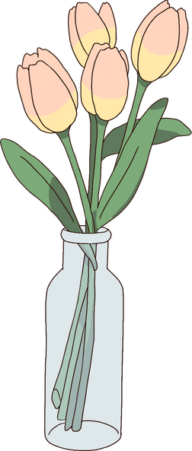

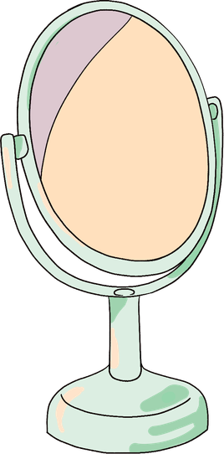




FREE RESOURCE PAGE

Slide 31















FREE RESOURCE PAGE

