Slide 1
Reimagining reference:
Training Undergraduates as Peer Research Consultants

Slide 2
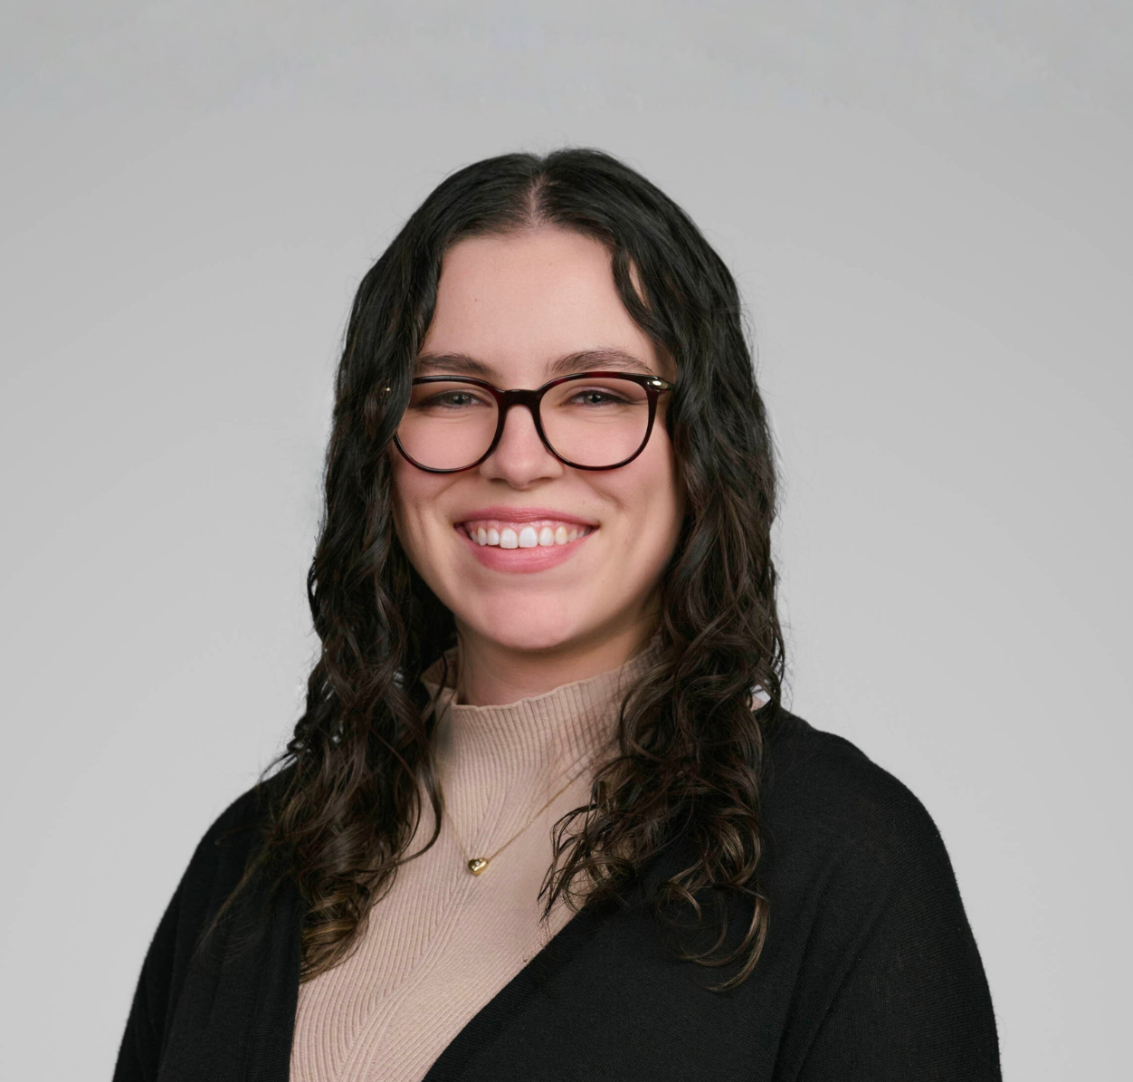
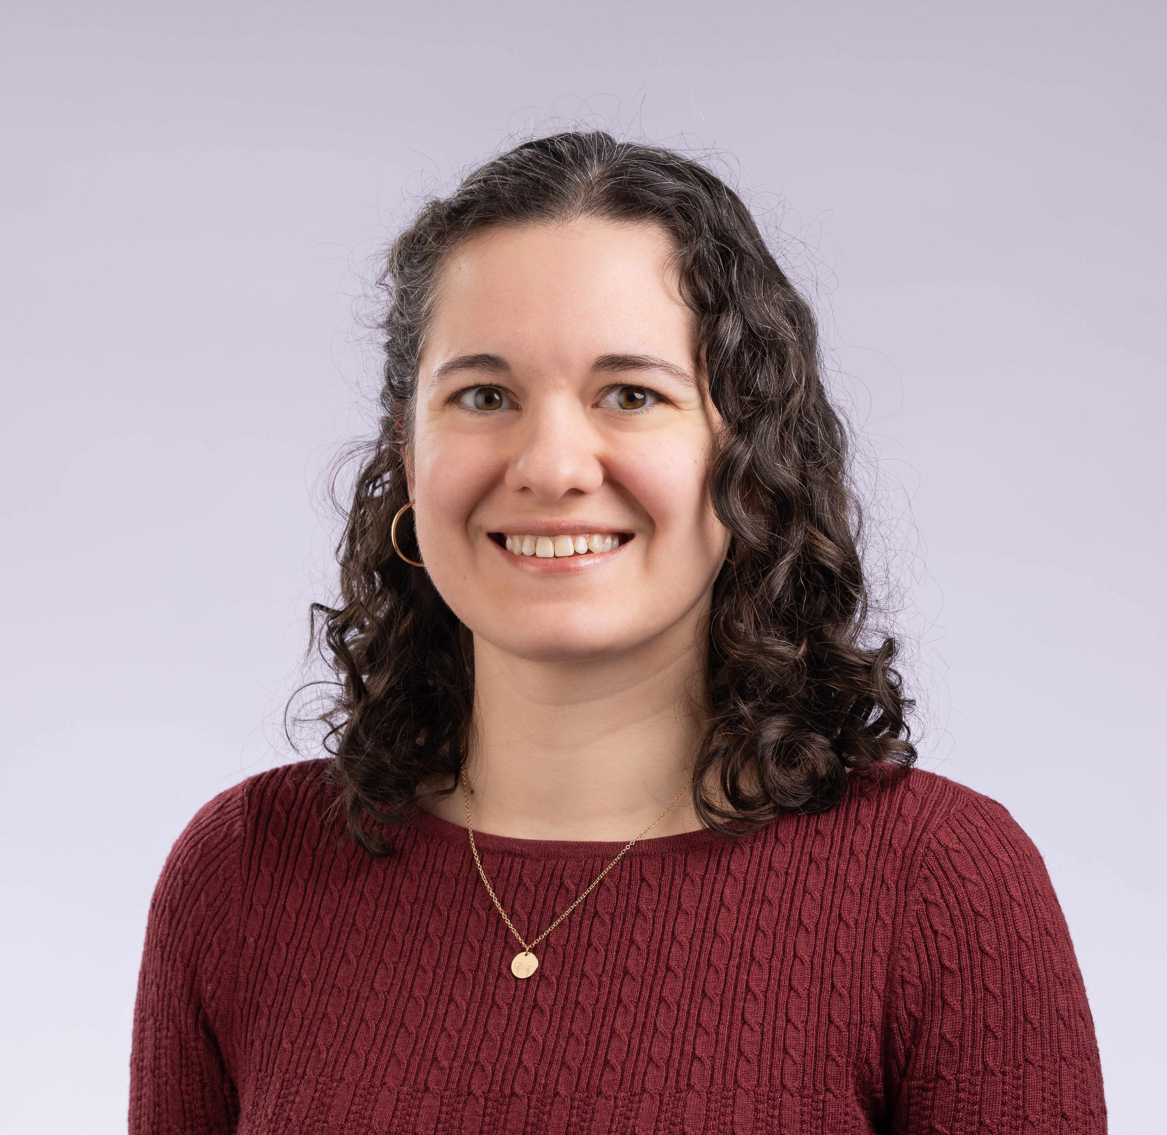
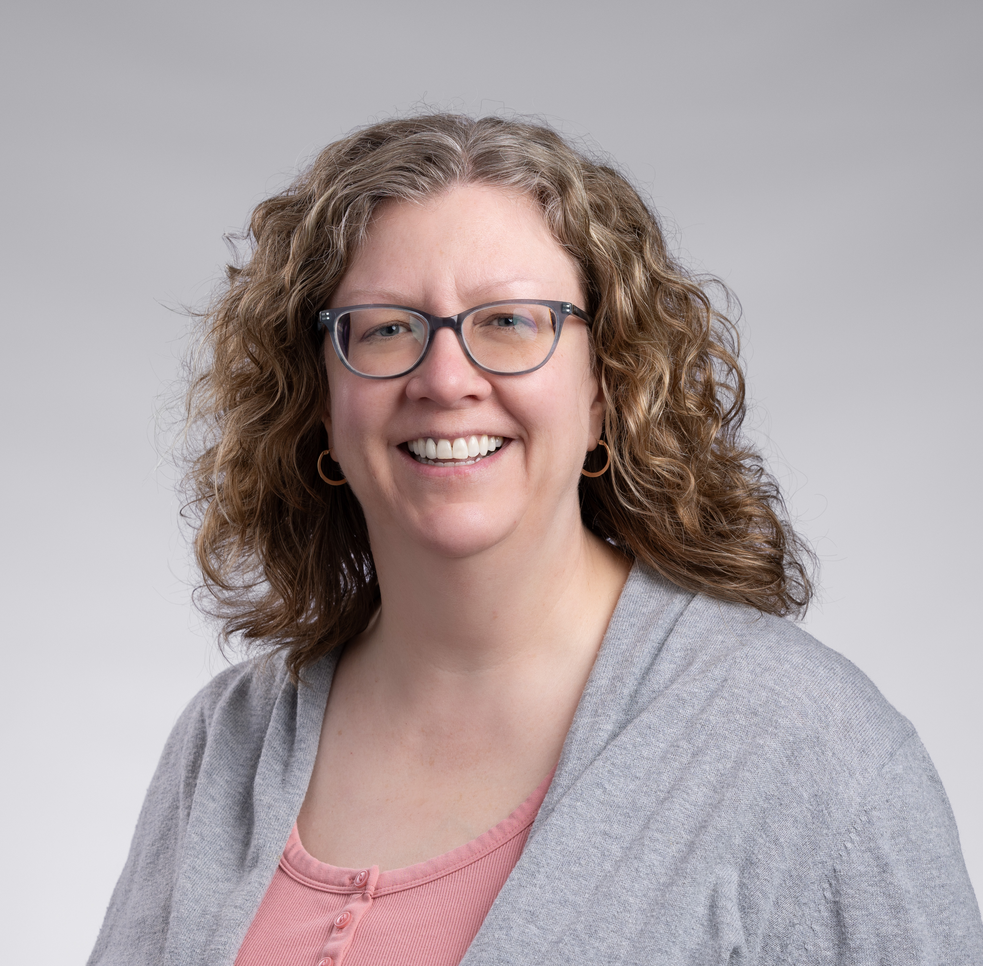
Who from WMU?
Malyn Berger (they/them)
Applied Sciences Librarian
Micky Carignano (she/her)
Natural Sciences Librarian
Carrie Leatherman (she/her)
Social Sciences Librarian

Slide 3
Agenda
Background
Training
  Development
  Implementation
Pilot + Stats
Lessons Learned
Practical Tools & Resources

Slide 4
background
Experiential learning in the strategic plan
Inspired by similar program at GVSU
Two groups: feasibility research + implementation
Interdepartmental collaboration
  User Services – program setup and supervision
  Instruction & Outreach – training
    Our 3-person team and other subject librarians

Slide 5
Hiring
Job description written by User Services
Micky was part of hiring committee
4 openings; 2 students per shift
Desired students who had...
  Customer service experience
  Some library experience
  Experience helping peers
Highly dependent on student schedules

Slide 6
Program GOALS
Peer consultant model reaches students who don't feel comfortable working with a librarian
  Peer consultant is a helper, not a teacher
  Guides student to work on their own laptop
Experiential learning opportunity
Triage and direct complex questions to subject librarians

Slide 7
Program parameters
Part of designing training was deciding what we were training them to do
Differs in breadth/depth of User Services circ desk students
Subject librarians had opportunity to set parameters
  For undergraduates only
  Topic to basic research question
  Navigating the library website and discovery layer
  Can tackle databases according to their abilities/comfort level
  Will recognize when they should refer questions to subject librarians
  Students are not mini librarians!

Slide 8
Question parameters
Question | User Services/Circ | Peer Consultants | Subject Librarians
Directional | X | X | X
How do I... | X | X | X
General/Undergrad research |  | X | X
Deep/Grad research |  |  | X
Available virtually |  |  | X
Available in-person | X | X | X
Walk-ins | X | X | X
Appointments |  | X | X

Slide 9
Reference fundamentals
Reference interview provides framework
  Vision > forms > training
  Created a post-consult response form modeled on reference interview
  Response form informed which skills we covered in training
Reference interview steps:
Greeting
Listen
Re-state the question
Find resources and/or referral
Discuss next steps
Closing

Slide 10
building the training
Resources:
  Training Research Consultants: A Guide for Academic Libraries, ed.
  by Torreano and O'Kelly
  Materials from GVSU research consultant training, e.g., training agendas
Used these to develop our list of training topics, but otherwise created our own training from scratch
Asked subject librarians and consultants for example reference
questions, research topics, and assignment descriptions

Slide 11
Training plan
Meet 1 week after classes began, Wed-Friday, Monday recap (8 hours total)
Informal, conversational format
Mix of demonstration, hands-on practice, lecture, other activities
Transparent about program launch + pilot nature of program
Everyone is resonsible for their learning
Understanding scope/expectations
Topics covered
  Expectations, library ethics
  Reference interviews & triage
  Amazing Library Race
  Paperwork
  Library discovery layer, ILL
  Libguides & librarians
  Topic selection, databases
  AI and plagiarism

Slide 12
Training: Reality
3 snow days bumped back training
1st day (Wednesday) as planned, then Monday, Wednesday, Friday
Change of schedule created more honesty
Adapted as we saw consultants’ abilities, needs, and questions
Sharing time with User Services, Marketing
Intended on having ongoing training; scheduling issues

Slide 13
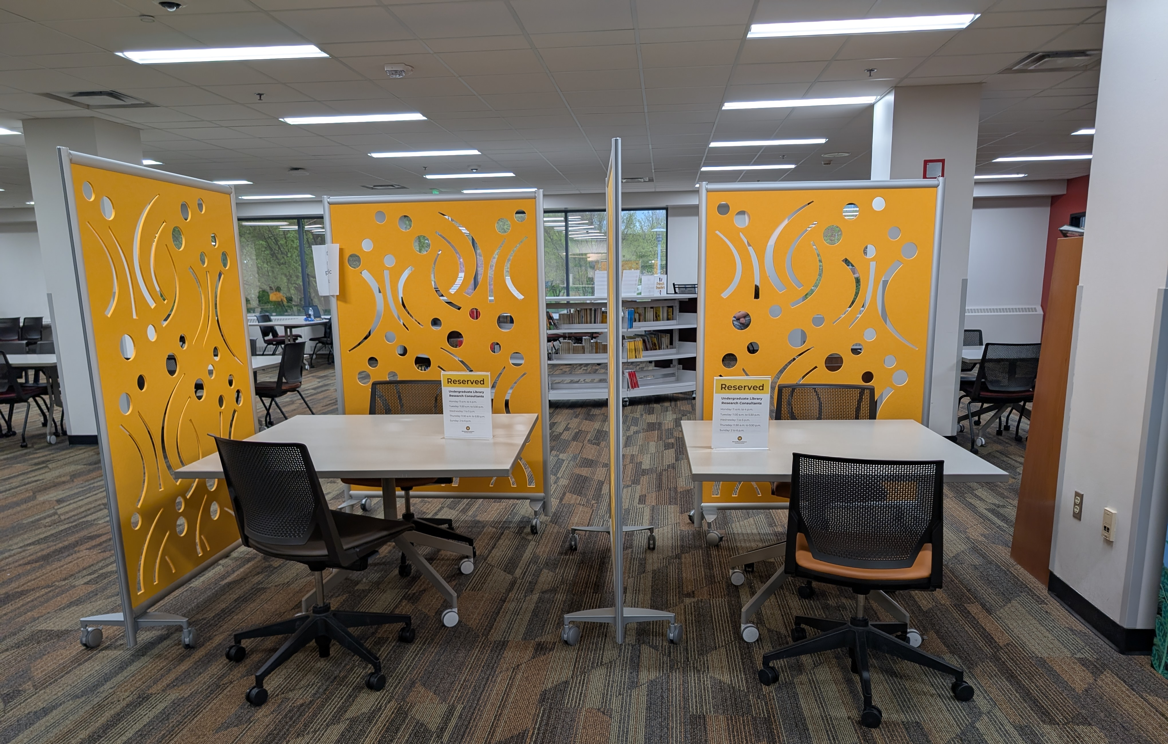
The setup
4 total consultants; 2 per shift
15-minute slots by appointment
Walk-in appointments also accepted
While one consultant is working,
the other is available for questions

Slide 14
How did it go?

Slide 15
Statistics
16 appointments
From patron satisfaction survey:
  Over 93% "somewhat" or "very comfortable" working with the consultant
  100% found the consultation "somewhat" or "very helpful" to their research
  81% were more confident about completing their assignment

Slide 16
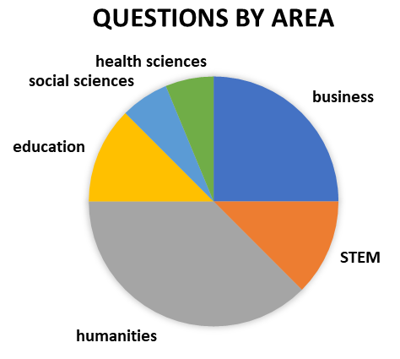
Question types
Using a resource: 2
Topic development: 2
Finding sources: 11
Other: 1
3 of 16 questions were from students writing honors theses

Slide 17
Feedback from consultants
Overall, the training was effective:
How well did the training prepare you to find information sources?
  4 of 4 answered "very well"
How well did the training prepare you to determine what help a researcher needed?
  3 answered "very well", 1 "moderately well"
How well have you been able to apply the skills taught during the training?
  2 "very well", 2 "moderately well"
Before your first shift, how well did you understand what the job entailed?
  1 "very well", 2 "moderately well", 1 "slightly well"

Slide 18
Feedback from consultants
Areas needing more training:
Interlibrary loan
Recording interactions in RefAnalytics
How to end an appointment that goes too long
More practice with example questions & assignment descriptions
When to refer to a librarian
Other than ILL, these suggestions matched what we were expecting

Slide 19
Lessons learned
Role and Scope
  Consultants had confusion about how their roles overlapped with others
  Empower them to choose when to hand off to a librarian
  Gaps created by cross-departmental courtesy > create touchpoints
Information Sharing
  Librarians accessing appointment confirmations would be helpful
  Could have checked on form filling for accuracy/completion
Ongoing Training
  Scheduling is a huge commitment
  Needed a/synchronous ongoing training (materials and meetings)

Slide 20
Learning journey
The peer consultants’ learning journey:
Occurred during training and after
Included:
  Info about "objective skills"
  Their "subjective experiences"
  Reflection on their training
Results:
  Experiential learning, knowledgeable consultants

Slide 21
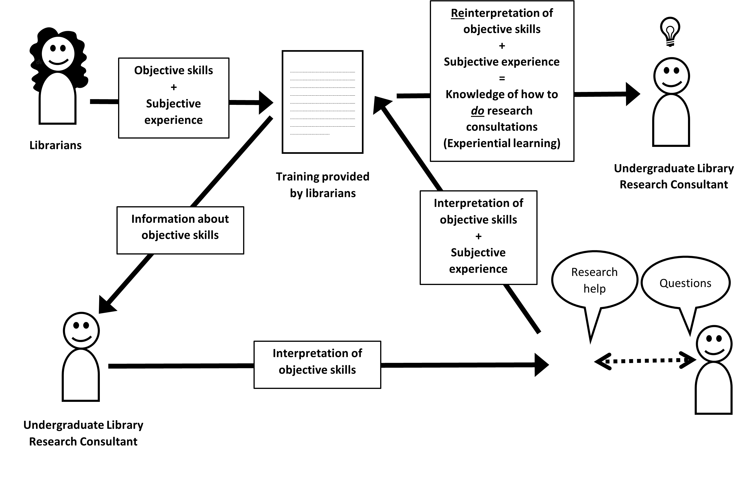


Learning journey
Student with research question

Slide 22
Tools & advice
Explore literature + case studies + other training and customize it
One of the hardest parts is scheduling
Plan for ongoing training well before the semester starts
Set expectations for sharing responsibility with other departments + touchpoints, forms, appointment confirmations, etc.
Ask how peer consultation service differs from other services in your library
Be involved in planning and hiring processes to share information
Part of this work is remembering what we've forgotten we had to learn

Slide 23
Questions?
Resource packets available digitally on Sched, including:
  Further reading
  Training topics, schedule
  Consultation form
  Job description
  Question triage by department
  More advice
  Website link to consultant page
  Presenter contact information

Slide 24
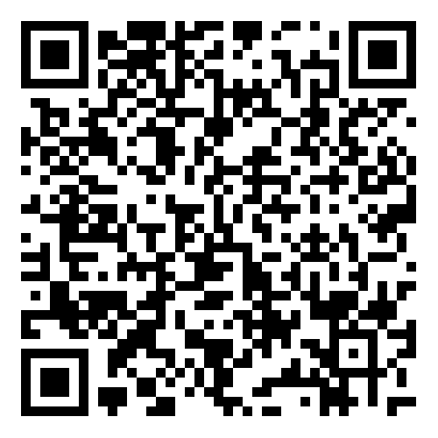
Thank you!
Malyn Berger | malyn.berger@wmich.edu
Micky Carignano | micaela.carignano@wmich.edu
Carrie Leatherman | carrie.leatherman@wmich.edu

