Slide 1
When Cost-Per-Use Isn't Enough
Solving the Small Department Dilemma
Notes:
Marcia

Slide 2


Nice to meet you!
Marcia Masters
Acquisitions & Collection Data Analysis Librarian
Johanna Boyle
Collections Management Librarian
Grand Valley State University Libraries & Art Museum

Slide 3

Agenda
Background context
Creation of rubric
Rubric testing
Moving forward
Notes:
Marcia

Slide 4
Who we are +
our priorities to date
Doctoral/professional
~20,000 students
Primarily undergraduate
Expanding grad programs
Breadth over depth
Curriculum driven
Creative cost saving strategies
Notes:
Marcia

Slide 5
Why this project now?
Notes:
Marcia
New head of collections – Fall 2024
New collections Management Librarian (Johanna) hired in February 2025
Re-envisioning of collections workflows & philosophies
Flat budget
Need for more in-depth resource reviews (a standardized approach)

Slide 6
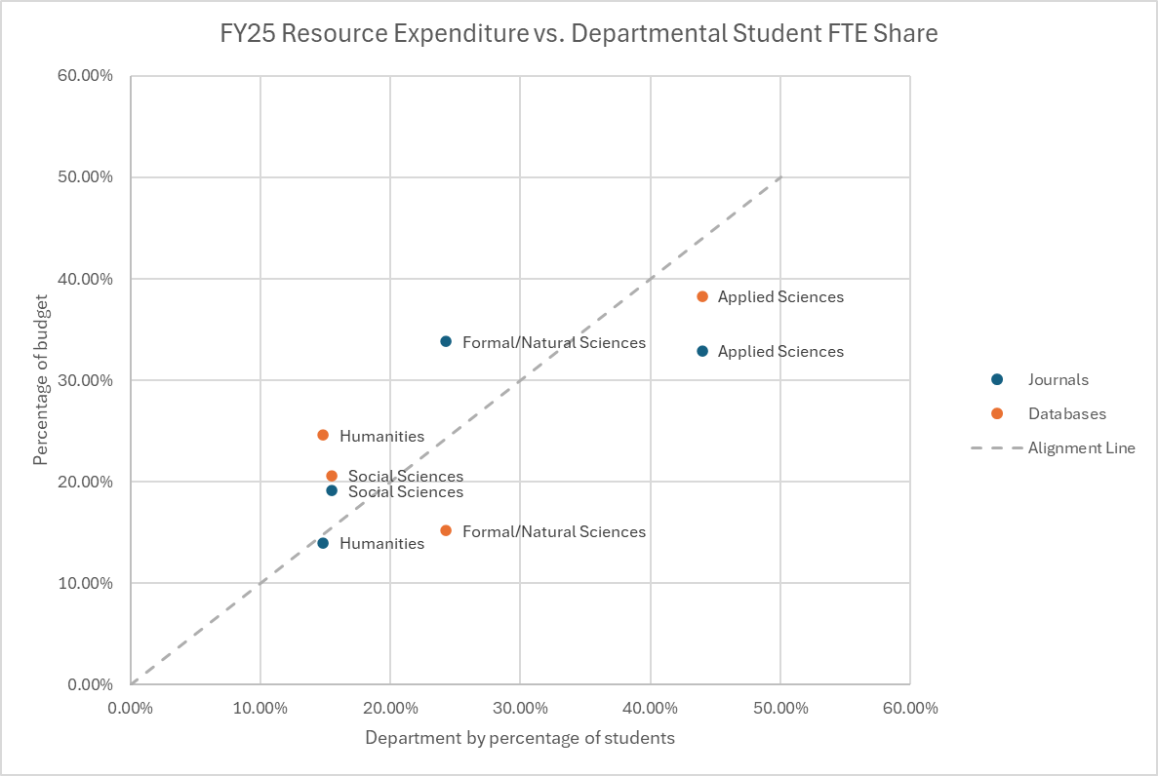
FY25 Resource Expenditure vs. Departmental FTE share
Notes:
Johanna
Initial idea - compare spending to FTE students - hoping to identify broad categories where we are overspending or underspending
Mapped all our subscriptions and our departments to four broad subject categories - Humanities, Social Sciences, Formal/Natural Sciences, Applied Sciences
Discovered our spending was largely in line with our student population
Scatter plot - dotted line indicates where Journal and Database spending would fall if they were perfectly in proportion with department FTE
Maybe a bit underspent in Applied Sciences
Maybe a bit overspent in Humanities
Formal/Natural Sciences are more supported by Journals rather than Databases\
Good news - no major outliers, Spending seemed to be generally well aligned with our user base - we did not need to make large cuts to any particular area to align spending
Bad news - Four general categories were too large/general to make any useful adjustments

Slide 7
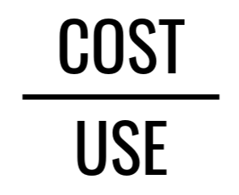

Takeaways from the Initial Idea
Needed a more granular breakdown
Some users might be disadvantaged by just using cost-per-use
Smaller FTE departments might need an extra boost
Notes:
Johanna
We need more granular breakdown - be able to take into account needs of specific departments
Smaller departments still need the resources they need - but have fewer users - might need a boost to cost per use
What does the boost look like?

Slide 8

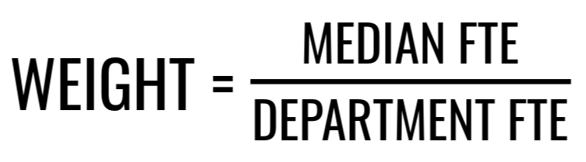
Raw CPU vs. Weighted CPU
Notes:
Johanna
Goal: create a boost for smaller departments so they have a more even playing field against resources used by larger departments
NOT to boost the rubric score so much that it doesn’t matter if the resource is underperforming
Option: create separate CPU thresholds for various sizes of department - seemed like a lot of legwork, what do you do about resources that are used by multiple departments?
Find Median FTE for all departments - measure of center
Divide Median FTE by either the department FTE or the combined FTE for multiple departments
Use weighted CPU for resources whose departments’ FTE are under the median
Track both weighted and raw for all
Weighted CPU helpful for identify resources above median FTE that are underused (based on weighted CPU) to encourage marketing/promotion
And how do we incorporate other metrics that are important to evaluating resources? A rubric!

Slide 9
Established Rubric Criteria - Core criteria
Required by department and/or for accreditation?
CPU/Weighted CPU
Average annual price increase
Overlap with other resources
Usability - are individual accounts required?
Accessibility
Access issues - is the resource down frequently?
Notes:
Marcia
What metrics are we going to use? ; Broke these into levels: Core, Supplementary, Bonus (initially)
Every renewal judged on these metrics:
Core Criteria – applied to every resource/renewal; equates to 100 points
CPU
Average annual price increase
Overlap with other resources
Usability - are individual accounts required at resource level?
Accessibility
Scale - i.e. have VPAT vs. don’t ; meet WCAG standards or don’t
Access issues - resource down frequently

Slide 10
Supplementary Criteria
Overlapping content
Content available via ILL
Limitation on # of seats
Interdisciplinary/Supports large number of users
AI factors
“Customer service friction”
DRM restrictions
OA supportive
Transparency of privacy policies
Indexed in EDS
“X” factor - does the vendor operate for greater good?
Notes:
Marcia -
Availability of content via ILL – is it easy to obtain content?
Limitation on # of seats
Interdisciplinary/Supports large number of users
AI factors – does any AI functionality negatively or positively impact user experience?
“Customer service friction” factor - issues with support, responsiveness vs. reps are wonderful, helpful, & meet us where we’re at
DRM restrictions
OA supportive
Transparency of privacy policies
Indexed in knowledgebase (EBSCO Admin’s HLM)
“X” factor - does the vendor operate for greater good?

Slide 11
Testing the Rubric
Testing priorities
  We know we want to keep it
  We know we want to get rid of it
Rubric was generally doing what we wanted it to.
Feedback
  GVSU Head of Collections
  MiALA eResources Interest Group
Notes:
Johanna
Questions
Should we make certain things more negative?
How will we archive the rubrics/track scores over time?

Slide 12
Baselines
Tested rubric on ~25% of renewals
Established renewal score threshold - 100
34% of renewals tested below threshold*
*tested several renewals “ready for review”
Notes:
Marcia
Ran a sample of renewals through rubric to determine “review”/”we’re concerned about this one” threshold
Threshold established : 100 points – correlates to our “core” criteria section totaling 100 points

Slide 13
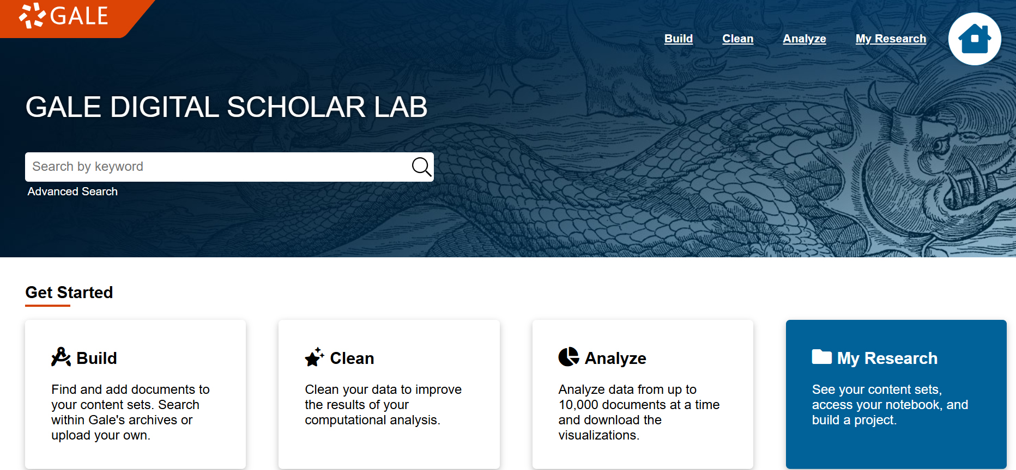
Small Department Resource: Gale Digital Scholar Lab
Weighted CPU eliminated 100 point demerit for “egregious” CPU
Nuance to consider in future - supports Digital Creator Lab (no formal FTE to apply)
Next step - increase marketing efforts & offer training opps
Notes:
Marcia
Unique resource because it supports not only one of our academic departments, but also our internal Digital Creator Lab – we’ll want to determine how to consider this piece within the rubric scoring
Example of a resource that even with weighted CPU considered is one that we’ll want to flag and review – although, the weighted CPU did remove the 100 point demerit for egregious CPU
Adjusted the rubric to ensure that it was doing what we wanted/aligned with our end goal to flag underused resources.

Slide 14

Unique Small Department Resource: Bloomberg Tax
It’s complicated.
Limited users
Needed by the department
  New graduate program Fall 2026
Pricing tier - already as low as we can go
Significant customer service friction
What you put into the rubric matters.
Notes:
Johanna -
Limited users - department had sunsetted program a few years ago, primary users are two faculty members - do use the resource to inform their teaching
New graduate program coming Fall 2026 - department reports those students will be using the resource
Not necessarily required for accreditation, but the department has expressed if we don’t have this resource, we need to have something comparable
We are already moved down to the lowest tier of pricing (100 seats)
Significant customer service friction

Slide 15

Moving Forward
The rubric is a tool (we don’t live and die by the rubric)
Is the median the right metric for creating the weight?
The rubric is a starting point - what do we do after scoring?
Usage metrics vary based on resource.
Journal packages need more digging.
Document process on collections website.
Notes:
Don’t live and die by the rubric - tool for helping us be consistent in how we evaluate resources and communicating collections decisions
We may find we need a heavier weight?
Use Q3
If something scores low:
Calculate CPU using multiple years’ worth of use and spend data
This could accommodate cyclical use - some years have higher use/lower use because of which courses are being taught
Open discussion with liaison librarians and departments
This is specifically why we are concerned about this resource
Identify options to increase usage or, if the issue is with the resource itself, can we find an alternative?
Usage is good but no VPAT, resource is frequently not usable, has a bad AI tool that we can’t turn off, and the sales team is difficult to work with
Specialized resources & indexes - use standard adjusted for CPU
Some resources might not have Total_Item_Requests
Do our best to be consistent.
Journal packages/subscriptions - CPU by title, averaged

Slide 16

THANK YOU!
Questions?
Link to rubric template, presentation slides, & example rubrics.
Fill out our evaluation form:
Notes:
Marcia

Slide 17
References
Western Libraries. (n.d.). Subscription evaluation. Subscription Evaluation | Western
Libraries | Western Washington University. https://library.wwu.edu/subscription-review-scoring
Forrest, J., (2025). Multiple-Objective Optimization for Library Journal Portfolios - A Machine
Learning Approach [Conference Session]. Southeastern Library Assessment Conference,
virtual. https://mediaspace.clayton.edu/playlist/dedicated/1_89dfo1pg/1_1negehcm

