Slide 1
Illuminating Digital Learning: A Library-Led Faculty Development Journey
Katie Edmiston
CMU Libraries

Slide 2

The Context
Central Michigan University became an Adobe Creative Campus in 2020.
The Adobe Digital Lounge opened in Fall 2022.
The Adobe Digital Lounge supports Adobe programs, but also supports digital literacy and creative/multimedia project development across campus.
Notes:
Digital Literacy is closely aligned with information literacy, and can be viewed

Slide 3




The Need
Limited engagement with Adobe tool across campus
Lack of support for faculty
Lack of visibility/discovery of current projects
Different faculty have different needs
Notes:
Current literature on faculty learning and professional development reveals that one-and-done workshops don’t yield the results we’d like to create: new tools being used in the classroom, new learning strategies for students, and innovation in the learning process. Instead, to create true change far more can be achieved by offering a sustained faculty development program.. Allowing faculty the time needed to truly engage with the iterative process of discovering new concepts, experimenting, applying, refining, and then implementing.

Slide 4

The Idea
Two CMU representatives attended an Adobe Innovation Summit at the University of Texas, San Antonio, in Spring 2025.
After three days of collaboration, conversation, and inspiration, an idea was born.

Slide 5
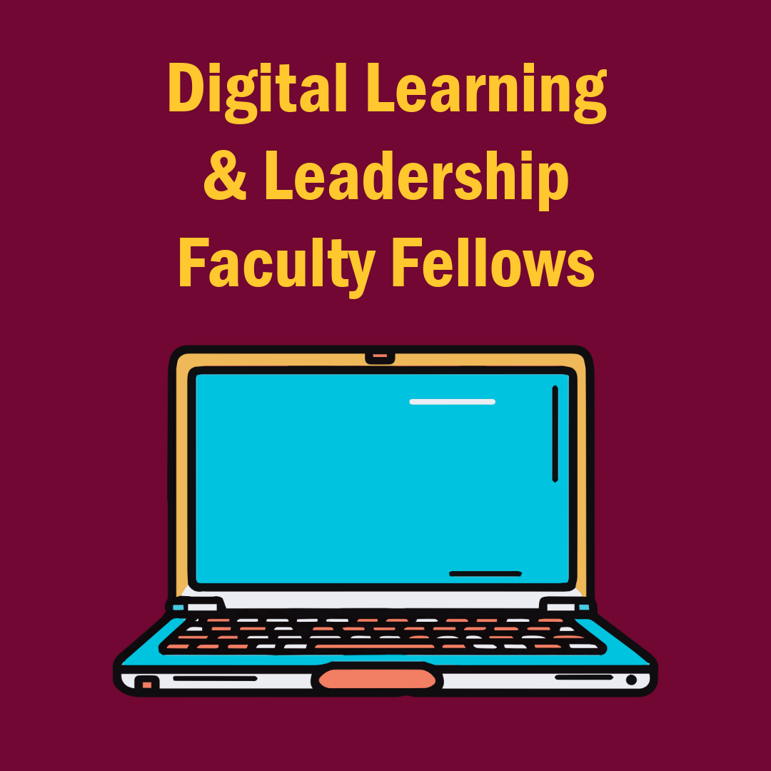
The Program
Year-long faculty development cohort
Meetings, including lunch, once a month for the entire academic year
$500 professional development stipend

Slide 6
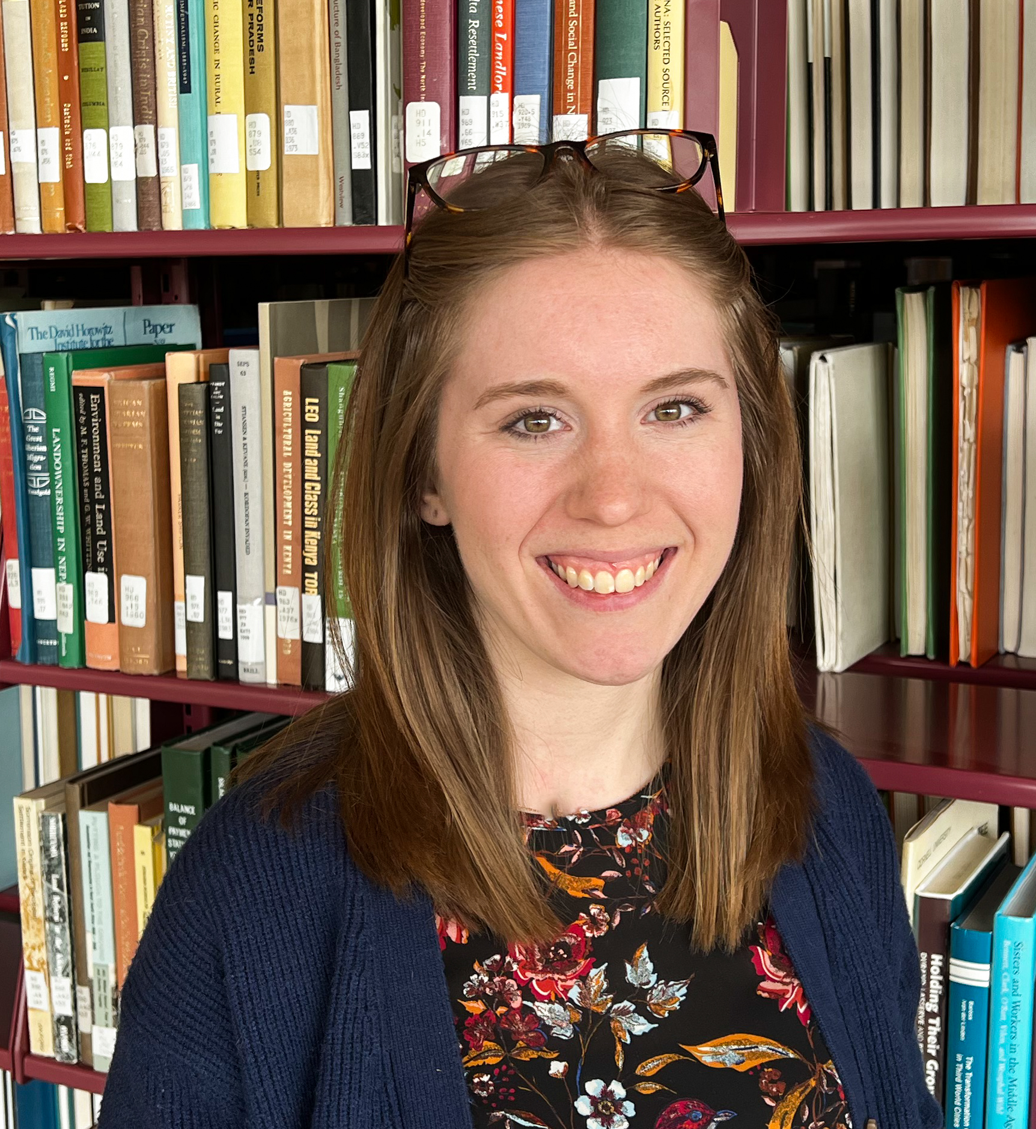
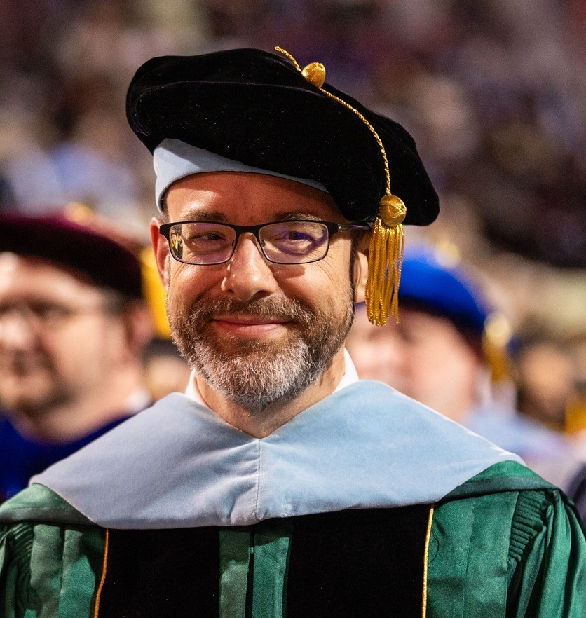
The Leaders
Katie Edmiston
Arts, Media, and Design Librarian
CMU Libraries
Dr. Troy Hicks
Interim Associate Dean
CMU College of Education and Human Services

Slide 7
The Funding
We submitted a program proposal to Adobe seeking funds to run the program:
  Funding for lunch at all meetings, and a $500 professional development stipend for all faculty who completed the program requirements
Adobe provided a $15,000 gift-in-kind, which would allow us to fund 20 faculty
After 39 faculty applied to the program, CMU Libraries committed an additional $15,000 to allow us to fund everyone.
Notes:
While funding is not required to run a faculty development cohort, an important aspect of the program was providing an incentive for faculty that would match the time and effort required to commit to the program expectations. We wanted the work faculty completed to be very thoughtful and engaged, and therefore wanted to match that effort with funds.
Troy and Katie reached out to Adobe to pursue funds for the program that would allow us to provide lunch at all meetings, and (ideally) a $500 stipend for each faculty member who completed the program.
Adobe committed to $15,000 in funds, which would have allowed us to fund 20 faculty for the program. After marketing the program we ended up with 34 faculty applying. The Dean of CMU Libraries, Kathy Irwin, graciously donated the remaining funds needed through the Friends of the Library fund to allow us to fund all 34 faculty.

Slide 8
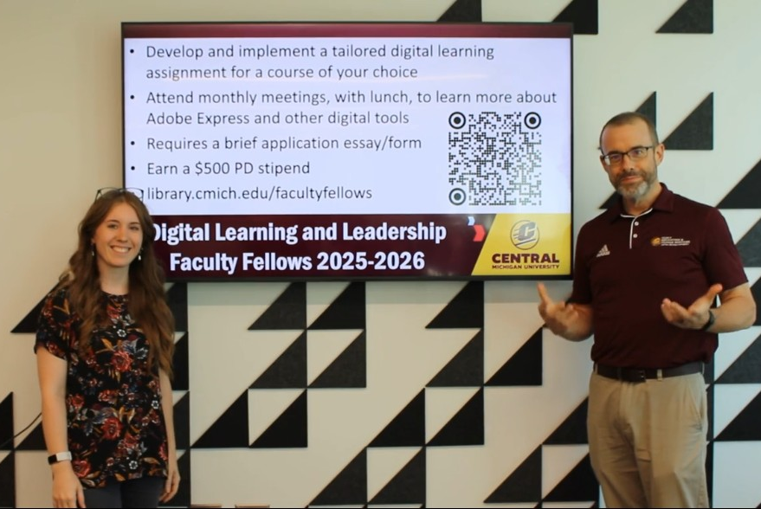

The Marketing
Focus on in-person, peer-to-peer marketing vs. digital communication channels
“Marketing blitz” for beginning of Fall semester
Targeted marketing efforts
Notes:
To spread the word about the program, Troy and Katie utilized both in-person and digital marketing methods across campus. They planned a “marketing blitz” for the beginning of the Fall 2025 semester, when faculty would be returning to campus and engaging in “back-to-campus” fall meetings with their colleges.
Troy reached out to each Associate Dean of the seven colleges at CMU to request 5-10 minutes for us to present the program at each meeting. 5 colleges graciously provided us time, which allowed us to present the expectations and outcomes of the program directly to many faculty. Those who could not provide time in their meeting’s agenda forwarded an email message marketing the program to their faculty.
In addition to campus-wide marketing, we also focused on targeted marketing to individuals we knew were engaging with digital literacy already in their classrooms. This targeted marketing resulted in at least 5 known faculty members to apply for the program as well.
While all forms of marketing are useful, we found the personal approach of reaching out to direct colleagues (especially in the case of Troy reaching out to other ADs as an AD himself) helped us distribute the message to as many people as possible beyond just another email in their inbox.

Slide 9
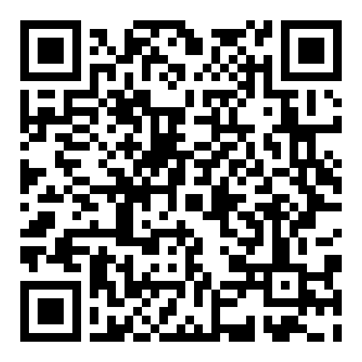
The Requirements
Design a multimodal assignment, to be implemented in a course of their choice at some point in 2025-2026.
Attend 6 out of 8 learning sessions, culminating an in-person showcase in April 2026
Create assignments would be saved in a digital portfolio that could be shared with other faculty across CMU/Adobe Creative Campuses
tinyurl.com/
DLLFFApply
Notes:
To market and spread the word about the program, Katie and Troy created an informational webpage using Adobe Express. This webpage shared all the details of the program, and was also where faculty could apply.
Troy and Katie wanted the program to directly impact students and real-time classrooms across campus. As such, the program required faculty to design a new assignment for a course of their choice, that would require students to create some sort of creative or multimodal product.
To balance the ask of designing a new assignment that would actually be implemented, we sought to include as much flexibility as possible. Faculty could choose to design an entirely new assignment, or revise a current, traditional assignment into something multimodal. We encouraged the use of Adobe Express (or another Adobe program) for the creation of the product, but it was not required. Many options were provided for the multimodal component to be created by students (a video, social media campaign, digital research poster, webpage, podcast, etc.), but ultimately faculty could choose exactly what they would ask their students to create.
To further develop faculty members’ exploration and discovery of digital literacy principles, we also required faculty to attend 6 out of 8 learning sessions, which would be scheduled monthly and focus on teaching and learning with digital literacy.

Slide 10
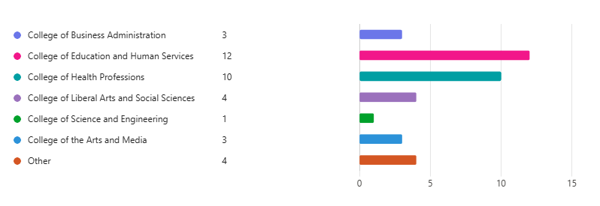
The Cohort
34 faculty – representing all seven colleges at CMU and 17 different departments – applied and were admitted to the Faculty Fellows program.
Notes:
The most represented colleges included the College of Education and Human Services (9 faculty) and the College of Health Professions (7 faculty).

Slide 11

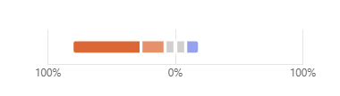
The Cohort
Level of Familiarity with Adobe Express
1 – 54.1%
2 – 18.9%
3 – 16.2%
4 – 10.8%
5 – 0%
Notes:
As part of the application process, we asked faculty to rate their level of familiarity/comfort with the Adobe Express design tool, to share their level of experience with Adobe programs in general, and to provide a brief description (200-300 words) of what qualified and interested them about the program.
17 said very limited to no experience with adobe – 0-1 programs (47.2%)
13 minimal/some experience with adobe (light usage of 2-3 programs) (36.1%)
6 considered themselves intermediate to advanced users, significant experience in 3+ programs) (16.7%)

Slide 12
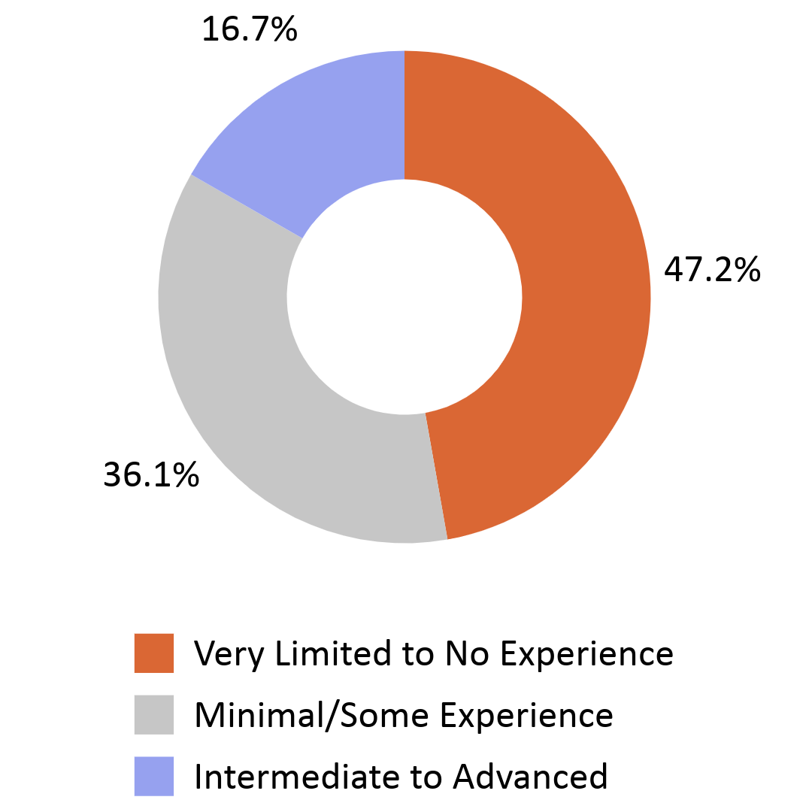
The Cohort
Notes:
As part of the application process, we asked faculty to rate their level of familiarity/comfort with the Adobe Express design tool, to share their level of experience with Adobe programs in general, and to provide a brief description (200-300 words) of what qualified and interested them about the program.
17 said very limited to no experience with adobe – 0-1 programs (47.2%)
13 minimal/some experience with adobe (light usage of 2-3 programs) (36.1%)
6 considered themselves intermediate to advanced users, significant experience in 3+ programs) (16.7%)

Slide 13
The Learning Sessions, Sep-Dec
Hybrid Learning sessions were planned monthly on Fridays at midday.
Focus on discovery:
  Kick-Off/Introducing Adobe Express
  Principles of Design/The Non-Designer’s Design Book
  Basics of Audio/Video Projects
  Webpages
Each session included equal amounts instruction, application, and reflection.
Notes:
The program facilitators designed learning sessions that would implement discovery, interactivity, digital exploration, and reflection for faculty. We wanted each session to include equal amounts instruction, applying learning, and reflection.
We structured the first half of the cohort to focus on discovered

Slide 14
Remixable Templates
Low-stakes
Puts the focus on content and demonstrating learning, instead of heavily on design
Completely customizable
Notes:
Explain the concept of Express ‘remixable templates’
Low-stakes
Focus on content/display of learning instead of heavily on design
-Completely customizable

Slide 15
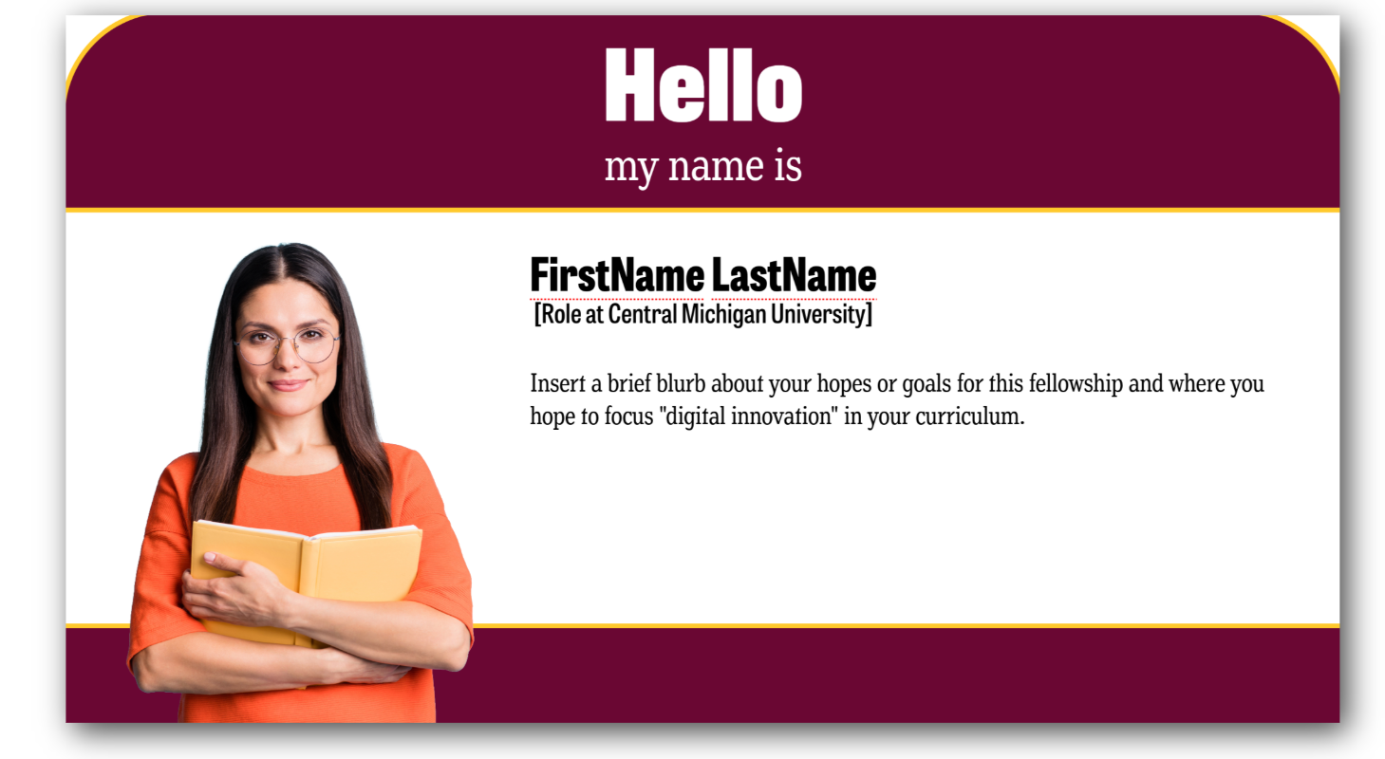
Name Tag

Slide 16
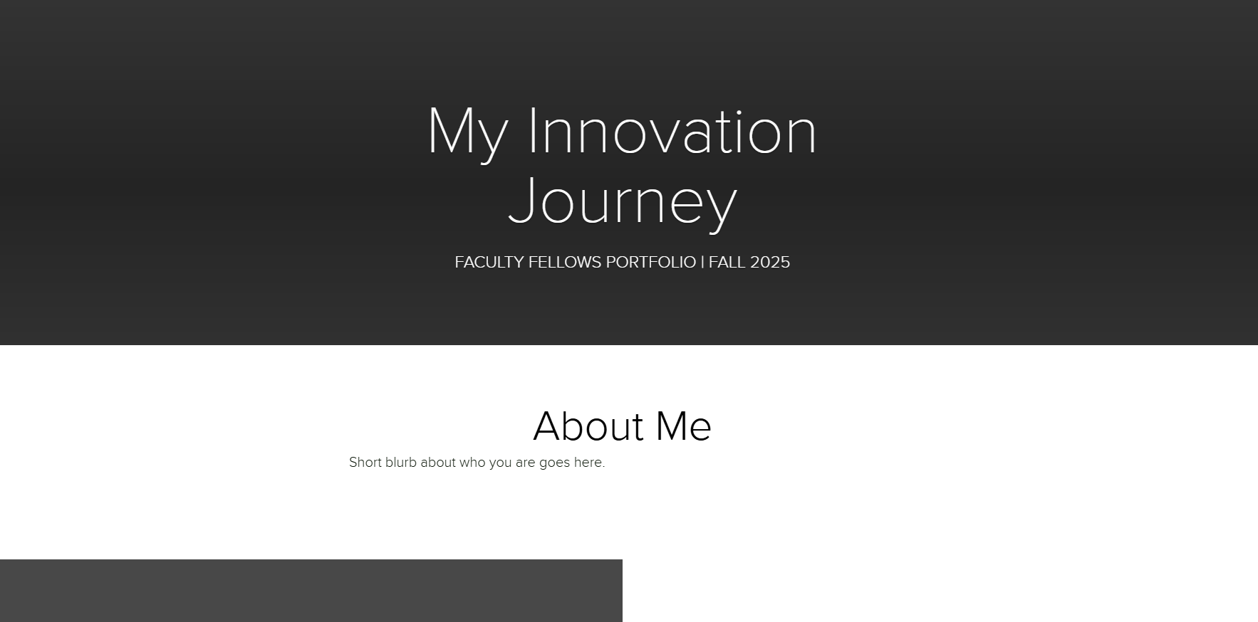
“Innovative Learning Journey” Webpage
https://tinyurl.com/AdobeCMU926

Slide 17
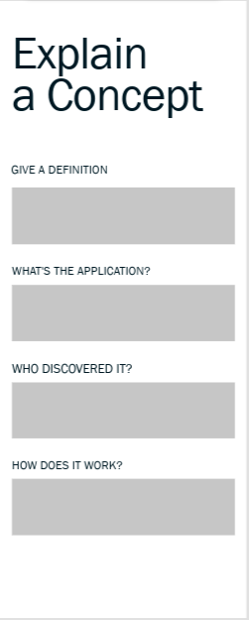
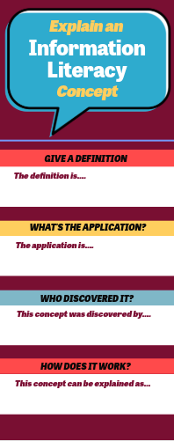
Infographic

Slide 18
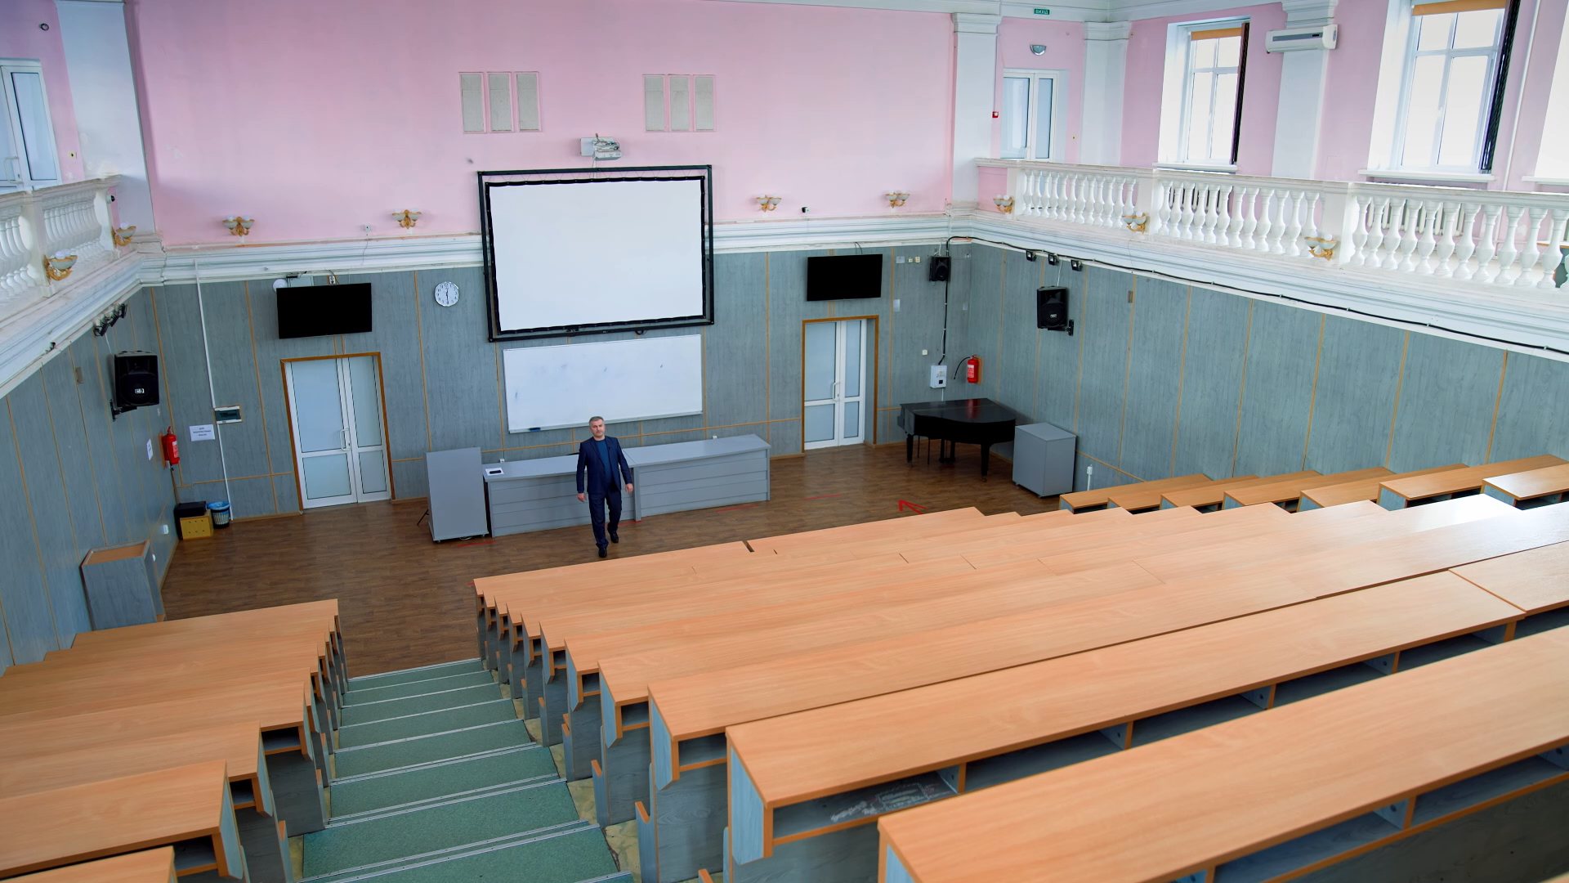
Explainer Video

Slide 19
The Learning Sessions, Jan-Mar
Implementing in the Classroom:
  TILT: Transparency in Learning and Teaching
  Identifying Digital Skills & Competencies
  Assessing Multimodal Projects
JISC Principles; Virginia Tech Digital Literacy Outcomes
PlayLab AI Chatbot Agents
  Defining Digital Literacy Competencies
  Designing a Rubric
Notes:
Contined targeted discovery moments, but shifting focus onto implementing assignments in the classroom, communicating the value of a digital literacy assignment, and assessing creative/multimodal assignments.

Slide 20
PlayLab Chat Agents
Defining Digital Literacy Competencies
Visit https://tinyurl.com/DLChatbot
Designing a Multimodal Assessment Rubric:
Visit https://tinyurl.com/RubricChatbot
Notes:
Add QR codes

Slide 21
One-on-One Support
Different faculty have different needs!
External support included:
  Brainstorming/consultations
  Reviewing assignments, instructions & rubrics
  Adobe Digital Lounge class tours
  Adobe Digital Lounge services for students
  Classroom visits
Notes:
The program facilitators designed learning sessions that would implement discovery, interactivity, digital exploration, and reflection for faculty. We wanted each session to include equal amounts instruction, applying learning, and reflection.
We structured the first half of the cohort to focus on discovered

Slide 22
The Showcase
April 17, 2026
Opportunity for faculty to showcase the assignments they designed to their peers & colleagues, and for students to speak on the work they created
21 faculty and 9 students participated

Slide 23
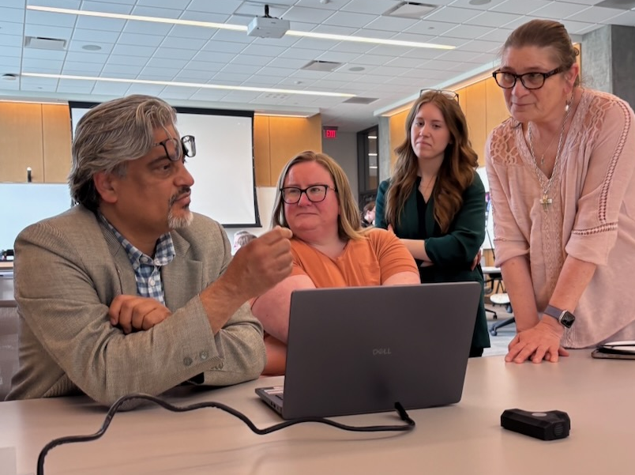
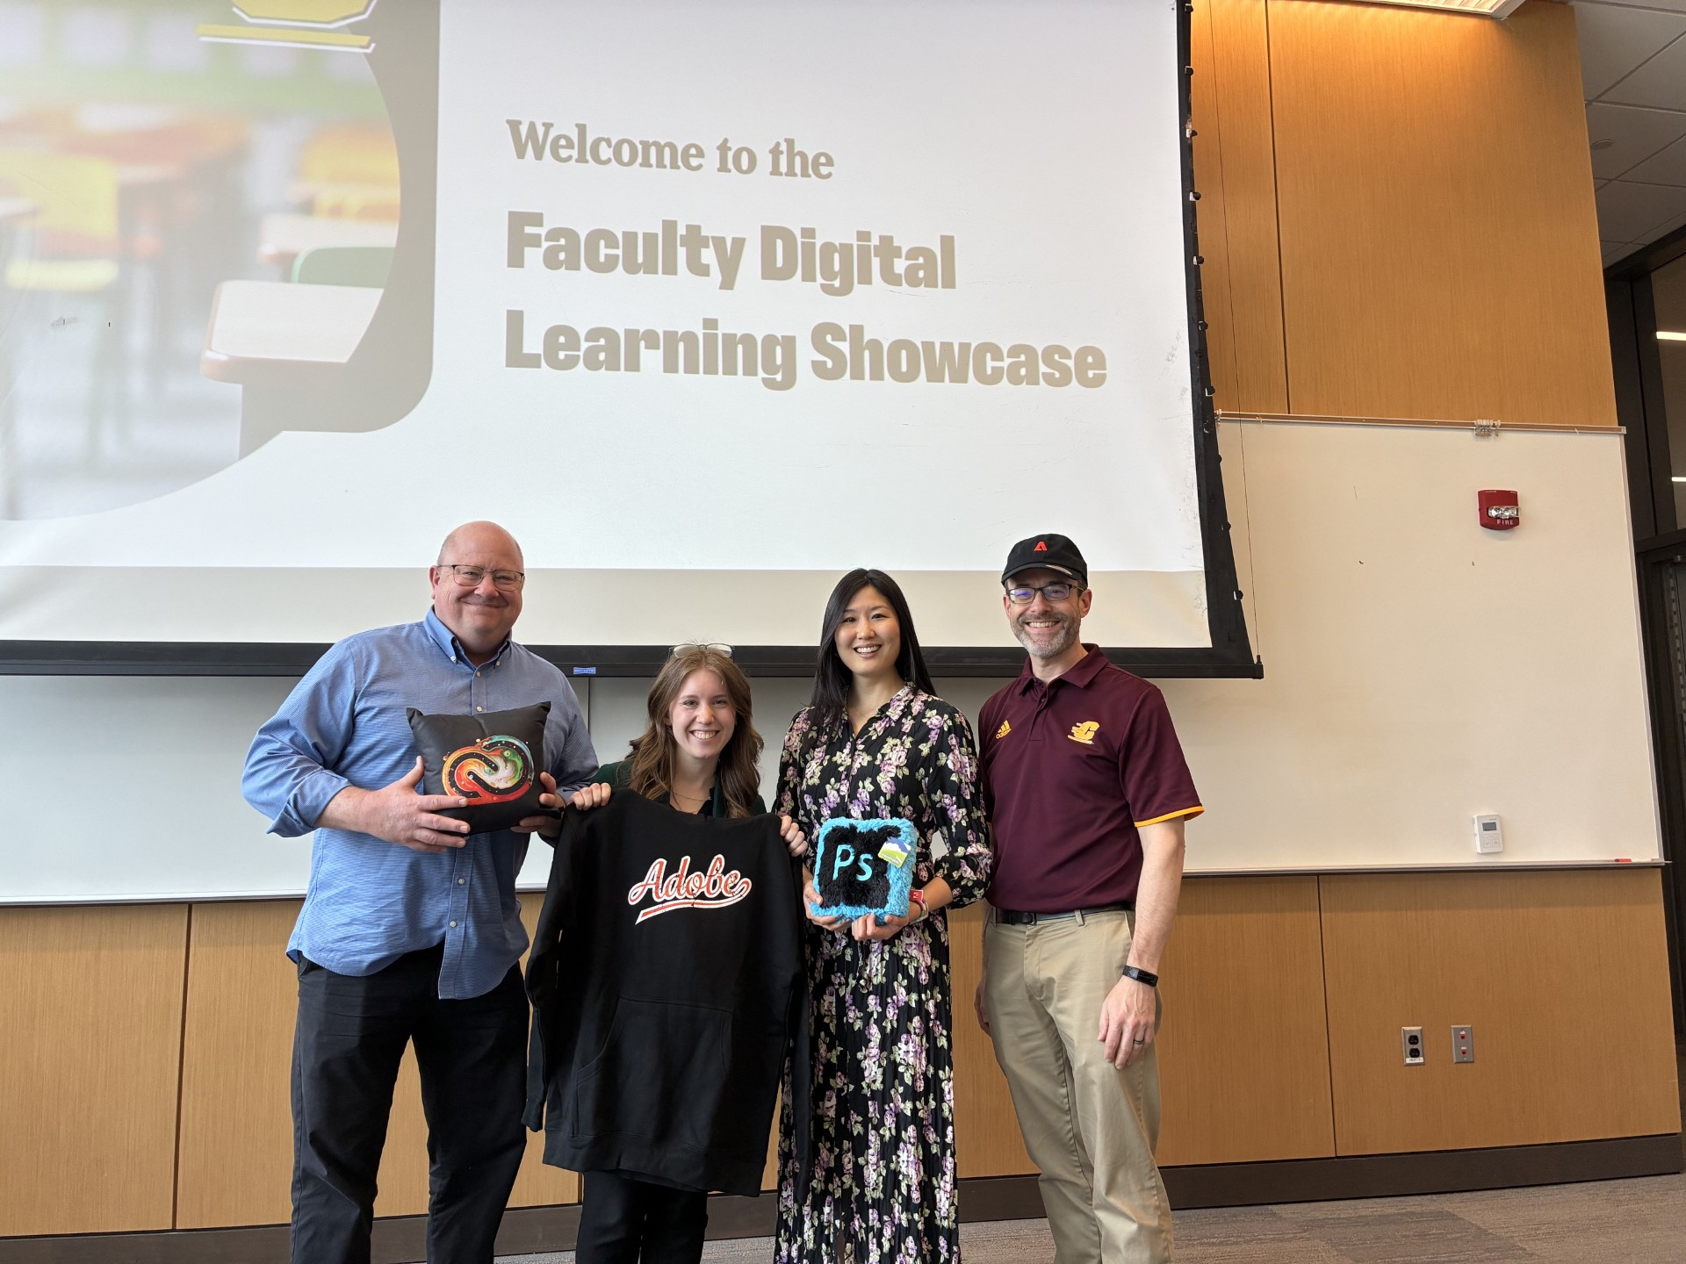
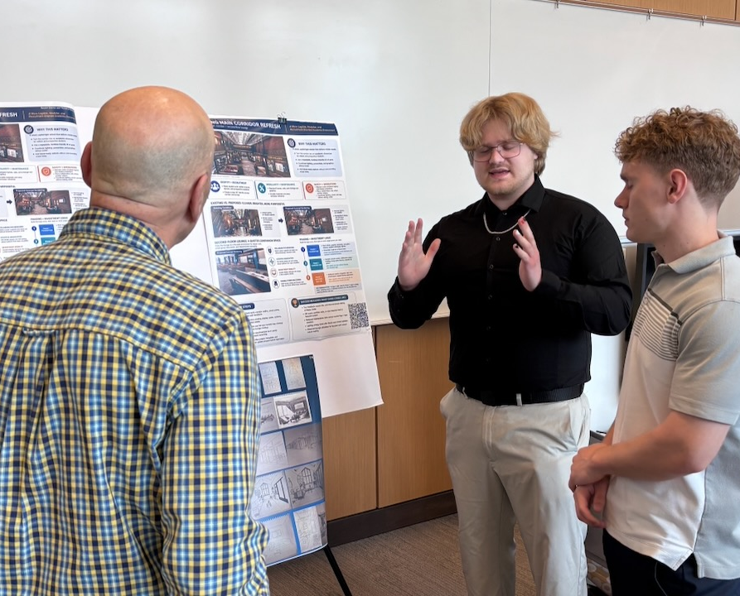
The Showcase

Slide 24
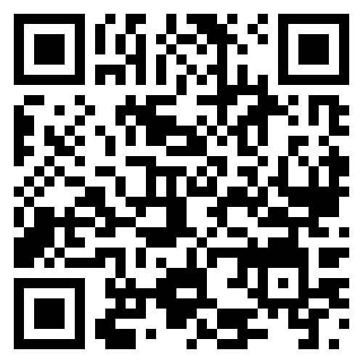
The Portfolio
Library.cmich.edu/facultyfellows

Slide 25


The Impact
Creative/multimodal
projects were designed for at
least 31 different courses
(likely more)
Estimated impact of 496
students exposed to
digital learning & Adobe
Express.
Notes:
Estimated impact of 496 students exposed to Adobe Express

Slide 26
Faculty Feedback
  “Seeing practical examples of how digital tools can enhance teaching across disciplines has helped me think creatively about integrating multimedia assignments into my own courses.”
  “Honestly the best part…is the conversations with other fellows. It's great to see how others are using these tools in their teaching.”
  “What has been most impactful thus far is hearing about the variety of ways that other faculty across disciplines are implementing Adobe Express in their courses. I have really enjoyed meeting other faculty and learning alongside them. The different perspectives are pushing my thinking and willingness to take some risks in my teaching!”
Notes:
Estimated impact of 496 students exposed to Adobe Express

Slide 27
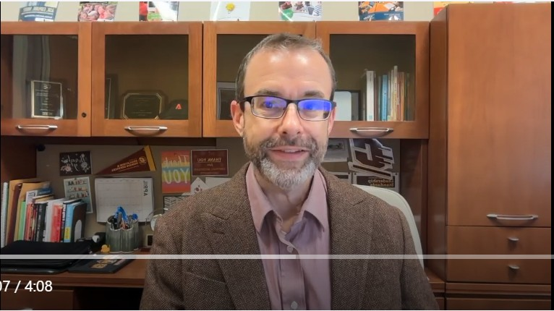
An Educator’s Perspective
Recording for Library Presentation (4-28-26).webm

Slide 28
Libraries as Creators of Community
Libraries are uniquely suited to position themselves as champions of community, innovation, and creativity on campus.
As a resource available to ALL majors, ALL faculty, and ALL colleges, the academic library is well-suited to offer support and community to our campuses
Notes:
Due to our continued support of digital literacy across campus, supporting the Adobe Creative Campus Initiative, and providing opportunities for meaningful, engaged faculty development, CMU Libraries has positioned ourselves a community hub and champion of innovation on campus.

Slide 29
Future Plans
Pursuing a second run of the Faculty Fellows in 2026-2027
  Tier 2 Faculty Fellows
  Additional small-group collaboration and peer support
More focus on assignment building and assessment in the first half of the year
Examples, examples, examples!
Notes:
Add thoughts about things we would change

Slide 30
Further Reading
Rainville, K. N. (2024). Faculty learning communities: Communities of practice that support, inspire, engage and transform higher education classrooms.
Rainville, K. N., Title, D. G. & Desrochers, C. G. (2024). Expanding the vision of faculty learning communities in higher education: Emerging opportunities for faculty to engage each other in learning, teaching, and support.

Slide 31
Thank You!
Have questions or looking for more information?
We’d love to hear from you!
Katie Edmiston
edmis2k@cmich.edu
Dr. Troy Hicks
hicks1tw@cmich.edu

