Slide 1
Crafting our Collective Compass: Collaborations to Advance Incarcerated Students’ Academic Library Access
Sarah Kolk, Calvin University
Jen Fiero, Jackson Community College
Cara Medvedenko, GVSU
Jessica Hronchek, Hope College

Slide 2
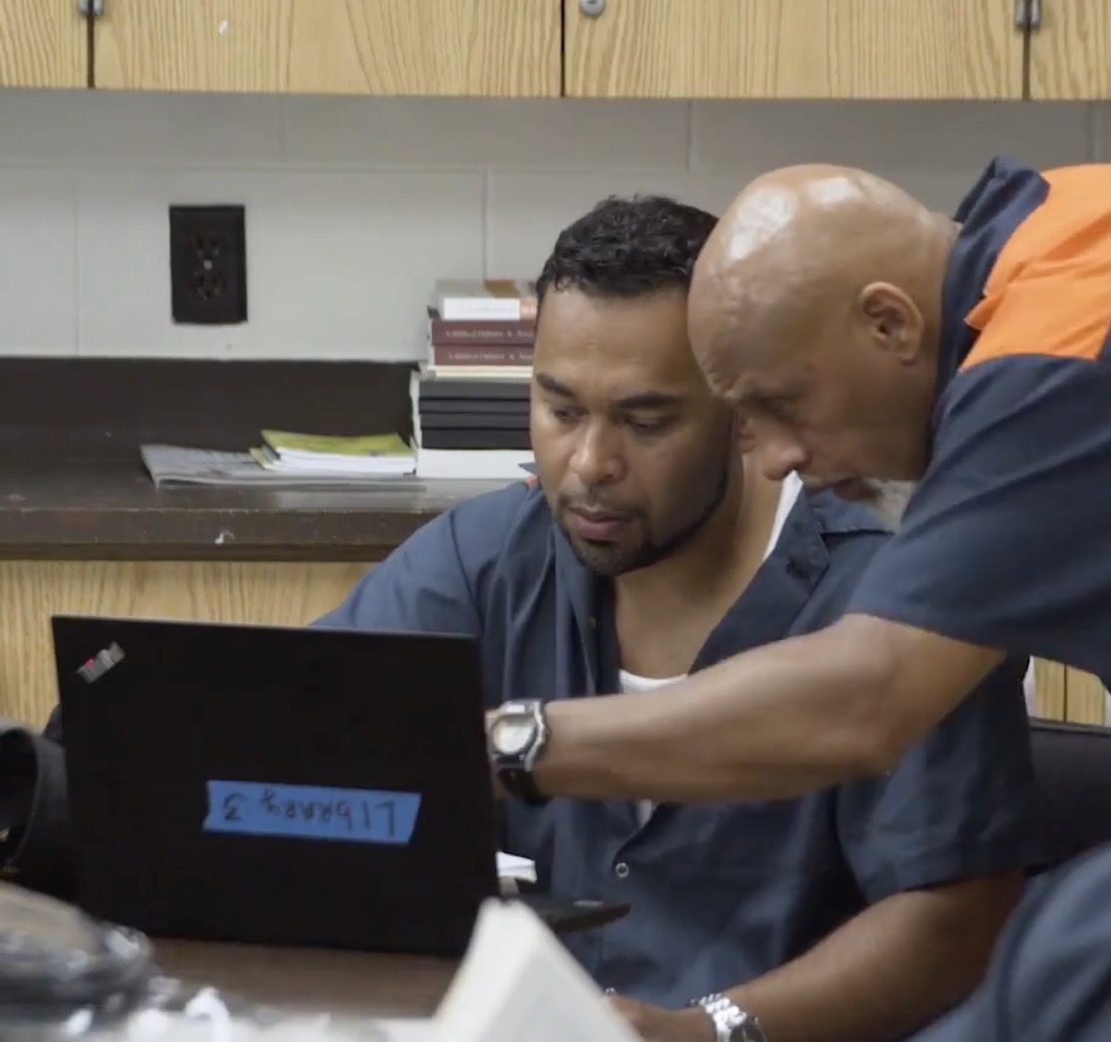
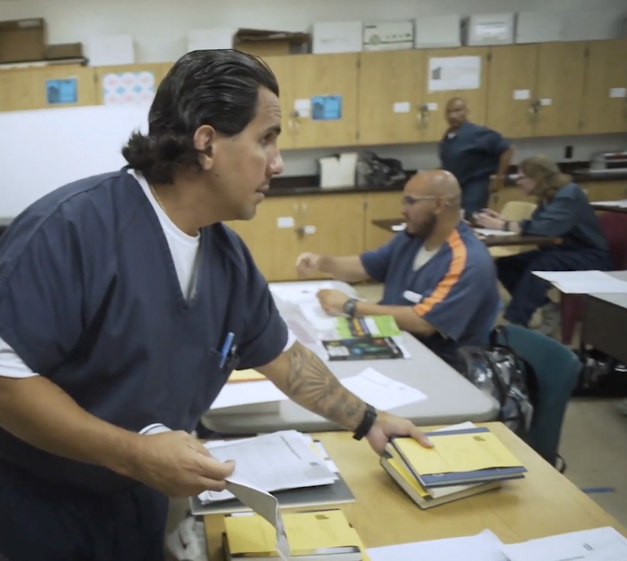
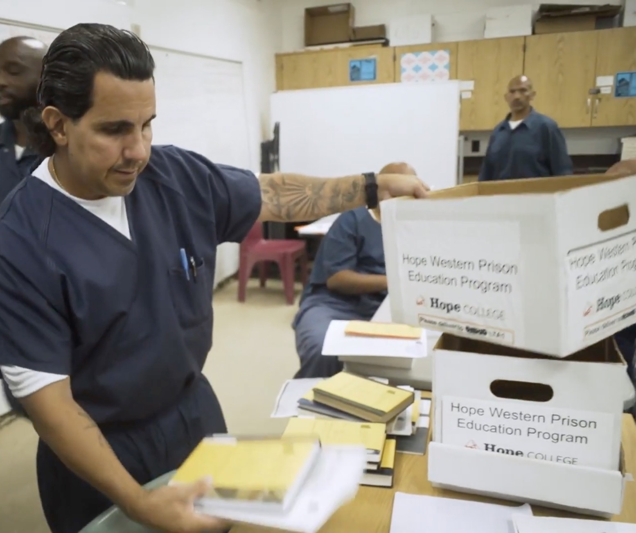
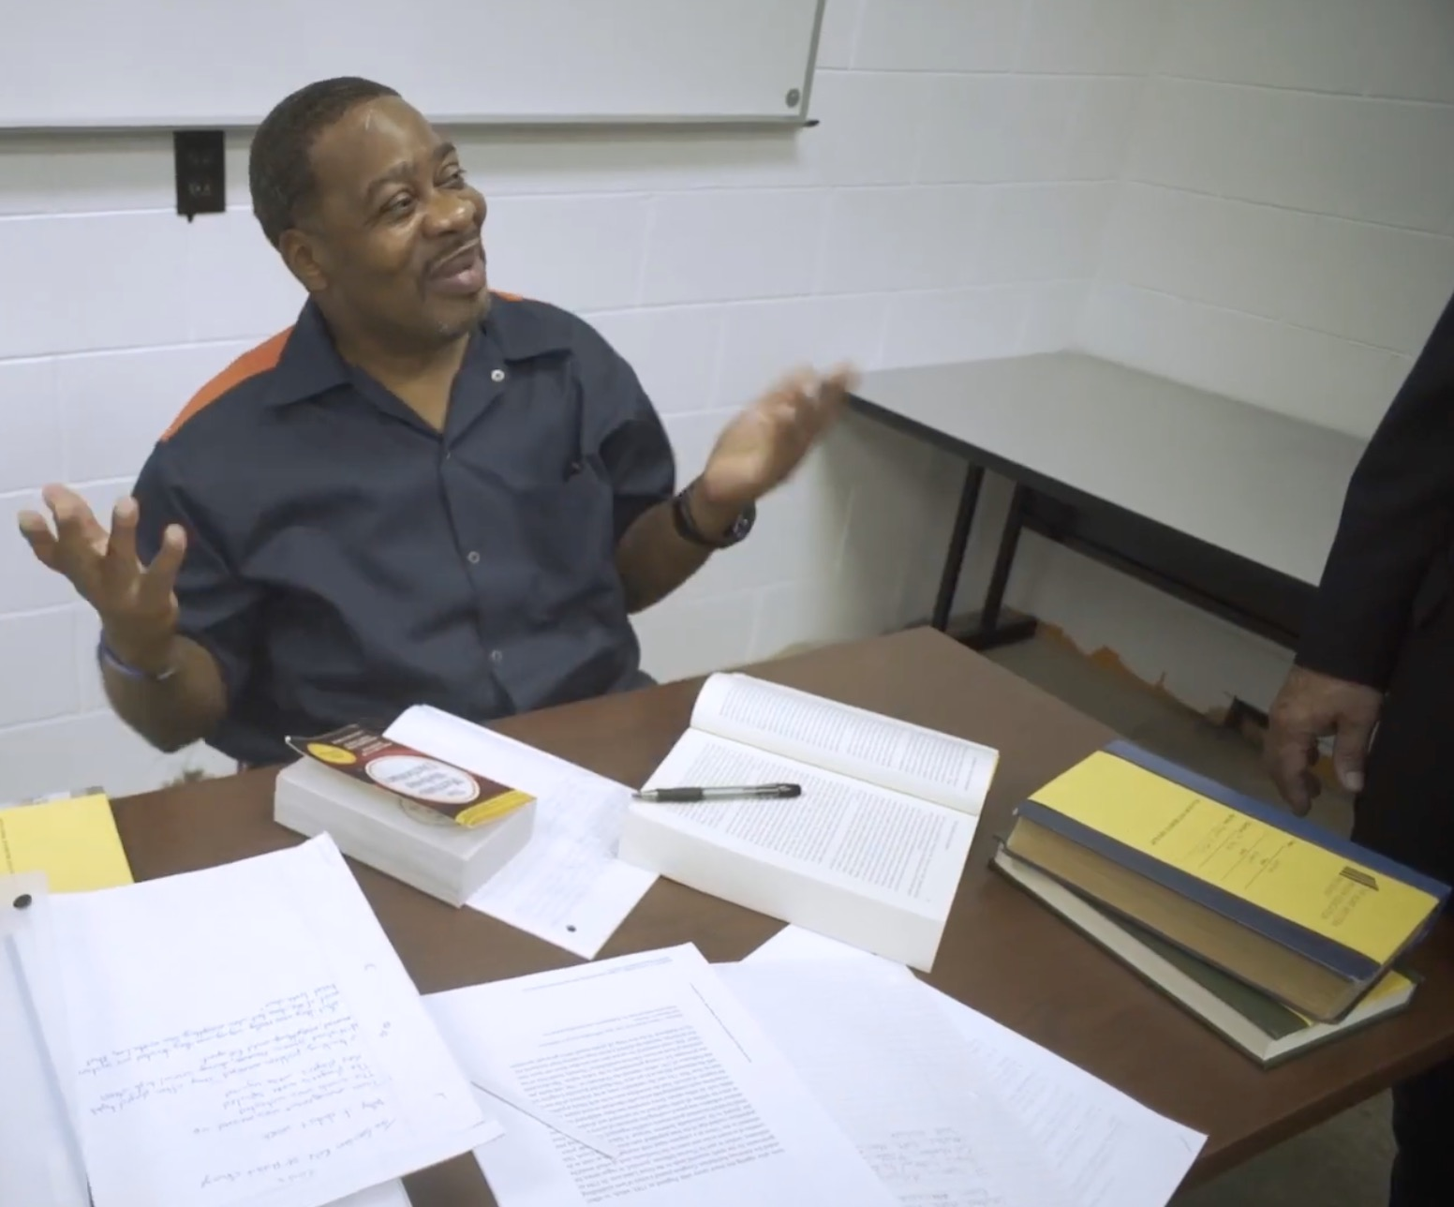
Higher Education for Incarcerated Students Interest Group
The Higher Education for Incarcerated Students IG will give academic libraries supporting or interested in supporting Prison Education Programs in carceral facilities a forum to share knowledge and experiences in this work. This group will meet and plan programming about meeting the unique research needs of incarcerated students. The group may also serve to advocate for information access for the incarcerated population of Michigan.
HWPEP Students using library resources

Slide 3
Panelists and Programs
Jackson College Corrections Education Program (CEP)
Partners - 6 MDOC facilities (Jackson, Adrian, St. Louis, Women’s Huron Valley); 1 federal (Milan)
Age of Program - 12 years
Program Type - Associate degrees & certificates
# of Students - 778
Calvin Prison Initiative (CPI)
Partner - Richard A. Handlon Correctional Facility (Ionia)
Age of Program - 11 years
Program Type - Associate and Bachelor’s degrees (plus two certificates)
# of Students - 104
GVSU Bellamy Creek Program
Partner - Bellamy Creek Correctional Facility
Age of Program - almost 2 years
Program Type - Bachelor's of Science
# of Students - 16-person cohort
Hope Western Prison Education Program (HWPEP)
Partner - Muskegon Correctional Facility
Age of Program - 5 years
Program Type - Bachelor of Arts
# of Students - 65-80

Slide 4
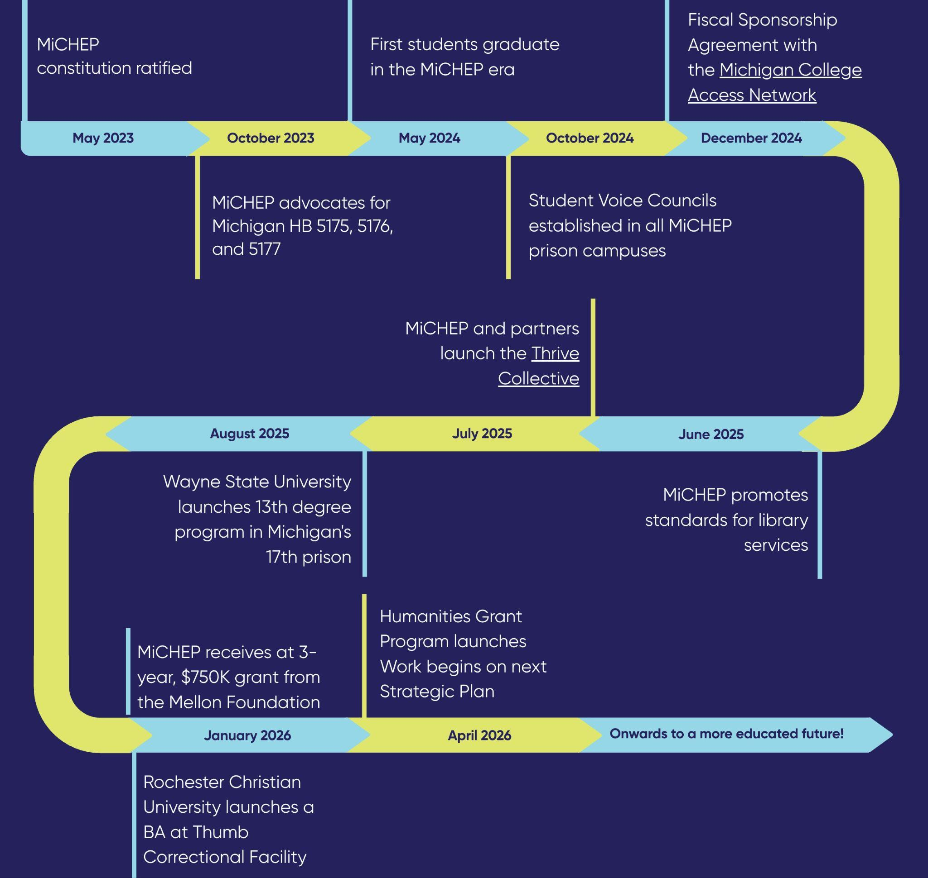
Michigan Consortium for Higher Education in Prison
14 Institutions offering PELL-funded certificate, associate, and bachelor’s programs in 15 facilities
MiCHEP Timeline Graphic

Slide 5
MiCHEP Library Collaboration
‘24-’25 - Library Services Working Group
Representatives from all libraries at MiCHEP institutions, alongside PEP program staff and MDOC education staff
In response to the Vera Report:
Taber, N., Nowak, A., Smith, M., Yang, J., & Strumph, C. (2024). The First Year of Pell Restoration: A Snapshot of Quality, Equity, and Scale in Prison Education Programs. Vera Institute of Justice. https://www.vera.org/publications/the-first-year-of-pell-restoration
Michigan received a “failing” grade for “Academic Research and library resources”
Goal: Establish Standards for library access and services in order to increase library resources for PEP students in Michigan
Model of “good, better, best”

Slide 6
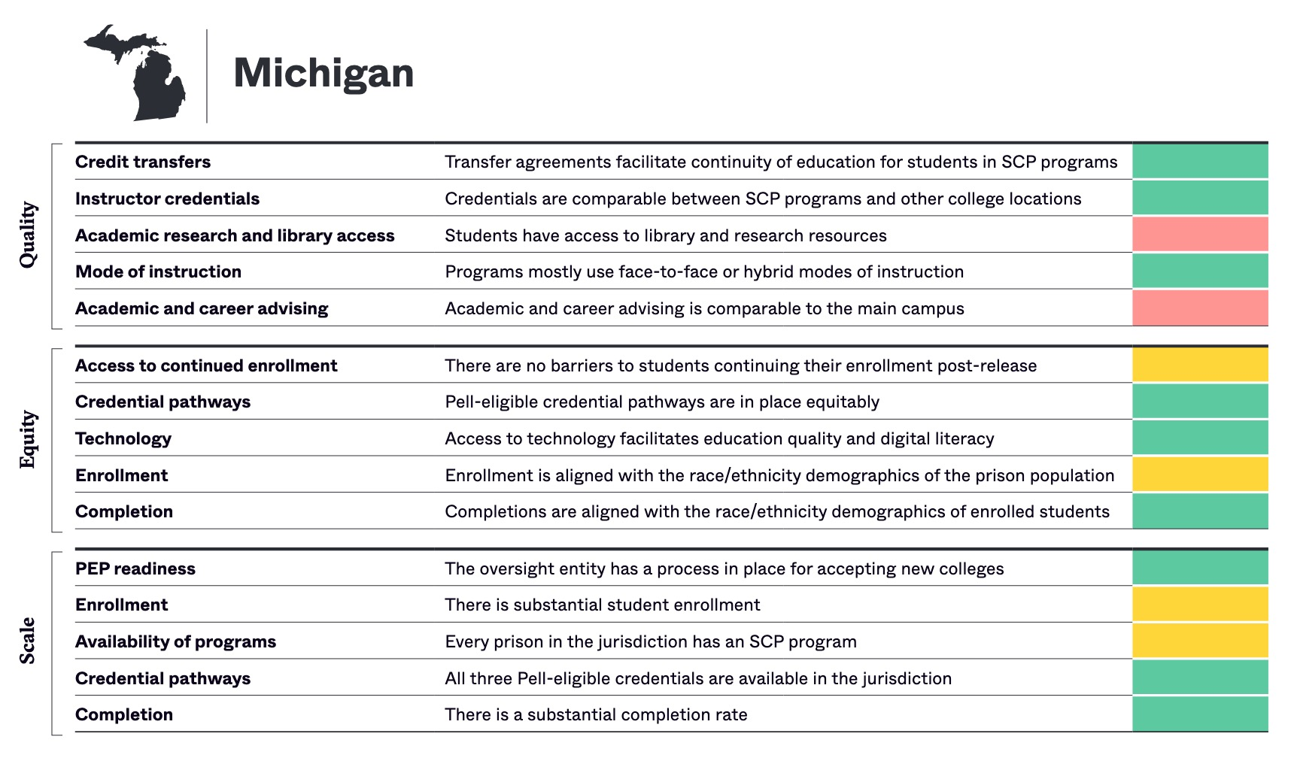
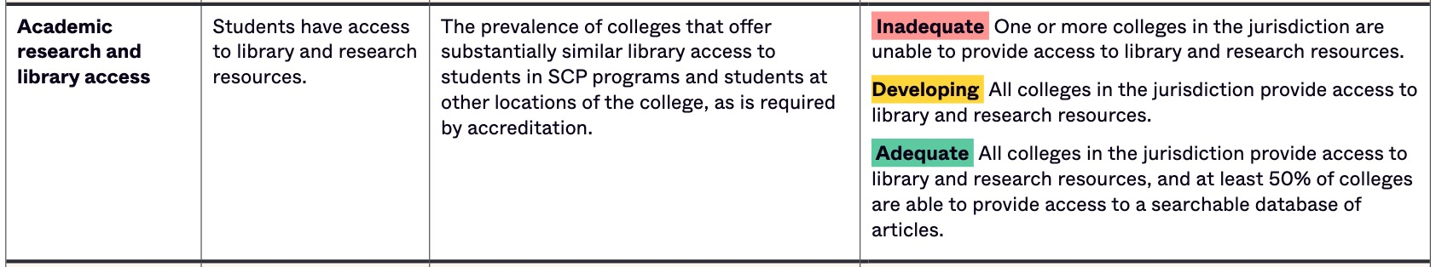
Vera
Report

Slide 7
Areas Covered by Whitepaper
1. Standard Titles: Physical copies of key reference titles are to be made available across all facilities. Enhanced levels include additional titles for disciplines and potential electronic access.
2. Reference Services: All institutions must implement paper-based reference request system. Enhanced levels involve in-person librarian visits or direct database access for prison librarians to assist students in real-time.
3. Physical Item Access: Recommendations aim to standardize delivery timelines and borrowing procedures for physical materials.
4. Information Literacy Instruction: Good practices include faculty-librarian collaboration and use of a shared lesson plan repository; the best practice includes direct in-person librarian-led instruction.
5. Research Database Access: Institutions must at minimum provide offline access to JSTOR’s Access in Prison database. Better and best include individual laptops preloaded with research databases or live, whitelisted online access to full-text scholarly content.
6. Library Catalog: All programs should provide at least offline access to institutional library catalogs. The best models grant whitelisted online access to full library discovery systems, emulating traditional student research experiences.
Link to Full Whitepaper (2025 version)

Slide 8
Example Good, Better, Best: Database Access
Good: Each PEP provides, at a minimum, access to the offline version of JSTOR or similar index of scholarly articles, enabling students to search/browse scholarly articles, and then request full-text articles from their academic library. This would be facilitated through a fixed workstation.
Better: Each prison education program provides offline access to JSTOR or similar indices of scholarly articles on individual student laptops
Best: Each prison education program provides live whitelisted access to JSTOR and similar indices of scholarly articles (e.g. EBSCO Correctional Ed) on individual student laptops that would help students formulate search strategies and to engage the materials that have been retrieved. The student laptops would be able to receive copies of articles and ebooks through a network or USB connection.
MCI Students Searching Library Laptop

Slide 9
MDOC funded core reference titles in all facilities
Are they all here? Do all programs have space? Communication gaps
JSTOR Offline + 1,500 articles on all student laptops
Not working consistently, particularly full text
Centralized place to work out resources that could be rolled out statewide
Example offline dictionary database
Better method to assess programs
Still challenging to ascertain “good, better, best” because of the diversity of experiences
Initial Successes (and Continued Challenges)

Slide 10
Q&A
Please share your own experiences!

Slide 11
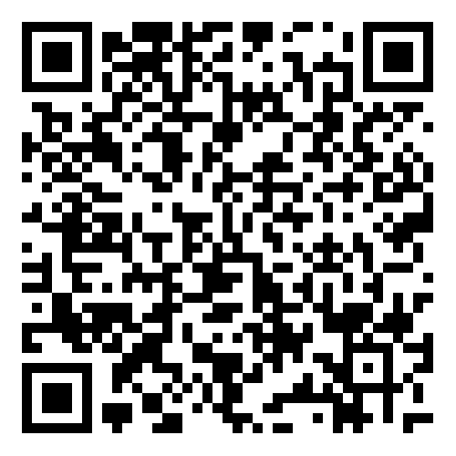
Consider Joining HEIS! Session Feedback
Members:
Log into MiALA website
Engagement tab
Interest Groups/Committees
Scroll to HEIS and click Sign Up!
Non-Members: email hronchek@hope.edu
Join our table at the Birds of the Feather lunch for more conversation!

