Slide 1
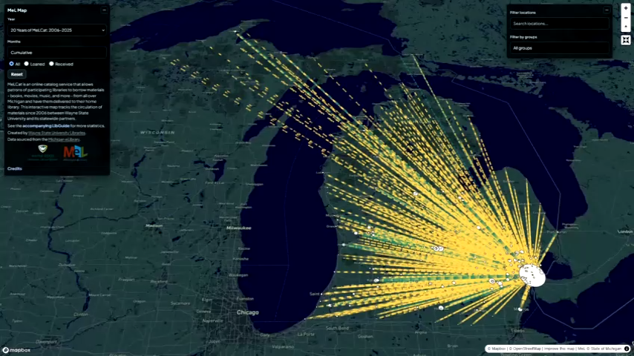
MeL Map: 20 Years of Connections Between Wayne State and Michigan Libraries
Vaughn Haynes – Graduate Student Assistant
Theresa Hovey – Library Associate Senior
Notes:
Hello, thank you for coming to our presentation on the MeL Map. We’ve got a short one for you today, this is a project about using data, visualization, and design, with a purpose. We're going to talk about a project we undertook last Summer where we took Wayne State University's MeL transactions with other Michigan libraries, and used that data to tell a story about a 20 year long relationship.

Slide 2

Background
In 2025, MelCat turned 20 years old
March 2025: Executive order threatening IMLS funds
December 2025: IMLS funds reinstated
WSU Libraries wanted to show how useful this funding was, so we started working on the MeL Mapping Project

Slide 3
Brainstorming

Slide 4
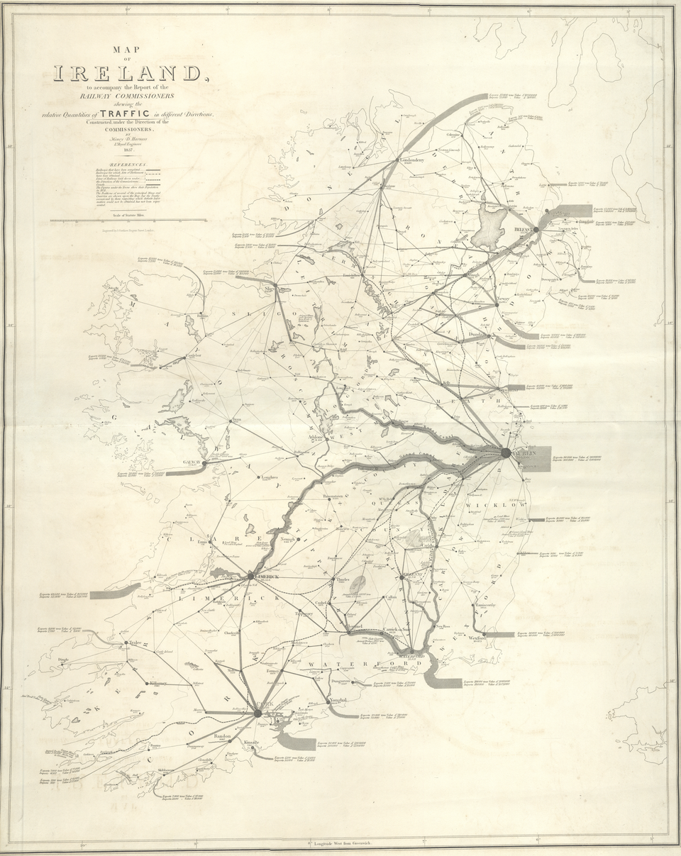
Visualization ideas
More than a chart
Something we can maintain
Something interactive
Flow map:
Movement between locations
Notes:
We were looking for something more than a chart. We wanted to visualize not just the data but also the scope and impact of the data.
We wanted something we can maintain. We wanted something people can regularly reference, just want a one-off exhibit.
We wanted something interactive. We wanted patrons to stick around, play around and get a tactile feeling of the data, and maybe move on to our library website.
And so, while looking for ideas I came across a map type called a flow map. Flow maps track movement between locations using arrows or lines, using thickness to represent the amount.

Slide 5
FlowMap Templates?
Canva
Wanted something interactive
PowerBI
Plugins were out-of-date
FlowMap Blue
Not tailored to our needs
Limited features
And lots, and lots, and lots of AI GARBAGE
Felt like a dead end, until...
Notes:
My first thought was to use something like Canva or another graphic design platform. This would be great visually, but we wanted something interactive.
We considered using Microsoft PowerBI, which is a dedicated platform explicitly for visualizing data. However, all the plugins to create flowmaps were last updated years ago, and were no longer compatible.
For anyone who's made a flowmap before, you've probably heard of FlowMap Blue. This is a great software, however, it's a very one-size-fits-all tool, that lacked the specificity we were looking for.
With all the tools, it seemed like you had to pick your limitations. Some tools looked great visually, but had limited customization. Others let you control your own data, but required you to host it on nefarious platforms like Google.
There were lots of AI options. I'm of the opinion that AI generated slop is not yours, therefore, I decided to not use any of those.
It felt like we were running out of options until...

Slide 6
Why don't we just make our own?
Notes:
Why don't we just make our own tool?

Slide 7
Principles
Accessibility
Simple, sleek, specific, and sortable
What bloat can we trim, and what can we beef up?
How can we best serve the story we're trying to tell?
Notes:
Some principles we wanted to follow:
Accessibility – we wanted as many users as possible to be able to interact with our data
Simple, sleek, specific, and sortable. All those s-words. We wanted something that looks modern, and we wanted something that was tailor-made to our data. The average user doesn't know how to do an SQL query, and they shouldn't have to in order to mess around with our data
What bloat can we trim, and what can we beef up? Some of those other platforms took a looooong time to load while they loaded a bunch of data we didn't need. Simultaneously, we had data that wasn't being utilized by these other platforms.
How can we best serve the story we're trying to tell? The takeaway is that MeLCat is a valuable resource that connects libraries all over Michigan – how can we make that idea as clear and impactful as possible?

Slide 8
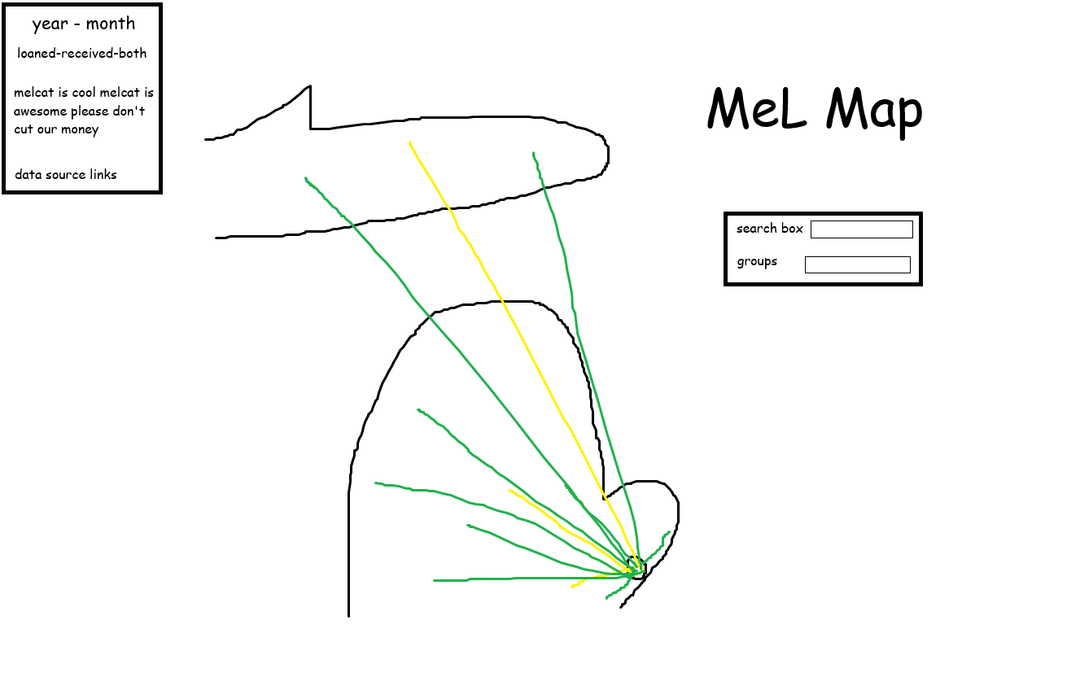
Notes:
Here's a rough outline, the basic idea was already there from our work with the other tools like FlowMap Blue.
The most obvious and important element is the Michigan map. There are a bunch of open source map tools you've might have heard of like Open Street Maps, so we knew that wouldn't be an issue. The great thing about having a fixed, central piece is that it becomes a matter of designing around an element, giving you parameters to work within instead of having to take a wild guess and see what works.
The question became what knobs and dials do we want the users to play around with? To answer that we had to go back to our central idea, which is that MeLCat connects libraries all over Michigan. So we obviously needed a search box, which was present in the other tools, but what wasn't present in the other tools was the ability to group data sets. There's consortiums al over Michigan like the Library Network or the Southwest Michigan Library Cooperative. And there's also groups that WSU specifically liaisons with, like Michigan's community colleges or the Michigan Association of State Universities. Also, you'll notice some lines are green, and some are yellow – we wanted a way to quickly visually distinguish between academic and public libraries.
Mel also publishes its statistics monthly as far back as 2020. So, that's how we decided to group the data – yearly and monthly. We also wanted a toggle between received items, or loaned (or both). And then finally a quick little blurb about the whole point of the entire operation.

Slide 9
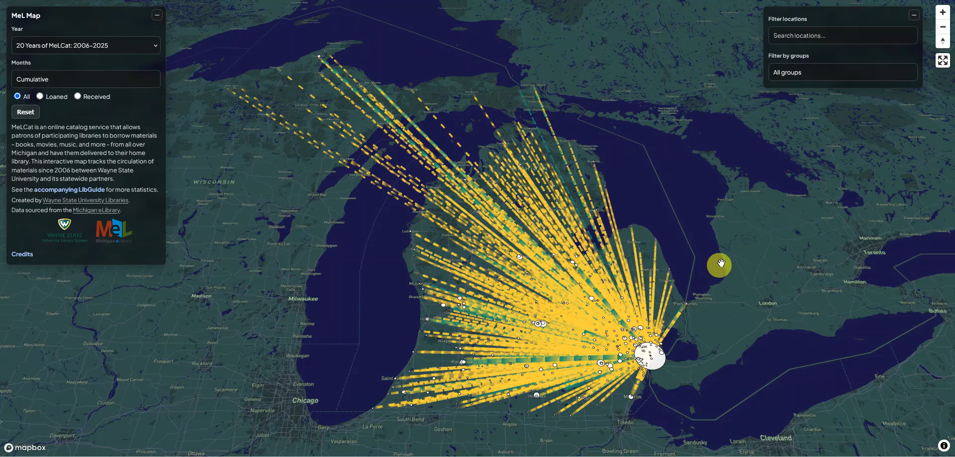

Slide 10
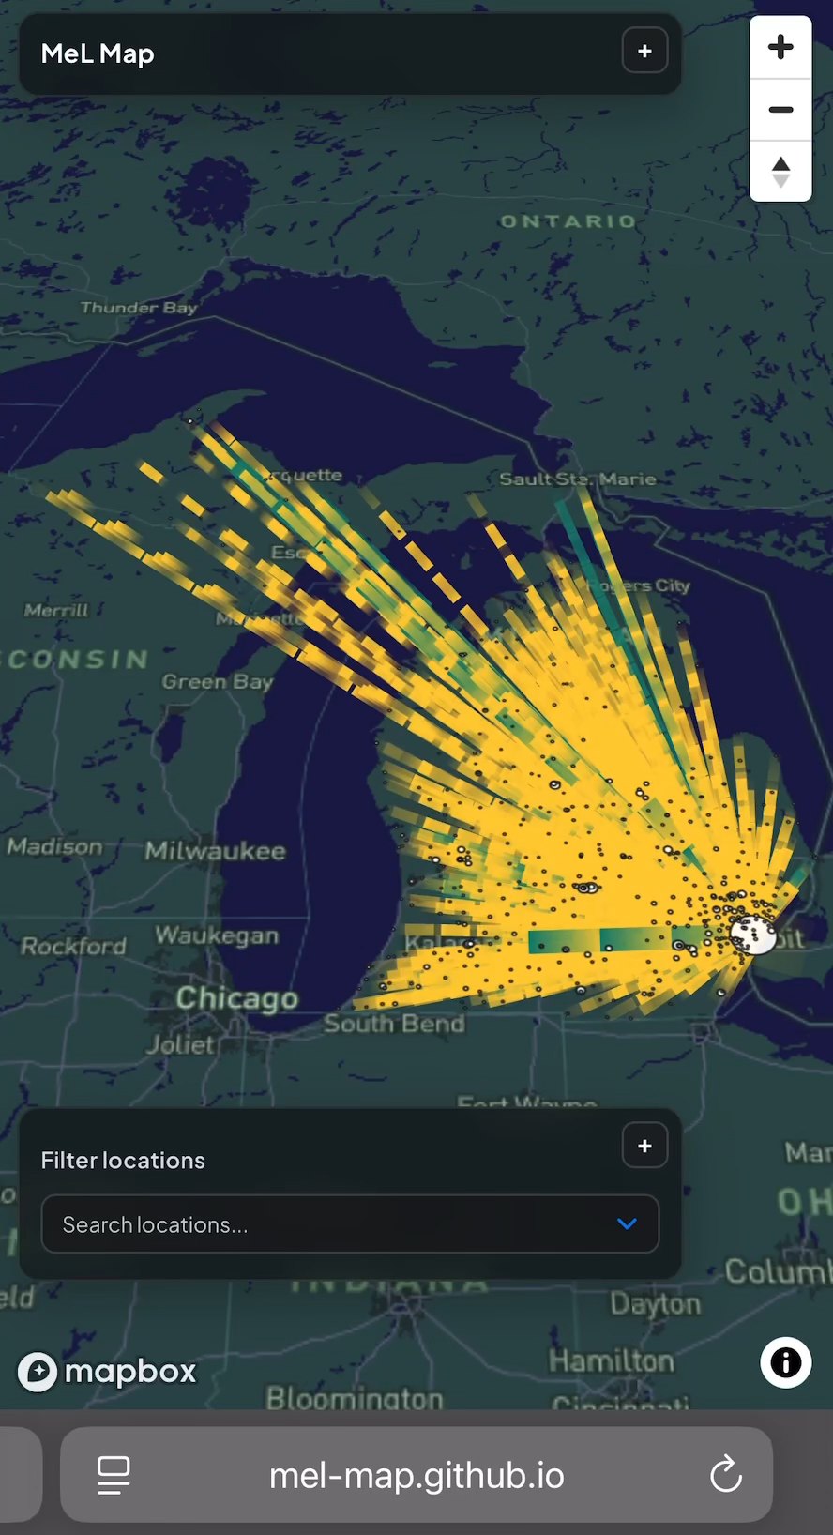
Mobile design
Condense condense condense
Consider what's really important
Reduced weight = reduced wait
Notes:
"Mobile-first" is a design philosophy where you design for the smaller screens before you design for the bigger screens. Obviously, we didn't do this, but, the average person isn't looking at a computer all the time, so we knew we needed mobile support. These were the principles we followed when adapting the Mel Map to the small screen:
-condense condense condense. As proud of the blurb as we were, it was covering up the whole screen. Bye bye blurbie.
-Following that – consider what's really important. The extra bells and whistles were more than just extra bells and whistles - they were the reason we made it our own in the first place. We made the boxes with the toggles expandable, so if you wanted to filter and refine the data, you still could without clogging up your screen.
-And one great thing about making the site smaller is that it loads much faster!

Slide 11
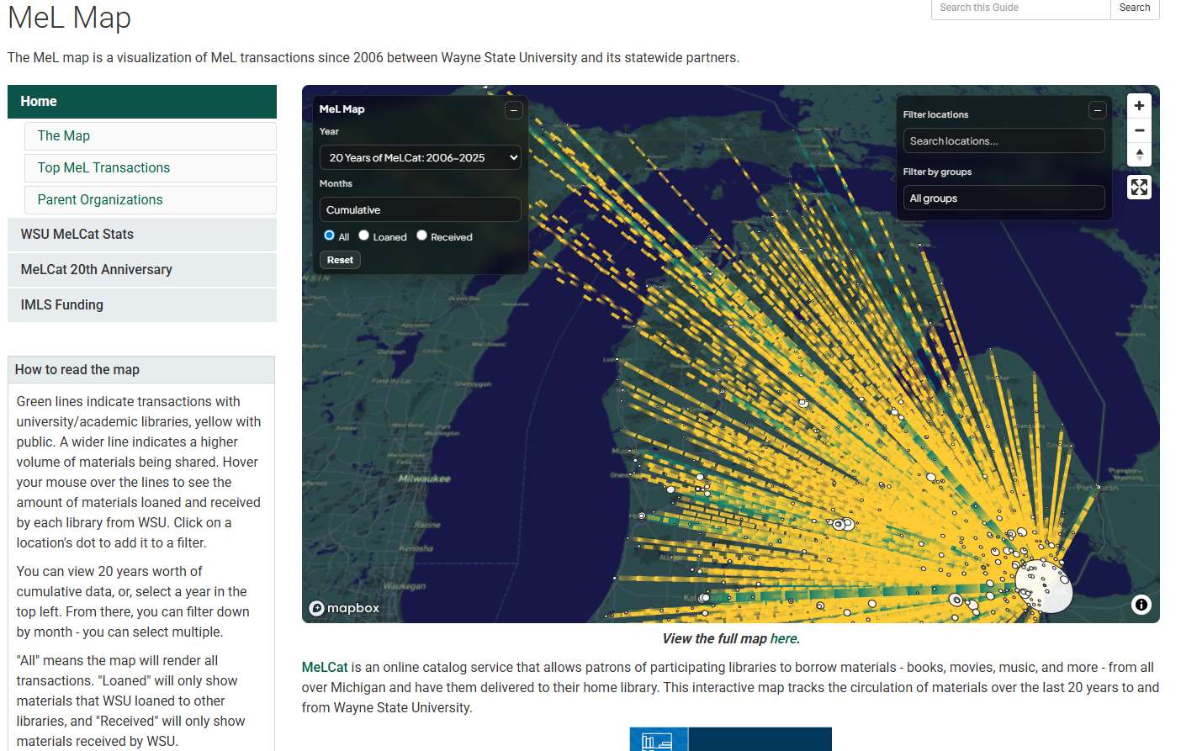
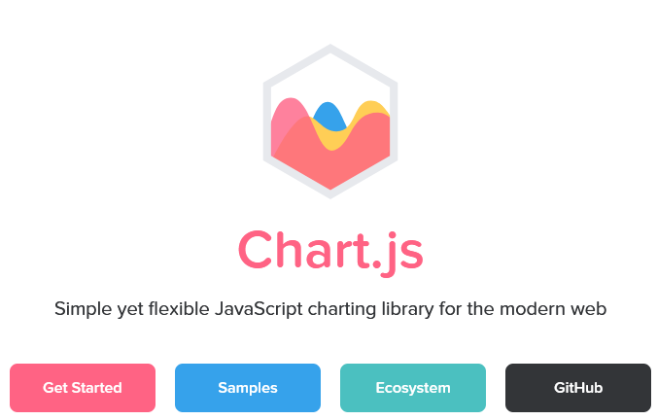
Bonus! Statistical LibGuide
Built a guide featuring the map and other Map statistics using chart.js
Notes:
As a way of showing off this exhibit, we put together a topical guide which features the map and a few other statistical treats. As of a few days ago, this guide has had 1,450 views since its initial publication in August

Slide 12
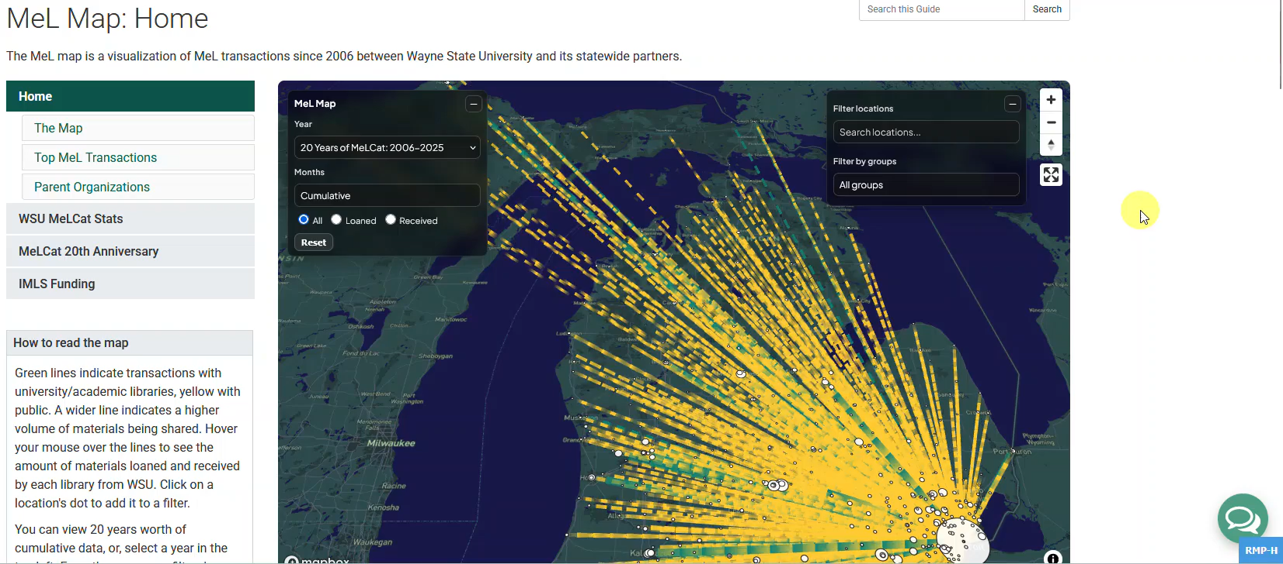

Slide 13


Check it out for yourself
Map
mel-map.github.io
Guide
guides.lib.wayne.edu/melmap
Notes:
And here are the links if you want to check them out! You can scan the code, follow the URL, and if you want to come back to this later, they're also included in the slide deck on sched.

Slide 14
Future
Not just a one-off project—updated each month
Going forward, maintaining the project is a responsibility of our MeLCat contact staff member.
Manageable project, fits well into existing workflow
Already do monthly searches
MeLCat already provides monthly fulfillments on wiki

Slide 15
Why?
Visualizing Information
Turns an imposing set of data into something that's easily searchable and easy to read
Accessible to all: Students, patrons, faculty, and library staff, not just our MeL librarian
Evaluation
Acts as a valuable tool to show exactly how useful the MeLCat program is
Data Tell a Story
Each line on the map is a relationship between institutions and between people

Slide 16
Questions?
Vaughn – vxh@wayne.edu
Theresa - gq1124@wayne.edu

Slide 17
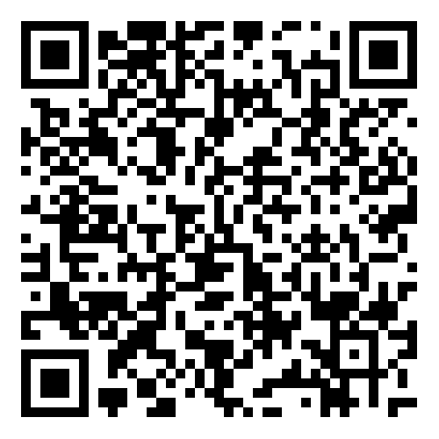
Thank you!
Survey Map Guide
Notes:
Here's a link to the MiALA feedback survey, please scan it and let us know what you think!

