Slide 1

Navigating Rough Terrains: Empowering Liaisons in Collection Decisions
Tiler Jewell, Collection Development Librarian, SVSU
Alex Hauser, Business Librarian, MSU

Slide 2
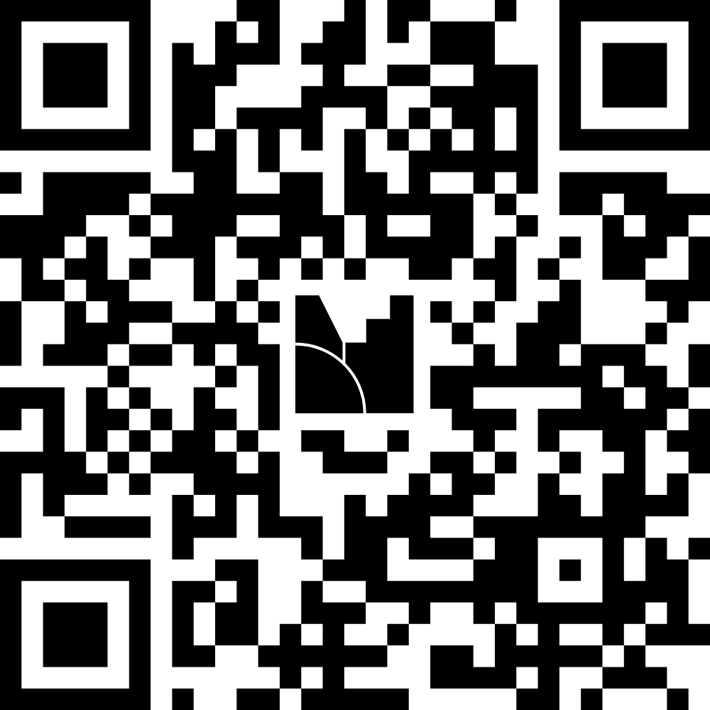
Agenda
Poll
Collection Development Perspective
Liaison Perspective
Group Discussion

Slide 3

Re- routing as Budgets tighten
Database costs are rising AND usage is taking a dive
SVSU has not experienced a budget cut, but we want to be prepared
Notes:
Database costs are rising and usage is going down
We’ve noticed an extreme downtick of usage in our resources, especially since AI came into the picture.
SVSU has not experienced a cut but we can see the iceberg ahead

Slide 4
Ground in Context
Time is limited
Limited faculty input
Liaisons were not consistently in the loop
Room for breakdown of trust
Reviewing Databases historically happens when invoices come.
Keeping in mind:
Faculty are changing the way they teach
AI, ADA and OER/OA
Library staffing is limited
Notes:
While reviewing databases do happen regularly, we have historically waited until close or when the invoice had already arrived.
This limits our time
Limits room for faculty input
Liaisons are not consistently in the loop
Break down trust
Reactive instead of being proactive
Keep in mind that
Faculty are changing their teaching methods, AI, ADA, OA are all apart of these conversations AND library staffing is limited—at svsu and I’m sure many other schools, we don’t have subject librarians but rather we each have role in addition to the liaison functions so while I’m a liaison to a few subjects, I’m also the collection development librarian but we have some librarians that have several subjects.

Slide 5
Charting the Course: Database Review
Step 1: Compile the data (shout out to our e-Resources team)
Step 2: Share information for each subject with respective liaison
Step 2a: Include context!
historical
Would these even be an equitable cut?
Any reasons beyond our control to contribute to low usage?
Class scheduling, etc
Step 3: Liaisons will share this information with faculty with discussion questions for specific feedback
Can this be done before the invoices/renewals hit us? That’s the goal!
Notes:
We have started a new workflow to help increase communication between faculty and the library because if we do need to make cuts, we need to be strategic about what gets cut. We support a lot of different departments who all have varying needs, and we aren’t that big of an institution. There are a lot of things out of our control right now, but one thing we can do is look at the data and utilize our relationships with faculty.
A few months before the renewals normally hit, I reach out to liasions with all of this data
Compiled usage and cost data
I add any context that should be considered including important inflationary info, usage changes between the last 3 years. As well as some additional things to think about like any historical information on this database. Did a particular prof want it for some specific reason and we just kept it? Would it be equitable to cut and is there any alternatives? Because some of our lower usage products may be lower use because they have a small program but that a really important database or product. Any other reasons out of our control (besides the obvious enrollment) like we have classes that are only offer certain semesters.
Liaisons can share this information on how they see fit. While I would love it if everyone could attend department meetings, that just doesn’t happen often and honestly, I am in the opinion that most of my colleagues know how to communicate with their faculty based on their experience. (I’m trying to learn still how to support newer librarians on liaison work because I’ve only liased for 2 years.)
Once input is given is then sent to me so I can record it and keep track of it.

Slide 6

Look for the Big Dipper, Find the North Star
Faculty who have responded, understand or want to understand
Revealed what products faculty don’t care or don’t know about
Led to faculty sharing products/databases/journals they do deeply care about
They know what’s endangered
Notes:
Faculty who have responded, understand or want to understand why we may be removing things. This has led to suggestions and questions about our products and processes.
Some conversations have led to faculty revealing they don’t use that but ended up asking about another product that we already had but they didn’t know. For instance, our philosophy department is very small but we had one database that looked like it was costing us 77 dollars a use. Turns out they didn’t care about it at all and the professor of Healthcare and ethics asked about UptoDate…which we have already! That philosophy product is very small compared to our big deal packages and other products, but if we’re looking to cut, that’s just one low hanging fruit right?
Other conversations on the other end gave more insight into what faculty do care about in terms of what journals or products we provide.

Slide 7

Altitude Adjustments (challenges)
Communication is hard
Liaisons are stretched thin
Data doesn’t reflect reality all the time
No real Visualization
Notes:
Communication is hard. I think we all can agree that it can be difficult to get ahold of people, especially faculty. They’re pulled into a ton of directions and emails do go unanswered. On the other side of that, even between my coworkers and I, I have had to follow up with them because I went unanswered
A lot of that is of course is that our liasions are stretched thin—we all have projects to do and our own lives on top of the essential duties of our jobs. Sometimes the time for some people isn’t there.
Data doesn’t always reflect the value it provides. Different products serve different purposes, and the impact isn’t measurable (I don’t think) So context becomes key.
No real visualizations—I have left it up to the liasions to make any garphics they want and have just been sending them information via excel. Which can be disengaging and it’s not always easy to understand fully.

Slide 8

*Note to self: Don't pack like an amateur. (Lesson's Learned)
Visualization. Using AI or PowerBI so data is more digestible
Providing suggested questions. I already started this but providing structured questions to get specific feedback.
Be Flexible. Be open to doing things differently and listen to liaisons.
Notes:
Visualization—After going to the ERL conference and learning more about visualization tools, I plan on learning a bit more about PowerBI and creating dashboards, I think it would make it more accessible and easier to talk about if faculty and liaisons were able to visualization the data.
Providing suggested questions so we can have more dialogue, this includes asking liaisons directly for their opinion.

Slide 9

Subject liaisons and collections decisions

Slide 10
Collections Work at Michigan State Gast Business Library
Collections Decisions
Business Collections Librarian
Collections Strategist
Business Librarian
Director of Business Library
Michigan State University's Gast Business Library
Branch location of the MSU Main Library
Four librarians including a Director and Business Collections Librarian
We are all "Business Librarians"
Collections decisions primarily responsibility of Business Collections Librarian
eResources, approval plans
Business librarians can make purchases, but they all flow through Business Collections Librarian
----------

Slide 11
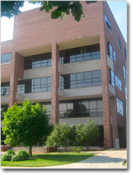
Liaison librarianship at the Gast Business Library
My primary liaison areas:
Advertising & Public Relations in the College of Communication Arts & Sciences
Marketing in the College of Business
General business questions as needed

Slide 12
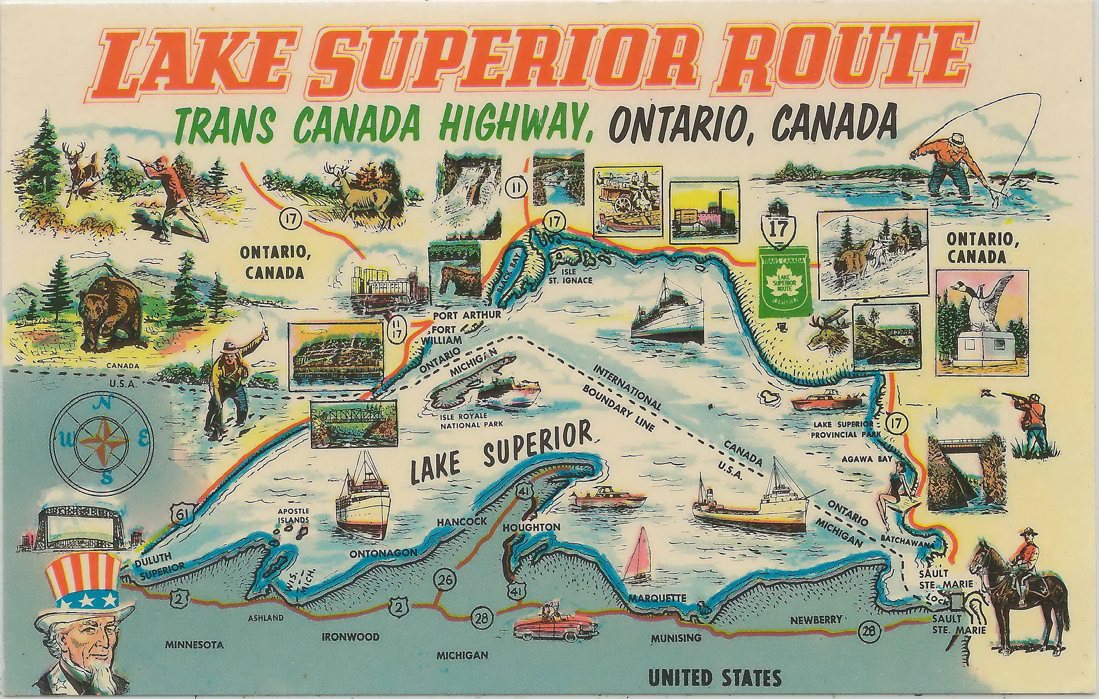
My road map for librarianship
Connecting with these departments drives my work
In-class library instruction, reference questions, purchase requests, faculty research questions all stem from my relationships with departments
I attend at least one faculty meeting each academic year
I am busy, nearly 30 instruction sessions in an academic year plus reference and other outreach
Don Harrison, Flickr

Slide 13
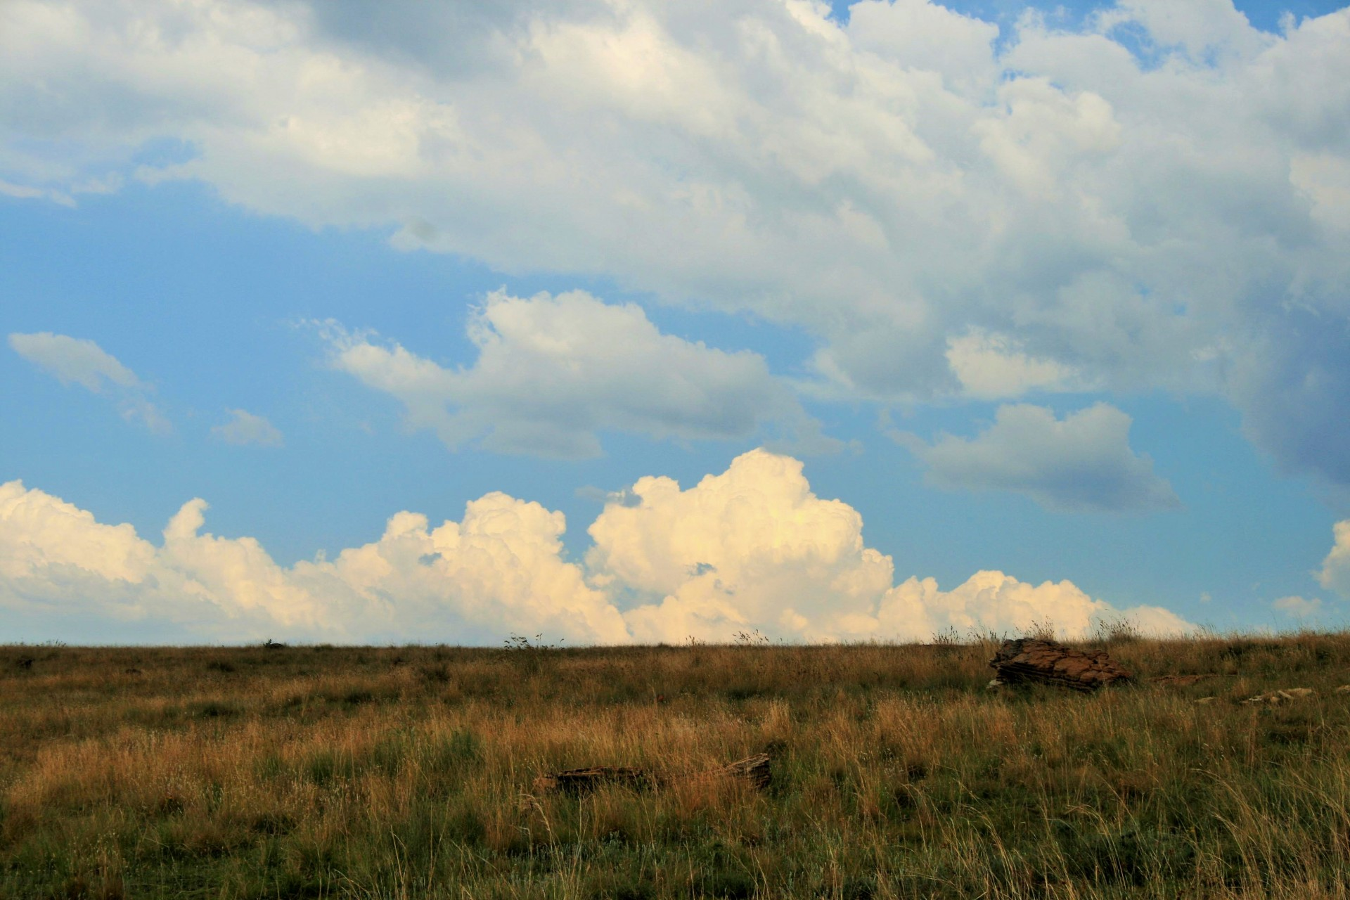
No Longer on the Horizon: Budget Cuts Are Here
June 2025: MSU asked all departments/units on campus to cut 9% over the next two years.
For the Libraries this meant cutting approximately $1.3 million for FY26, with approx. $1 million coming from the collections budget.
Across all collections, BizLib just a portion
Further cuts will be made for FY27, the amount is still being determined.

Slide 14

Approaching the Budget Cuts Head-On
How it Worked in Practice
Business Collections Librarian led our team's approach following discussion with Collections Strategist.
Business Collections Librarian created a spreadsheet of all Business Library subscriptions for us to rank each resource:
Can Stop
Use Caution
Essential to Keep
Unknown/Not my area
A notes field for comments, questions, and justification for your ranking
Photo by Annie Spratt on Unsplash

Slide 15
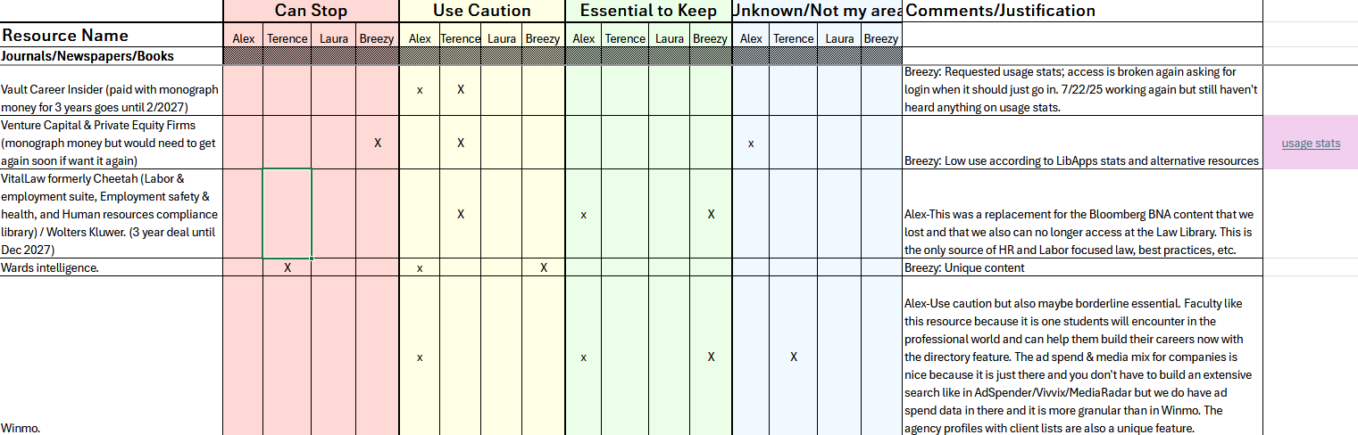
Collaborative Work is Essential

Slide 16
Teamwork Makes the Dreamwork
Business Collections Librarian
Procured usage stats
Set a deadline for our initial ranking/analysis
So important!
Together
Asked & answered questions as they came up
Met for review and discussion after the individual rankings
Talk through our choices, ask clarifying questions, firm up decisions

Slide 17
Observations as a Not-Super-Collections Focused Liaison
The Bad
Uncomfortable
Questioned my own expertise as subject librarian
Afraid of making the "wrong" choice
The Good
Collaboration
Close examination of the eResources
Timing
Summer project
Deadlines

Slide 18
Librarian (Magic) Hard Work!
Making collections cuts is challenging work
Especially if this is not your usual role
It is behind the scenes but also not
It is hidden until someone realizes you've made a choice that negatively impacts them then it is highly visible
Emotional labor
Someone is (probably) going to be unhappy with your choice(s)
And you will have to deal with that

Slide 19

Believe In Your Contributions
Remember your expertise
As subject librarian/liaison you know what is being used and what is not
Even if you think you don't know, you do!
Your interactions with faculty and students in your subject areas give so much knowledge

Slide 20
Thoughts for all librarians doing this work
Get comfortable with being uncomfortable
Still working on this ourselves
Communication!
You as a liaison are doing different work than a collections librarian & your calendar is different
Your role may be more public-facing
Different schedules, heavy workload periods
Communicate with your liaison departments about impactful decisions
No library jargon!

Slide 21
Communication is Key
Collections librarians
Communicate in advance with librarian partners
Be clear about your expectations
Be open and flexible.-
Deadlines may have to change
Workflows can be revised
Trust the insights that liaison/subject librarians have
"Clear is Kind. Unclear is unkind" -Brene Brown
Notes:
Communicate in advance with librarian partners
Be clear about your expectations
Be open to different workflows for getting the work done
Be flexible with deadlines but also set deadlines
Trust the insights that liaison/subject librarians have

Slide 22
Discussion Questions
Subject librarians in the room, when are your busiest times of the semester or academic year?
Collections librarians in the room, when are your busiest times of the semester or academic year?
Thinking about your busiest times, when do you want to be contacted with collections data/decisions/projects?
How much lead time do you need to work on collections projects? How far out should the deadline be?

Slide 23
Audience Questions
Thank you!!!

