Slide 1
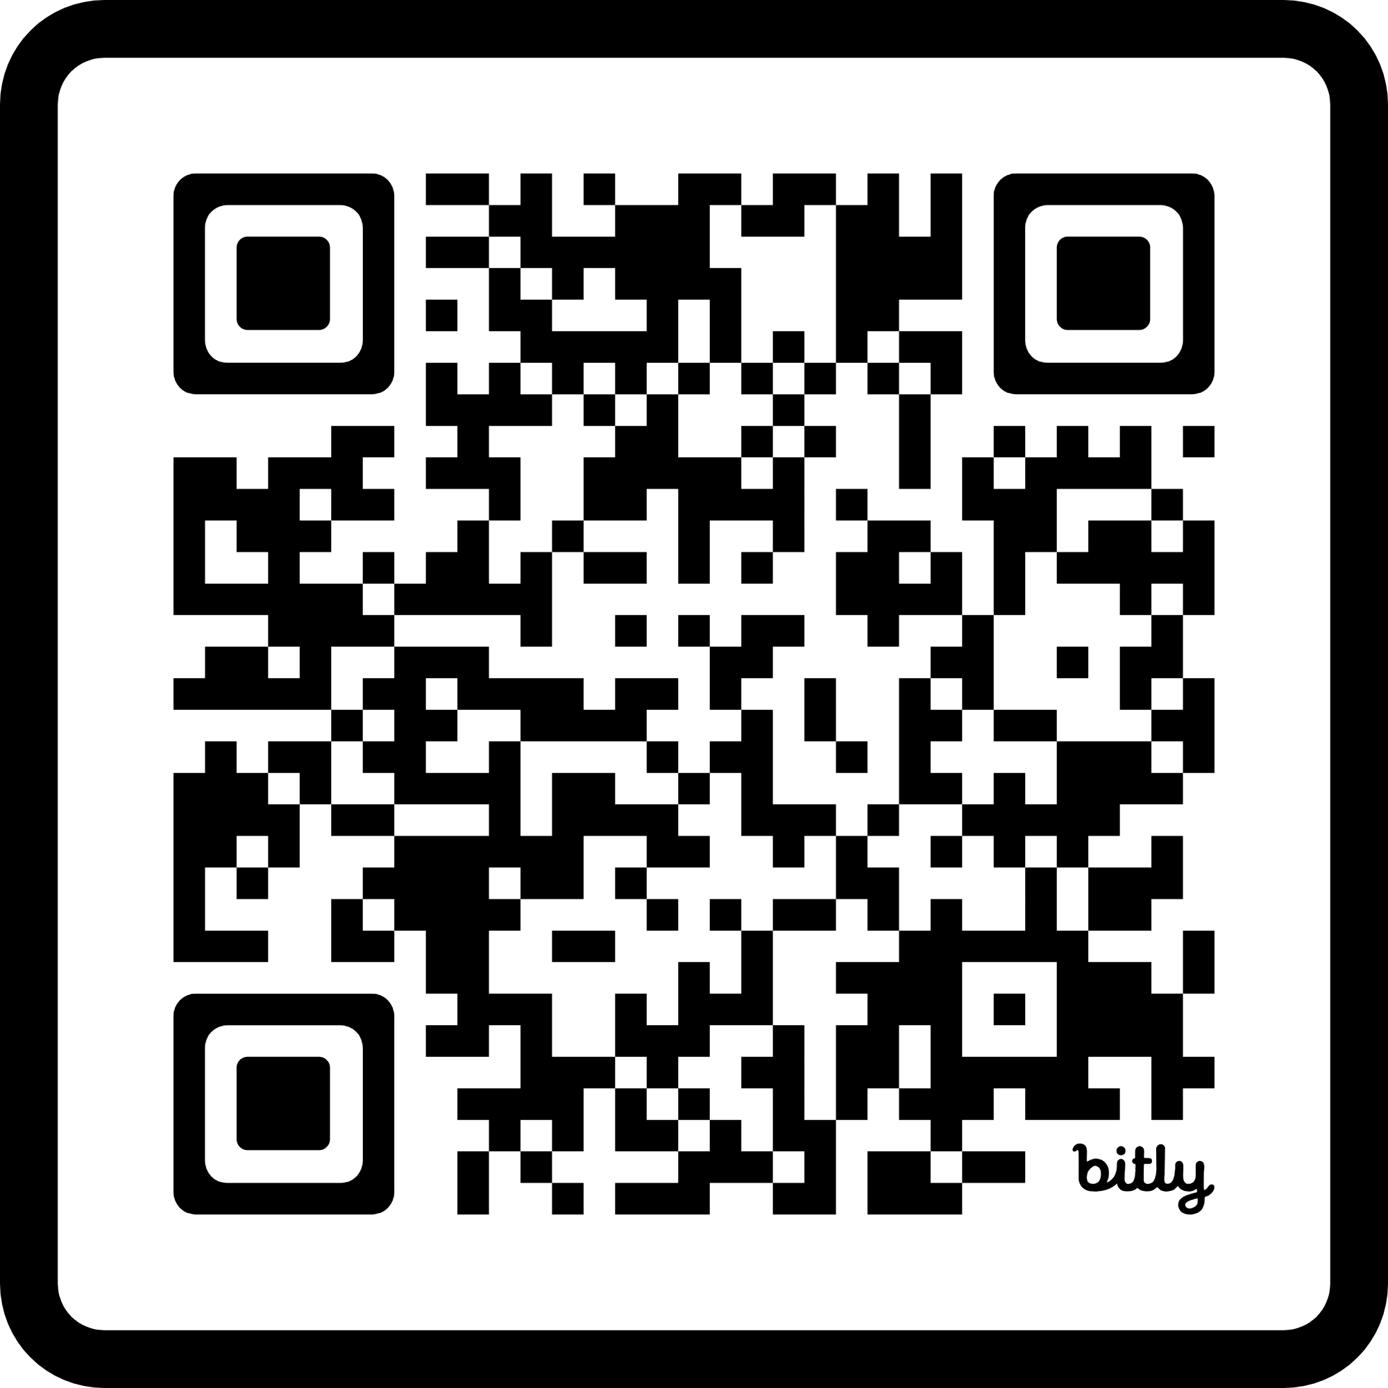
List of Active MiALA Interest Groups
Archives & Special Collections
Assessment
Cataloging and Metadata
Critical Librarianship
Distance and Online Learning
E-Resources
Early Career Library Professionals
Fine Arts
Health Sciences
Higher Education for Incarcerated Students
Instruction and Information Literacy
Librarian Scholarly and Creative Activity
Michigan Community College Libraries
Mid-Level Leadership
Open Educational Resources
Outreach
Upper-Level Leadership
Web/UX
Scan for details!

