Slide 2




Don’t Miss!
50/50 RAFFLE
Tickets are $1 each and can be purchased from Conni Strittmatter or David Dahl! The winner takes home half the pot.
SILENT AUCTION
Visit the Silent Auction in the exhibitor hall to place your bids before 10 a.m. on Friday, May 8th.
PUB QUIZ
Thursday, May 7
8:00 – 10:00 p.m.
Choptank Ballroom
KARAOKE
Thursday, May 7
6:00 – 10:00 p.m.
Windjammer

Slide 3

Maryland State Library Agency:
Impact, Innovation, and What’s Next
Morgan Lehr Miller, MLIS
Maryland State Librarian

Slide 4

A Statewide System, Designed for Impact
24 Public Library Systems
3 Regional Library Systems
State Library Resource Center
Library for the Blind and Print Disabled
Deaf Culture Digital Library
Governor’s Young Readers Program
County Library Capital Grant Program
Library Associate Training Institute

Slide 5
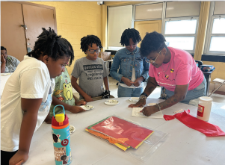
Maryland Libraries by the Numbers
17.2 million visits
53.1 million items borrowed
3.49 million questions answered
2.7 million program attendees
$380M+ in library funding

Slide 6
What’s behind the numbers?
👉 Trend: Physical and digital borrowing together sustain high overall usage—libraries are not “losing” circulation; it’s diversifying,
👉 Trend: Libraries have firmly reestablished themselves as physical community hubs as in-person visits continue to increase
👉 Trend: Programming is a key driver of engagement.
👉 Trend: Youth services are a dominant and a growing share of library impact.
👉 Trend: Libraries remain essential infrastructure for internet access and digital equity.
👉 Trend: States and localities are reinvesting in library infrastructure, aligning with rising in-person use.
👉 Trend: Hybrid library model is here to stay
Physical visits ↑ + Digital use ↑ = not a tradeoff, but expansion.

Slide 7
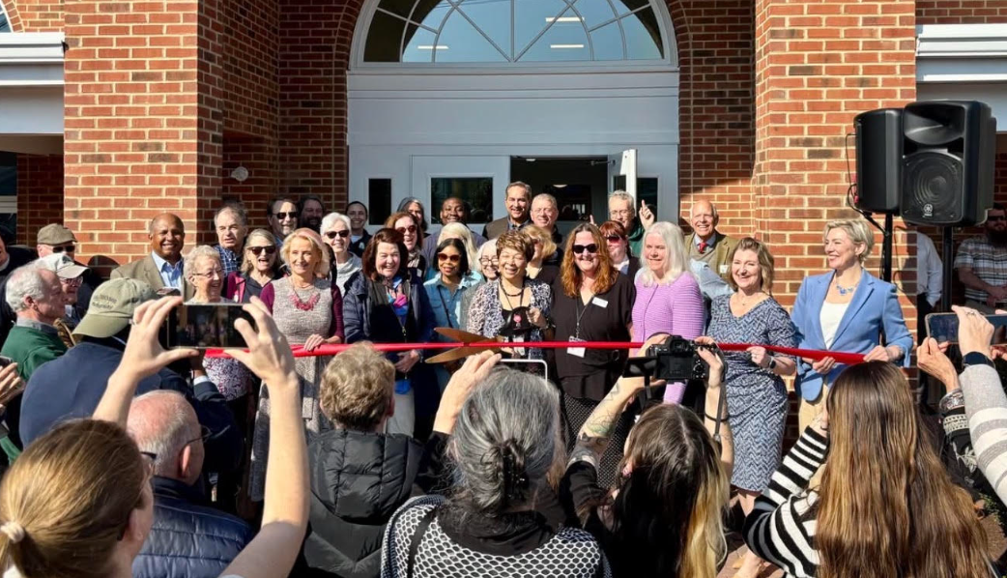
Libraries are Critical Public Infrastructure
~$500M invested since 2008 in library infrastructure through the
  MSLA County Library Capital Grant Program
$12.8M dedicated this year for new/renovated libraries in 8 counties
New/renovated spaces in 2026:
Friendsville (Garrett County)
St. Michael’s (Talbot)
Pocomoke (Worcester)

Slide 8

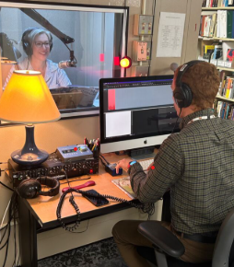

Accessibility & Inclusion Leadership

Slide 9

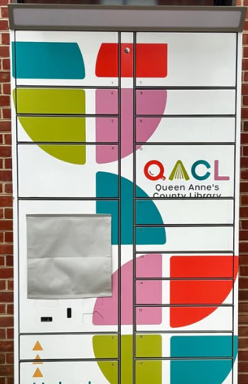
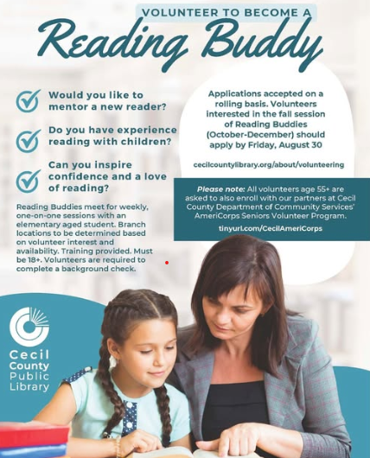
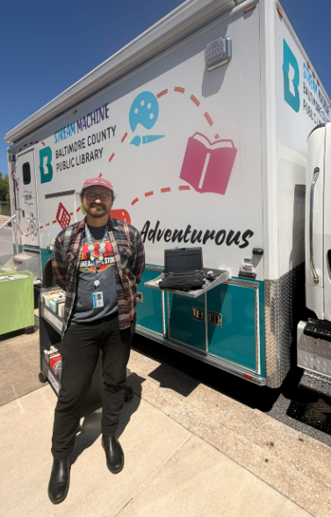
Empowering Innovation Across Maryland
$1.7M annually in federal IMLS funds brokers statewide training and development resources, staff development grants for every library system to support MLA conference attendance, strategic and facilities planning, and locally responsive innovation grants. Local innovation grants supported everything from outreach vehicles and study pods to AI training, workforce development initiatives, literacy mentoring, digitization projects and arts programs.

Slide 10
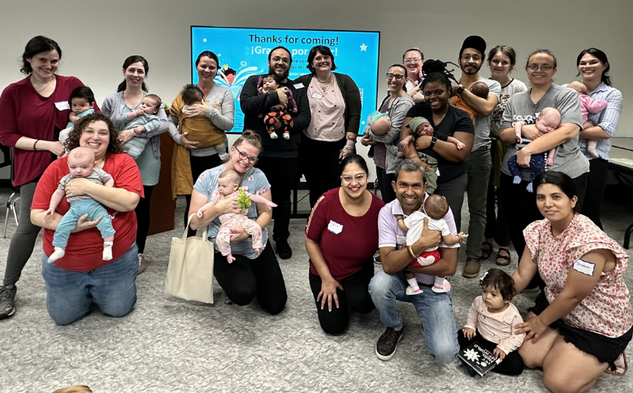
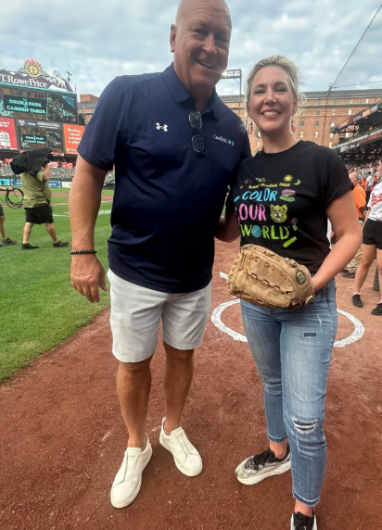
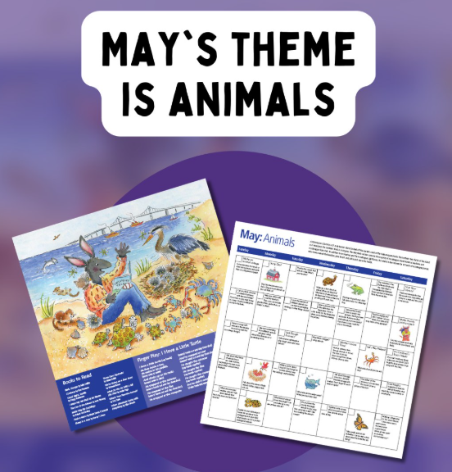

Early Literacy & Youth Impact
Hatchlings Program
Day-by-Day
Early Literacy Calendar
Governor’s Young Readers’ Program
Summer Reading & Learning Program

Slide 11
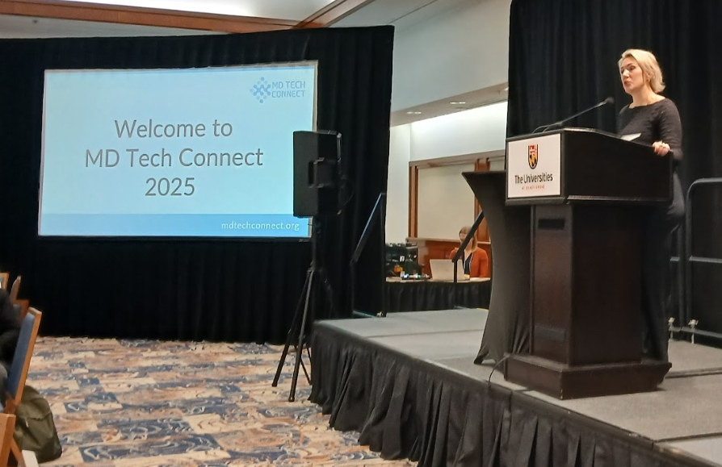
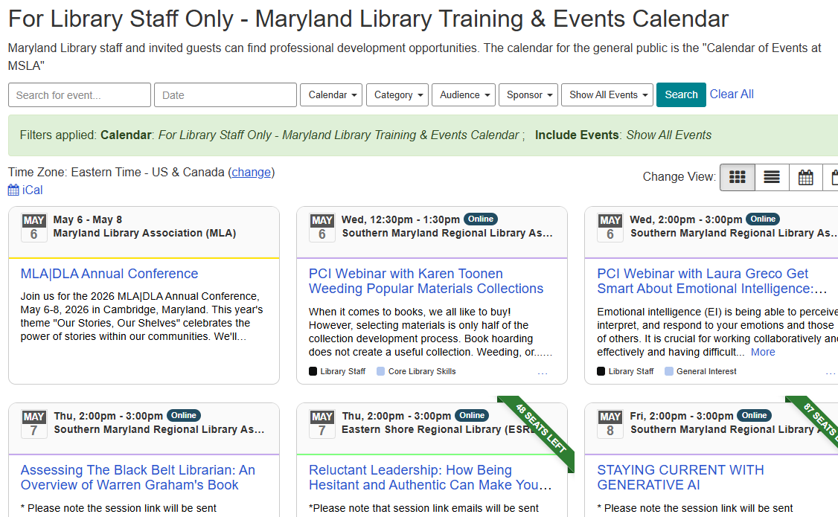
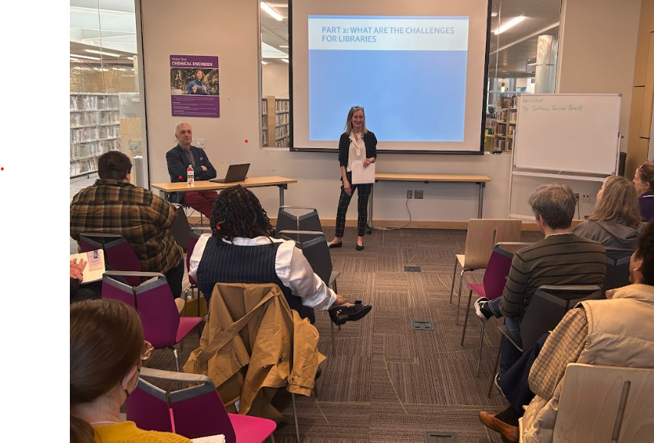
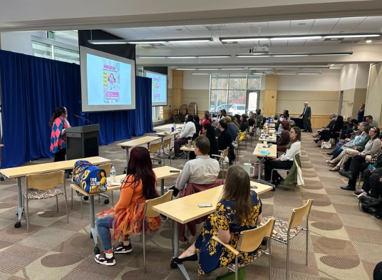
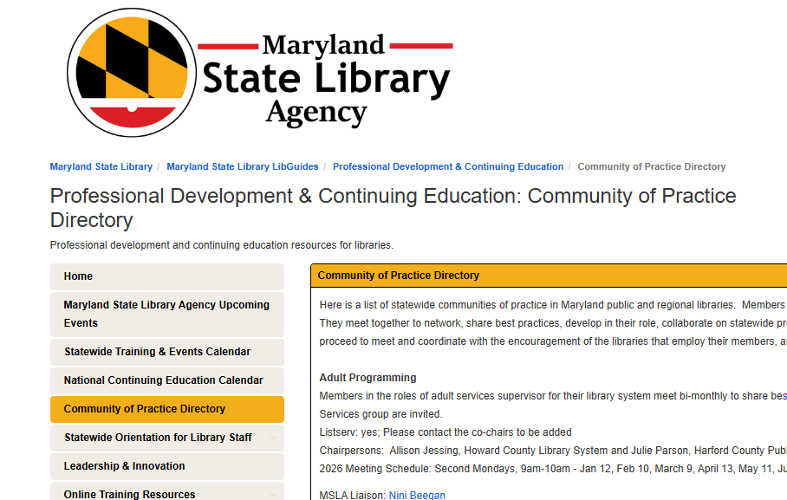
Workforce and Library Development Impact
LATI, Tech Connect, Emerging Adults Summit, Teen Connect, Communities of Practice, LIBCAL!

Slide 12


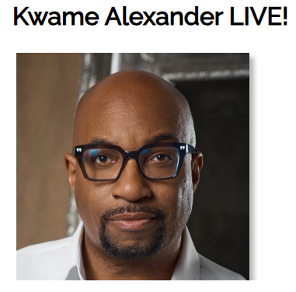
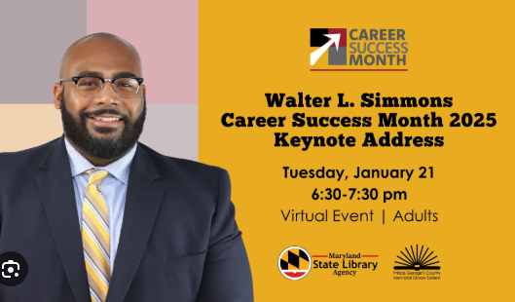
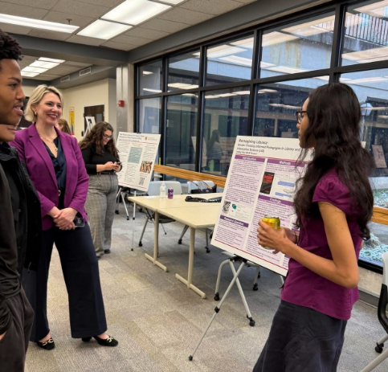

Statewide Partnerships

Slide 13
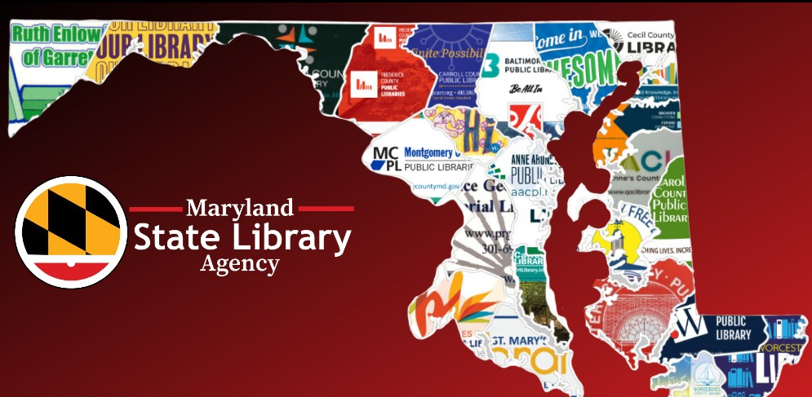
Looking Ahead
Save the Date! Library Literacy Summit- October 6th at the Elkridge Branch (Howard County)
Support for Youth Representatives Serving on Boards of Trustees
Enhanced Training and Development for Trustees, Friends, and Foundations
Increased and Enhanced training and programs from the Deaf Culture Digital Library
Development of a Statewide Master Plan for Library Facilities

Slide 14
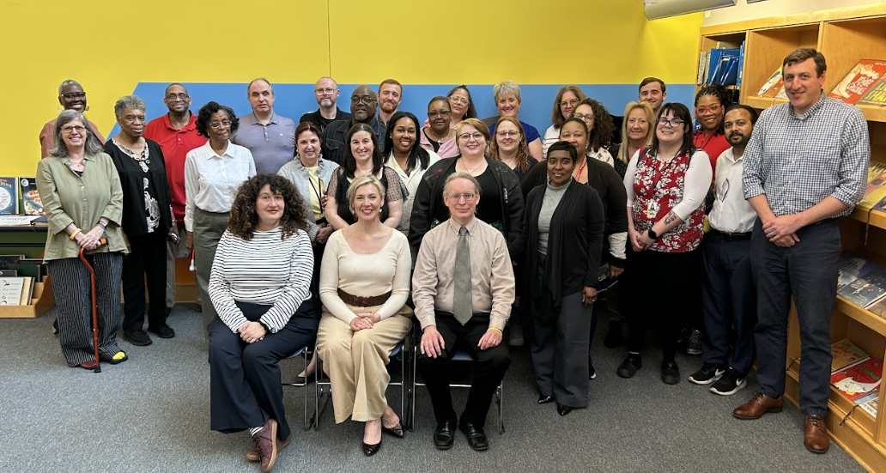
Thank you!
morgan.miller1@maryland.gov

Slide 15
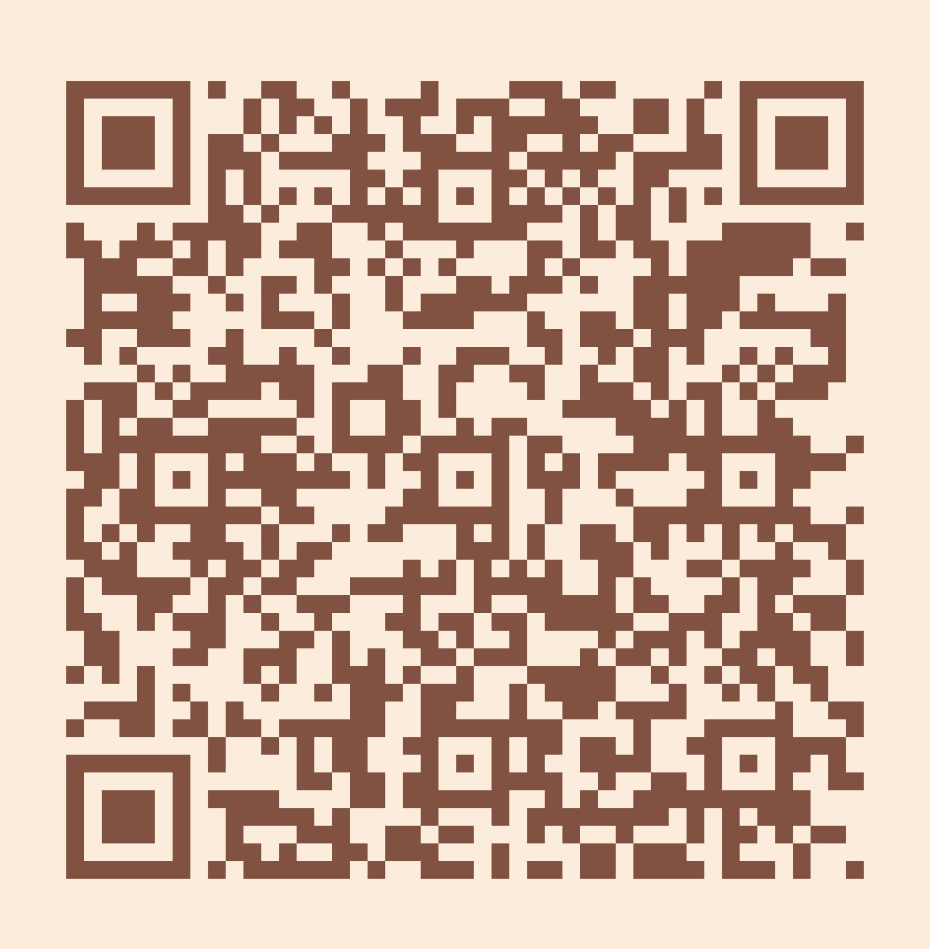
Please take a moment to complete the program survey.
SCAN ME!

