Slide 2




Don’t Miss!
50/50 RAFFLE
Tickets are $1 each and can be purchased from Conni Strittmatter or David Dahl! The winner takes home half the pot.
SILENT AUCTION
Visit the Silent Auction in the exhibitor hall to place your bids before 10 a.m. on Friday, May 8th.
PUB QUIZ
Thursday, May 7
8:00 – 10:00 p.m.
Choptank Ballroom
KARAOKE
Thursday, May 7
6:00 – 10:00 p.m.
Windjammer

Slide 3
From Circle Time to Story Time:
Bringing Classroom Strategies to the Library
PRESENTER:
Hilary Fudge

Slide 4
Who am I?
Youth Services Coordinator at the Bridgeville Public Library, a role I have held for over 5 years. I am currently in my second year serving as Vice President of the Youth Services Division of the Delaware Library Association. Although this is my first paid position in a library, my connection to libraries began in high school when I volunteered at my local branch to fulfill my National Honor Society service hours.
Before joining the library world, I spent more than 16 years working with children as a nanny, daycare provider, and preschool teacher. I love bringing my educational background into my story times and children's programs. In addition to leading story times, I plan all teen and family programs and strives to offer creative, and engaging activities for patrons of all ages.

Slide 5
Objectives:
• Examine how young children learn - Why things work
• Explore strategies supporting classroom-style routines (hello/goodbye rituals, visual schedules, movement, engagement, etc.)
• Learn techniques for managing group behavior and gain ideas for interactive transitions and activities.
• Share concerns/questions and Celebrate successes

Slide 6
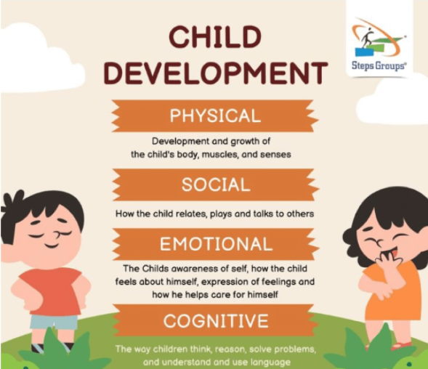
Understanding Early Childhood Development (Ages 3–6)
Key Developmental Areas
•Cognitive Development: Kids this age are learning through play, repetition, and routine.
•Social-Emotional Development: They are learning how to manage emotions, take turns, and express needs.
•Language Development: Vocabulary is exploding; they’re learning narrative structure and conversation.
•Physical Development: Gross and fine motor skills are still developing. Sitting still is hard!
Takeaway:
Children aren’t misbehaving, they’re learning how to behave.

Slide 7
Questions/Comments?

Slide 8
How preschool teaching strategies can support developmental appropriateness in story time
why foundation - why kids act the way they do, and why certain strategies help.
•Short attention spans
•Need for routine and predictability
•Still developing self-regulation and social skills
•Learn best through movement, repetition, and play
•Why classroom strategies translate well to the library
•Both settings require group management and engagement
•Kids don’t understand the “rules change” in different settings unless explicitly taught

Slide 9
Questions/Comments?

Slide 10
Explore strategies supporting classroom-style routines (hello/goodbye rituals, visual schedules, movement, engagement, etc.)
how-to of setting up storytime in a developmentally appropriate way.
Include:
•Storytime routine examples:
•Welcome song
•Story → movement → story → song or activity → goodbye song
•Why routines work (based on brain development)
•Build emotional safety
•Help with transitions and attention
•Hello/goodbye rituals
•Same song or action each time = predictability
•Use of visual aids
•Visual schedule with images or icons
•Use props to signal what's next (e.g., a puppet brings out the storybook)
Practical Tips:
•Keep transitions short but consistent
•Use the same phrasing each week ("It’s time to sit for our first story!")
Bonus Tools to Share:
•Sit spot ideas (dots, carpets, etc.)

Slide 11
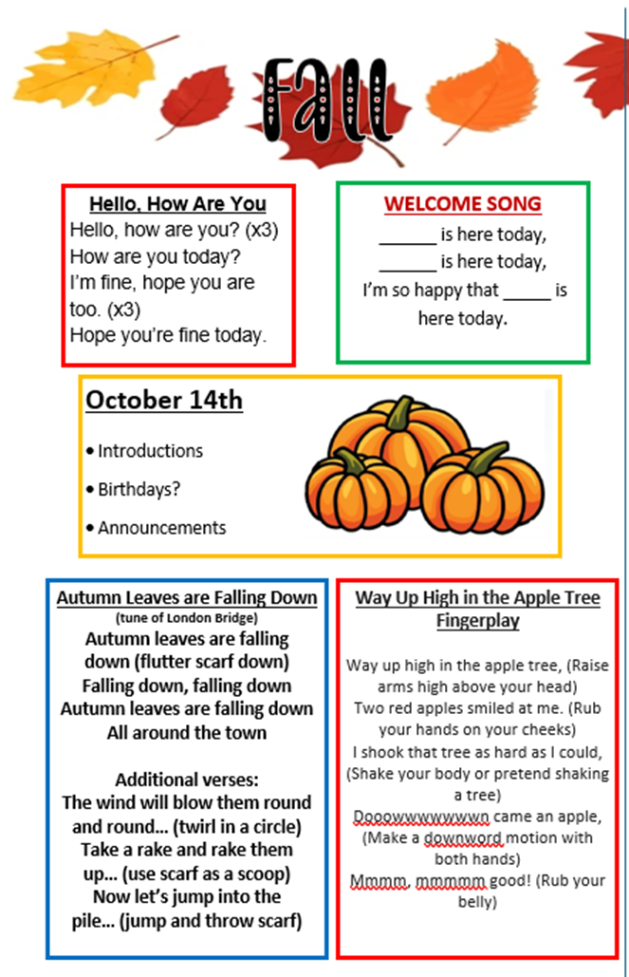
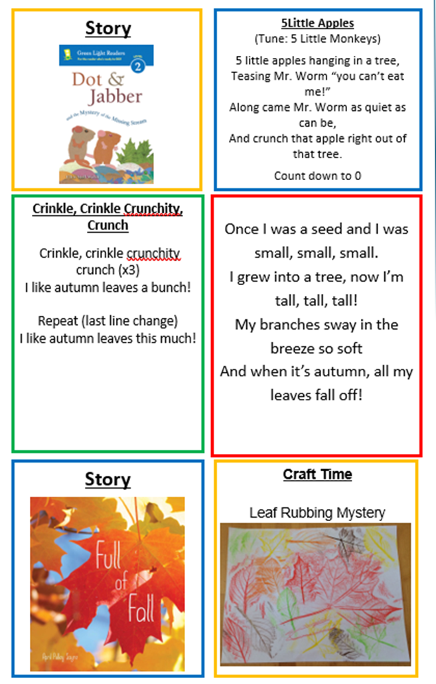
Example:

Slide 12
Learn techniques for managing group behavior and gain ideas for interactive transitions and activities
•Understanding behavior as communication
•Tantrums, wandering, shouting = unmet needs or unclear expectations
•Positive phrasing
•“Use your walking feet” instead of “Don’t run”
•Classroom-style behavior tools:
•Use songs to cue cleanup, sitting down, or transitions
•Countdown: “5 more minutes until clean-up”
•Puppets or props to model behavior
•Managing the wiggles
•Movement breaks
•Fingerplays, scarves, dancing
•Calming strategies
•Breathing activities
•Soft music or fidget items
Transition Examples:
•Use a “transition song” between activities (e.g., “If You’re Happy and You Know It, Take a Seat”)
•Scarves or parachute to change focus
between active and quiet activities

Slide 13
Questions/Comments?

Slide 14
Wrap Up
Keep in mind that these are just suggestions.
You know your storytime audience best, and not everything I’ve shared will work for every group.
Feel free to experiment, adapt, and change things as needed. There’s no single right way to do this.

Slide 15
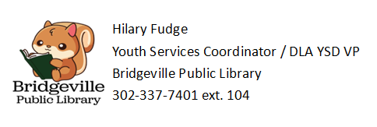
Thank you!

Slide 16

Please take a moment to complete the program survey.
SCAN ME!

