Slide 2




Don’t Miss!
50/50 RAFFLE
Tickets are $1 each and can be purchased from Conni Strittmatter or David Dahl! The winner takes home half the pot.
SILENT AUCTION
Visit the Silent Auction in the exhibitor hall to place your bids before 10:45 a.m. on Friday, May 8th.
PUB QUIZ
Thursday, May 7
8:00 – 10:00 p.m.
Choptank Ballroom
KARAOKE
Thursday, May 7
8:00 – 11:00 p.m.
Windjammer

Slide 3
Thinking Money For Kids: Financial Literacy Programs for Children from ALA and FINRA
PRESENTERS:
Stacey Freedman, Children’s Instruction & Research Supervisor, Howard County Library System - Miller Branch
Rebecca Maron-Ryan, Youth Services Librarian, New Castle County Libraries - Claymont Library

Slide 4
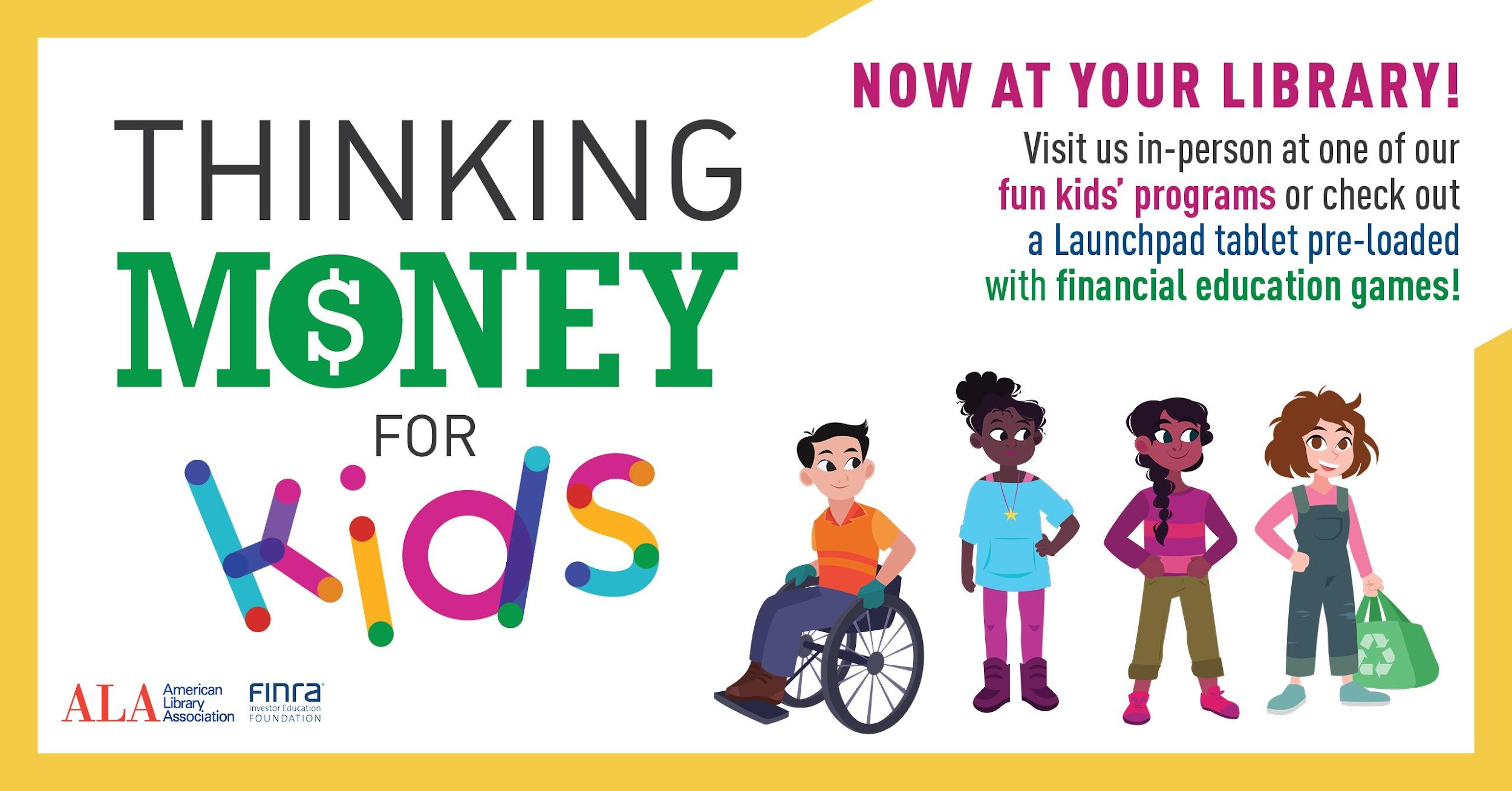
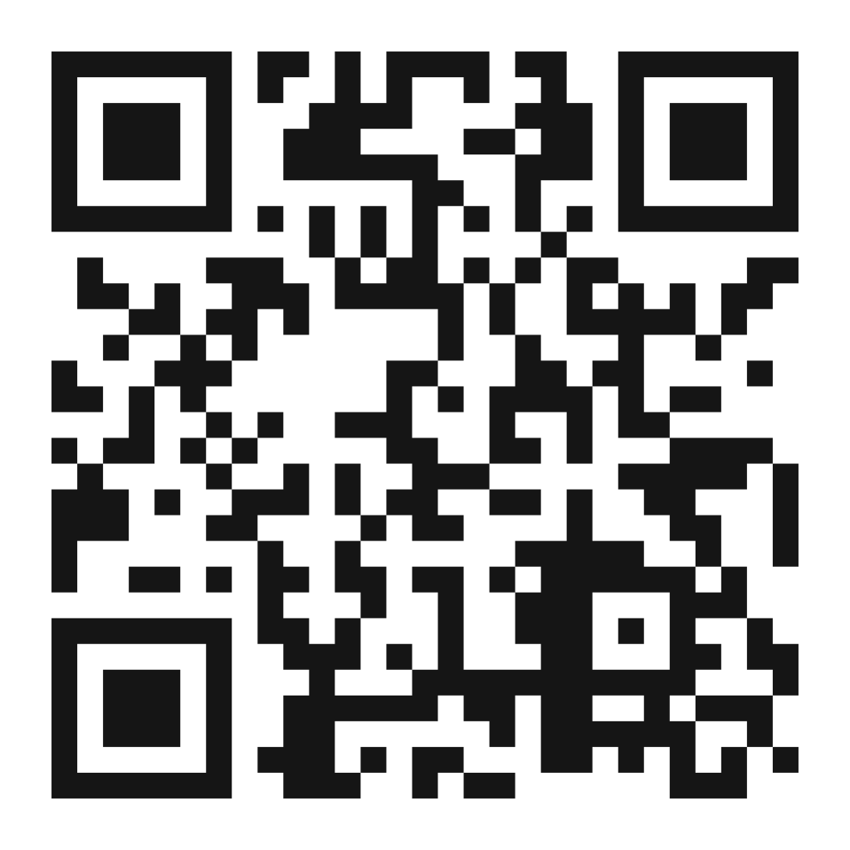
Thinking Money For Kids Library Support Materials
https://www.ala.org/tools/programming/thinking-money-kids/programkit/grantee-materials
General Info, Program Kit Contents, Publicity, Financial Education Resources, Training Videos

Slide 5
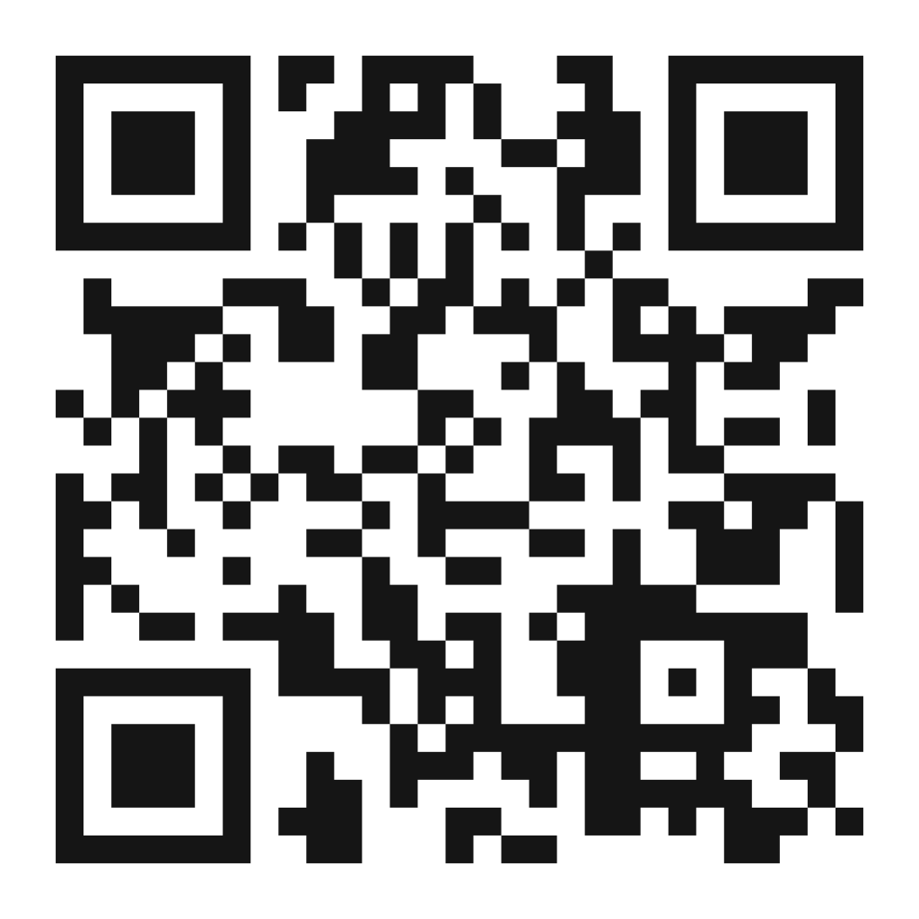
What is Thinking Money For Kids?
“With free resources from ALA and the FINRA Investor Education Foundation, libraries can teach children and their parents, caregivers, and educators about financial topics — like saving, spending, sharing, and budgeting — in a way that is both meaningful and fun.”
Description from https://www.ala.org/tools/programming/thinking-money-kids
Five Games/Activities that teach concepts of financial literacy:
Currency Conga
Piggy Bank Theater
Making Mooo-lah
Penny Pinchers’ Party
Pet Cents
https://www.ala.org/tools/programming/thinking-money-kids/programkit/grantee-materials/kit-
contents

Slide 6
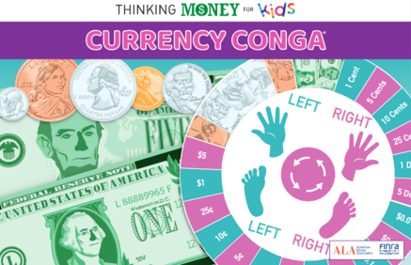
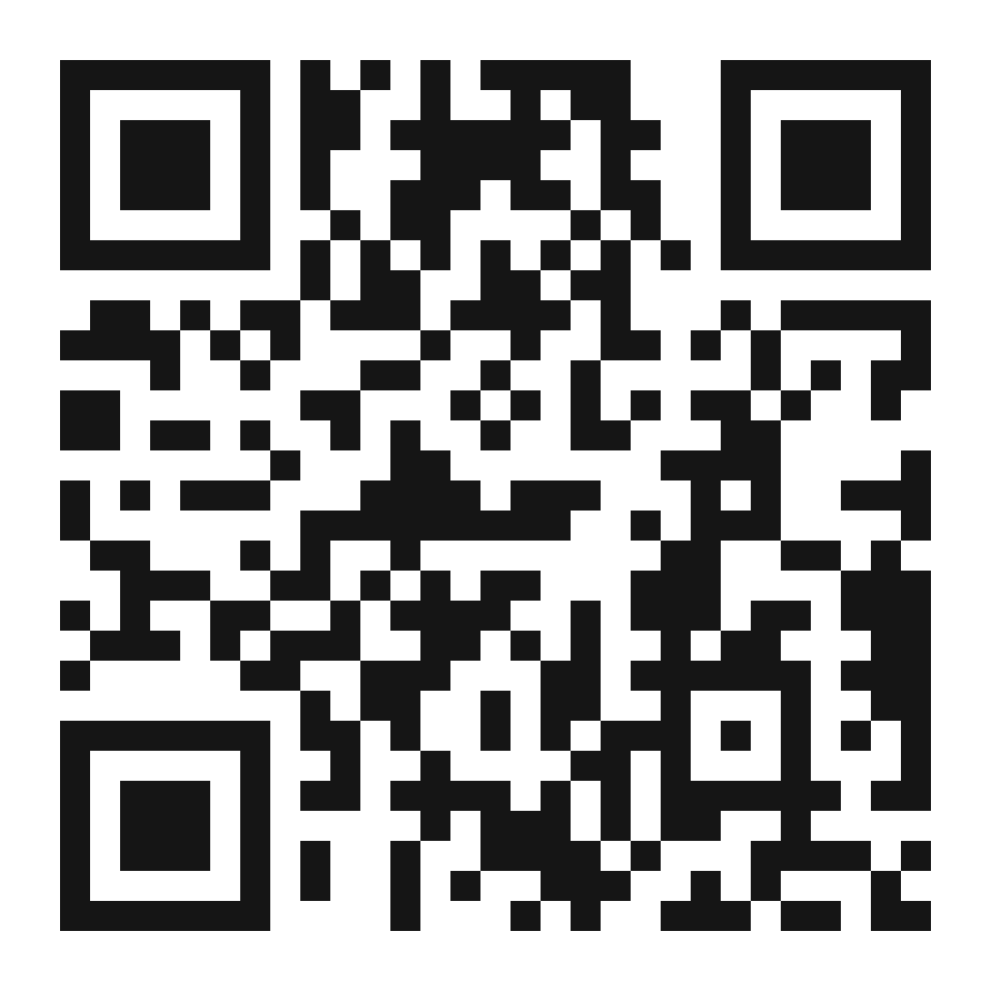
Currency Conga!
Essentially a money-themed version of the game Twister
At the flick of a spinner, players vie for space on a vinyl mat as they attempt to touch the correct coins and bills — and improve their currency recognition and money math skills in the process. There are two ways to play depending on the age and skill level of your group: for a younger crowd, explore real coins (included) and discuss what they are worth, then spin the Identifying Currency spinner to test their skills; for older kids use the Money Math spinner to challenge with addition, multiplication, and percents.
https://www.ala.org/tools/programming/thinking-money-kids/programkit/grantee-materials/kit-contents#currency

Slide 7
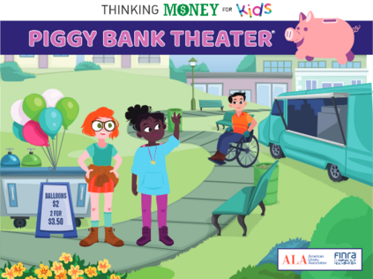
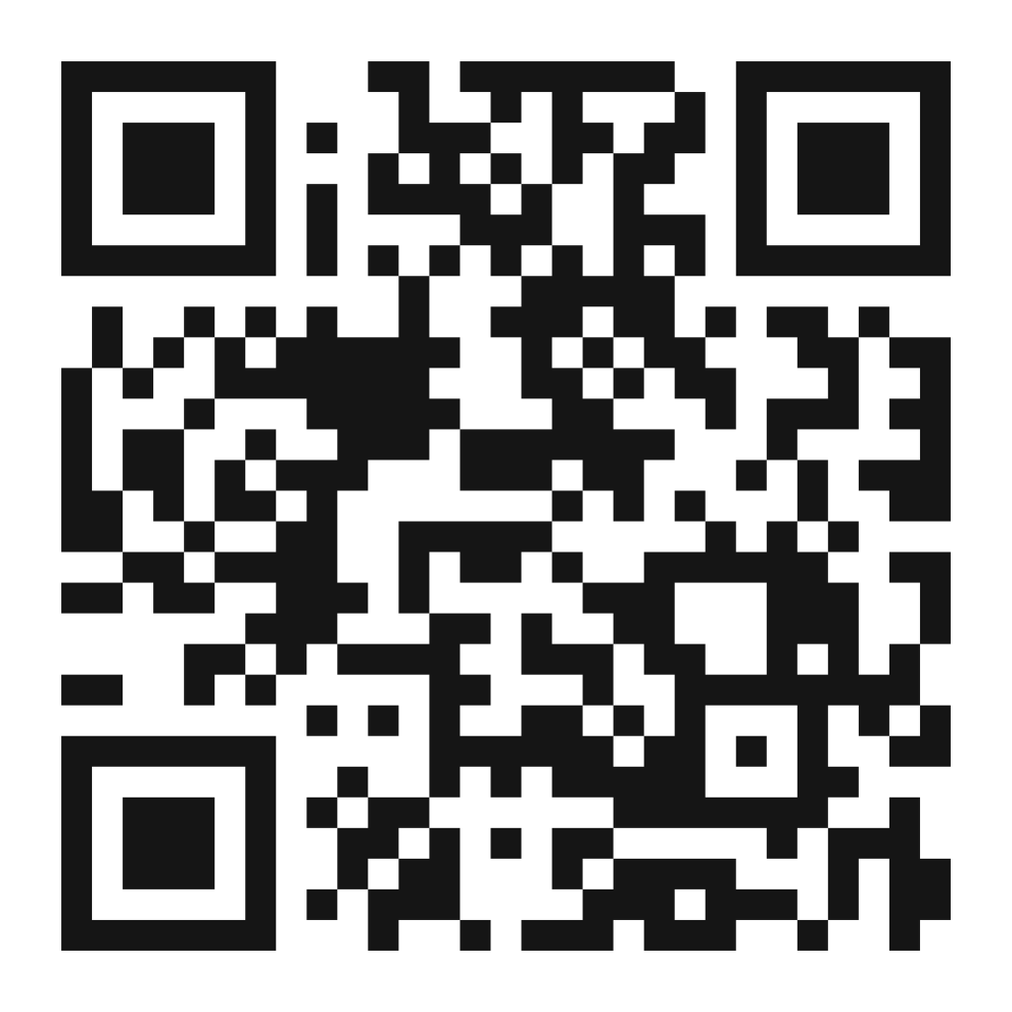
Piggy Bank Theater
A scripted story-time about earning money, spending money, and saving money
In this twist on the classic storytime, audience members learn how three young characters — Kenji, Grace, and Emma — build their childhood interests into successful careers, making financial choices along the way. During the story, audience members are encouraged to respond whenever a character earns, spends, or saves money by raising a paddle (for earning and spending) or by cueing the facilitator to put a toy coin in the piggy bank (for saving).
Basic premise can be adapted to use with other stories involving earning/spending/saving, but there is a digital version of this actual story available for download
https://www.ala.org/tools/programming/thinking-money-kids/programkit/grantee-materials/kit-contents#piggy

Slide 8
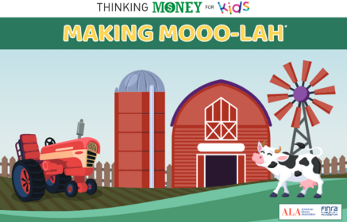
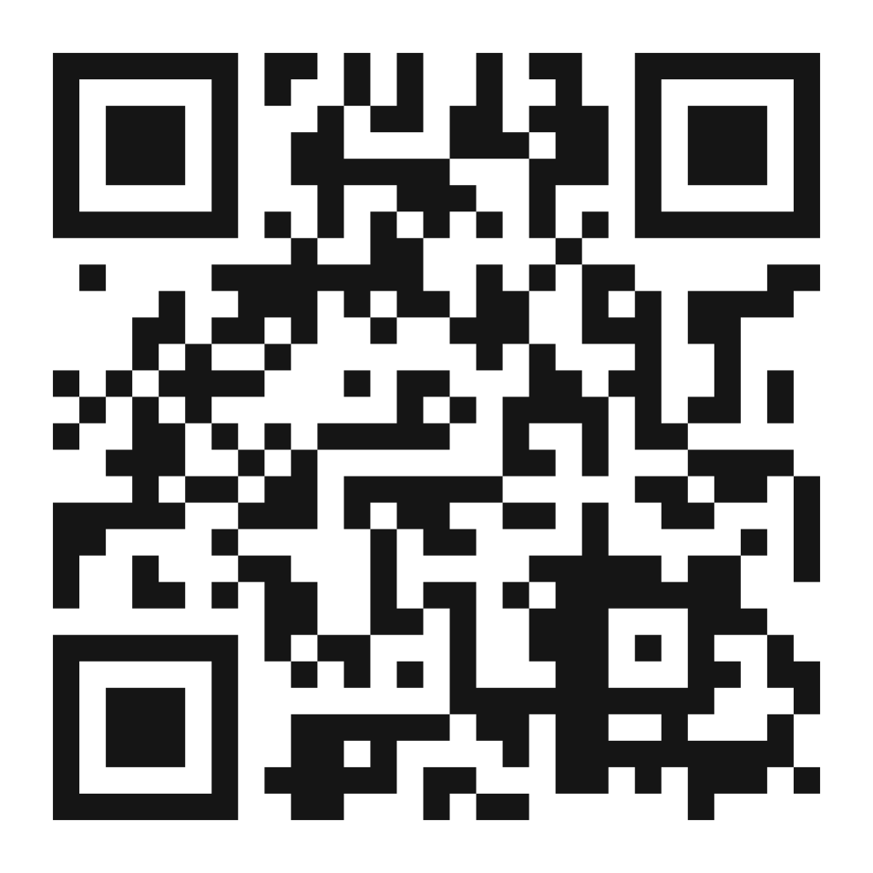
Making Mooo-lah
A game about running a farm over the span of one in-game year
Welcome to the farm! In this collaborative simulation, players work together to see if they can run a financially successful farm. Players take turns rolling the die and moving their bodies through a life-size game board. Depending on where they land, they might buy something for the farm, sell their crops at the farmers’ market, pay taxes, or face an unexpected event. Starting with $200 in their bank account, can the team turn a profit in 12 months?
Full physical game is life-size, players actually stand on floor mats and move around giant game board. Online materials can be easily adapted for tabletop play (which frankly would be significantly easier to set up)
https://www.ala.org/tools/programming/thinking-money-kids/programkit/grantee-materials/kit-contents#mooo

Slide 9
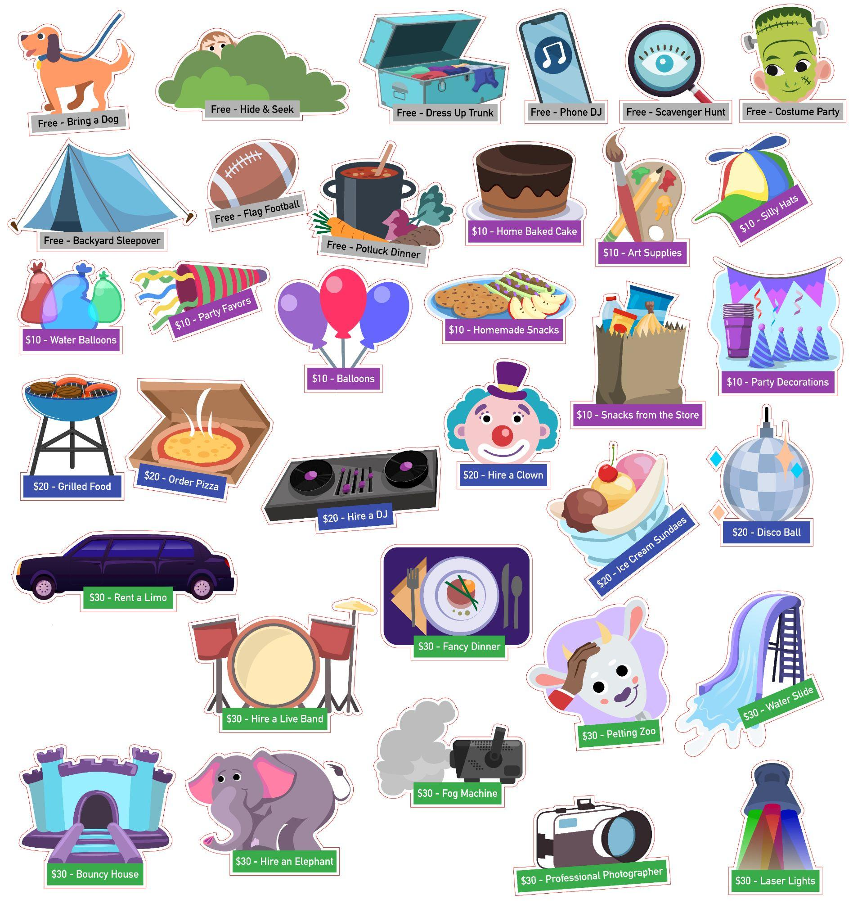
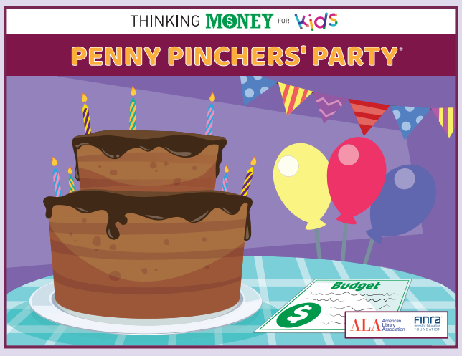
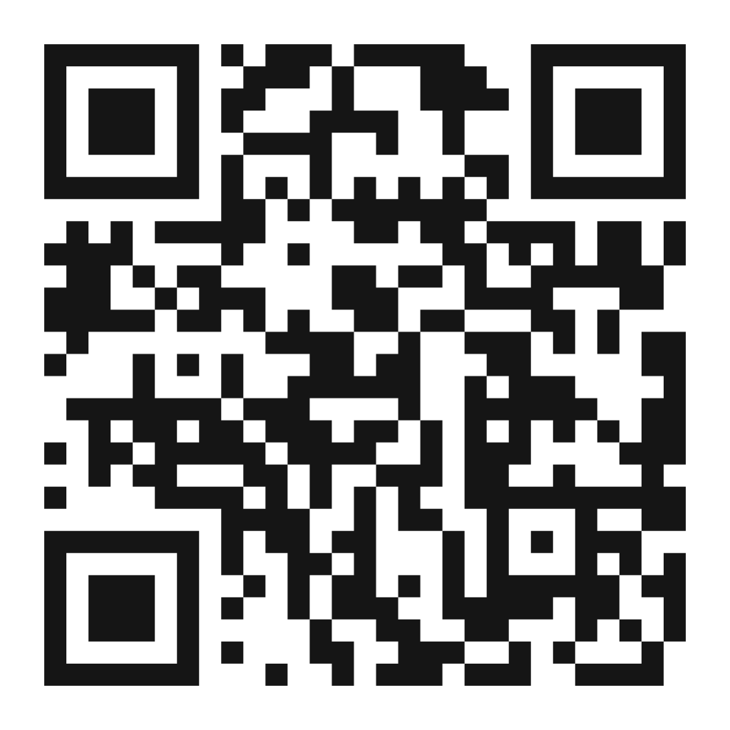
Penny Pinchers’ Party
Planning a party and staying within butdget
Kids become party planners, creating Planning Boards for their clients while staying on budget. With a budget of $100, the players take turns selecting items from a party warehouse managed by the program facilitator. After five turns, players share their plans with the group and explain their choices. The facilitator, or the group as a whole, may opt to select a Party Champion — the participant who plans the most entertaining or creative party while keeping expenses within budget
https://www.ala.org/tools/programming/thinking-money-kids/programkit/grantee-materials/kit-contents#penny

Slide 10
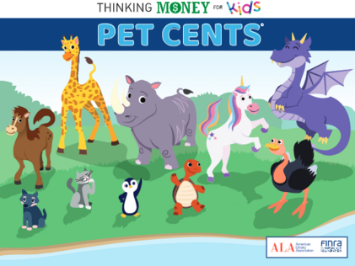
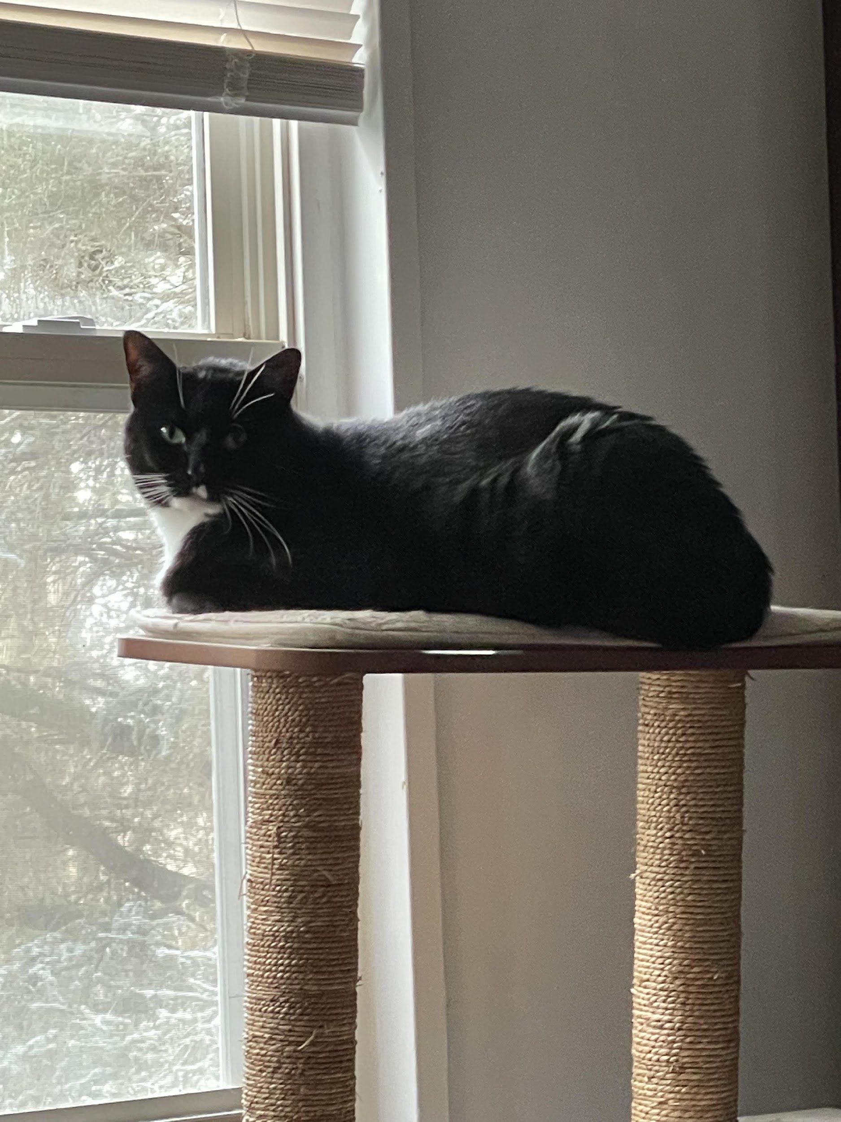
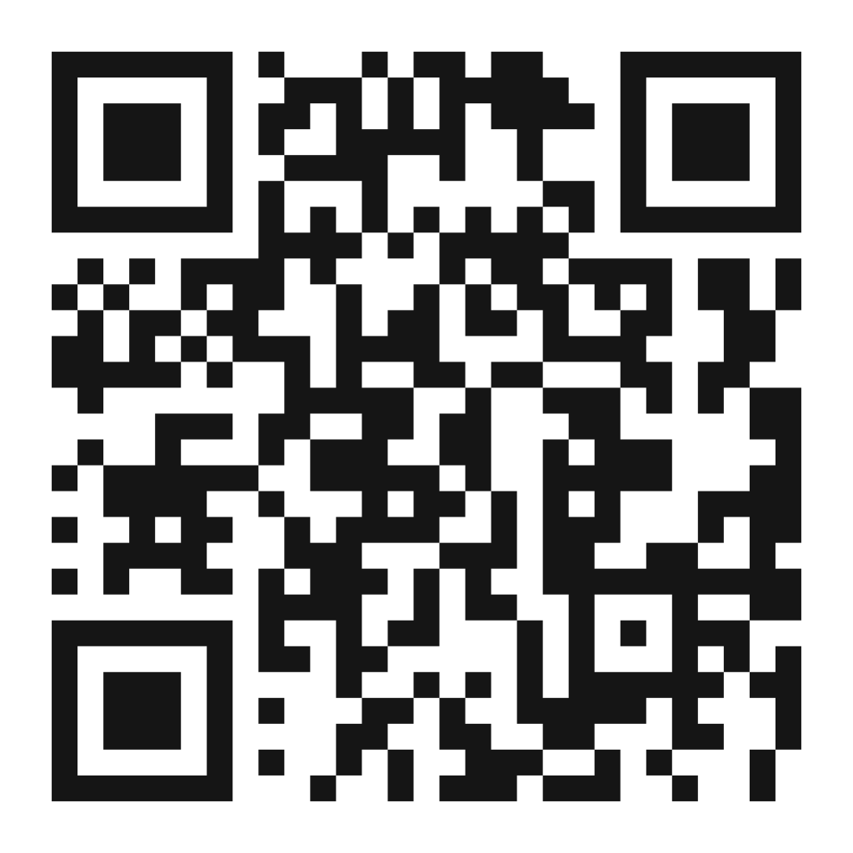
Pet Cents
How much does pet ownership cost?
Players adopt a pet — and take on the financial responsibilities of pet ownership — as they visit various stations. At each stop, players engage in financial transactions with an assistant/cashier (i.e., an adult or older kid), spending and receiving money until the timer runs out. Along the way, they are faced with unexpected events that could result in a financial windfall or expense. All transactions are tracked on the player’s Pet Card. The goal of the game is to meet a pet’s needs while retaining as much money as possible.
https://www.ala.org/tools/programming/thinking-money-kids/programkit/grantee-materials/kit-contents#pet

Slide 11
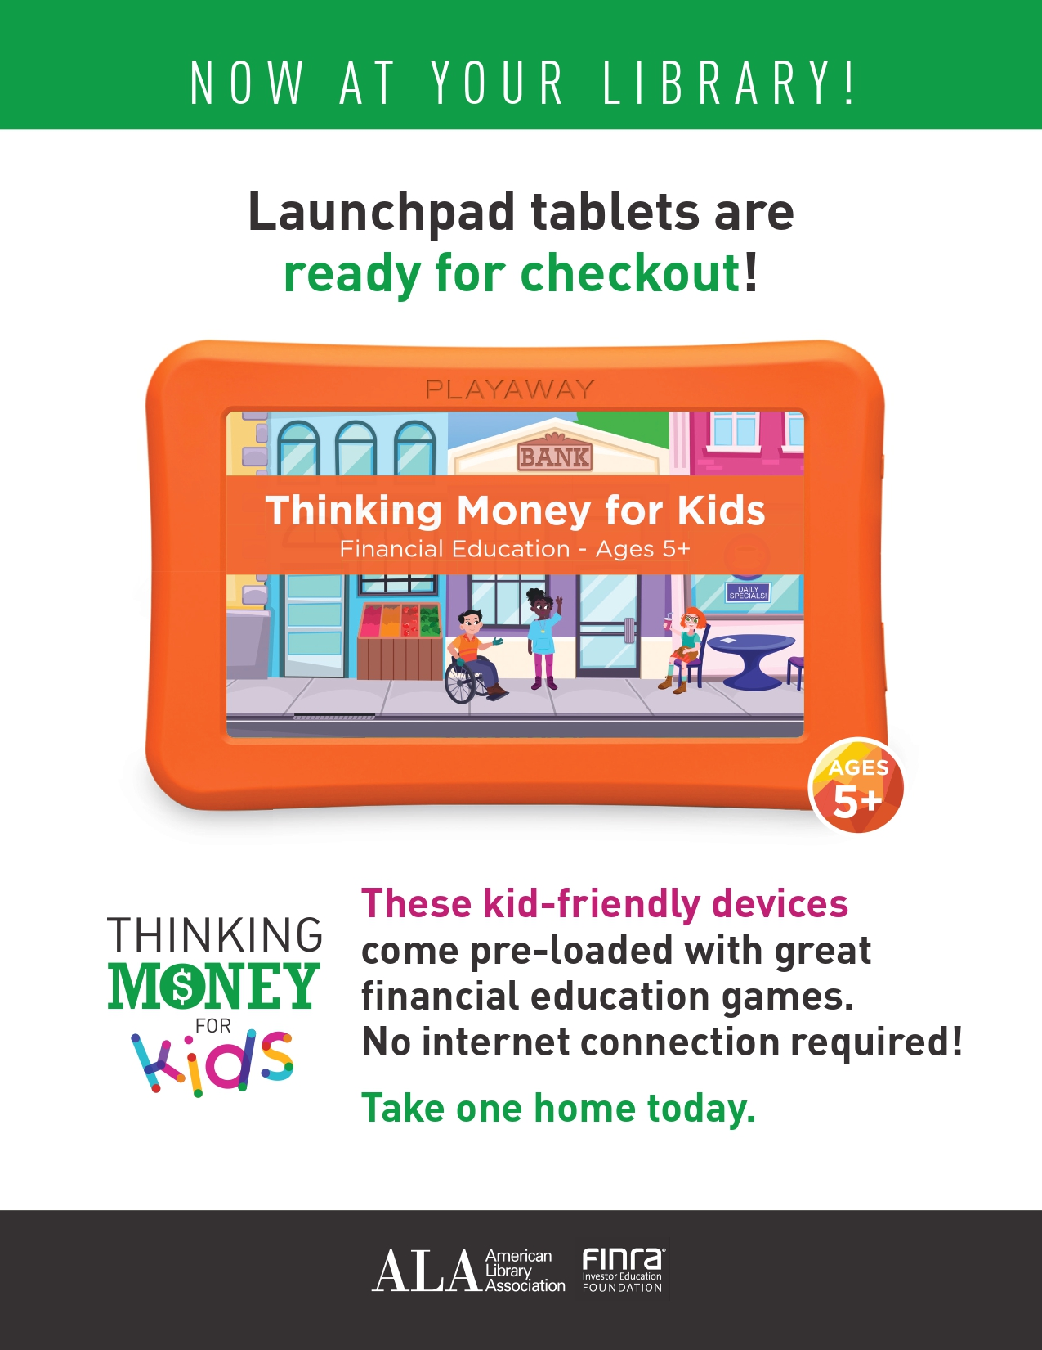
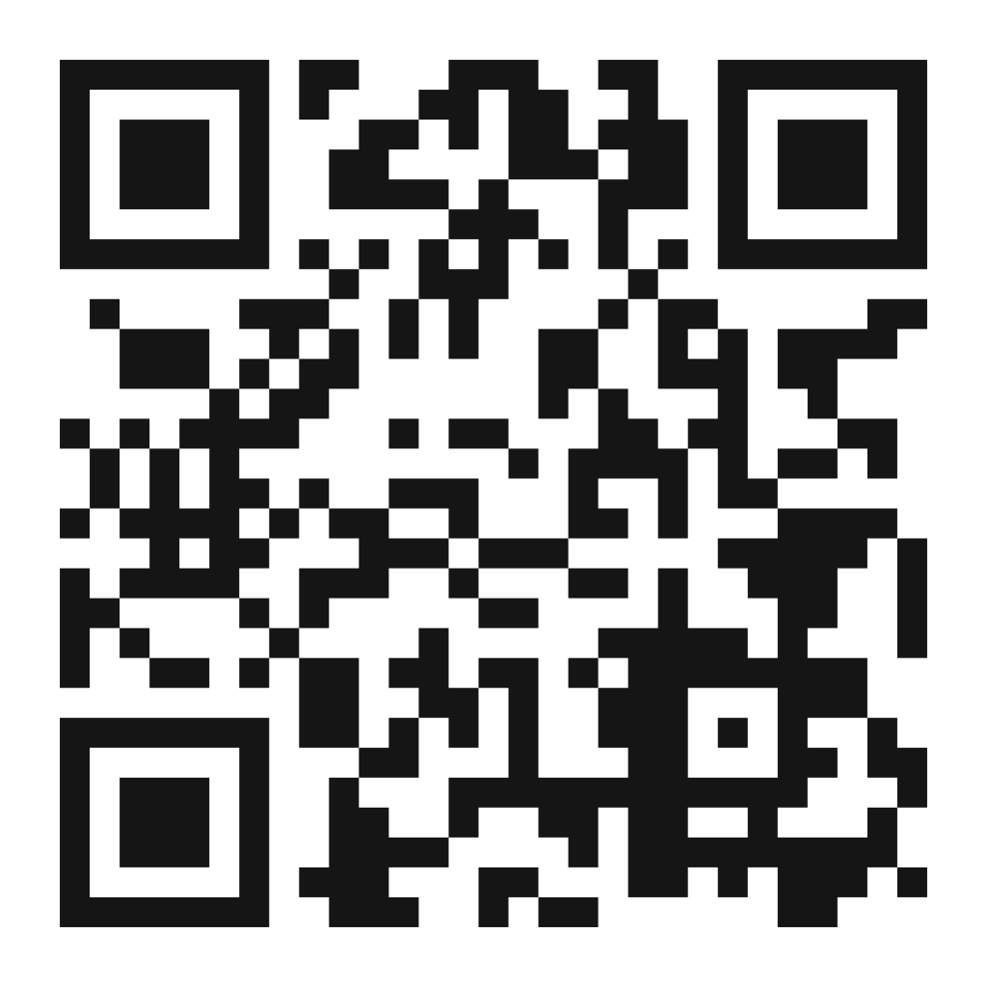
Launchpads and Online Games
For Delaware–Claymont Library has five Launchpads to circulate containing digital versions of the five activities
For Maryland–Howard County Libraries has five to circulate as well
Online versions of the games (plus more!): https://tm4k.ala.org/

Slide 12
Thank you!
CONTACT INFO:
Stacey Freedman - stacey.freedman@hclibrary.org
410-313-1980
Rebecca Maron-Ryan - rebecca.maron-ryan@newcastlede.gov
302-395-5907

Slide 13
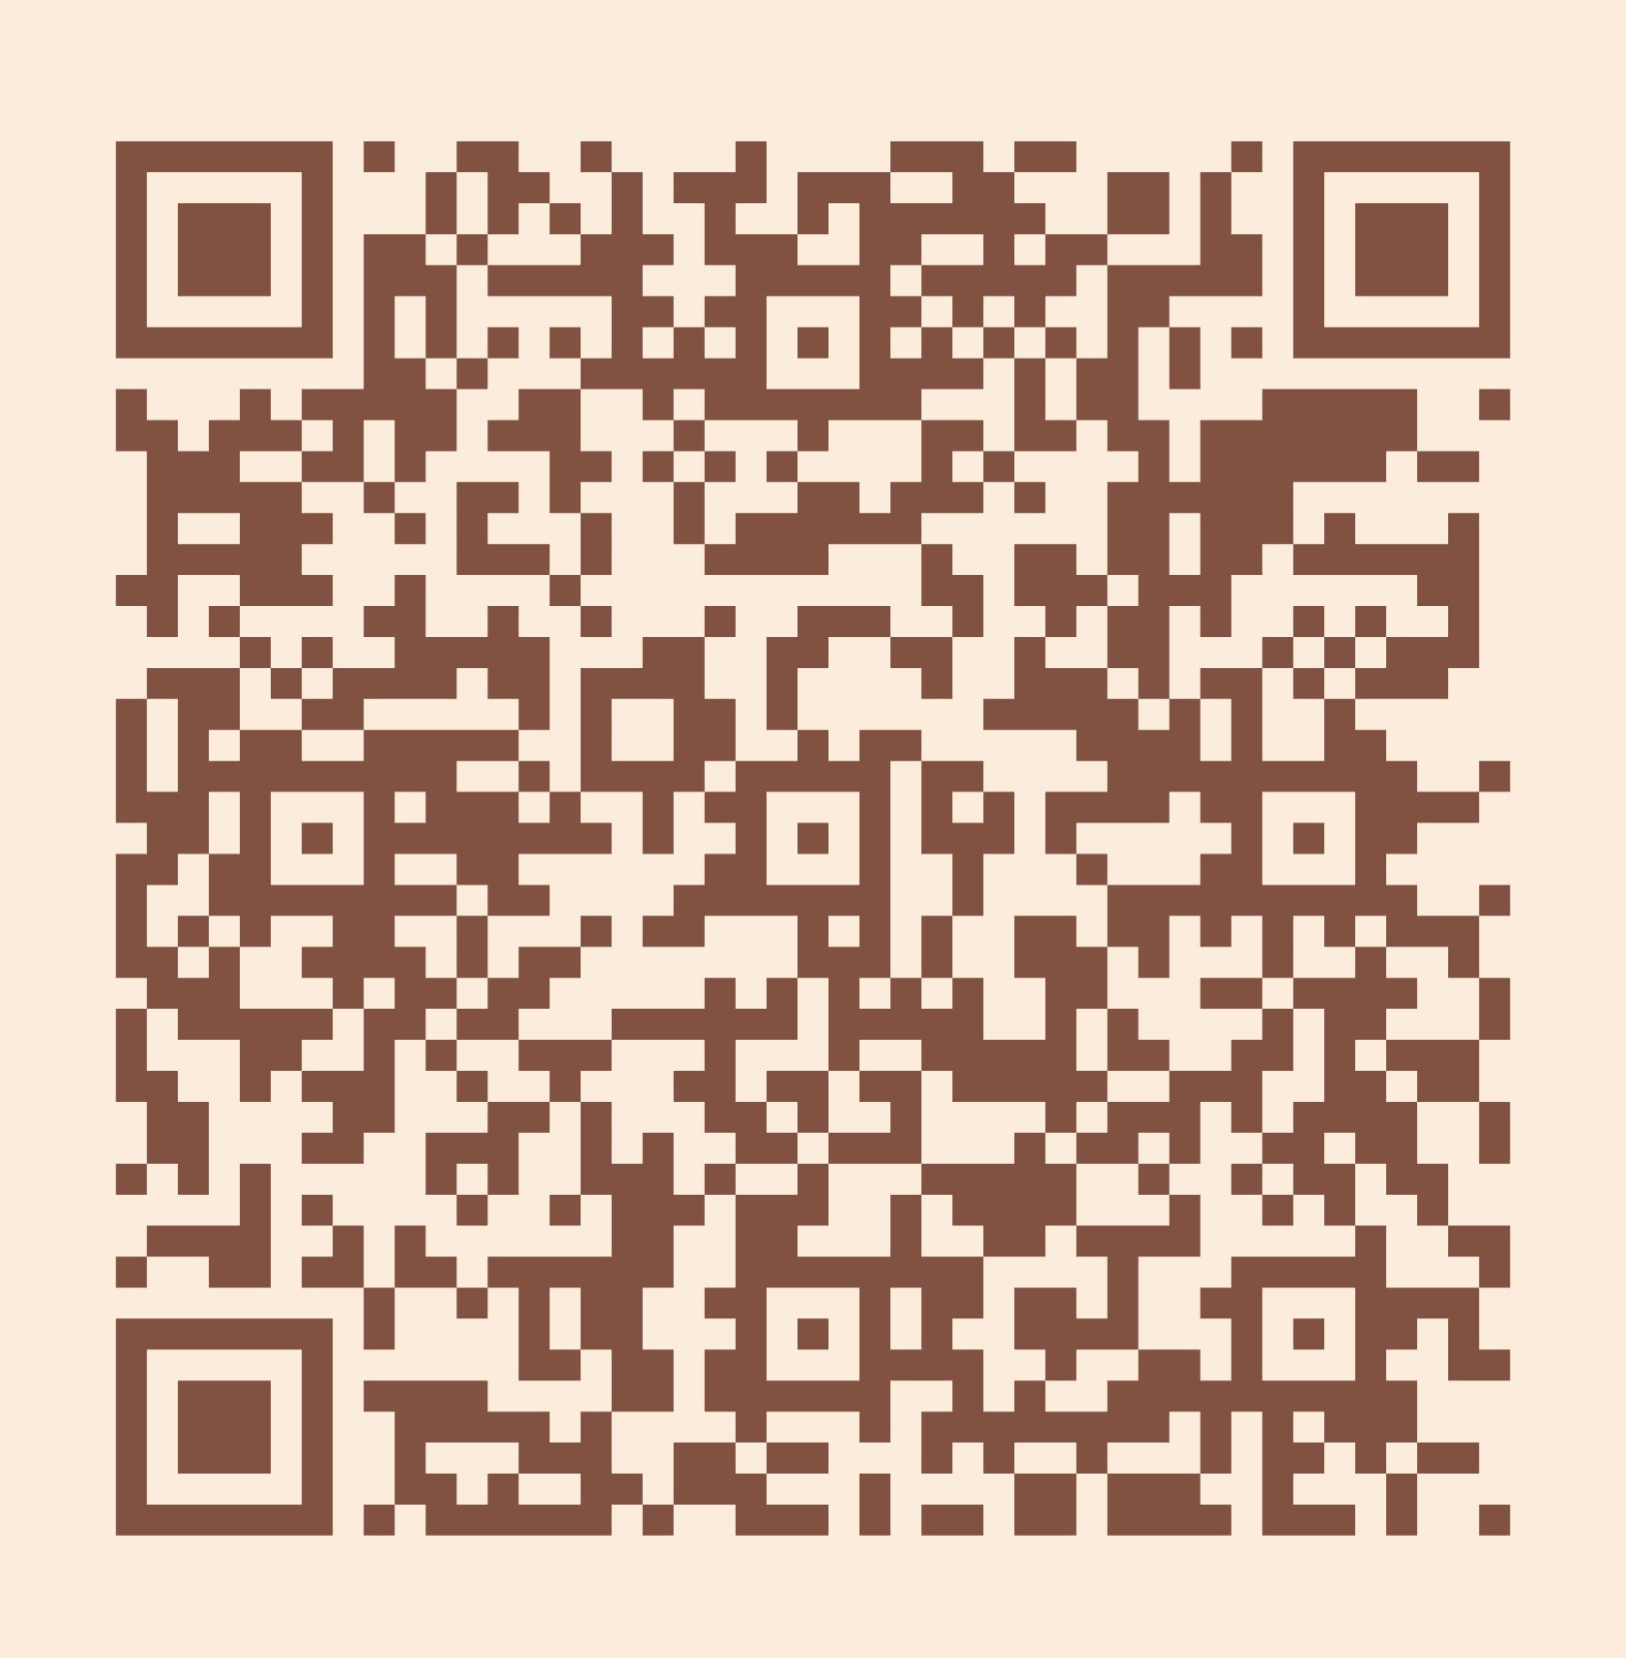
Please take a moment to complete the program survey.
SCAN ME!

