Slide 2
Cripping Credentialism: Un Testimonio from MEd to Academic Librarian to MLIS Student
PRESENTER:
Laura M. Aguilera, M.Ed.

Slide 3
Un Testimonio
My story into librarianship is my testimony
Latina Feminist Group (2001): Third-wave Latina feminist method of sharing un testimonio
un testimonio
synthesis of critical observation, self-awareness, reflection, and transmuting the lessons learned while capturing the complexity and layers to our lives

Slide 4
From Student Affairs to Academic Librarian
Master of Education, Higher Education and Student Affairs Administration
Worked in Disability Services, Residential Life, cultural centers, and Diversity, Equity, and Inclusion offices
Found Undergraduate Engagement Librarian job posting from UC Santa Cruz

Slide 5
Cripping Credentialism
Subvert normative stories of professionalization
Centering my disabled experience, my disability shapes my story
Testimonio of resilience, survival, and growth

Slide 6
Cripping Credentialism
“We, the disabled, the chronically ill, and the Mad carry within us archives. We are intergenerational memory banks filled with the labor, organizing, and artmaking of our radical disabled, queer of color contemporaries, elders, and ancestors. We carry stories of resilience and survival, stories of growth and trauma. In sharing our crip stories, we unearth legacies of colonialism and nondisabled supremacy.”
(Kafai, 2021, p. 71)

Slide 7
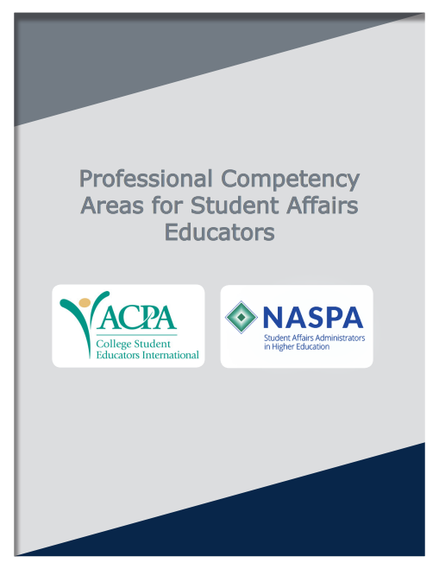
Transferability from Student Affairs to Librarianship
Personal and Ethical Foundations (PPF)
Values, Philosophy, and History (VPH)
Assessment, Evaluation, and Research (AER)
Law, Policy, and Governance (LPG)
Organizational and Human Resource (OHR)
Leadership (LEAD)
Social Justice and Inclusion (SJI)
Student Learning and Development (SLD)
Technology (TECH)
Advising and Supporting (A/S)

Slide 8
First Example: Student Development Theory
Student Affairs Competency:
Student Learning and Development
Theoretical perspectives on student development shape my approach as an academic librarian

Slide 9
Second Example: Building Community
Student Affairs Competencies:
Organizational and Human Resource
Leadership
Social Justice and Inclusion
Student Learning and Development
Advising and Supporting

Slide 10
Current MLIS Candidate
MLIS training now prompts me to reflect
ACPA/NASPA competency area for Technology was not as easily transferable
I am now learning:
Foundations of LIS
Serving information needs
The language of information literacy

Slide 11
Cripping Credentialism
There is value in MLIS training
As a new librarian, I had a comprehensive onboarding
I would not have wished for my journey to be any different → I do not have all the answers!

Slide 12
Prompts for Reflection
What have you witnessed of yourself that only you could put into words and speak into existence?
What gifts have come from the roadblocks in your journey?
How can we as LIS professionals remain open-minded to the potential in hiring folks with different professionalization?
While balancing that there are benefits to the MLIS degree, how can one be properly trained into a librarian role without the formal training?

Slide 13
References
ACPA—College Student Educators International & NASPA—Student Affairs Administrators in Higher Education. (2015). Professional competency areas for student affairs educators (2nd ed.). https://www.naspa.org/focus-areas/pro-competencies
Kafai, S. (2021). Crip Kinship : The Disability Justice and Art Activism of Sins Invalid. (1st ed.). Arsenal Pulp Press.
Latina Feminist Group. (2007). Telling to live: Latina feminist testimonios. Duke University Press.
Seale, M., & Mirza, R. (2019). Empty Presence: Library Labor, Prestige, and the MLS. Library Trends, 68(2), 252–268. https://doi.org/10.1353/lib.2019.0038
University of Minnesota. (2026). Terminology. Critical Disability Studies Collective. https://cdsc.umn.edu/cds/terms

Slide 14
Thank you!
laguile1@umd.edu

Slide 15
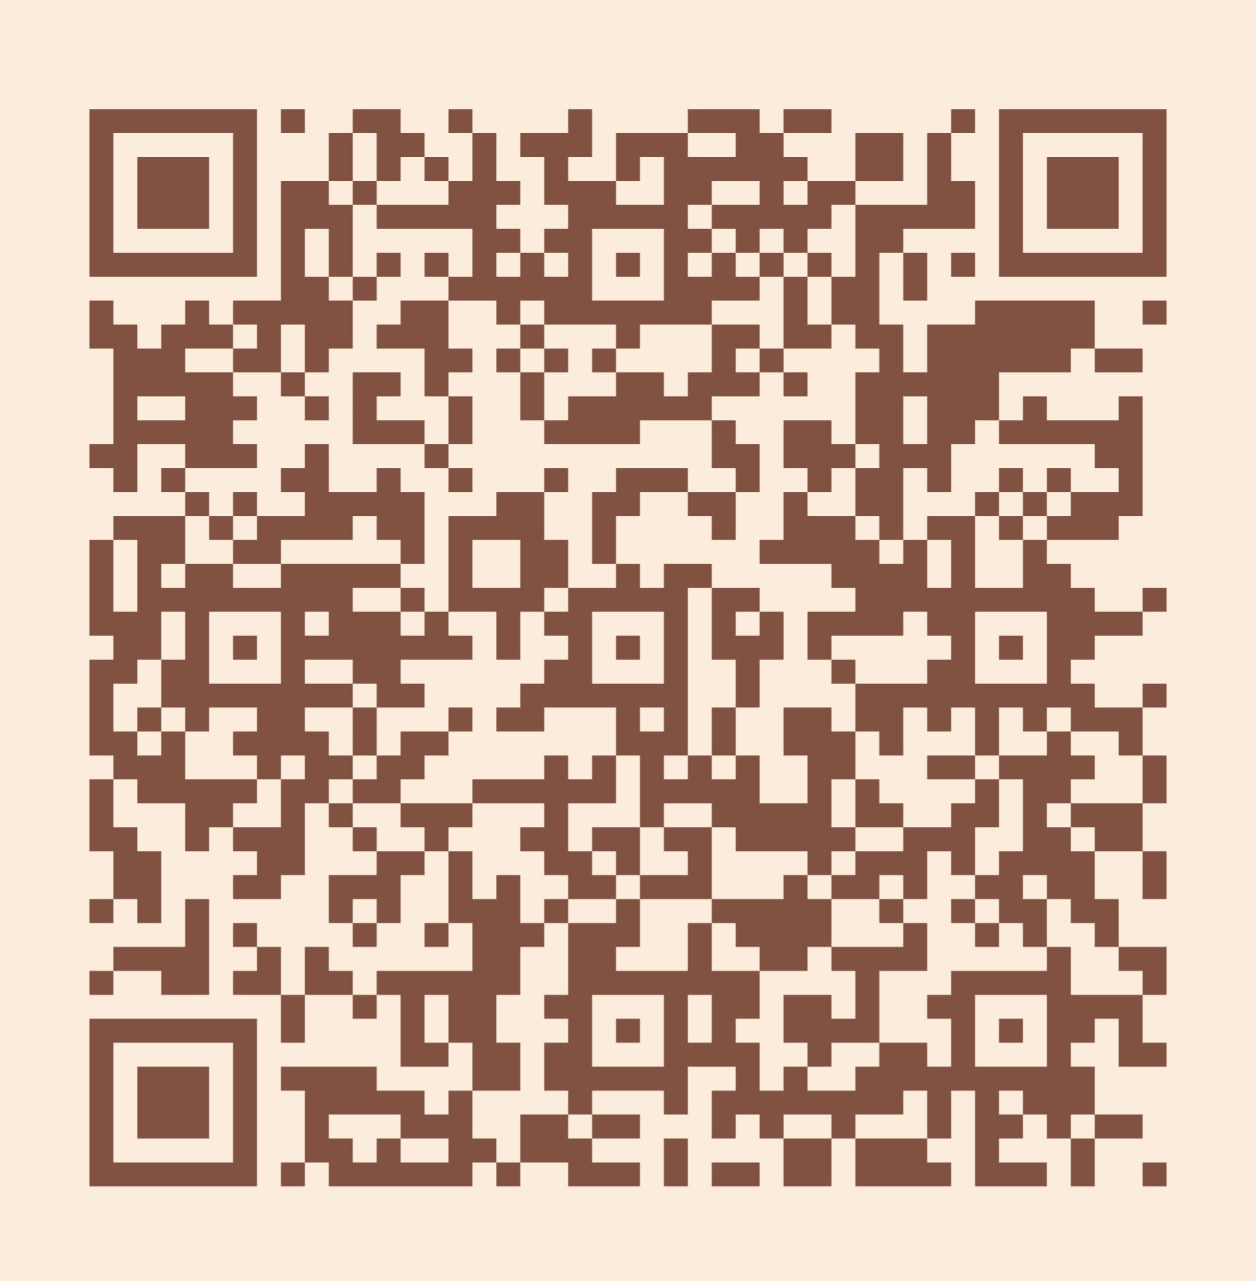
Please take a moment to complete the program survey.
SCAN ME!

