Slide 1

50/50 RAFFLE
Tickets are $1 each and can be purchased from Conni Strittmatter or David Dahl! The winner takes home half the pot.
SILENT AUCTION
Visit the Silent Auction in the exhibitor hall to place your bids before 10:45 a.m. on Friday, May 8th.
PUB QUIZ
Thursday, May 7
8:00 – 10:00 p.m.
Choptank Ballroom
KARAOKE
Thursday, May 7
8:00 – 11:00 p.m.
Windjammer

Slide 2

Digital Maryland, the DPLA, and the Power of Access
Tracy Thompson,
Digital Resources Manager, EPFL
Megan Kean,
Digital Projects Manager, EPFL
Kim Steinle-Super,
Imaging and Metadata Librarian, EPFL
Notes:
Introduce ourselves, welcome to ask questions throughout- just raise your hands

Slide 3
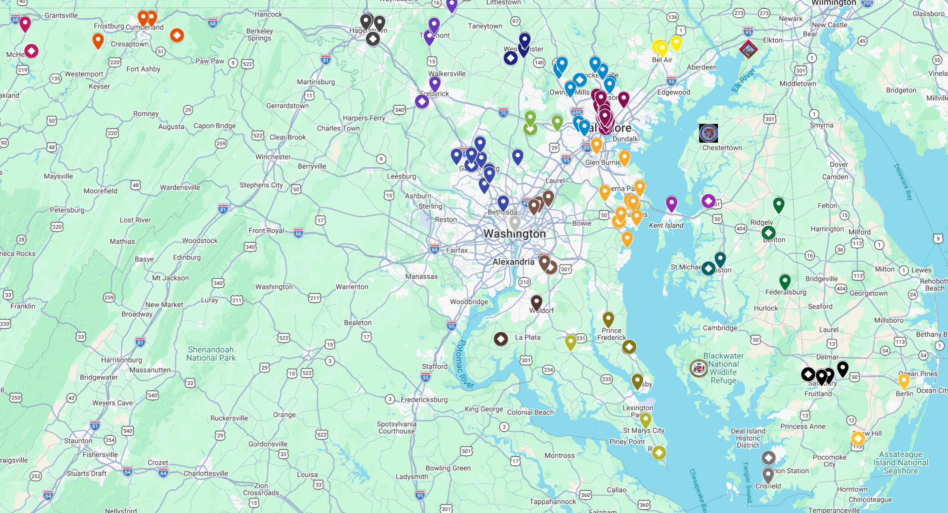
Digital Maryland Quick Facts:
First collections went live in 2004
Currently 188 collections
Over 300,000 images
130 partners from across the State
Directories, diaries, minutes, photograph collections, letters, oral histories….and more!
Link to interactive map

Slide 4
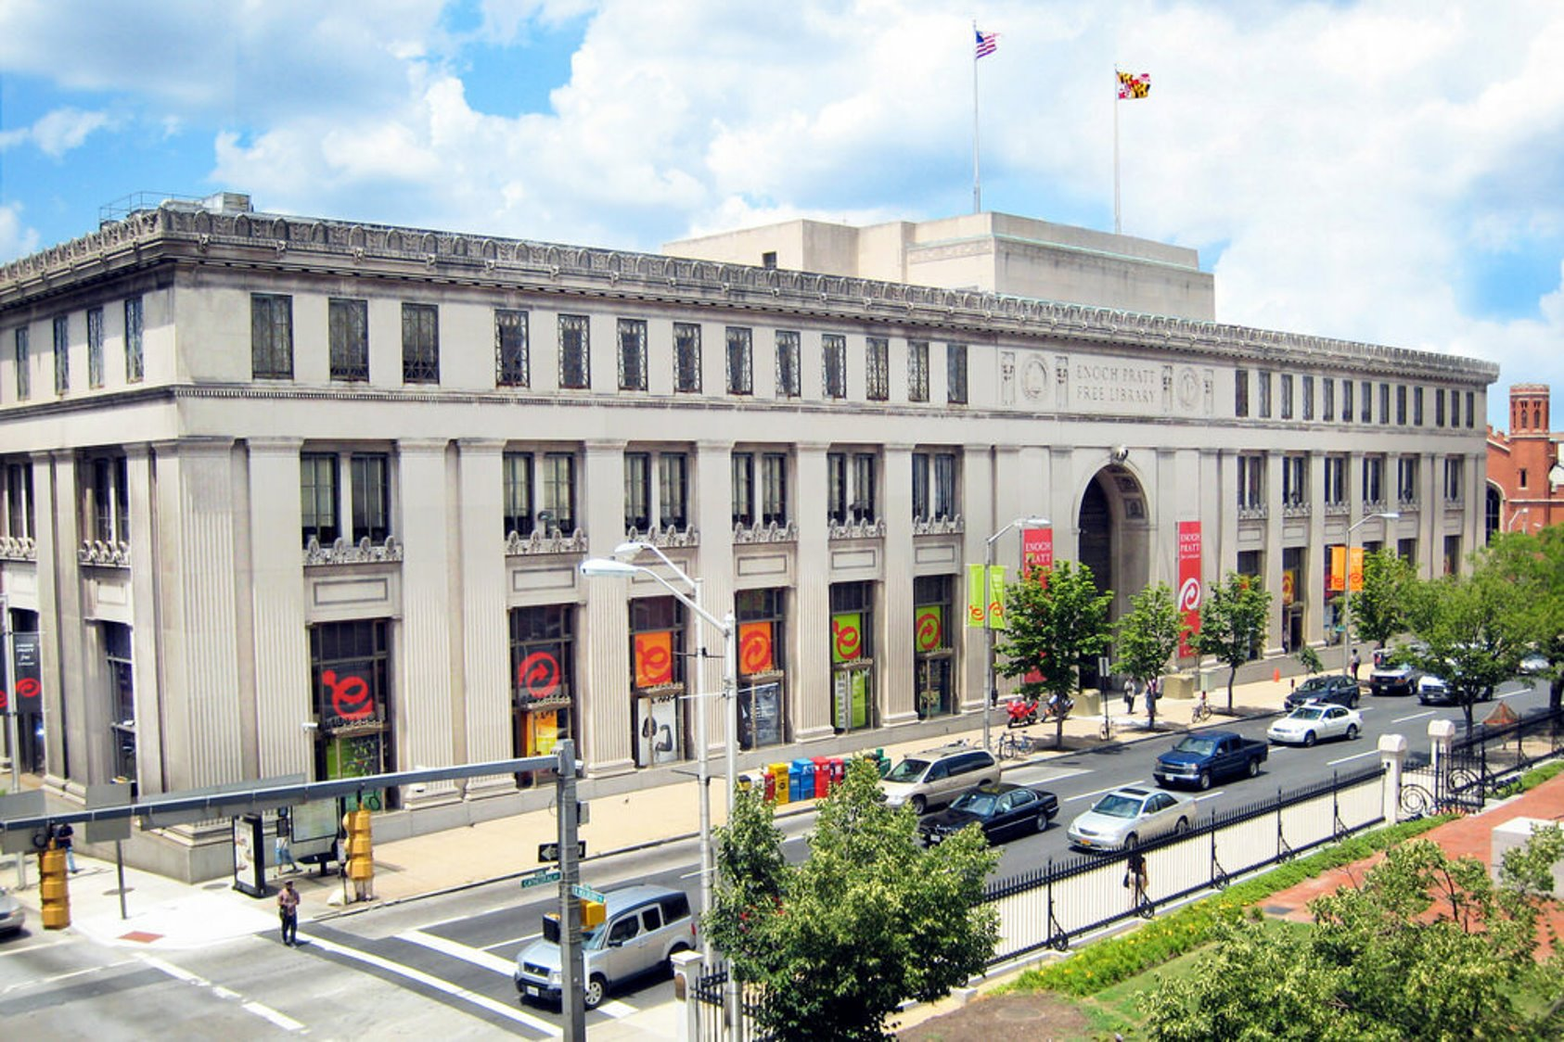

Notes:
SAILOR, MARINA, Databases -

Slide 5
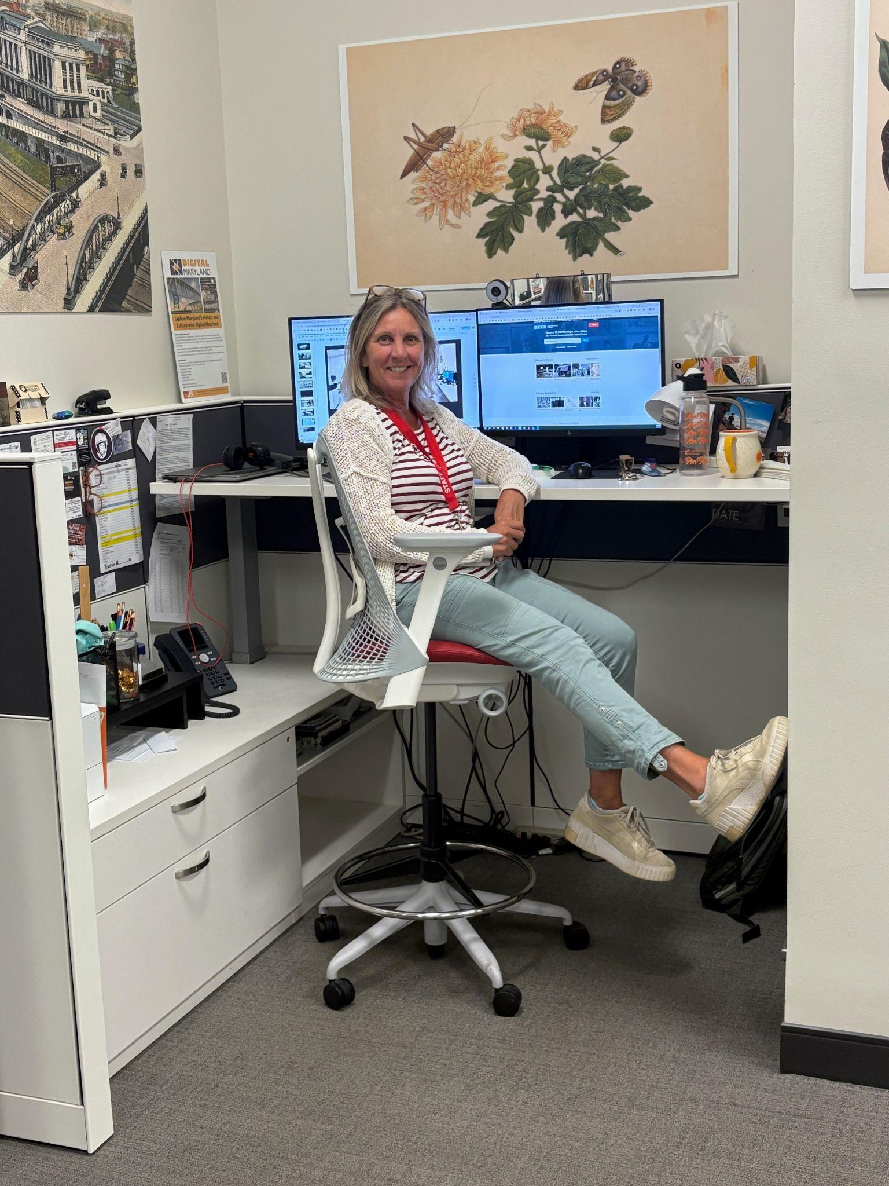
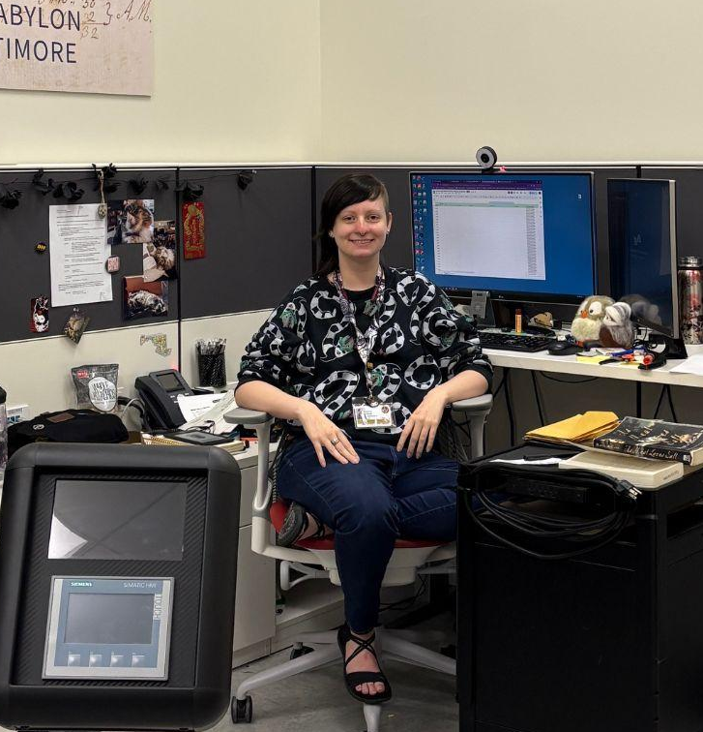
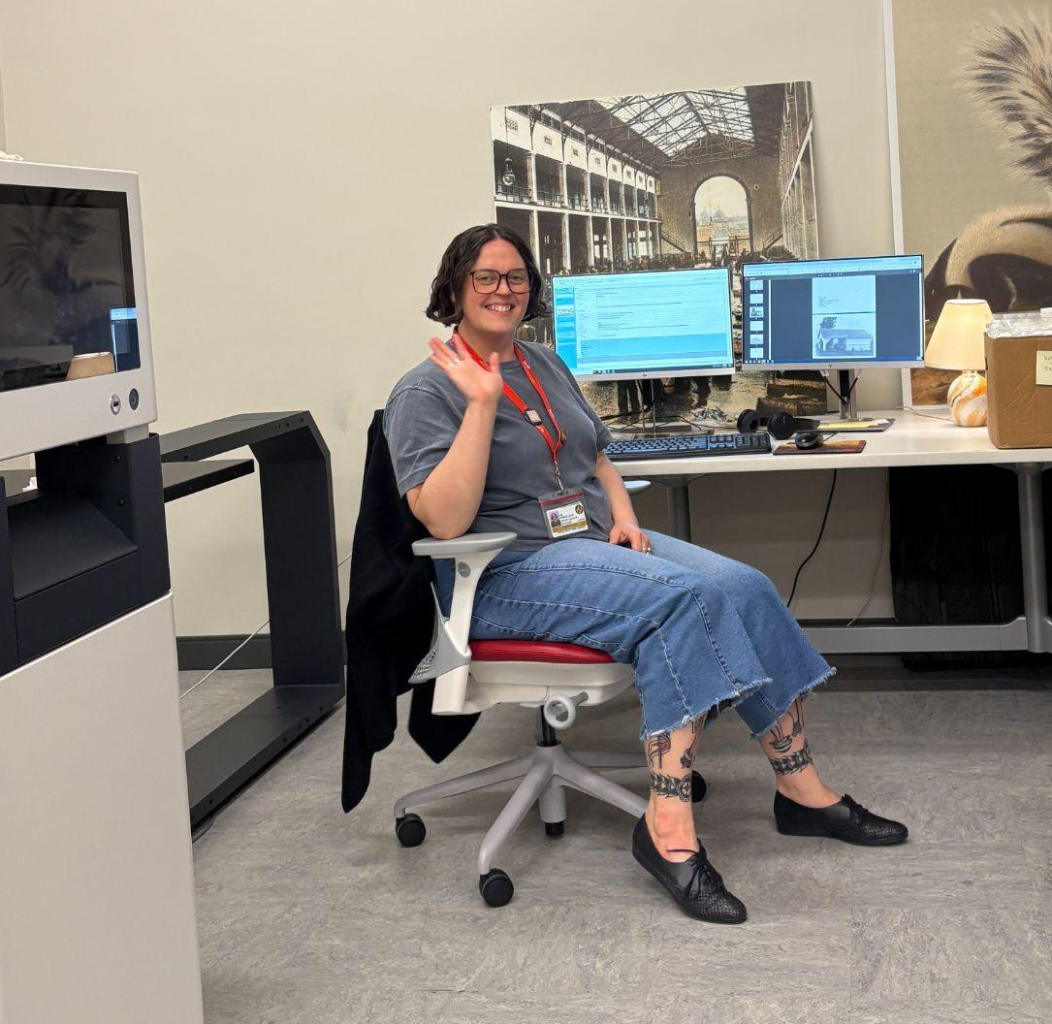
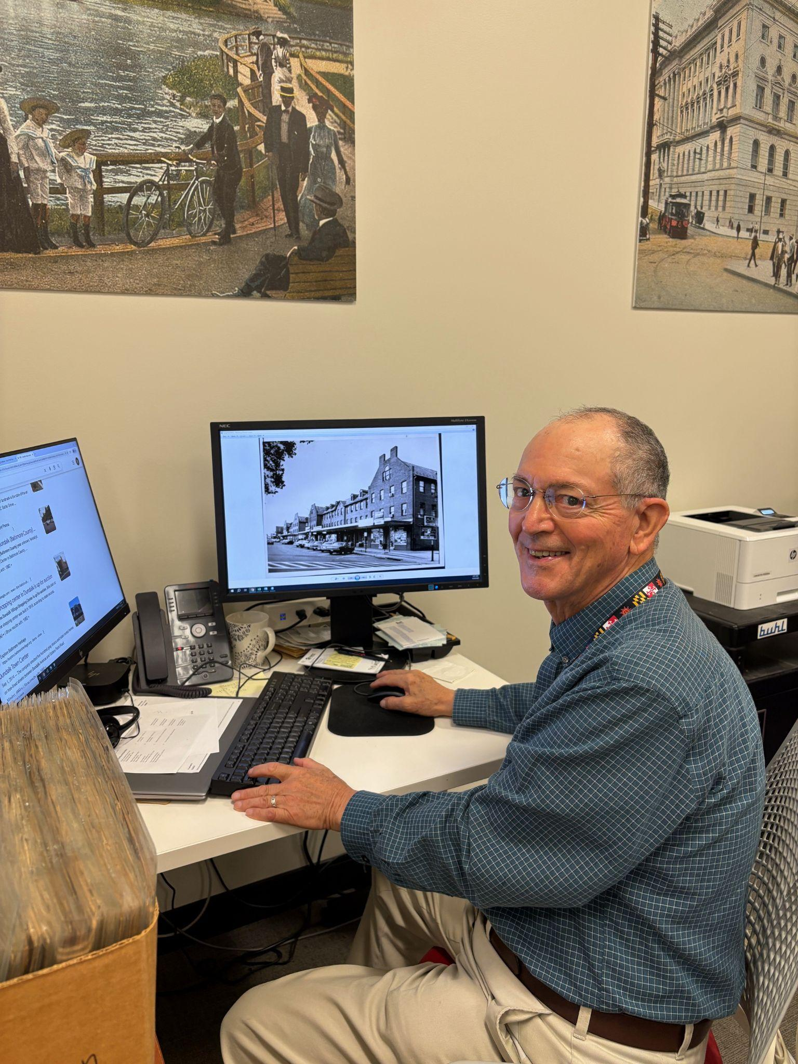
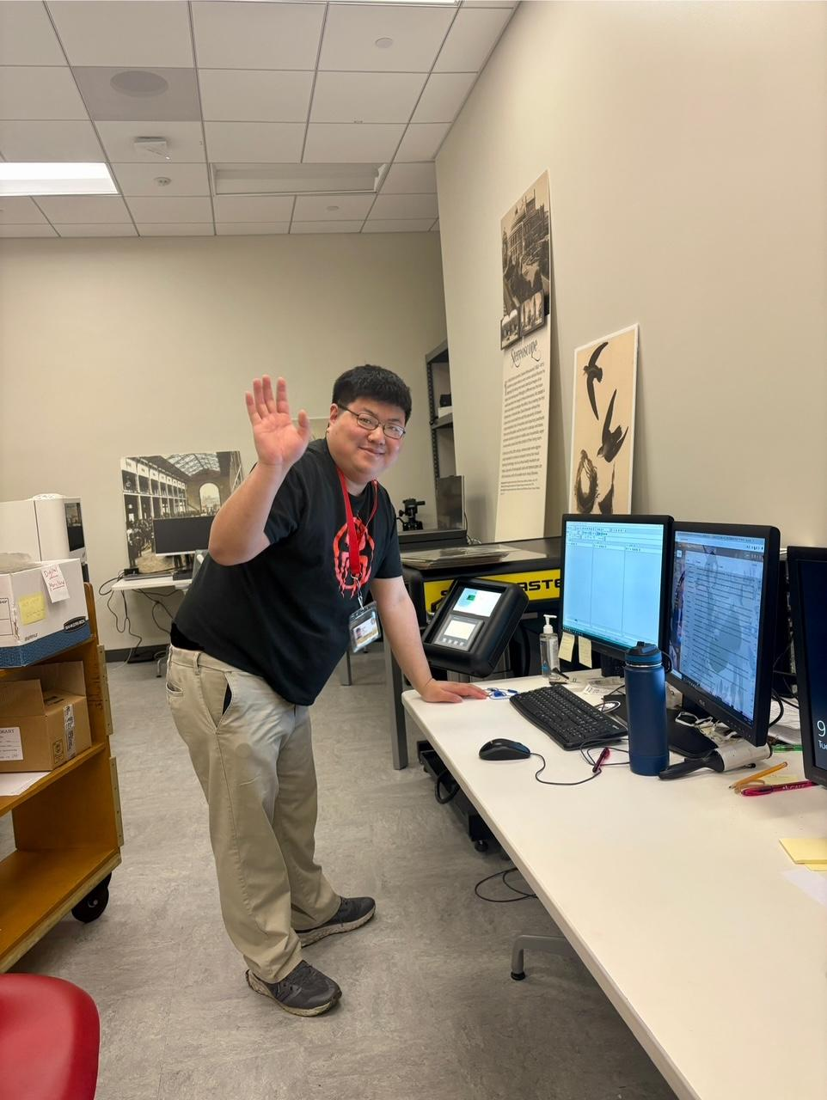
The Digital Maryland Team
Tracy Thompson,
Digital Resources Manager
Megan Kean,
Projects Manager
Kim Steinle-Super,
Digital Imaging and Metadata Librarian
Bill Cady,
Metadata Technician
Eugene Yim,
Scanning Technician
…plus interns and virtual volunteers!

Slide 6
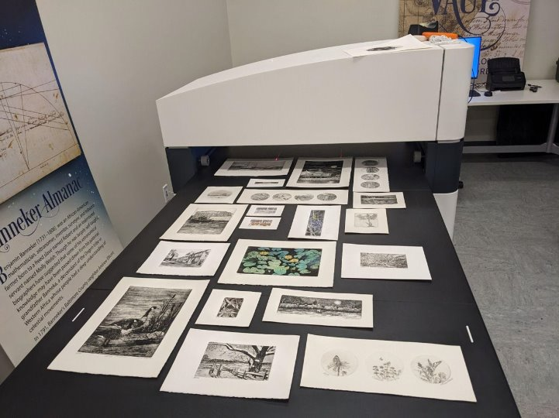
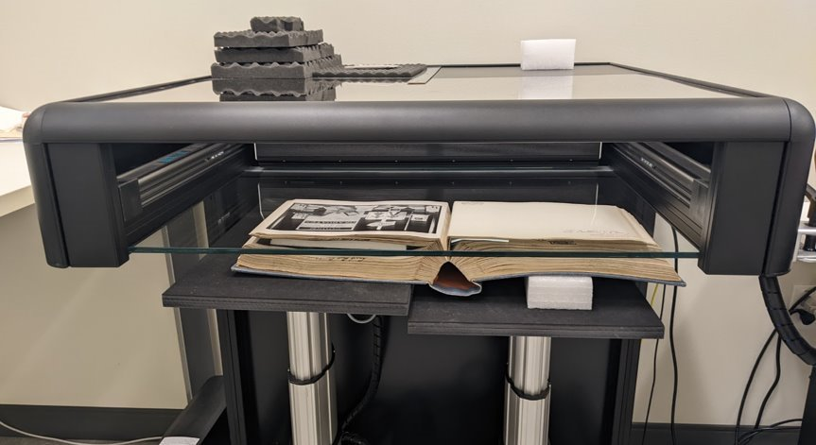
New Partner Workflow
Discussing needs and Collection Policy
Material dropoff or file transfer
Metadata creation
Publication
Harvesting
Above: ArtTek Art Scanner, 4' x 6' bed
Left: ScanMaster0 scanner, 2' x 2' bed
Notes:
https://collections.digitalmaryland.org/digital/collection/mdzb

Slide 7
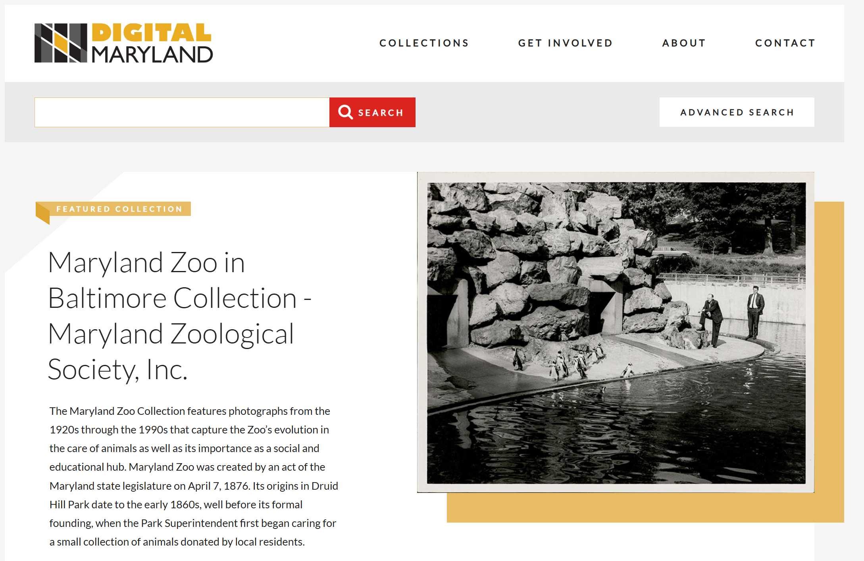

Slide 8
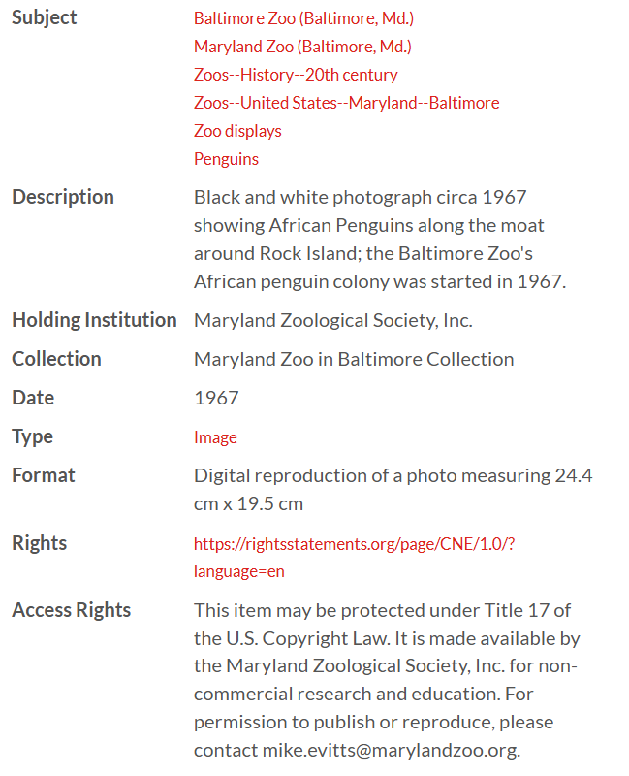
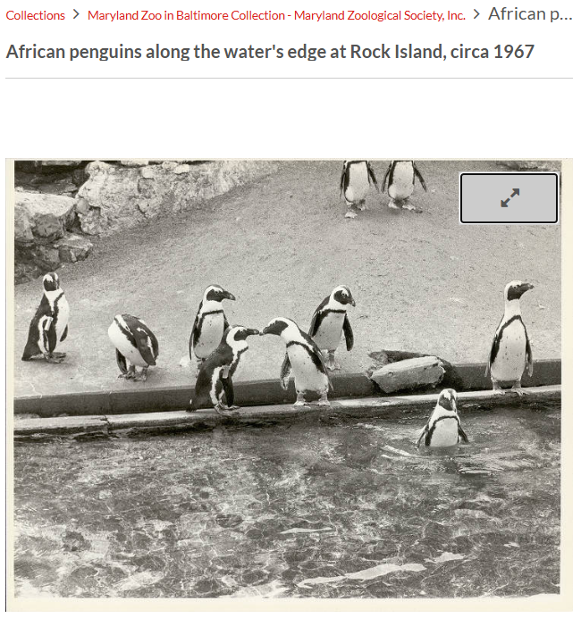
Digital Maryland id: mdzb0109 [link]
Notes:
https://collections.digitalmaryland.org/digital/collection/mdzb/id/51/rec/12

Slide 9
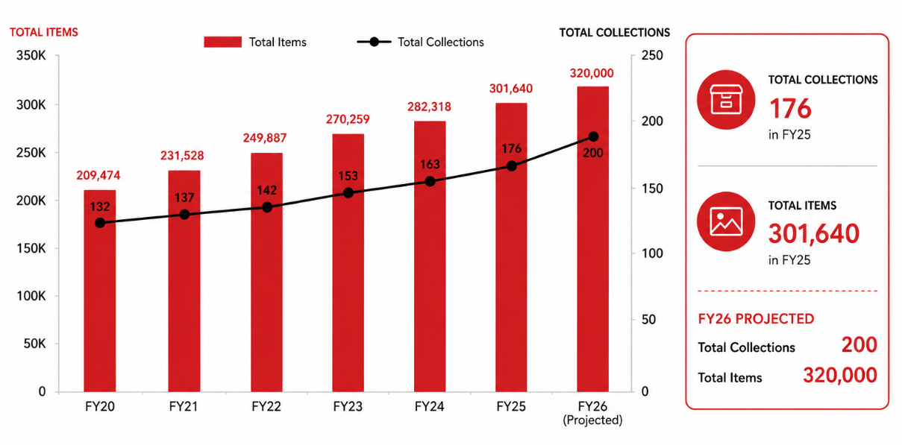
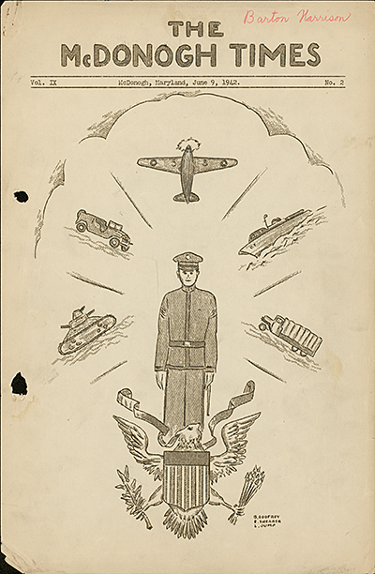
Digital Maryland's Growth
Digital Maryland's Growth
The McDonogh Times, vol. 9, no. 2, mdsp036. [link]

Slide 10
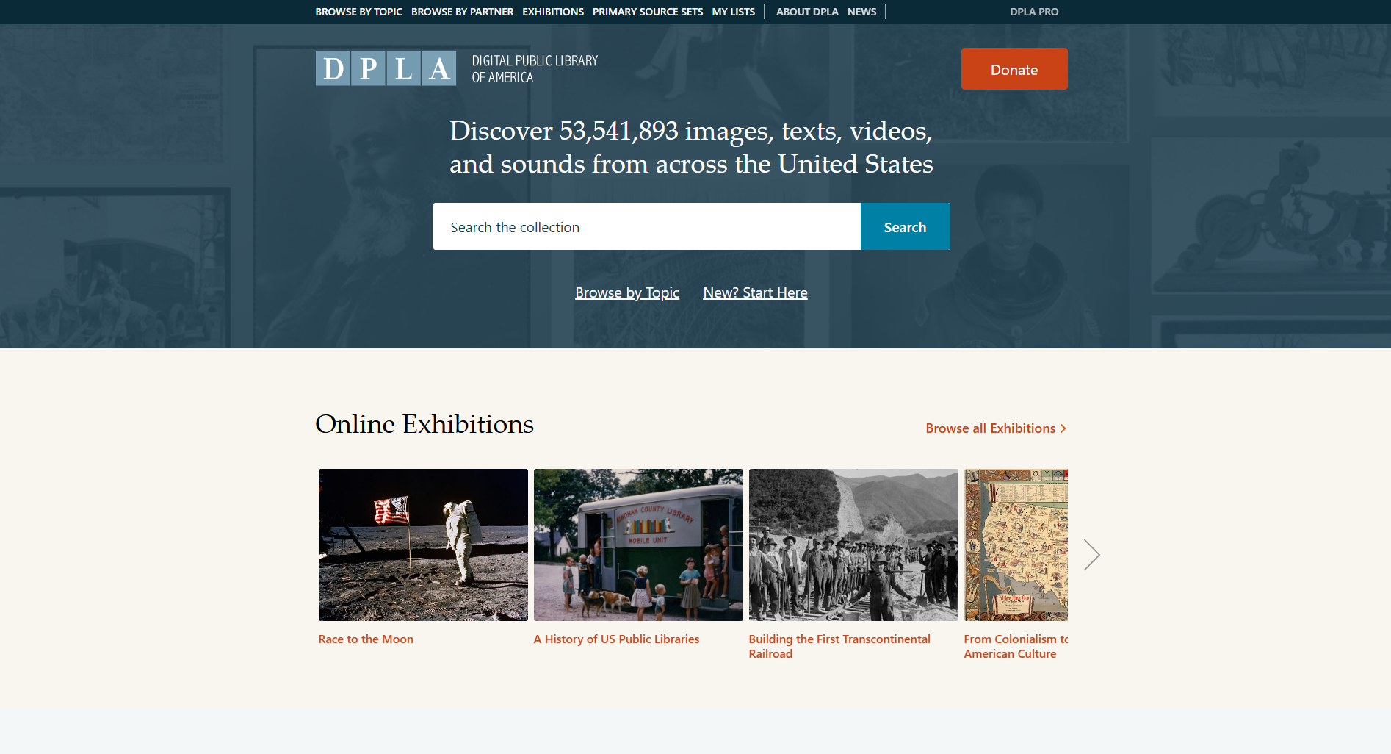

Slide 11
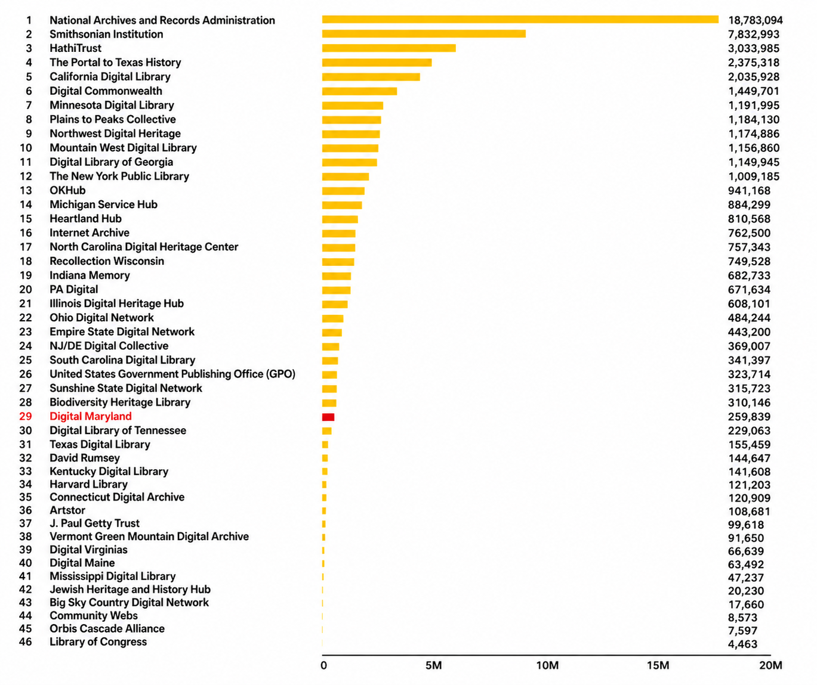
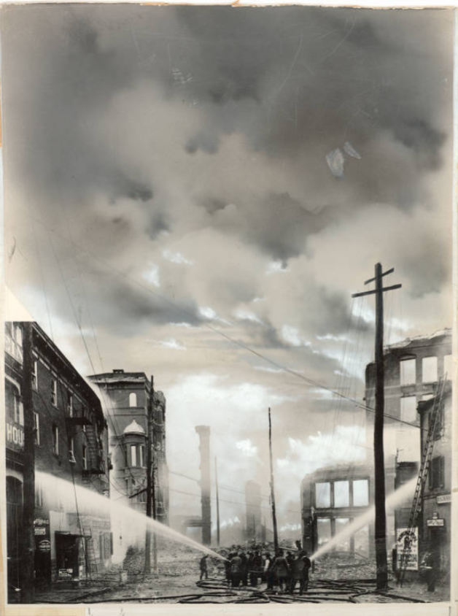
DPLA Hubs
Fire fighters spraying water on buildings at German and Liberty Streets, 1904, mdbf019. [link]

Slide 12
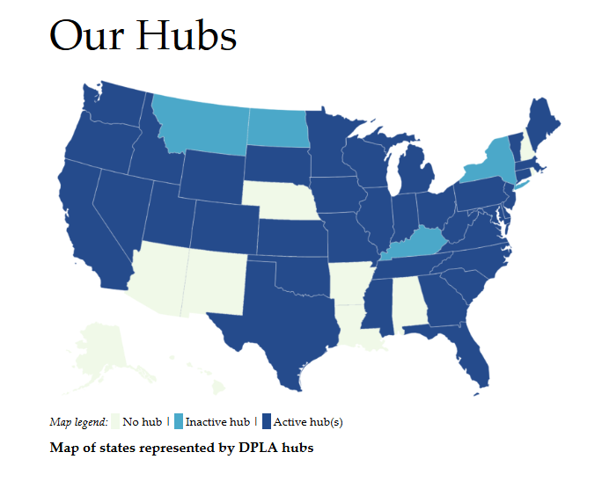
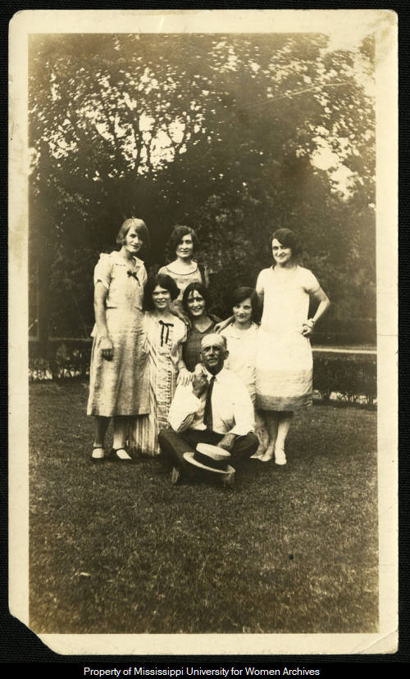
States represented by DPLA
Mr. Crook And Students; 1926, mcj.photos.0076. [link]

Slide 13
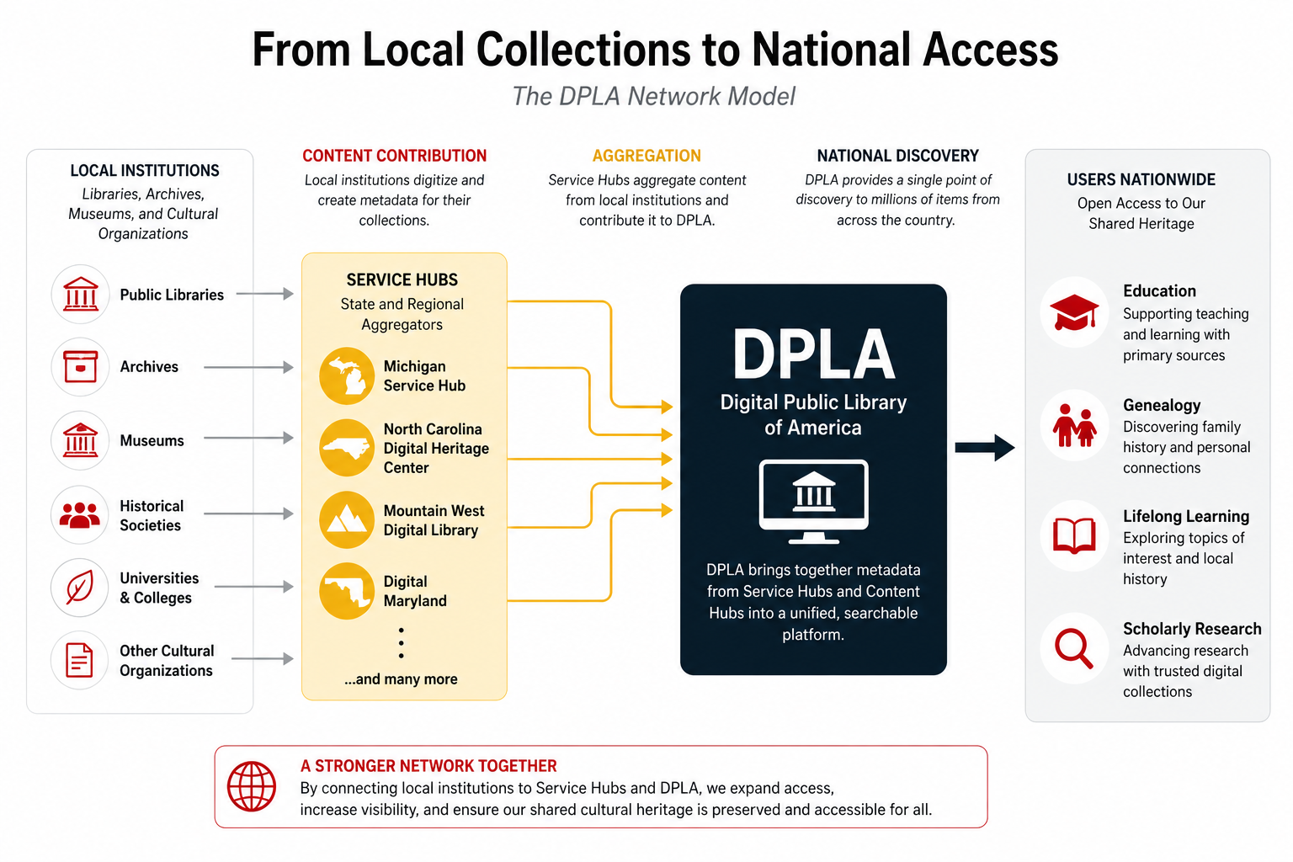
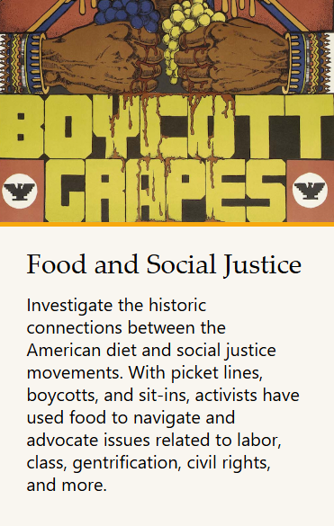
DPLA: aggregator of aggregators
Food and Social Justice [link]
DPLA Topic page

Slide 14
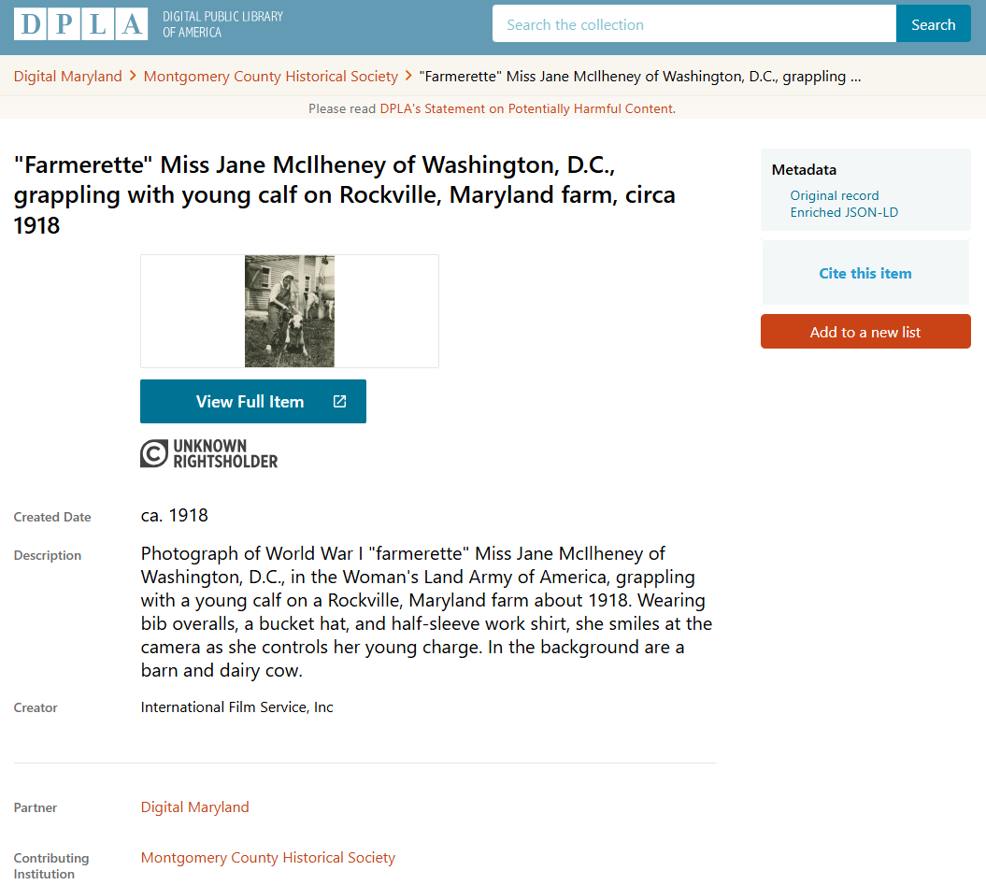
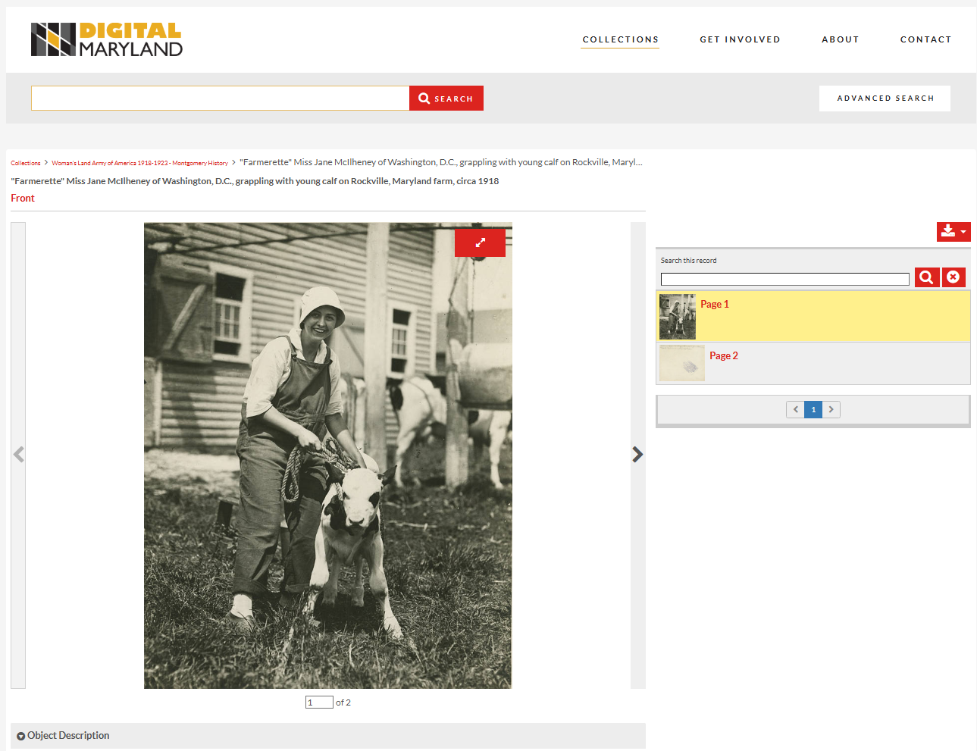
Search and Access
DPLA Version [link]
Digital Maryland version [link]

Slide 15
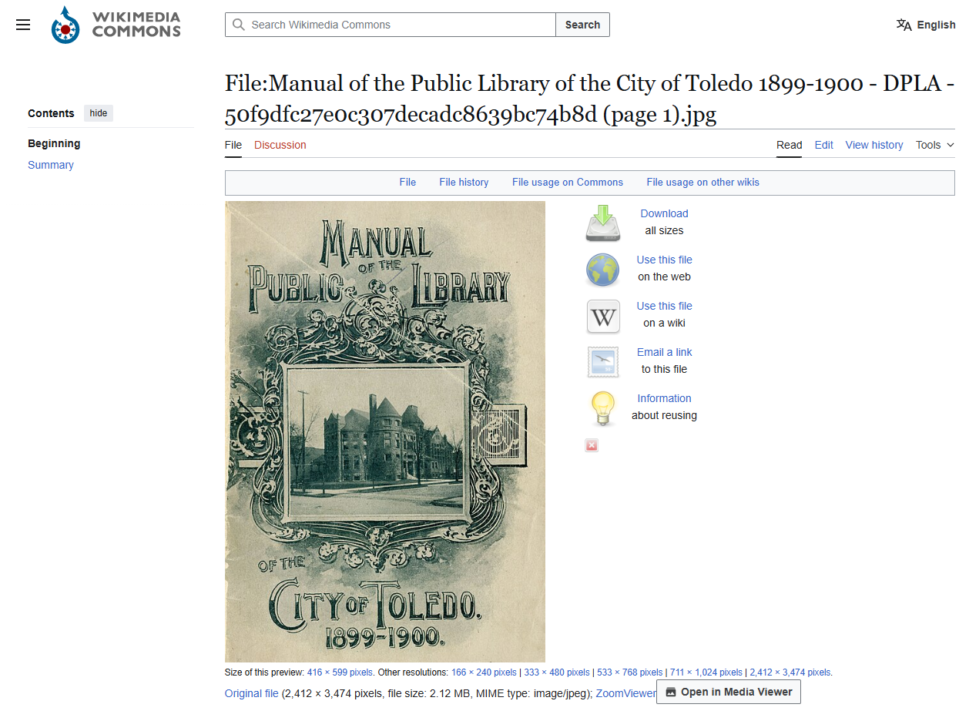
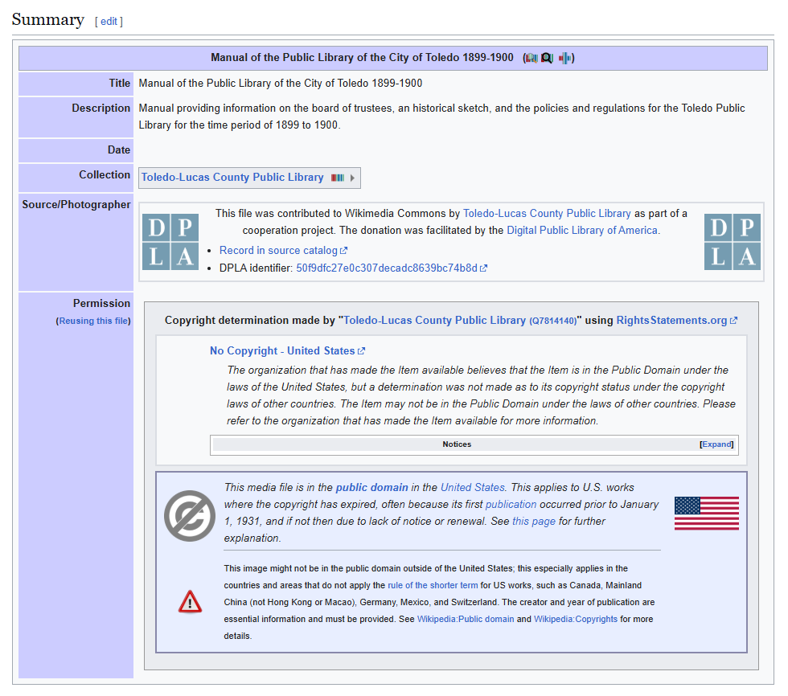
The Wikimedia Push

Slide 16
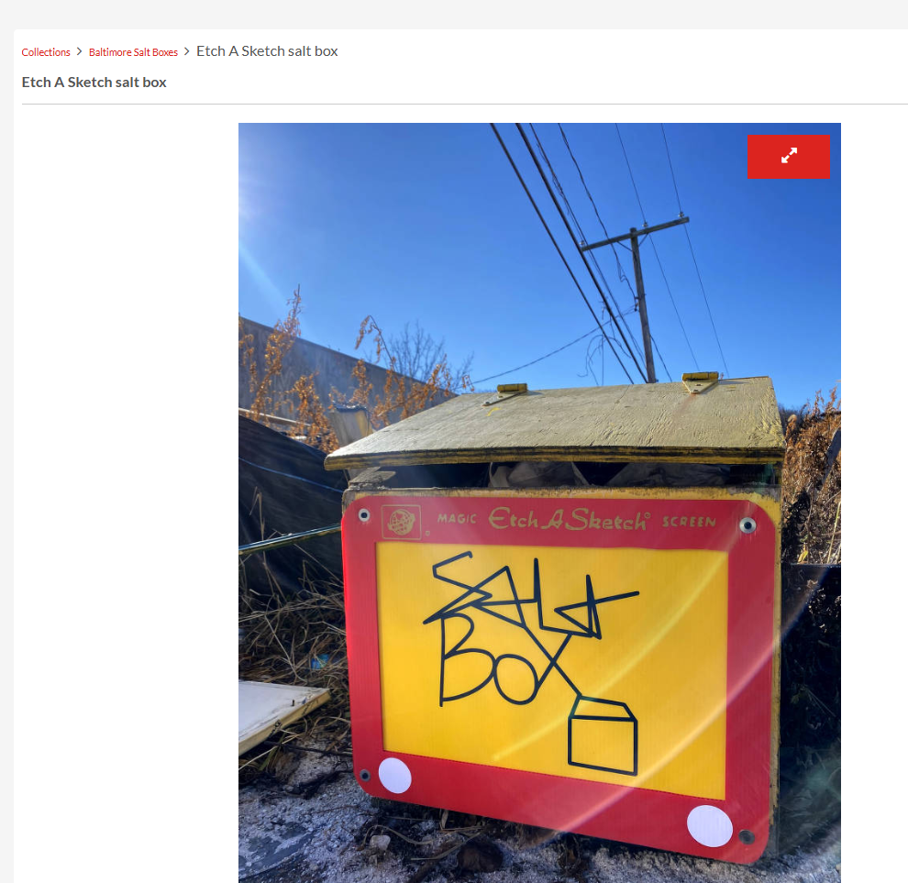
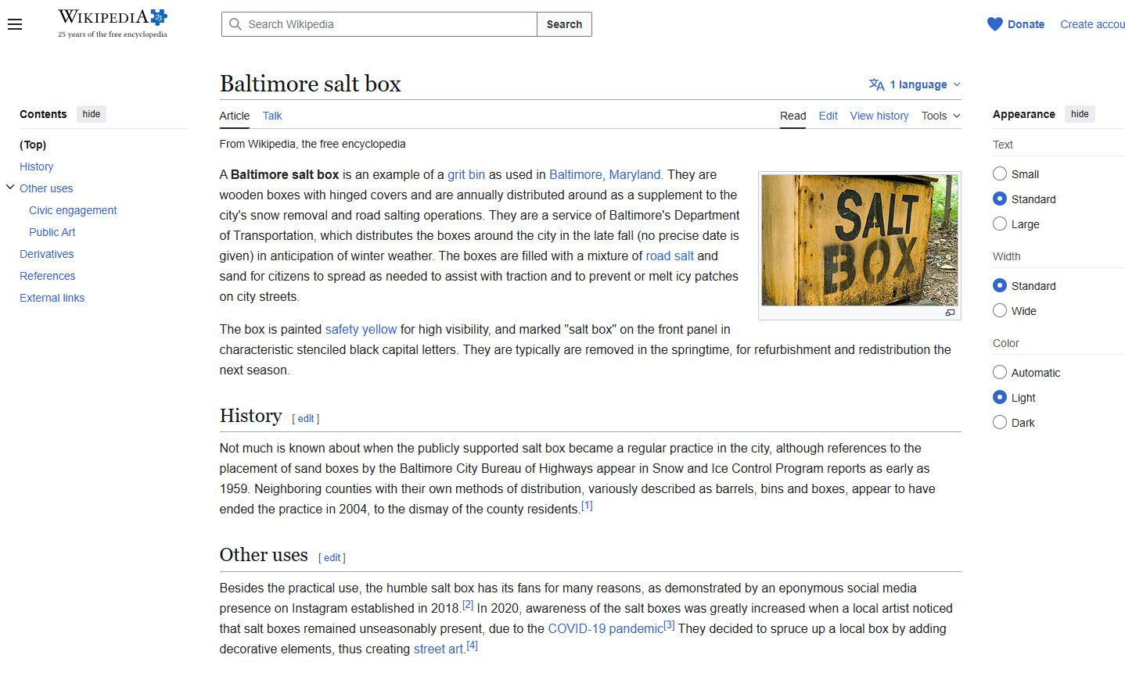
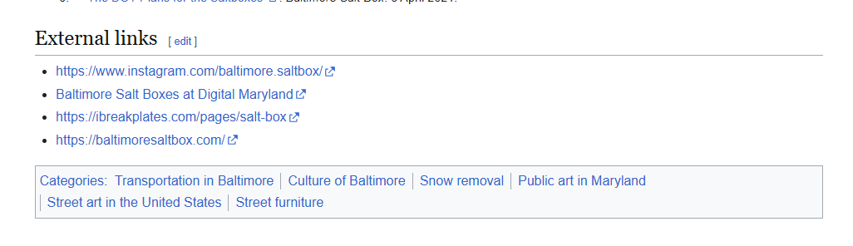
Wikipedia
Etch a Sketch salt box, salt0034. [link]

Slide 17
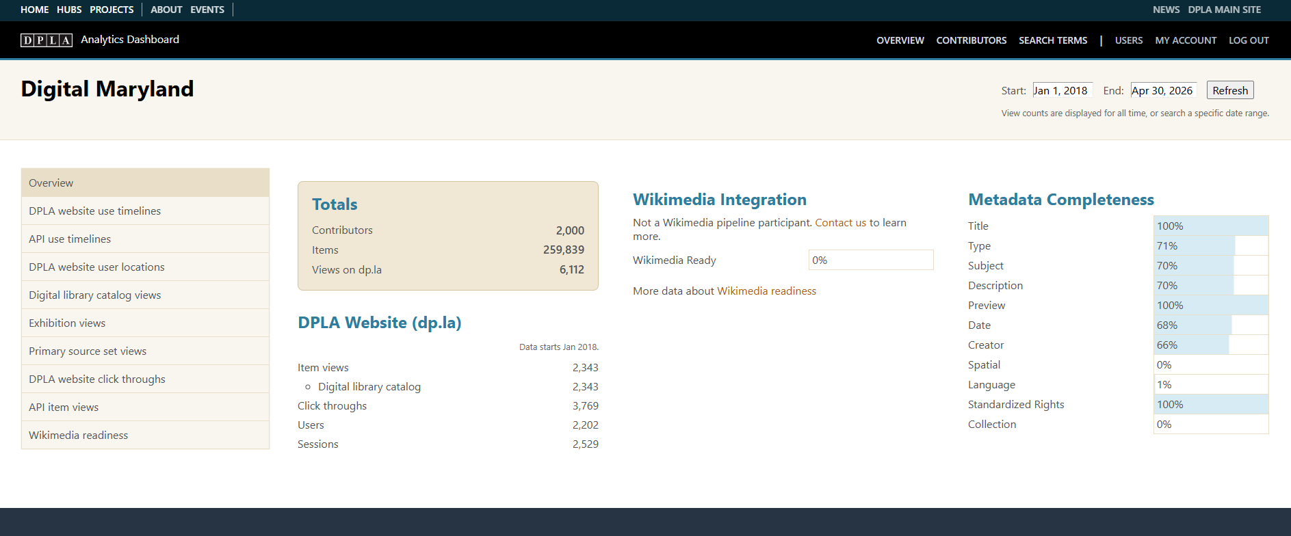
DPLA's New ANALYTICS Dashboard

Slide 18


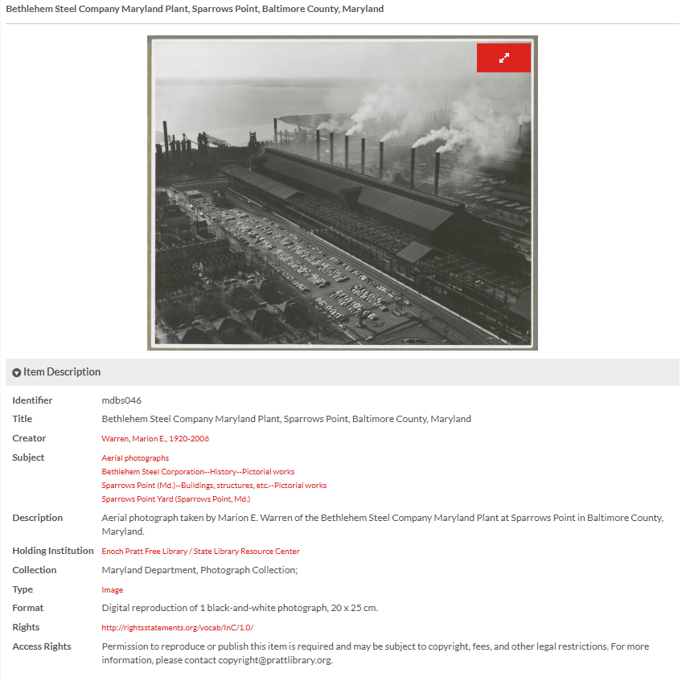
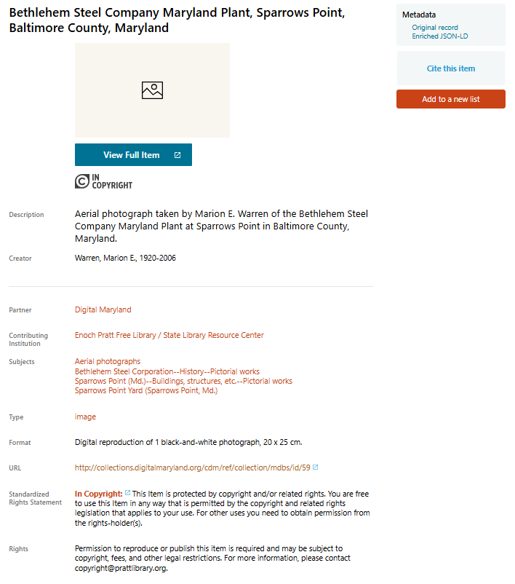
Harvesting
Notes:
As the metadata librarian, I wanted to talk a little bit about how partnering with DPLA has impacted our metadata standards at Digital Maryland.
As Tracy discussed, DPLA has their own set of metadata standards and properties which are part of its metadata application profile, or the DPLA MAP.
These pull from several different standards including Europeana Data Model (EDM) and Dublin Core, and are designed for interoperability with DPLAs API.
What this means for us, is that we have integrated DPLA’s standards into our own metadata schema so its already built into our process and workflows and that information can be easily harvested from Digital Maryland’s ContentDM system every time we add a new collection.

Slide 19
Mapping Profile
Digital Maryland Metadata | DPLA MAP Fields
Identifier* | DPLA Identifier
Title* | Title*
Creator | Creator
Subject* | Subject
Description* | Description
Publisher | Publisher
Holding Institution* | Data Provider*
Collection* | Collection Title*
Date | Date
Type* | Type
Format* | Format
Language | Language
Rights* | Rights Statement*
Access Rights* | Rights (Free text)
*Required

Slide 20
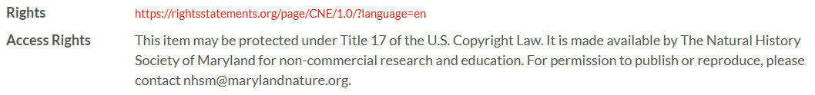
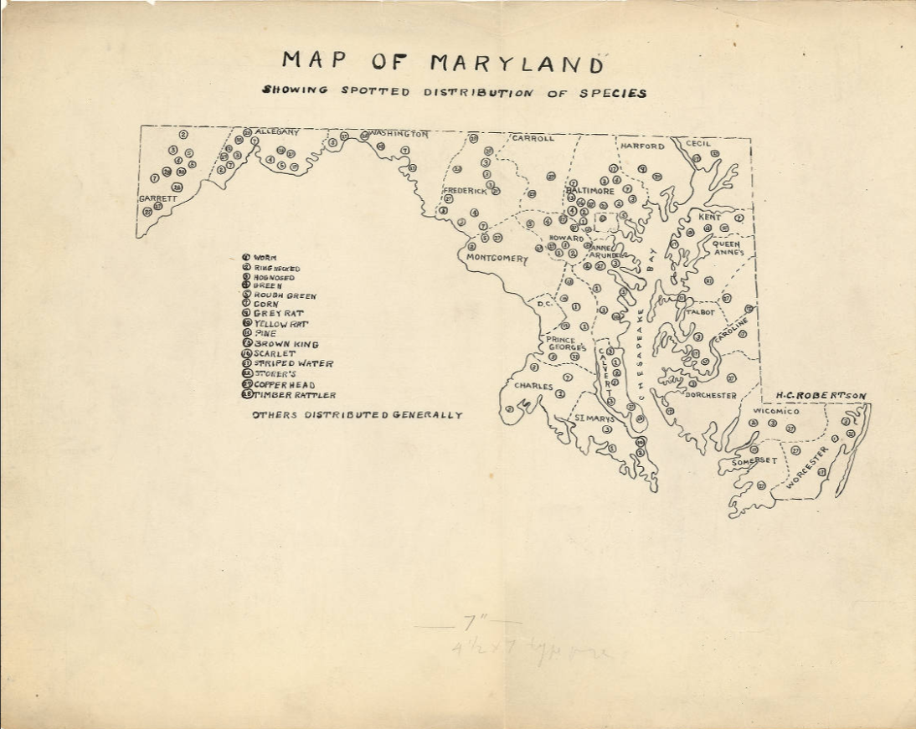
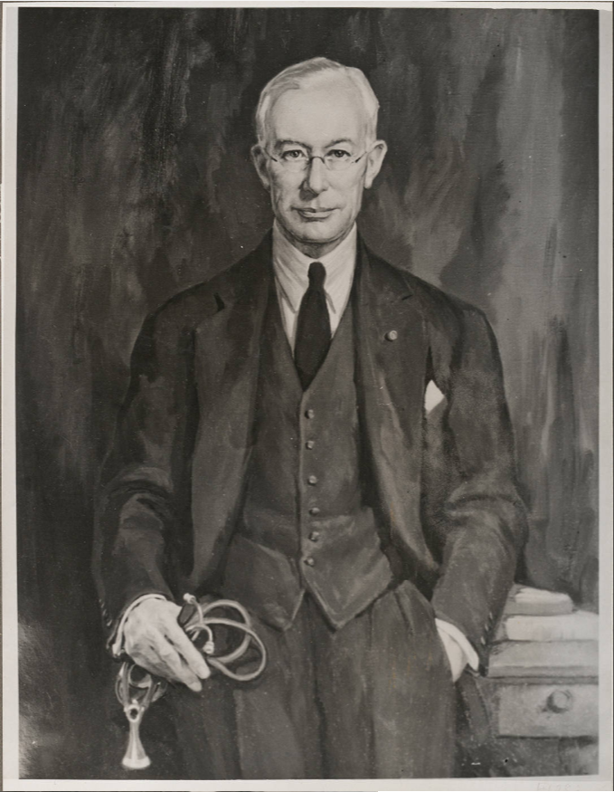
Mediating Metadata – Challenges & Strategies
MD
or
MD?
Digital Maryland id: hakc0265 [link]
Digital Maryland id: mdph002446 [link]

Slide 21
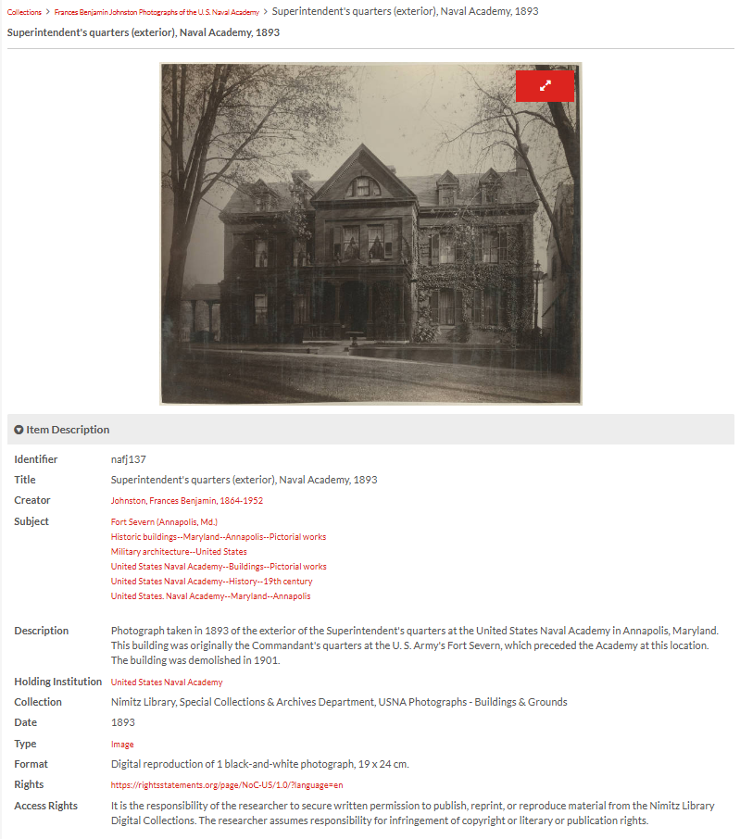
Maintenance & Revision
Digital Maryland id: nafj137 [link]

Slide 22
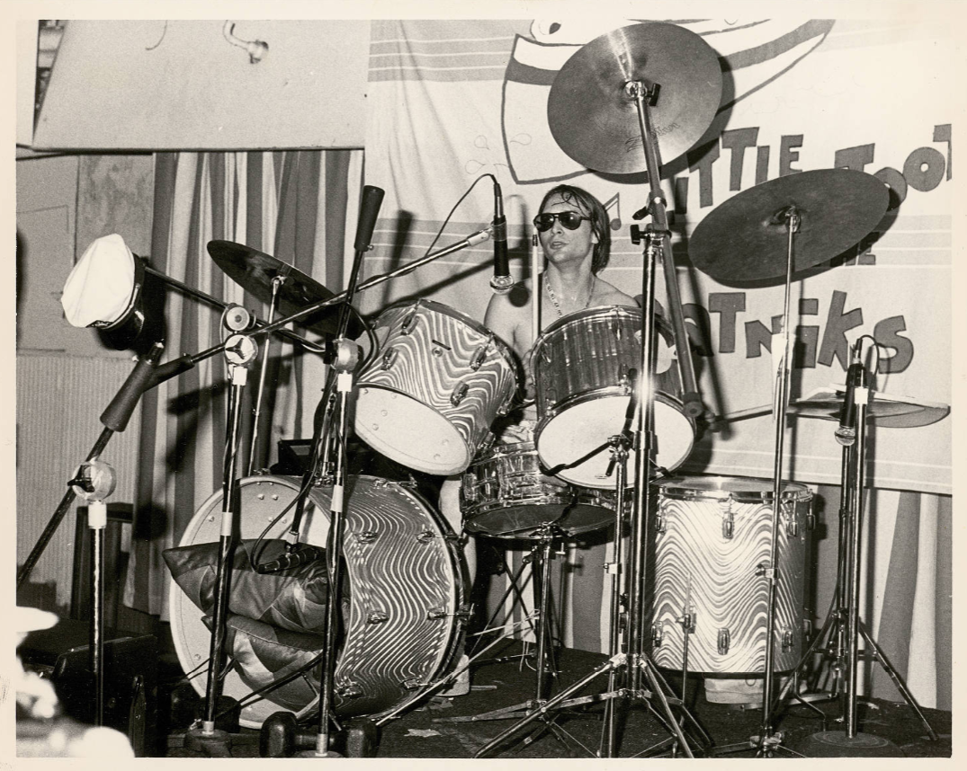
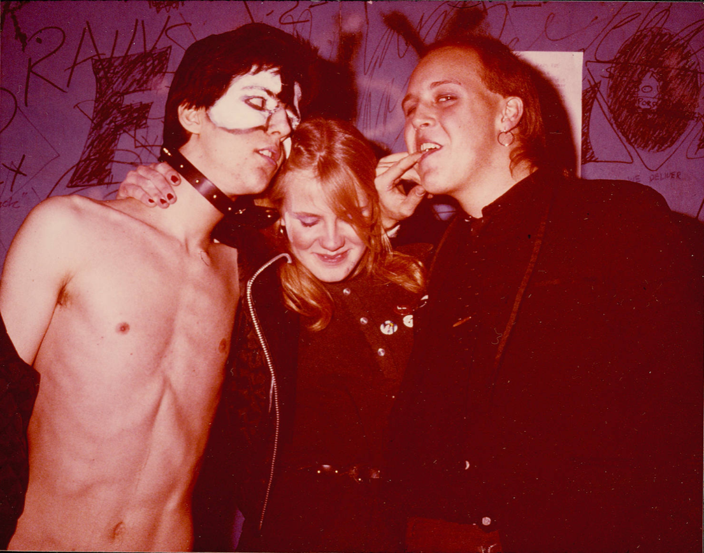
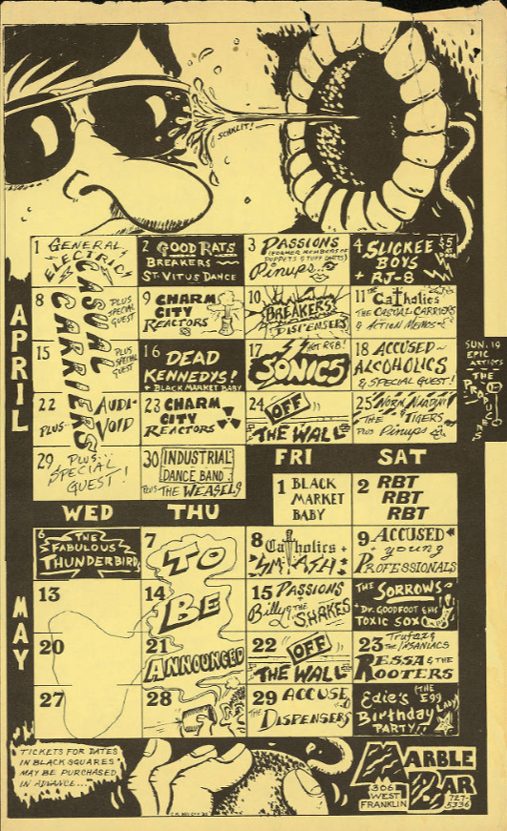
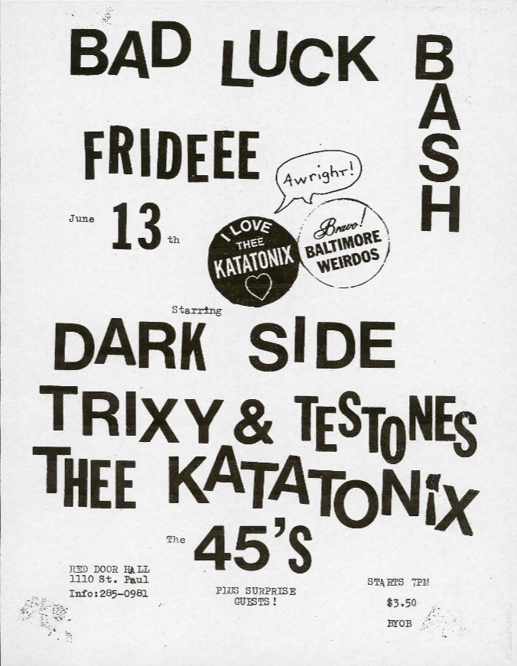
Amplifying Community Voices
Maryland Punk Archive
https://collections.digitalmaryland.org/digital/collection/punk [link]

Slide 23
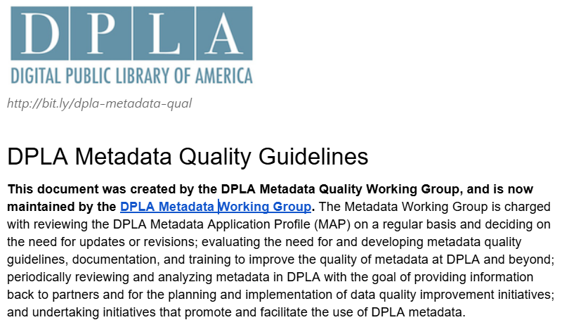
"Compliance with the recommendations in [the dpla metadata quality guidelines] would result in higher quality metadata in virtually any context."

Slide 24
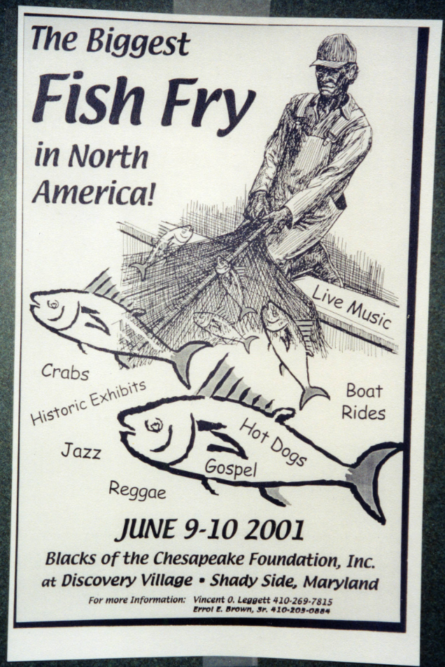
QUESTIONS?
Biggest Fish Fry in North America Poster, msa_scbox35_20-0001 [link]

Slide 25
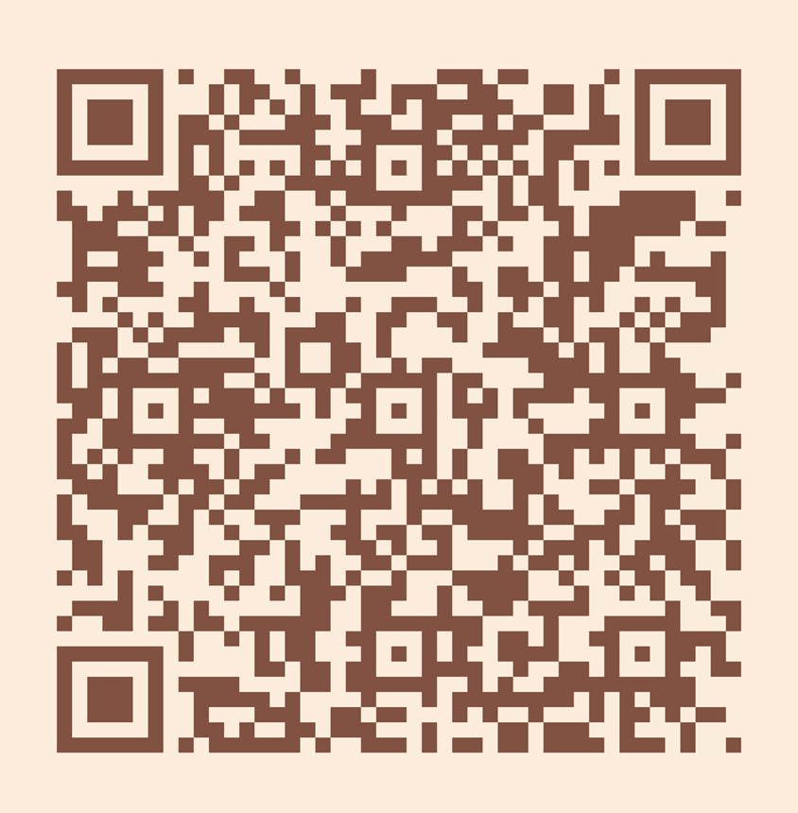
Please take a moment to
complete the program survey.

