Slide 1
Stories of Broadcasting History from the Shelves of the Special Collections in Mass Media and Culture at University of Maryland Libraries
PRESENTER:
Andrea Schuba
Monographs Cataloging Librarian
University of Maryland, College Park
Notes:
Hello! I’m Andrea Schuba, the Monographs Cataloging Librarian at University of Maryland in College Park. In this presentation, I will briefly describe the Mass Media and Culture Collection at University of Maryland. Then, I will spend most of my time describing individual items from the pamphlets collection that I find interesting. Because I cataloged hundreds of these items, the items that I describe will be quite random and they don’t necessarily tie into each other. This is exactly what it’s like to catalog! I get tidbits of information about lots of things.

Slide 2
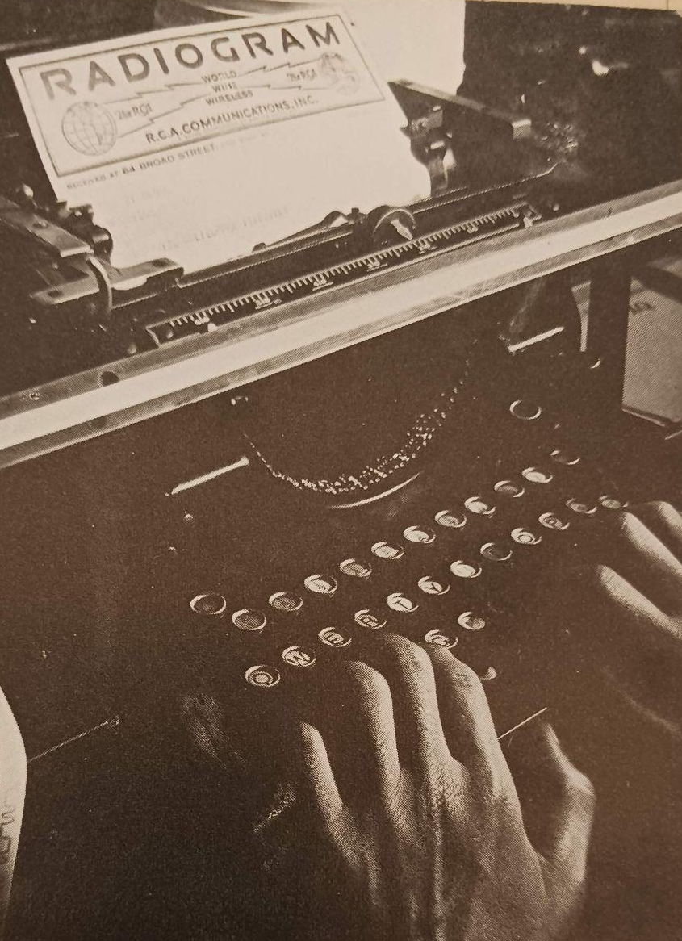
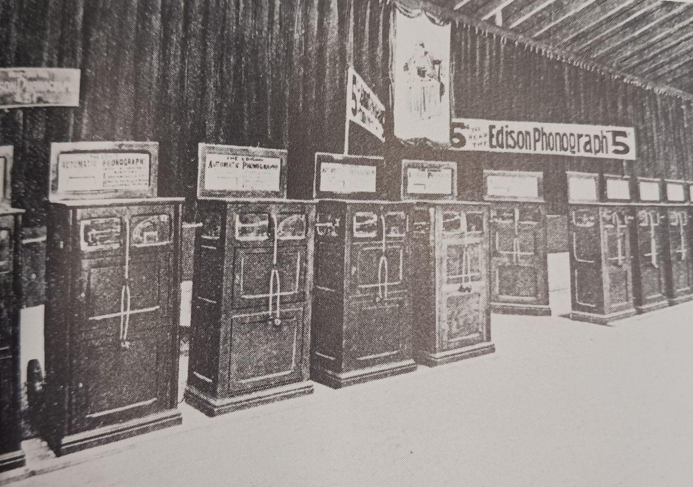
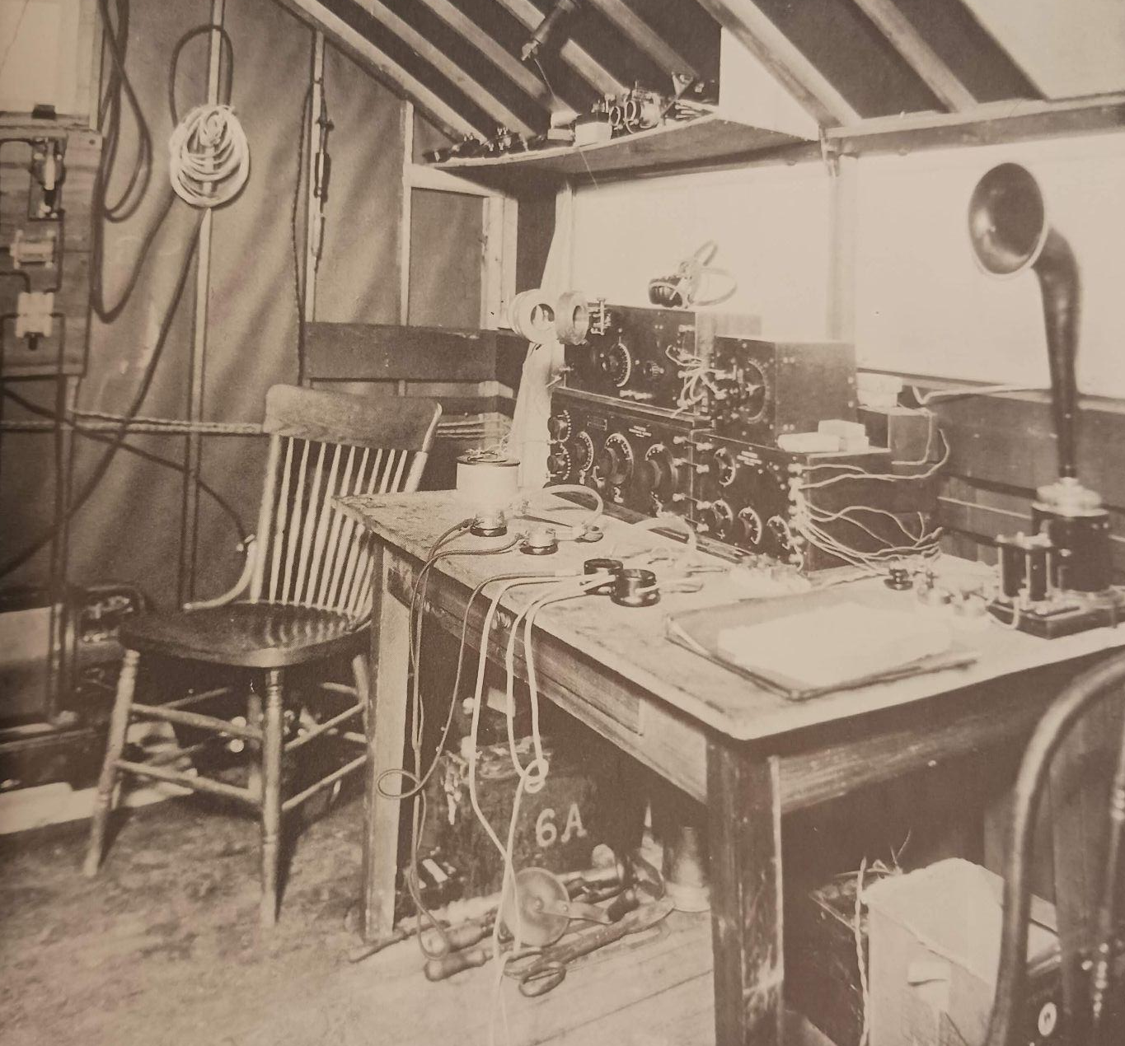
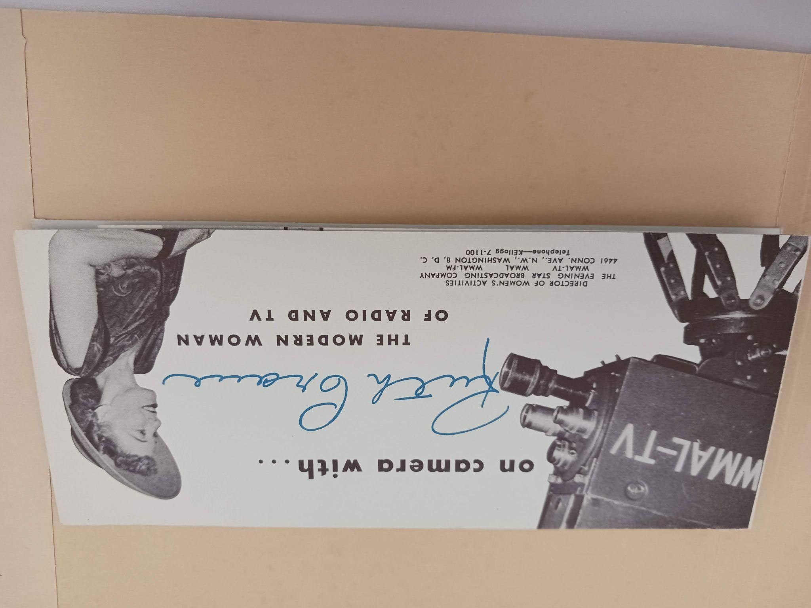
Mass Media & Culture Collection in UMD Special Collections and University Archives
This collection covers radio and television broadcasting history. This includes broadcasting business, consumer research, technical operations of stations and equipment, and the careers of broadcasting professionals and personalities. Over 6000 pamphlets in this collection have been cataloged at the item level and they can be found in UMD’s discovery layer, UMD Discover.
Notes:
The Mass Media and Culture Collection is located in UMD’s Special Collections and University Archives and it covers radio and television broadcasting history. This includes broadcasting business, consumer research, technical operations of stations and equipment, and the careers of broadcasting professionals and personalities. Over 6000 pamphlets in this collection have been cataloged at the item level by a few different catalogers and they can be found in UMD’s discovery layer, which is called UMD Discover.

Slide 3
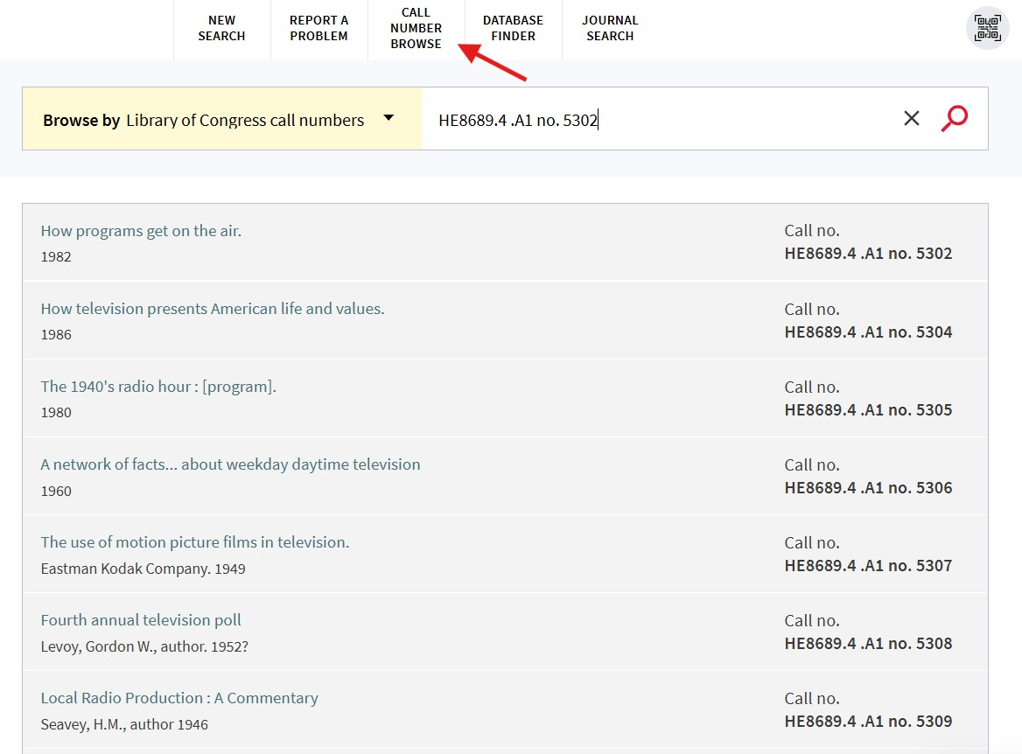
Searching for the Mass Media & Culture Pamphlet Collection in UMD Discover
Within the pamphlets collection, every cataloged item has the same call number, HE8689.4 .A1. The call number includes the item number.
For example: HE8689.4 .A1 no. 5302
You can use the “Call Number Browse” feature in UMD Discover to browse records for the entire pamphlet collection.
Notes:
The Pamphlets Collection is just one collection within the entire Mass Media and Culture Collection. Every cataloged item within the pamphlets collection has the same call number, HE8689.4 .A1, and includes the item number. You can use the “Call Number Browse” feature in UMD Discover to browse records for the entire pamphlet collection.

Slide 4
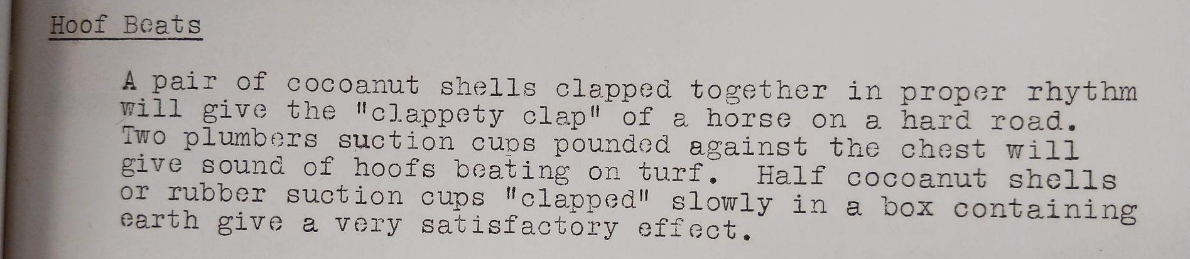
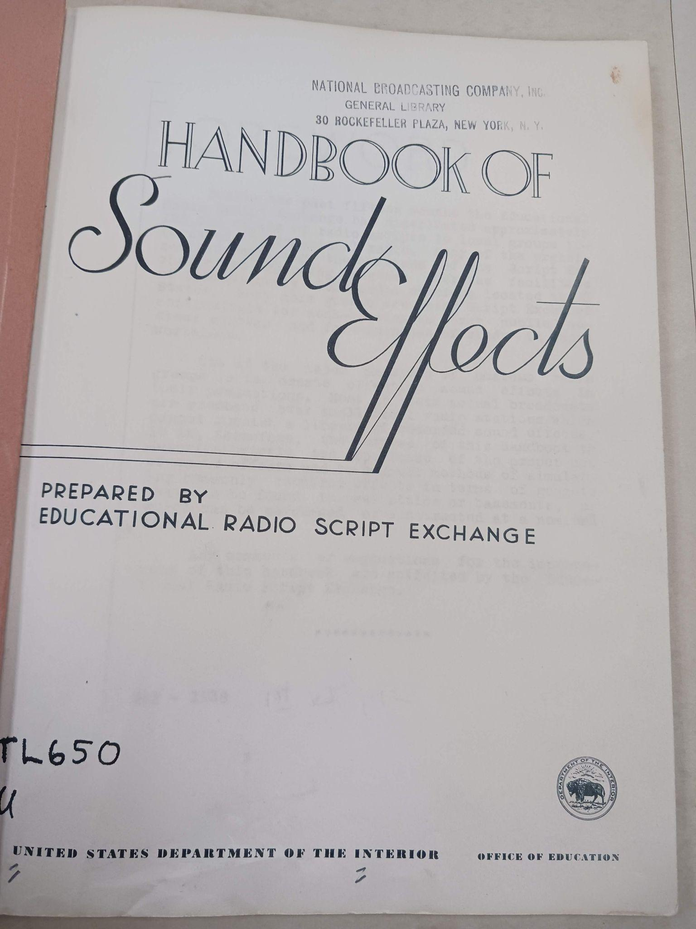
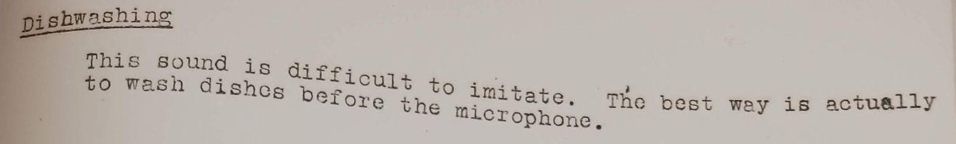
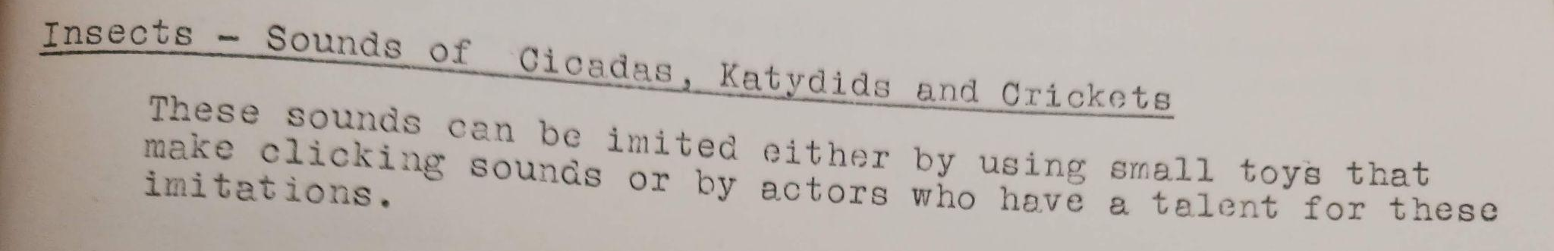
Handbook of Sound Effects, May 1938, Item no. 5570
Notes:
This is the first item that I’ll describe. The U.S. Department of Interior’s Educational Radio Script Exchange created this version of the Handbook of Sound Effects in May 1938. The Educational Radio Script Exchange distributed thousands of copies of radio scripts to stations. The Exchange realized that sound effects were hard for small radio stations to create effectively and published this guide and catalog on how to create them. Three examples from this handbook are on the screen. To create a hoof beats sound, “a pair of coconut shells clapped together in proper rhythm will give the clappety clap of a horse on a hard road”. I like this example because this is exactly how they ride horses in Monty Python and the Holy Grail. For dishwashing, this sound is difficult to imitate. The best way is actually to wash dishes before the microphone. For insects, you can use small toys that make clicking sounds. Or, you can employ an actor who has a talent for making insect imitations. Sometimes sound effects can be a lot more complex than these examples. The descriptions of some sound effects take up half of a page in this handbook.

Slide 5
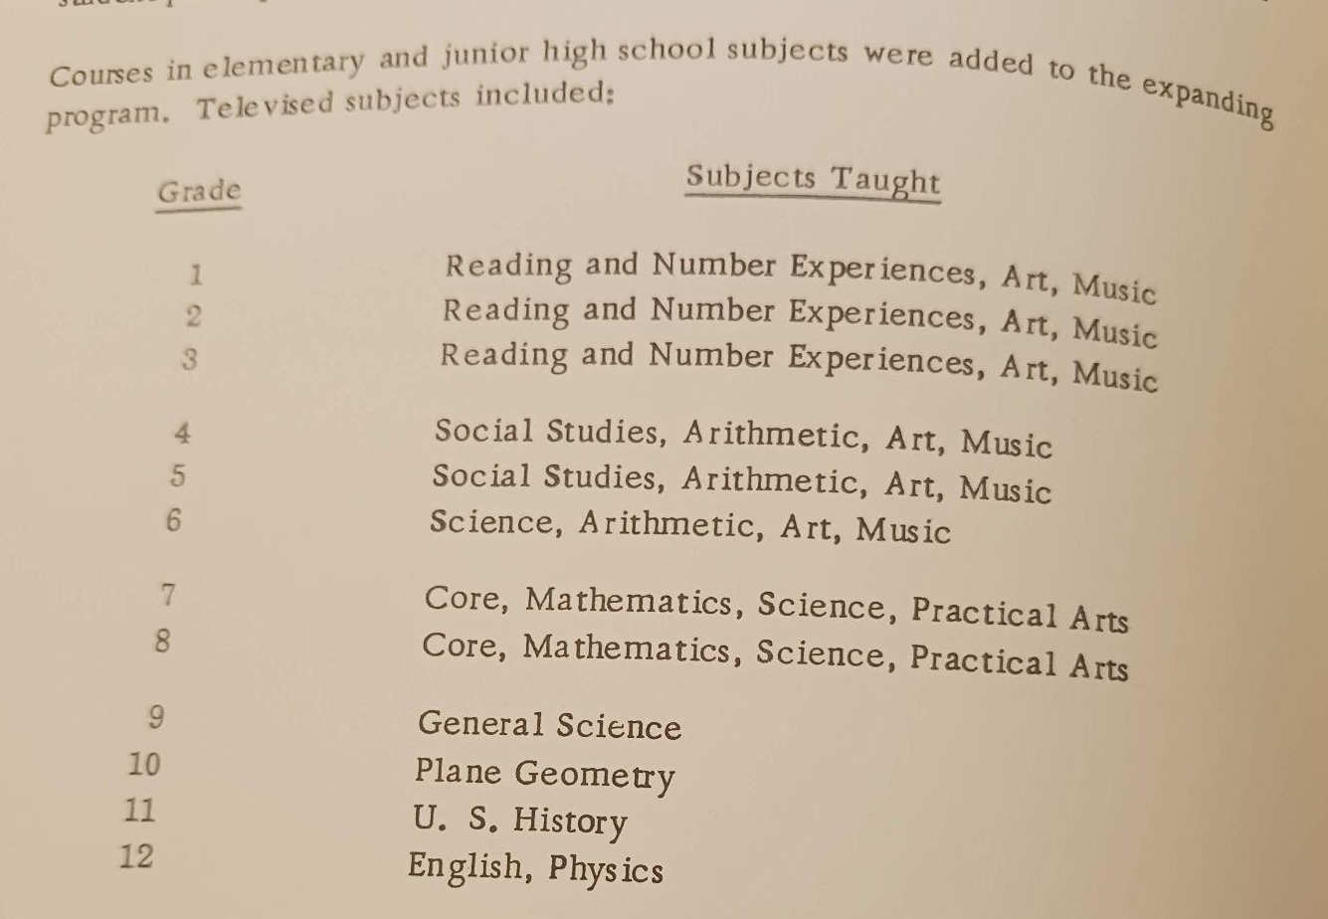
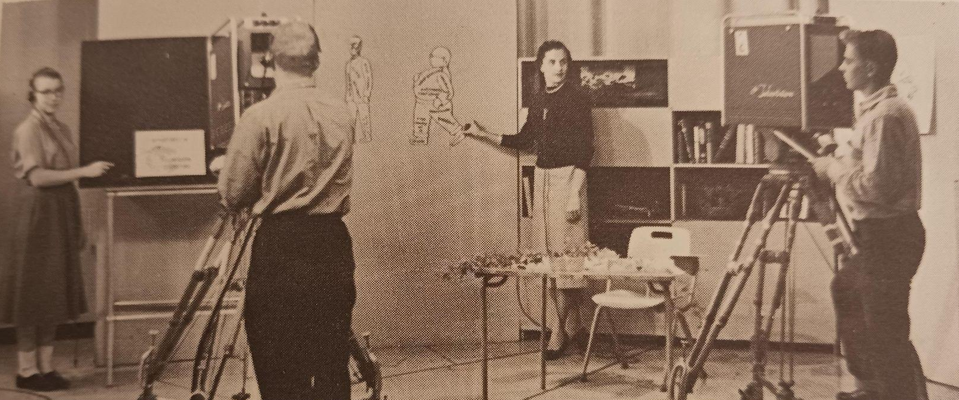
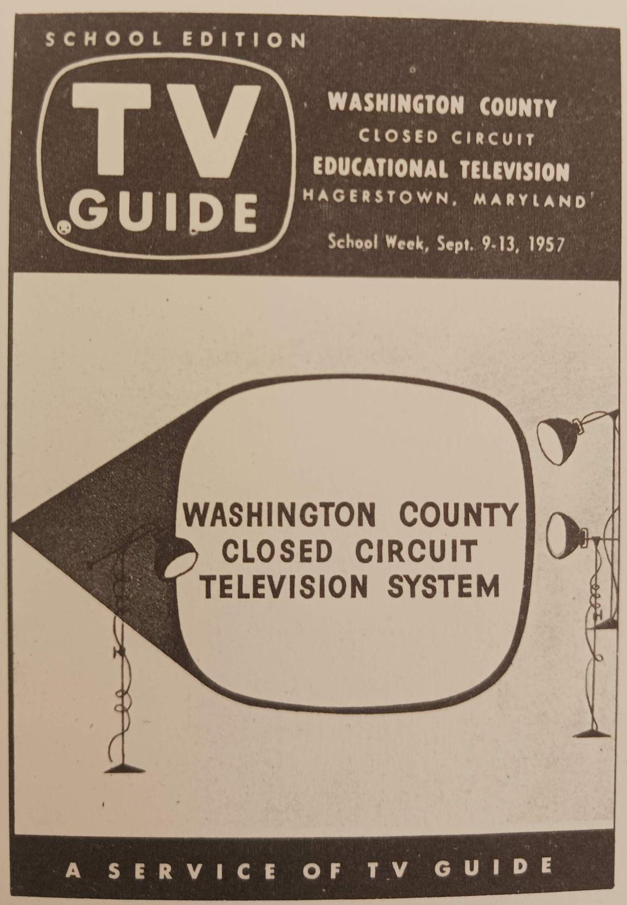
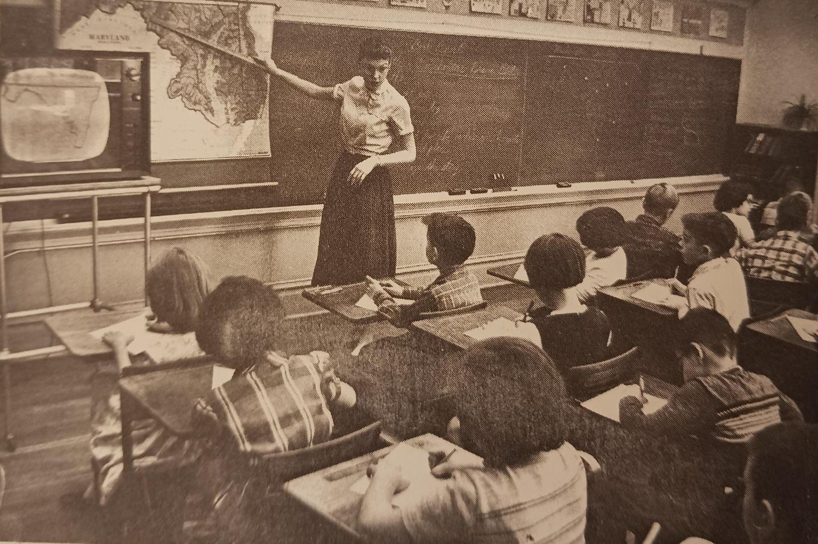
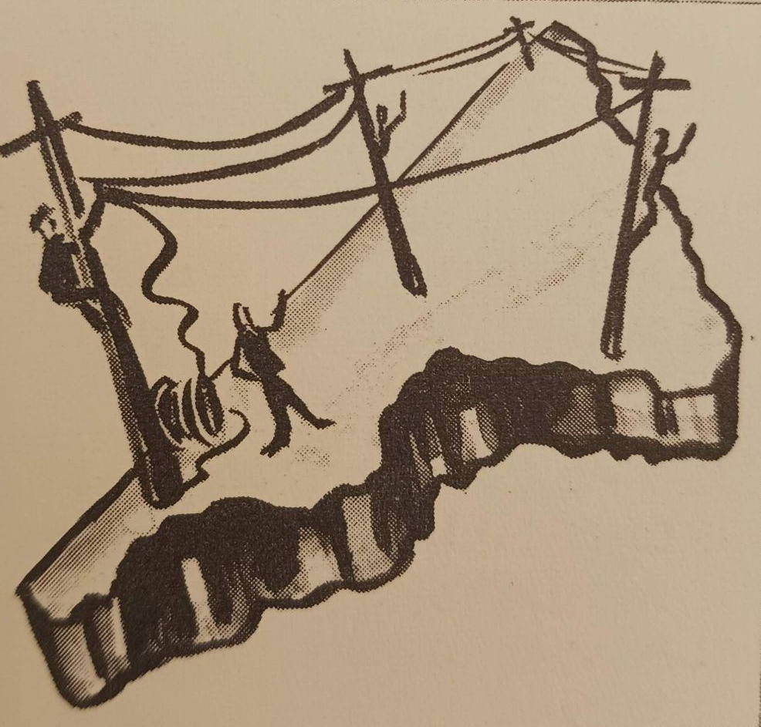
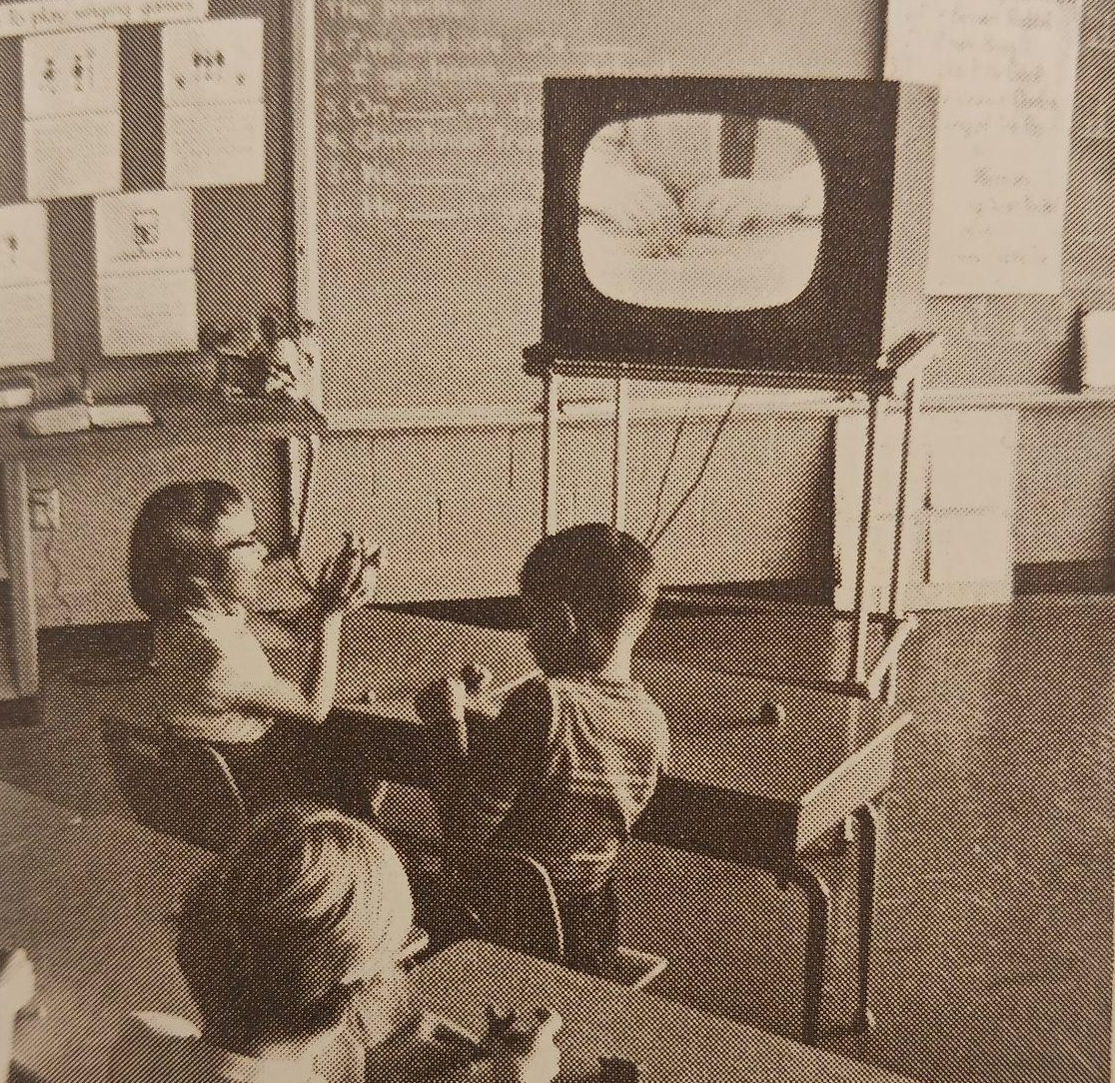
Washington County Closed-Circuit Educational Television Project, Item no. 5389
Notes:
In September 1956, Washington County, Maryland began a project to experiment with using television in the classroom. According to this 1959 progress report, few schools were using televised lessons in 1956. However, by 1959, hundreds of school districts, universities, and colleges were using TV.
To implement the project, some of the Washington County teachers became studio teachers and worked with classroom teachers to create televised lessons. Junior college students operated the television equipment and produced the lessons. The school district also had to set up a system for broadcasting in schools. The Chesapeake and Potomac Telephone Company installed and connected schools to a coaxial cable system in order to broadcast lessons.
As the project progressed, classroom teachers would request lessons for certain subjects and make recommendations on how to improve lessons. Students would usually receive less than 60-80 minutes of televised lessons throughout the day. This report evaluates the project and lists some benefits and drawbacks of televised lessons. Although in 2026, we are used to educational television, findings in this report are reminiscent of any new technology. This report states that television can be used to show places where students can’t go, show current events as they take place, and show activities that are too dangerous to do in the classroom. However, the report reiterates that TV cannot replace classroom teachers, especially because it is a one-way channel where it cannot receive feedback from students. Teachers and schools need to understand the television process, use it intelligently, and combine it with other experiences throughout the day.

Slide 6
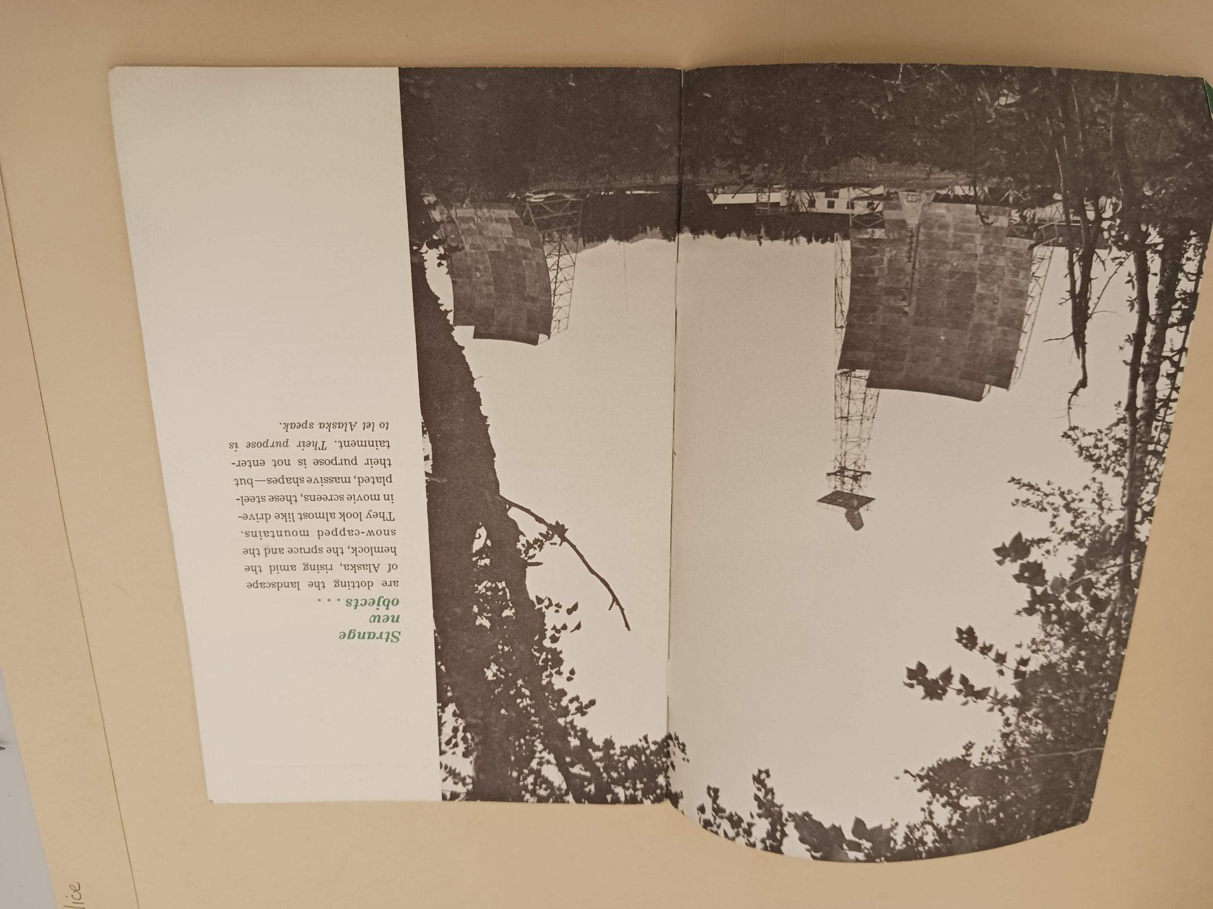
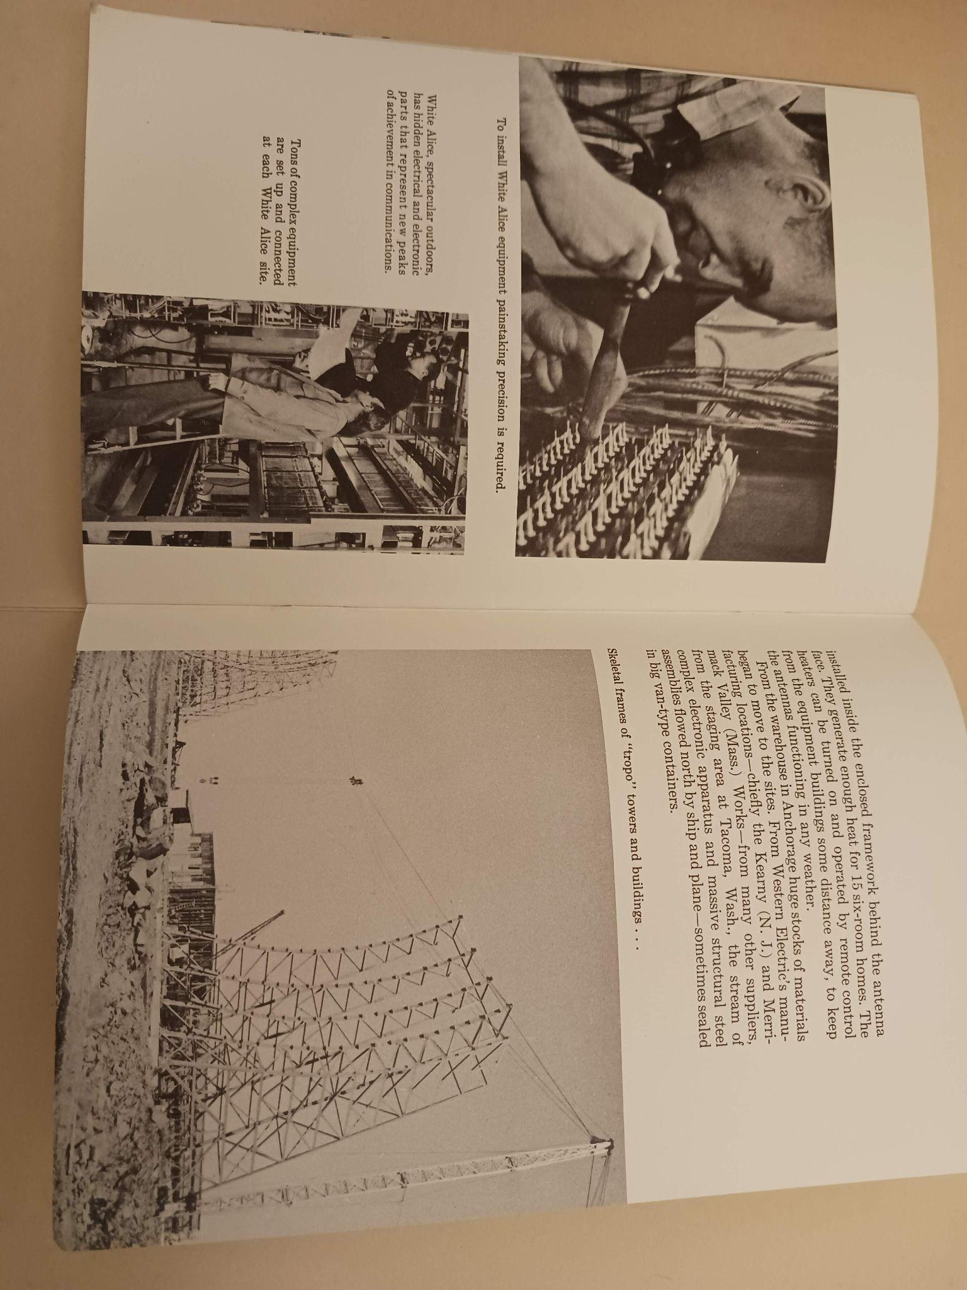
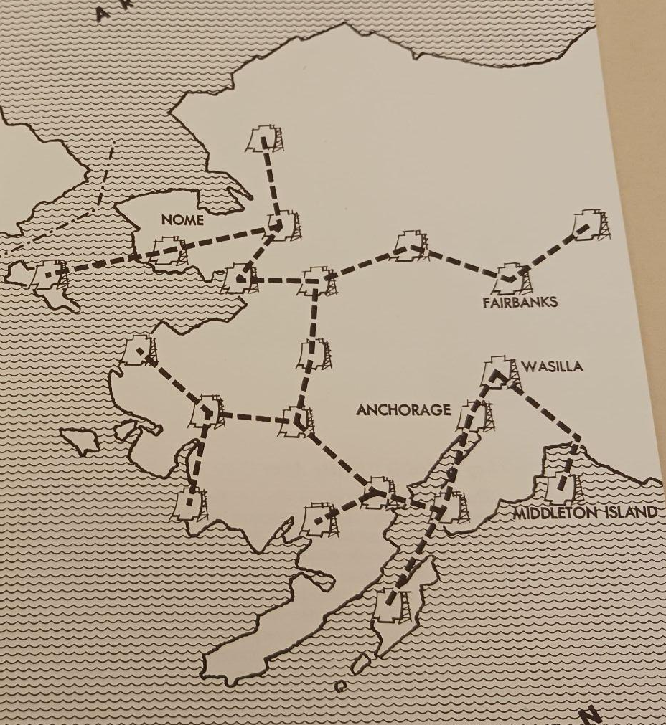
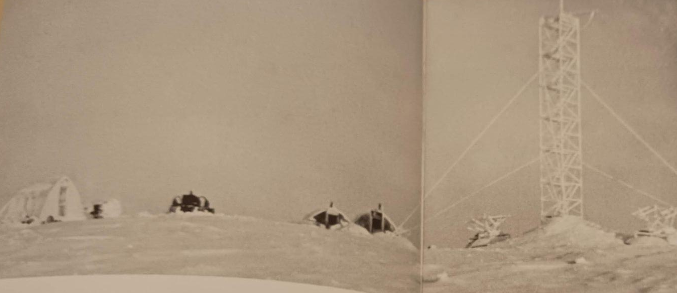
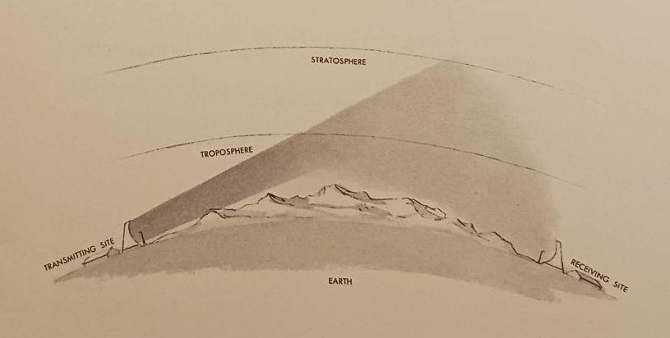
White Alice, Item no. 5050
Notes:
And now we will travel from Maryland to Alaska. Beginning in 1954, the U.S. Air Force and the Western Electric Company began creating a telephone and telegraph system throughout Alaska. They called this project White Alice. The photo on the top right shows the 60 foot scoop-like antennas. They were installed in remote parts of Alaska. Many sites were only accessible by helicopter and this book describes the rough terrain and bad weather conditions that workers experienced while surveying land and building the antennas. It was used for military communications. For example, the Air Force could use these antennas to receive reports from radar outposts north of the Arctic Circle. White Alice also allowed Alaskans to have more reliable telephone access, especially those in remote parts of Alaska.
Workers involved in White Alice needed to build a communication system that worked with near-Arctic storms and across long distances. To do this, they used a nearly new system called forward propagation tropospheric scatter, which bounces parts of radio beams off of the sky. The bottom center photo shows Earth, the troposphere, the stratosphere, a transmitting site, and a receiving site. At the transmitting site, telephone conversations and telegraph messages are combined into one radio signal. Each of the movie screen-like antennas has a tower in front of it. Each tower has a feed horn that sprays the radio signal against the movie screen antenna. Then, the signal bounces off the antenna and the signal beams out towards the sky. A small part of the signal is deflected downwards by the Earth’s troposphere and a different antenna receives it. In the more populated parts of Alaska, White Alice planned to use micro-wave radio relay for radio transmission since this was already used throughout the United States.
The antennas were built from 1955 to 1958 and used until the 1970s.

Slide 7
Fun Facts about Maryland Radio History
Maryland’s first FM college radio station was WBJC, 88.1. In 1951, it was licensed by Baltimore Junior College (now Baltimore City Community College).
In Baltimore in March 1949, less than 50% of independent grocery stores and drug stores had radios. A little more than 50% of bars, taverns, and beauty shops had radios. 82% of barber shops had radios.
In 1954, Maryland radio stations (primarily in Baltimore) had some programming in languages other than English. Languages included German, Greek, Italian (4 stations), Lithuanian, Polish (2 stations), and Yiddish.
In 1950, popular radio shows among Baltimore area radio audiences included Arthur Godfrey, Dialing for Dollars, and My Friend Irma.
Notes:
Now, we are done with our vacation to Alaska and we are back in Maryland. Here are some facts for you that are possibly fun.
Maryland’s first FM college radio station was WBJC, 88.1. In 1951, It was licensed by Baltimore Junior College, which is now Baltimore City Community College. (From: List of Standard and FM Educational Radio Broadcast Stations, 9-1-1951, Item no. 5326)
In my next fact, it’s interesting to think about the experience of running errands in Baltimore in 1949 and how quiet the experience might be. In March 1949, Frank P. Montgomery Jr. and Francis G. Malone interviewed thousands of commercial establishments throughout Baltimore to determine actual or potential radio listening audiences. They found that a lot of barber shops had radios. 82% of them had radios. However, customers were less likely to hear radio in independent grocery stores, drug stores, bars, taverns, and beauty shops. Between 41% and 56% of these establishments had a radio. (From: Radio listening audiences in commercial establishments in Baltimore City, Item no. 1127)
In 1954, most radio programs on Maryland stations were in English. But, some programs were in other languages. Languages included German, Greek, Italian, Lithuanian, Polish, and Yiddish. (From Directory of foreign language broadcasting on U.S. radio stations., Item no. 1349)
The American Research Bureau studied radio listening audiences. A report from 1950 lists Baltimore area radio stations, programs, and the number of listeners for each program. Only a few programs had more than one hundred thousand listeners. These shows included Arthur Godfrey, Dialing for Dollars, and My Friend Irma. Arthur Godfrey started his radio career in Baltimore in the 1930s before moving to Washington D.C. and Dialing for Dollars was a game show that began on Baltimore radio station, WCBM, before moving to TV because of its popularity. (From: The Baltimore radio audience, October-November 1950 : a continuing study of radio listening in metropolitan Baltimore, Item no. 54)

Slide 8
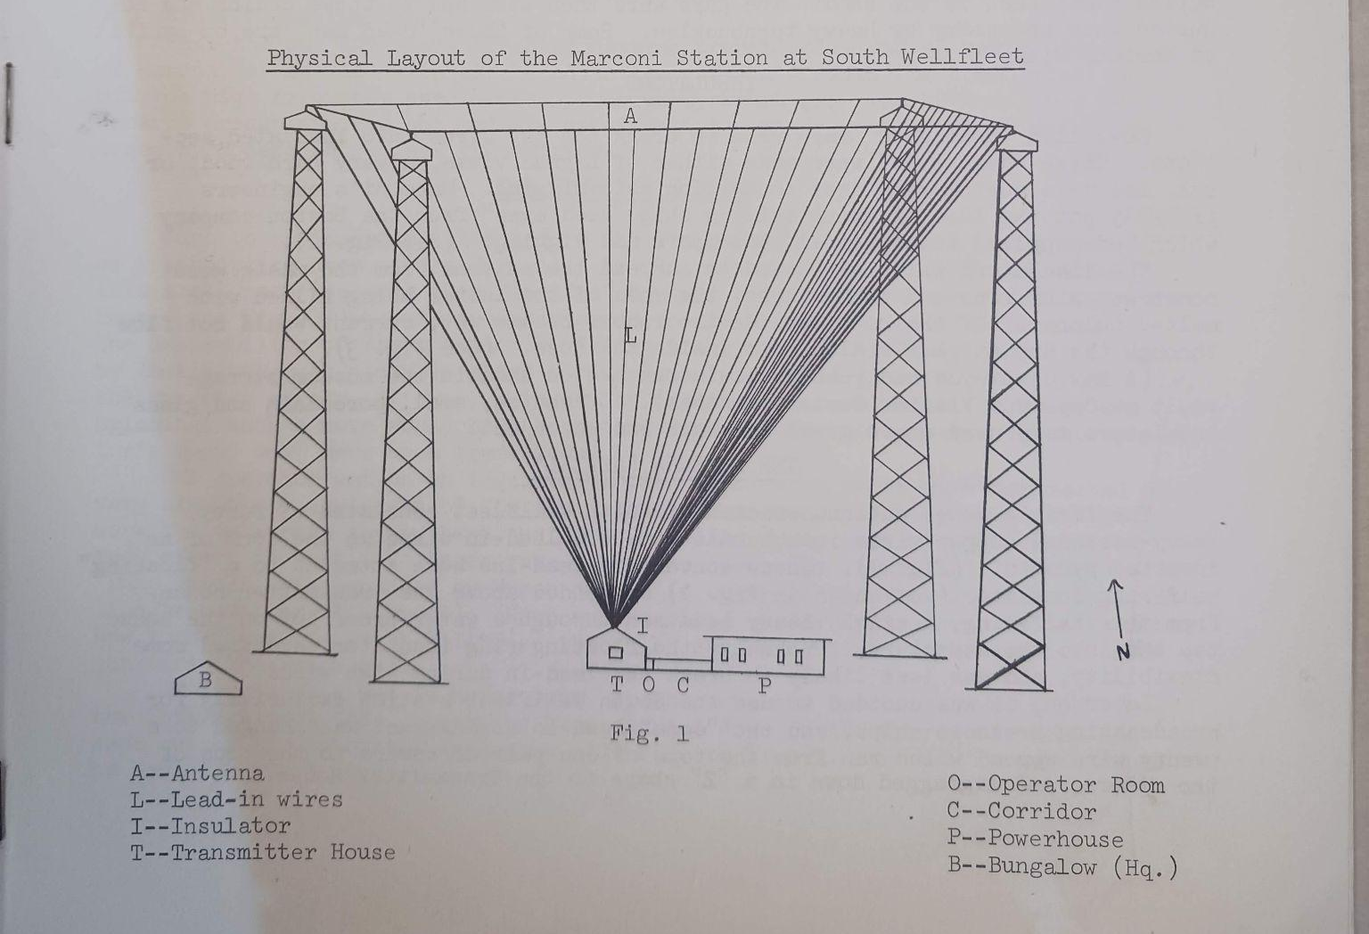
A Technical History of Marconi's South Wellfleet Wireless Station, Item no. 6038
In the late 1800s and early 1900s, Guglielmo Marconi began experimenting with transmitting messages without using wires.
By 1901, Marconi could transmit wireless messages 200 miles away by using electromagnetic waves.
Marconi built stations in Massachusetts, Nova Scotia, and England.
In 1903, the first two-way wireless communication happened between the United States and England at Marconi’s South Wellfleet and English stations.
Physical layout of the Marconi Station
Notes:
Here is my last item. At some point in the mid-20th century, E.P. Lohr, a park historian at Cape Cod National Seashore, wrote this essay about the Marconi South Wellfleet Wireless Station.
In the late 1800s and early 1900s, Guglielmo Marconi began experimenting with transmitting messages without using wires. By 1901, Marconi could transmit wireless messages 200 miles away by using electromagnetic waves. Marconi built a station in South Wellfleet, Massachusetts as well as one in England and one in Nova Scotia. In 1902, Marconi’s first South Wellfleet station was destroyed and the station was rebuilt to look like the illustration on the left side of this slide. At all three of Marconi’s stations, the four towers were wooden, cemented at the bottom, and 210 feet tall. The towers were placed in a square and set 200 feet apart. The towers were also painted a barn red color.
In 1903, the first two-way wireless communication happened between the United States and England at Marconi’s South Wellfleet and English stations. Messages between President Theodore Roosevelt and King Edward VII were translated into international Morse Code and broadcast. Throughout the early 1900s, many ships used the Marconi stations to communicate. However, the sun had an adverse effect on transmission and many ships would require repeat messages when they received messages during the daytime. In 1917, the U.S. Navy closed the South Wellfleet station for security and news censorship during World War I and it never reopened. In 1920, the station was dismantled.

Slide 9

My Email
Andrea Schuba
aschuba@umd.edu
Mass Media & Culture Collection Employees
Laura Schnitker
Mass Media & Culture Curator
lschnitk@umd.edu
Mike Henry
Mass Media & Culture Coordinator
mlhenry@umd.edu

