Slide 2




Don’t Miss!
50/50 RAFFLE
Tickets are $1 each and can be purchased from Conni Strittmatter or David Dahl! The winner takes home half the pot.
SILENT AUCTION
Visit the Silent Auction in the exhibitor hall to place your bids before 10 a.m. on Friday, May 8th.
PUB QUIZ
Thursday, May 7
8:00 – 10:00 p.m.
Choptank Ballroom
KARAOKE
Thursday, May 7
6:00 – 10:00 p.m.
Windjammer

Slide 3
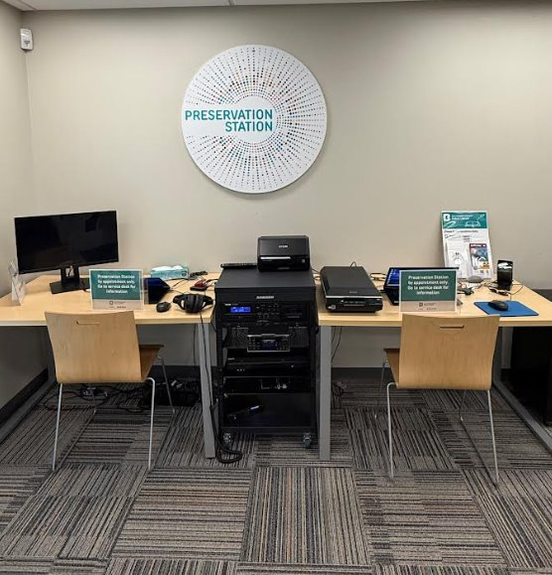
Preservation Station

Slide 4
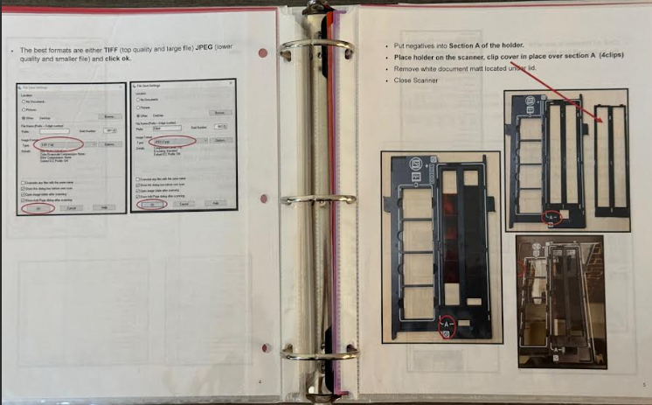
Step-by-Step Instruction Manual

Slide 5
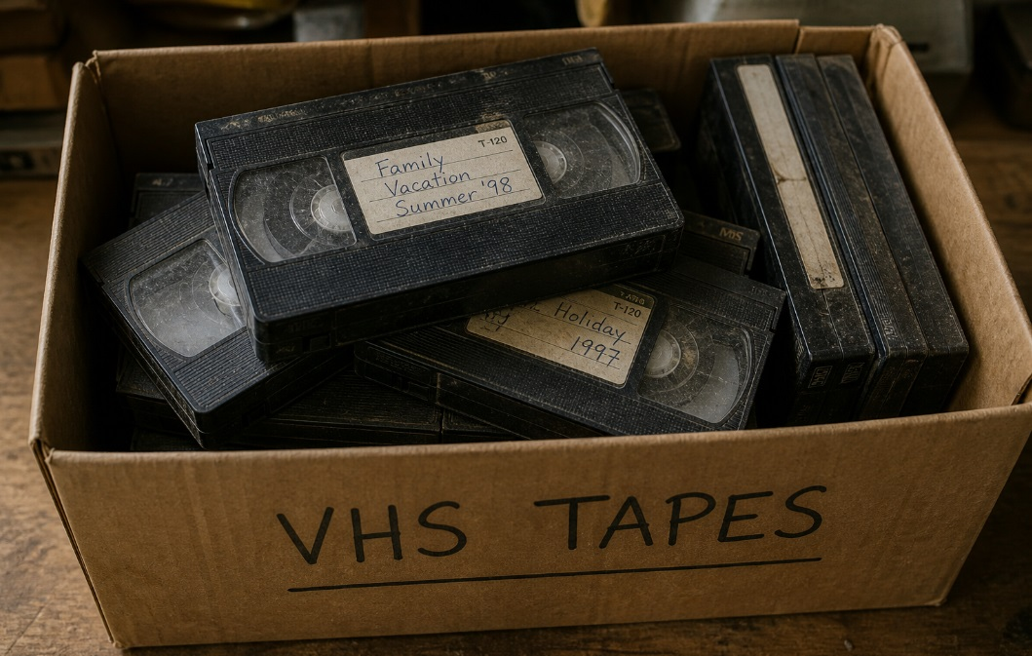
Memories

Slide 6
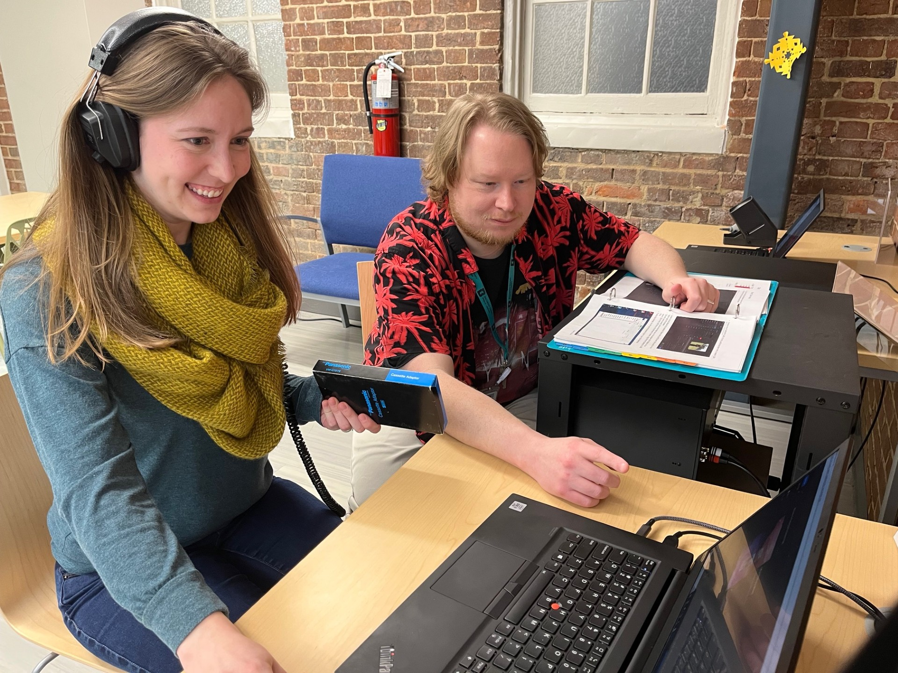
Appointments

Slide 7
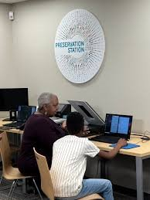
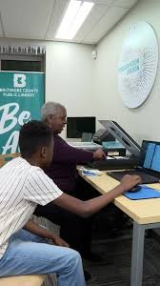
D.I.Y. Service

Slide 8
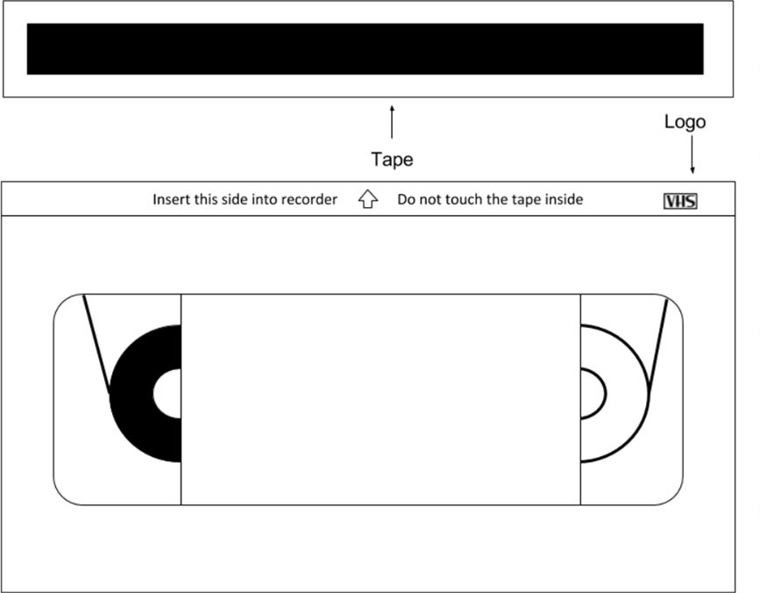
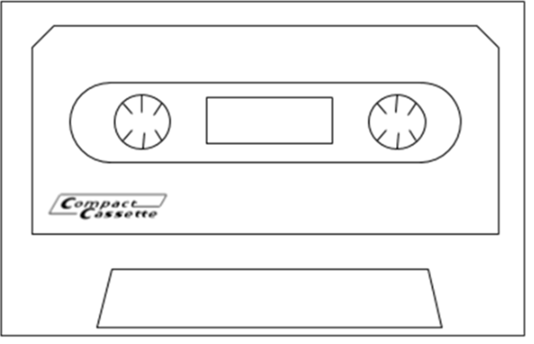
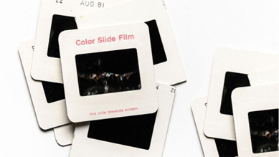
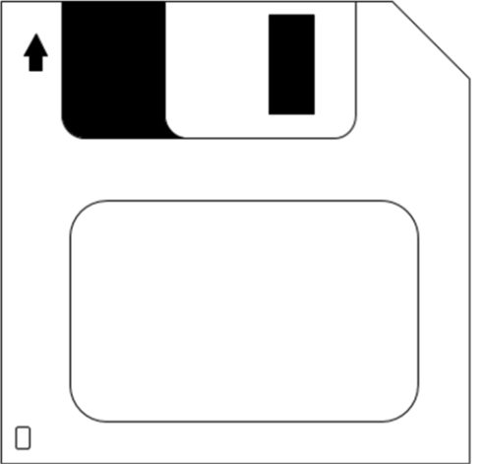
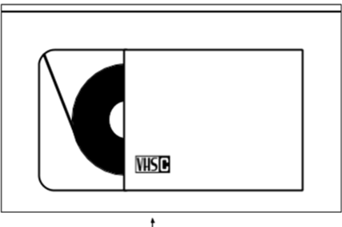
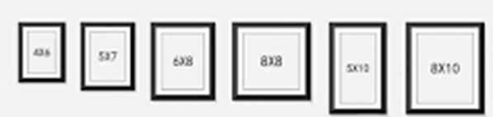
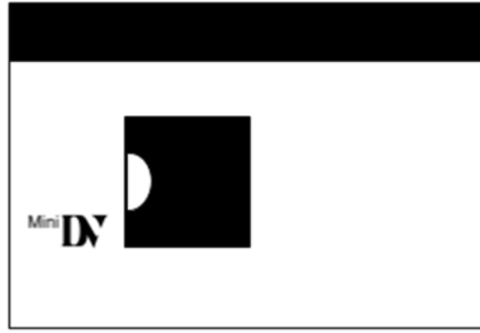

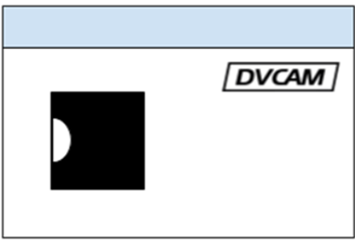
Things We Digitize
= VHS
= Audio Cassette
Video Home System
= Slides
= VHS-C
= Floppy Disc
Smaller version of VHS
= Mini Digital tape
= Photos
= 35 mm Negatives
= DVCAM
Digital Video Camera

Slide 9
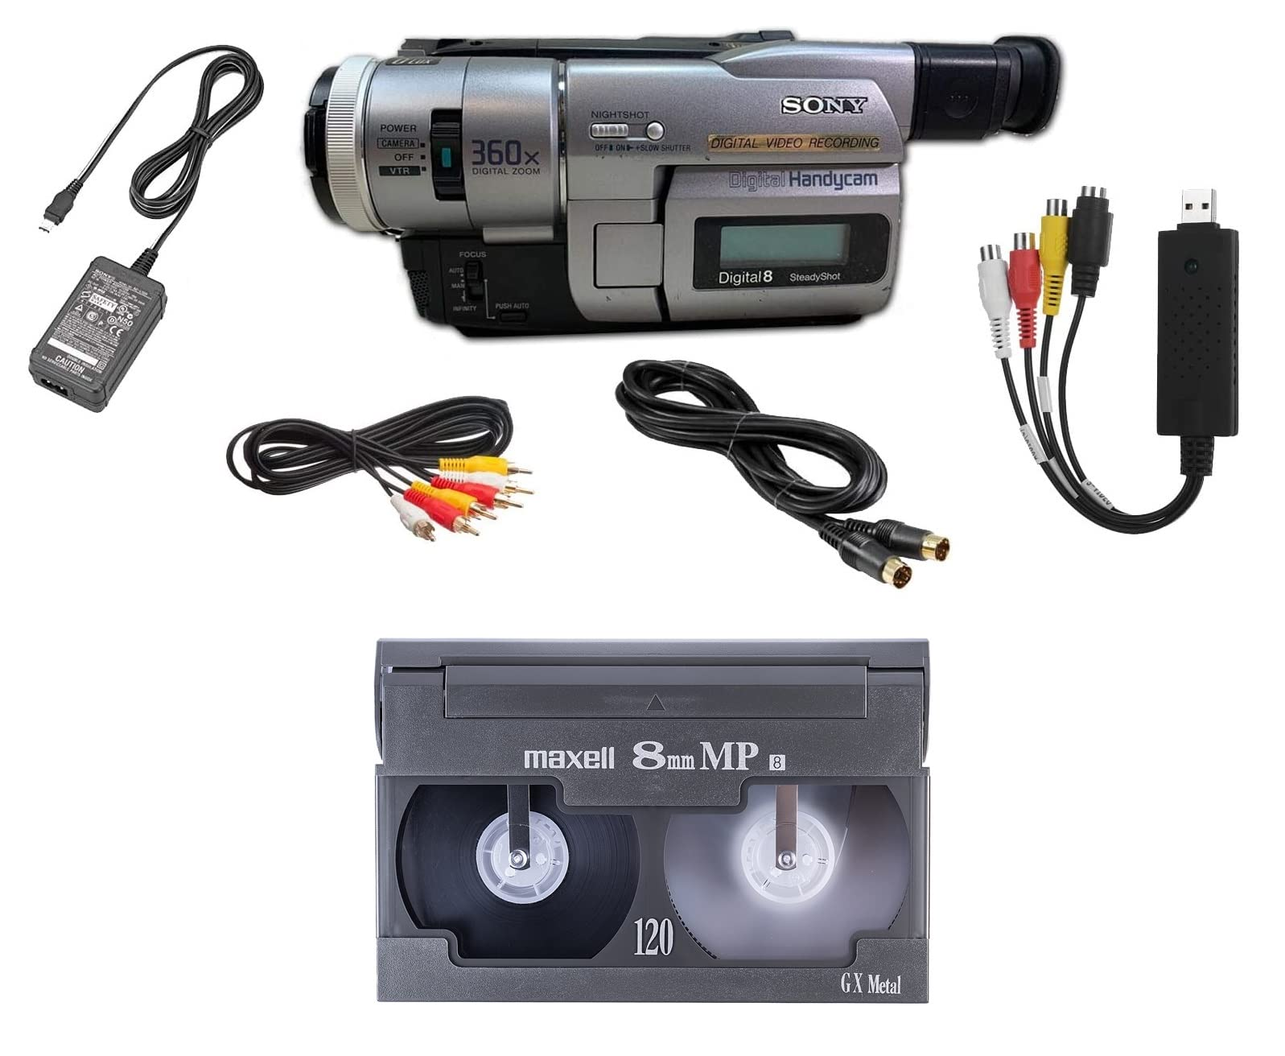
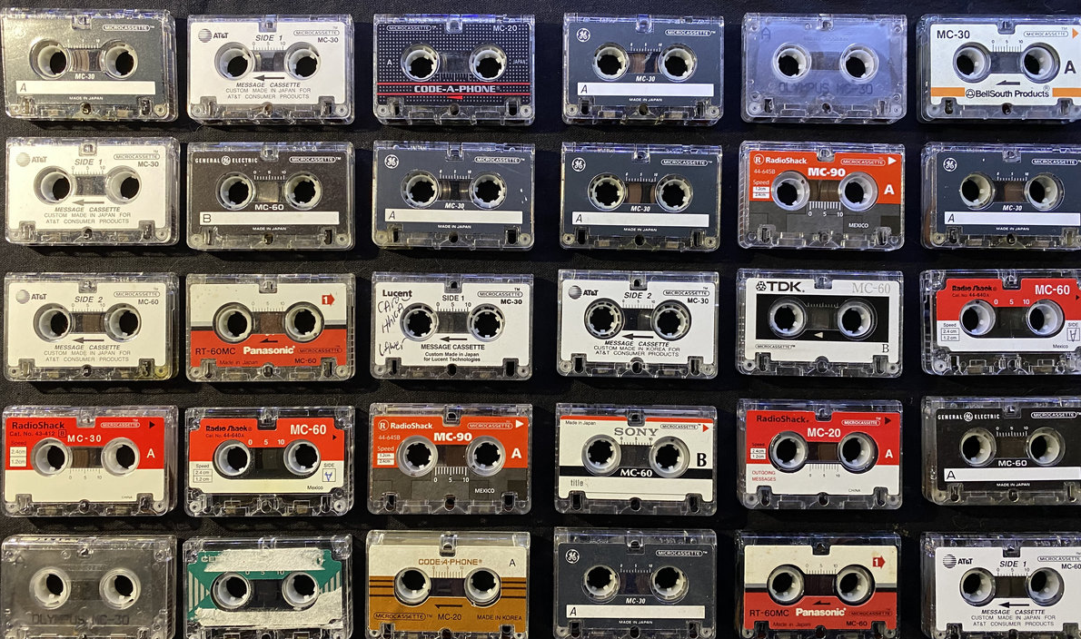
Coming Soon

Slide 10
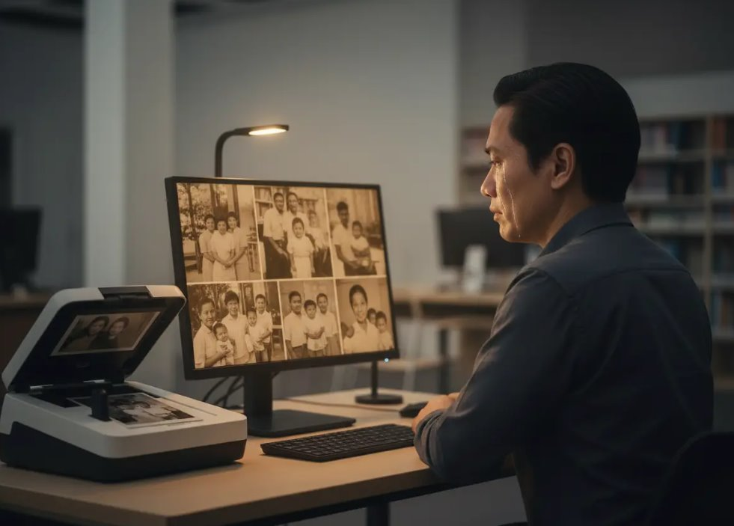
Emotional Impact

Slide 11
Customer Testimony
"My daughter and I came in today to restore my mother and father's 30-year-old wedding video.
By the end of the process, we were in tears-happy tears. My father passed away at 36 years old from colon cancer. Most of the relatives on the video passed away as well. To see my family members, especially my dad, warmed my heart and moved me to tears. My daughter was able to hear her grandfather's voice for the first time. We will share the video with my mom for Christmas, which is also her birthday. Thank you BCPL for giving this invaluable gift to my family."

Slide 12

Interesting and Unexpected Moments

Slide 13
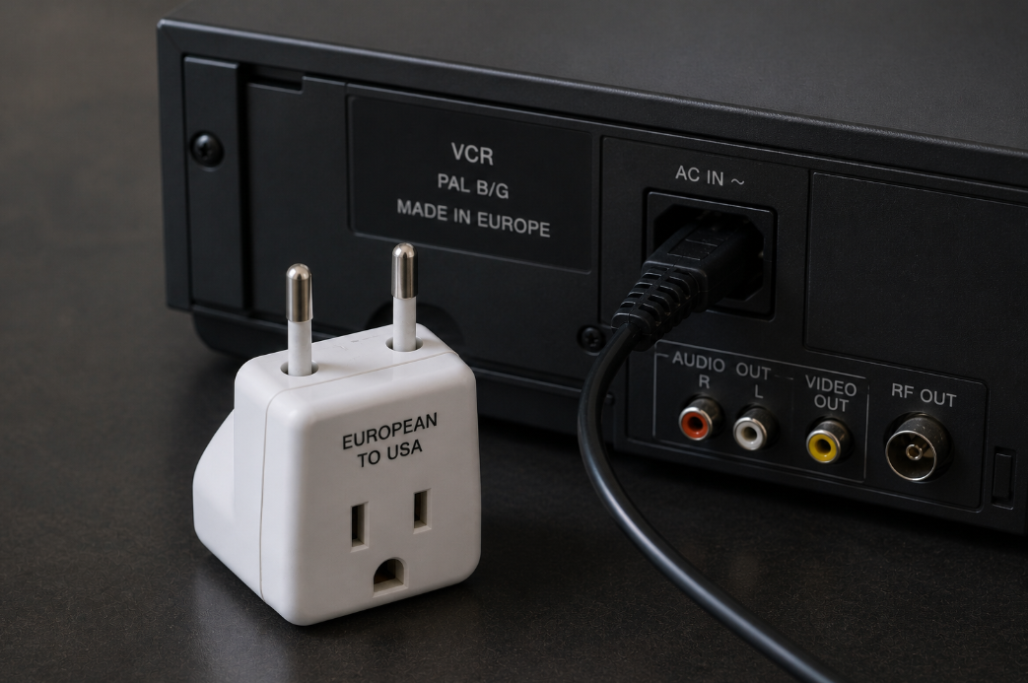
Challenges

Slide 14
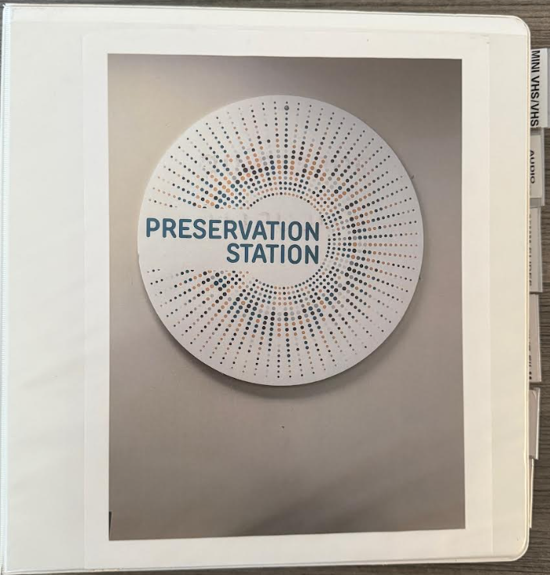
Challenges

Slide 15
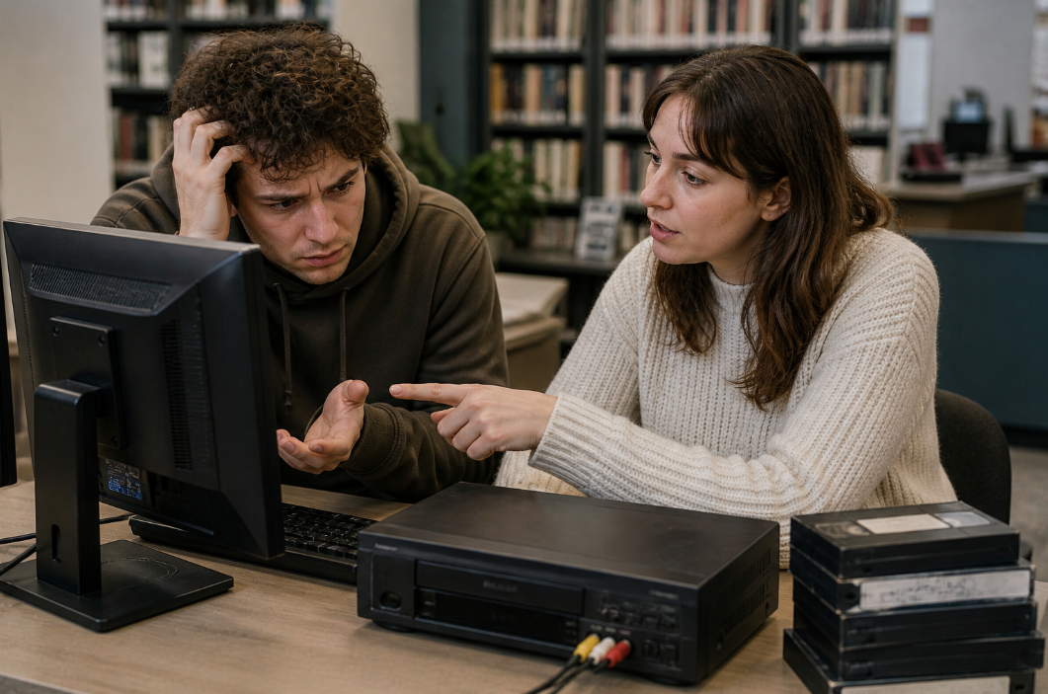
Challenges

Slide 16

Questions?

Slide 17
Thank you!
Pam Oakley
Reisterstown Branch
Baltimore County Public Library
poakley@bcpl.net

Slide 18
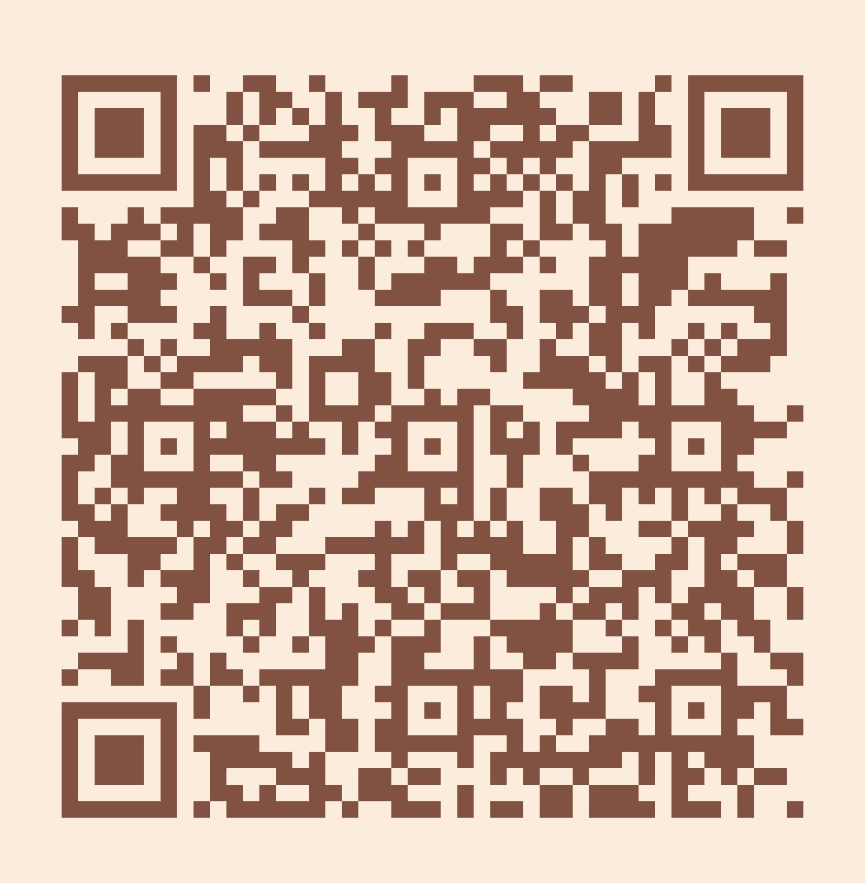
Please take a moment to complete the program survey.
SCAN ME!

