Slide 1
Our Stories, Our Shelves – MLA | DLA Conference 2026

Slide 2




Don’t Miss!
50/50 RAFFLE
Tickets are $1 each and can be purchased from Conni Strittmatter or David Dahl! The winner takes home half the pot.
SILENT AUCTION
Visit the Silent Auction in the exhibitor hall to place your bids before 10:45 a.m. on Friday, May 8th.
PUB QUIZ
Thursday, May 7 8:00 – 10:00 p.m. Choptank Ballroom
KARAOKE
Thursday, May 7 8:00 – 11:00 p.m. Windjammer

Slide 3
AI Ethics Library Instruction and Educational Autonomy
Ernest Anderson (he/him/his)

Slide 4
Additional Context
About Me
About the Presentation
Employed at Towson University (faculty librarian)
Research & Instruction Librarian
I work with a lot of early career students
Liaison to STM departments
Not a STEM person, but pretty good at faking the lingo
Early-ish career academic librarian (3 years)
Recent-ish Texas expat (1 year)
Previously at East Texas A&M University
I have been doing “AI literacy-related stuff” for students, faculty, staff, and the public since Jan. 2023, often in environments with heavy AI hype/FOMO
I often have academic R&I librarian tunnel vision, so if your context is different, please share that!
I am prone to going off on tangents - please catch me if I wander :)
I have included sample slides I have used in classes. Please use and remix however you like.
I also have full slide decks, including some on algorithmic bias, Gen AI & water, and AI detector tools. Email me if you want those!
There’s a separate document in Sched that’s a text-only version of the slides with transcripts for text-heavy images

Slide 5
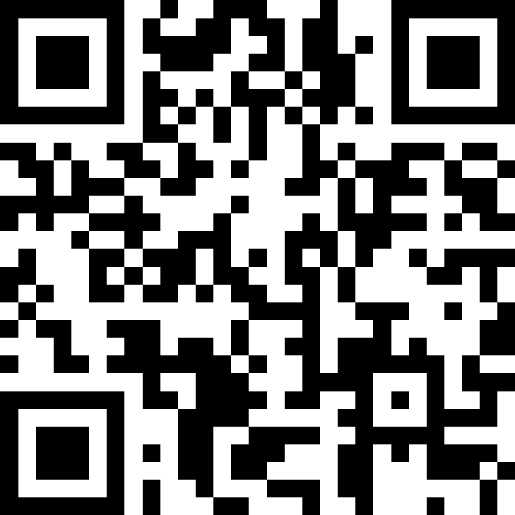
Icebreaker Question(s)
Option 1: What is one thing you already know about generative AI and ethics?
Option 2: What is one thing you want to learn about generative AI and ethics?
Join at slido.com
#4684 263

Slide 6
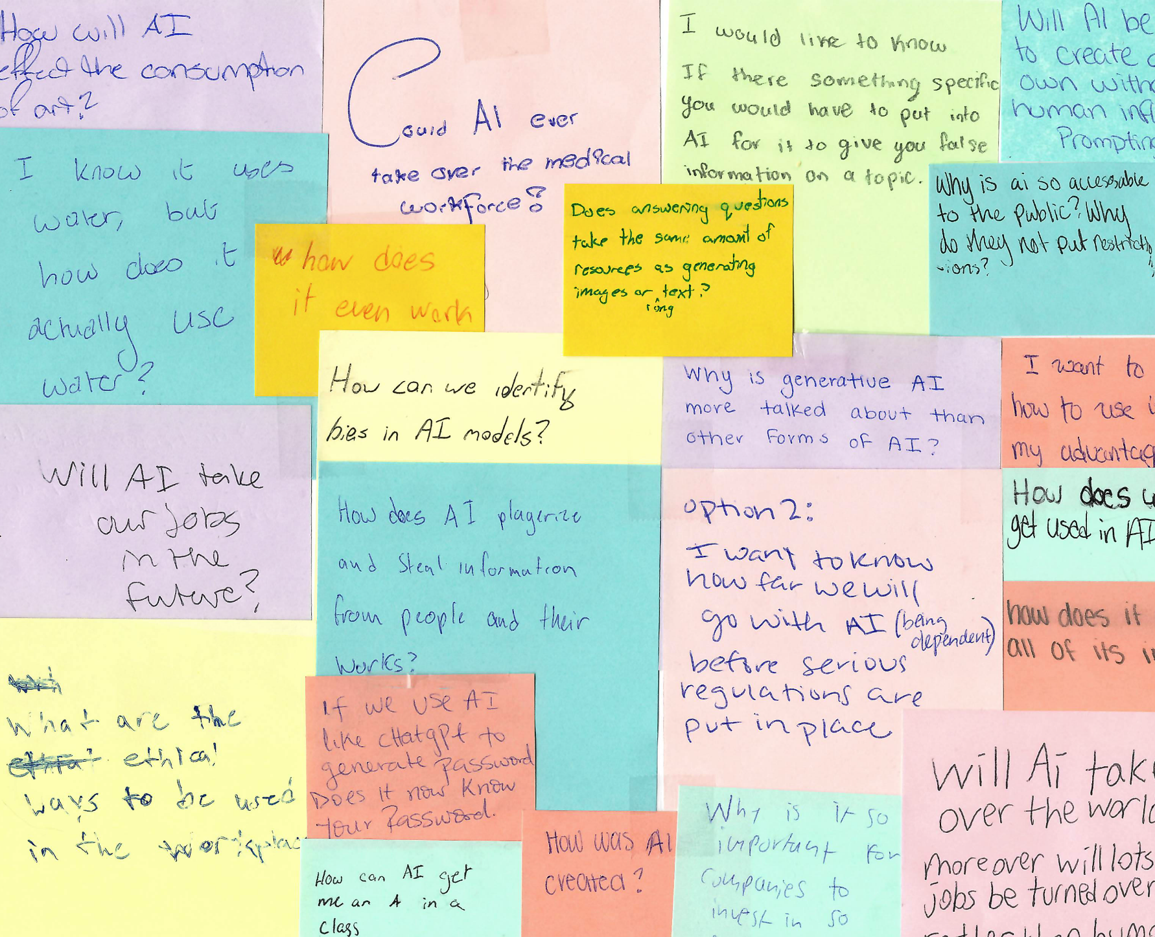
Student Responses
Get a read on the group’s interests and prior knowledge
Help steer the conversation towards what they want to learn
Student attitudes towards Generative AI are so much more diverse than usage stats imply
(Transcript -> Sched!)

Slide 7
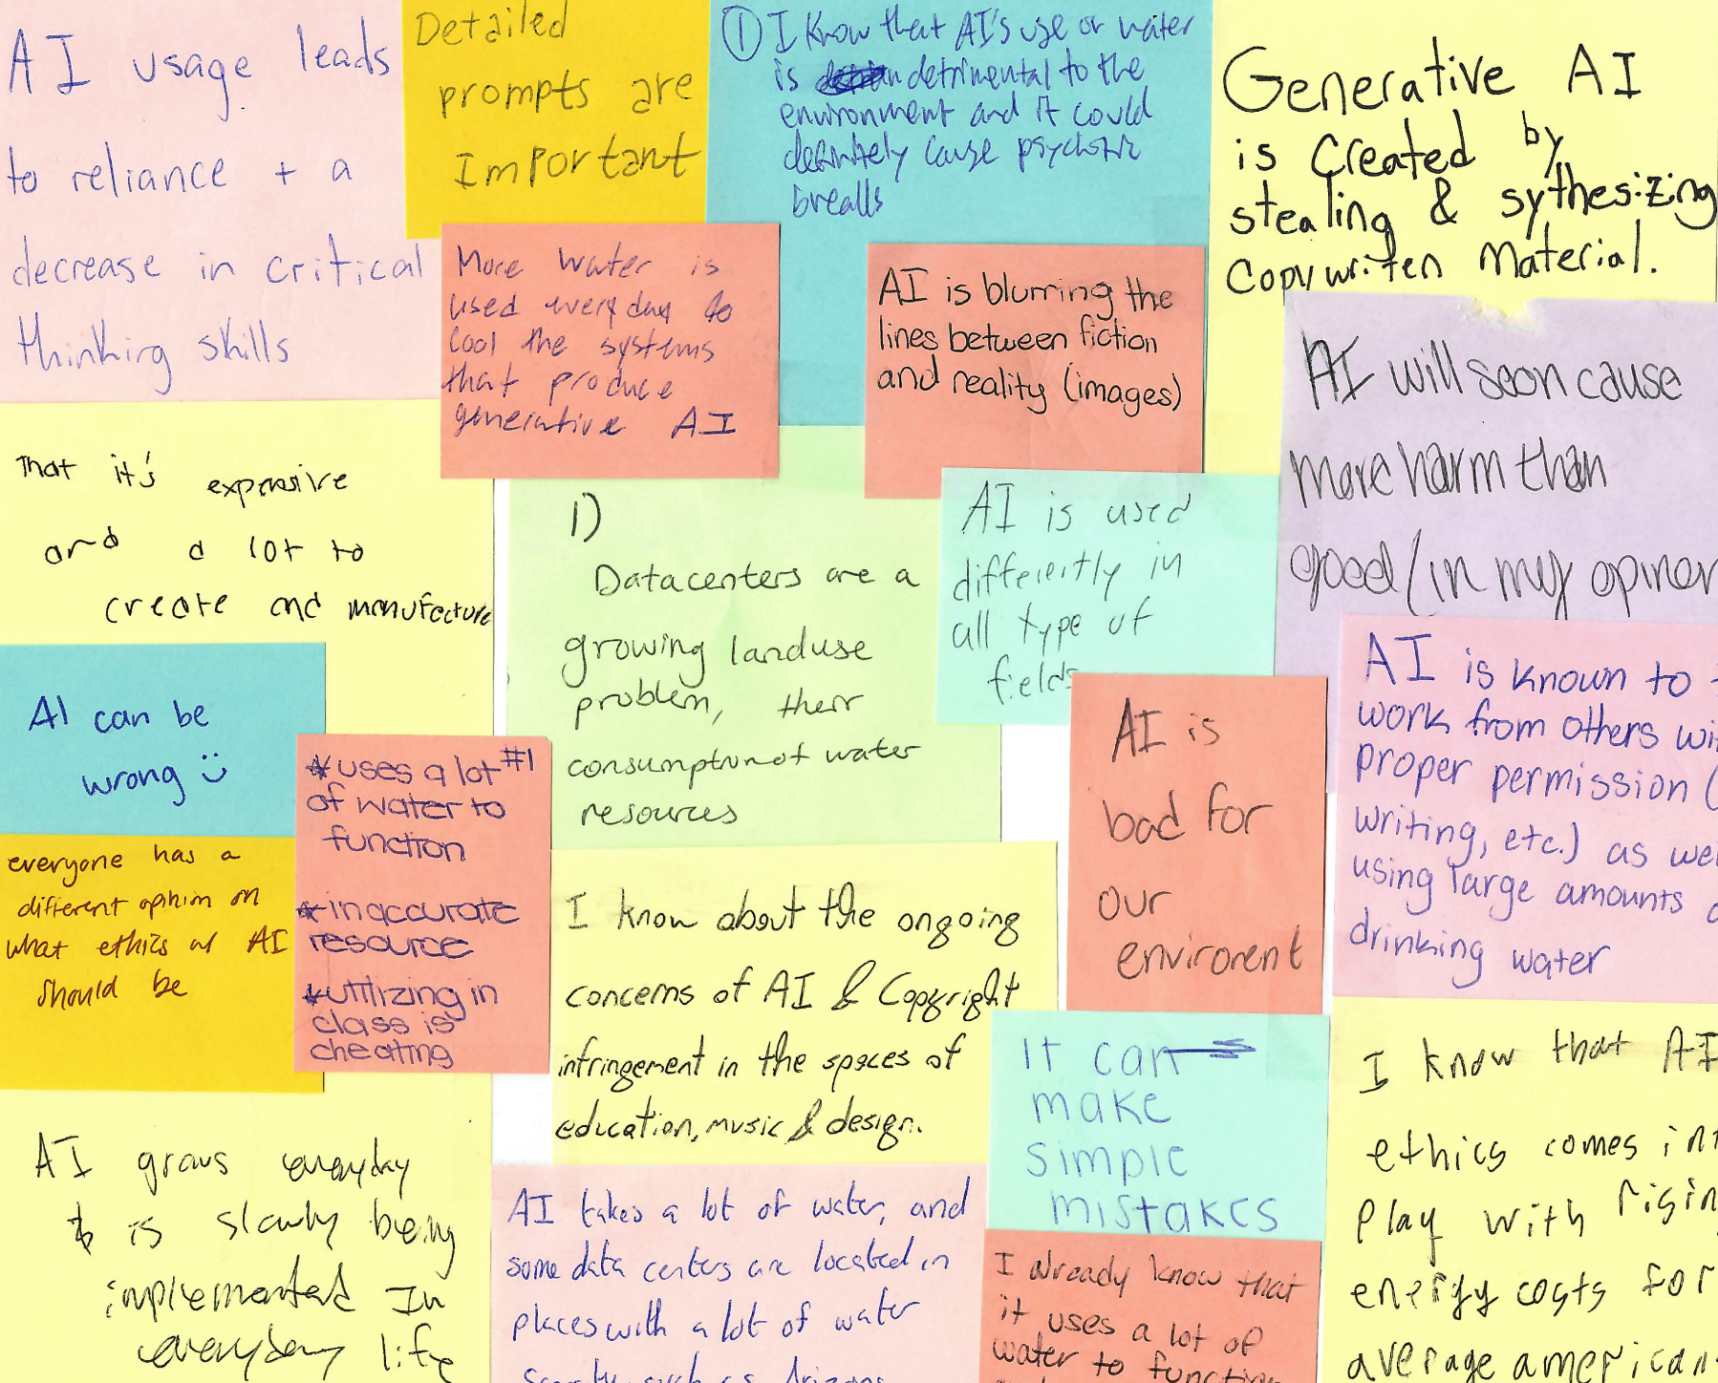
Sticky Notes?
I love getting physical responses & feedback from students so much, y’all. I am a sticky note die-hard for in-person classes.
Students can leave follow up questions with a choice of anonymity (I send answers to their instructor if they don’t leave me their email).

Slide 8
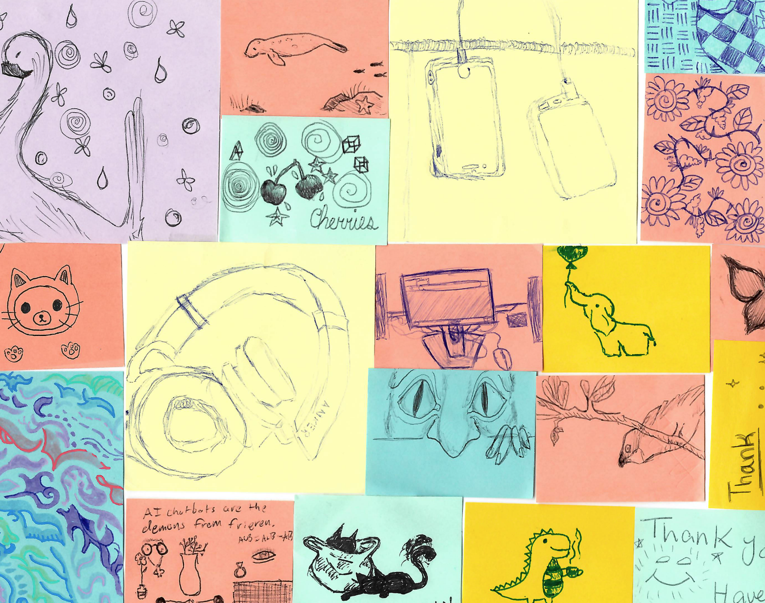
Focus Doodles!
Students can also take notes for themselves on paper if they wish, or doodle to focus.
They’re free to take their notes or leave them behind, but I do tell them if they draw me something cool, I will cherish it forever.
Many have taken me up on it.

Slide 9
Educational Autonomy
(AKA setting students up to make their own informed choices about their information-seeking behaviors and technology use, AKAx2 the thing librarians have been doing for a really long time now)

Slide 10
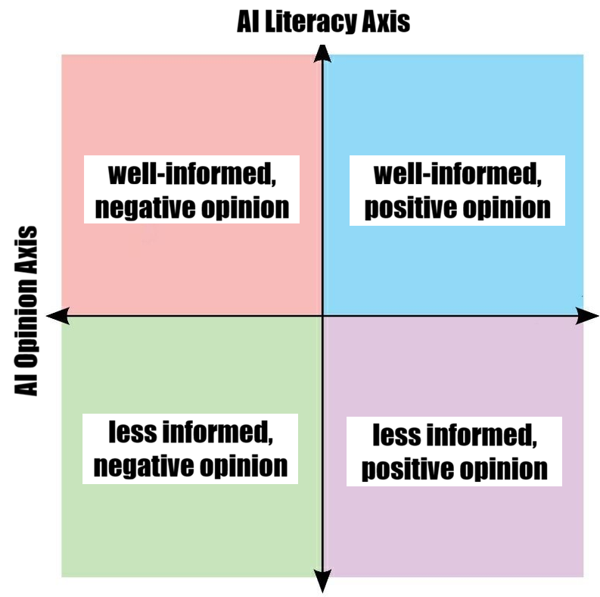
AI Literacy vs AI Opinion
I have found this kind of framing helpful when planning AI literacy instruction, particularly in conversations with faculty (& when planning trainings for my colleagues).
Gen AI can be a polarizing topic and it can help put people at ease to be reminded that the goal is education rather than persuasion.
Shout-out to the folks in that pre-conference session with me yesterday who spoke on the value of authenticity & imperfect products. It resulted in this slapdash MS Paint edit of a meme template - enjoy!

Slide 11
Unclear Expectations vs Rigid Rules
🎉 Many schools have taken the approach that it should be up to individual instructors to decide when, how, and if generative AI should be used in their classrooms. 👍 👍 👍
❓ One of the most common types of feedback I get from students is that they want their instructors to give clear expectations about how they define acceptable use. Many instructors don’t.
In the same semester, a full-time undergraduate student might take
one course where Gen AI use is banned completely
one course where Gen AI use is mandatory with no way to opt-out
two courses where instructors offer no guidance and leave them to guess what they’re expected to do

Slide 12
But students need AI skills for their careers!
Which skills?
Which tools?
In which contexts?
How much decision-making power are we assuming our students will have in their future careers?
Are we showing them how to use one or two tools on the market today, or are we preparing them to chart the course for responsible AI use in the future?
“Universities are hearing from employers that they want students who know how to use these tools. This is not because the tools actually have shown much value-add — they want Gen Z to show them where the value-add is.”
-Alex Hanna, April 2026
Notes:
Quote from Alex Hanna, the director of research at the Distributed AI Research Institute (DAIR), in an April 2026 article from the Verge about Gen Z AI haters.

Slide 13
Become Unmarketable!
“... Marketing efforts aiming to make AI more accessible to a broader audience by demystifying how AI works may inadvertently reduce consumers’ receptivity toward AI by making it seem less magical. Thus, marketing efforts targeting low-AI-literacy consumers may benefit from promoting an aura of magic around AI …”
Tully, S. M., Longoni, C., & Appel, G. (2025). Lower artificial intelligence literacy predicts greater AI receptivity. Journal of Marketing, 89(5), 1–20.
If students learn how the tools work, they are better positioned to evaluate use cases for a tool based on capability and context rather than hype.

Slide 14
Demystify It!

Slide 15
What I’ve Learned Collaborating with Teaching Faculty
There is a desire for support and collaboration!
… But I need to be up front about ways that I can/can not/will not assist.
Standalone or follow-up sessions after a more typical library introduction
Comparisons of traditional research methods vs those that include a Gen AI component
Building sessions in collaboration with faculty
Email and Zoom conversations to ask questions and talk about concerns
Requests for faculty-focused workshops
Clear explanation of what I mean by “AI Literacy” & what/how I teach
AI ethics discussions vs Prompt Engineering 101 vs “D.A.R.E. for AI”
I can’t tell if your student used ChatGPT (& AI detectors probably can’t, either)
Workshopping ways for students to try AI tools (& ways they can opt out)
Syllabus language for AI policy

Slide 16
Gen AI Basics
Concepts I try to get across even in short or multi-topic sessions:
When I have more time:
Standardized vocabulary
Gen AI vs other types of AI, or at least specificity about which type I mean
See also: ACRL’s AI Competencies for Library Workers, 2.1
Gen AI is not sentient and it will give incorrect information
Hallucination/Confabulation
Simplified explanation of the AI learning process
Discussion activity about how the learning process relates to AI ethics or changes the end user experience
Algorithmic bias
Environmental impact
Spread of misinformation

Slide 17
Terminology
Chatbots
Definitions adapted from Lacy & Chedraoui, 2025 and Stryker & Scapicchio, 2024.
Large Language Model (LLM)
Large Language Model (LLM)
Large Language Model (LLM)
Generative AI (or “GenAI”)
Large Language Model (LLM)
an AI tool that can produce new output as a response to users' prompts/requests based on patterns the AI found in its training data
output types can include text, images, video, audio, and more
a type of foundation model that is the basis for many GenAI systems.
LLMs are trained on huge volumes of raw data and build upon data patterns (ex. the next word in a sentence)
the interface through which users typically interact with a LLM. Chatbots are designed to match output to users' prompts.
examples: ChatGPT, Claude, Copilot, Gemini, Llama

Slide 18
Predictive AI
Definitions adapted from Carnegie Council, n.d.
Examples:
Rather than producing content based on training data patterns, predictive AI models predict likely future outcomes.
Predictive AI models that are purpose-built for a specific task usually have limited datasets compared to those of a LLM.
Related concepts: Analytical AI & Discriminative AI (categorization)
Weather forecasting
Sales/market analytics
Medical/diagnostic AI
Military intelligence & predictive policing

Slide 19
Important Notes:
GenAI is not truthful.*
GenAI is not intelligent.
Although language models are good at mimicking human writing, they are not truly thinking for themselves. They are replicating patterns and creating “average” output to match users’ prompts.
They only replicate the patterns they have observed in their training data. That “reality” does not always line up with the real world. Models can (and do) draw unexpected or false conclusions.
(*This does not mean that GenAI “lies.” It is just not designed to tell the truth.)
Notes:
Depending on the class & instructor, I will sometimes build upon the second statement to talk about the Harry G. Frankfurt Theory of Bullshit as a category of information - it isn’t a lie, it’s a statement made by a speaker who does not care if it is true or false.

Slide 20
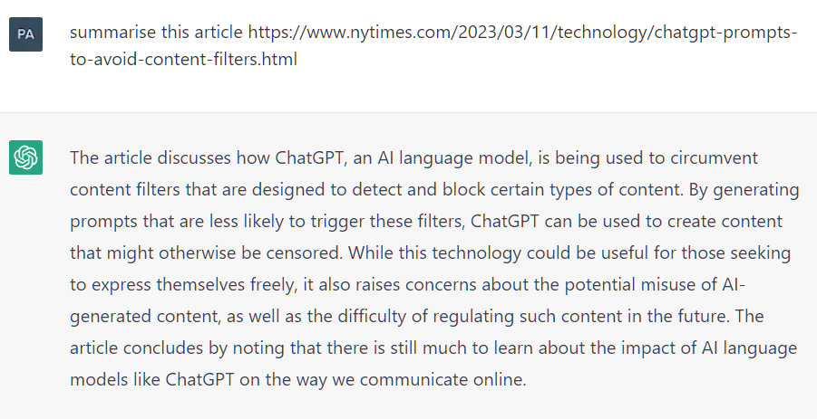
Confabulation
The article summarized below does not exist.
(Often called “Hallucination”)
The tendency of chatbots and other GenAI tools to:
Deliver false information with the same confidence as real facts
Produce fake references/sources or mis-cite real sources
Oversimplify or draw incorrect conclusions when summarizing
Yilku1. (2023). ChatGPT hallucination. Wikimedia Commons.
Notes:
Personally, I prefer the term “Confabulation” for many mostly opinion-based reasons. 1) I tend to find we can have more honest conversations about AI tools if we avoid personifying them. 2) It doesn’t feel accurate to give the issue a name that implies the model is “behaving wrong.” This issue is foundational to how these models were trained. 3) NIST’s guidance tends to use “Confabulation” and I picked it up there even if those guidelines aren’t a priority/actively being challenged by the current admin.

Slide 21




Learning: Training Data & Patterns
Dataset Assembly
Programmers assemble as much data as they can of the type they want the Gen AI model to reproduce (ex. text, photos, code).
Datasets are often cleaned to remove irrelevant or inappropriate content.*
Data Labeling
Supervised learning: human data workers must provide context for items in a dataset.
Unsupervised learning: the program identifies patterns in unlabeled data.
Pattern Finding
The program detects patterns and learns to make predictions based on what is included in its data.
Programmers can fine-tune accuracy during this time.
Reinforcement Learning
Programmers (or users of a Gen AI tool after it is deployed) identify good output vs bad output to teach the model to be more accurate.
Brown (MIT Sloan, 2021). *For more on dataset cleaning, see: Bender et al. (FAccT ‘21, 2021) section 4.1 and Xu et al. (arXiv, 2021).

Slide 22
Discussion Activity
Learning stages:
Dataset Assembly
Data Labeling
Pattern Finding
Reinforcement Learning
ALA’s Core Values of Librarianship
Access
Equity
Intellectual Freedom & Privacy
Public Good
Sustainability
Consider the Gen AI learning process in the context of the ALA’s Core Values of Librarianship.
What would Gen AI look like if it had been developed according to our profession’s values?
How do you evaluate whether a use case for a Gen AU tool meets these values?
Talk with someone next to you. We’ll come back together as a group in a moment.
Notes:
Bonus questions:
Where do you think extra caution should be taken by developers during the learning stages?
What mistakes could happen?

Slide 23
Thank you!
CONTACT INFO:
ErnestAnderson@towson.edu

Slide 24
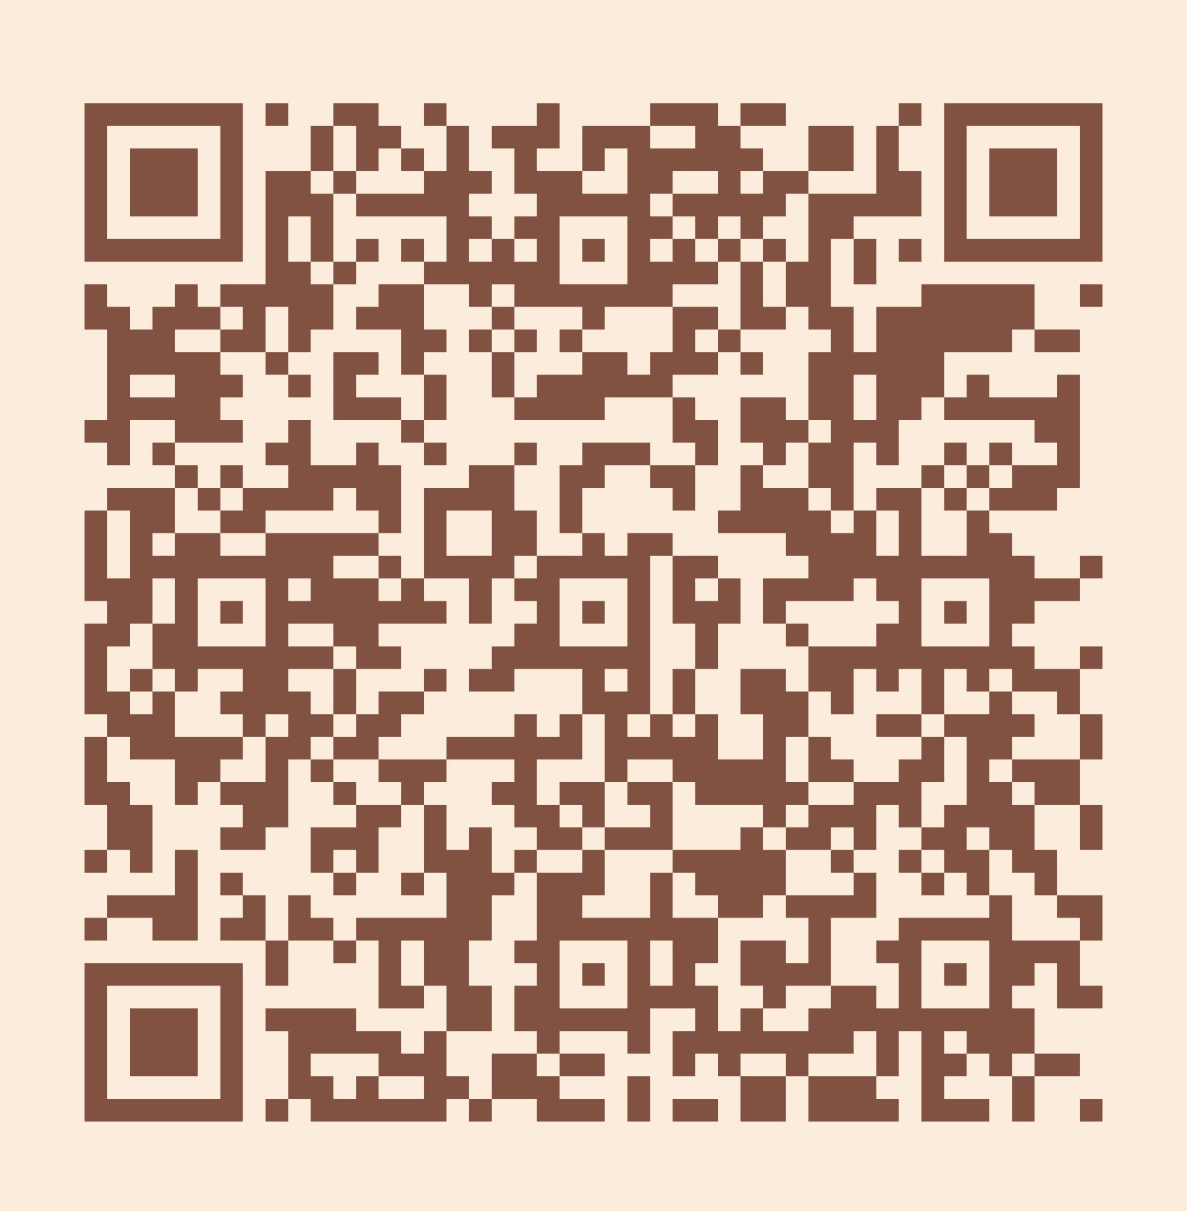
Please take a moment to complete the program survey.
SCAN ME!

Slide 25
Closing Slide: Our Stories, Our Shelves MLA | DLA 2026

