Slide 1
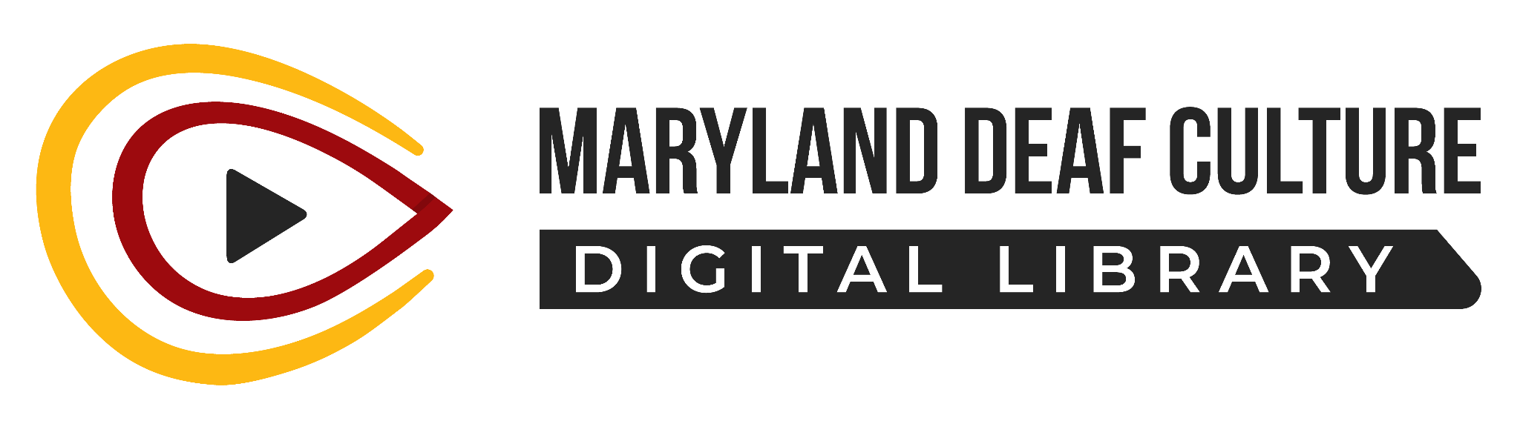

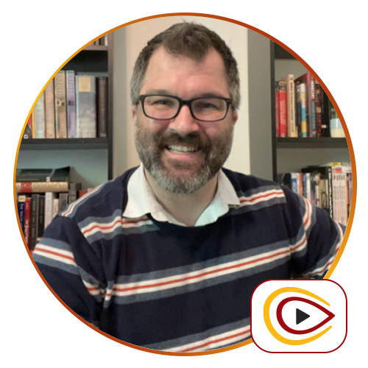
Maryland Deaf Culture Digital Library
Brandt Van Unen (He/Him)
Library Coordinator/Librarian

Slide 2
What Do We Have To Offer
Programming
Overdrive ebooks and audiobooks
ASL and Deaf family resources
Trainings
Events Calendar
And…

Slide 3
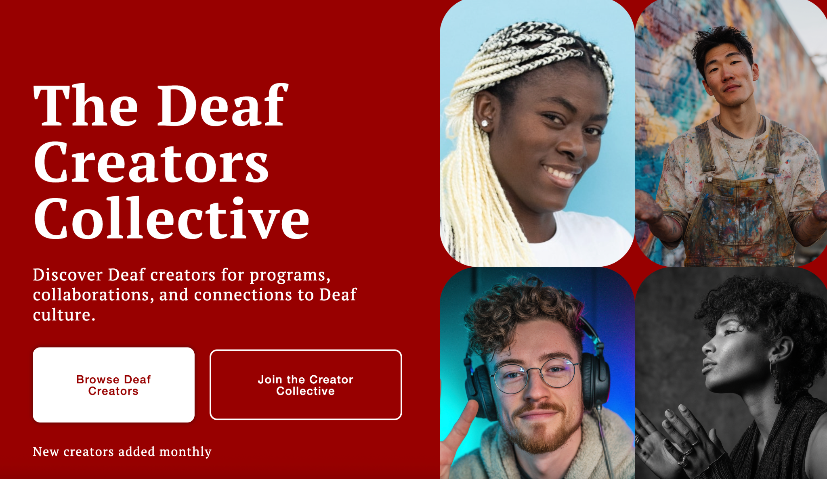

Slide 4
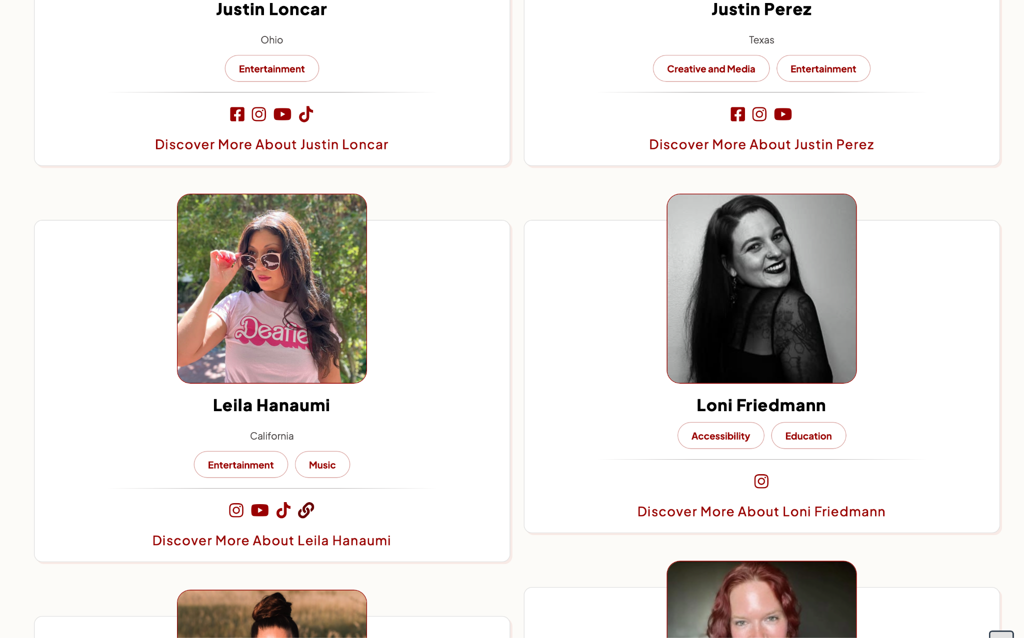
Deaf Creators Collective
The Human Library concept
Deaf community is visual-based
Collection of Content Creators

Slide 5
The Catalog’s Purpose
Curated reliable sources of information:
ASL Learning
Spectrum of Deaf Community
General and Specialized Information in ASL
And more!
Notes:
What if you are looking for a good source of information on learning ASL?
You find a popular YouTuber whose videos are ASL-focused. You learn how to sign “red”...or you thought you did. As it turned out, you learn how to sign “syrup” and you look back on how many times you used the wrong sign that’d change the context entirely.
Similar signs with the same handshape:
Finnish
Teeth
Addiction
Apple
Recent
You decided to look into the YouTuber’s background and it turned out that they were a hearing ASL student.

Slide 6
Future
Sub-Categories: Local and Archived
Libraries use our catalog to reach out to creators to teach subject matter, perform, or do author talks

Slide 7
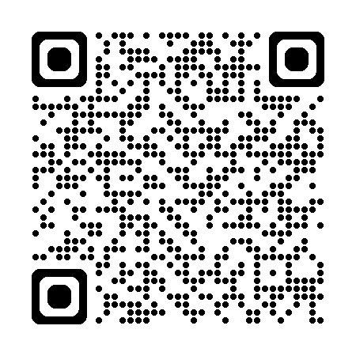
Contact us:
Maryland Deaf Culture Digital Library
www.marylanddcdl.org
info@marylanddcdl.org

