Slide 1
Notes:
NH

Slide 2
St. Mary’s County Library
S.E.E.D.S.
PRESENTERS:
Nicole Hance
Amy Dickinson

Slide 3



Notes:
NH

Slide 4

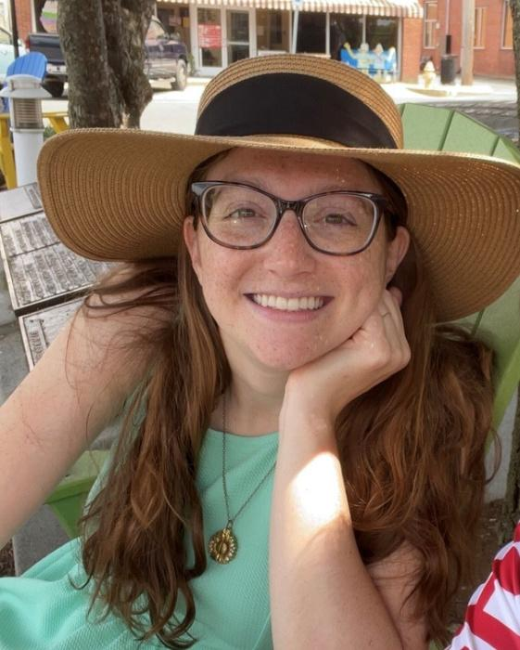

Meet Your Presenters
Nicole Hance
Amy Dickinson
Lexington Park Library
Leonardtown Library

Slide 5
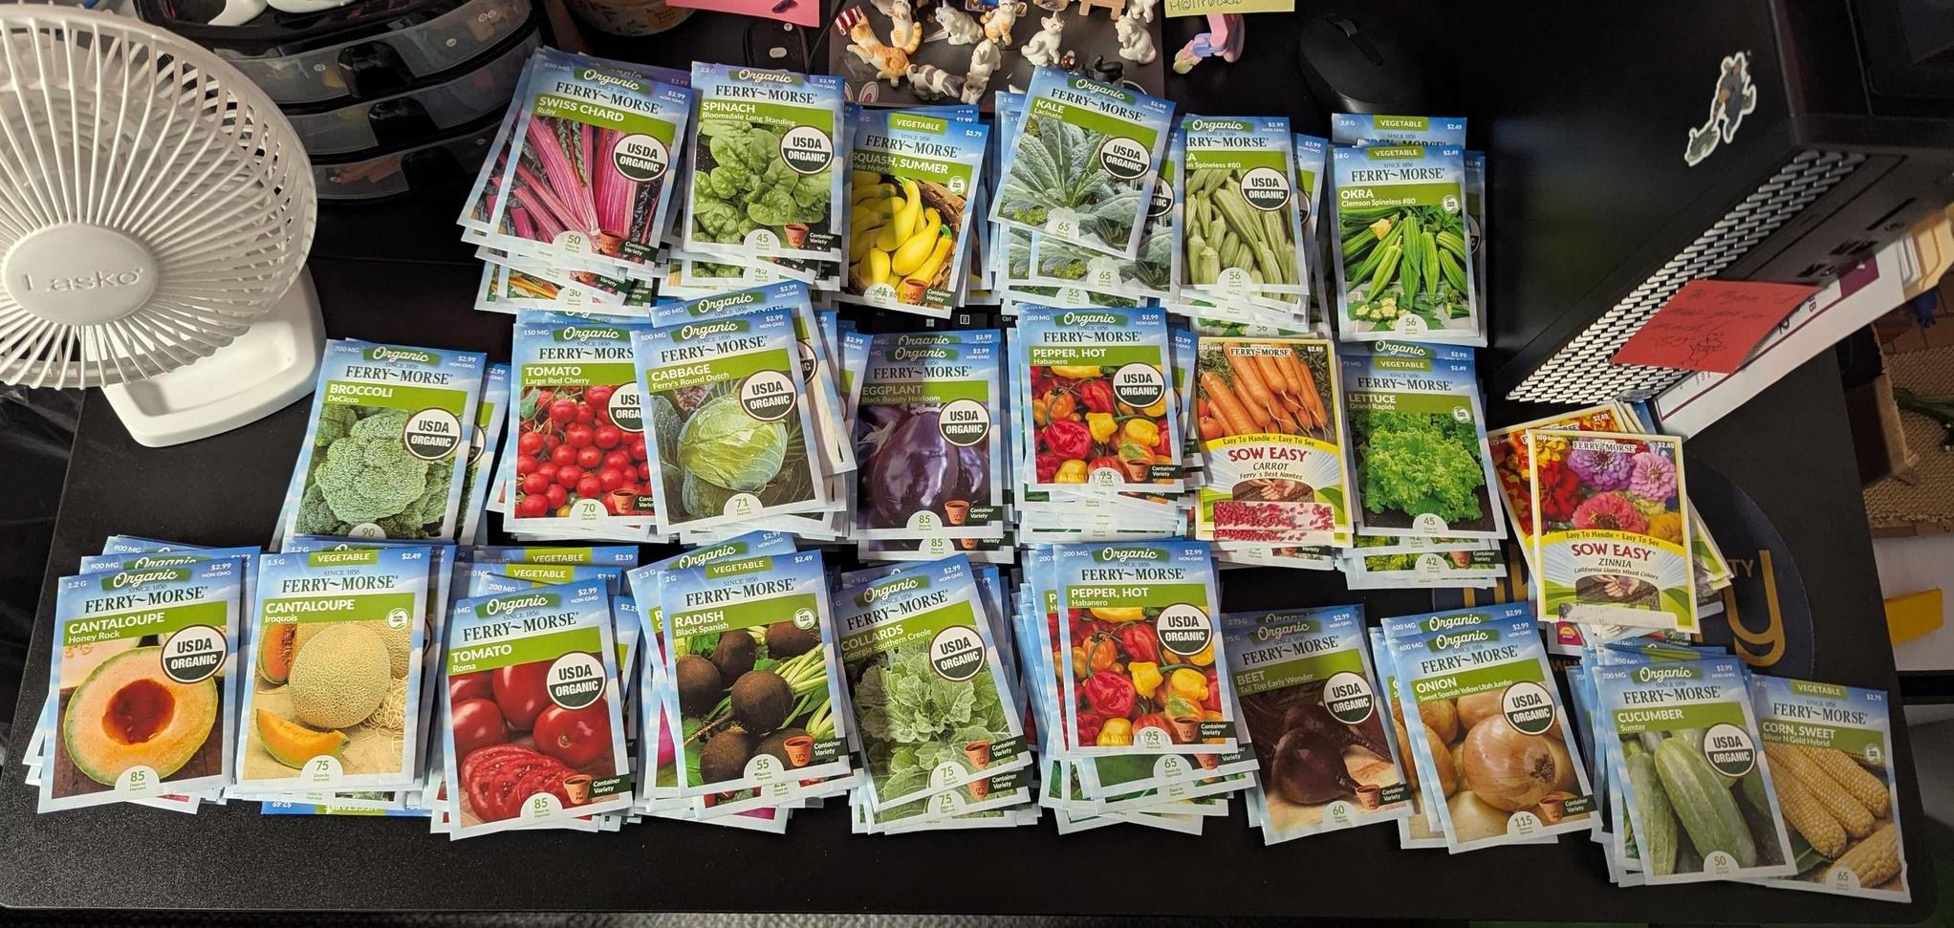


About Us
Our mission is to bring the members of our community together and give them access to free seeds and the information they will need to grow their own plants.
We hope to cultivate a flourishing network of gardeners,
plant enthusiasts, and avid learners who are dedicated to
the sharing of seeds and knowledge.
Notes:
NH

Slide 6
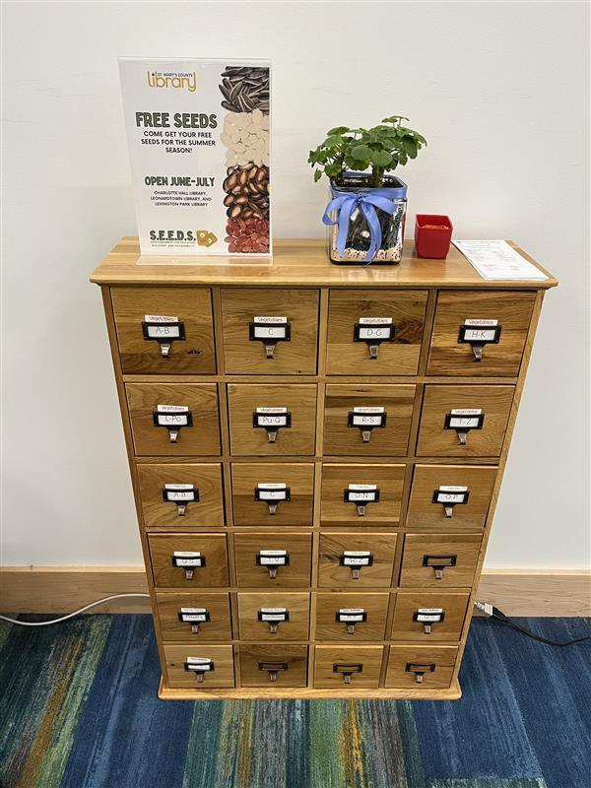
Getting Started
April 1, 2024: St. Mary’s County Library SEEDS opens with immediate popularity.
Seeds were acquired through grant funds, donations and native plants harvested from the Leonardtown Library’s Front Yard.
Within the first two weeks of being open, the Seed Library gave out over 1,300 seed packets to over 200 patrons!
Within the first month, we determined that we needed seasons, incorporating closures for restocking
Notes:
NH

Slide 7



Seasons
As many iterations as years in service
2024
Spring, Summer, Fall & Winter
We made changes to our distribution schedule based on capacity, popularity, and planting seasons:
  Capacity: Packaging seeds takes time. We needed time between seasons to restock our catalogs
  Popularity: We quickly learned that winter is not a popular time for planting - or picking up free seeds!
  Planting Seasons: Different plants need to be planted at different times! We now offer seeds only during their appropriate planting season
2025
Spring & Summer
2026
Spring & Fall
Notes:
NH
2024: Each season is two months with a month in between
2025: Each season is two months - March-April & June-July
2026: Each season is three months - March-May & August-October
Stat about spring usage vs winter usage: We gave out fewer seeds in the entire two-month Winter season than we had in the first 2 weeks of our spring season!
Many Maryland native seeds require cold-moist stratification. Many As such, we have begun to offer programming that reviews that process and distributing said items at that time.
Remaining seeds for distribution are chosen based on their standard planting times so that the items may be placed in the ground as soon as received.
Excess seeds or seeds donated that have not provided enough for distribution are offered to patrons free, but are not monitored for appropriate planting seasons.

Slide 8
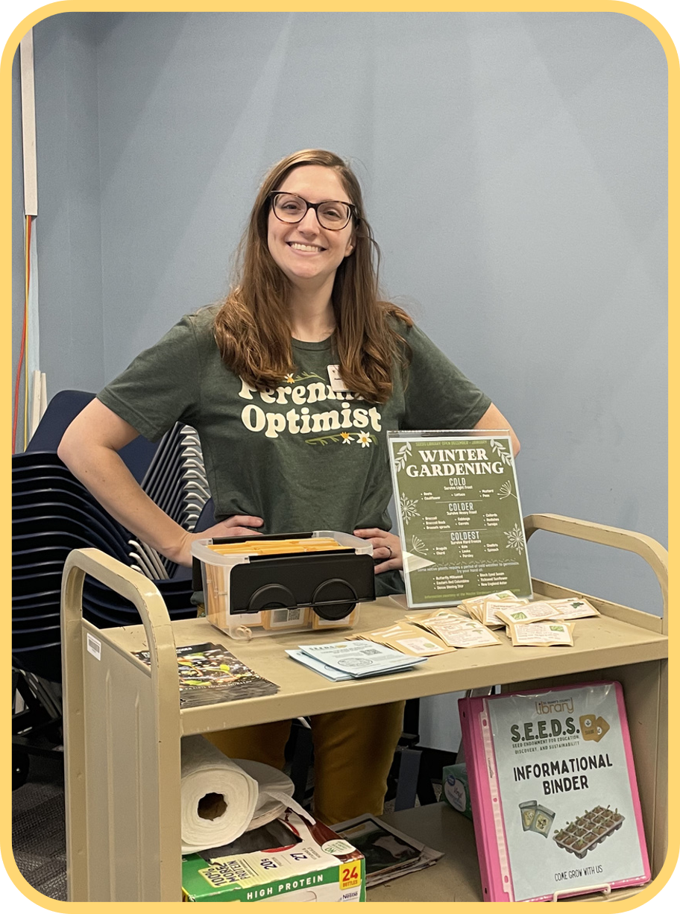
Distribution
  Patrons are provided a certain number of packets available dependent upon stock available for that season.
  Seeds are distributed by household, not party on an honor system basis that seeds are only to be received once per season.
  Patrons may receive a certain amount of vegetables, herbs, flowers and native plants.
Notes:
AD
This can vary greatly depending on the stock we have from donations. We have luckily received great support from many gardening distributors and have had ample supply to give to our patrons.
Seeds are only distributed by household. We would love to be able to do it by single party, but we quickly learned we could run out with certain categories if that was the case, proving to be inequitable to our community. We generally supply anywhere from 4-6 veggies, 2-4 herbs, and 3-5 flowers and natives.

Slide 9
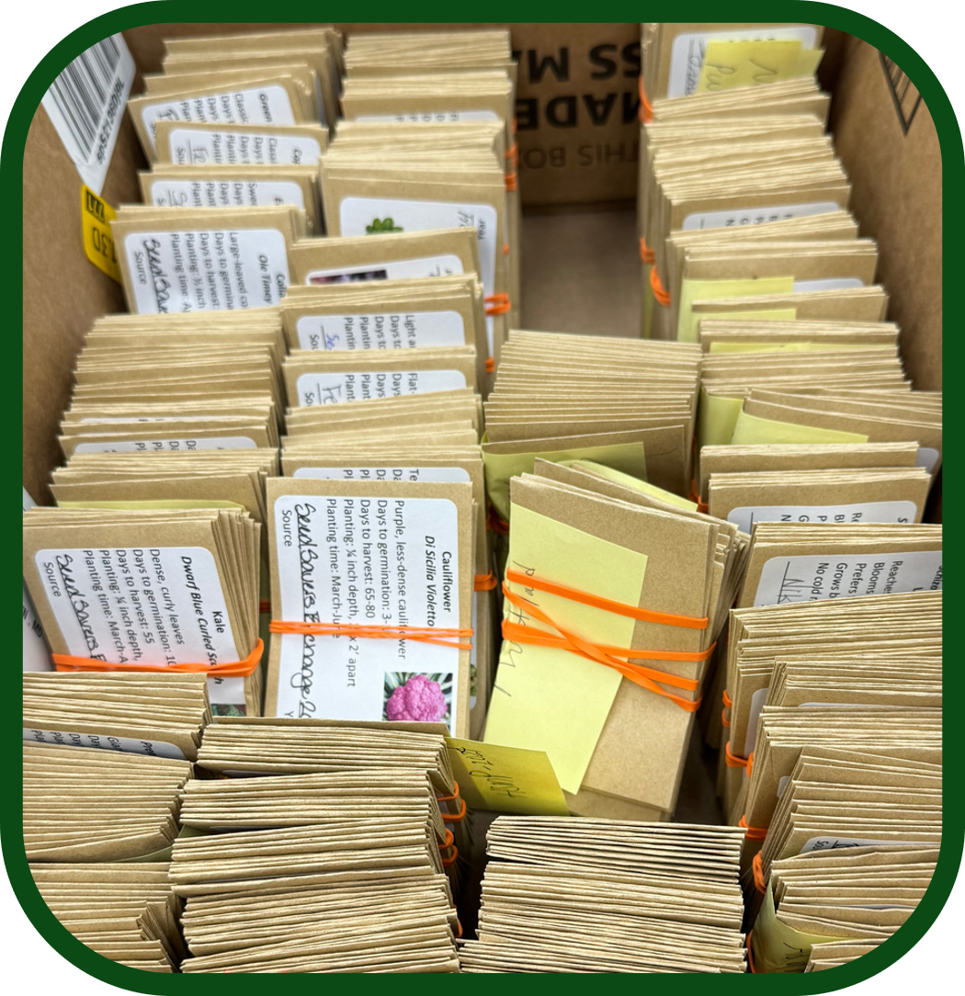
Process - Packing
  Volunteers help to measure, label and bag the seeds. The initial opening provided over two thousand packets to local patrons. The second year provided over double that amount.
  Seeds are measured to provide an ample amount enough for a small home garden. Patrons are essentially given enough stock for a sample garden to help them determine what items will grow best in their yards.
  Seeds are packed with a label indicating the item with an image of the plant and a QR code providing planting instructions and full information on the item.
Notes:
AD
Volunteers have proven to be invaluable during this process. The seed packing time alone could be a full time position. Seeds are divided to provide enough yield for a single garden. This is somewhat of a sampling for our patrons for them to determine if this crop is something they would like to continue to pursue or even expand upon. Each item has a an image and a QR code that links directly to our website with up to date planting guidelines for the item.

Slide 10
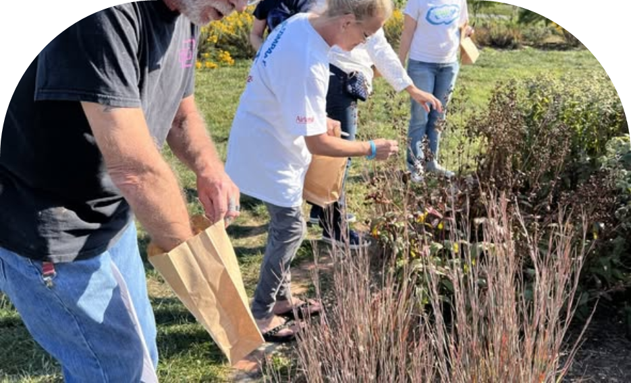
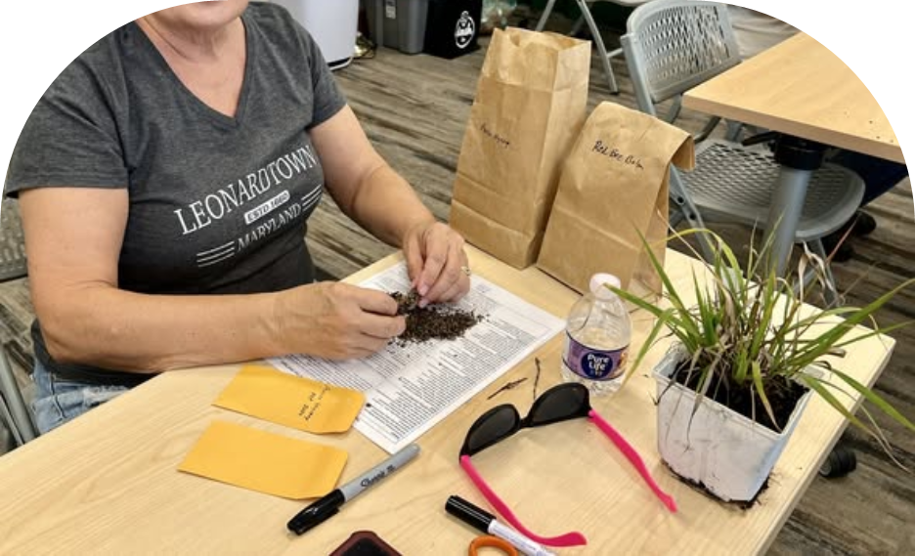
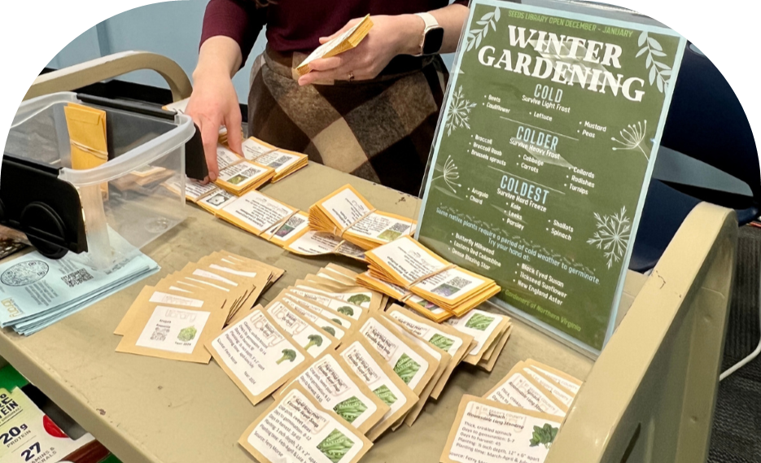
Volunteers & Partners
Seed Donations
Seed Processing & Packing
Other Support
  The Library applies for several SEEDS grants and works with local and regional suppliers to acquire donations for the season.
  Items are vetted for durability, potential invasive factors, and zone health.
  Volunteers help to measure, label and bag the seeds for the appropriate season approaching.
  Items are counted for equitable distribution at each library location.
  Volunteers enter statistics of patron orders
  Assist with programs
Notes:
AD

Slide 11
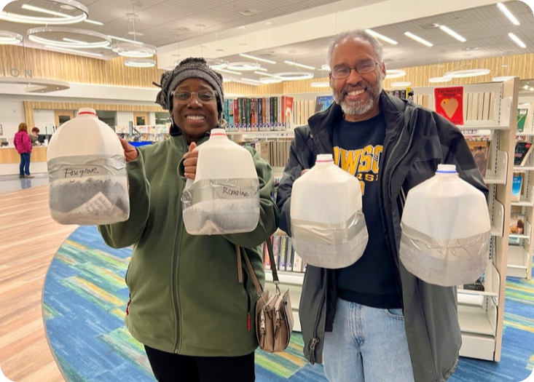
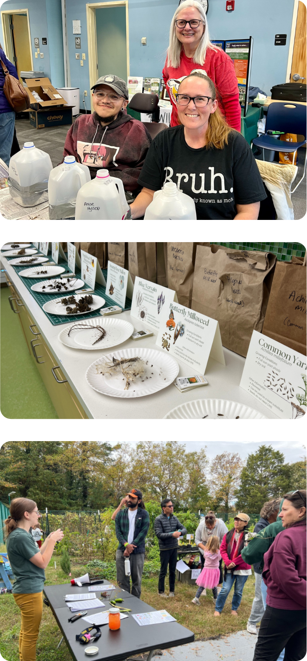
Volunteers & Partners
Programming
Partners include:
  UMDE Master Gardeners
  County Health Department
  Local Community Garden
Partners bring our SEEDS initiative full circle by providing educational presentations on everything from seed starting to harvest to cooking and canning!
Notes:
NH
Helps us bring the process full circle

Slide 12


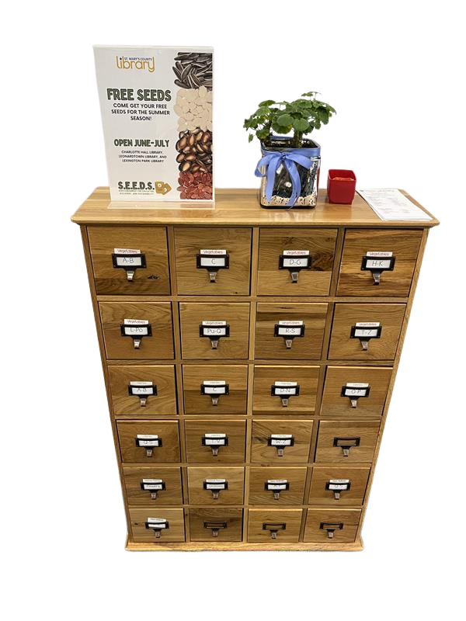
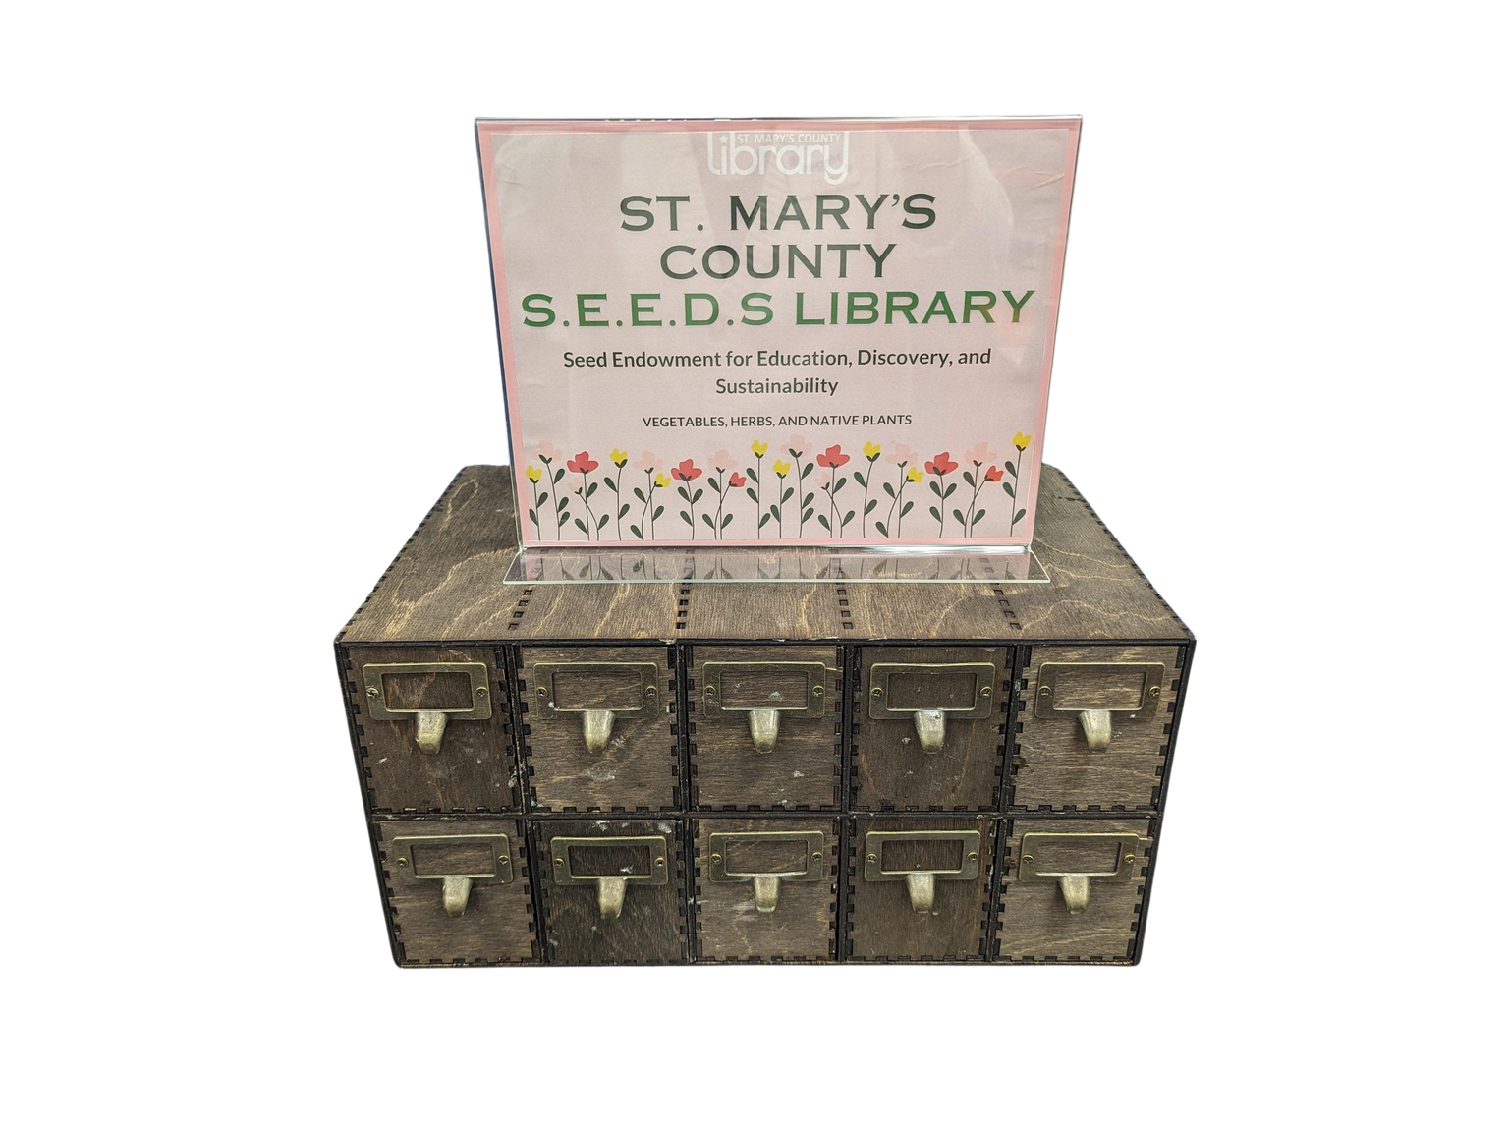

Lessons Learned
  Storage is a real consideration
  Inventory is a constant challenge. Keep the details you need, ditch the rest!
  Donations can be tricky. It’s nice to get a variety of peas to provide to patrons, but inconvenient if you only have enough to distribute in one location
  Packing takes a long time and you run out of materials quickly.
  Defer to the expertise of your partners. They can teach you everything from how to harvest seeds to how and when to plant them for the best yield.
  Be prepared for this to be a much larger project than you expected it to be.
Notes:
AD

Slide 13

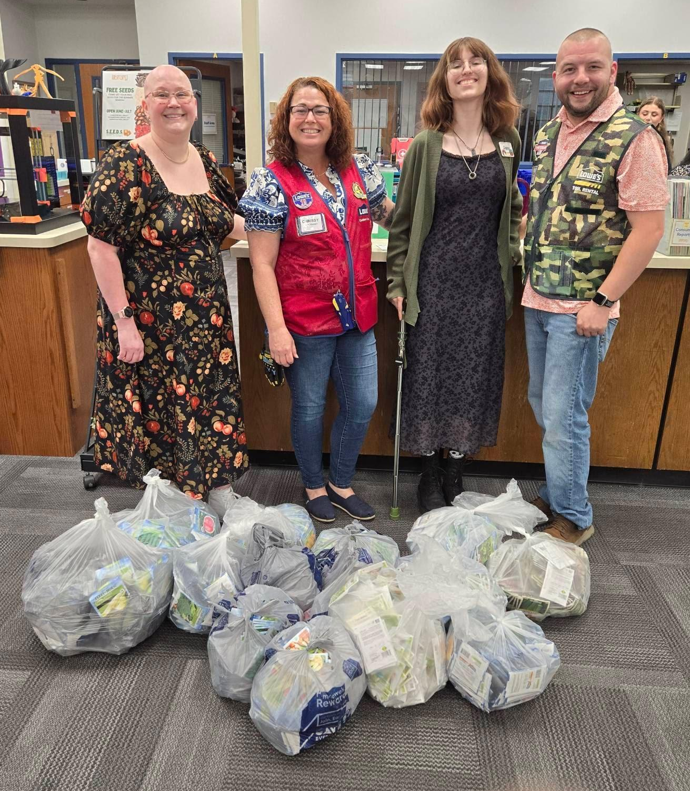

What You Need to Get Started
  Partners
  System support
  Strong volunteer base
  Community interest
  Space - and lots!
  Time
Notes:
Partners (preferably an extension or local gardening club)
. System support (both financial and staff)
Strong volunteer base (great opportunity for scouts clubs)
Community interest
Space (much more thank you think)
Seed storage
Supplies storage
Packing area for staf/volunteers
Seed distribution for patrons
Time

Slide 14
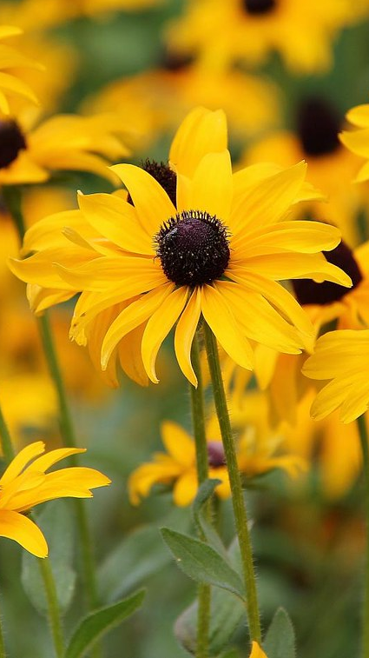
Future Plans
Keep Growing!
Continue streamlining inventory, order forms, and processes.
Continue on with our mission to make gardening exciting and accessible for the next generation.
Notes:
NH

Slide 15
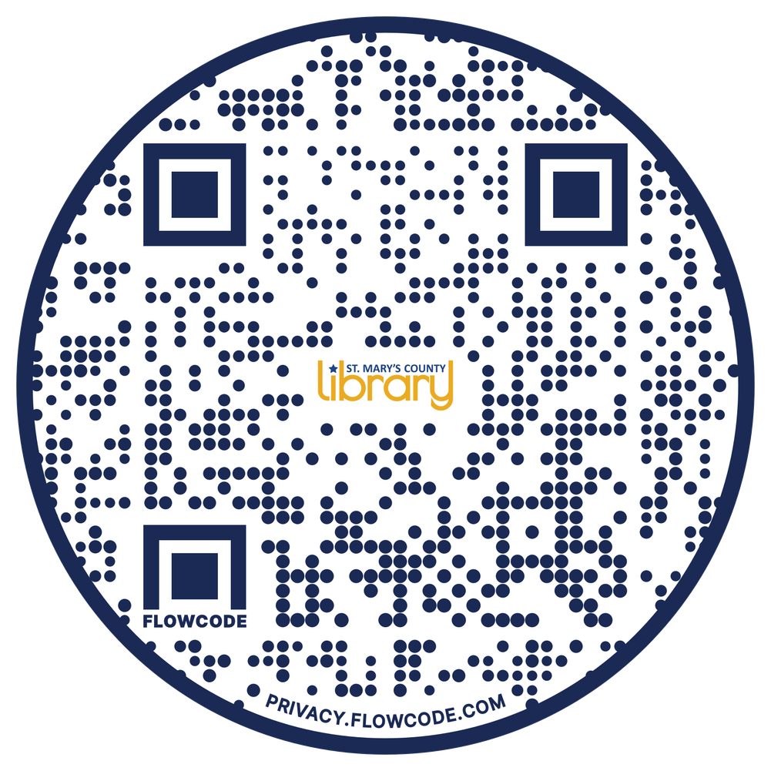
Let’s Grow Together!
SCAN THE QR CODE TO
BE DIRECTED TO THE
SEEDS PAGE OF THE
LIBRARY WEBSITE
www.stmalib.org/SEEDS
Notes:
AD & NH

Slide 16

THANK YOU

