Slide 2
Collections to Creations: A Flexible Mindful Making Model for Teen Services
PRESENTERS:
Witt Salley, Montgomery County Public Libraries
Leslie Salley, Prince George’s County Public Schools

Slide 3
Session Roadmap: Experience, Translate, and Plan
Experience a mini Mindful Making activity. Grounding, zine-making, prompts, and gratitude reflection
Break down the program model. Structure, access supports, supplies, and collection connections
Plan one version for your setting. Stations, staffing, materials, and evaluation
Participation is flexible: make, write, observe, or plan quietly. Sharing is always optional.
Notes:
Today begins with a short Mindful Making experience. Leslie will lead an opt-in grounding, guide us through a mini zine activity, offer writing prompts, and close with a brief gratitude moment. Then, we will step back and translate that experience into a flexible teen services model you can adapt for your own library, staffing, supplies, and community.

Slide 4
Participation and Boundaries
You may make, write, observe, or plan quietly.
Sharing is always optional.
You do not need to explain or display personal work.
Mindful Making supports well-being through calm, choice, creativity, and connection.
Mindful Making is not therapy or clinical treatment.
Staff provide structure, encouragement, and resource connections.
Notes:
Before we begin the activity, we want to set clear expectations. You can participate in the way that works for you. Sharing is optional, and observing is a valid form of participation. Mindful Making supports well-being through calm, choice, and creativity, but it is not therapy or clinical treatment.

Slide 5
Opening Grounding
Participation in this grounding is optional.
You may lower your eyes, look at one point, or simply stay as you are.
Notice your feet, your hands, and one sound in the room.
Take one slow breath in and one slow breath out.
Let yourself arrive before we begin making.
Notes:
Before we begin making, take a moment to arrive. You may join this grounding exercise only if you feel comfortable. You may lower your eyes, look at one point, or stay exactly as you are. Notice your feet on the floor. Notice your hands. Notice one sound in the room. Take one slow breath in and one slow breath out. You do not need to feel calm to begin. You only need to begin.

Slide 6
Mini Zine Activity
Start with one sheet of paper.
Fold the paper into eight panels.
Cut one center slit.
Collapse the paper into a small booklet.
Add words, images, color, or collage after the fold is complete.
Your zine can hold a thought, question, reflection, image, or takeaway.
The goal is to begin, not to make something perfect.
Notes:
Now, we will make a mini zine. A zine is a small, self-made booklet that can hold writing, images, questions, lists, or anything else you want to collect. Leslie will walk us through the fold step by step. Once the booklet is made, you can respond to one of the prompts or write whatever feels meaningful in the moment.

Slide 7
Writing Prompts
You may respond to one prompt, combine prompts, or write something else that feels meaningful.
“What do I want to take away from today?”
“What is one question I am carrying right now?”
“What helps me feel grounded when a day feels full?”
“What is one small thing I am grateful for?”
“What do I want to remember about this moment?”
Notes:
Now that your zine is folded, choose one prompt to begin. You can also write about something else that feels meaningful in the moment. Your zine can hold a reflection, a question, a takeaway, a list, a drawing, or any idea that came up during the activity. Nothing has to be polished.

Slide 8
Gratitude Close and Optional Share
Take one minute to name one thing you appreciate right now.
Your gratitude can be small, ordinary, or private.
You may write it, draw it, or simply notice it.
Sharing is optional.
If you share, keep your comment brief so we can hear from several people.
After this reflection, we will unpack the activity as a teen services model.
Notes:
To close the making portion, take one minute to name one thing you appreciate right now. The gratitude can be small: a person, a place, a supply you enjoyed using, a moment of quiet, or something you noticed about yourself. You can write it in your zine, draw it, or simply keep it private. Sharing is optional. After this, we will step back and look at how this activity becomes a flexible program model for teen services.

Slide 9
From Activity to Program Model
The zine is one Mindful Making station.
The model can also use journals, watercolor, collage, blackout poetry, or bookmarks.
The structure stays the same: grounding, prompts, stations, and reflection.
Materials can change based on staffing, supplies, space, and community needs.
The goal is a calm, choice-rich environment.
Notes:
What we just did is one version of Mindful Making, not the only version. The important part is the structure: a brief grounding, clear options, flexible materials, and a low-pressure close. Once that structure is in place, the specific activity can change. You can use zines, journals, watercolor, collage, blackout poetry, or whatever supplies you already have.

Slide 10
Core Structure
Begin with a brief grounding. Use an opt-in, secular prompt to help participants arrive.
Offer a prompt menu. Give teens several low-pressure starting points.
Set up flexible stations. Match activities to staffing, supplies, space, and time.
Close with reflection. Invite optional sharing or a short anonymous response.
Notes:
The specific activity can change, but the structure stays consistent. A brief grounding helps mark the space as calm and intentional. A prompt menu gives teens a starting point without forcing one outcome. Flexible stations let staff use the supplies they already have. The closing reflection helps teens notice what they did and gives staff simple feedback for improving the next session.

Slide 11
From Activity to Program Model
Post a visual schedule so participants can see the session flow.
Provide large-print prompts at each station.
Offer a low-stimulus seating option when space allows.
Use scent-free supplies and avoid glitter.
Keep sharing optional at every stage.
Allow participants to switch stations, pause, observe, or work quietly.
Use simple signage so participants can begin without waiting for staff help.
Notes:
Access supports do not have to be complicated or expensive. The goal is to reduce barriers before they become problems. A visual schedule, clear prompts, scent-free supplies, and opt-in sharing make the room easier to enter for more teens. These supports also help staff because participants can understand the choices and expectations without constant verbal directions.

Slide 12
Supplies and Scaling
Start with the structure, not the craft.
Use supplies you already have before purchasing new materials.
Limit the session to three stations when staffing or space is tight.
Pre-portion supplies into table kits to reduce crowding.
Substitute folded paper for journals, markers for watercolor, and scrap paper for collage.
Keep one “create-your-own” option for participants who already have an idea.
Design cleanup into the final five minutes.
Notes:
Mindful Making works because the structure is flexible. The program does not depend on one craft or one perfect supply list. Staff can begin with paper, pens, markers, scrap paper, and prompt cards. More supplies add variety, but the model still works when materials are limited. Pre-portioned table kits also make the room easier to manage, especially when one staff member leads the program.

Slide 13
Collections Connections
Use a small display as a prompt source, not just decoration.
Pair making stations with related titles, such as Be, Awake, Create, Your Brain on Art, or Looking at Mindfulness.
Connect prompts to shelves: zines → graphic memoirs and DIY books; journals → writing guides and guided journals; watercolor → art and mindfulness books.
Invite teens to create shelf talkers, bookmarks, or mini zines that recommend books.
Add a QR code to related catalog searches, e-books, audiobooks, and e-resources.
Notes:
Mindful Making works best when the collection connection is concrete. A display can give teens language, images, and ideas before they begin making. For example, a gratitude journal station can connect to writing guides, guided journals, and mindfulness titles. A mini zine station can connect to graphic memoirs, comics, and DIY publishing. A watercolor station can connect to art, creativity, and mindfulness books. Teens can also create shelf talkers or bookmarks that bring their own recommendations back to the shelves.

Slide 14
Evaluation and Iteration
Keep evaluation brief, anonymous, and optional.
Track attendance, station use, and supply needs.
Use a simple reflection card to ask what helped and what participants would change.
Report feedback in aggregate rather than quoting individual teens without context.
Use results to adjust prompts, supplies, room setup, and access supports.
Avoid clinical claims; measure engagement, usefulness, access, and next-step improvements.
Notes:
Evaluation should match what the program can responsibly claim. We are not measuring clinical outcomes. We are looking at participation, perceived usefulness, access needs, and what to improve next time. A short reflection card and staff observation log can give enough information to support future planning without making the program feel like a survey or assessment.

Slide 15
Adaptations Across Settings
Public libraries can use the model for after-school programs, wellness weeks, or open studios.
School libraries can adapt it for advisory, RELA collaboration, wellness weeks, or lunch programs.
Academic libraries can use it for de-stress weeks, first-year programs, or makerspace outreach.
The structure stays the same; time, supplies, and evaluation can change.
Notes:
The model transfers because the structure is simple. A public library might use the full 60-minute version. A school library might shorten it for advisory or a wellness week. An academic library might use it as a de-stress pop-up. The setting changes, but the core stays the same: calm arrival, choice-based prompts, flexible materials, and a low-pressure close.

Slide 16
Planning Your Version
Choose one audience and one realistic time frame.
Select three stations that fit your supplies and staffing.
Add at least two access supports.
Identify one collection connection.
Choose one simple evaluation method.
Leave with one next step you can take this month.
Notes:
Now, we will use the planning worksheet. Start with a real setting, not an ideal one. Choose stations you can actually support with your space, staffing, and supplies. Then, add access supports, one collection connection, and one simple evaluation method. The goal is not to design a perfect program. The goal is to leave with a version you could pilot.

Slide 17
What You Can Take With You
Run Mindful Making with a brief grounding, a prompt menu, flexible stations, and an optional reflection.
Adapt the model to your staffing, supplies, space, and community.
Connect teen creative work to displays, readers’ advisory, e-resources, and teen voice.
Evaluate the program without making clinical claims.
Find session materials in the conference app or see us afterward.
Notes:
Before we close, I want to return to the core promise of this session. Mindful Making does not require a perfect supply list, a large budget, or a clinical frame. The model gives teens a calm, choice-rich space to create, reflect, and connect with the library. All session materials are available in the conference app, and the QR code on this slide links directly to the toolkit.

Slide 18
Questions and Discussion
What would make this model useful in your setting?
What barrier would you need to solve first?
Which station, prompt, or access support would you adapt?
What questions can we answer before you leave?
Notes:
We would like to close with questions and discussion. You might ask about adapting the model to your staffing, supplies, space, audience, or collections. You can also ask about the zine activity, the accessibility supports, or the evaluation tools. Session materials are available in the conference app and through the QR code from the previous slide.

Slide 19
Selected References and Resources
CDC Youth Risk Behavior Survey data inform the teen mental health context.
The U.S. Surgeon General’s youth mental health advisory supports cross-sector approaches.
Research on mindfulness and arts engagement informs the model, with cautious, nonclinical claims.
988 Suicide & Crisis Lifeline language supports appropriate resource referral.
Notes:
We are keeping the slide brief because full APA references are already included in the session packet and uploaded with the conference materials. The key point is that the model is evidence-informed, not clinical. We use research to support careful program design, and we limit claims to what a public library program can responsibly observe and evaluate.

Slide 20
Thank you!
Witt Salley, Teen Services Librarian Quince Orchard Library, Montgomery County Public Libraries witt.salley@montgomerycountymd.gov
Leslie A. Salley, RELA Department Chair DuVal High School, Prince George’s County Public Schools leslie.salley@pgcps.org

Slide 21
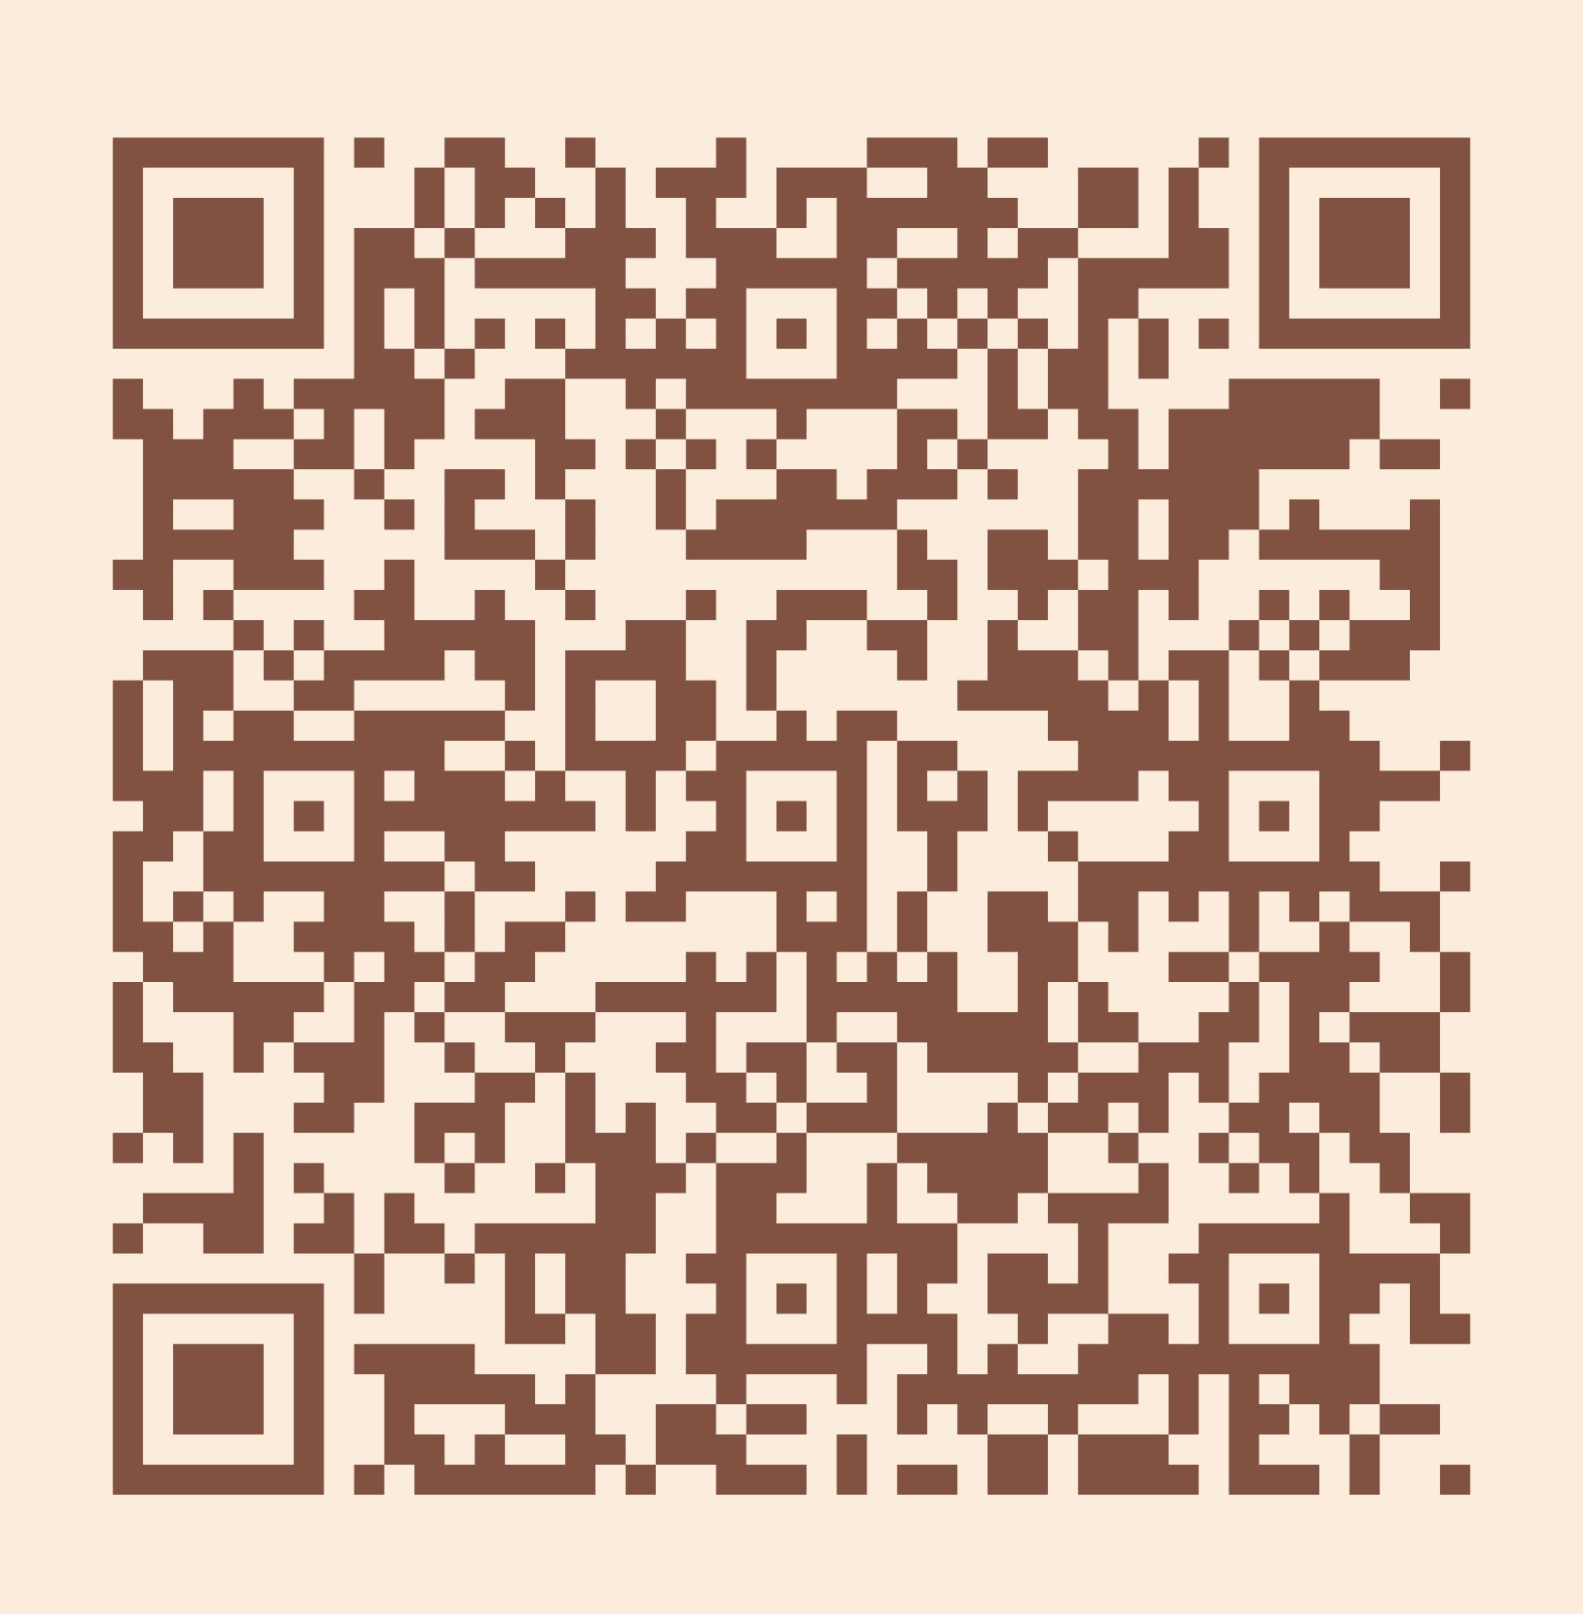
Please take a moment to complete the program survey.
SCAN ME!

