Slide 2




Don’t Miss!
50/50 RAFFLE
Tickets are $1 each and can be purchased from Conni Strittmatter or David Dahl! The winner takes home half the pot.
SILENT AUCTION
Visit the Silent Auction in the exhibitor hall to place your bids before 10:45 a.m. on Friday, May 8th.
PUB QUIZ
Thursday, May 7 8:00 – 10:00 p.m. Choptank Ballroom
KARAOKE
Thursday, May 7 8:00 – 11:00 p.m. Windjammer

Slide 3
Amy S. Millin
Maryland Lynching Memorial Project
Maryland Lynching Truth and Reconciliation Commission
John-Phillip Williams
Prince George’s County Lynching Memorial Project
Genealogical Researcher & Reparations Advocate
Karen Lee Scrivo
Prince George’s County Lynching Memorial Project
Community Minister, Unitarian Universalist Church
Lula Beatty
Prince George’s County Lynching Memorial Project
Maryland Lynching Memorial Project
PRESENTERS:

Slide 4
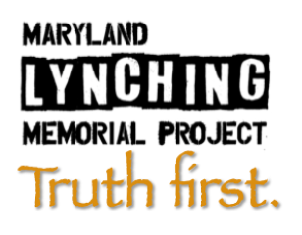
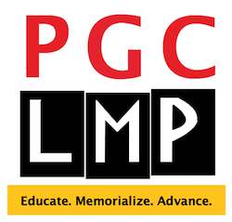
Truth First:
Educating, Memorializing and
Advancing Racial Justice in Maryland
MLA | DLA 2026 Annual Conference
May 7, 2026

Slide 5
Our Stories
Amy S. Millin: Overview of Maryland Lynching Memorial Project
Maryland Lynching Memorial Project
Maryland Lynching Truth and Reconciliation Commission
Karen Lee Scrivo: Overview of Prince George’s County LMP
Community Minister, Unitarian Universalist Church
Prince George’s County Lynching Memorial Project
John-Phillip Williams: Digital Preservation and Access
Genealogical Researcher & Reparations Advocate
Prince George’s County Lynching Memorial Project
Lula Beatty: Library Memories and Dreams
Prince George’s County Lynching Memorial Project
Maryland Lynching Memorial Project

Slide 6
What is Community?

Slide 7
What is Community?
“Community is the spirit, the guiding light of the tribe, whereby people come together in order to fulfill a specific purpose, to help others fulfill their purpose, and to take care of one another. The goal of the community is to make sure that each member of the community is heard and is properly giving the gifts he has brought to this world. Without this giving, the community dies. And without the community, the individual is left without a place where he can contribute. The community is that grounding place where people come and share their gifts and receive from others.”
The Spirit of Intimacy: Ancient African Teachings in the Ways of Relationships
Sobonfu Somé, 1997

Slide 8
What is MLMP?
Maryland Lynching Memorial Project works to advance the cause of racial reconciliation in our state by working to:
research and document the history of racial terror lynchings in the state
advocate for public acknowledgement of these murders
support the Maryland Lynching Truth and Reconciliation Commission
honor and dignify the lives of the victims

Slide 9
Maryland Lynching Victims (documented)
18. Charles Whitely
19. Benjamin Hance
20. John Biggus
21. Asbury Green
22. James Taylor
23. Isaac Kemp
24. Stephen Williams
25. Jacob Henson, Jr.
26. James Bowens
27. Sidney Randolph
28. William Andrews
29. Garfield King
30. Wright Smith
31. Lewis Harris
32. Henry Davis
33. James Reed
34. William Burns
a.k.a. Robert Hughes
35. King Johnson
36. Matthew Williams
37. unknown
38. George Armwood
June 6, 1886
June 17, 1887
November 23, 1887
May 13, 1891
May 17, 1892
June 8, 1894
October 20, 1894
May 28, 1895
November 17, 1895
July 4, 1896
June 9, 1897
May 26, 1898
October 5, 1898
March 26, 1900
December 21, 1906
July 28, 1907
October 6, 1907
December 25, 1911
December 4, 1931
December 4, 1931
October 18, 1933
Prince Frederick (Calvert)
Leonardtown (St. Mary’s)
Frederick (Frederick)
Centreville (Queen Anne’s)
Chestertown (Kent)
Princess Anne (Somerset)
Upper Marlboro (Prince George’s)
Ellicott City (Howard)
Frederick (Frederick)
Rockville (Montgomery)
Princess Anne (Somerset)
Salisbury (Wicomico)
Annapolis (Anne Arundel)
Bel Air (Harford)
Annapolis (Anne Arundel)
Crisfield (Somerset)
Cumberland (Allegany)
Brooklyn (Anne Arundel)
Salisbury (Wicomico)
Salisbury (Wicomico)
Princess Anne (Somerset)
1. David Thomas
2. Frederick Pearce
3. Jim Wilson
4. John Fields
5. Isaac Moore
6. Jim Quinn
7. Thomas Juricks
8. John Jones
9. John Henry Scott
10. John Simms
11. Michael Green
12. James Carroll
13. George Peck
14. John Diggs-Dorsey
15. George Briscoe
16. Townsend Cook
17. Howard Cooper
October 10, 1854
September 26, 1861
November 1, 1862
April 24, 1863
July 22, 1868
October 2, 1869
October 12, 1869
July 29, 1872
March 23, 1875
June 14, 1875
September 1, 1878
April 17, 1879
January 10, 1880
July 27, 1880
November 26, 1884
June 2, 1885
July 13, 1885
Denton (Caroline)
Queenstown (Queen Anne’s)
Cecilton (Cecil)
Oakland (Caroline)
Bel Air (Harford)
Whitehall (Harford)
Piscataway (Prince George’s)
Elkton (Cecil)
Notley Hall (Prince George’s)
Annapolis (Anne Arundel)
Upper Marlboro (Prince George’s)
Point of Rocks (Frederick)
Poolesville (Montgomery)
Rockville (Montgomery)
Jacobsville (Anne Arundel)
Westminster (Carroll)
Towson (Baltimore)

Slide 10
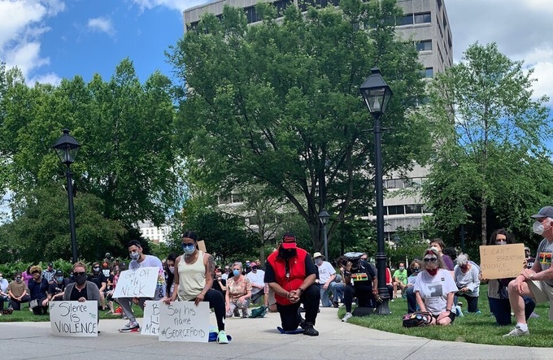
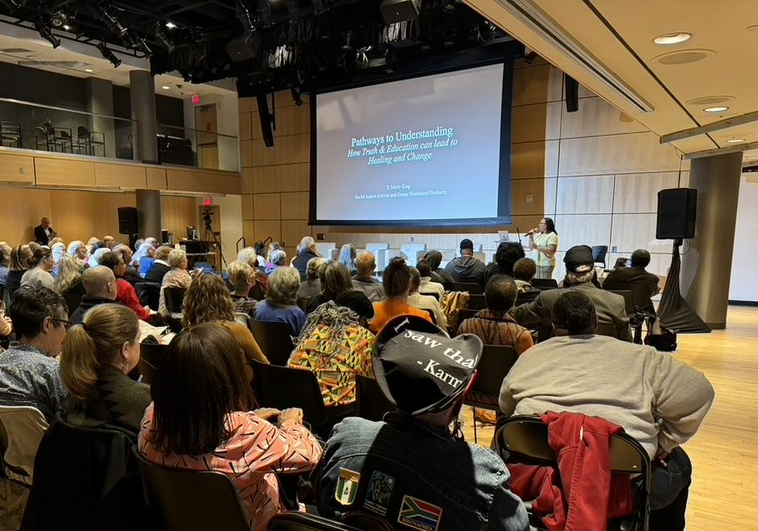
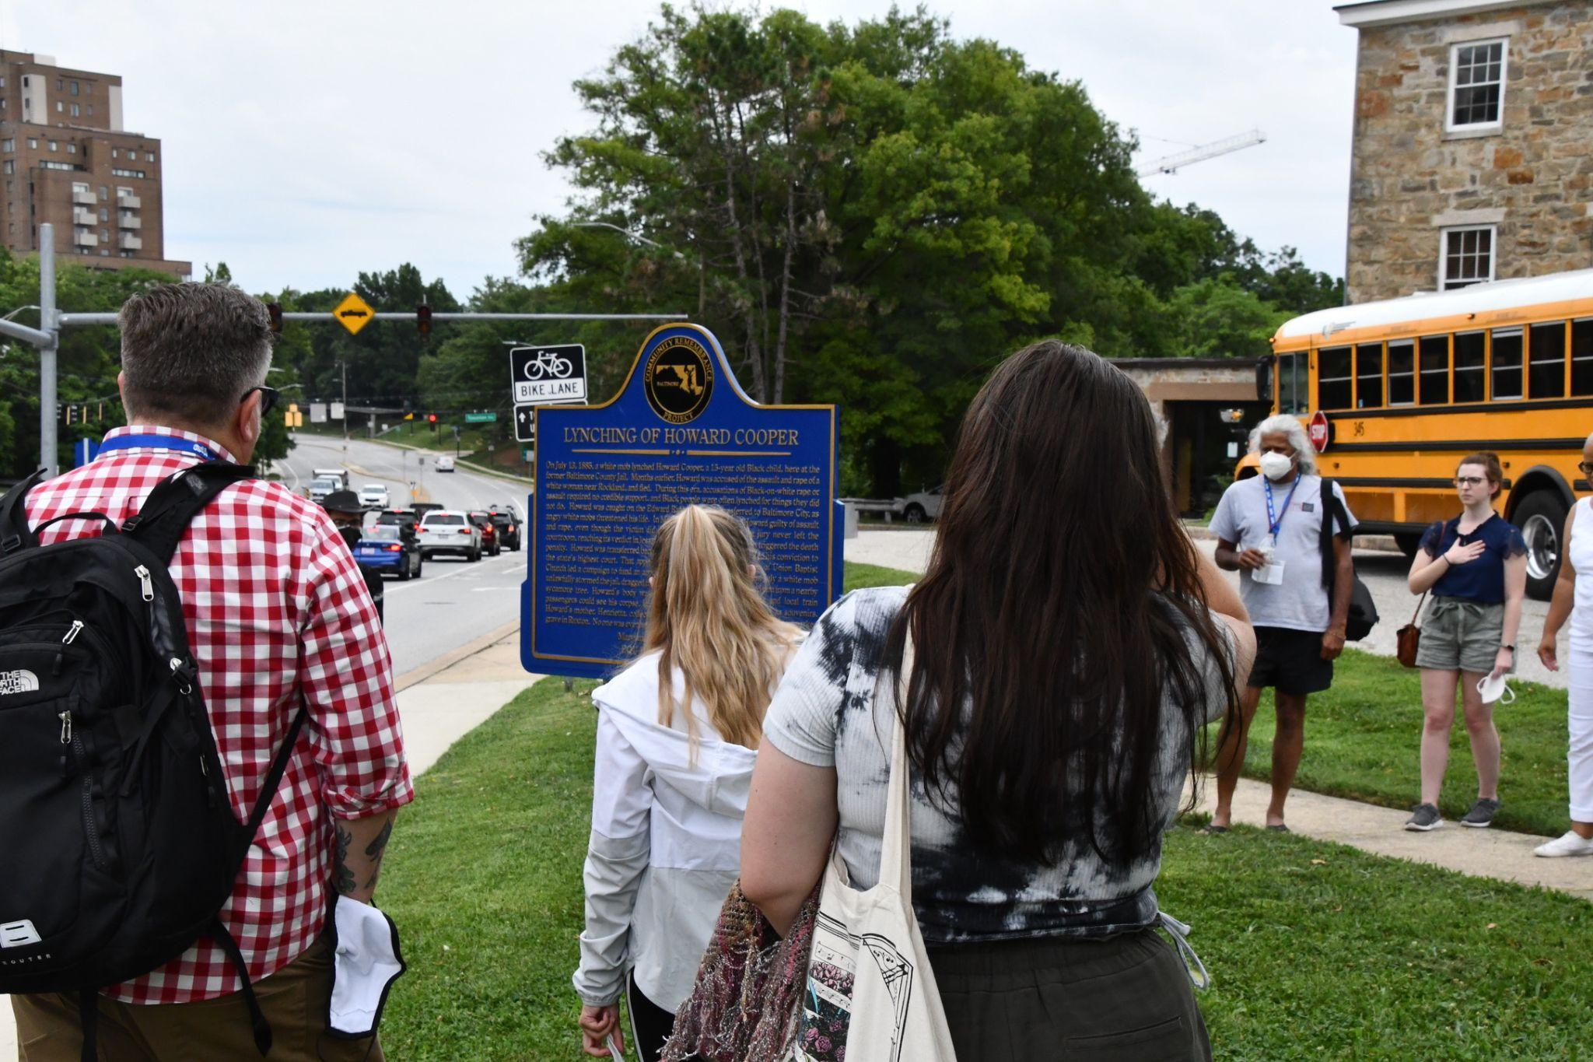
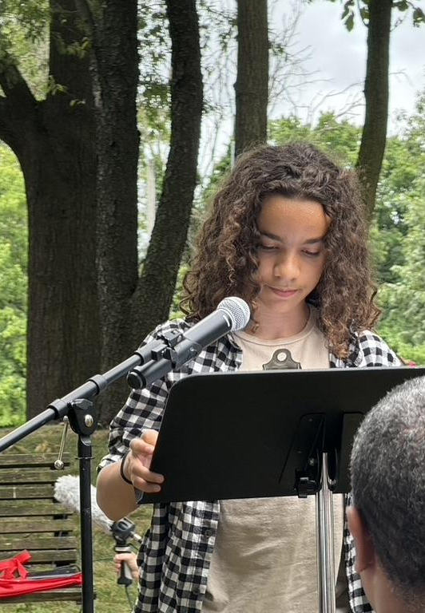
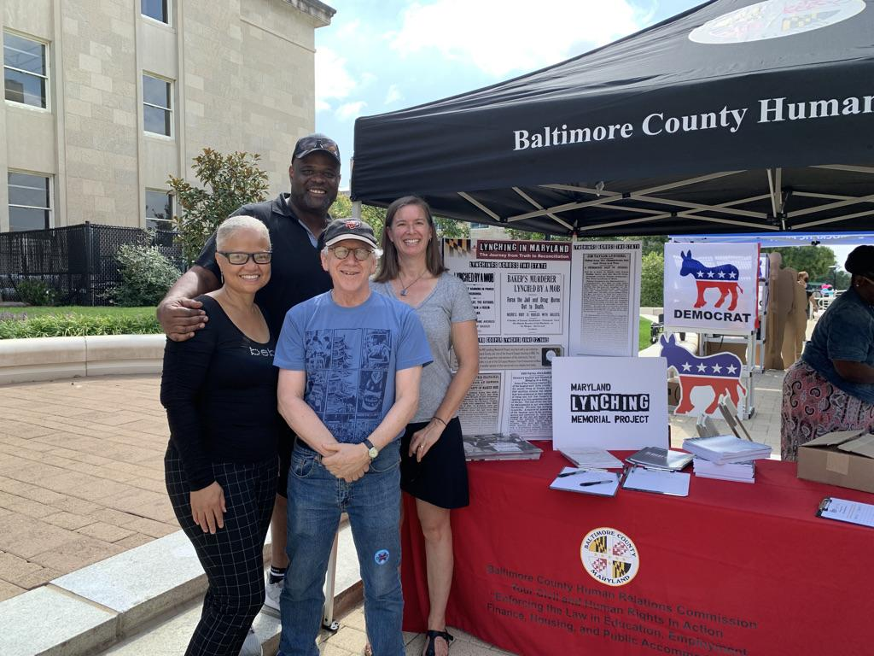

Slide 11
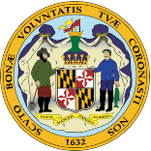

Building Partnerships
Maryland Lynching
Truth & Reconciliation
Commission

Slide 12
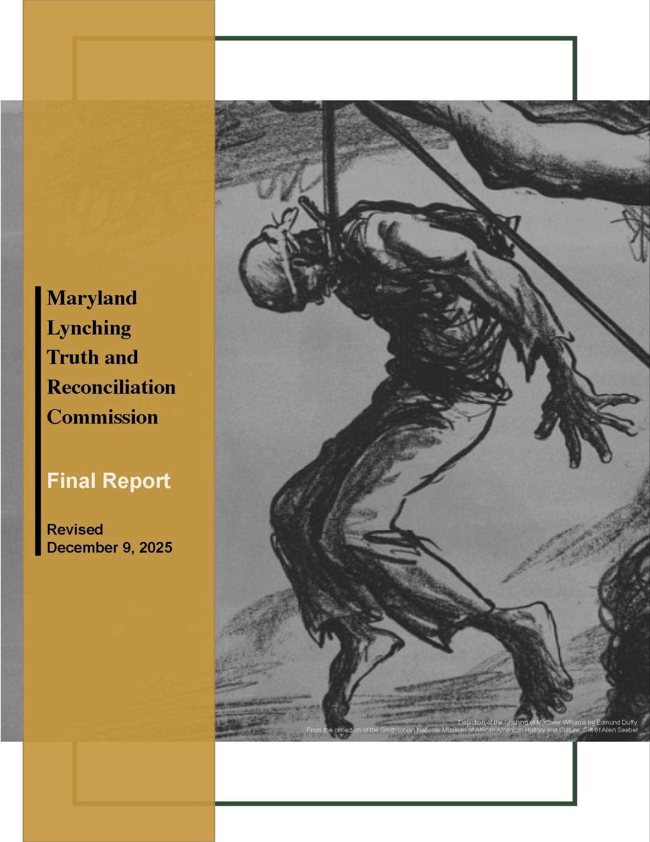
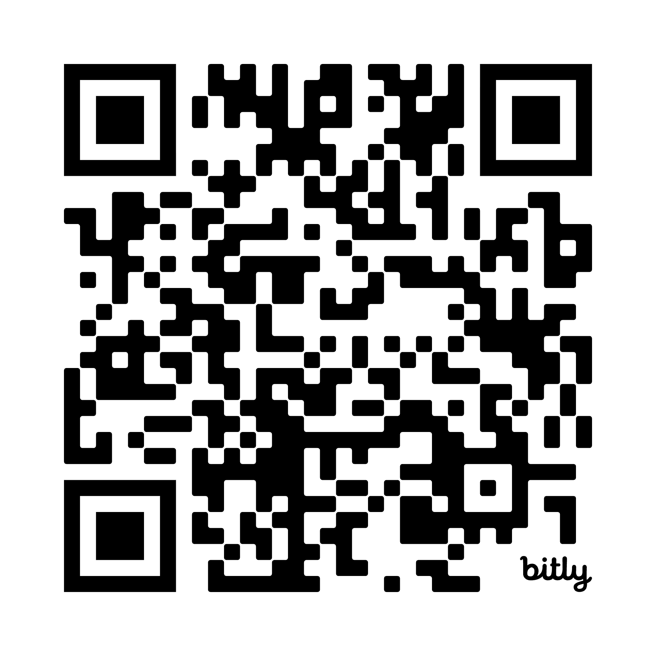
Building Partnerships
Maryland Lynching
Truth & Reconciliation
Commission

Slide 13
Building Partnerships
Maryland Lynching
Truth & Reconciliation
Commission
Allegany
Anne Arundel
Baltimore Co.
Calvert
Caroline
Carroll
Cecil
Frederick
Harford
Howard
Kent
Montgomery
Prince George’s
Queen Anne’s
St. Mary’s
Somerset
Wicomico

Slide 14


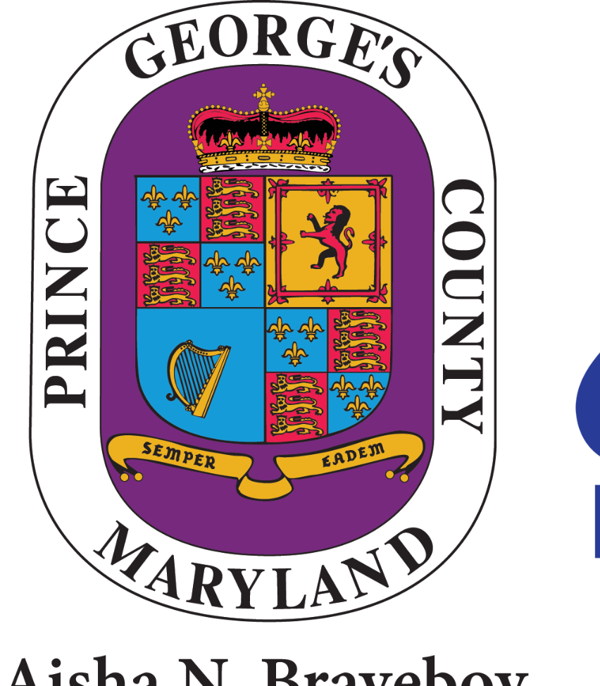


Building Partnerships
Maryland Lynching
Truth & Reconciliation
Commission
Allegany
Anne Arundel
Baltimore Co.
Calvert
Caroline
Carroll
Cecil
Frederick
Harford
Howard
Kent
Montgomery
Prince George’s
Queen Anne’s
St. Mary’s
Somerset
Wicomico
Community researchers past & present

Slide 15
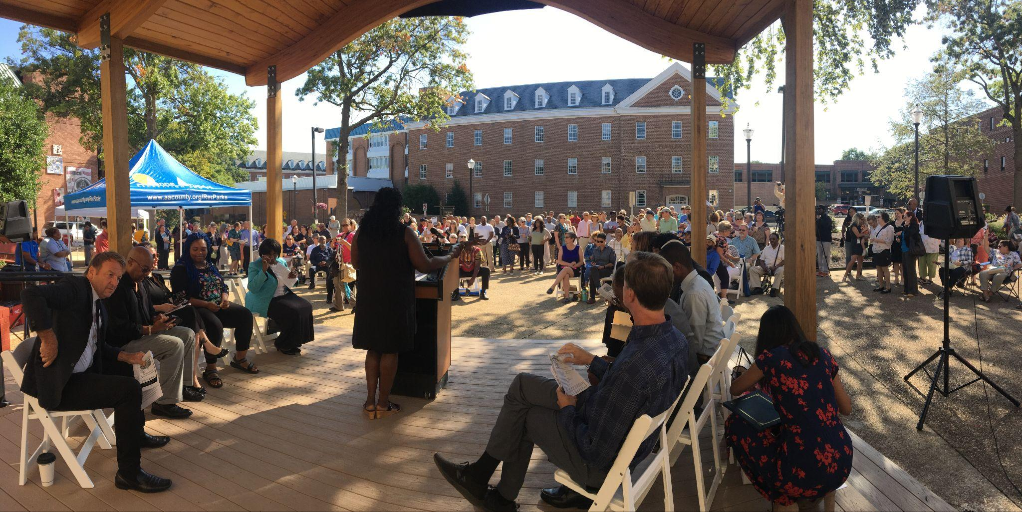
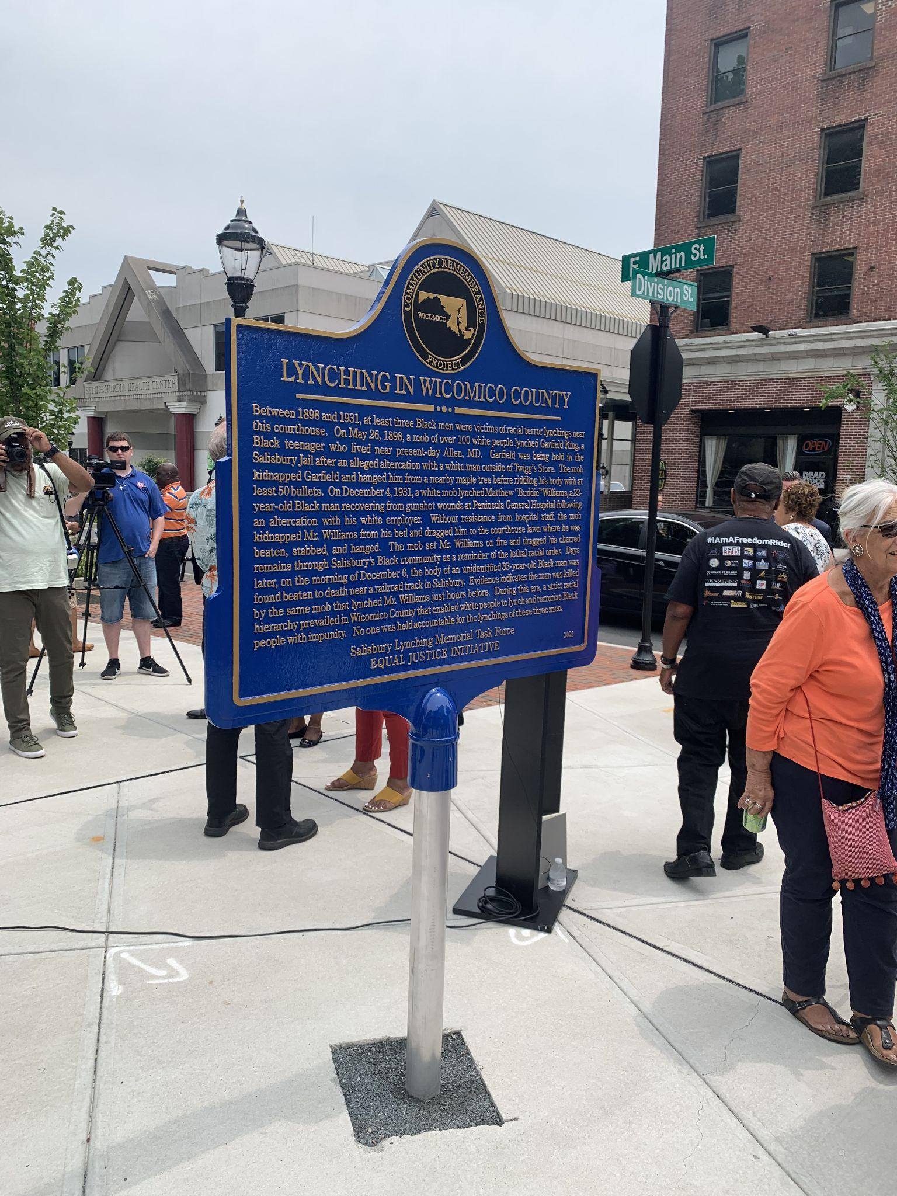
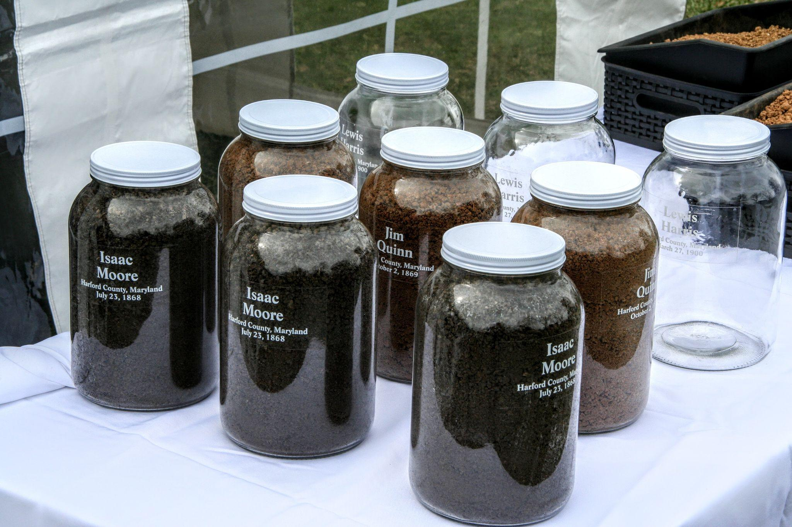
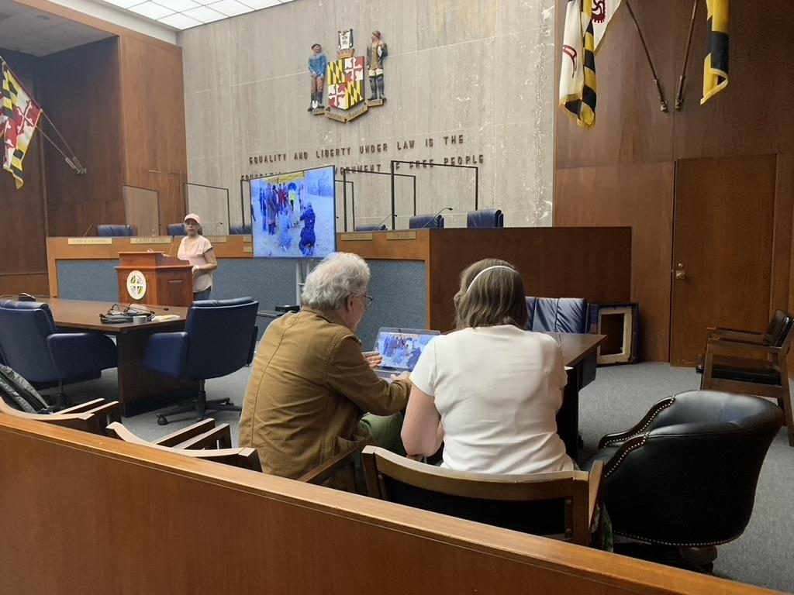
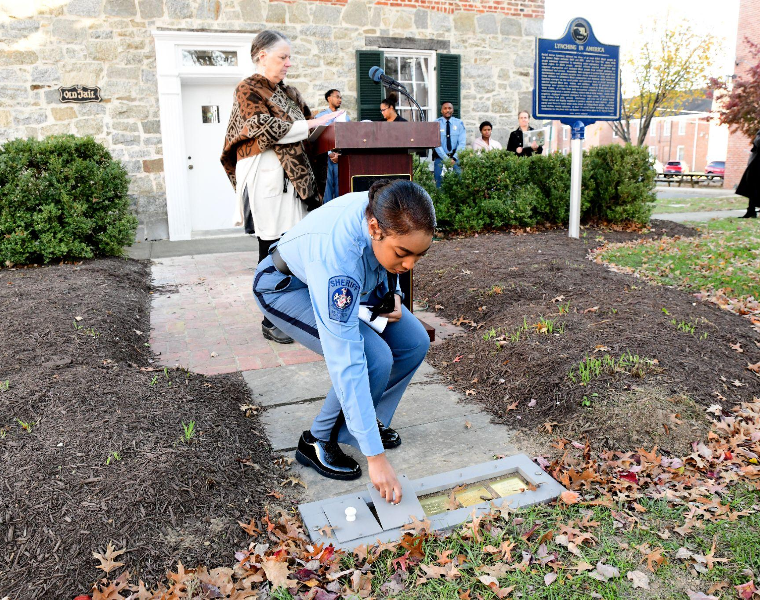
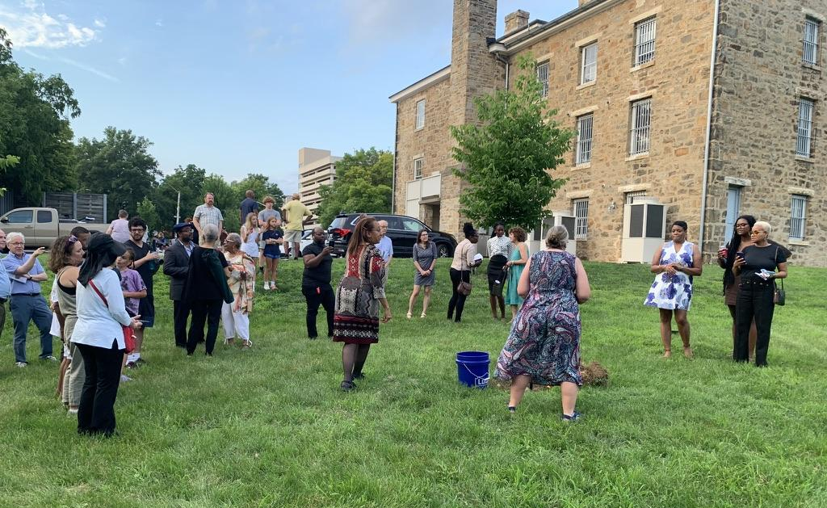

Slide 16
MLMP: Truth Telling and Memorialization
Research, MLMP Digital Archive, Oral Histories
Soil Collections
Historic Markers
County Community Forums
Youth-focused Arts Contests, Exhibitions, Workshops
Remembrance Events
Tours, Trails, Walks
(Re)Naming Spaces
Community Partnerships
“Lynching in Maryland” permanent exhibit at The Lewis Museum
Programming: Films, Speakers, and Annual Conference (October 24, 2026)

Slide 17
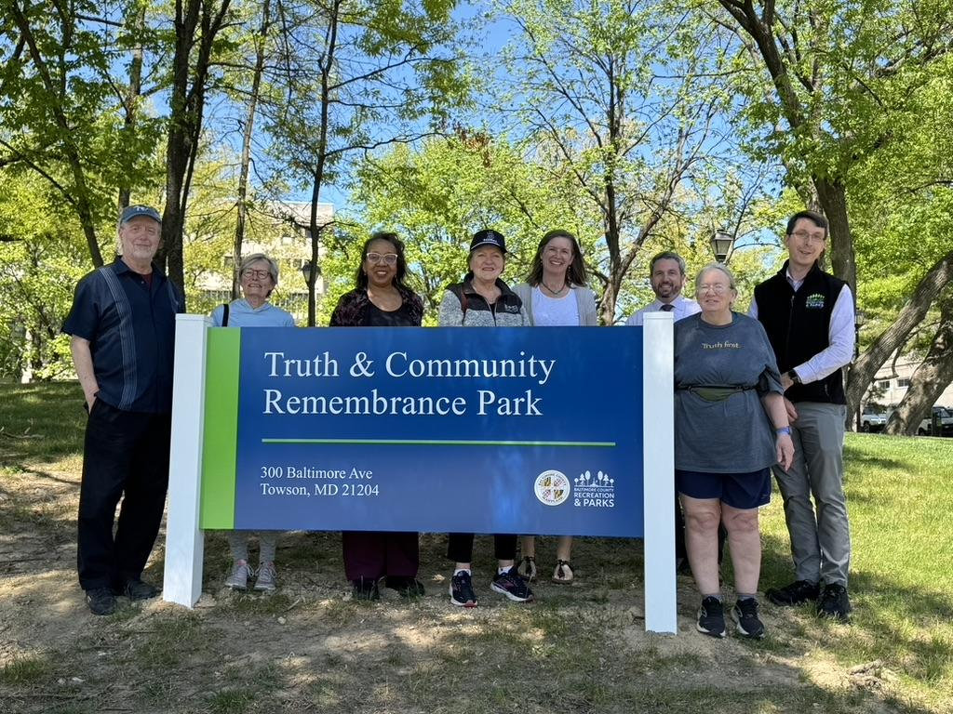
Truth & Community Remembrance Park
Towson, Baltimore County
Because there is a path to recovery and reconciliation when we tell the truth about our history in public, acknowledging racial harm in public spaces is a critical first step in racial reconciliation. —EJI Website’s Community Remembrance Page

Slide 18
Thank You!
Please visit and contact us at:
www.mdlynchingmemorial.org
amillin@mdlynchingmemorial.org
https://pgclmp.org
princegeorgescolmp@gmail.com
MLA | DLA 2026 Annual Conference
May 7, 2026

Slide 19
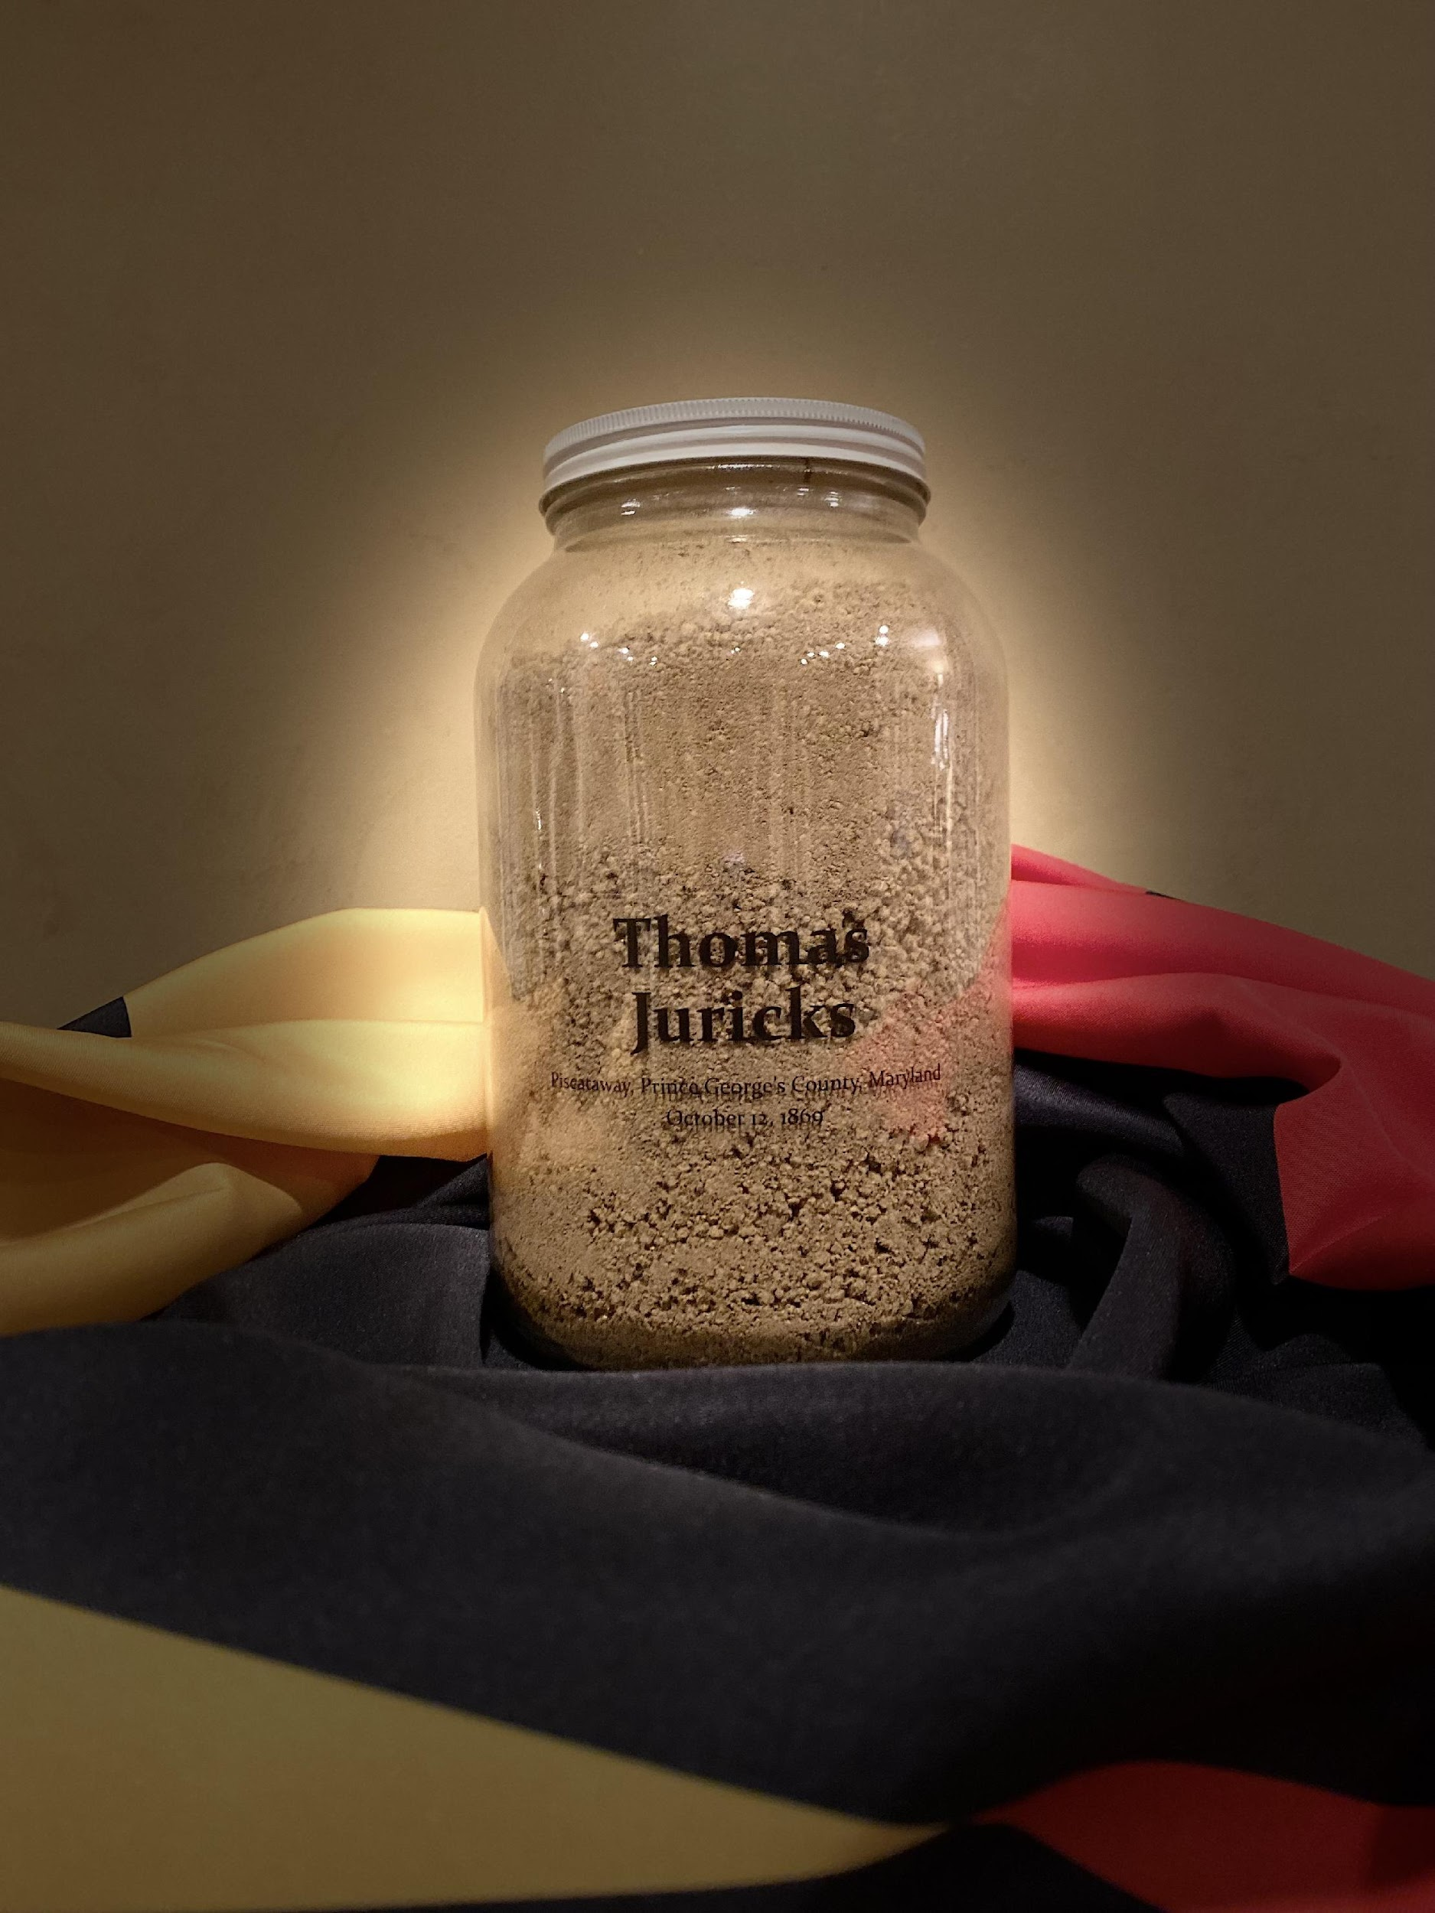
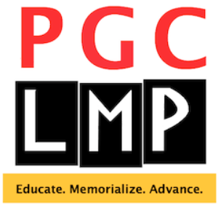
Prince George’s County
Lynching Memorial Project
Notes:
Good Morning, we appreciate the opportunity to tell you about the work of the Prince George’s County Lynching Memorial Project.
Formed in 2019, the PGCLMP is a grassroots, all-volunteer, county-wide coalition with nearly 600 members.

Slide 20
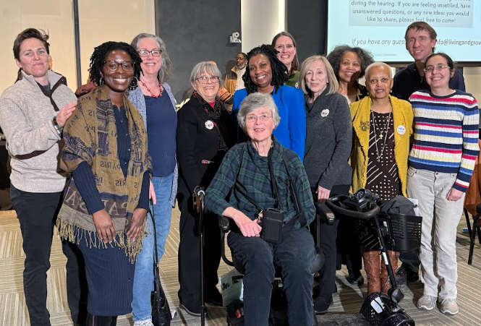
Who Are We?
Notes:
We are diverse in race, ethnicity, gender, age, county geographic region, life experience, and professional expertise.
We are retirees, religious leaders, educators, historians, journalists, elected officials, genealogists, community organizers, lawyers and mental health practitioners to name a few.
We are affiliated with civic associations, churches, colleges/universities, the Afro-American History and Genealogical Society, the NAACP, and the Black History Department of the County’s Park Department.
What unites us is our common commitment to truth telling and racial justice and believing that Prince George’s County can be a model of that.

Slide 21
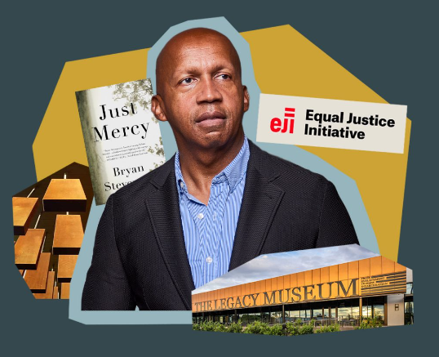
Our Inspiration: Bryan Stevenson and the Equal Justice Initiative
Truth first.
“It is critical for communities across the country to do the difficult work of unearthing and confronting their own histories of racial injustice, while exploring how that history continues to shape the present.”
Notes:
Our work, like that of the Maryland Lynching Memorial Project, other LMPs in the state, and other similar groups across the country, is inspired by the work and vision of Bryan Stevenson, a criminal justice reform advocate, and the executive director of the Equal Justice Initiative in Montgomery, Alabama.

Slide 22
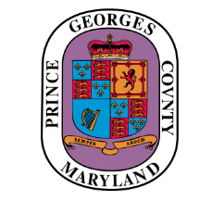
Lynching in Maryland
38 documented racial terror lynchings in 17 Maryland counties between 1854 and 1933
4 occurred in Prince George’s County:
Thomas Juricks
Piscataway, October 12, 1869
John Henry Scott
Oxon Hill, March 23, 1875
Michael Green
Upper Marlboro, September 1, 1878
Stephen Williams
Upper Marlboro, October 20, 1894
Notes:
Racial terror lynchings epitomize the racial disparities in the criminal justice system and their long-term harm inflicted on Black and white communities. There are 6500 documented lynchings of Black men, children, and women. We work to bring this history to light and use it as a platform in righting past and current wrongs.
Maryland has 38 documented racial terror lynchings across 17 of its 24 counties.
4 occurred in our Prince George’s County.
The men murdered were: Mr. Thomas Juricks, Mr. John Henry Scott, Mr. Michael Green and Mr. Stephen Williams.
Like all other racial terror lynchings, no one was ever held accountable.

Slide 23
Past is Present
How do racial terror lynchings from our past connect to more recent incidents of racial violence?
From Emmett Till in Mississippi in 1955,
to Prince Jones Jr. in Virginia in 2000,
to Freddie Gray in Baltimore in 2015,
to Mother Emanuel AME Church in Charleston in 2015,
to Breonna Taylor in Kentucky in 2020,
to George Floyd in Minnesota in 2020,
to the Buffalo Supermarket in 2022,
to name but a few.
Notes:
Racial Terror Lynchings were about more than the one person murdered.
They were an instrument of intimidation to make everyone in the Black community afraid.
Racial terror has not gone away, it has simply evolved.

Slide 24
Our Mission
The Prince George’s County Lynching Memorial Project (PGC LMP) seeks to:
Educate the public on the truths of our nation’s continuing legacy of the institution of slavery and its impact on enslaved persons and their descendants,
Memorialize victims of racial terror lynchings in our county, and
Advance the cause of racial justice and reconciliation through mutual support and collaboration.
Notes:
Our mission is to:
Educate the public,
Memorialize victims of racial terror lynchings
Advance the cause of racial justice.
Our work is even more important and urgent, given the current climate in our country, where history is being suppressed and sanitized (white-washed?) and hard-won advances around racial equity are being reversed.

Slide 25
Major Programs and Events
Memorializing
Soil Collection and Community Remembrance Events
Memorial Markers
Historical Research
Educating and Advancing
Racial Justice Essay and Creative Arts Contest for High School Students
Materials Development, e.g., presentations, fact sheets
Book Discussions and Webinars
Notes:
I will summarize some of our major programs, starting with our memorialization work.

Slide 26
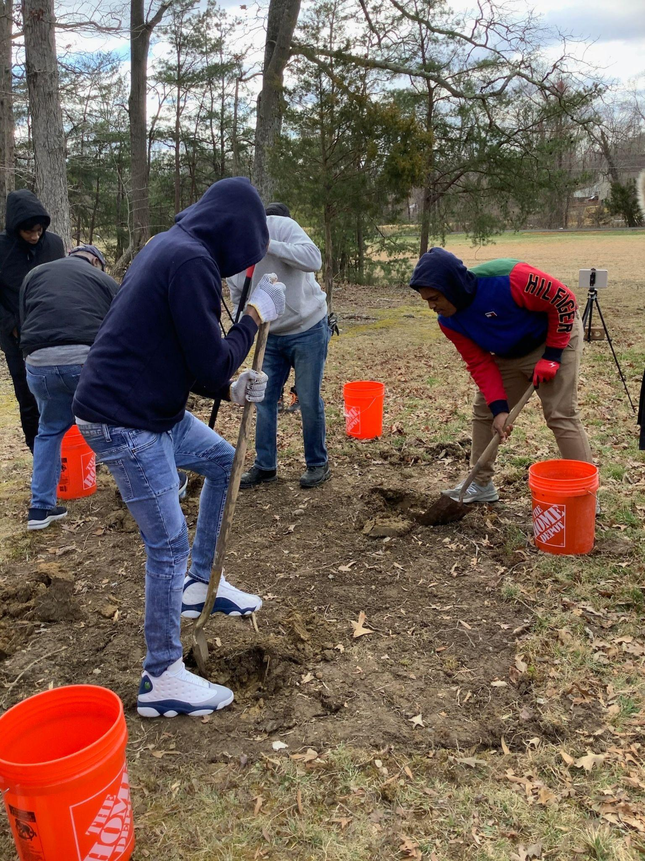
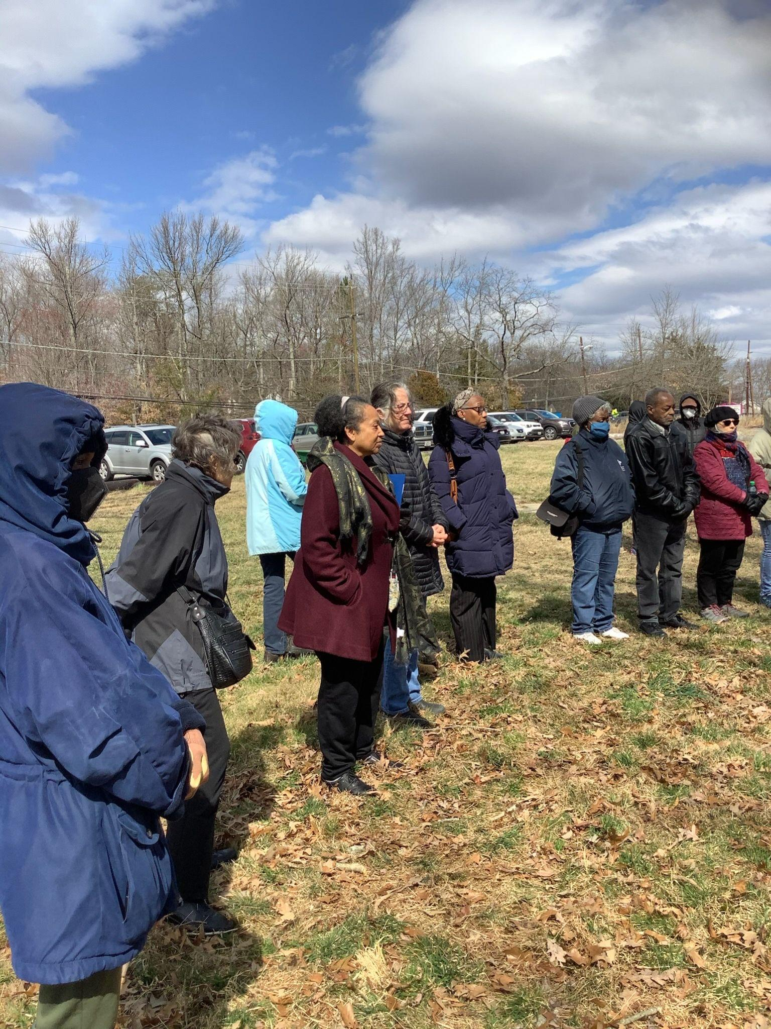
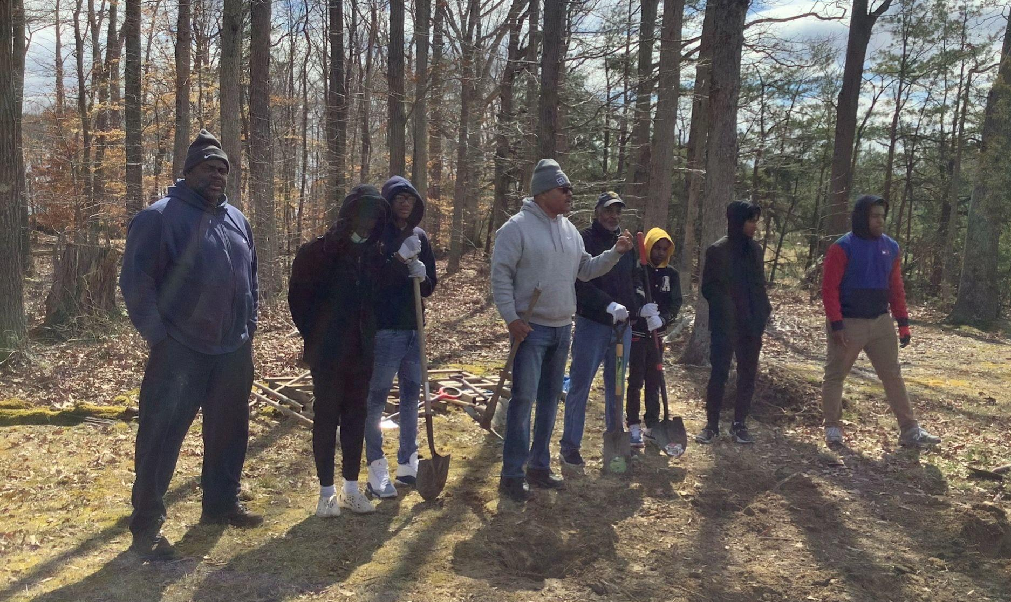
Soil Collection for Thomas Juricks
Young men from the Mighty Men Mentoring Program in Brandywine
led us in the solemn soil collection.
Notes:
Mr. Thomas Juricks, our earliest known lynching victim, lived in the Chapel Hill, Fort Washington area. We worked with the Chapel Hill Citizens Association and other community members and groups to plan his soil collection and remembrance – or homegoing --program.
The Mighty Men Mentoring Program, led by Minister Rodney Taylor from Union Bethel AME Church in Brandywine collected the soil at the symbolic lynching site on March 11, 2023 and led the processional at the remembrance program held at Harmony Hall Arts Center on April 15, 2023.
Students from Bowie State University under the leadership of Art Professor Gina Marie Lewis recorded both events.

Slide 27
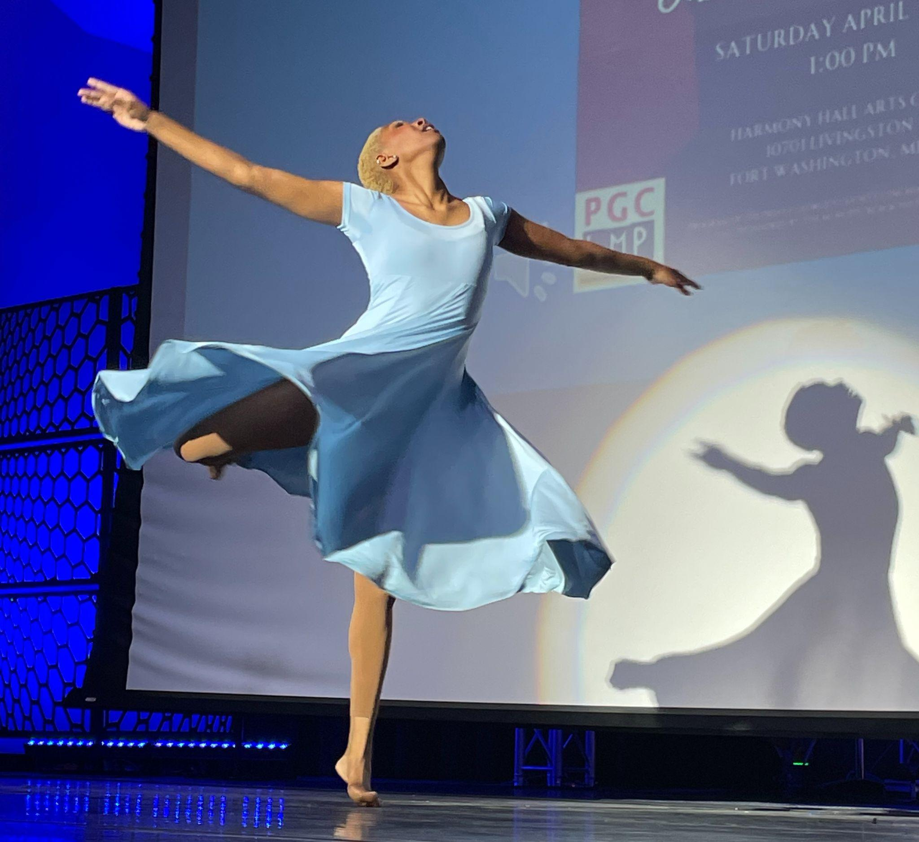
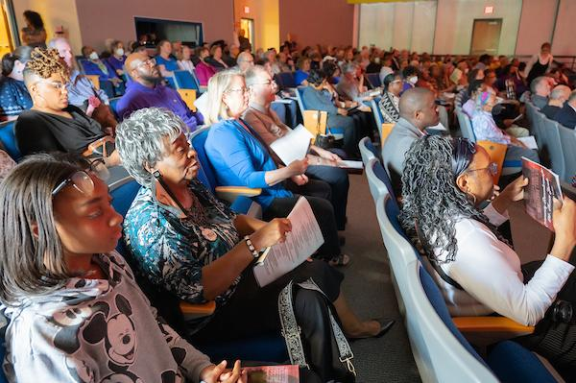
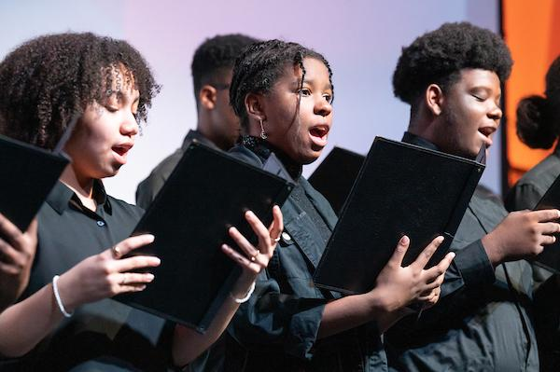
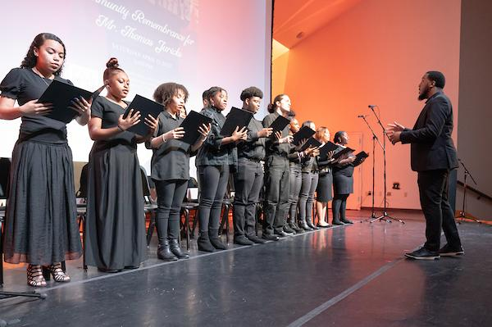
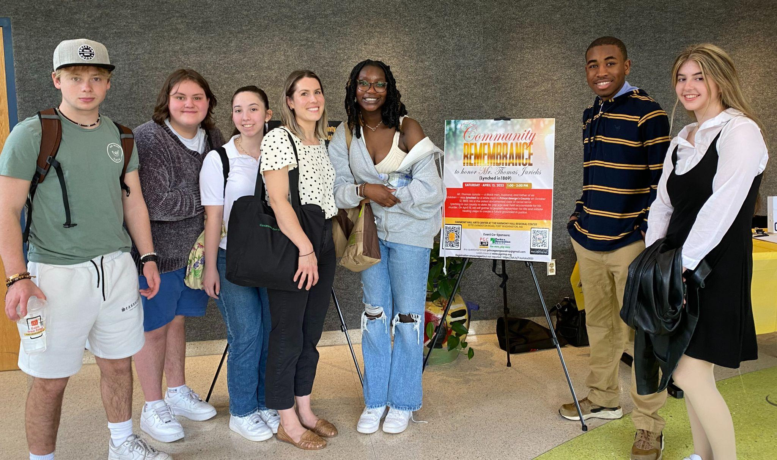
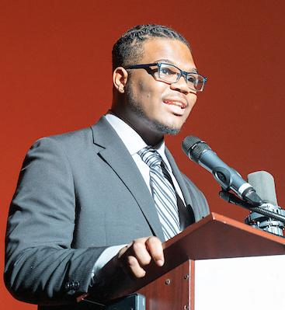
Community Remembrance - Harmony Hall
Notes:
The Remembrance ceremony was generously co-sponsored by the M-NCPPC Black History Program, funded by a grant from the Prince George’s County Historic Preservation Commission, and professionally filmed by the Maryland Lynching Memoria Project. It was packed, standing room only.
The ceremony included remarks by several elected officials and community members and significant participation of students.
Chase Matthews, one of our 2022 creative arts contest winners came back from college to read his poem, “Hoodie”, the Frederick Douglass High School Choir performed, and Christione Johnson, a student from the Center for Visual and Performing Arts at Suitland High School closed the program with a dance performance that brought the crowd to their feet.

Slide 28
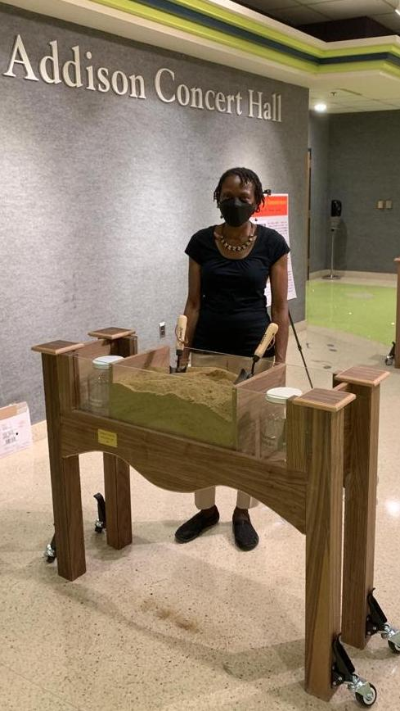
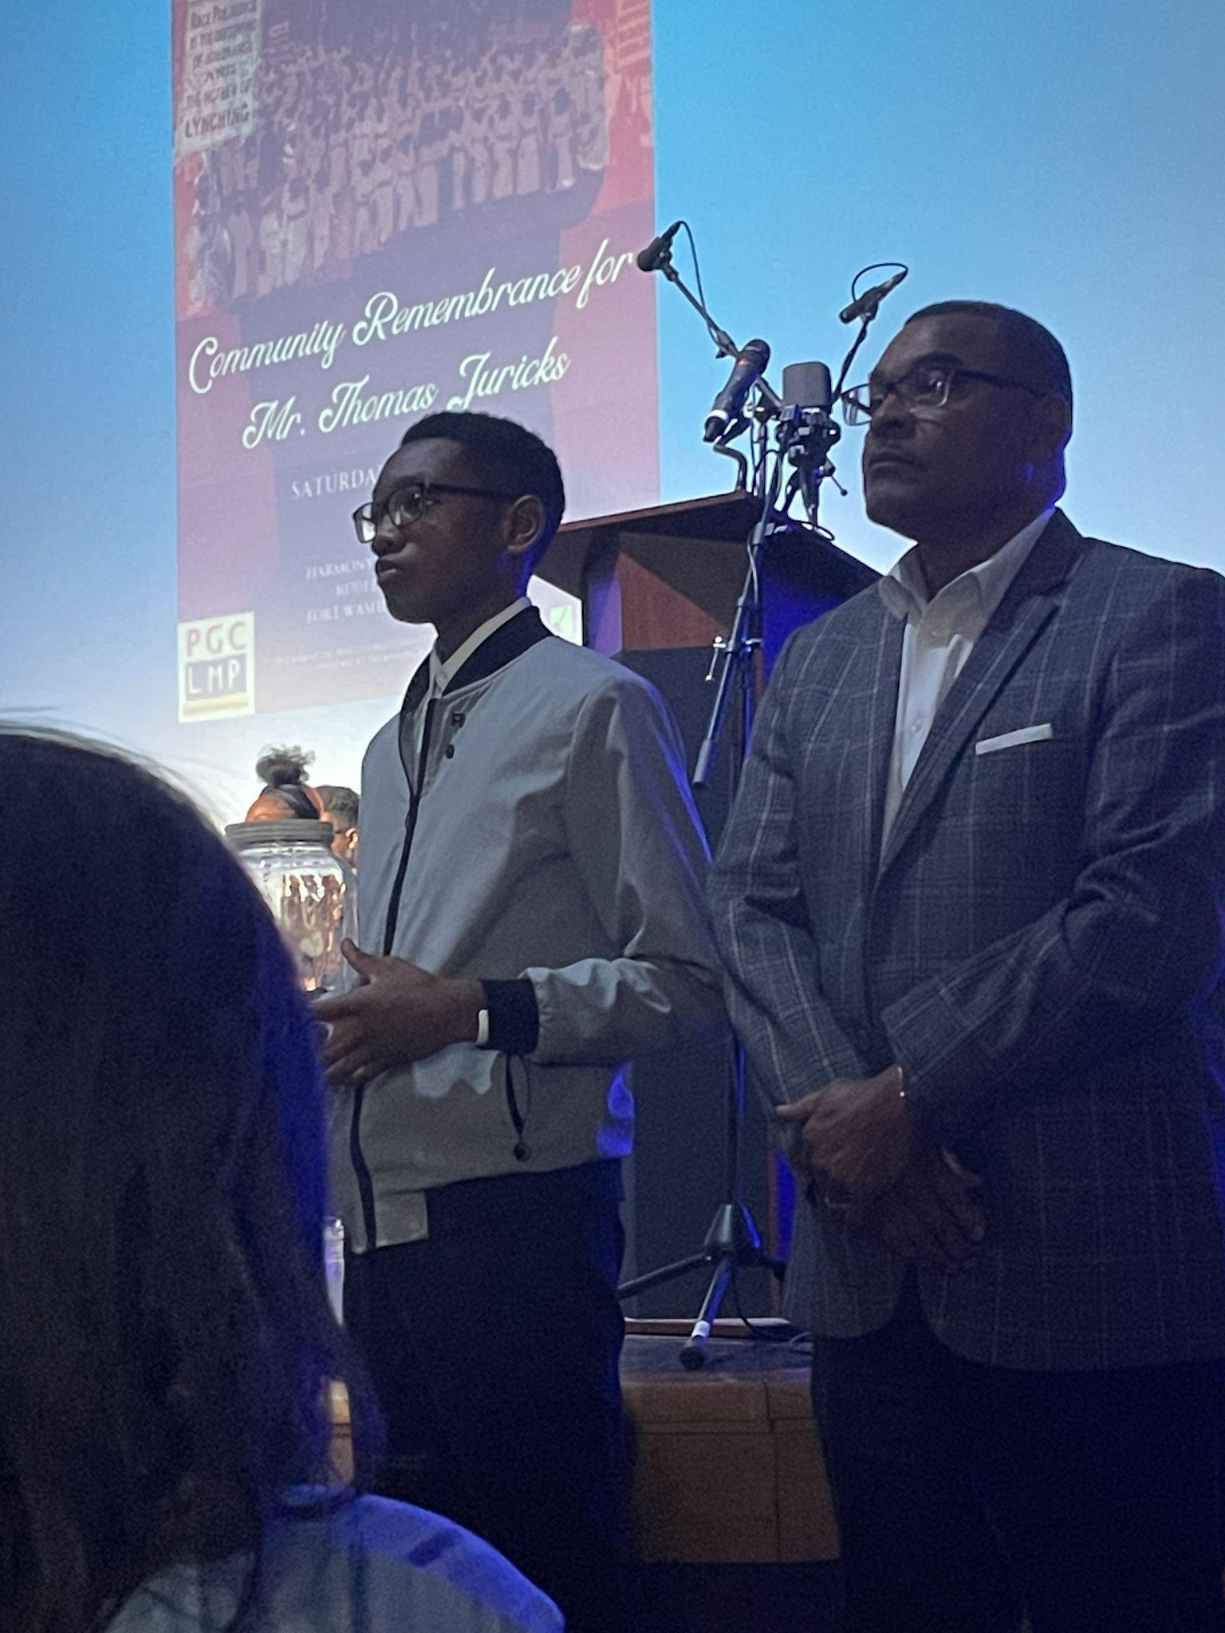
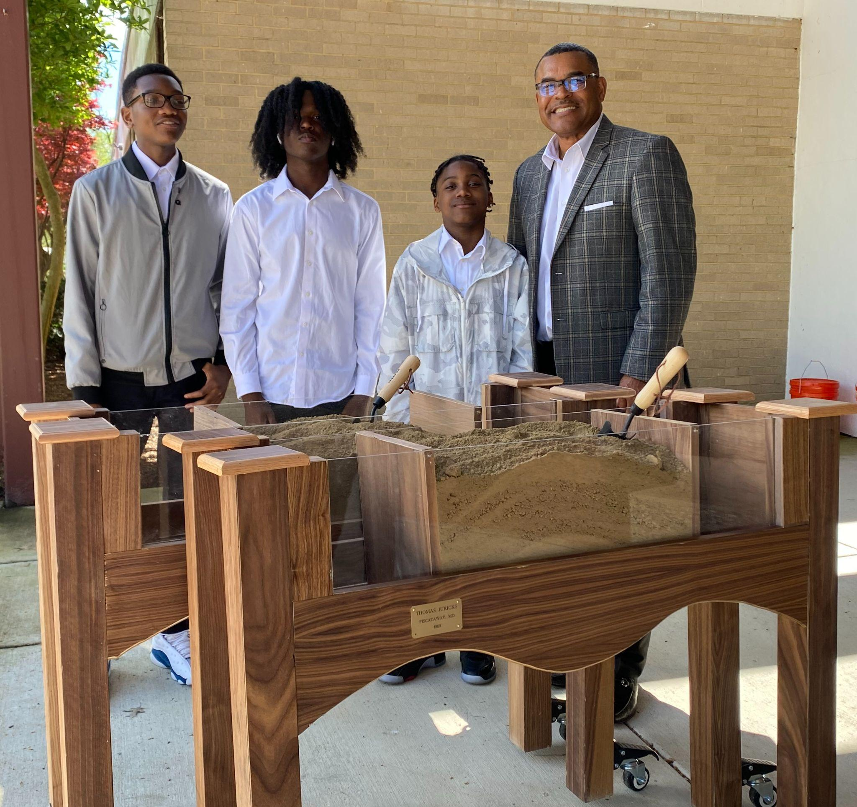
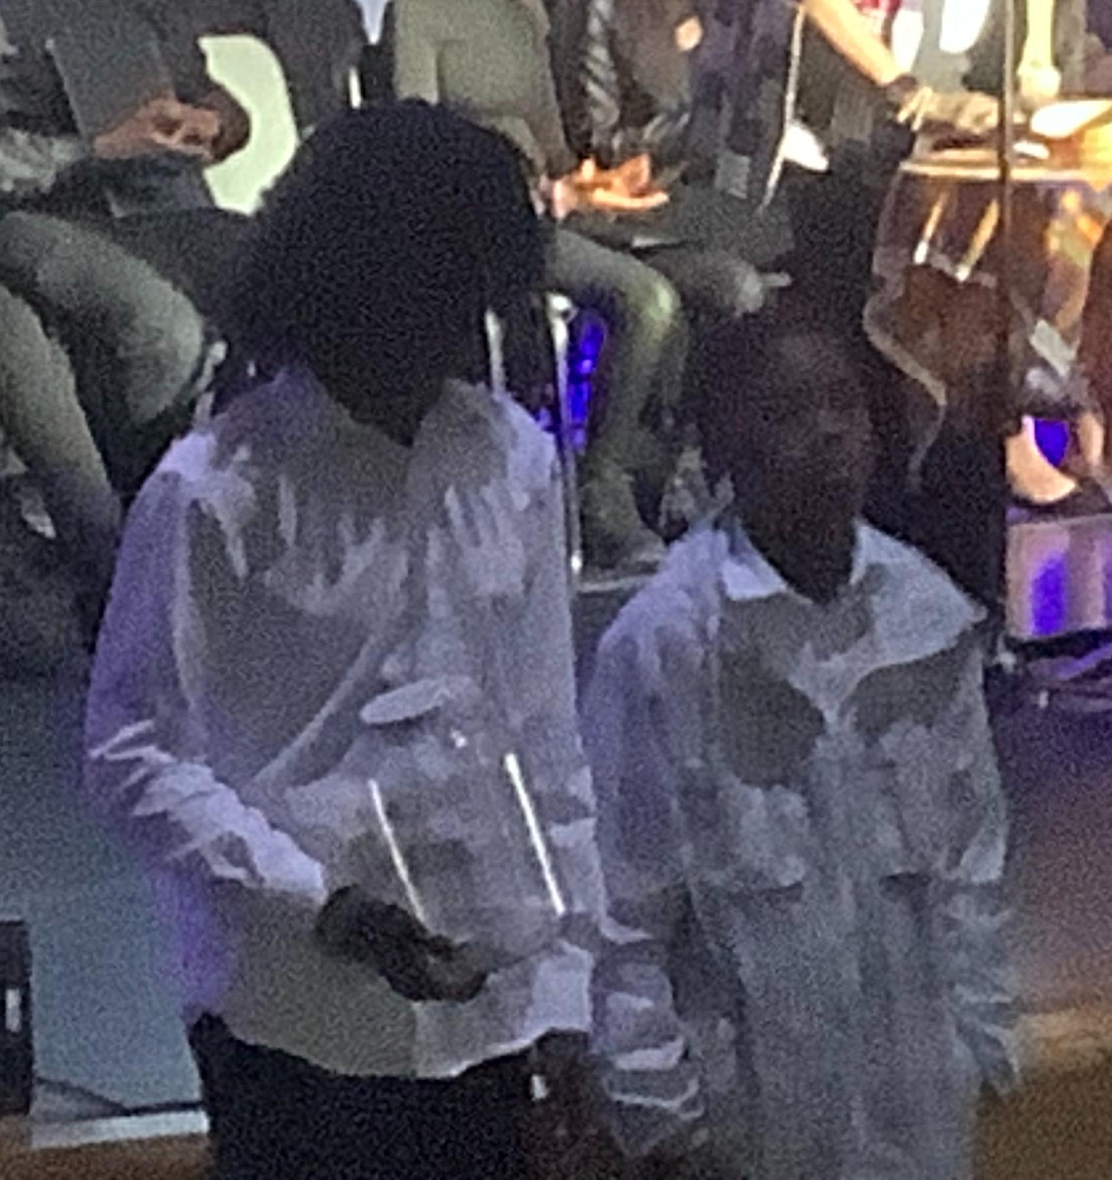
Soil Procession
Notes:
Everyone in attendance was invited to follow the Mighty Men youth mentees to the memorial carts to fill the memorial jars with the collected soil, soil which will be displayed at the Legacy Museum in Montgomery and is on display at the Reginald F. Lewis Museum in Baltimore.

Slide 29
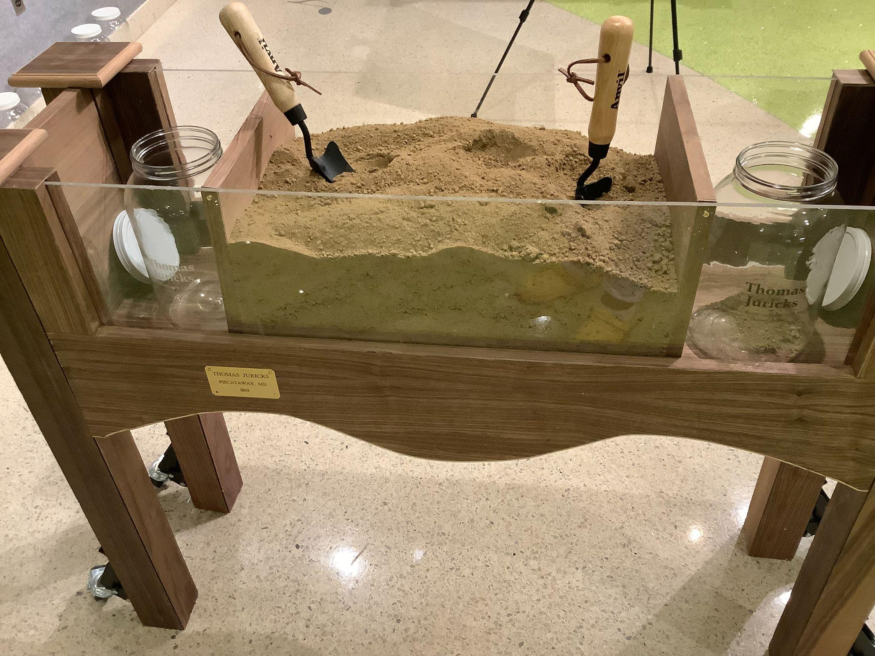
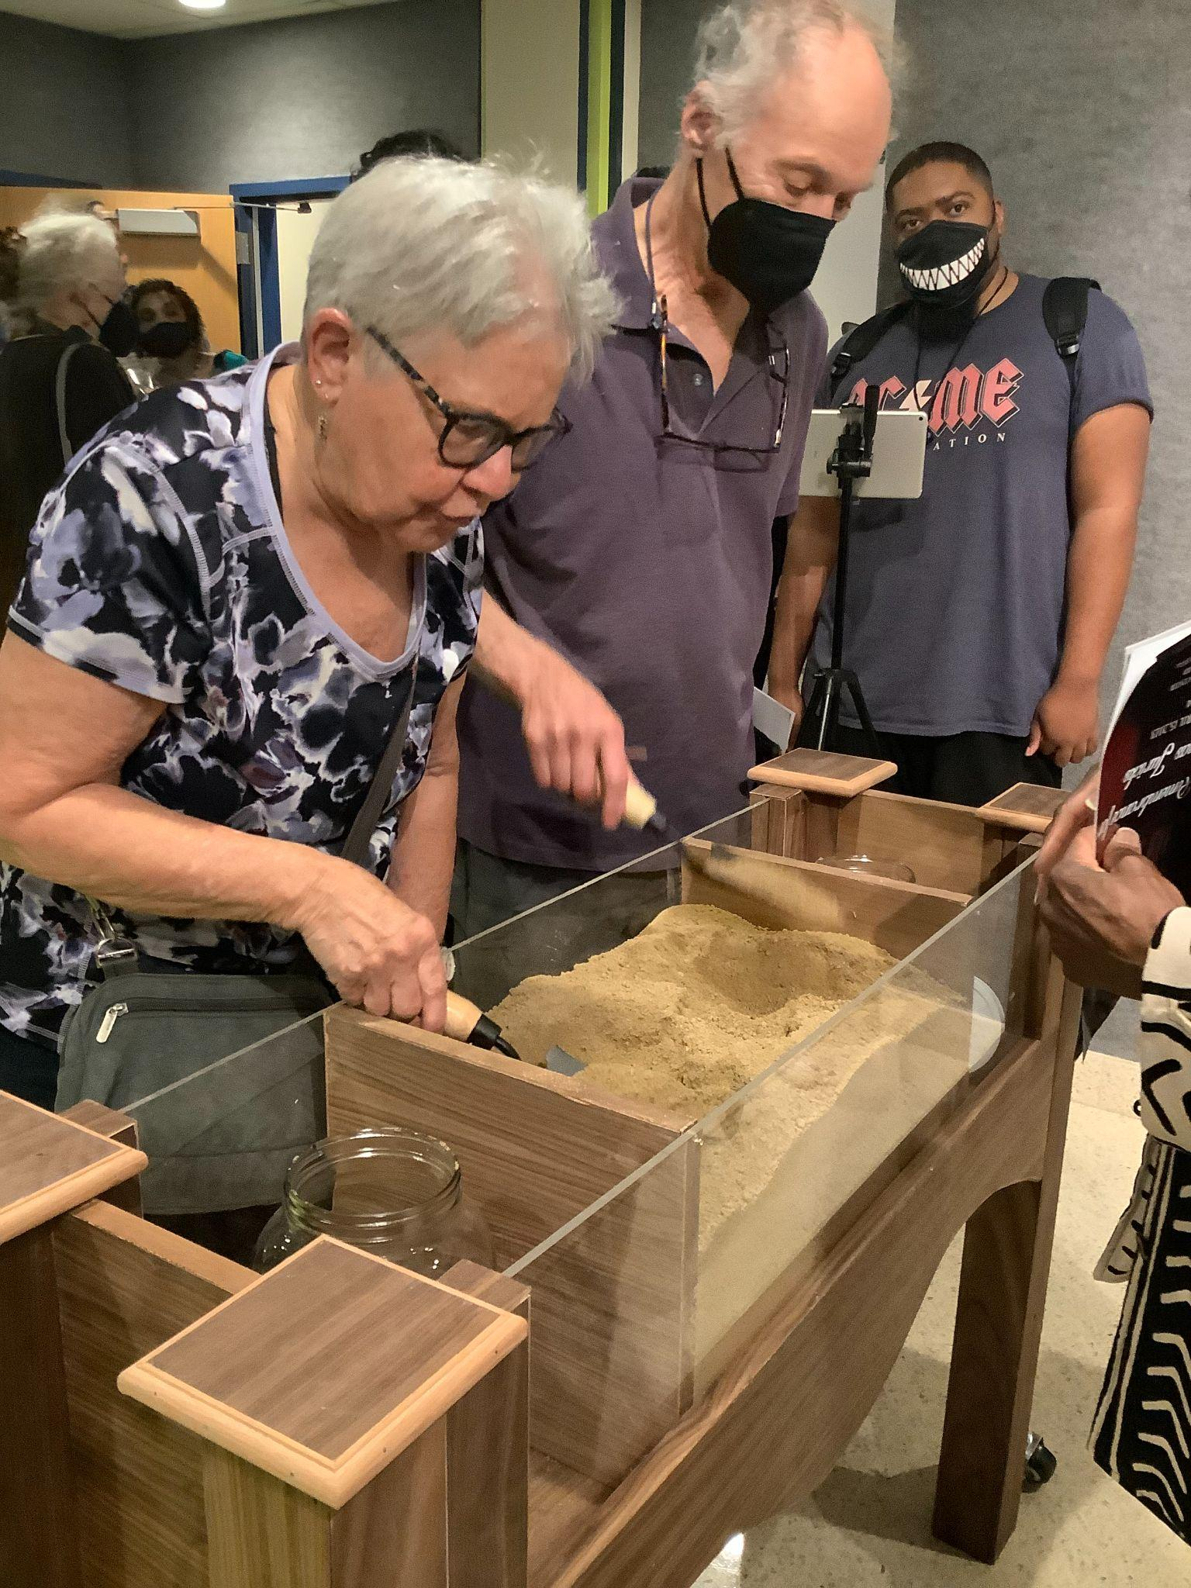
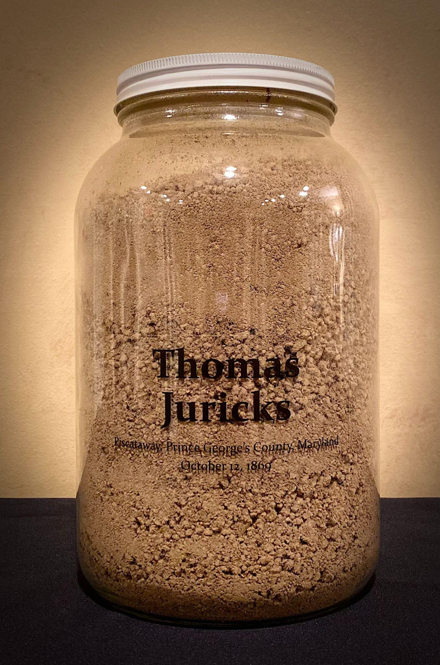
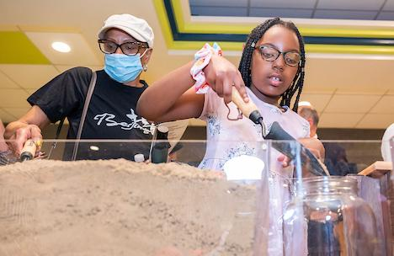
Memorial Cart & Jars
Notes:
The beautiful memorial carts holding the jars and soil were built by students and their instructor, Mr. Charles DiNatale, from the Prince George’s County Public School’s Non-Traditional Program South in Cheltenham
Plans are underway to hold a remembrance program for Mr. John Henry Scott in 2026.

Slide 30
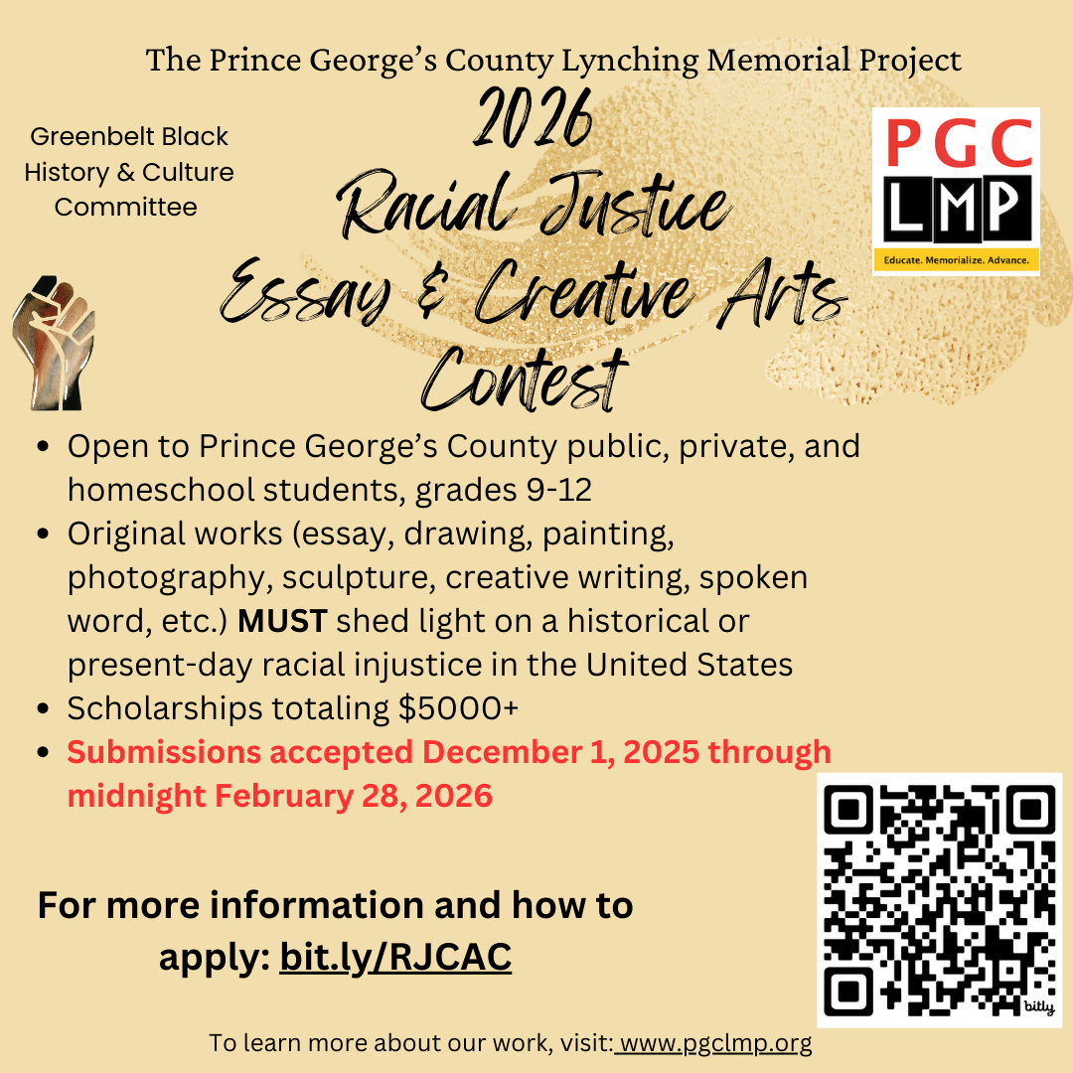
Annual Racial Justice Essay and Creative Arts Contest
Open to all High School Students in Prince George’s County
Strong participation from across the County
2026 is the fifth year
Provided over $22,000 to 41 students
Invited to participate in PGCPS’ first Teen Writing Conference (February, 2025 at Oxon Hill High)
Two teachers won support to participate in a civil rights travel/study program
Curating student entries for display in public libraries
Notes:
As part of our education effort, we sponsor an annual racial justice essay and creative arts contest that’s open to all Prince George’s County high school students.
Students must explore a historical or current racial justice issue. We’ve had strong participation from schools across the County.
We have had community cosponsors each year including the Hurston-Wright Foundation, the local NAACP, Joe’s Movement Emporium, and the Greenbelt Black History and Culture Committee.
A panel of volunteer expert judges select the winners. Judges include university administrators and faculty, lawyers, former Prince George’s County public school educators, artists, and publishers. Some reside in the county, some don’t, but all are enthusiastic about the contest and the entries received.
2026 will be our fifth year. Our 2026 Contest opens in December 2025 and closes February 28, 2026.
So far, we’ve provided over $22,000 to 41 students, money donated by individuals and church and other groups, and funds from a county council grant. In addition to scholarship money, other recognitions and prizes have included citations from elected officials, studio space time and mentoring at Art Works Now in Hyattsville, and participation in a summer oral history workshop at Howard University.
We’re pleased with some unexpected benefits of the contest including being Invited to participate in PGCPS’ first Teen Writing Conference (February,2025 at Oxon Hill High);
Seeing two teachers supportive of the contest being selected and supported to participate in a competitive civil rights travel/study program sponsored by the Institute for Common Power ; ,and having the public libraries express interest in displaying the students’ work.
We’re Curating student entries for display now.

Slide 31
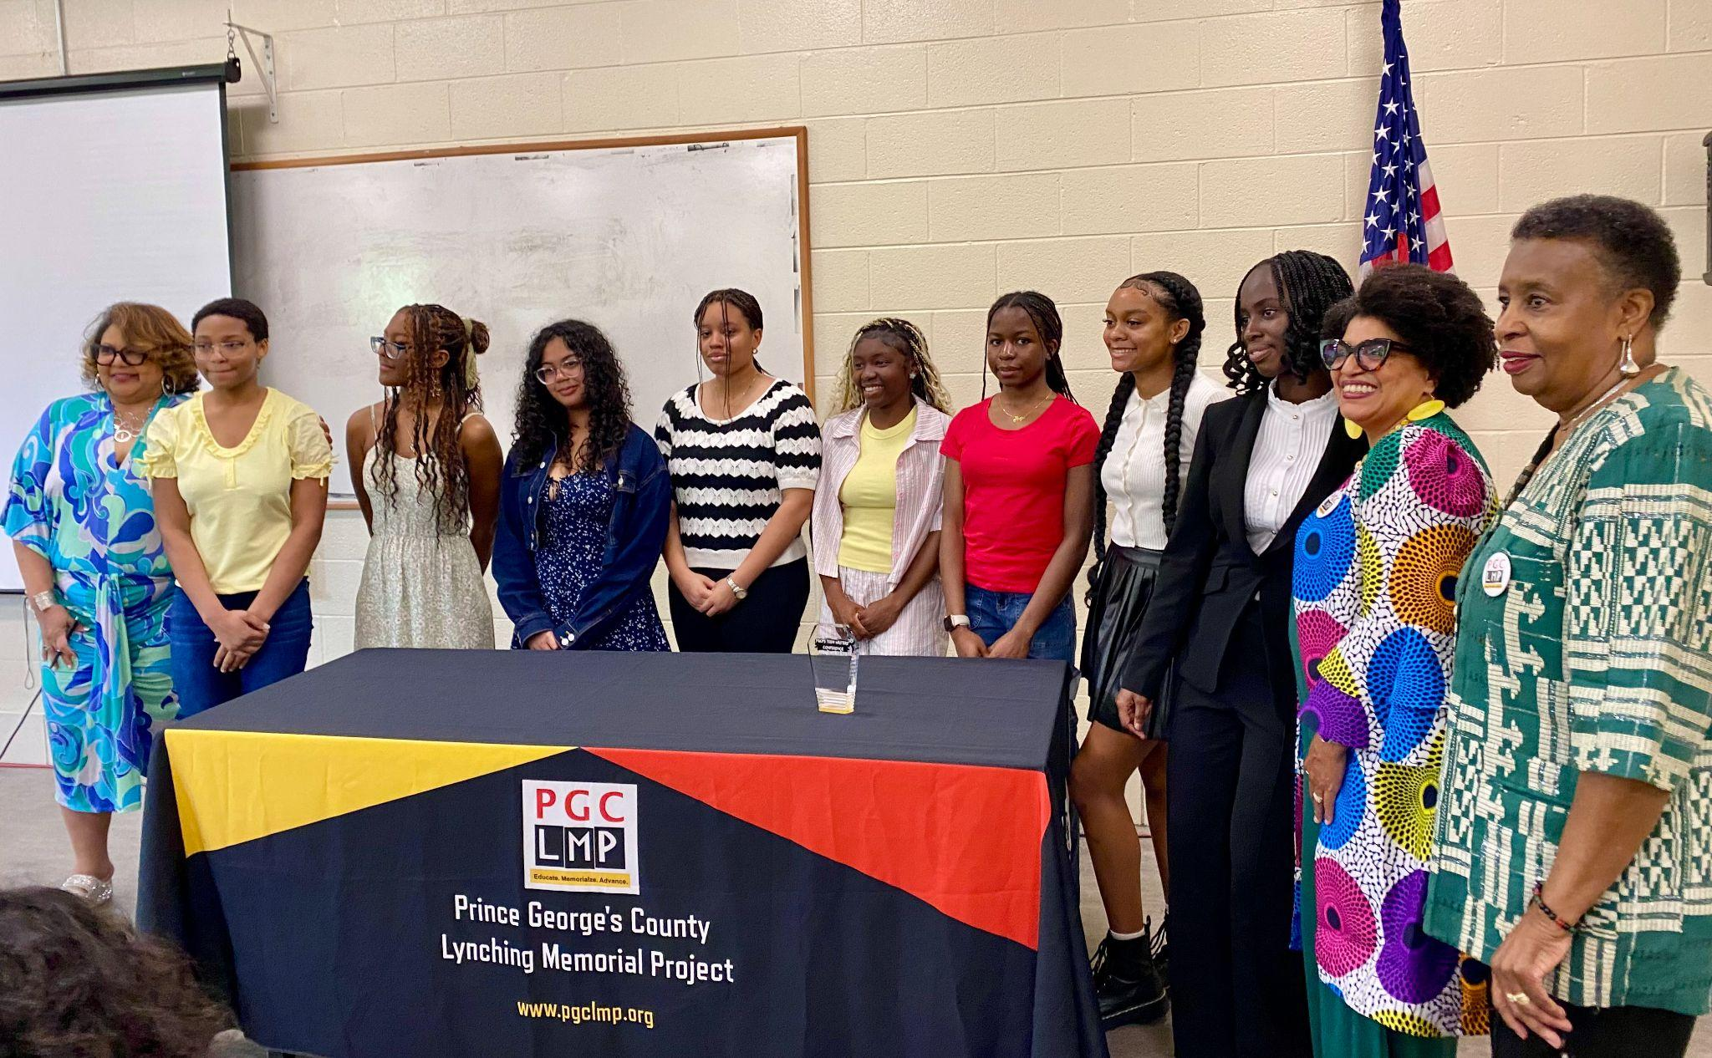
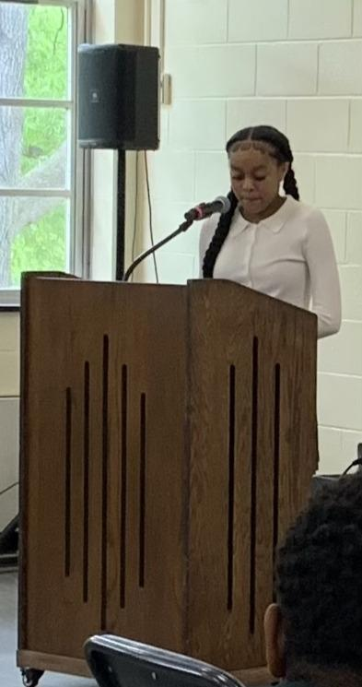
Contest Awards Ceremony
Ava Raines at the 2025 Awards Ceremony reading her poem, “Parties Unknown” about the Lynching of Stephen Williams, on October 20, 1894 in Upper Marlboro.
2025 Contest Winners
Notes:
We celebrate student winners at an Awards program where they present their work to an enthusiastic audience of families, friends, teachers, legislators and community members.
The contest Awards Ceremony for 2026 will be on May 2nd at the Greenbelt Community Center.

Slide 32
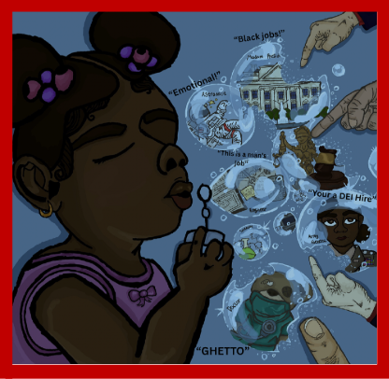
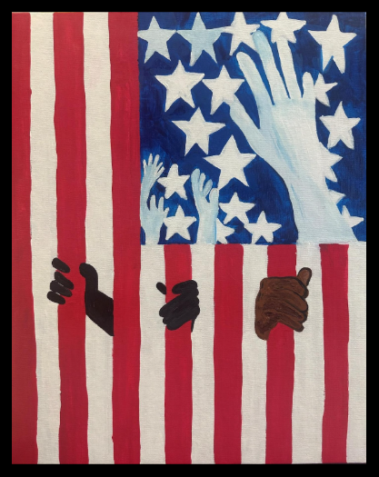
The Intercepting Fingers
created by Angel Adesoji 2025
Chesapeake Math and IT Academy North High School
Bars of Freedom
created by Jaxelynn Walker 2024
Chesapeake Math & IT Academy North High School
Notes:
This is some of the artwork.
Essays have addressed disparities in women’s health,the unfinished fight against lynching, the struggle to desegregate the Prince George’s public schools, and colonialism in the Domincan Republic.

Slide 33
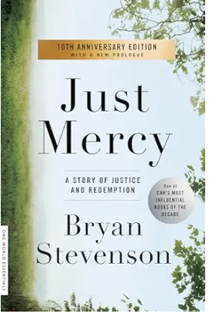
Book Discussions
2020 - On the Courthouse Lawn: Confronting the Legacy of Lynching in the Twenty-first Century, (2007) by Sherrilyn A. Ifill
2022 - How the Word Is Passed: A Reckoning with the History of Slavery Across America, (2021) by Clint Smith
2023 - The Color of Law: A Forgotten History of How Our Government Segregated America, (2017) by Richard Rothstein
2024 - Don't Let Them Bury My Story: The Oldest Living Survivor of the Tulsa Race Massacre in Her Own Words, (2023) by Viola Ford Fletcher and Ike Howard.
2025 - Barracoon: The Story of the Last Black Cargo, (2018) by Zora Neale Hurston
2026 selection:
Just Mercy
by Bryan Stevenson
Notes:
We hold book discussions each year.
Our 2025 book was Barracoon by Zora Neale Hurston. It talks about Cudjoe Lewis who was brought over with 109 other Africans on the last illegal slave ship, the Clotilda. Evelyn D. Milton, a fourth-generation descendant of Clotilda survivors, joined us for the discussion
Our 2026 Book is Just Mercy by Bryan Stevenson. We’re working to include students in our discussion. This book is on the schools’ reading list. Funds from a county council grant allowed us to purchase books for students to facilitate their participation.
This year's book discussion was led by Abd'Allah Lateef, deputy director of Campaign for the Fair Sentencing of Youth. We were joined by students from Frederick Douglas High School in Upper Marlboro, MD.,and Eleanor Roosevelt High School in Greenbelt, MD and their teachers.

Slide 34
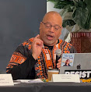
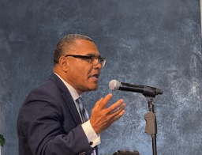
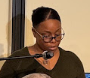
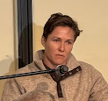





MLTRC Public Hearing for Prince George’s County
Nicholas Creary, PhD
Commissioner, MLTRC
Rev. Rodney Taylor, of the Mentors for Mighty Men Ministry
Crystal Queen - 4th great niece of lynching victim Mr. Stephen Williams
Blair Bowie, descendant of
a PGC enslaving family
Crystal Carpenter, Co-Chair PGC LMP
Maryland Attorney General Anthony Brown
Delegate Jamila Woods
Del. Joseline Pena-Melnyk
Mark Winston, PhD. PGC Memorial Library System CEO
Notes:
We are proud that Maryland was the first state to enact legislation to study racially motivated lynchings. The Maryland LMP was helpful in that effort. The legislation established the Maryland Lynching Truth and Reconciliation Commission (MLTRC) in 2019 to research cases of racially motivated lynchings and hold public hearings where a lynching of an African American by a white mob has been documented.
Each county with a lynching could hold a hearing. The Public Hearing for Prince George’s County was held on January 25th, 2025 at Bowie State University. The hearing recognized the 4 victims of lynching in our county and facilitated reflection and dialogue about the legacies of racism and racialized violence in the State of Maryland.
Our coalition partnered closely with the Commission in planning the hearing for our county.
Our hearing had record attendance with approximately 300 people in attendance The Commission expressed positive comments about our hearing such as the many young voices included in the program and the “all star cast” in attendance including Maryland’s Attorney General.
During the public testimony period, Minister Rodney Taylor, lead of the Mentors for Mighty Men ministry at Union Bethel AME Church in Brandywine spoke movingly about the positive changes he saw in his young mentees as a direct result of their participating in PGCLMP’s soil collection and remembrance programs for Mr. Thomas Juricks-- citing improvement in academic performance and behavior.
Blair Bowie, a member of our coalition (and a voting rights attorney), testified as a descendant of an enslaving family. Since her testimony she and her family have begun establishing scholarships in memory of our four lynching victims at Bowie State University.

Slide 35


Marker for Mr. Thomas Juricks
Notes:
This is Mr. Juricks marker.
We hope to hold an installation ceremony for this marker in Summer of 2026.

Slide 36

Youth Detention Cemetery in Cheltenham
Notes:
We have new memorialization work planned.
We strongly support the long overdue efforts now underway by the Maryland Legislative Black Caucus to find, exhume, identify, document and honorably bury the bodies of the hundreds of Black boys and teens now in the unkempt Youth Detention Cemetery in Cheltenham, Prince George’s County.
State Senator Will Smith has spoken with us at our general meeting. We applaud the work of Dr. Well’s journalism students in documenting the forgotten teens of Cheltenham.

Slide 37

Questions?
To Stay Updated about Upcoming Events…
Subscribe to our Mailing List
by
Sending an email to: princegeorgescolmp@gmail.com
Notes:
Thank you for your interest, time and attention today.
We would now like to open things up for your questions about our organization.
So please let me introduce PGC LMP co-chair, Rev. Diane Teichert, who will facilitate our conversation with you.

Slide 38


Digital Preservation & Access:
Unpacking The Research Process on the Untold Story of
John Henry Scott
Notes:
Good Morning,
My name is John-Phillip Williams. I am the newest member of the Prince George’s County Lynching Memorial Project.
I am also one of the researchers and the head presenter for our most recent presentation entitled <click>

Slide 39

The Untold Story of the Lynching of
Mr. John Henry Scott
Oxon Hill, Maryland
March 23, 1875
Presented by The Prince George’s County Lynching Memorial Project (PGCLMP)
Notes:
“The Untold Story of the Lynching of John Henry Scott” which occurred in Oxon Hill Maryland in 1875. <click>

Slide 40
Lynching in Prince George’s County Maryland
The Prince George’s County Lynching Memorial Project is documenting racial terror lynchings throughout the county.
4 occurred in Prince George’s County
4 occurred in Prince George’s County
Thomas Juricks Piscataway, October 12, 1869
John Henry Scott Oxon Hill, March 23, 1875
Michael Green Upper Marlboro, September 1, 1878
Stephen Williams Upper Marlboro, October 20, 1894
Notes:
John Henry Scott is the focus of our current work and was the second of the four black male victims of racial terror lynching that occurred in Prince George’s County Maryland. <click>

Slide 41

Getting Involved with PGCLMP
Notes:
Before I take a deeper dive into John Henry Scott’s story and my research around his lynching I want to provide a little personal background story on how I got involved with PGCLMP. <click>

Slide 42


Stepping Out of the Shadows
Maryland Lynching Truth and Reconciliation Commission
April 5, 2025
Notes:
I became aware of the existence of the Maryland Lynching Truth and Reconciliation Commission or MLTRC last year, which was established in 2019.
As they were nearing the end of their statewide, county to county in person commission hearings, I ended up attending the MLTRC’s Institutional and Reconciliation hearing at the Reginald F Lewis museum in Baltimore and had the opportunity to provide public comments. <click>

Slide 43






Passion Project
Rubin Stacy
Isaiah Fountain
Fort Lauderdale, FL (1935)
Charles Johnston
Easton, MD (1919)
Swainsboro, GA (1893)
Notes:
This work is very personal for me. Back in 2020 in the middle of the pandemic I discovered by shear divinity that I had a racial terror lynching in own my family. I was participating in a virtual book club and we were reading, “The Cross and the Lynching Tree” by Theologian and father of Black Liberation Theology, Dr. James Cone.
In this book I came across 3 racial lynchings that hit very close to home. <click> The first occurred in my hometown of Fort Lauderdale, Florida of a black man named Rubin Stacy in 1935. <click> The second was of a black preacher named Charles Johnston in Swainsboro, GA in 1893 just one county over from where my maternal grandparents were born. And the last, <click> a well known attempted lynching and what eventually resulted in a state sanctioned hanging just 20 minutes up the road from here in Talbot County in Easton, MD of a black man named Isaiah Fountain in 1919. <click>

Slide 44



Jim Crow in Rural Georgia
Notes:
<AUTO>
Knowing that both of my grandparents were born in rural Georgia in the 1930s I asked myself “what did they experience growing up in the Jim Crow south.”
I began to do some research and to my surprise, I discovered that a racial riot had taken place right outside of their hometown.
I was even more surprised to find out that the victims of the lynching had the same last name as my grandmother’s maiden name. I began to ask questions to family members, and not too long after they realized that I had learned the entirety of this tragic story, they reluctantly confirmed that the individuals involved were indeed related to us. <click>

Slide 45




The Red Summer of 1919
Notes:
I learned that my second great grandfather and his 3 sons were the central characters in a racial riot that led to the murder, brutal lynching and burning of two of his sons, one 18 years old and the other 29. The terror of a white mob swept through the Black community resulting in murder, the destruction of black churches and property, as well as generational familial wealth.
This incident was the very first documented racial riot or more appropriately, racial terror massacre of The Red Summer of 1919, a term coined by American writer and Civil Rights Activist James Weldon Johnson, describing the immense bloodshed from dozens of racial riots that resulted in the death of hundreds that summer, including Isaiah Fountain of Talbot County, Maryland.
As you can imagine learning this had a profound impact on me, especially as a former African American Studies and History major, genealogical researcher and reparations advocate. <click>

Slide 46



Prince George’s County Lynching Memorial Project
Educate. Memorialize. Advance
Notes:
<AUTO>
I made a commitment to join PGCLMP because I wanted to use the power of my family story, both to inspire other descendants of racial terror lynchings in Maryland to step out of the shadows and to have the courage to share our stories.
As well as to educate the community about our shared tragic history of racial terror lynching and to unearth and highlight stories like that of Isaiah Fountain, John Henry Scott and so many more.
So let’s transition and unpack some the research regarding the Untold Story of the Lynching of John Henry Scott in Oxon Hill, MD by examining the critical role that librarians and library systems play in preserving and providing digital access to resources that help us to do this work. <click>

Slide 47



Digital Preservation & Access:
Unpacking The Research Process on the Untold Story of
John Henry Scott
Notes:
it’s funny because when I was asked to join the team to present here today to speak about the role of libraries and librarians in our work, I had realized that I did not step foot into a library until it was time to present our findings to the community.
But as I went back through my presentation on John Henry Scott, I realized that I had used digital library resources throughout the entirety my process
This is why I chose to speak today about Digital Preservation and Access.
Before I jump into the differents aspects of my research, allow me to give a short synopsis on who John Henry Scott was and his tragic story. <click>

Slide 48





John Henry Scott
(Summary)
Old County Jail in Marlboro, MD
(Pre-1927 Building)
Notes:
So, Who was John Henry Scott?
John Henry Scott was a Freedman, born into slavery in 1852 in the Piscataway District of Prince George’s County Maryland. <click>
John Henry Scott worked for the Nelson Family.
The Nelson Family, Edgar and Arelia Nelson were Northerners from Madison County, NY who purchased land and moved to Oxon Hill, Maryland around 1871<click>
The Nelson Family farm was located right north of the present day National Harbor, a waterfront resort destination right off the banks of the Potomac River across from Alexandria, VA<click>
Despite having a mutually friendly and trustworthy relationship with the Nelson family, John Henry Scott was accused of sexually assaulting Misses Nelson and making homocidal threats.<click>
He was apprehended by the appointed Justice of Peace with intentions of being escorted to the county Jail in Upper Marlboro Maryland within Prince George’s County.<click>
However, sadly, he was intercepted by a lynch mob and hanged on a nearby black walnut tree until be passed away.<click>

Slide 49


Digital Archival Preservation
250 of American Independence
151 years of archival preservation
Without Librarians and Archivist, our stories would be lost to history!
Affordability
Efficiency
1776
1826
1876
1926
1976
2026
99 years ago
151 years ago
1875
The Lynching of John Henry Scott
Notes:
<click>
Lets talk very briefly about the importance of Archival Preservation
As many of you are aware, this year we are celebrating 250 years of American Independence.
To make a point about the importance of preserving archival resources, I wanted to paint a picture by using a historical timeline to express how important the work of librarians and archivist are to what we do. <click>
The lynching of John Henry Scott which took place in 1875 occurred 151 years ago.
To put this into context, the process of researching, collecting, digitizing and ultimately preserving the historical documents that we were able to access in order to recreate and bring to life the Untold Story of the Lynching of John Henry Scott is an amazing feat.<click>
Without librarians and archivist helping to preserve this information, directing us to different types of sources and most importantly making these documents readily available through digital access, not only would our stories be lost to history, but barriers such as affordability and the efficiency at which we are able to do our work would be much more diffiicult. <click>

Slide 50





Digital Access to Resources
Books
Newspapers
Census Records
Maps
Archives
Notes:
<click>
The research process on John Henry Scott incorporated many different types of resources such as census records, newspaper archives, maps and books.
As we go through each of the different types of sources, I want to highlight some the keypoints that I touch on in the actual presentation on the Untold Story of John Henry Scott as well as talk about some of the platforms that I use to do my research and to hightlight some of the alternative digital library resources that people can access to do research for free.<click>

Slide 51














Newspaper Archives
Resource
“…her husband it is said, is by no means as much a believer in the equality of the races as he was before.” - Alexandria Gazette (VA)
Platform I Used
Free Library Resources
“…social equality with a race whom a wise Creator has stamped as distinct and different.” - Alexandria Gazette (VA)
Alexandria Gazette
Hart Park
(partial area)
The Baltimore Sun (1875)
“…the natural consequence of the social equality doctrines...”- The Clarion (MS)
“Civil Rights was too much for him to bear.” - The Critic and Record (DC)
The Alexandria Gazette (1875)
Notes:
The first recourse we will talk about is Newspaper Archives
In order to recreate the story of John Henry Scott’s lynching I spent months searching through digital archives of newspapers such as <click> The Baltimore Sun and the Alexandra Gazette from the 1870s.
Having digital access to these newspaper accounts allowed us to cross-reference dozens of racially biased newspaper articles to spot inconsistencies in the coverage of this event.
During my research it became very obvious to me that this event was meant to be expeditiously covered up and never to be spoken about again. <click> This sentiment is captured perfectly in this clip from the Alexandria Gazette’s last article on the lynching stating…(read quote on screen aloud). I personally can’t imagine that those who committed this heinous act of terror would have thought that we’d be here today talking about this 150 years later.
We consider the story of John Henry Scott to be a living story because we are still unearthing information in our research. For example, by examining news publications in Virginia, such as the Alexandria Gazette , we were able to discover a new lead that revealed to us where the remains of John Henry Scott are said to be buried, which is somewhere in a historic neighborhood within Oxon Hill, MD called Hart Park <click> (pause)
The last point I want to cover about newspapers before we move on to the next resource actually relates to something that we are living through again in this very moment. Just a week ago the Supreme Court issued a ruling that essentially eviscerated section 2 of the Voting Rights Act, opening the doors to states to enact discriminatory maps with impunity. As a result, this means that black voters and other communities could face the elimination of districts across the country, especially in Southern states.
This is relevant because one of the central themes that I highlight in the presentation on John Henry Scott dealt with the political intent surrounding lynchings. These newspaper clippings directly attack the political aims towards “equality of the races” and “civil rights” including the 15th amendment which at that time was meant to give Black men the right to vote. This last clip here (point to clip in the bottom right corner) states that “Civil Rights was too much for him to bear.” This insinuates that providing civil rights and allowing black men to vote would embolden them to carry out barbaric acts against white women. So we see this linear attack a century and a half later from 1875 to 2026, pushing back on the efforts to fully incorporate black people into the political process of our American Democracy as full citizens.
The platform that I used to do my research was Newspapers.com
And some alternative Free Library Resources that are available to do the same at no cost are the Library of Congress website which allows you to access newspaper archives and to ask a librarian for help
As well as Newspapers.com libraries edition distributed by ProQuest that allows libraries to provide these services to the public. <click>

Slide 52








Census and Inventory Records
Resource
Platform I Used
Free Library Resources
U.S. Census - Oxon Hill MD
(1880)
Notes:
<click>
Our second resource is Census and Inventory Records.
The use of Census documents were absolutely crucial to my research. I was able to do things like verify individual ages, locate the whereabouts of individuals and families over time and potentially find descendants by accessing census and inventory records from slavery, up to the lynching of John Henry Scott in 1875 and beyond.
For example, through a combination of examining newspaper articles and census documents we were able to find the name and location of the family that owned John Henry Scott during slavery <click>. With that information we were able to access other records regarding the family such as slave schedules, wills, probate and inventory records to trace a more accurate age for John Henry Scott other than what was reported.
To do this I used both Ancestry.com and Family Search which provides phenomenal access to repository resources like probate, wills and inventory records.
And the available free resources that allow the public to access this can be found at libraries such as the Enoch Pratt Libraries in Baltimore through their Heritage Quest online database. They even allow users to create a free electronic library card to gain access to this database.
Another free resource is the Family Search Affiliate Library program which is available through select libraries and other organizations such as genealogical societies and churches. <click>

Slide 53







Maps and Land Deeds
Resource
Platform I Used
Free Library Resources
Approximate location of the Nelson family farm and within the vicinity of the lynching of
John Henry Scott
Oxon Hill Maryland
District 12 Map (1878)
G.M. Hopkins
Notes:
<click>
One of my favorite resources that we came across in our research were the various historical maps.
This is a 1878 district map of Oxon Hill, Maryland and it is 1 of about 59 different maps within a series produced by a Griffith Morgan Hopkins, who was a civil engineer who owned a family surveying firm based out of Philadelphia, PA. This was a very interesting find. They essentially surveyed all of the surrounding counties fifteen miles around the city of Washington DC both in Maryland and Virginia. <click>
This map is extremely significant to our work because it was produced in 1878 just 3 years after the lynching of John Henry Scott in 1875.
We were able to use this map to identify land and property owners in the area during this time which has the potential to provide us with more leads to find out who may know more information about this racial terror lynching.<click>
This is the approximate location of the Nelson’s farm property where John Henry Scott worked <click> according to land deeds<click> (pause). <click>
As I said before the property is located right North of the present day National Harbor Resort in Oxon Hill, MD. <click>
And of course the platform that we used to discover the map is with the Library of Congress

Slide 54




Books
Resource
Platform I Used
Free Library Resources
Notes:
And last but not least are Books!
Most recently, I read,<click> On the Courthouse Lawn - Confronting the Legacy of Lynching in the 21st Century - by Sherrilyn Ifill
The book focuses on the history of the lynching era right here on the Eastern Shore of Maryland.
She also gives different examples of other countries who have experienced racial and ethnic violence, expounding on the importance of collectively investing in a reconciliation process that fully acknowledges the harmful generational effects of racial violence on communities for the purposes of healing and moving forward in a way that give honor to our past and encourages a better future.<click>
I’ve also picked up these 3 books, one on the history of Oxon Hill Maryland, another on the History of Fort Washington Maryland just south of Oxon Hill and lastly a book on the history of the Civil War in Prince George's County.<click>
And The platform that I used other than checking out the physical copy of the book out at the library was the Libby App which is my favorite.
The Libby App allows for digital access to reading materials in the form of ebooks and audiobooks.
And this concludes my presentation on Digital Preservation and Access and Unpacking the Untold Story of the Lynching of John Henry Scott.<click>

Slide 55
Thank
You!
“Librarians are guardians of books. They guide others along their paths, offering keys to help unlock the doors of knowledge.”
— Ellen Klages
Notes:
And I’ll leave you with this quote (read quote aloud)
Thank You!

Slide 56


Library Memories and Dreams
Notes:
My name is Lula Beatty and I am co-secretary of the Prince George’s County Lynching Memorial Project and the secretary of the Maryland Lynching Memorial Project.. I joined the PGCLMP after retiring from a career as psychologist. I was trained by deconstructionists in Black psychology, a movement to question prevailing Eurocentric assumptions and theories about Black people . In my last position as Senior Director for Health Disparities at the APA, I worked on a couple of passion projects – to produce reports on stress and health disparities and to develop programs on health disparities in boys and men with a particular focus on Black boys and men. A common thread running through my professional—and community-- life and now with the PGCLMP is to question, look for truth and paths to justice, and to assist others in doing the same.
The PGCLMP feeds that life-long interest as well as I suppose a spiritual urging that I attribute in part to my upbringing in the Jim Crow south surrounded by beloved male friends and relatives who were at high risk of harm just by being (existing?). (Revise?_) I have one other memory to share. My uncle was the janitor for the town in NC in which my father’s family lived; he was responsible for maintaining the City Hall. As a treat, he took me to work with him on a Saturday when there was no one there. I saw the jail cell on one floor. On the main floor, I looked through a glass wall and saw books and small tables and chairs – a library for children. I was in love with that library (or the idea of it) tailored for children, a library that I could not enter and for which there was no “colored” equivalent. It may have triggered my life long love of the potential and hope for libraries and how they could enrich our lives. (Rework this).
Ron McNair

Slide 57
What I will be talking about
Framework for What We Aspire to Be and Do
Educating and Engaging Youth: Focus on our Racial Justice Contest
Hope and Opportunities for Working with Librarians and Libraries
Notes:
My name is Lula Beatty and I am co-secretary of the Prince George’s County Lynching Memorial Project and the secretary of the Maryland Lynching Memorial Project.. I joined the PGCLMP after retiring from a career as psychologist. I was trained by deconstructionists in Black psychology, a movement to question prevailing Eurocentric assumptions and theories about Black people . In my last position as Senior Director for Health Disparities at the APA, I worked on a couple of passion projects – to produce reports on stress and health disparities and to develop programs on health disparities in boys and men with a particular focus on Black boys and men. A common thread running through my professional—and community-- life and now with the PGCLMP is to question, look for truth and paths to justice, and to assist others in doing the same.
The PGCLMP feeds that life-long interest as well as I suppose a spiritual urging that I attribute in part to my upbringing in the Jim Crow south surrounded by beloved male friends and relatives who were at high risk of harm just by being (existing?). (Revise?_) I have one other memory to share. My uncle was the janitor for the town in NC in which my father’s family lived; he was responsible for maintaining the City Hall. As a treat, he took me to work with him on a Saturday when there was no one there. I saw the jail cell on one floor. On the main floor, I looked through a glass wall and saw books and small tables and chairs – a library for children. I was in love with that library (or the idea of it) tailored for children, a library that I could not enter and for which there was no “colored” equivalent. It may have triggered my life long love of the potential and hope for libraries and how they could enrich our lives. (Rework this).

Slide 58

Inspiration: Social Change Model by Deepa Iyers, Solidarity and Building Movement Project

Slide 59

Roles PGCLMP Plays in Fulfilling its Mission
Key Roles I Believe We Aspire to Be
Roles We Encourage Students to Consider
Weavers – See the through lines
of connectivity
Builders – Generate bold
possibilities, hopes and dreams
Storytellers – Share community
stories, histories and possibilities
through art, music, media, and
movement
Guides – Teach, counsel, and
advise through discernment and
wisdom
Storytellers – Racial Justice contest, work with journalism students and professors at the University of Maryland (e.g., brochure development, webinar on newspaper coverage of lynchings, future webinar on the children buried at Cheltenham); participation in soil collection and community remembrance programs; our participation in the school systems Teen Writing conference
Visionaries – Hope students will offer new justice visions and
dreams and ways to actualize
them for the benefit of us all

Slide 60

Educating and Advancing:
Racial Justice Contest for Students

Slide 61
Students: Injustices on their Minds
Cheltenham: Unmarked graves of children
Disparities in Black women’s pregnancy morbidity outcome; gynecological research on Black women that led to modern gynecological practices
Lynching
School to prison pipeline
Police brutality
Racial injustice in figure skating
Dual identity: Latino and African American
Stereotyping
Gentrification
Voting
/

Slide 62



Award-winning Art, 2026
Suitland High School, Academy of Health Sciences at Prince George’s Community College,
Charles Flowers High School

Slide 63
Roles of Librarians?
My/Our Perspective
How do Librarians See Themselves
(Beyond the Books: The Evolving Role of the Modern Librarian – Librarian Certification)
Weavers – See the through-lines of connectivity between people, places, organizations, ideas and movements
Builders – Develop, organize, and implement ideas and resources in service of a collective vision
Caregivers – Nurture and nourish the people around me by crafting a community of care, joy and connection
Storytellers – Craft and share community stories, cultures, histories and possibilities
Guides – Teach, counsel, and advise using my gifts of well-earned discernment and wisdom
Transforming … from traditional, managing books, enforcing silence, and gatekeeping … to
Educators
Technologists
Community Builders
Guides and Navigators for Users
Defenders of Intellectual Freedom

Slide 64


Working Together
Oxon Hill & Hyattsville Branch Libraries
Hannah Erickson and Paul Moreno: Conversation and Possibilities with Hyattsville Branch
Prince George’s County Room – local history and genealogy
Has collected oral histories about PGCLMP from co-chair and co-secretary; plan to collect others
Wants to help curate and exhibit student work
Can host the Racial Justice Award Ceremony
Serve as repository for our work
Partnership under discussion

Slide 65
Thank you!
Email: princegeorgescolmp@gmail.com
Website: https://pgclmp.org/

Slide 66

Please take a moment to complete the program survey.
SCAN ME!

