Slide 1
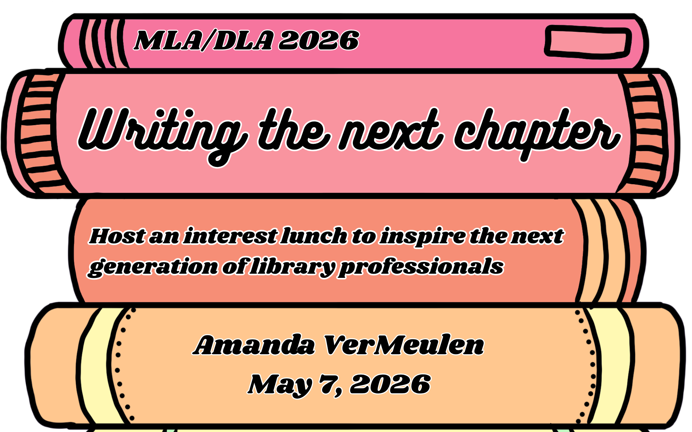

Slide 2

Who am I?
Amanda VerMeulen (she/her)
Director of the Library & Archives at St. Mary’s College of Maryland (SMCM) - go Seahawks!
Director since August 2022, previously STEM librarian 2015-2019

Slide 3
What is the lunch (& why do we do it)?
Low stakes opportunity for traditional age undergrads to talk with library professionals about careers
Encourage students who may not otherwise think about LIS as a viable career option

Slide 4
A brief history 2017-2026
2017
2018-19
2020-22
The beginning
Chill and low stakes
Pandemic years hiatus

Slide 5
A brief history 2017-2026
2023
2024
2025
2026
Bringing it back
Expanding student reach
Inviting outside guests
Biggest year yet!

Slide 6
So you want to do it too…
Identify your motivation
Identify your audience and their needs
Pick a scale you can manage
Plan the event like it’s…an event
Iterate and improve
Keep going!

Slide 7
Identify your motivation
Name your why
Is it an external motivator, internal, or both
All are valid!

Slide 8
Identify your audience
Who are you trying to reach?
What do they need?

Slide 9
Pick a scale you can manage
Start small (or start big!) but start where you feel comfortable
How many people do you think will show up?
Know your resources
How much money do you have?
What do you already have?
Who can help you?

Slide 10
Plan the event
Send logistics emails for outside guests
Make name tags & swag bags
Follow up with feedback forms
Book space in advance
Use RSVP forms & calendar reminders
Get the word out
Budget!

Slide 11
Iterate and improve
How will you gather feedback…
…and what will you do with it?

Slide 12
Keep going!
How will you build on you success?
How will you manage if the event doesn’t meet your expectations?

Slide 13
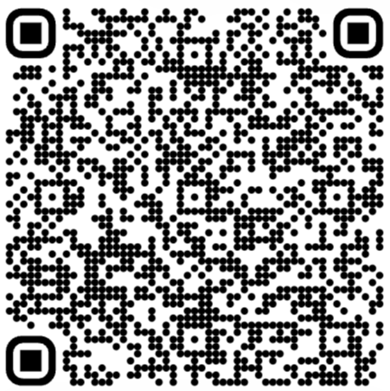
Wrap up
Questions?
Email me! aavermeulen@smcm.edu
Resources →

