Slide 1
Corky and Questionable Observations from a Print Processor
PRESENTER: Miriam Heard
Program Manager, Content Library
YMCA of the USA

Slide 2
Goals of the Presentation
Have fun!
Observe and report
Capture the whimsy

Slide 3
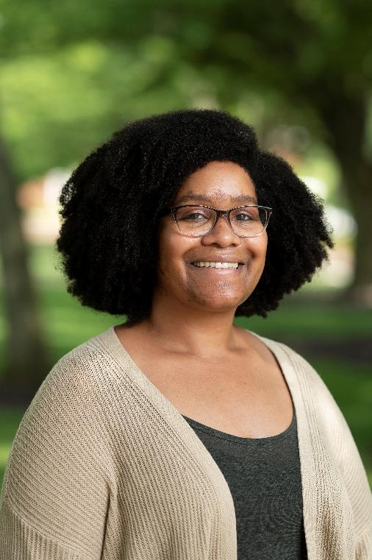
About Me
Academic libraries (10+ years)
Bindery support, collection development, course reserves
Chicagoland (14 years) to Baltimore (5 years)
On-site to fully remote
Access services to born digital content management

Slide 4
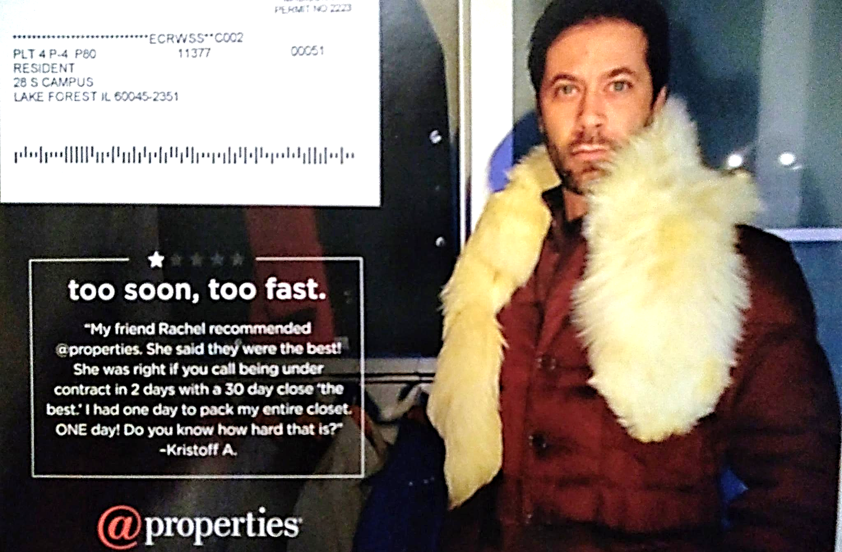
The Audacity!
“My friend Rachel recommended @properties. She said they were the best! She was right if you call being under contract in 2 days with a 30 day close ‘the best.’ I had one day to pack my entire closet. ONE day! Do you know how hard that is?” – Kristoff A.

Slide 5
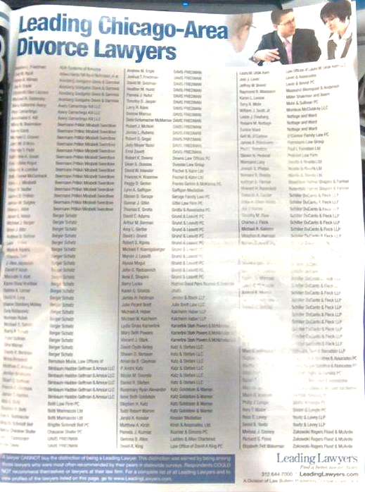
Interesting…
Leading Chicago-Area Divorce Lawyers

Slide 6
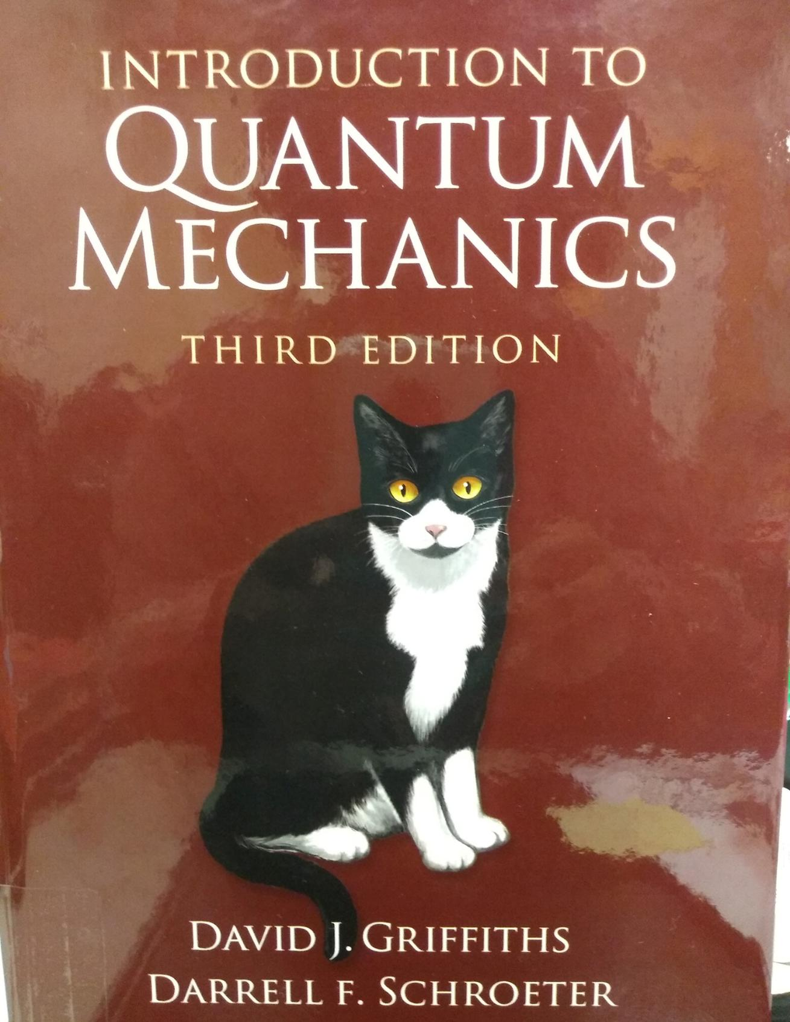
Textbook, but make it cats

Slide 7
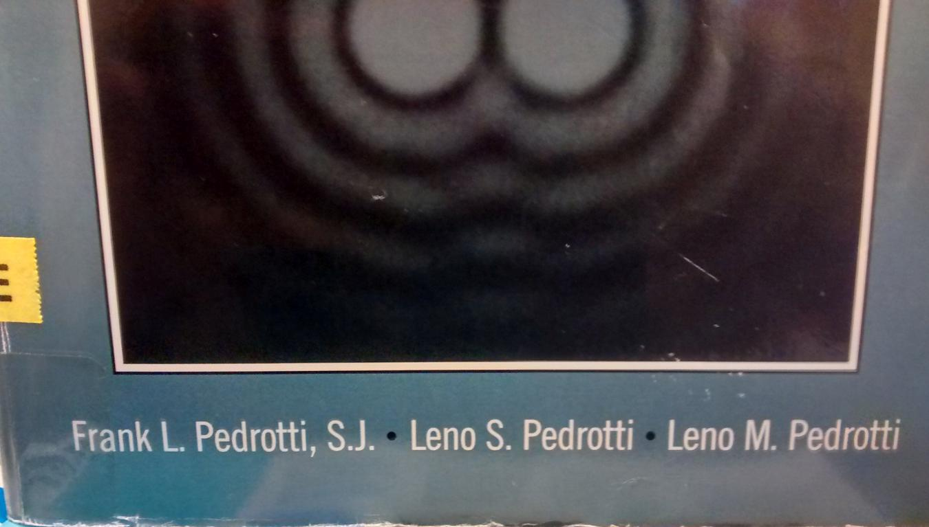
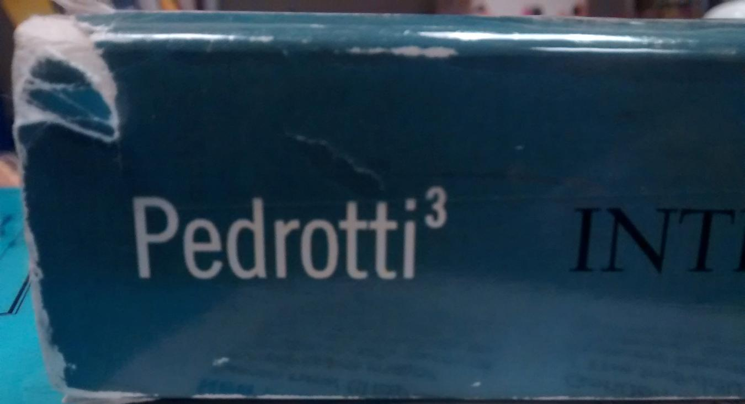
Clever!

Slide 8
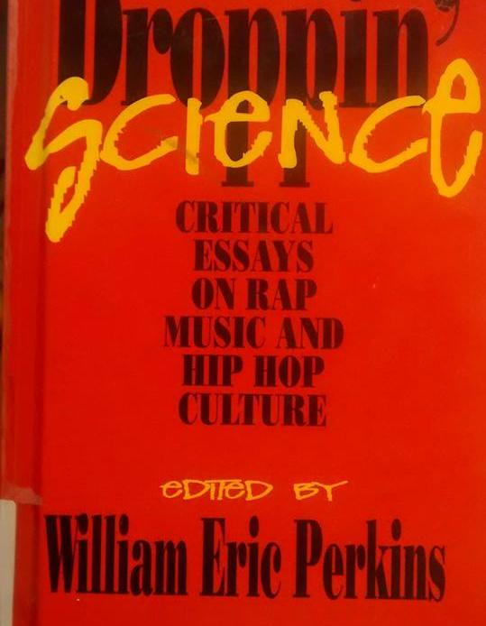
Ohhh, 1996

Slide 9
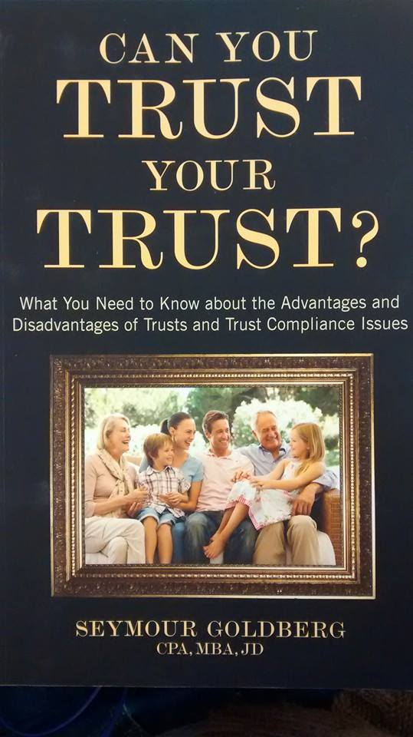
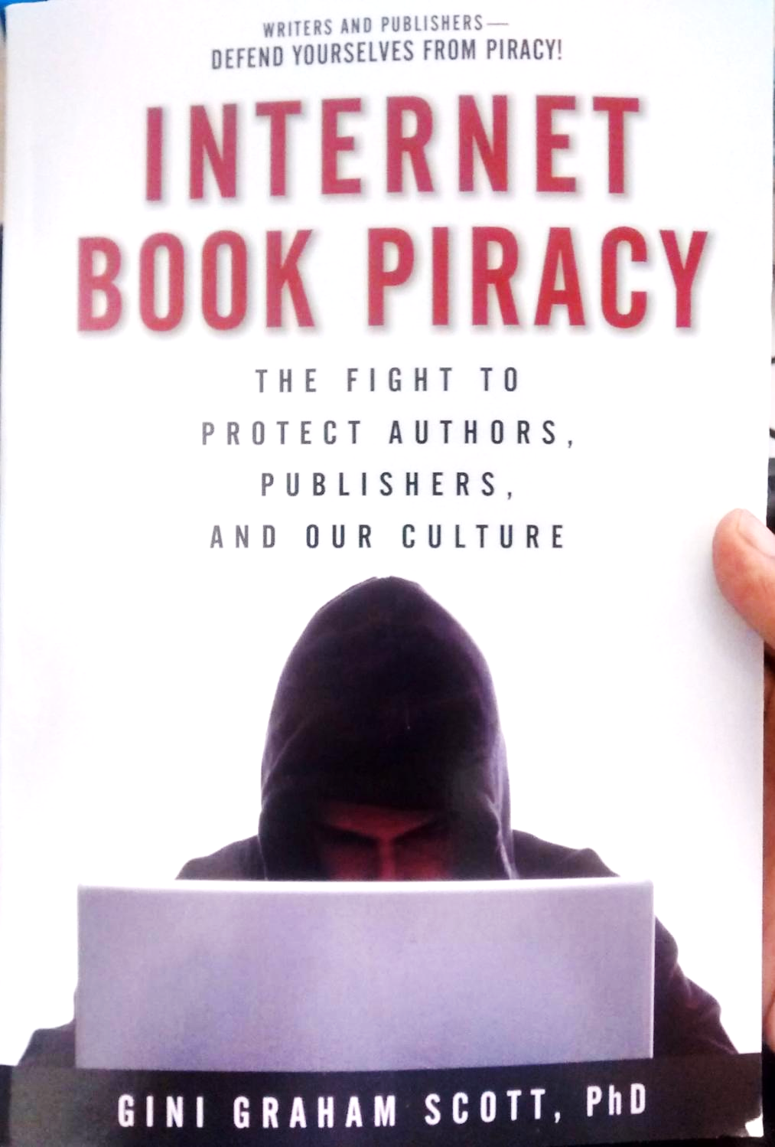

Slide 10
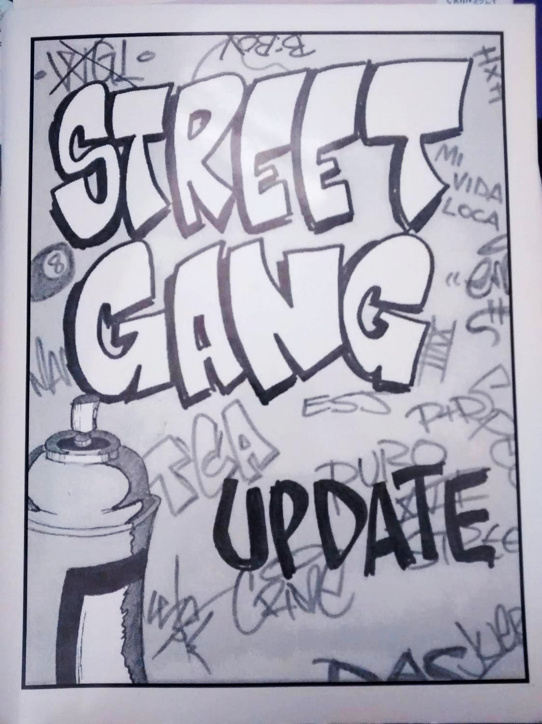
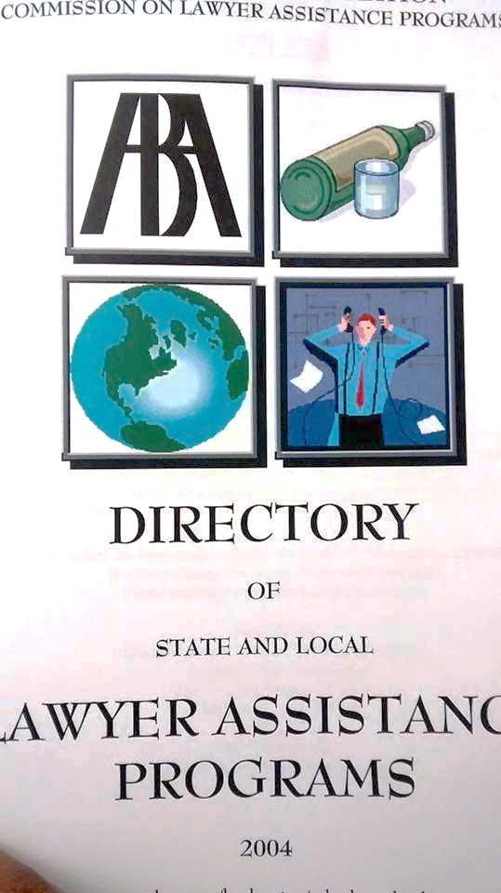
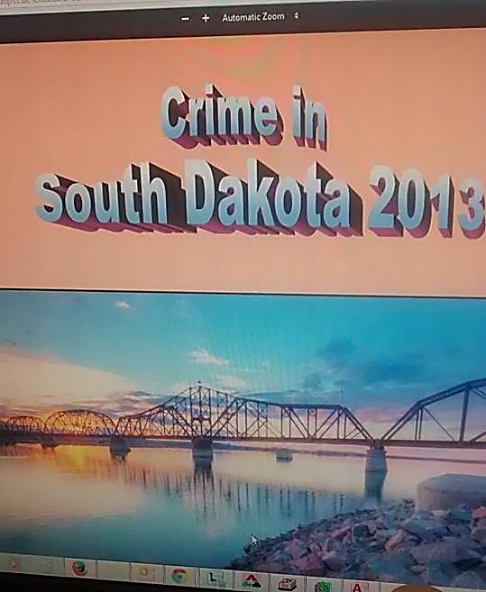

Slide 11
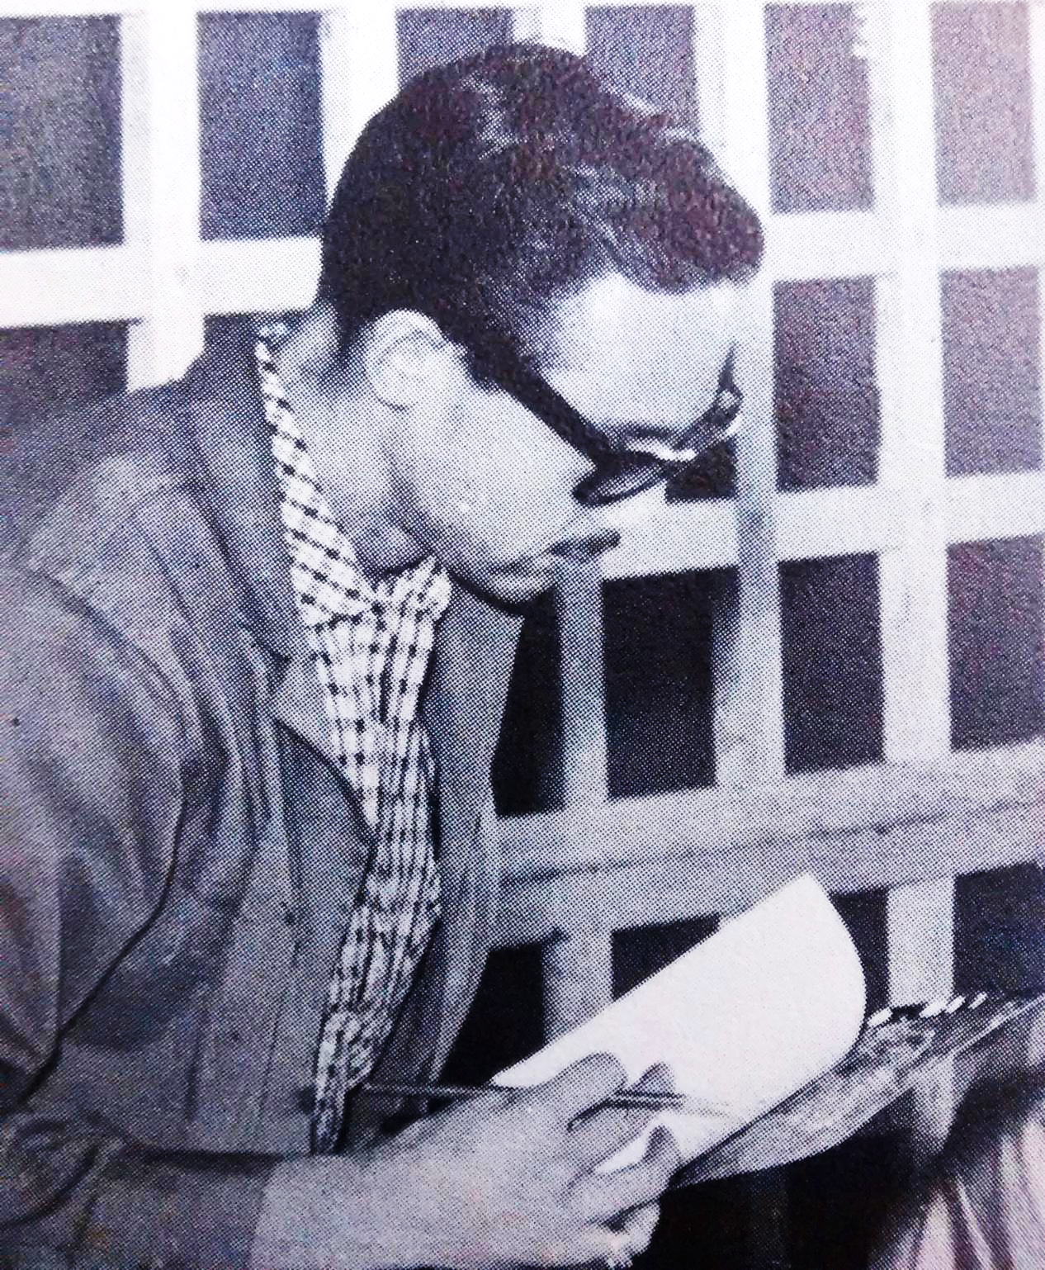
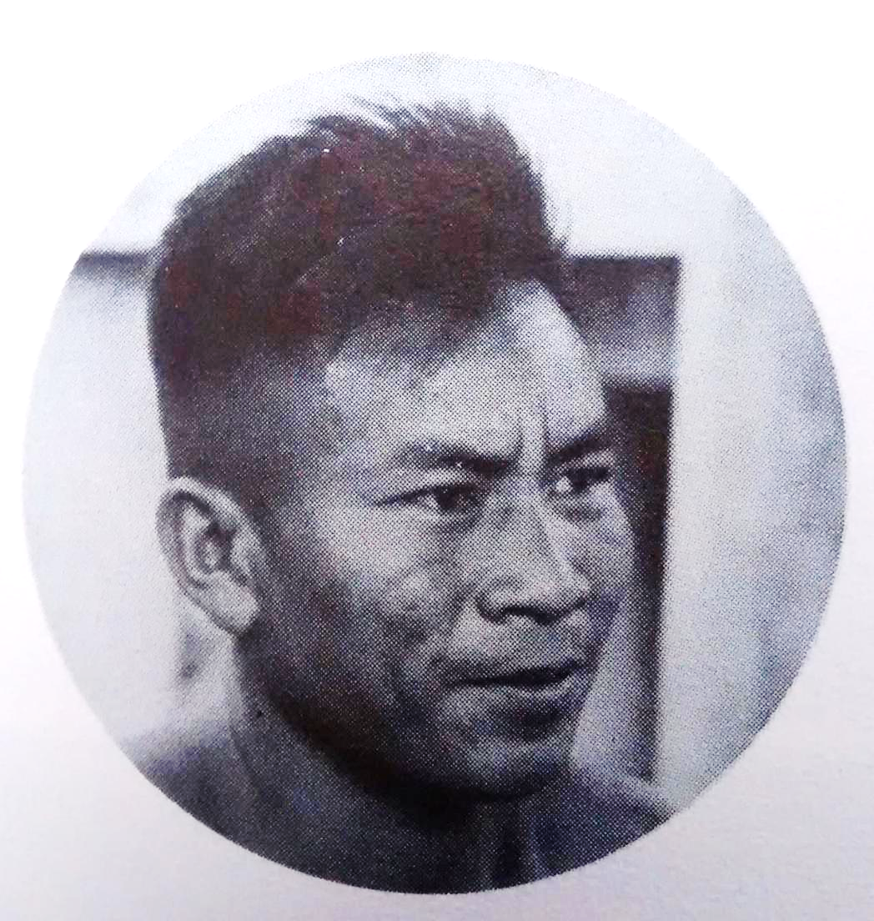
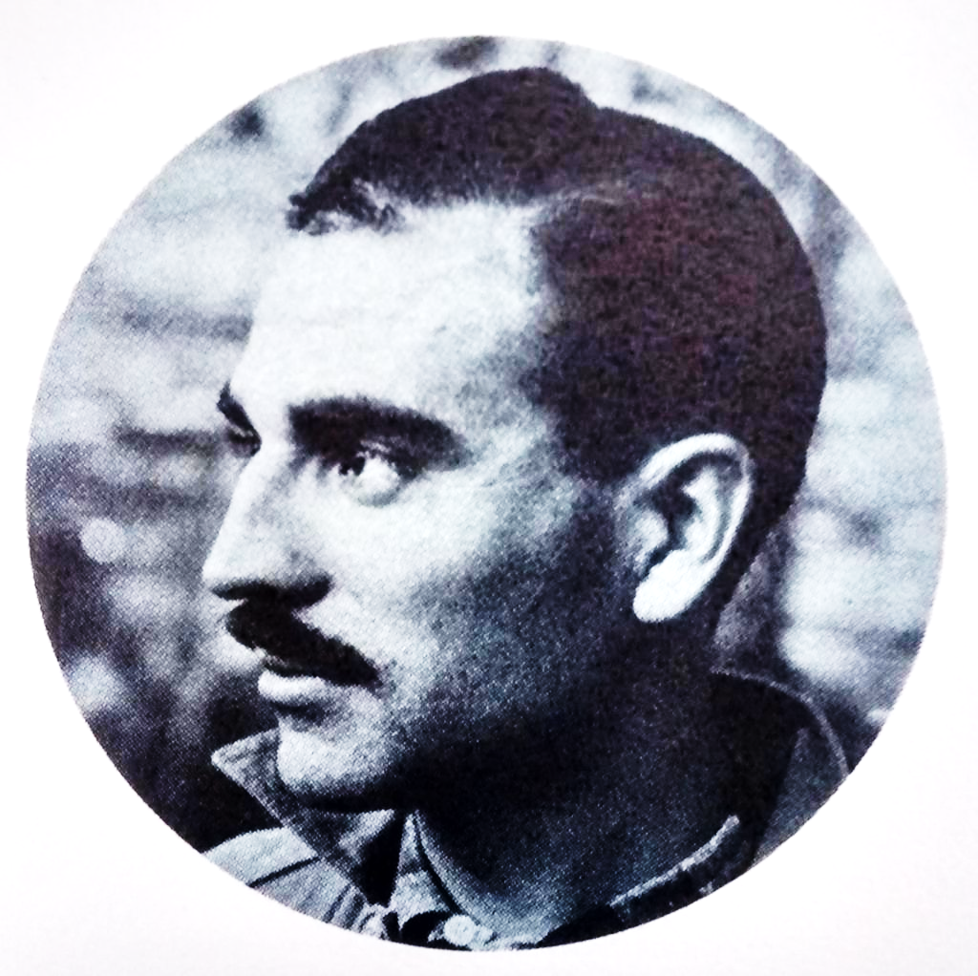

Slide 12
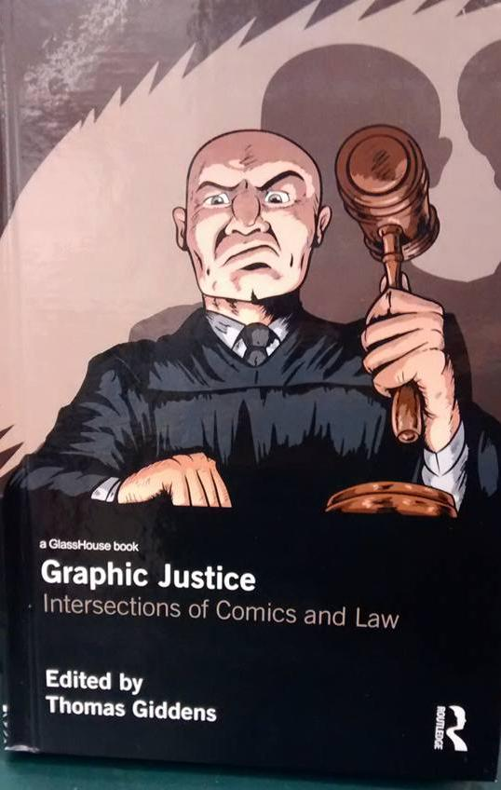
Graphic Justice: Intersections of Comics and Law

Slide 13
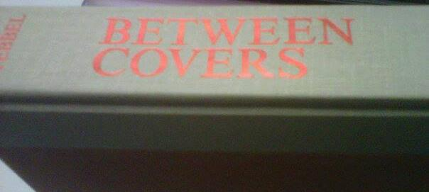
Spicey?
Between Covers

Slide 14
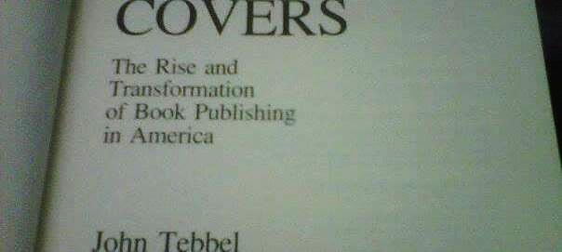
Sike!
Between Covers: The Rise and Transformation of Book Publishing in America

Slide 15
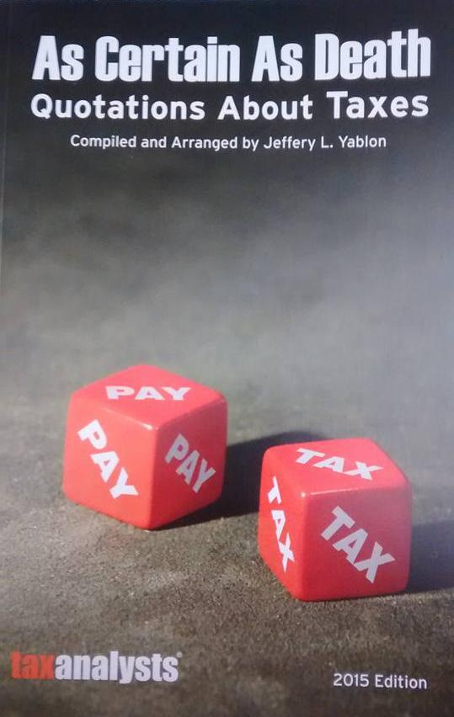
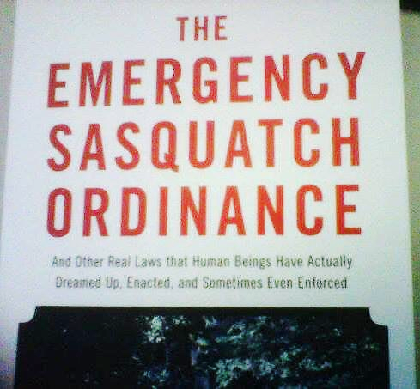

Slide 16
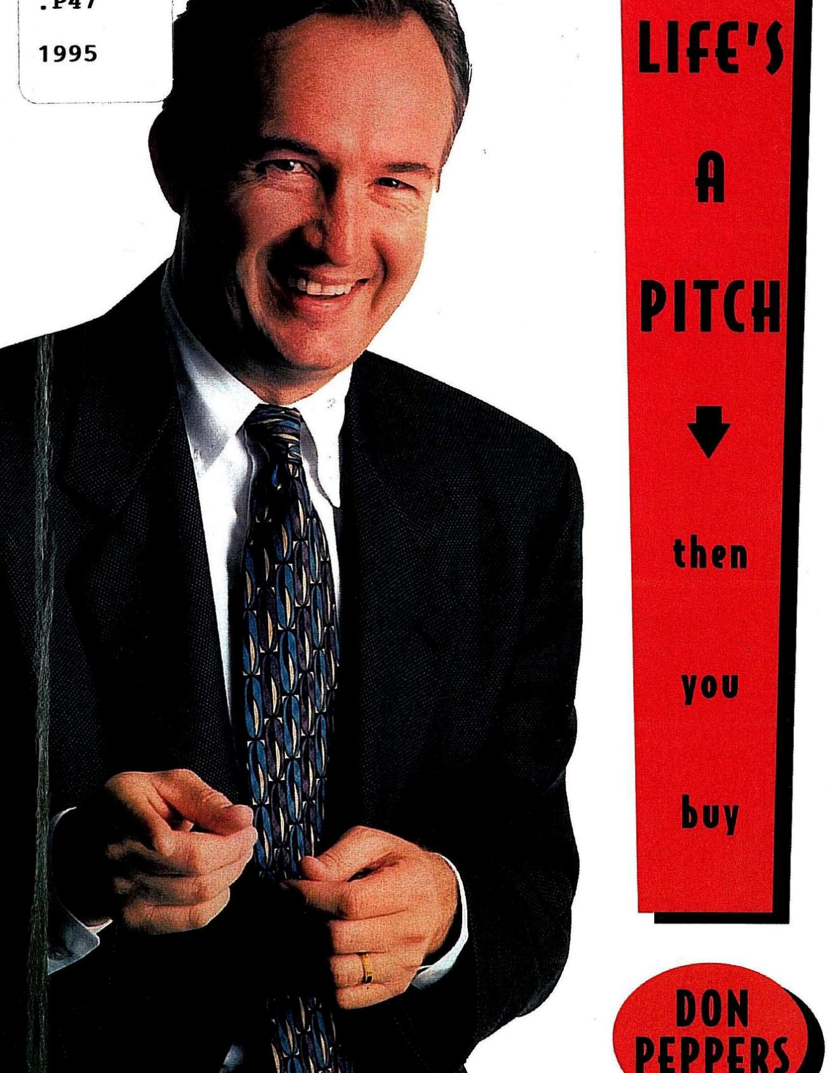
Gold!

Slide 17

Thank you!
Miriam Heard Program Manager, Content Library
YMCA of the USA Miriam.Heard@YMCA.net

