Slide 1


Slide 2





Slide 3



Slide 4
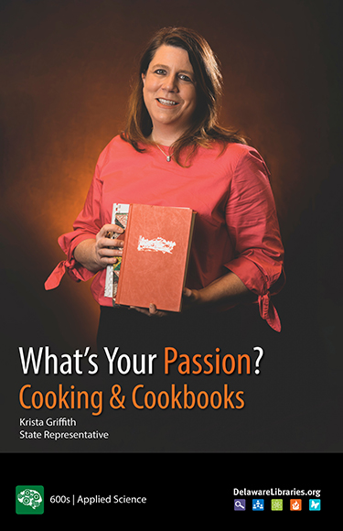
Freedom to Read
HB 119

Slide 6


Slide 7

Library Services for Preschool

Slide 8
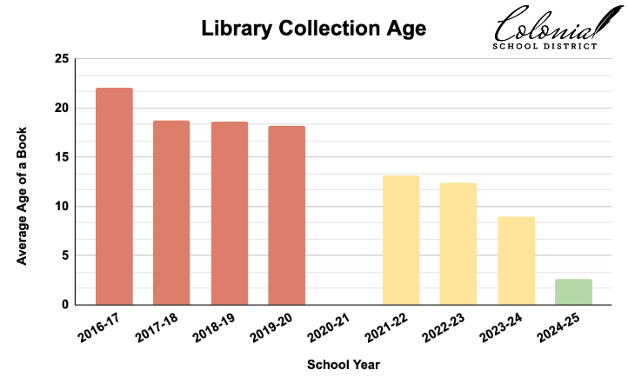
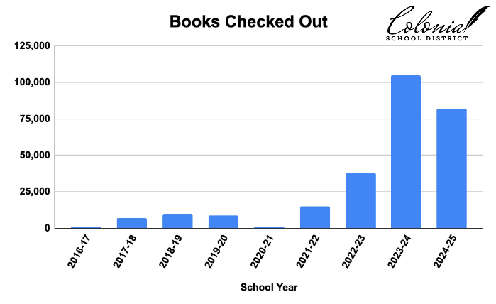

Slide 9
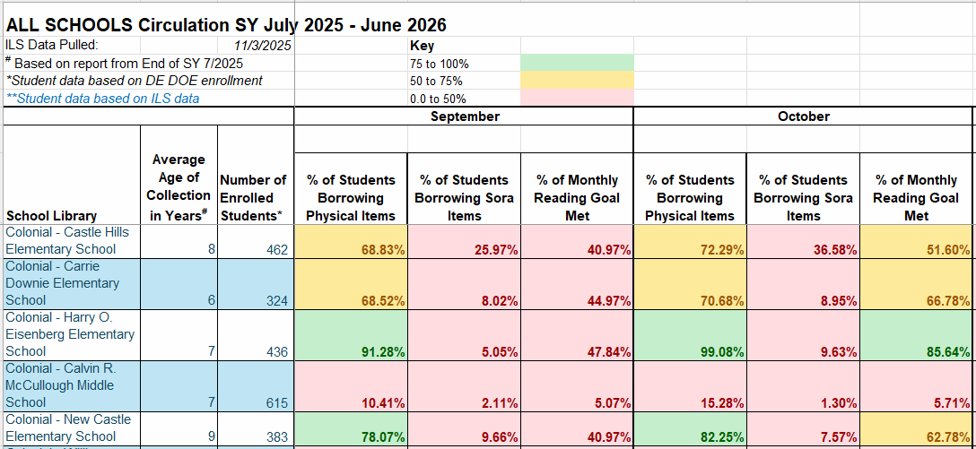
Measuring for Continuous Improvement

Slide 11



Slide 12
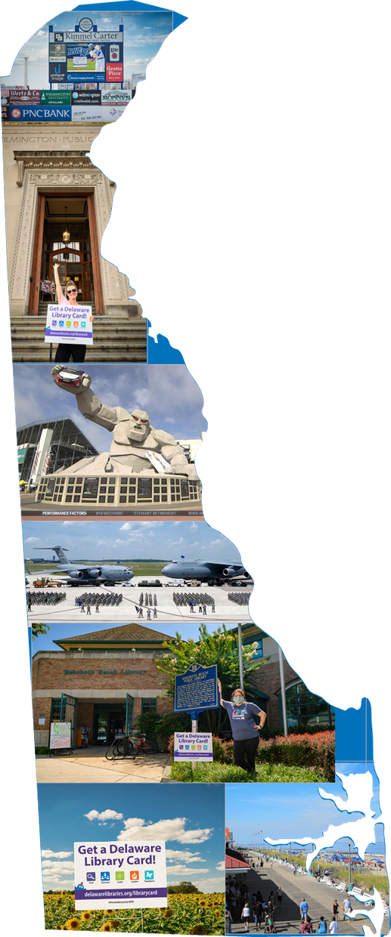

Questions?
Anne Hiller Clark
Anne.HillerClark@Delaware.gov
Notes:
DelawareLiteracyAlliance.org

