Slide 1
Six Literacies, One Shared Story:
Reimagining research & learning across the library
PRESENTER:
Amanda Kramer, Associate Director, Research, Technology, & Collections, Loyola Notre Dame Library

Slide 2
LNDL at a glance!
LNDL Library is located in Baltimore, central to Loyola University Maryland and Notre Dame of Maryland University
Loyola ~ 4600 FTE
NDM ~ 1800 FTE
LNDL employs ~ 25 staff; new director is Alison Gregory who came from Marymount in Virginia!

Slide 3
LNDL’s Research & Learning Program: Background history
LNDL wanted a clearer, cleaner way to communicate our expertise
  Info lit classes each year ~ 100 first semester and 60 second semester
Instruction librarians return from LOEX with a blueprint from Baylor University
  https://libguides.baylor.edu/literacies
  Met with Baylor librarians
  Chose to pause on micro credentialing courses

Slide 4
LNDL’s Research & Learning Program: Planning Phase
Asked - What do we teach across all units?
  Brainstorm sessions to extract all teaching literacies
  Lifelong learning, financial, design thinking left on the table
Discussed - Literacy vs Fluency
  Literacies are a continuum of learning to help students achieve their goals and participate in their communities
Challenged
  Teaching and unit differences
  Assessment adjustments

Slide 5
What we created: LNDL’s Research & Learning Program
Providing a holistic overview of learning opportunities at LNDL. Expertise areas:
Archival Literacy & Digital Scholarship: locating and working with important archival materials
Artificial Intelligence Literacy: navigating the complexities and opportunities posed by artificial intelligence
Copyright Literacy: understanding the rules and ethical considerations of copyright
Health Sciences Research Literacy: recognizing the unique needs associated with health sciences research
Maker Literacy: using our Innovation Station makerspace for creativity and hands-on learning
Research & Information Literacy: making deliberate and informed choices about research

Slide 6
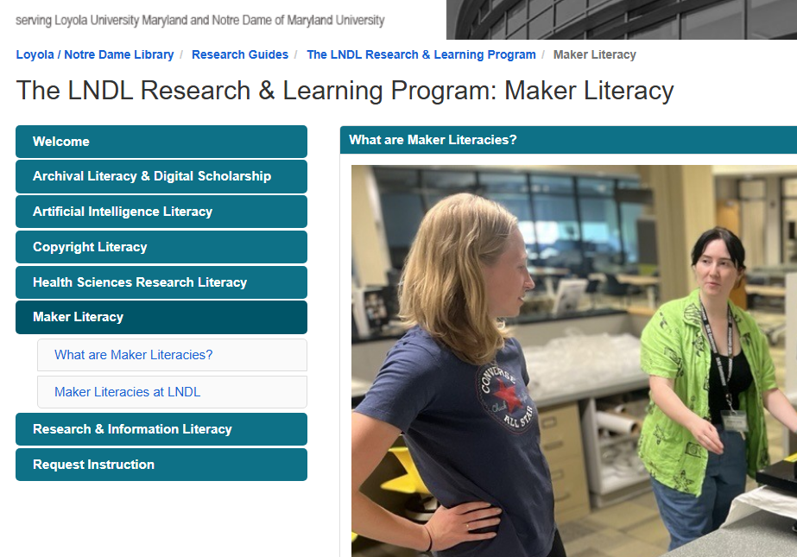
In
Libguide Creation

Slide 7
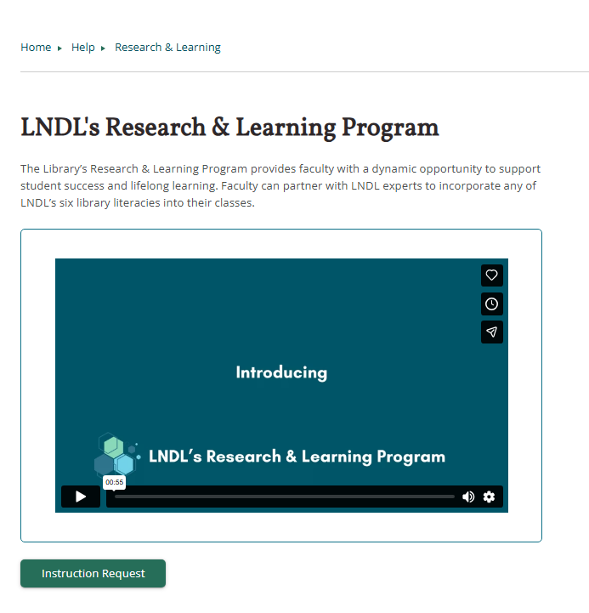
Website Transition

Slide 8
Final thoughts
What are we hearing?
Easier to schedule
Clearer explanation of instruction variety
Student survey results in next few weeks
Faculty “milestone assignment” surveys are telling us that students that who took part in instruction are getting better grades on their assignment
What’s next?
Continued maker literacy course plan development
Formalized peer observation program
Continue building online learning options and possible credentialing in cooperation with schools

Slide 9
Thank you!
Please send a note to: akramer2@loyola.edu

Slide 10
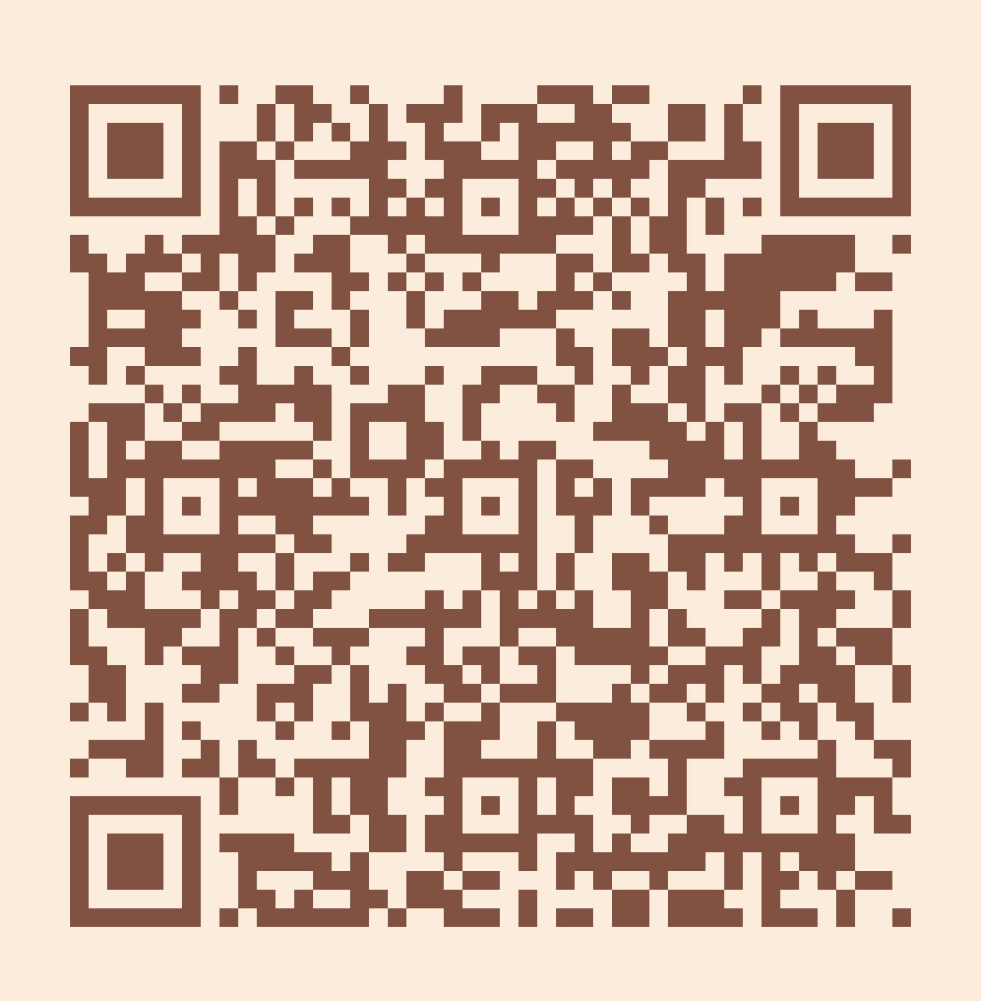
Please take a moment to complete the program survey.
SCAN ME!

