Slide 1
Archival Bonds: Restoring and Forming Connections for Digital Access
PRESENTERS:
Claire Jeter
Shamica Terry

Slide 2
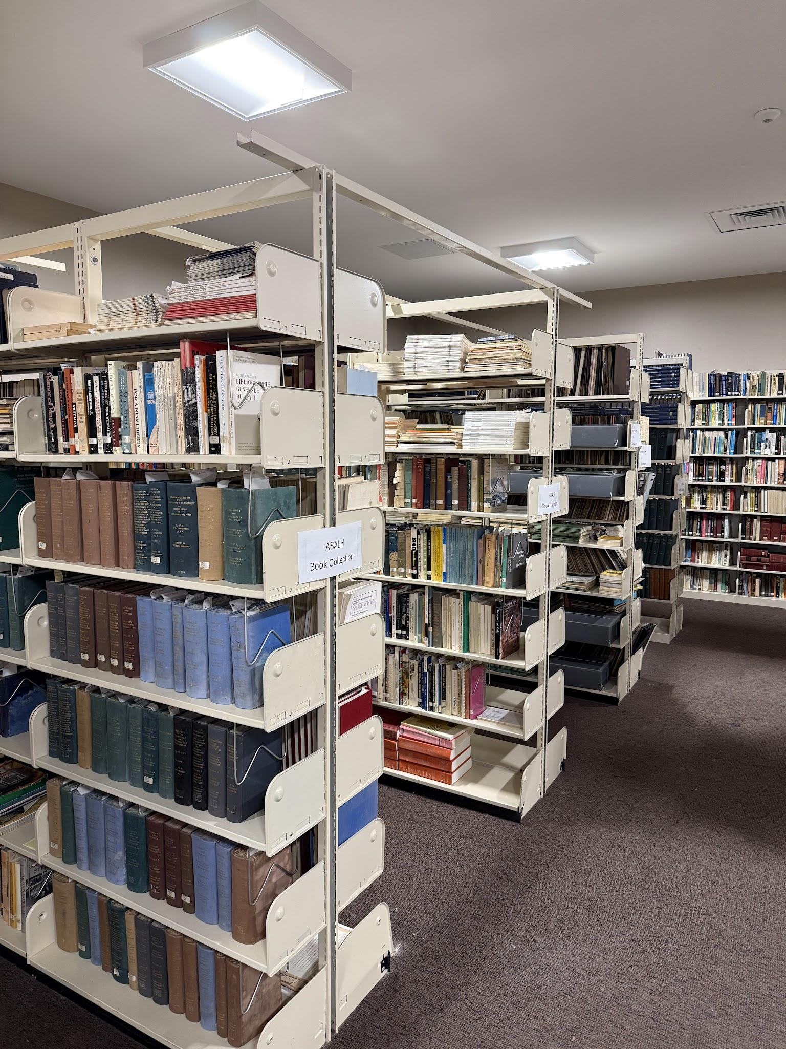
Community Digitization
Timeline
Solutions to ‘speed bumps’
Prioritizing Collections
Identifying Community Groups

Slide 3
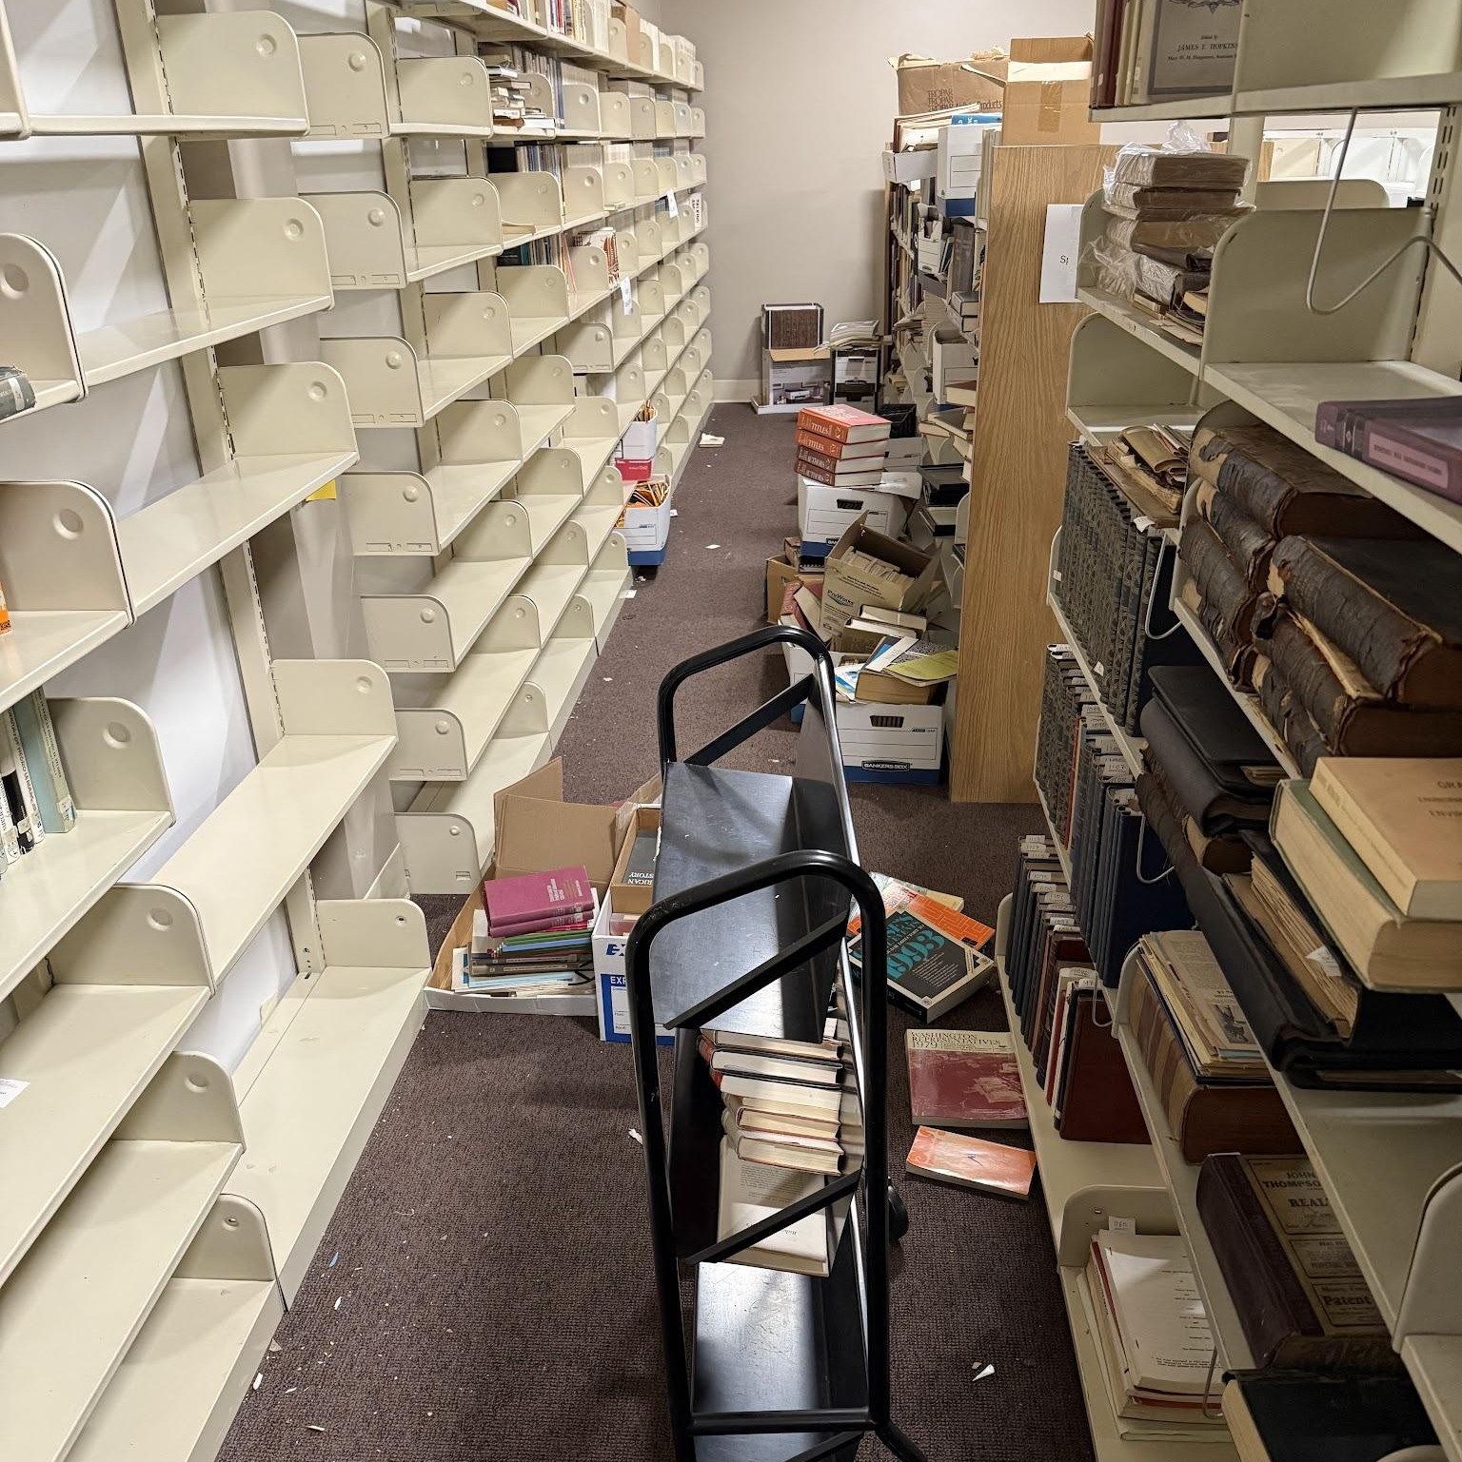
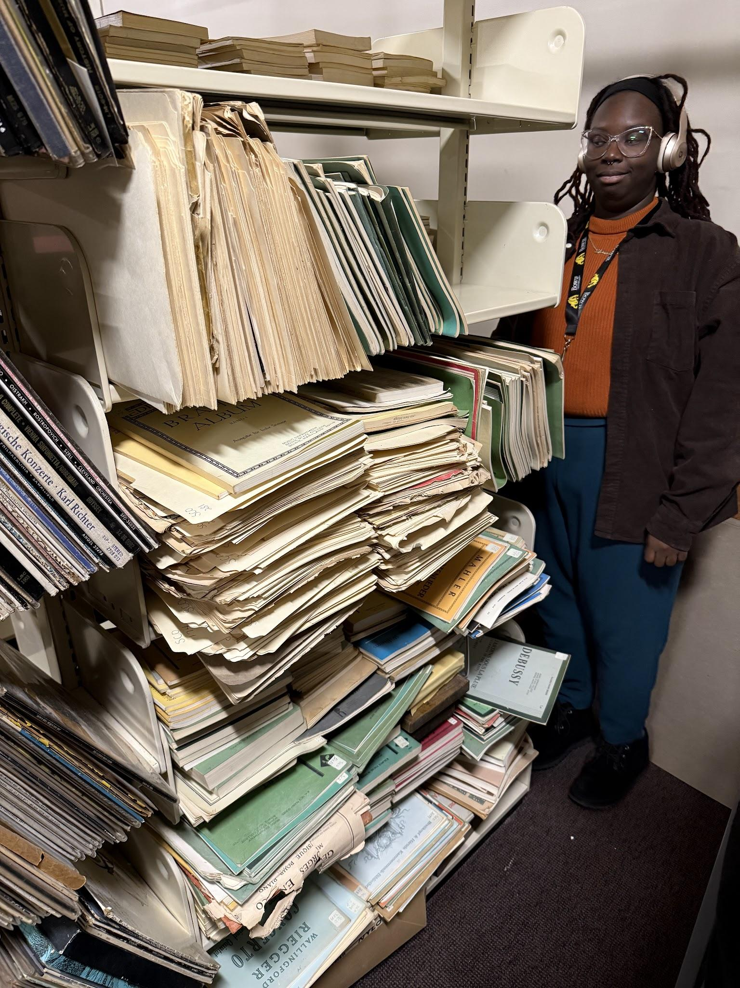
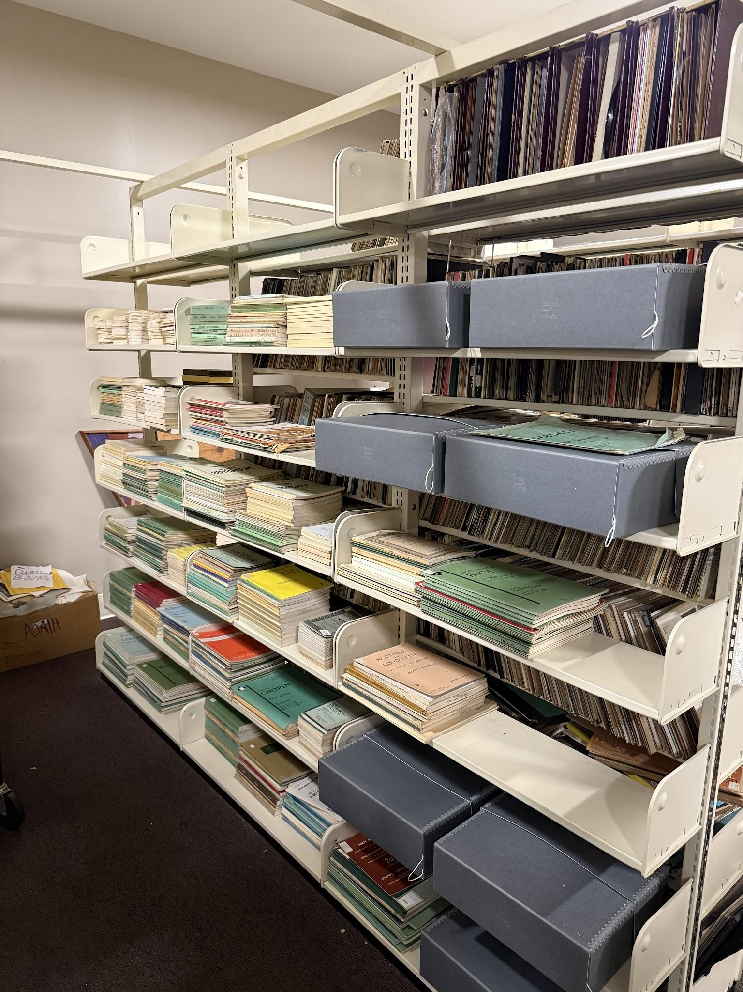
Untouched Collections
Note: The archives is no longer like this!
Notes:
Sometimes we don’t want to talk about it but archivists do sometimes come to archive in this state.

Slide 4
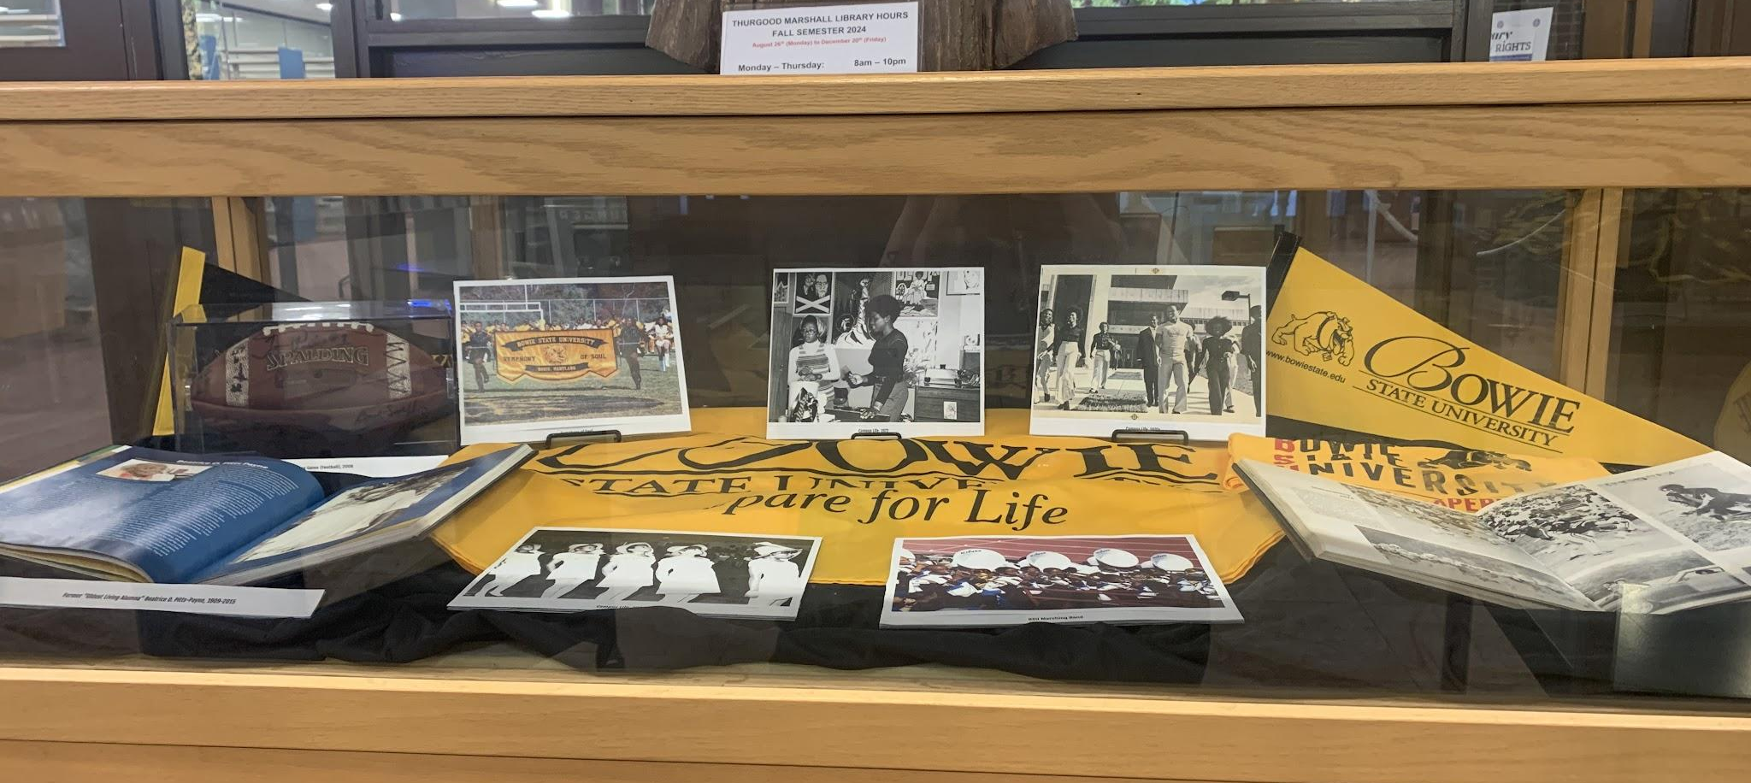

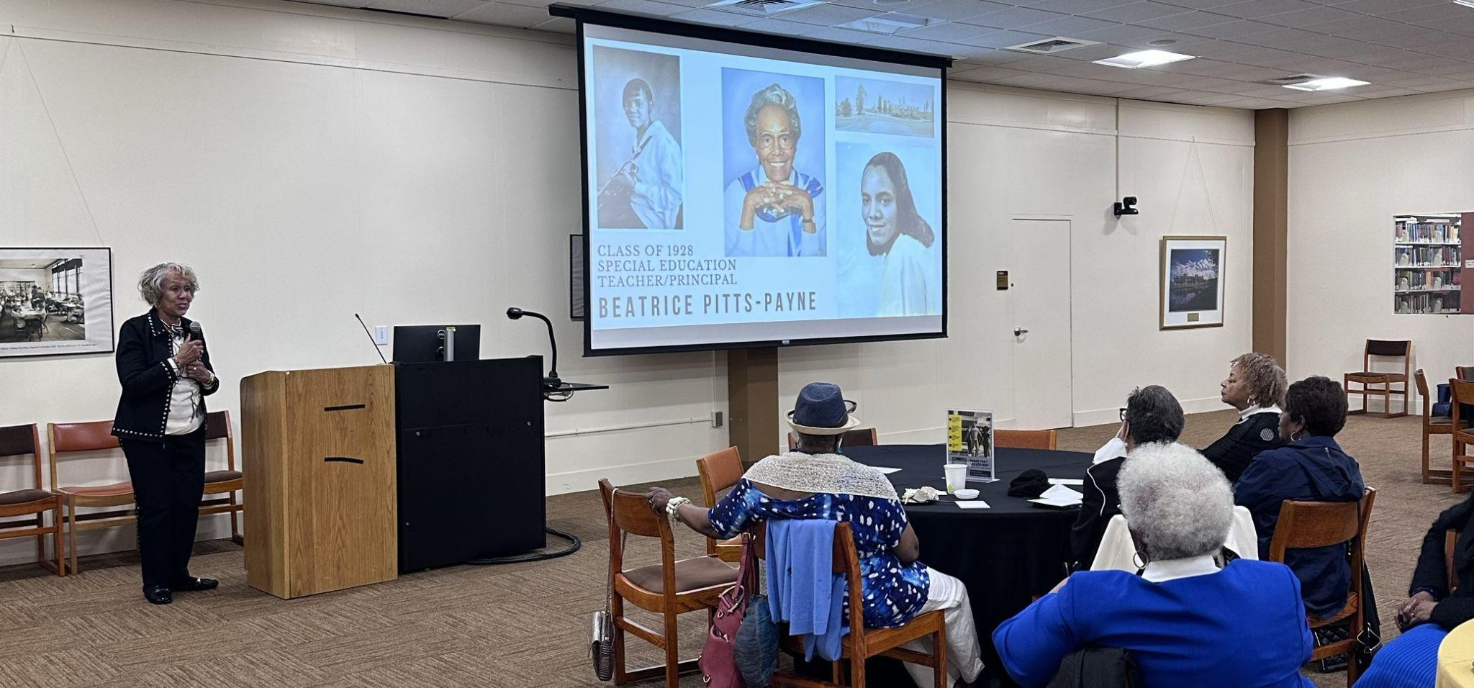
University Push and Working with our Colleagues
Support
Building and maintaining relationships by using one another’s expertise
Collaboration
Working together to advance library goals and strengthen community impact
Communication
Networking, sharing ideas and building professional connections

Slide 5
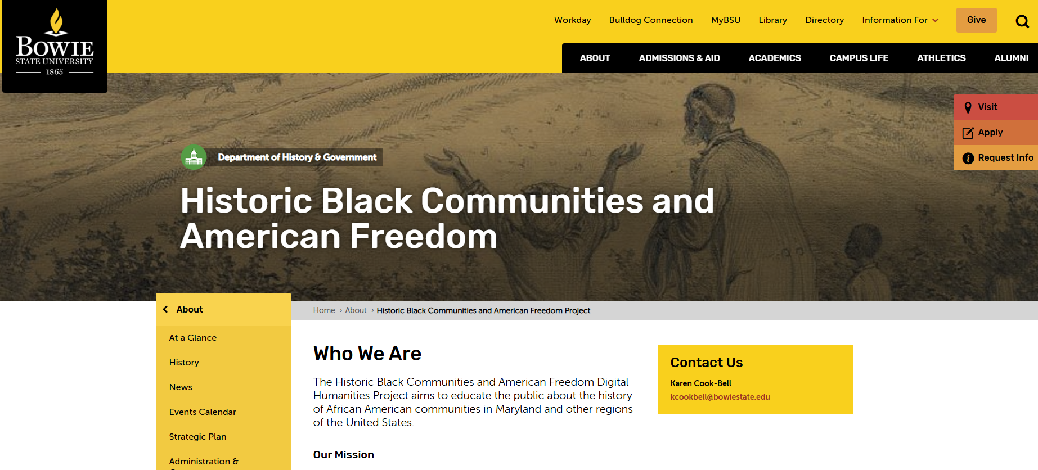
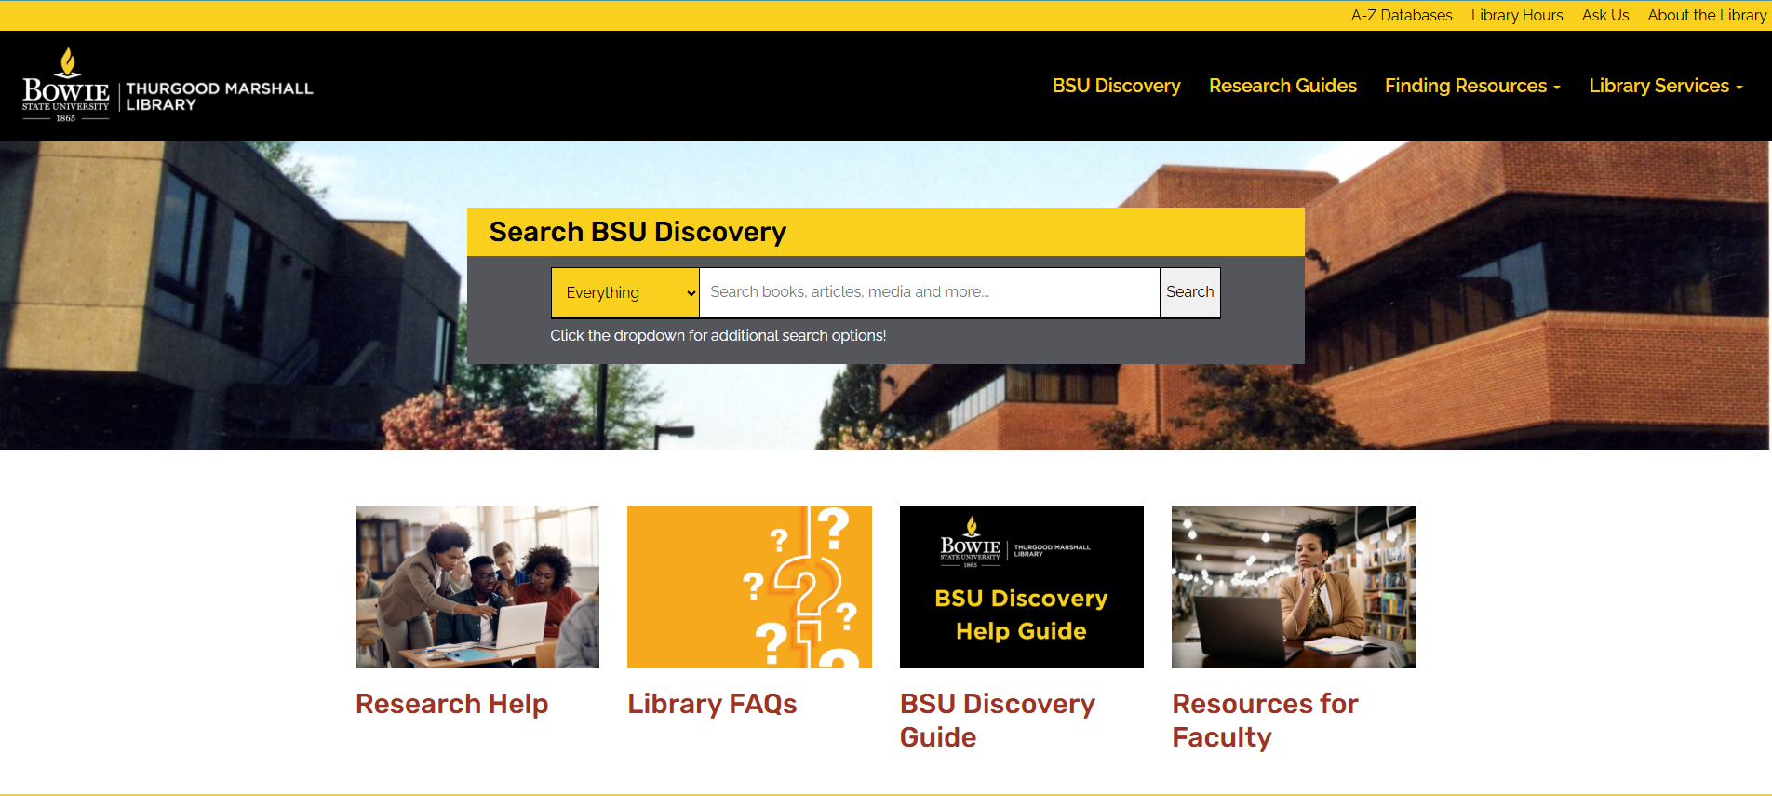
Navigating Challenges
Budget & Staffing
Funding for project stopped
Unexpected Project Pivot
Digital Platform change
Reprioritizing Efforts
Library wide projects vs. Department projects
Above: An example of the Old Website layout; Below is an a screenshot of our current website
Notes:
maybe get screenshot of old website and new website

Slide 6
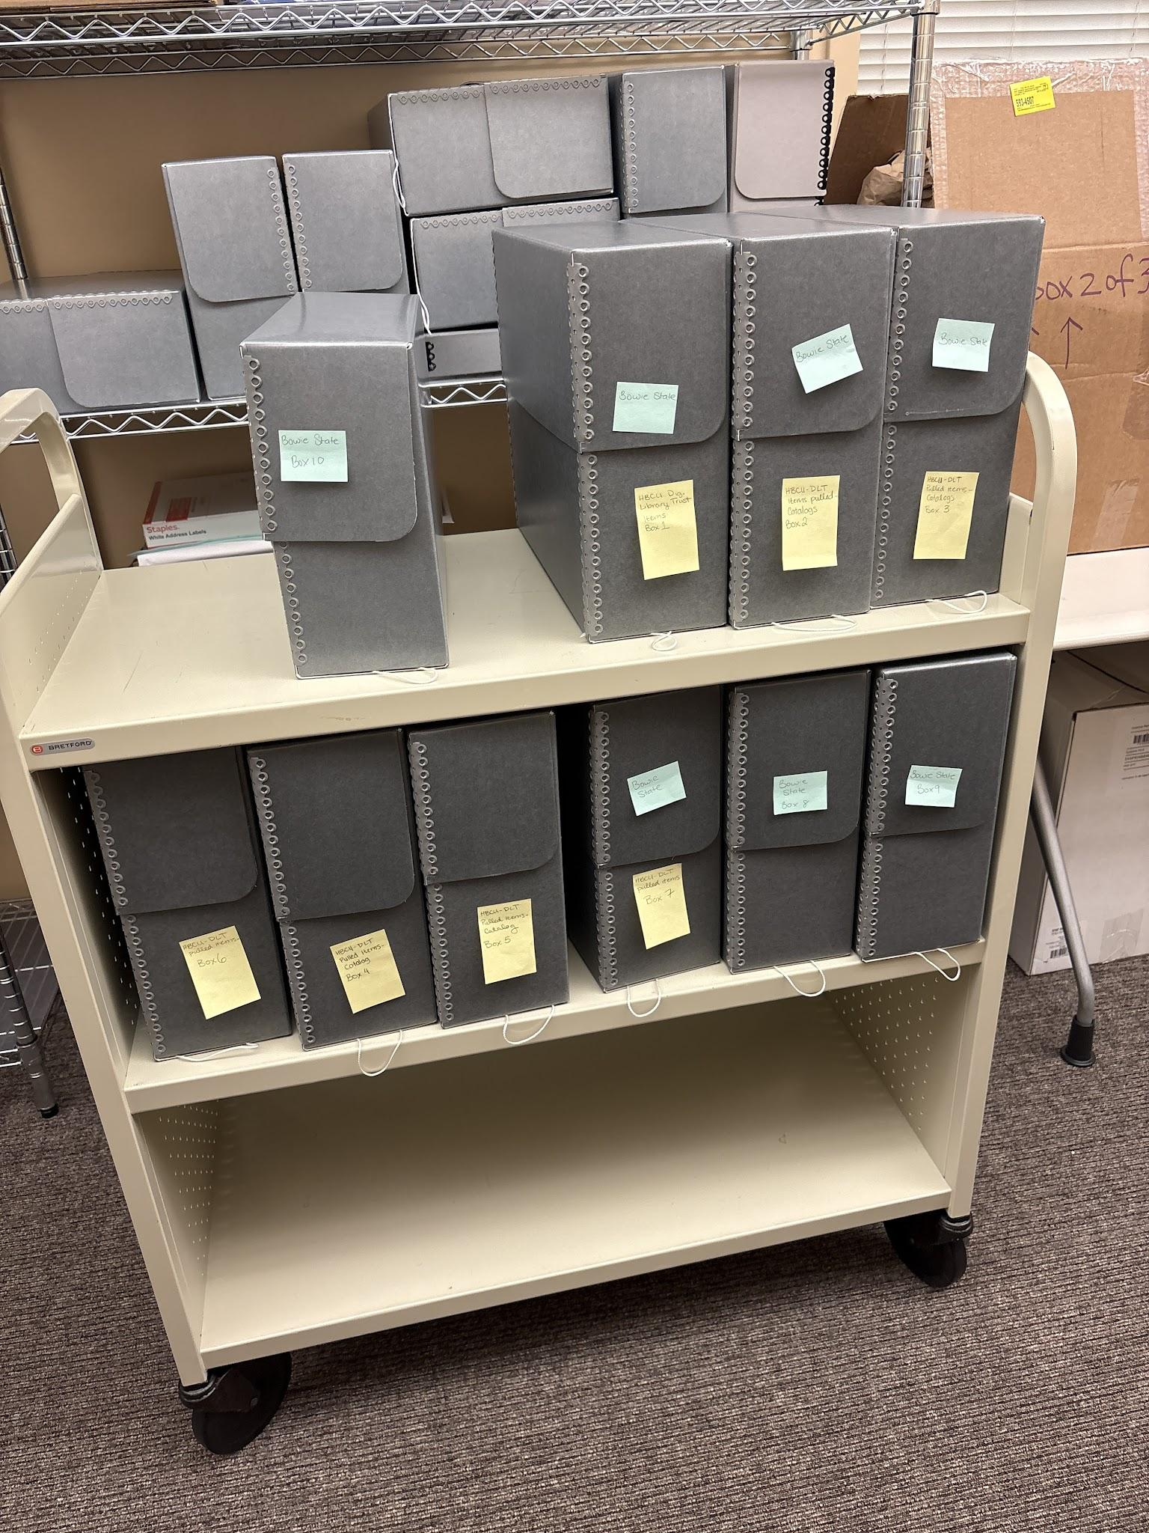
Evaluating Platforms for our Collections
What we looked at:
Quartex
ContentDM
BePress & More!
What we Choose:
HBCU Digital Library Trust
MD-SOAR
Notes:
and talk about prioritizing collections for the different platforms

Slide 7
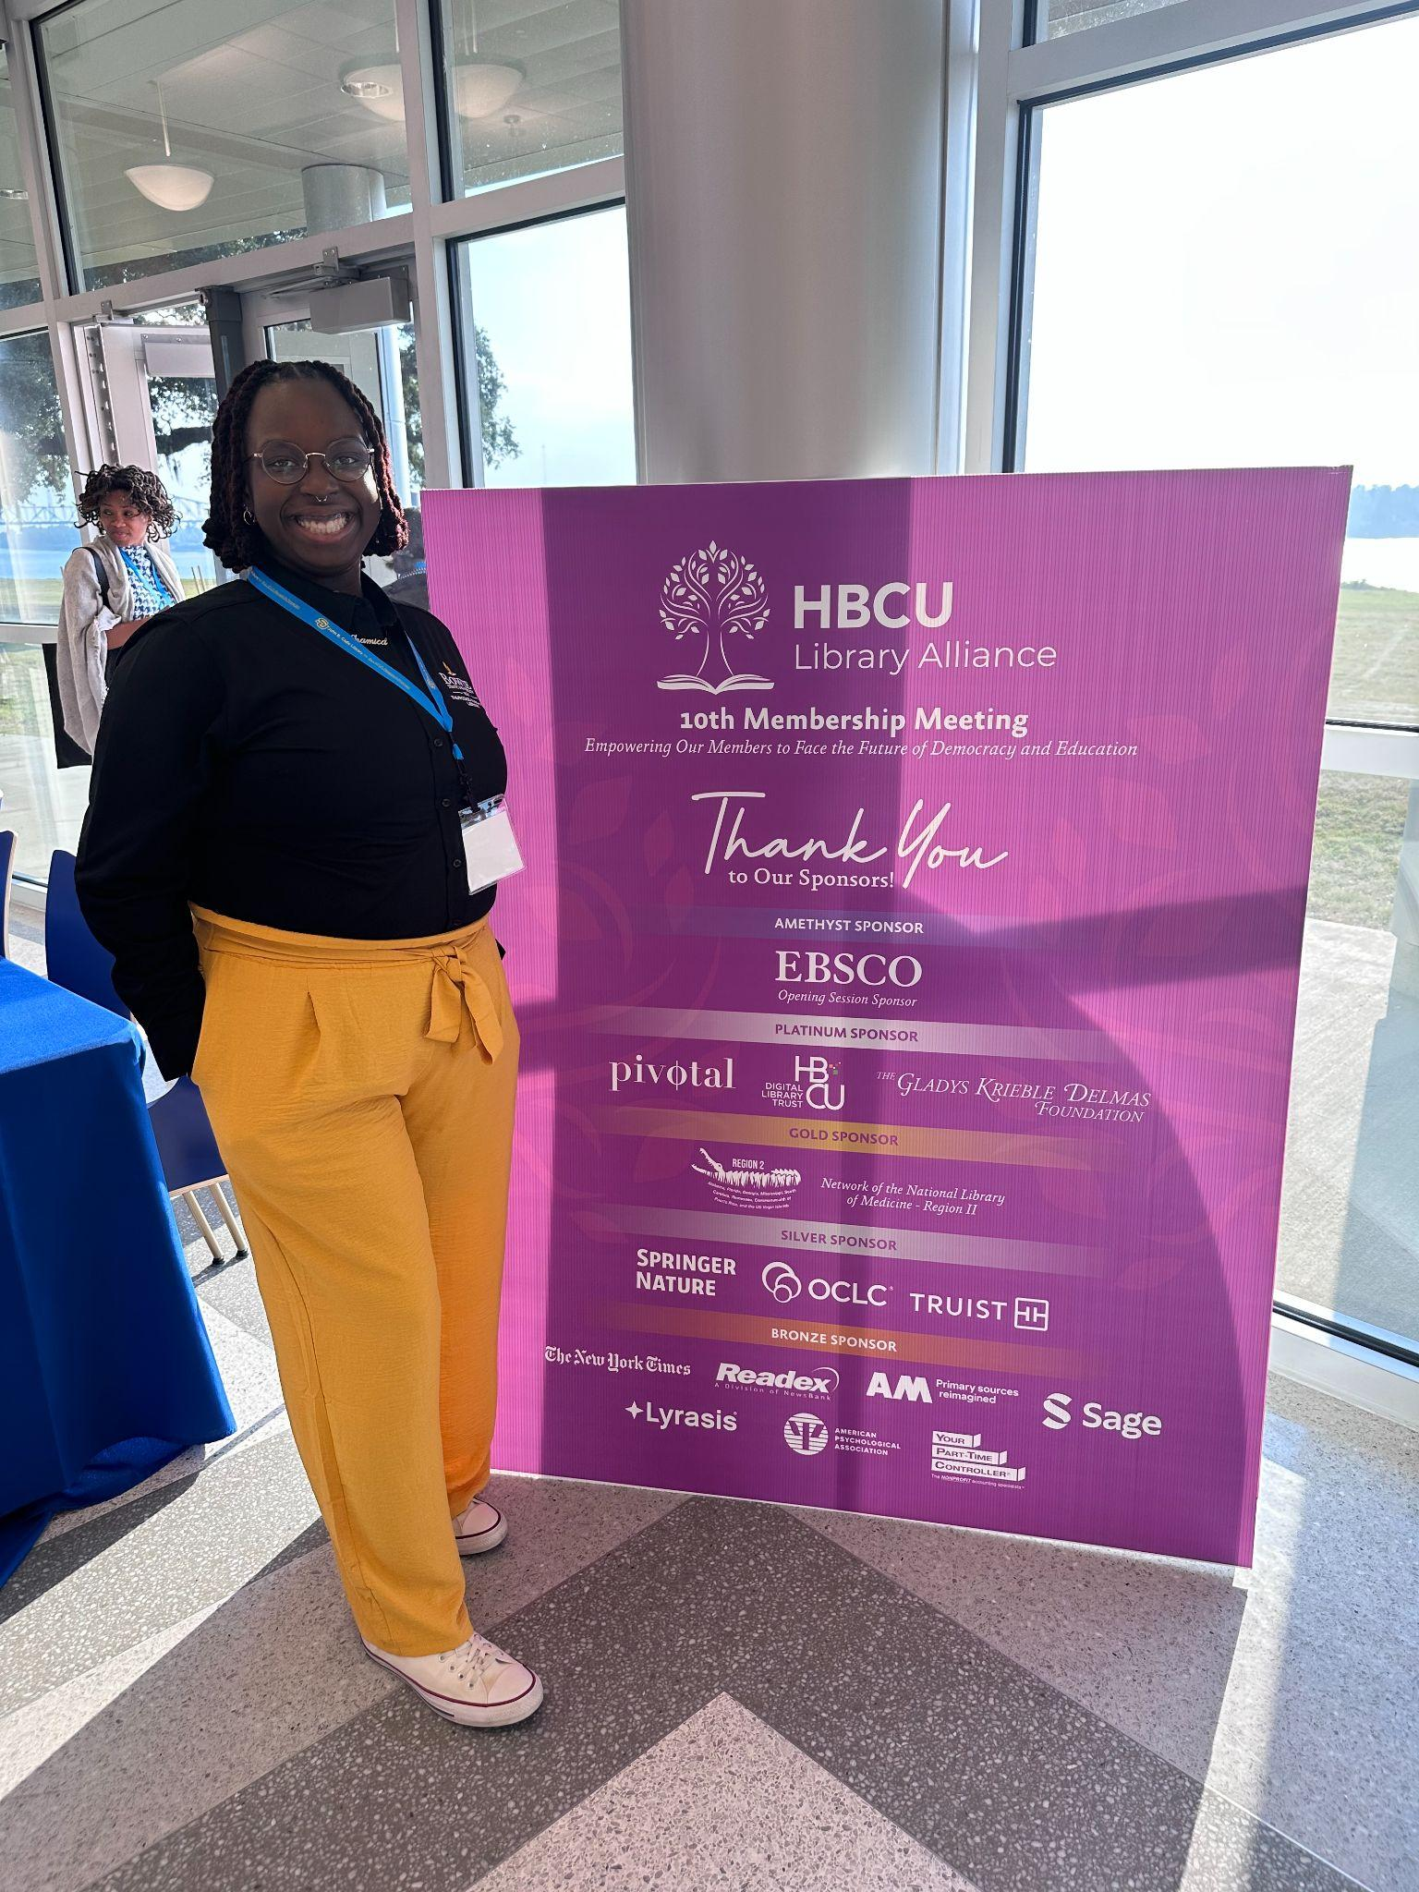

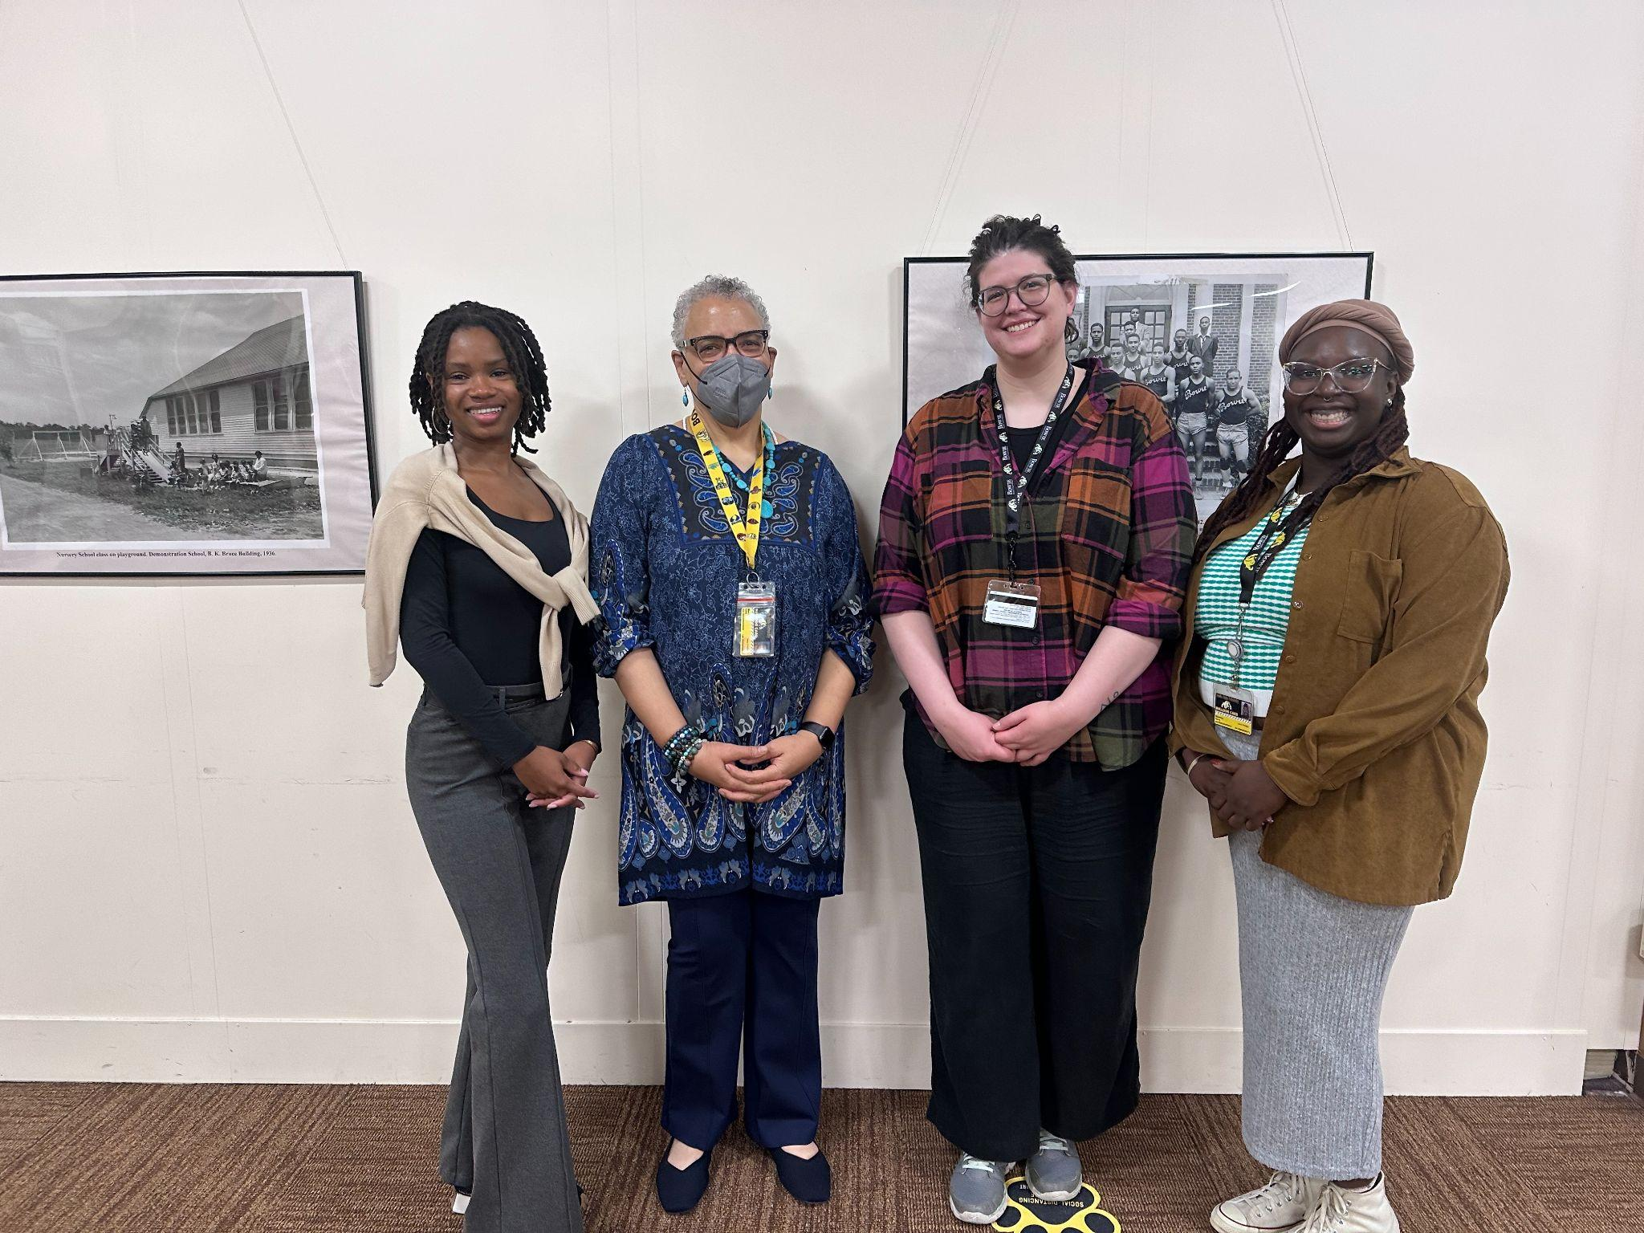
The Solution: Our Communities

Slide 8
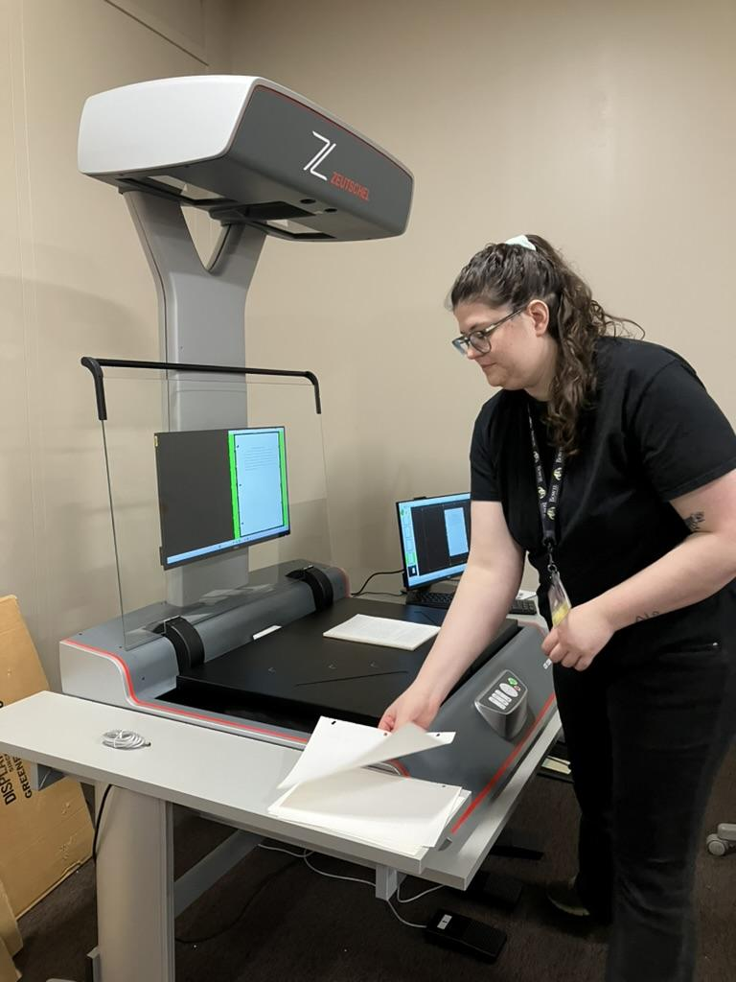
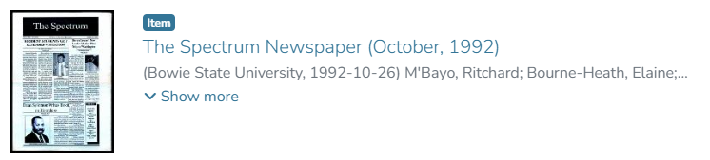
Prioritizing Collections
Patron Demand
Yearbooks
Course Catalogs
Theses and Dissertations
Building off what we already have
Digitized photos
Newspapers
What we couldn’t do in house

Slide 9
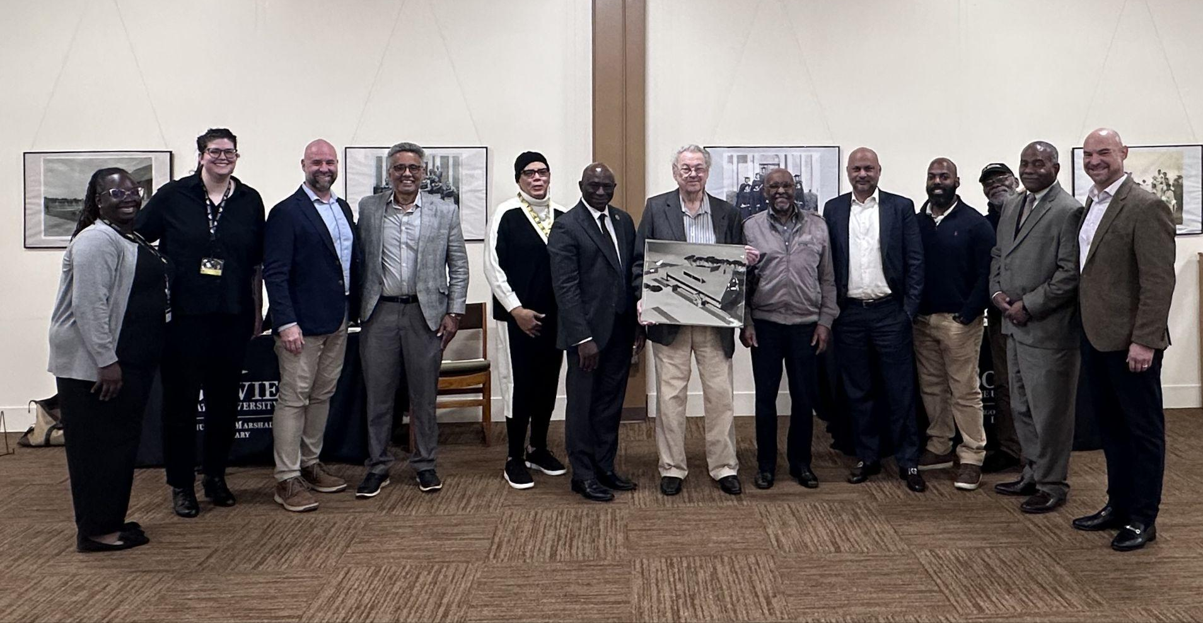
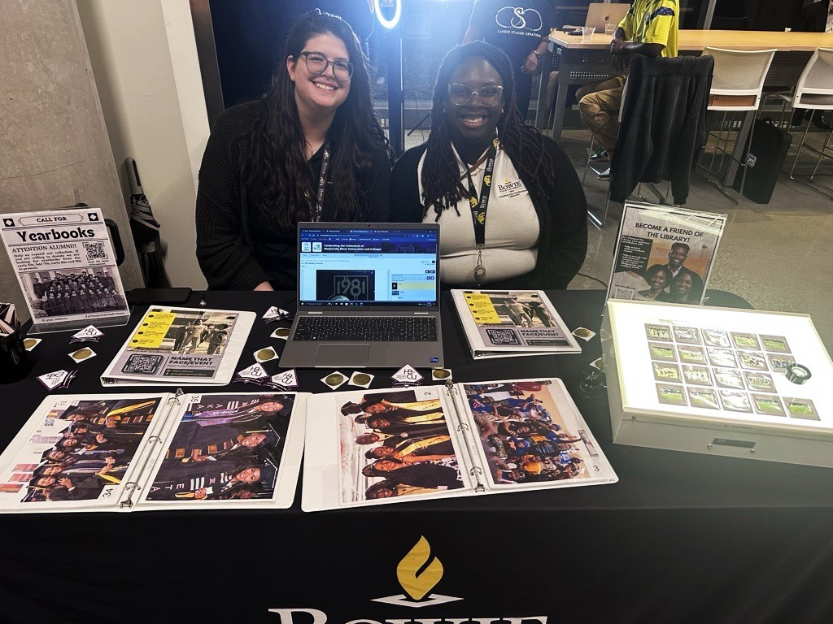
Ongoing Work
Building Relationships with
Students
Faculty and Former Faculty
Alumni
Continuing Projects
Oral History Project with the HBCU DLT
ArchivesSpace
Notes:
Stilling reaching out to alumni, former faculty, and our greater bowie communities
Title may change - still building…forming…fostering…getting our name out there

Slide 10
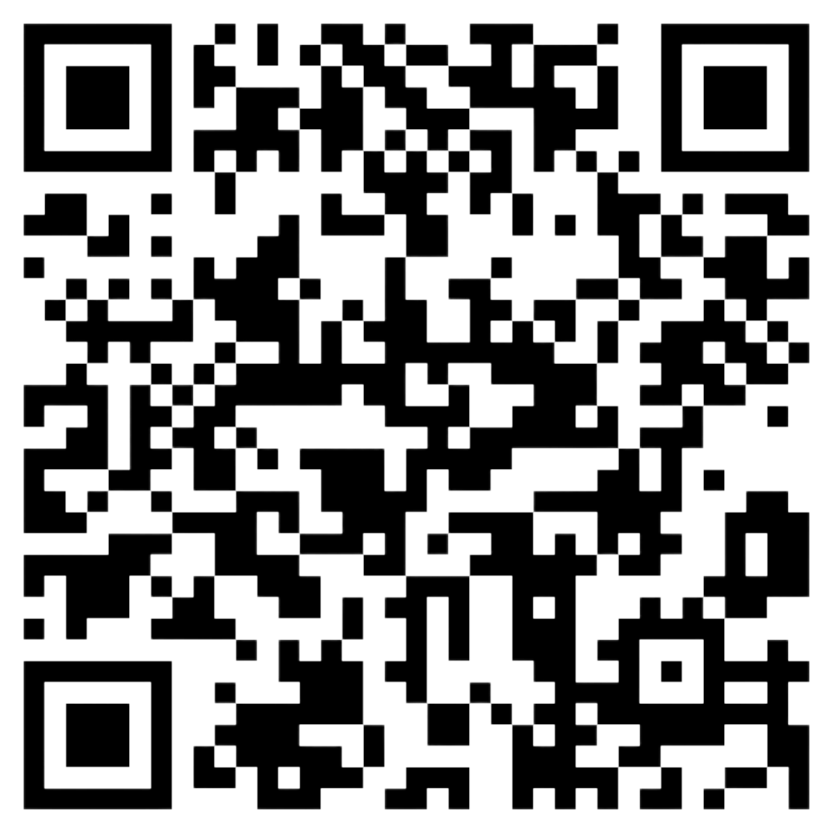
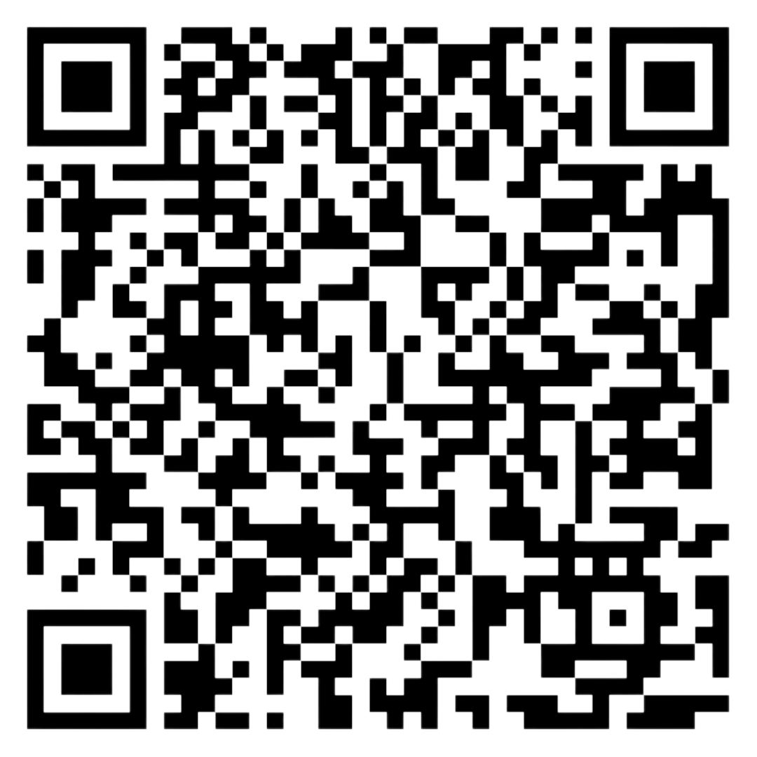
Check out Our Digital Collections
BSU Collection on the HBCU DLT’s Digital Collection
BSU Newspaper Collection on MD-SOAR

Slide 11
Thank you!
Claire Jeter
cjeter@bowiestate.edu
Shamica Terry
sterry@bowiestate.edu

