Slide 2




Don’t Miss!
50/50 RAFFLE
Tickets are $1 each and can be purchased from Conni Strittmatter or David Dahl! The winner takes home half the pot.
SILENT AUCTION
Visit the Silent Auction in the exhibitor hall to place your bids before 10 a.m. on Friday, May 8.
PUB QUIZ
Thursday, May 7 8:00 – 10:00 p.m. Choptank Ballroom
KARAOKE
Thursday, May 7 6:00 – 10:00 p.m. Windjammer

Slide 3
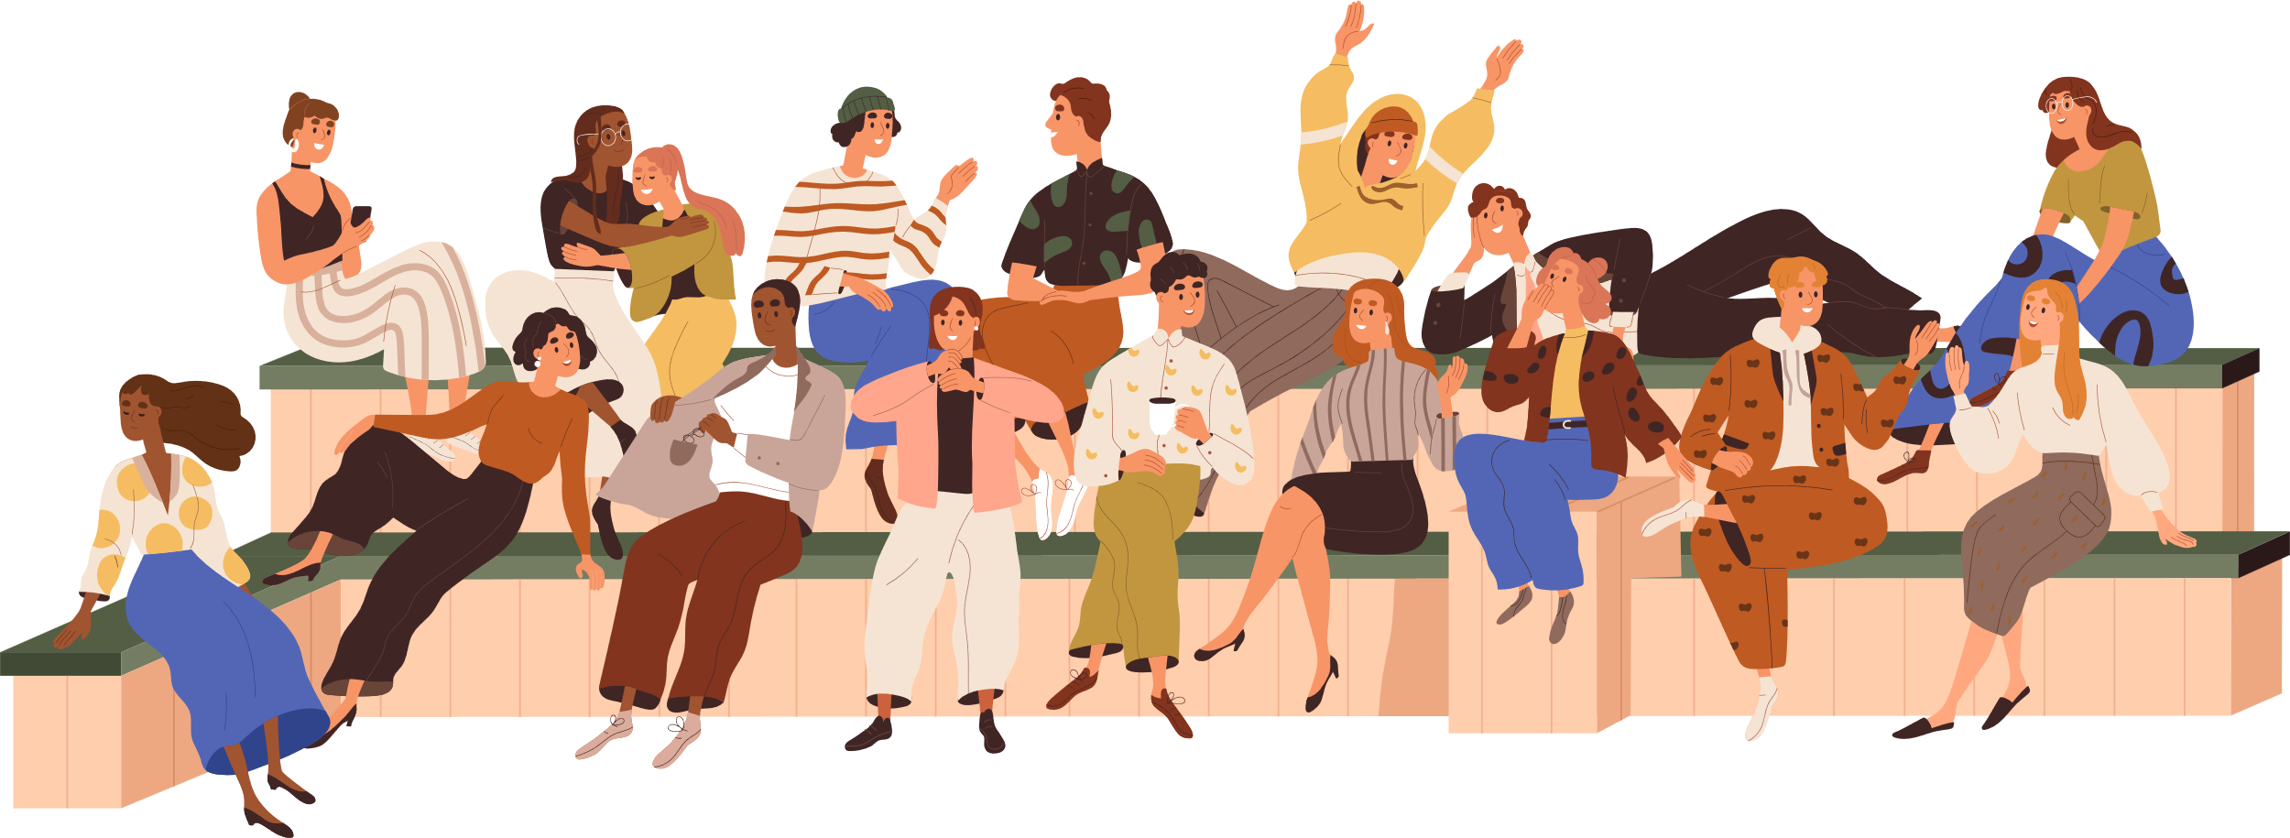

The anthropologist
in the Library

Slide 4
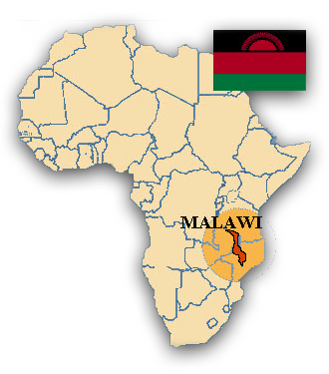
Hi! I’m Miss Lisa!
But also . . .
PhD, Cultural Anthropology (University of Wisconsin, Madison)
Playing a Serious Game: Encounters Between the Local Community and Western Volunteers in Malawi

Slide 5


today’s agenda
Facts on Paper vs. Facts on the Ground
What Is Ethnography?
Ethnographic Methods for the Library
Fieldnotes
Reflexive Journaling
Mapping
Digital Ethnography

Slide 6
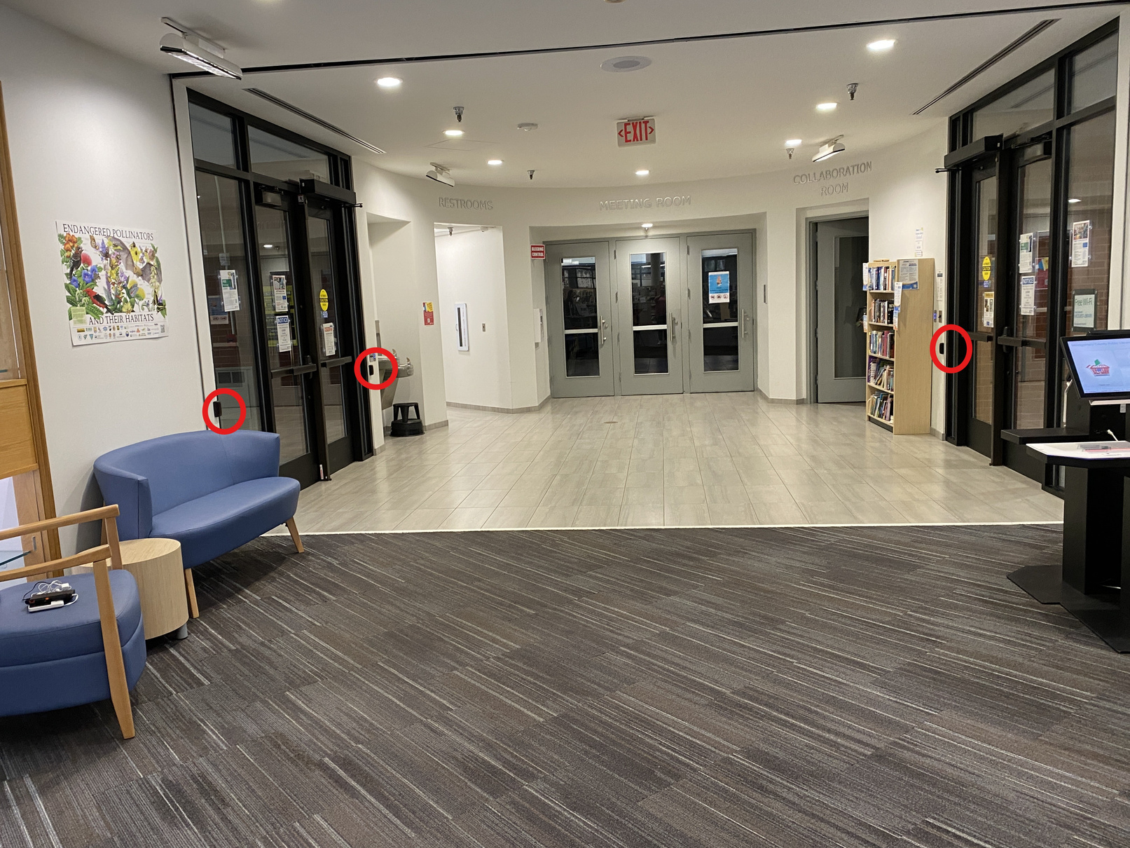
Lies, D*&! Lies, and Statistics

Slide 7


Lies, D*&! Lies, and Statistics

Slide 8


survey says?

Slide 9

survey says?
Self-selecting Participants
Not representative of general population
Mere Measurement Effect
Aspiration vs. Reality

Slide 10
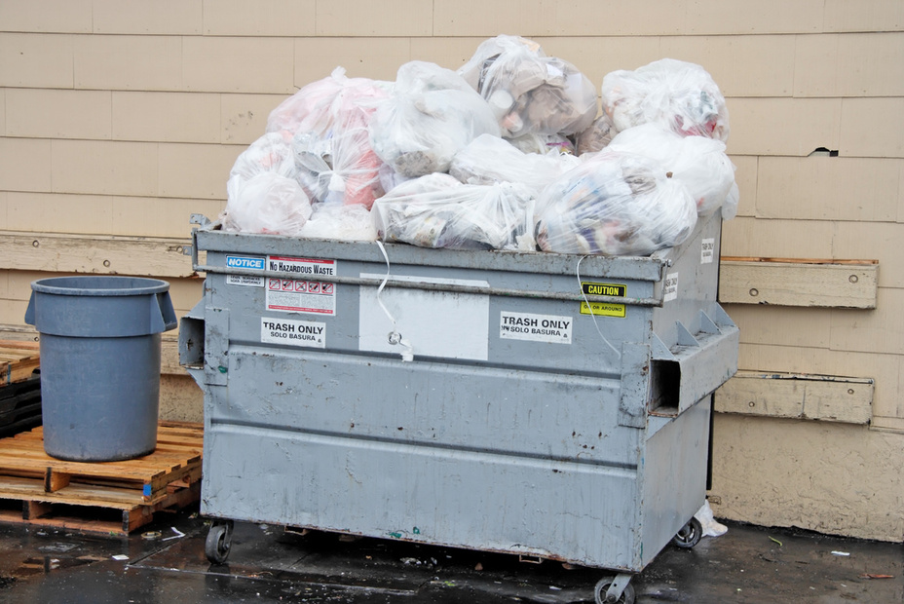


garbage in, garbage out

Slide 11
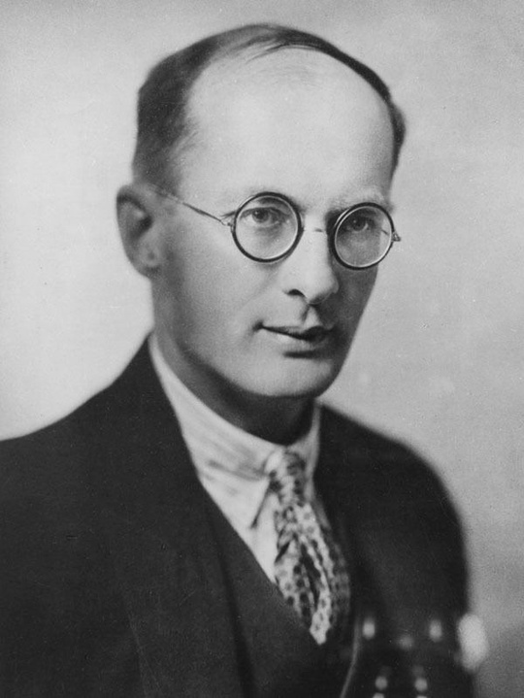

What is Ethnography?
get off the veranda (or out from behind the desk)
“The anthropologist must relinquish his comfortable position in the long chair on the veranda of the missionary compound, Government station, or planter's bungalow, where, armed with pencil and notebook and at times with a whisky and soda, he has been accustomed to collect statements from informants.”
Participant Observation (AKA Deep Hanging Out)
“It is good for the Ethnographer sometimes to put aside camera, notebook, and pencil, and to join in himself in what is going on.”
“The main principle of my work in the field: avoid artificial simplifications. To this end, collect as concrete materials as possible; note every informant; work with children, outsiders, and specialists. Take side lights and opinion.”
Bronislaw Malinowski
Quotes from Malinowski, B. Argonauts of the Western Pacific. London: George Routledge & Sons Ltd., 1922; Malinowski, B. A Diary in the Strictest Sense of the Term. London: Routledge and Keegan Paul, 1967.

Slide 12
imponderabilia of everyday life
“There is a series of phenomena of great importance which cannot possibly be recorded by questioning or computing documents, but have to be observed in their full actuality. Let us call them the imponderabilia of actual life. Here belong such things as the routine of a man’s working day, the details of his care of the body, of the manner of taking food and preparing it; the tone of conversational and social life around the village fires, the existence of strong friendships or hostilities, and of passing sympathies and dislikes between people; the subtle yet unmistakable manner in which personal vanities and ambitions are reflected in the behaviour of the individual and in the emotional reactions of those who surround him.”
“These imponderable yet all important facts of actual life are part of the real substance of the social fabric.”
Bronislaw Malinowski
Quotes from Malinowski, B. Argonauts of the Western Pacific. London: George Routledge & Sons Ltd., 1922.

Slide 13

verified, actionable gold

Slide 14

What is Ethnography?
Systematic
Interaction
Observation
Long Time

Slide 15
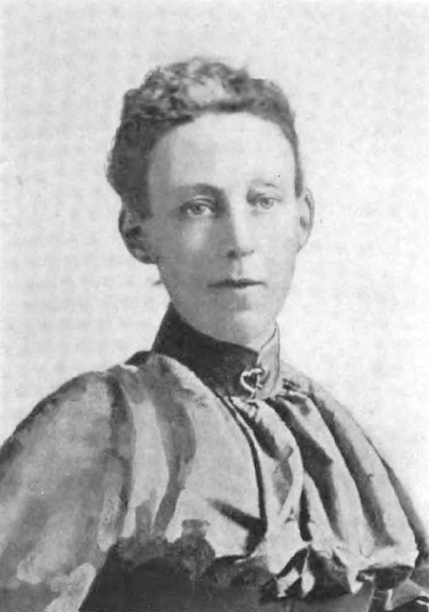
community study
“The librarian should be a careful student of his own town. He should know its history and topography, its social, political, business, literary, and ecclesiastical life . . . the city officers, the party bosses, the labor leaders, members of the board of trade, manufacturers, leading women in society . . . the clergy . . . the school superintendent and the teachers. . . those who shape the charitable organizations . . . reporters, policemen, and reformers.
“To what end? Broadly, that he may catch the spirit of the civic life and relate the library to the whole as the organs to the body. Specifically, that he may reach the entire population through the natural leaders, that he may select books, establish branches, open up new avenues of communication between the library and the people."
Mary Salome Cutler Fairchild
Quoted in Evans, C., “A History of Community Analysis in American Librarianship,” Library Trends, January 1976. Image by J. T. White & company, 1893, Public Domain, https://commons.wikimedia.org/w/index.php?curid=74250201

Slide 16

Ethnographic Methods
Mapping
Fieldnotes
Reflexive Journaling
Digital Ethnography

Slide 17
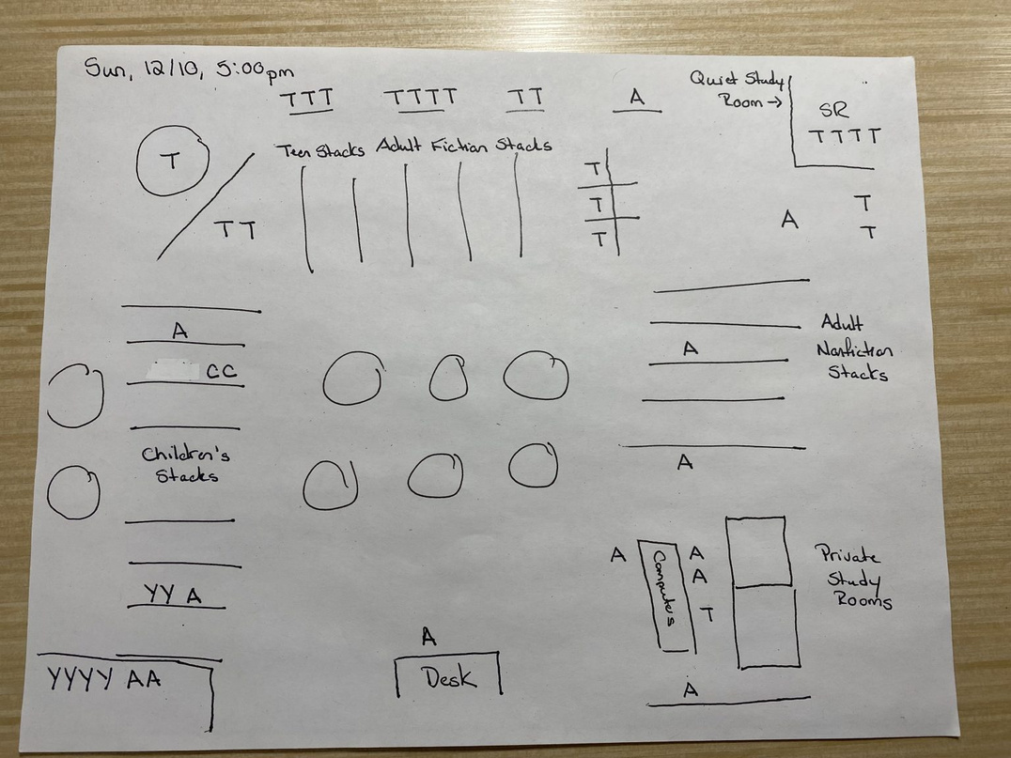

Mapping

Slide 18
Mapping
When do various groups come to the library? Does that match up with staffing and programs?
Where do your patrons go in the library? How do different age groups spread out across the space? Do patrons spend time in the stacks, or do they stick to the communal areas around the periphery?
How are people using the library? What do they do while they are in the library? How long do they stay?

Slide 19
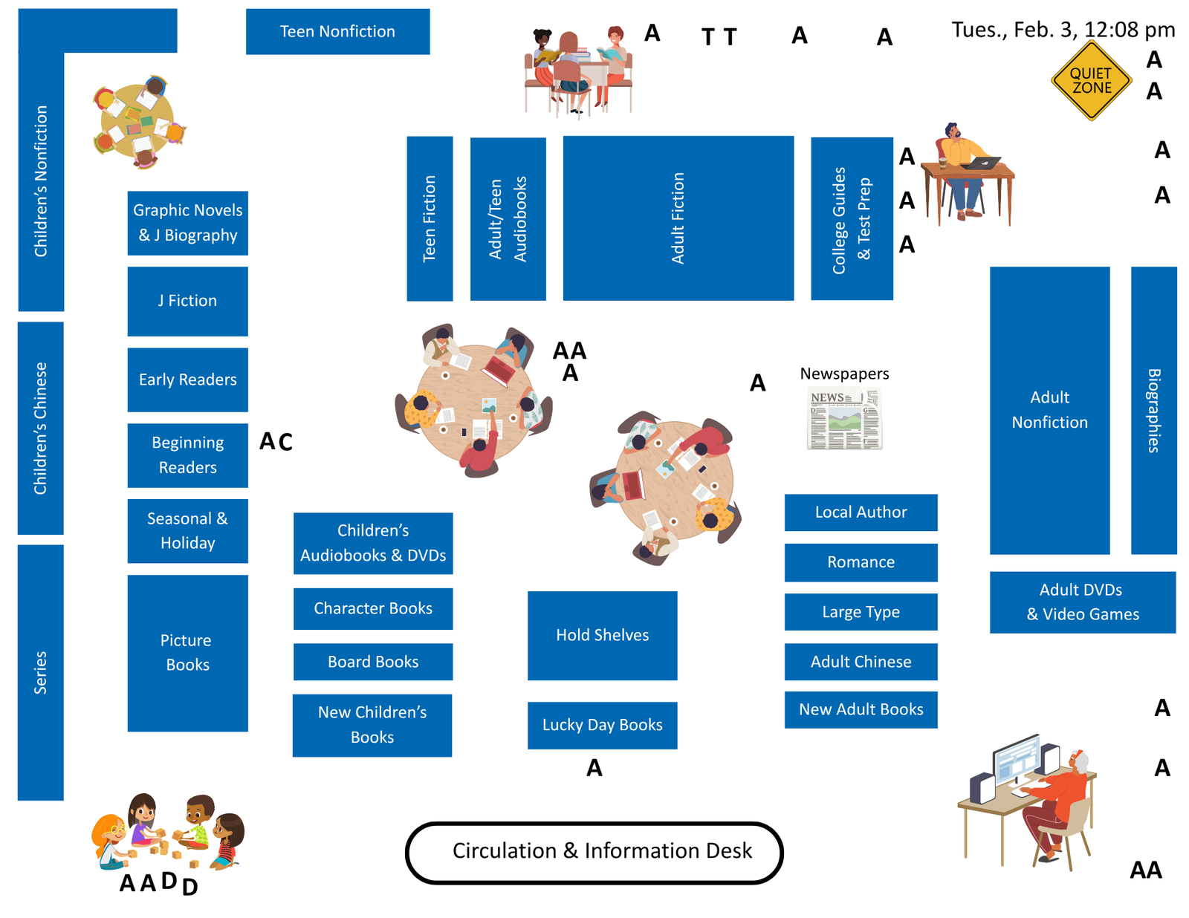

Slide 20


Slide 21


Slide 22


Slide 23
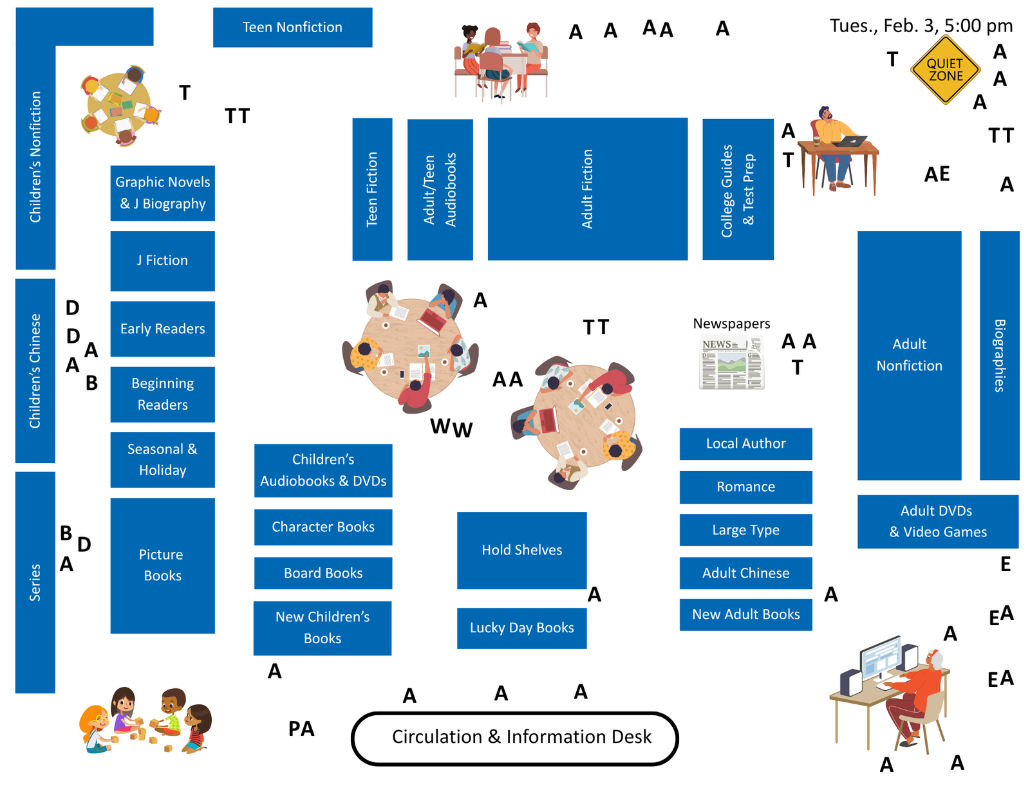

Slide 24


Slide 25


Slide 26
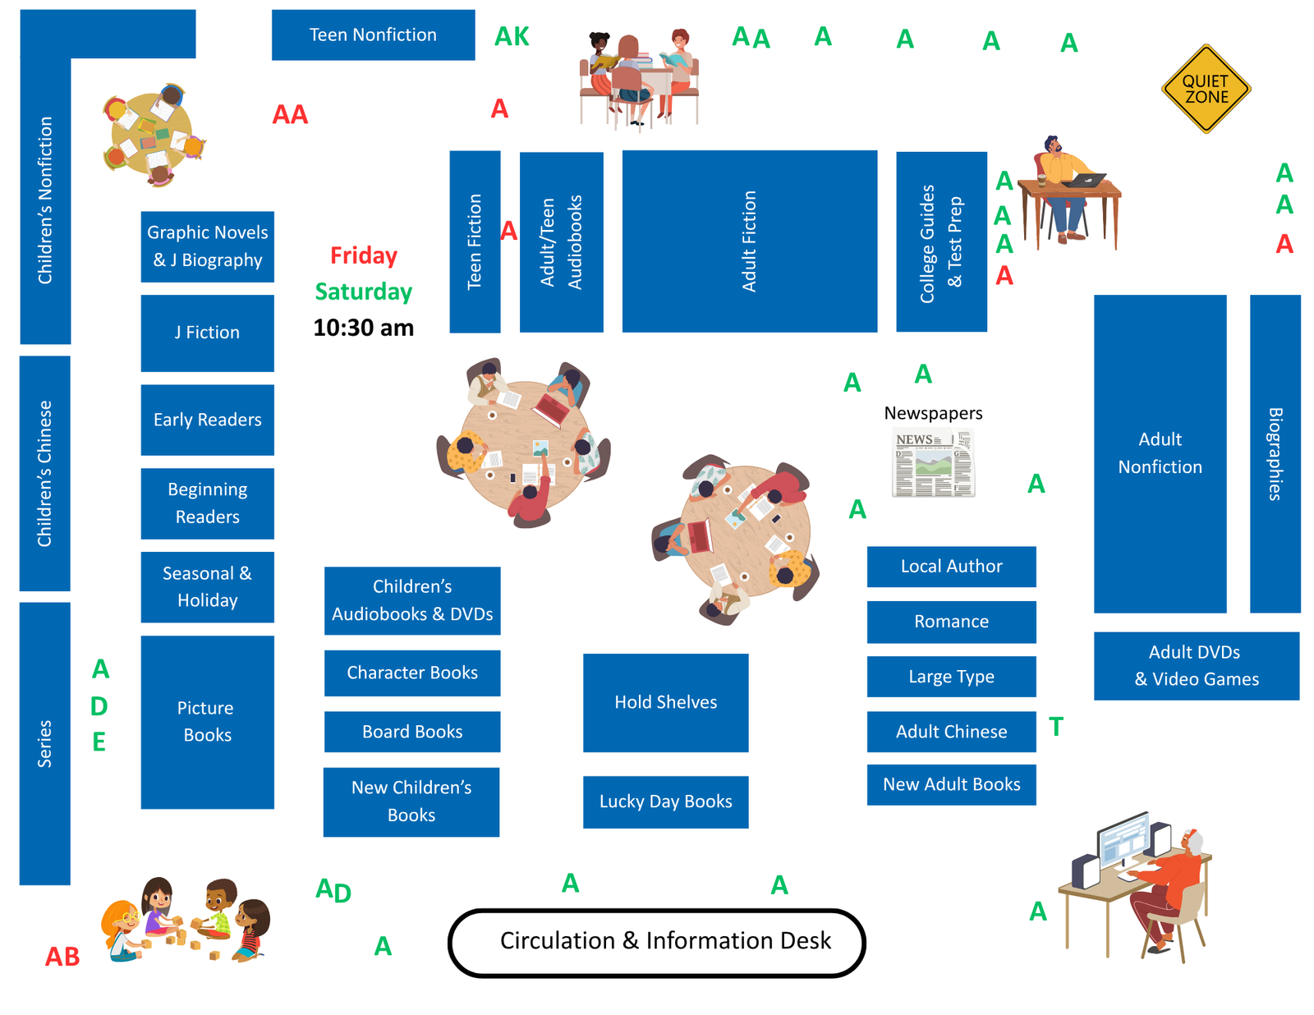

Slide 27


Slide 28

fieldnotes
Who
What
When
Where
How
(But not why!)
“An ethnographic diary, carried on systematically throughout the course of one’s work in a district would be the ideal instrument for this sort of study.”
-Bronislaw Malinowski

Slide 29

fieldnotes
Inductive (grounded theory)
Observations
Questions
deductive
Questions
Observations

Slide 30
fieldnotes
Concrete & Specific
We had a lot of older adults in the library this morning.
About a dozen older adults came in between 10:15 and 10:45. Singly or in pairs. Two immediately went to the computers. Seemed to know exactly what they wanted to do. Two browsed the Lucky Day books and displays. The rest went straight to the newspapers and sat reading them at the tables in the center of the library.

Slide 31
fieldnotes
Use Neutral Language
The kids were completely out of control this morning. The library looked like a plague of locusts had gone through.
After storytime, the kids were very active and making a lot of noise in the children’s section. After they left, we found that almost all the character books had been taken off the shelves and were piled on the black cart. There were also a bunch of books piled in the blue bins in the play area.

Slide 32
fieldnotes: example
According to W., the project has had 5 or 6 volunteers this year, for one week at a time, and they split their time between PG and Chembe orphanage. He thought the volunteers were helpful because they brought their ideas---he cited one volunteer who helped design the garden---and their skills---such as some women who taught writing to local women, although W. admitted that they couldn't do much in just one week. We were then joined by C., a man in his early thirties, and D. and A., both in their midtwenties.
Some topics of conversation:
Mutharika: The general consensus was that he wastes too much money on useless projects, like the new flag, and only helps his home region.
Muluzi: Opinion was more charitable toward him. Two of the guys didn't believe that he was guilty of embezzling government money; one said that the charges were just so that the current government could keep the UDF (Muluzi's party) from gaining power.
Poverty in Malawi: Everyone agreed that Malawi has not improved, that conditions are just as bad as ever; some even laughed when I said that Malawi had recently been lauded for its progress on meeting the MDGs. When I asked why Malawi is poor, D. replied, "Maybe I can reply like this. Maybe people here are depending on, are waiting for outsiders to help them and to bring them ideas."
D. and A. were both very curious about the US---the music; religion---the perceived lack of religion, ideas about Muslims; Obama; race relations and human rights; its problems. They had the impression that few people knew "how to worship," that the US is very violent, but that the standard of living is much higher.

Slide 33
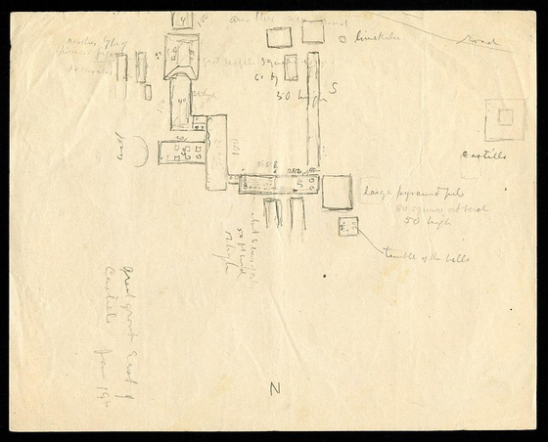
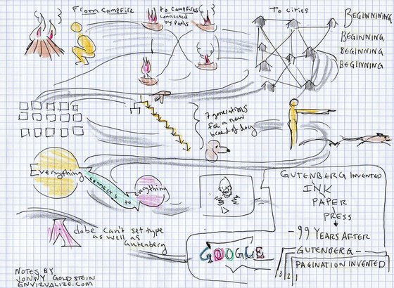
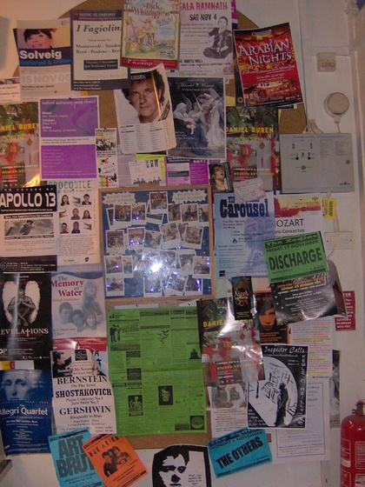
fieldnotes
Written
Narrative
Dialogue
Bullet points
Oral
Visual
Sketches/Illustrations
Collage
Ephemera
Images: “n27_w1150” by Biodiversity Heritage Library, Public Domain; “Visual Notes 1 of Richard Saul Wurman at SenseMaker Dialogs” by jonny goldstein, CC BY 2.0; “Bright Lights, Big City” by carnavalet, CC BY-SA 2.0.

Slide 34

Reflexive Journaling
“From my own experience, I can say that, very often, a problem seemed settled, everything fixed and clear, till I began to write down a short preliminary sketch of my results. And only then, did I see the enormous deficiencies, which would show me where lay new problems, and lead me on to new work.”
-Bronislaw Malinowski

Slide 35
Reflexive Journaling
Why? So What? What Now?
Summarizing, Clarifying, & Synthesizing
Making connections
Tracking changes over time
Evaluating “facts on paper” vs. “facts on the ground”
Identifying problems, needs, and opportunities
Questioning and challenging assumptions
Making “invisible” knowledge visible
Raising new questions
Thinking through future plans and next steps

Slide 36

Reflexivity
Conscious, intentional, explicit
Beliefs, background, experiences, identities, and positions
Effects
What you observe
How you interpret your observations

Slide 37
Reflexive Journaling
Participant/Observer
Full Participant
Part Participant, Part Observer
Fly on the Wall
Relation to Culture/Group
Insider
Outsider
Length in Field
Long Term
Short Term
Adapted from Introduction to Qualitative Research Methods Copyright © 2023 by Allison Hurst. Licensed under a Creative Commons Attribution-ShareAlike 4.0 International License, except where otherwise noted.

Slide 38
reflexive journaling: example
I get asked for book recommendations a lot, and often outside of my comfort zone. I’m getting asked for recommendations for fantasy novels for older elementary kids, fifth or sixth grade. And the kids here are big readers, so they’ve already read the popular series.
I’m getting a good number of people at Crafternoon, but mostly on the low end of the age range. I was hoping to gear Crafternoon more toward elementary age and start a separate program for the littles, but I may need to rethink that plan. The kids here seem to be more comfortable with coming up with their own projects than the kids at my previous branch, so I might need to move toward more process art and fewer structured crafts.

Slide 39
reflexive journaling: example
People in NB seem much more ready to blame azungu for their problems and to suspect long-term azungu residents of being corrupt than the people in Blantyre are. The people in Blantyre tended to blame each other or the government for their problems. Although I heard about incompetent and misbehaved volunteers in the south, I rarely heard anyone suggest that an azungu was corrupt, stealing money from the community, or responsible for failing projects. Here, nearly everyone has a story of an azungu who made false promises or misused money or used the community for his/her own profit.
I find it a little strange because I would think that the attitudes would be reversed. The Northern region has a reputation of having benefitted the most from early Western helpers, particularly through the mission schools, while being marginalized by the government. The Southern region is seen as having received the most from the government, although in very specific areas.
These differences may be more a reflection of the specific sites and their primary interactions with azungu. Blantyre is a commercial center, where most of the communities' interactions with azungu are through aid agencies. NB is a tourist town and most interactions are mediated through the tourism industry. And, indeed, the most vehemently negative reactions that I've gotten have been from people who have either been shut out of the industry---such as Sammy---or whose livelihood has been threatened by azungu influence---such as the curio boys.
Which leads me to another question: How reliable are my informants? Sammy and the curio boys are living on the margins---"have-nots" who are struggling to survive---watching azungu "volunteers" living as "haves" (at least in relative terms) and controlling Malawian opportunities (by directing tourists to or from particular vendors, hiring and salaries, etc.).

Slide 40
Reality: a mix of both
Chimwemwe Umbrella has had its funding cut off by Africa Unplugged UK. AUP is going to continue to fund the village shelter school and nursery school. But it is cutting off the funding for all other programs, for the office, for the shelter school in town, and for all allowances. According to C., AUP wants to shift from funding CBOs to project-specific funding. Something about cutting their overhead so they can have a greater impact. . . .
As an example of its new model, AUP funded an art project through CUB. Or, really, through Mr. H. I got a call from C. a couple of weeks ago; AUP wanted to do an art auction as a fundraiser. So they wanted Mr. H. to get artwork from local students. But C. didn't trust Mr. H. to actually implement the project, so he wanted me to act as a sort of monitor. I was to go with Mr. H. to get the money from Western Union for supplies, go with him to buy the supplies, go with him to distribute the supplies, help judge the artwork submitted to pick the best from each school, and make sure the final pieces were sent to the UK in time for the auction. . . .
From a research perspective, I think the most important part of this incident is the distrust in the relationship between funders and locals, in which volunteers become monitors/overseers. Funders want proof that their money is being spent in the "right" ways. Often these reporting requirements are onerous for locals---not just receipts, but videos and photos, weekly e-mailed reports, so volunteers or other azungu have to step in to help.

Slide 41

Digital Ethnography
“There was reason here to know my community, to make my library an essential part of it, to connect my books with my people. . . the useful and practical point of view, could come to us only from a knowledge of the lives of those whom we were to serve, . . . of the details of this new living of theirs and of the new problems with which they were daily struggling.”
-Mary Frank & John F. Carr
Quote from Frank, Mary, and Carr, John F. "Exploring a Neighborhood," Century Magazine 98:375-77, July 1919.

Slide 42
demographic data
US Census Bureau
American Community Survey
Current Population Survey
Pew Research Center
Migration Policy Institute
Urban Institute
Montgomery County Planning Department

Slide 43

Digital ethnograpy & Social Media
What are people posting?
What questions are they asking?
What programs and services are they looking for?
What events are happening?
What organizations and businesses are active?
What resources are being shared?

Slide 44
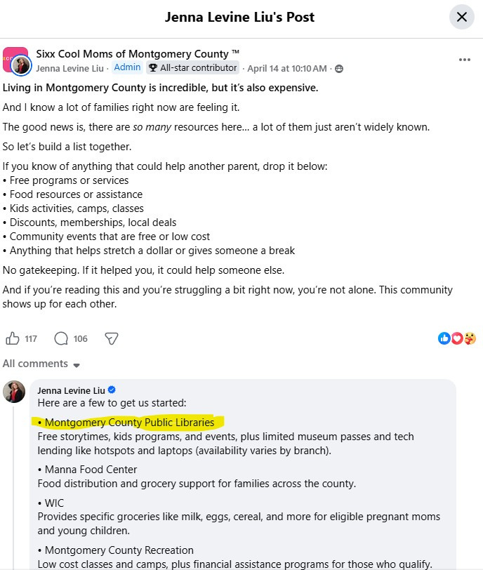

Slide 45

Digital ethnograpy & Social Media
Facebook
Instagram
TikTok
Reddit
Nextdoor
Twitch
Discord

Slide 46

ethics & ethnography
Be honest and open
Respect privacy and boundaries
If in doubt, ask first

Slide 47

Thank You
Contact Me:
elizabeth.bintrim@montgomerycountymd.gov

Slide 48

Please take a moment to complete the program survey.
SCAN ME!

