Slide 1











Slide 2








DON’T MISS!
50/50 RAFFLE
Tickets are $1 each and can be pURCHASED FROM CONNI STRITTMATTER OR DAVID DAHL! THE WINNER TAKES HOME HALF THE POT.
PUB QUIZ
Thursday, MAY 7
8:00 – 10:00 P.M.
CHOPTANK BALLROOM
SILENT AUCTION
Visit the Silent AuctION IN THE EXHIBITOR HALL TO PLACE YOUR BIDS BEFORE 10 A.M. ON FRIDAY, MAY 8ᵗʰ.
KARAOKE
Thursday, MAY 7
6:00 – 10:00 P.M.
WINDJAMMER

Slide 3




FROM ZERO TO FESTIVAL:
How One Library Pulled Off a Big Event with No Budget
(And you can, too!)

Slide 4
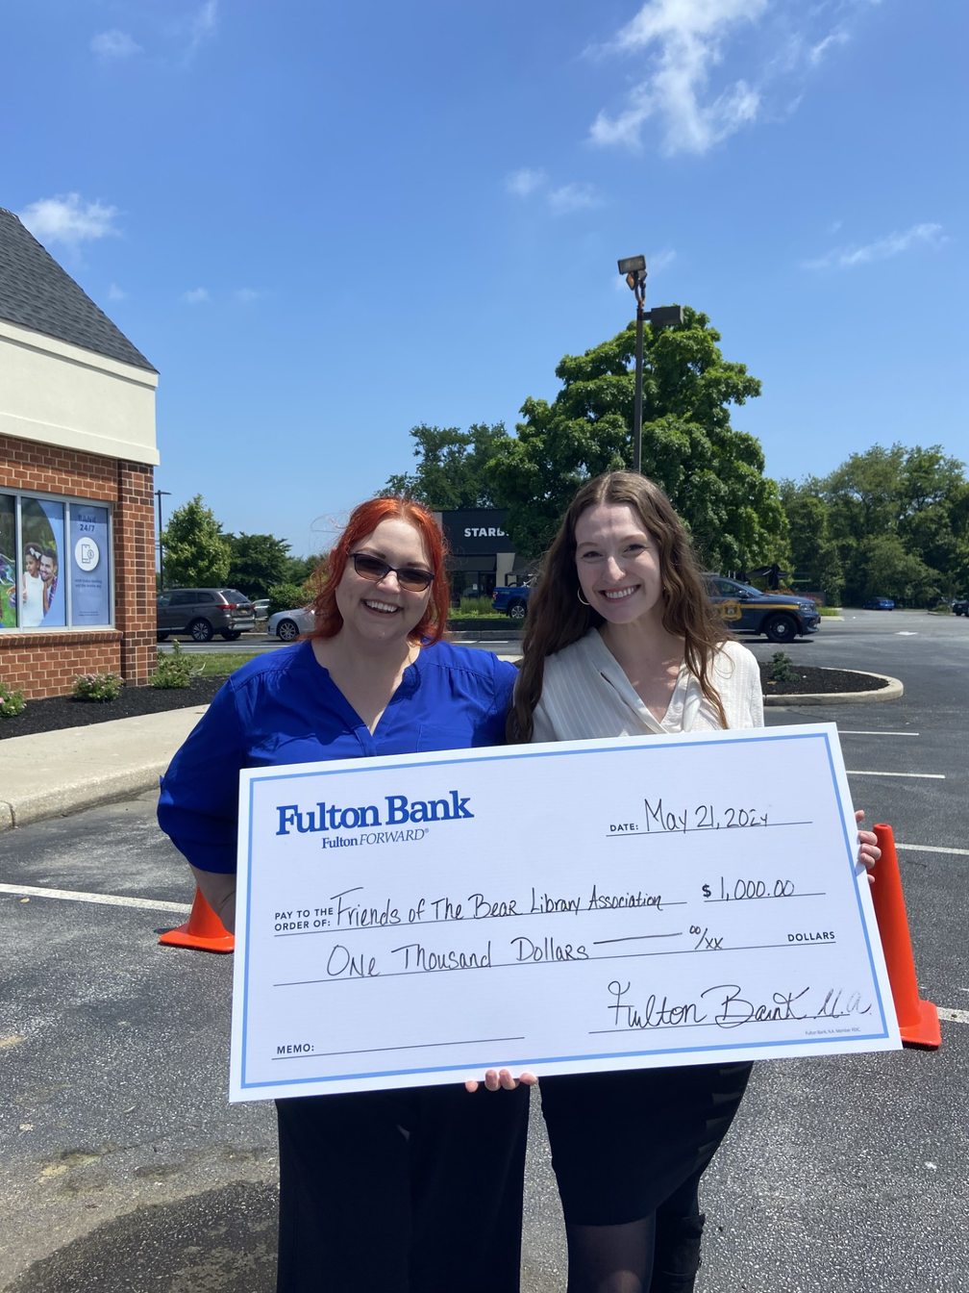

HELLO!
Kathryn Hatfield (She/Her)
Adult Services Librarian
Elizabeth Mayer (She/Her)
Children’s Services Librarian

Slide 5

Introductions!
Let’s go around the room and introduce ourselves! Please share:
  Your name and pronouns
  The library, organization, or school where you work
  What you’re hoping to get out of this training today
(5 minutes)

Slide 6

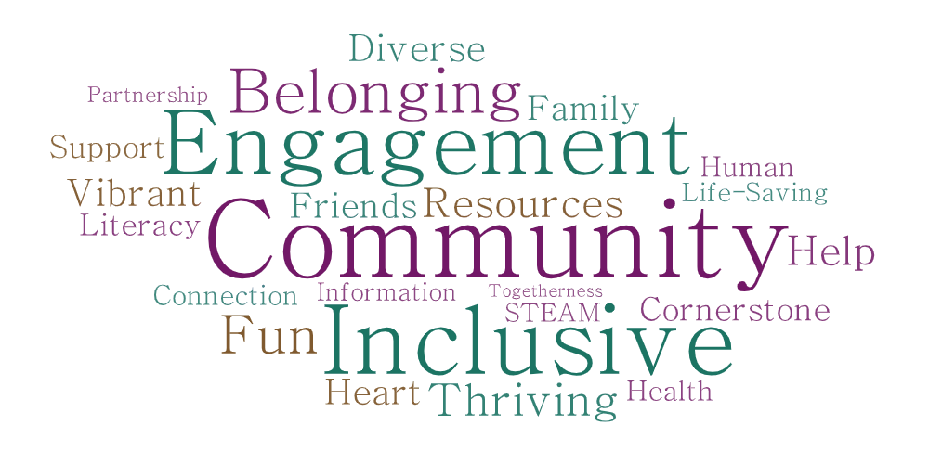

Slide 7
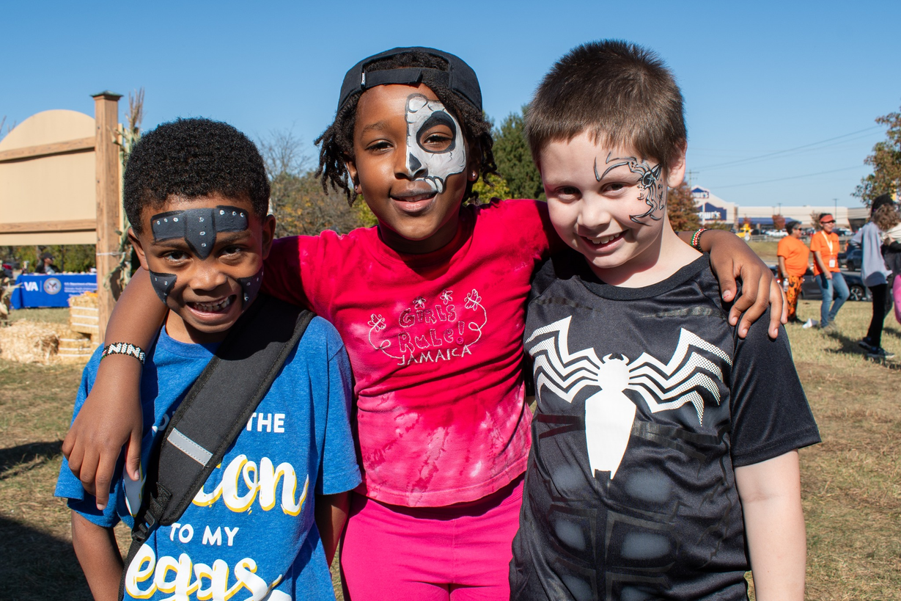
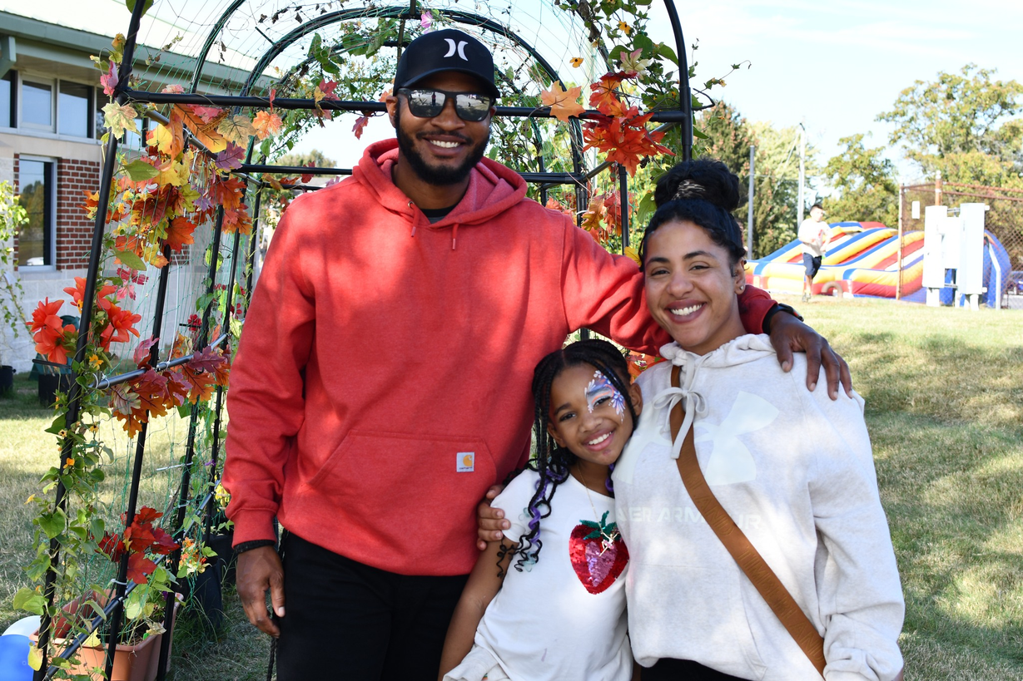
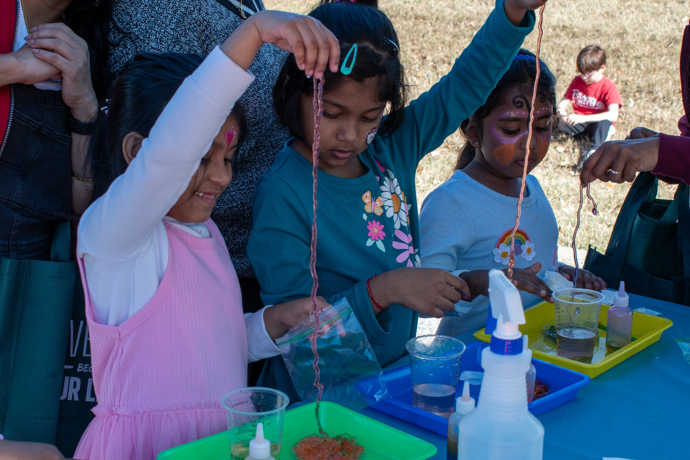
THE BEAR LIBRARY’S
ANNUAL FALL FESTIVAL!

Slide 8

WHY ARE YOU DOING THIS TO YOURSELF?!
BUILD COMMUNITY
ENHANCE WELL-BEING
PROMOTE THE LIBRARY
NETWORKING
YOU THRIVE ON STRESS
GIVE BACK

Slide 9
Brainstorming
As a table (or individually), take a moment and write down all the reasons why you’d like to host a mega event at your library on a post-it note!
Note: you will be building on this idea throughout the training!
(5 minutes)

Slide 10
OUR ANSWER:
Build community and promote the library during a post-covid slump.

Slide 11




What event meets that need?
The “What” should support the “Why”
Build Community?
Give back to the community?
Bring people to central location and create a shared experience!
Promote Library or Library services?
Look at what your community needs and ask what you can do to meet that need.
Focus on the service’s theme!

Slide 12
Brainstorming
Expand on your post-it note idea!
Remember: the “what” should support the “why!”
The Why = the reason, goal, or intention
The What = what you actually do, say, or create
(5 minutes)

Slide 13
OUR ANSWER:
  To build community!
    We wanted a free, family event that would give community members a place to engage in a shared experience with others
  To promote the library!
    We wanted a large, outdoor event that would be visible from the street to generate interest from community members who don’t normally come into the library.

Slide 14
QUESTIONS?

Slide 15




Large events need...
FUNDING
TIME
PEOPLE
  Equipment (sound, lighting, staging)
  Marketing and promotion
  Staff, permits, insurance
  Plan logistics (venue, schedule, permits)
  Coordinate vendors and speakers
  Promote the event so people actually show up
  Organizers and planners
  Volunteers or staff
  Specialists (marketing, tech, security, etc.)
What do we have vs. what do we need?

Slide 16
Brainstorming
As a table (or individually), take a moment to explore what you have in regards to time, people, and funding. Then explore what you need in regards to time, people, and funding. Write your ideas on a post-it.
(5 minutes)

Slide 17
Draft!
Now that you’ve had time to consider why you want to host a large-scale event and the resources available or required (such as time, personnel, and funding), draft a general concept for a program you would like to host using the ideas on your post-it notes. This does not need to be highly detailed, but it should clearly reflect the program’s purpose (i.e. building community, promoting library resources...). Use the giant post-its to map out your ideas (if needed). This can be done as a group or individually.
(10 minutes)

Slide 18


5 MINUTE
break!

Slide 19
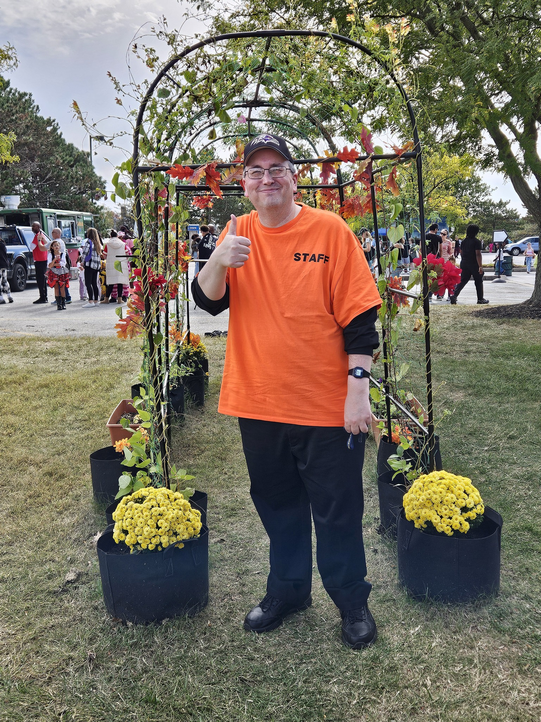
Writing a mission statement
  Communicates intent and purpose
  Communicates primary function and strategy
  Communicates benefits to patrons/stakeholders

Slide 20

Here are four essential questions your mission statement must answer:
 | Who are we? State the name of your program or organization (i.e. “The mission of the Bear Library is_____”). Avoid vague pronouns like “Our mission is…”
 | What do we do? Includes the primary functions or activities. Illustrates the most important functions, operations, outcomes and/or offerings of the program.
 | Why do we do it? State the purpose of the program/event. Should include the primary reasons why you perform your major activities.
 | For whom do we do it? These are the stakeholders (e.g., students, seniors, families) of your program.

Slide 21
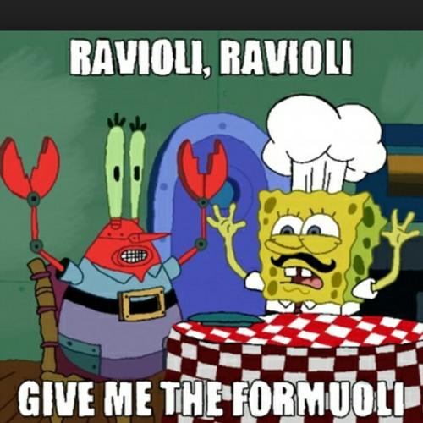
Mission Statement Formula
The mission of <the name of your program or
organization> is to <your primary purpose(s)>
by providing <your primary functions or activities>
to <your stakeholder(s)>.
Tips!
  Add any clarifying details as needed.
  Keep it short and sweet.

Slide 22
OUR MISSION STATEMENT:
The Bear Library’s Annual Fall Festival strengthens community connections, fosters meaningful engagement, and links patrons with essential resources. By creating an inclusive and dynamic gathering space, the festival reinforces the library’s role as a central hub and cornerstone of the Bear community where everyone belongs and thrives.

Slide 23
Write your own mission statement
Write a mission statement for the program idea you drafted earlier.
The mission of <the name of your program or
organization> is to <your primary purpose(s)>
by providing <your primary functions or activities>
to <your stakeholder(s)>.
(5-10 minutes)

Slide 24
QUESTIONS?

Slide 25
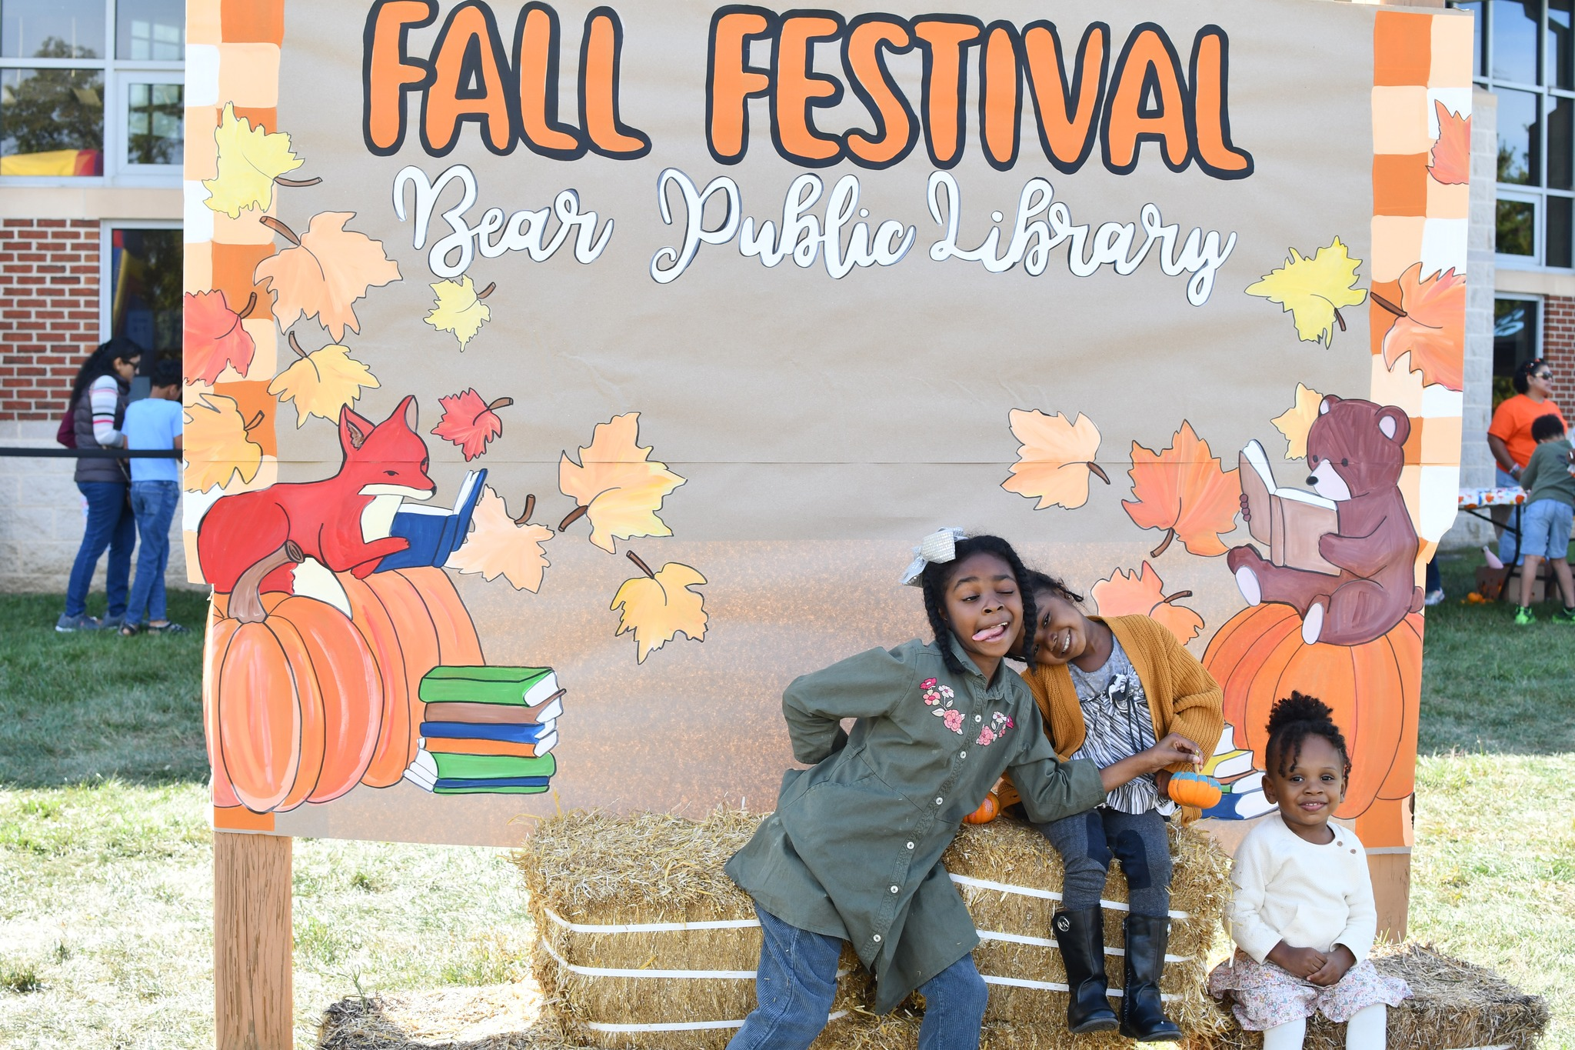
How do we make these smiles happen?
  Organizing
  Creating Partnerships
  Fundraising
  Marketing
  Legal & Safety

Slide 26

Organizing
  Debrief Meeting with your Team!
    Meet with your team after the event to discuss what went well, what didn’t go when, and what changes should be made.
    Send survey to participating staff to get their candid feedback about the event.
  Permits and Insurance
    Secure necessary licenses (e.g., for music, alcohol) and obtain liability insurance, particularly for public spaces.
  Define Goals and Target Audience
    Determine if the goal is to raise awareness, build community, or celebrate. Identify who you are trying to reach (e.g., families, seniors) to plan relevant activities.
  Form a Committee or Team
    Recruit volunteers or staff to help with planning, marketing, and execution, assigning specific responsibilities to each person.
  Plan Logistics
    Map out the site layout, including food, security, and safety measures.
    Staff and volunteer assignments
    Marketing!
    Have a back-up plan!
  Execute and Follow Up
    Create a detailed day-of timeline and send thank-you notes to volunteers and partners afterward.
  Create a Budget
    Determine costs (venue, entertainment, supplies) and identify funding sources such as sponsorships or donations.
  Promote the Event
    Use a mix of channels, including social media, flyers, and local newsletters to ensure a good turnout.
  Select Venue and Date
    Choose an accessible location with adequate parking and facilities. Check for conflicting community events.

Slide 27
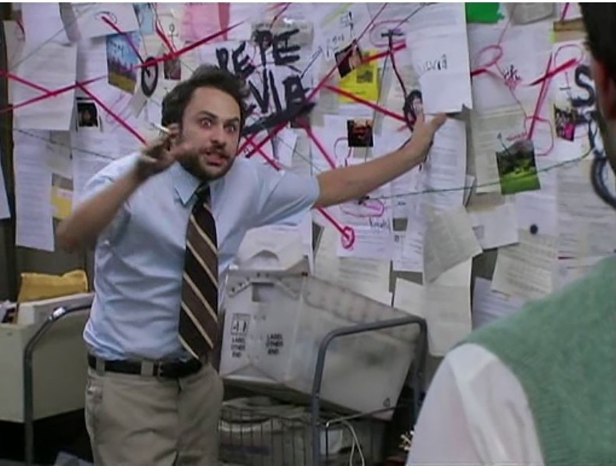
Create a system that works for you
Organization is essential when planning large events, but it’s important to recognize that the process isn’t always linear. Priorities can shift, and plans may need to be adjusted along the way. Establishing a centralized system helps keep materials organized, reduces mistakes, and ensures nothing is misplaced, even as things evolve. When multiple people are involved, clear structure and communication are critical to avoid confusion and potential pitfalls. While this is the approach we use for Fall Fest, you may find a different system that works best for your program or library.

Slide 28
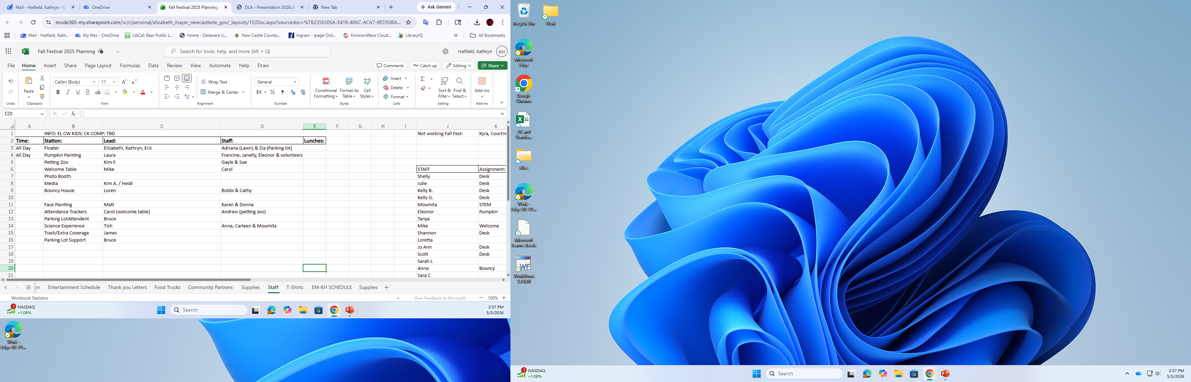

Slide 29
5 MINUTE
break!

Slide 30
Creating Partnership
  Start with Community Mapping! (See hand-out)
    What organizations, businesses, individuals are related to this event?
    If they have money, they’re more likely to be interested in sposoring an event that relates to their mission or is high interest.
    If they don’t have money, they may still be interested in donating their time.
Reach out regardless of the connection level!

Slide 31
Community Mapping
Using the hand-out provided, identifying physical assets (buildings, parks), and social infrastructure (groups, institutions) in your community.
Remember: Community input is extremely valueable!
(5-10 minutes)

Slide 32
QUESTIONS?

Slide 33



Fundraising
  Cold Calling
    Going door-to-door to businesses and organizarions in your community.
    Least successful pathway.
  Grants & other formal channels
    The Bear Library received grants through Walmart, Shoprite, DLA, Art Council, DE Humanities.
  Connections
    Most of our funding came from personal connections (i.e. Walmart, Chick-fil-A, CrossFit Bear).

Slide 34
Fundraising Continued!
Connections to Consider
Your Community Matters:
  Financial Institutions: Credit unions & local banks
  Community Leaders: Local officials & influencers
  Local Businesses: Independent franchises & restaurants
  Examples: Chick-fil-A, Dunkin’, Smoothie King, coffee shops, gyms, Chipotle, minor league teams
Keep in Mind:
  Families support events like the Fall Festival through donations
  “Friends of the Bear Library” host a 50/50 raffle to help fund programs
Not all partners can give money—but many can donate supplies, gift cards, or volunteer time
  Examples:
    Target, Walmart, ShopRite, Starbucks, Costco

Slide 35

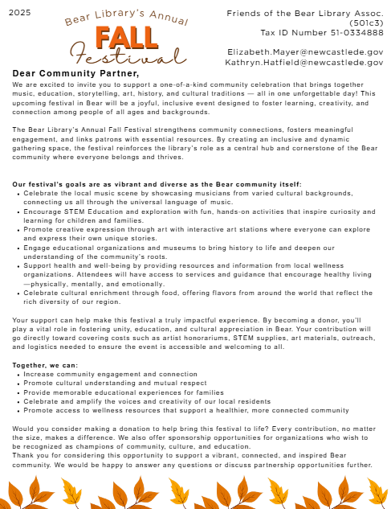
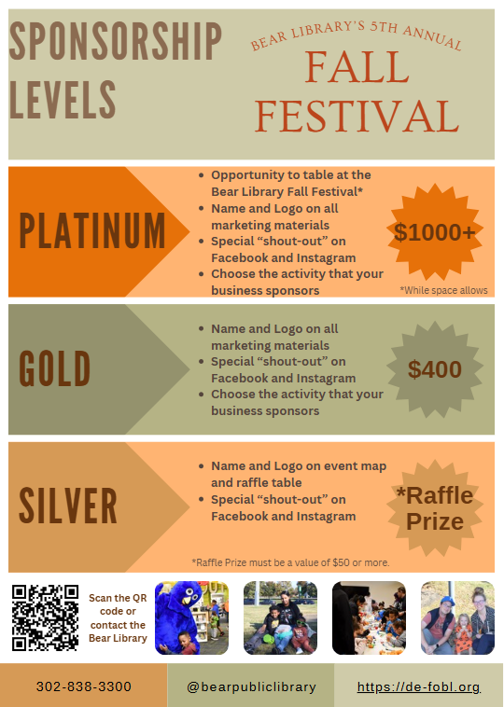
Fundraising Documents

Slide 36
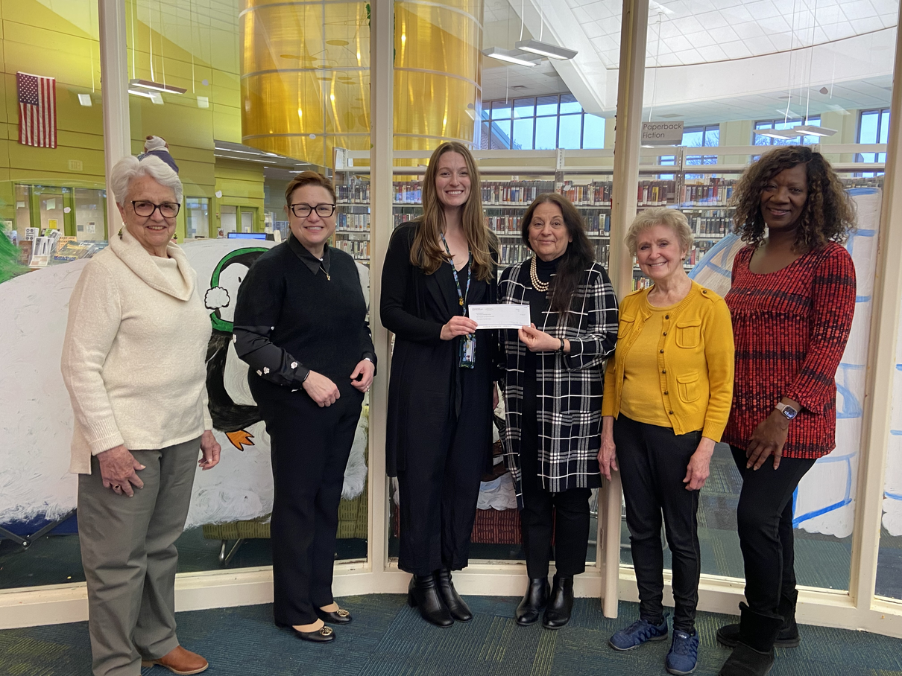
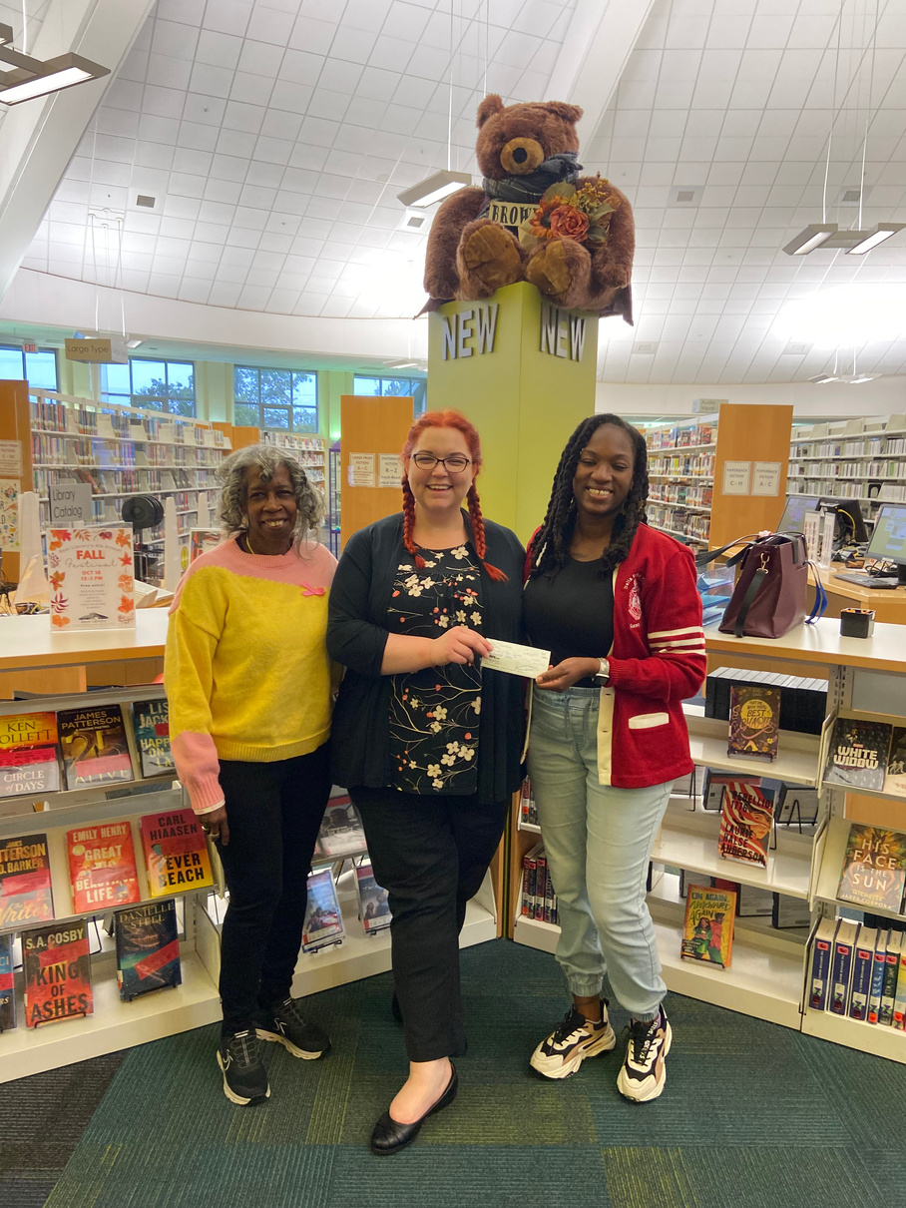
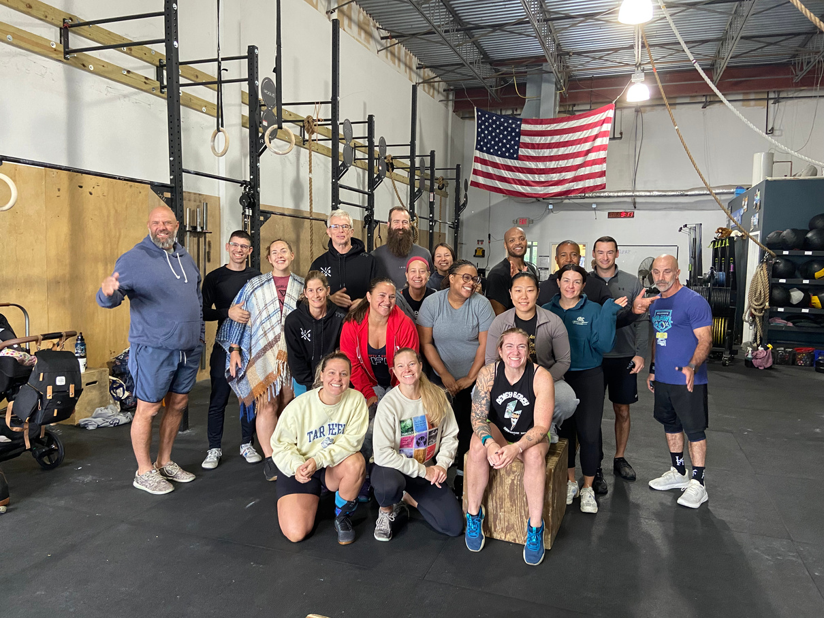
Our Successes!

Slide 37
QUESTIONS?

Slide 38
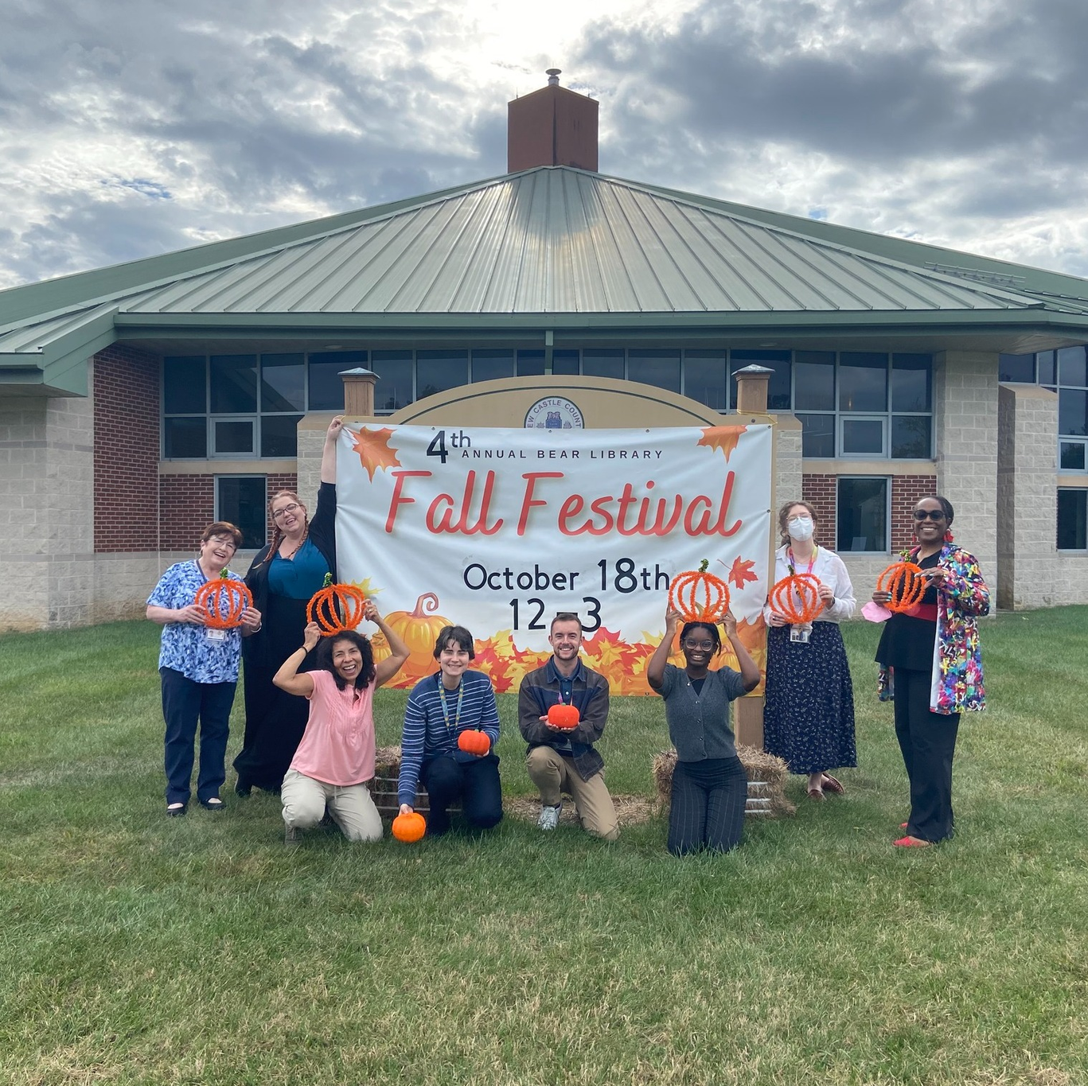
Marketing!
  Social Media Marketing
    Create an event on Facebook or Eventbrite
    Build brand awareness
    Share updates
  In-House Marketing
    Flyers
    Digital Displays
    Book Displays
    Staff talking points
  Email Marketing
    Monthly newsletter to subscibed patrons
  Influencer Marketing
    Sponsors, community partners, and local leaders share information about the event on their platforms

Slide 39



Legal & Safety!
COMPLIANCE
RISK MITIGATION
PREPARATION
  Laws
  Organizational Rules
  Permits/Licenses
  Copyright
  Hazard Prevention
  Signage
  Contracts
  Insurance
  Waivers
  Security
  First Aid

Slide 40
QUESTIONS?

Slide 41





Common Pitfalls
What could possibly go wrong?... A LOT!
 | Planning and Strategy Failures Procrastination: Waiting too long to start, leading to rushed decisions and higher costs. Unclear Objectives: Organizing without defining the "why," resulting in disjointed agendas and wasted resources. Planning by Committee: Involving too many people in decision-making causes delays and a lack of a clear, unified vision. Ignoring Audience Needs: Failing to consider the attendee's perspective, such as providing poor networking opportunities or not understanding demographics
 | Logistics and Operational Pitfalls No Contingency Plan (Plan B): Lacking backups for bad weather, speaker cancellations, or technical issues. Poor Venue Selection: Booking a space that is hard to navigate, lacks capacity, or is inaccessible to transportation. Inadequate Signage & Navigation: Allowing attendees to feel lost or confused regarding where to go. Understaffing: Not having enough personnel for registration, security, or support. Ignoring Attendee Flow: Creating bottlenecks and traffic jams in high-traffic areas.
 | Communication and Marketing Poor Vendor Management: Lack of written confirmations or regular communication with vendors. Inconsistent Messaging: Failing to promote the event properly, leading to low attendance. Vendor Error: Vendors not showing up or mixing up the dates
 | Other?

Slide 42
QUESTIONS?

Slide 43

BRINGING IT ALL
Together

Slide 44
Mind Mapping
Working individually or in a group, use the large Post-it and the materials provided to design a mind map for your mega event. Your proposal should include:
  A clear and well-defined concept for the event
  A mission statement that explains the purpose and goals
  An overview of the resources currently available to you (such as time, people, and funding)
  Any potential challenges or pitfalls you anticipate encountering during the planning or execution of the event
In addition, identify any opportunities or connections for gaining extra resources (time, people, or funding) that you discovered while creating your community map.
(15-20 minutes)

Slide 45









CONCEPT
MISSION STATEMENT
Large, outdoor event to build community and bring people to the library
The Bear Library’s Annual Fall Festival strengthens community connections, fosters meaningful engagement, and links patrons with essential resources. By creating an inclusive and dynamic gathering space, the festival reinforces the library’s role as a central hub and cornerstone of the Bear community where everyone belongs and thrives.
FALL
FEST
PITFALL
TIME
  Rain!
  Competing events
  No-show vendors
  Reserves spaces 12 months out
  5-6 months of active planning
  2 months of “Fall Fest Mode”
FUNDING
PEOPLE
  $5,000 required to impliment
  Continuing Partnerships: $2,000
  Community Giving: $500
  Rotating Partnerships: $2,500
  Black-out weekend for all staff
  Volunteers
  The Friends of the Bear Library
  Community Partners

Slide 46

PROGRAM
share
(15-20 minutes)

Slide 47
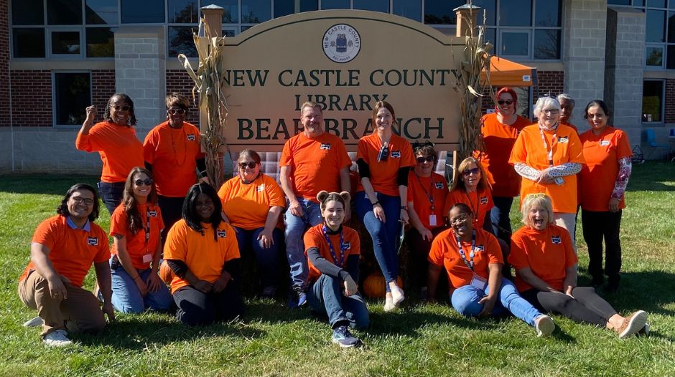
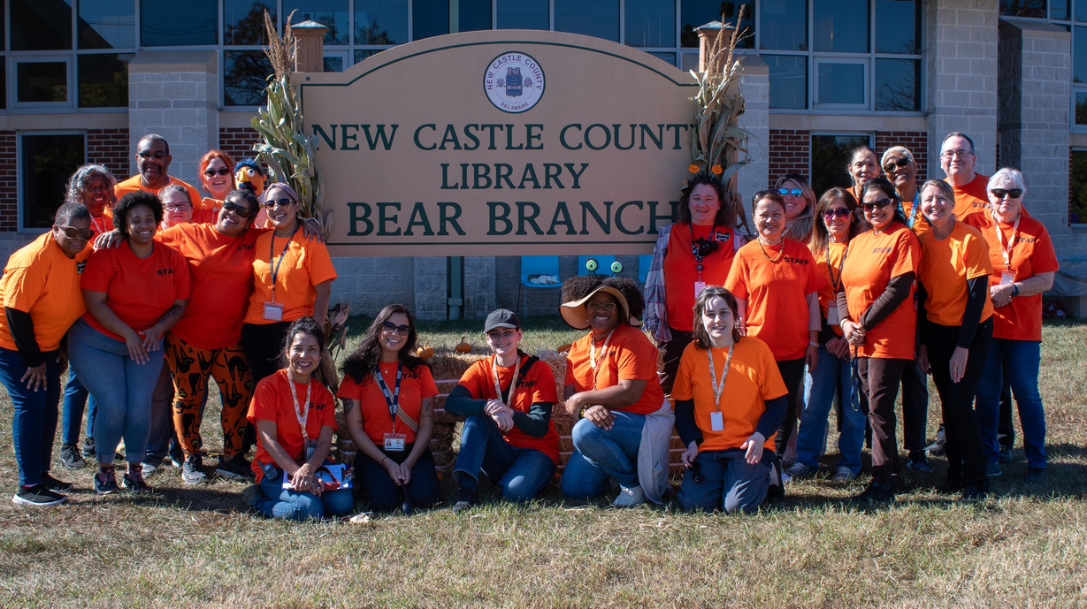
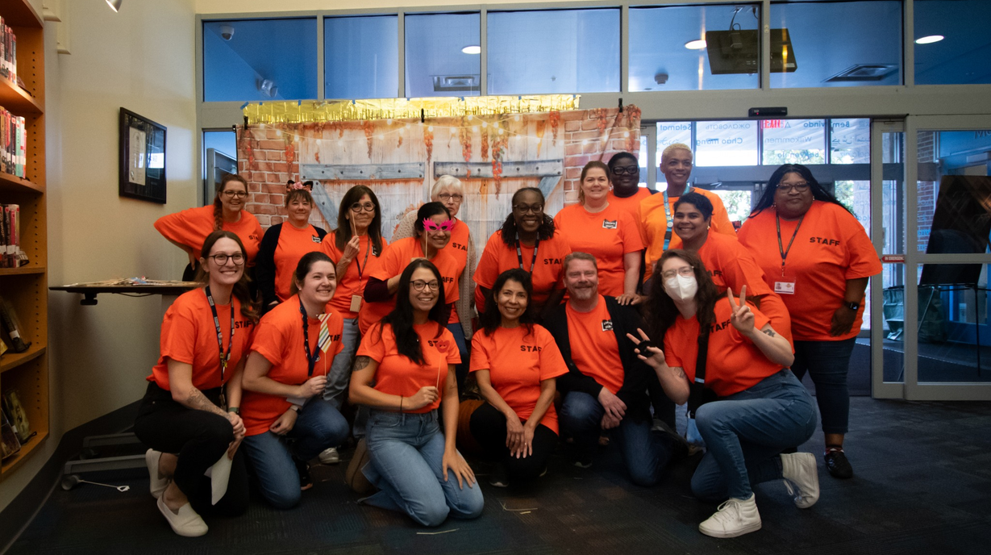
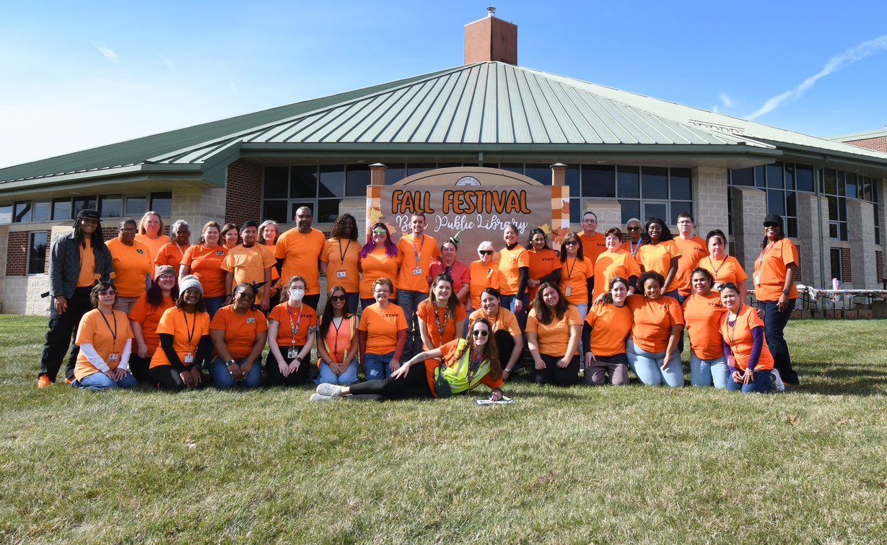
2022
2024
2023
2025

Slide 48
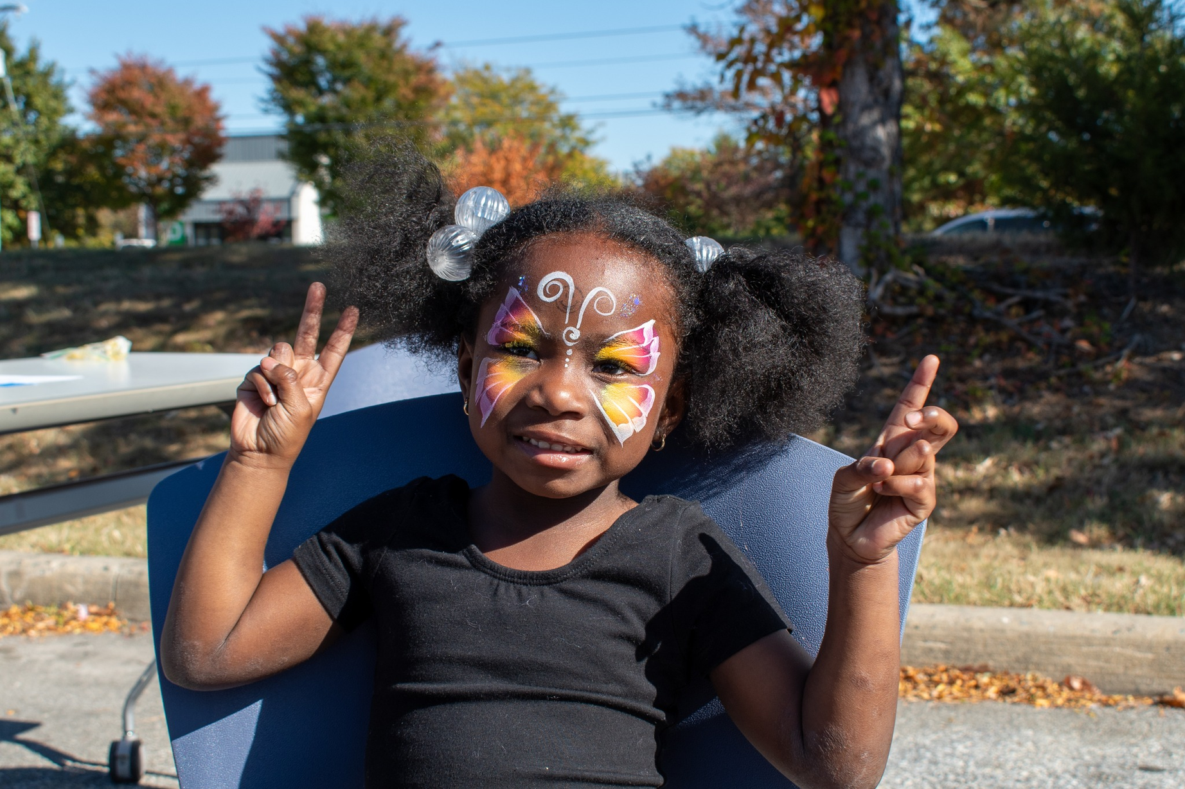
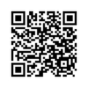

Thank you so much
Elizabeth Mayer (she/her)
Elizabeth.Mayer@NewCastleDE.Gov
Kathryn Hatfield (she/her)
Kathryn.Hatfield@NewCastleDE.Gov

Slide 49


You’re Invited!

Slide 50

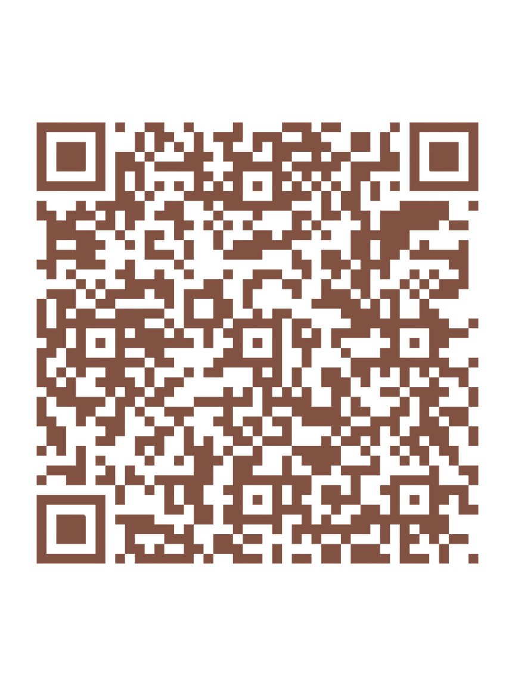
Please take a moment to
complete the program survey.

