Slide 2




Don’t Miss!
50/50 RAFFLE
Tickets are $1 each and can be purchased from Conni Strittmatter or David Dahl! The winner takes home half the pot.
SILENT AUCTION
Visit the Silent Auction in the exhibitor hall to place your bids before 10 a.m. on Friday, May 8th.
PUB QUIZ
Thursday, May 7 8:00 – 10:00 p.m. Choptank Ballroom
KARAOKE
Thursday, May 7 6:00 – 10:00 p.m. Windjammer

Slide 3
Practical Intellectual Freedom Strategies for Front Line Workers: Strategies, Advocacy, and Action for Library Staff
PRESENTERS:
Skip Dye & Rosie Stewart
Notes:
Skip – Welcome to the session - Practical Intellectual Freedom Strategies for Front Line Workers: Strategies, Advocacy, and Action for Library Staff. (Click Slide)

Slide 4
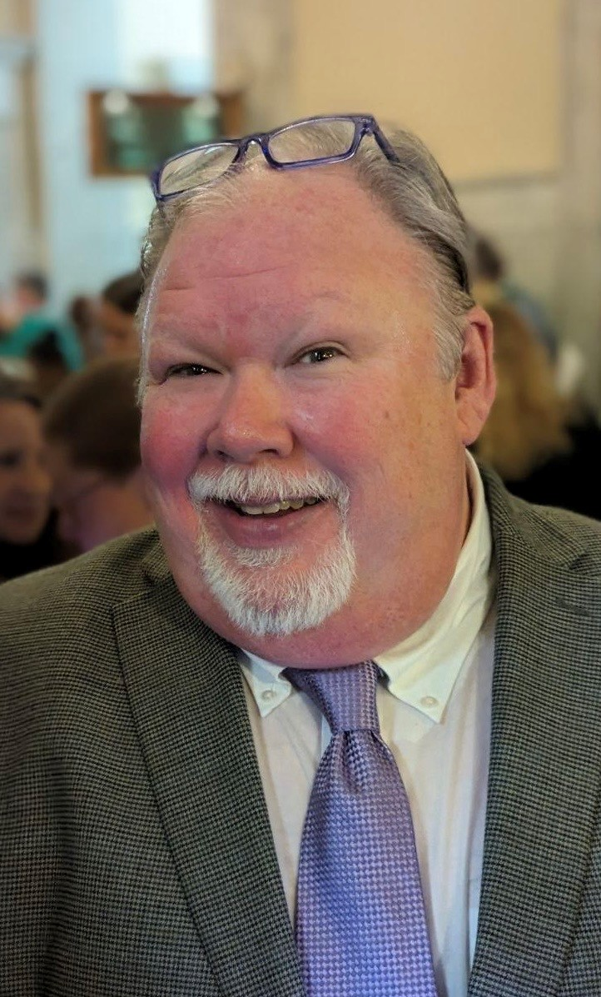

Presenters
Skip Dye
SVP, Library Sales & Digital Strategy;
Chair, PRH Intellectual Freedom Taskforce
Rosie Stewart
Senior Public Policy
Manager
Notes:
Introduce each other ourselves. Skip first – Rosie second.
Skip: This session’s goal is to provide practical strategies for handling censorship challenges, focusing on real-world applications.
Rosie: We will be grounding everything in the ethical foundations of librarianship. I know that you may be trying to take notes – we will be sharing this presentation with all our speaking notes included at the end and through the app. We want to include discussion, scenarios, and give some time for us for reflection and questions at the end of the session. But, if something comes up that is confusing – please let us know.
(CLICK TO NEXT SLIDE)

Slide 5
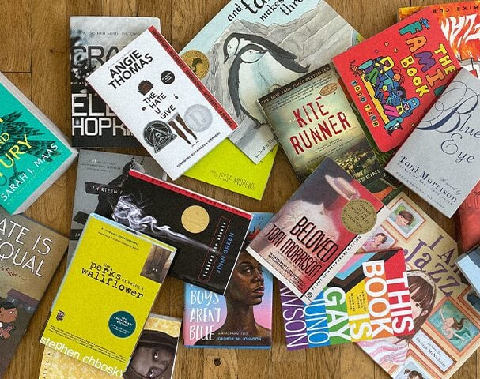
Rising book challenges and censorship pressures Front-line staff face complex interactions Need for confidence and clarity in responses
Why This Matters
Notes:
(Slight Delay – Do Not Need to Click)
Skip: What we’re seeing right now is not an isolated trend—it’s a sustained increase in book challenges and broader censorship pressures across the country. These challenges are happening in public libraries, school libraries, and increasingly in coordinated ways. For front-line staff, that national trend shows up very locally. It shows up at the service desk, in a conversation, often without warning. And those interactions can be complex. They can be emotional, they can be public, and they can carry a lot of weight in the moment.
Rosie: What makes this particularly challenging is that staff are often expected to respond immediately—without always having time to consult policy, call a supervisor, or step away. So, the response in that moment becomes incredibly important. That’s why confidence and clarity matter. Not confidence in having all the answers, but confidence in the role you play, in the policies that guide your work, and in the process that supports you. And clarity---not just in what you say, but in how you say it, and how consistently that message is delivered. This session is really about building that foundation so that when those moments arise, you’re not improvising under pressure, you’re responding with intention and consistency.
Skip: Given this landscape, it’s important to recognize that library workers are not navigating these challenges without support. In both Maryland and Delaware, Freedom to Read legislation has been enacted to provide a legal framework that protects access to materials and supports the work of libraries. Let’s take a moment to look at what those protections are and what they mean in practice
(CLICK TO NEXT SLIDE)

Slide 6
Understanding the Local Context (MD & DE)
Maryland
Freedom to Read Act, SB 738/HB 785
Local boards of education and county library officials must adopt state standards
The bill defends the professional judgment of educators in vetting and selecting books and.
Staff are supported by state-level policy frameworks
Delaware
Libraries for All Act (HB 299) in 2024 added public libraries to the state's Equal Accommodations Law. In 2025, Bill 119 was structured as a series of amendments to existing state code, and it was signed alongside a second bill, Senate Bill 80.
HB 119
Protect Public/School Libraries
Uniform standards for collection development and review polices
Shield libraries from retaliation
SB 80
Anti-SLAPP laws to as sword protections
Shields readers, librarians, and educators.
Know your library’s policies and state protections
Notes:
(Click to Start the MD Section)
Rosie: The Maryland Freedom to Read Act (House Bill 785 / Senate Bill 738) was signed into law by Governor Wes Moore on April 25, 2024. Enacted as an emergency measure, it took effect immediately to establish statewide standards for protecting library materials and staff from politically motivated censorship. The Act sets clear mandates for both public and school libraries across Maryland:
Anti-Censorship Standards: Libraries are prohibited from removing materials from their collections solely due to the creator's origin, background, or views, or because of partisan, ideological, or religious disapproval.
Standardized Review Process: Each local school system and public library must develop a written policy for handling material objections. Books must remain available on shelves while a challenge is being reviewed.
Protection for Staff: The law shields librarians and media specialists from retaliation (such as being fired, demoted, or reassigned) for performing their duties in accordance with these state standards.
Funding Accountability: Compliance is tied to state funding. The State Comptroller is authorized to withhold state funds from libraries that fail to adopt or follow policies consistent with these standards
(Click to Start the DE Section)
SKIP: Delaware also passed multiple bills to recodify existing laws. The Libraries for All Act (HB 299) in 2024, which added public libraries to the state's Equal Accommodations Law to ensure they serve all community members without bias, regardless of identity or background Rather than being a standalone bill HB 119 revised three specific titles of the Delaware Code to integrate "Freedom to Read" protections into current legal structures:
Title 29 (State Government): Amended to require the Division of Libraries to create model collection policies for both public and school libraries.
Title 14 (Education): Modified to mandate that local school boards establish uniform review processes for material objections.
Title 9 (Counties): Updated to ensure that county-run library systems adhere to these new statewide standards.
Governor Matt Meyer signed Senate Bill 80 at the same ceremony. While HB 119 focused on library access, SB 80 was designed to strengthen broader free speech protections:
Anti-SLAPP Focus: It updated Delaware’s laws against Strategic Lawsuits Against Public Participation (SLAPP). These are often used by powerful entities to silence critics through expensive, frivolous litigation.
Joint Goal: Together, the bills were framed as a "pro-free speech" package—one ensuring that libraries remain open for diverse ideas and the other protecting citizens from legal retaliation for speaking their minds
(Click to bring in final line) SKIP: It is essential to Know your library’s policies and state protections
(CLICK TO NEXT SLIDE)

Slide 7
Detailed Comparison
Enforcement vs. Standing
Structural Oversight
“Package Approach”
Maryland's Financial Teeth: Maryland's law is distinct for its financial mandate. The State Comptroller can withhold state funding.
Delaware's Targeted Access: Delaware (HB 119) specifically restricts who can file a challenge in schools. Limited to those directly served by the school (parents/students).
Maryland: Relies on existing educational frameworks. Maryland State Board of Education’s reversal in Harford County to restore the book, Flamer.
Delaware: Established a specific School Library Review Committee. Committee: State Officials like the Secretary of Education and the State Librarian plus local decision-makers. Must align with the new state standards.
Maryland passed its protections in one comprehensive Act.
Delaware combined the FTR Act (HB 119) with the Uniform Public Expression Protection Act (SB 80). This second bill is designed to protect citizens from "SLAPP" lawsuits offering a broader shield for First Amendment activities beyond just library
Notes:
(NO Animation on this slide)
Rosie: While both Maryland and Delaware have taken bold stands against book censorship, they go about it in very different ways. Maryland's Freedom to Read Act (2024) is effectively the "hammer" approach; it ties compliance directly to a library’s wallet by allowing the State Comptroller to withhold state funding if standards aren't met. Delaware, on the other hand, passed a package of bills in late 2025 (HB 119 and SB 80) that focuses more on strictly limiting who can challenge books—restricting that right only to a school's own students, parents, or staff to keep outside political groups at bay.
Skip: Delaware also created a unique Statewide School Library Review Committee for final appeals, whereas Maryland relies on its existing State Board of Education to step in and reverse local bans. Essentially, Maryland uses financial accountability to drive state standards, while Delaware focuses on tightening the legal and procedural hurdles for challengers. Determining which is "better" depends on whether you prioritize strong enforcement (Maryland) or procedural protections (Delaware). Both laws seek the same end—preventing the removal of books for ideological reasons—but they use different levers to get there. Maryland’s approach is often seen as "stronger" because of its direct financial consequences. Delaware’s strategy is often viewed as "better" for protecting the daily operations of libraries by filtering out bad-faith challenges.
(Click to Next Slide)

Slide 8

Practice Makes Perfect Being Prepared
De-escalation Fundamentals
Notes:
Rosie: Now that we’ve outlined the legal protections for the freedom to read in Maryland and Delaware, the question becomes: what does this look like in practice? For front-line staff, these protections are most meaningful in the moments when a concern is raised directly.
(CLICK to Next Section)
Rosie: Practice Makes– being Prepared
This section focuses on how to translate those legal frameworks into clear, confident, and effective responses. Imagine it’s a busy afternoon. A patron approaches the desk, holding a book, and says, ‘Why is this in your library?’ That’s the moment we’re preparing for. We all know these situations can feel high-pressure and unpredictable. So instead of just talking about what should happen, let’s take a few minutes to work through how we actually respond --- what we say, what we do, and how we support each other in those moments.
(CLICK TO NEXT SLIDE)

Slide 9
Here’s what to keep in mind in real time
You’re Not the Decision-maker
Stay Calm – Regulate Your Tone
Be steady.
Be consistent.
And, let policy do the heavy lifting.
Acknowledge without Agreeing
Stick to Policy/Process
Use Clear, Repeatable Language
This is Not a Debate
Offer The Next Steps
Maintain Boundaries
Document, Document, Document
Support Each Other
Notes:
(Click for each one!)
Skip:
1. You are not the decision-maker Don’t get pulled into defending or critiquing the book yourself. Your role is to guide the patron into the library’s established reconsideration process. The authority comes from policy, not personal opinion.
2. Stay calm and regulate the tone Even if the patron is upset, you set the temperature of the interaction. Keep your voice steady, avoid reactive language, and don’t mirror escalation. A calm presence often diffuses intensity faster than any argument.
Rosie:
3. Acknowledge without agreeing You can validate that someone is concerned without endorsing their position. Example framing: “I hear that this is important to you.” Avoid: “You’re right, this shouldn’t be here.”
4. Stick to policy and process Anchor everything in your library’s collection development policy and look to the Library Bill of Rights. Know your Reconsideration procedures. This keeps the conversation objective and consistent across staff.
Skip:
5. Use clear, repeatable language Have a few “go-to” lines ready so you’re not improvising under pressure: “We have a formal process for reviewing materials.” “I can show you how to submit a reconsideration request.” “Our collection is developed to serve a wide range of community needs.” Consistency across staff is critical—mixed messaging creates risk. Walk through it clearly, if it helpful – What happens once the form is submitted; Who reviews it; Criteria used; and, give typical timelines.
6. Don’t debate content Avoid getting into specifics about the book’s themes, passages, or merit. That’s the job of a review committee, not a front-line interaction.
Rosie:
7. Offer the next step immediately Shift from complaint → process: Provide the reconsideration form; Explain what happens next (timeline, review body); Offer contact with a supervisor if appropriate; This gives the patron a sense of being heard and a structured path forward.
8. Maintain boundaries You are not required to endure harassment. If the interaction becomes aggressive, involve a supervisor. Follow your library’s behavior and safety policies. It’s appropriate to disengage if needed. If no supervisor, ask for another library worker to join the conversation as a witness.
Skip:
9. Document the interaction Record: Date/time; Name of the person; Nature of concern; Actions taken. This protects both staff and the institution if the situation escalates. Document even if the conversation is non-confrontational.
10. Support each other These interactions can be stressful. Debrief with colleagues or supervisors afterward. A strong internal support culture is part of sustaining intellectual freedom work.
11. Be steady, be consistent, and let policy do the heavy lifting. Your job is to move the situation out of a personal confrontation and into a formal, transparent process that reflects the library’s values and obligations. Remember that we must shift our mindset. This is not a personal confrontation. This is not a debate to win. This is a process to guide and manage.
CLICK TO NEXT SLIDE

Slide 10

What Happens After A Challenge
Building Community Support for Intellectual Freedom
Notes:
Rosie: Front-line staff often feel isolated in these moments. This section’s goal is to share that you are not alone. Support for Intellectual Freedom is broader than staff.
(CLICK to bring up next)
Community relationships can de-escalate, diffuse, and even help to prevent challenges.
(CLICK TO NEXT SLIDE)

Slide 11
Shift the Narrative - Internal Response to External Reinforcement
Make Intellectual Freedom Visible
Integrate Intellectual Freedom into Programming and create displays that emphasize choice and access (e.g., “Many Voices, Many Stories,” “Read Freely”); Host a program on How Libraries choose materials.
Use Everyday Interactions to Reinforce the Mission
Build Relationships Before There’s a Problem
Prepare Simple, Shareable Language
Partner with Friends Groups
Keep Trustees and Board Members Informed.
Highlight the Library’s Value to the Community.
Notes:
(Animation for next of the items. Click through each)
Skip: Building Community Support for Intellectual Freedom is very important and should be integral to a library’s DNA. Challenges don’t happen in a vacuum—they are community-driven. Visible support from others can shift tone and outcomes. Trustees, Friends groups, and patrons often influence public perception and decision-making. Intellectual freedom is strongest when it is visibly supported by the community, not just the library.
Make Intellectual Freedom Visible (without being confrontational). Make it part of the culture, not just a response. Integrating Intellectual Freedom into your programming and create displays that emphasize choice and access (e.g., “Many Voices, Many Stories,” “Read Freely”) Include subtle signage: “Libraries provide access to a wide range of viewpoints” Rotate displays regularly so it feels normalized—not reactive. Run programs beyond just during Banned Books Week or Freedom to Read initiatives. Focus on literacy and accessible themes and ideas that help to support Intellectual Freedom in your community.
Rosie:
Use Everyday Interactions to Reinforce the Mission. Front-line moments matter more than formal messaging. For example, try this – when recommending books highlight variety (“We try to offer something for everyone”) When asked about a title: reinforce access, not endorsement. Model neutral, inclusive language consistently.
Build Relationships Before There’s a Problem. This is the most important and something that is often overlooked. Learn names and build rapport with regular patrons, especially those that you know are activate and supportive of the library and staff. Engage and keep track of those patrons. You don’t need formal campaigns. Practical approaches: Invite engaged patrons to attend programs or discussions; encourage participation in book clubs that explore diverse perspectives. When appropriate, let patrons know how they can share feedback with leadership or boards.
Prepare Simple, Shareable Language - Consistency builds trust across the community and equipping staff with phrases like – “Our role is to provide access to a wide range of materials. We have a formal process to review concerns. We serve a diverse community with diverse needs.” Why this matters? The same message, repeated across staff is critical.
Skip:
Partner with Friends of the Library Groups. Even front-line staff can help bridge this. Many Friends or volunteers interact with staff and want to be supportive. Friends' groups can advocate in ways staff cannot. Share with them phrasing like Rosie noted. It helps to build credibility and trust.
Keep Trustees and Board Members Informed. You may not present to board or to your trustees, but they need to be aware of what is going on in your library. Better informed Trustees and Boards means stronger institutional backing and better policy making. They need to know how to best support staff.
Highlight the Library’s Value to the Community. This shouldn’t go without stating – promote stories of impact – literacy, education, community connection, workforce development – keep framing the library as a public good not just a collection of books. Use your newsletters, displays, conversations, programming to reinforce the library’s role in your community. This helps you own the narrative of your library and not imposed on you by detractors.
(CLICK TO NEXT SLIDE)

Slide 12

While policies and procedures guide our responses, long-term success in upholding Intellectual Freedom depends on the strength of our community relationships.
Notes:
Rosie: While policies and procedures guide our responses, long-term success in upholding Intellectual Freedom depends on the strength of our community relationships. The more visible, consistent, and connected we are, the more support we build—not just in moments of challenge, but every day.
(CLICK TO THANK YOU SLIDE)

Slide 13
Thank you!
Skip Dye
sdye@prh.com
Rosie Stewart
rstewart@prh.com
Notes:
Skip: Thank you. Our contact information is here. We also have cards if you want them.
(CLICK TO NEXT SLIDE –QUESTIONS)

Slide 14

Questions?
Notes:
(CLICK AT THE END OF QUESTIONS)

Slide 15

Please take a moment to complete the program survey.
SCAN ME!
Notes:
SKIP: Please do the program survey!

