Slide 2




Don’t Miss!
50/50 RAFFLE
Tickets are $1 each and can be purchased from Conni Strittmatter or David Dahl! The winner takes home half the pot.
SILENT AUCTION
Visit the Silent Auction in the exhibitor hall to place your bids before 10:45 a.m. on Friday, May 8th.
PUB QUIZ
Thursday, May 7
8:00 – 10:00 p.m.
Choptank Ballroom
KARAOKE
Thursday, May 7
8:00 – 11:00 p.m.
Windjammer

Slide 3
Reading with One Maryland One Book
PRESENTERS:
Aditya Desai
Program Officer, Literature
Maryland Humanities

Slide 4

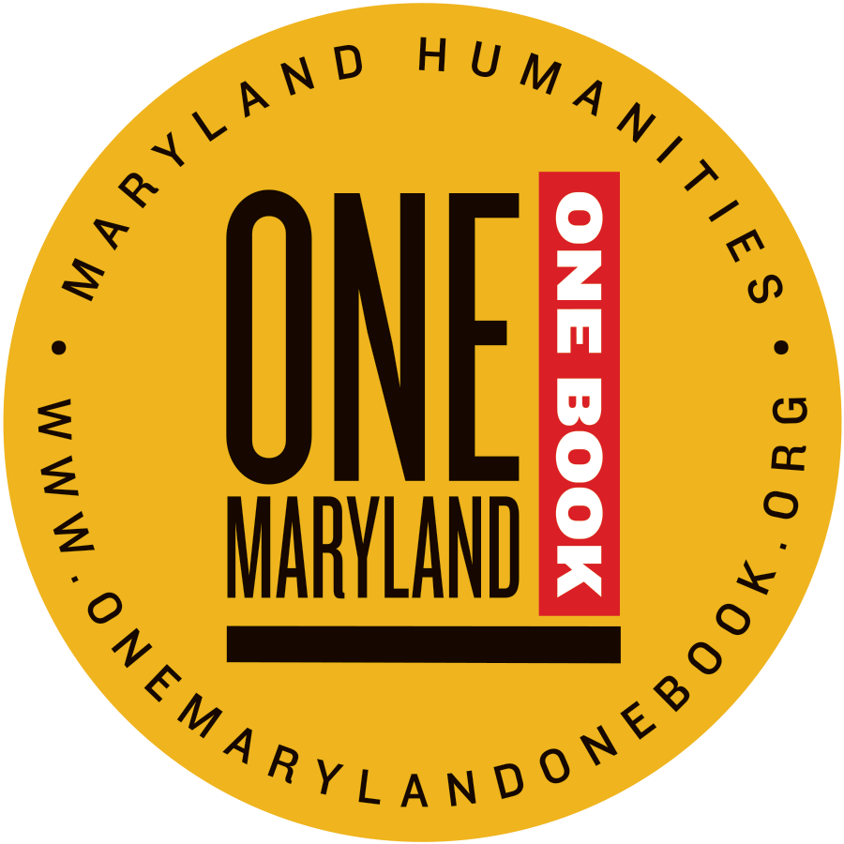
What We Are
Maryland Humanities
One Maryland One Book
Inspire learning and promote dialogue about our heritage, culture, and future as Marylanders through:
Maryland History Day
Regional Humanities Networks
Museums on Main Street
SHINE Grants Program
Bring together diverse people in communities across the state through book-centered discussions and programs at:
Public libraries
High schools
Colleges
Museums
and other community organizations around the state.

Slide 5
What is One Maryland One Book
Launched in 2008.
Brings together communities across the state through the shared experience of reading the same book by offering free copies and producing public programs.
Chosen by 1) a public call for titles, 2) a longlist culled by staff, and 3) three-rounds of review and vote by a selection committee of literature workers across the state.
Supports programs through development of reading guides, toolkits, promotional material, and capacity-buidling workshops.
Produces a statewide Author Tour in regions across the state.

Slide 6
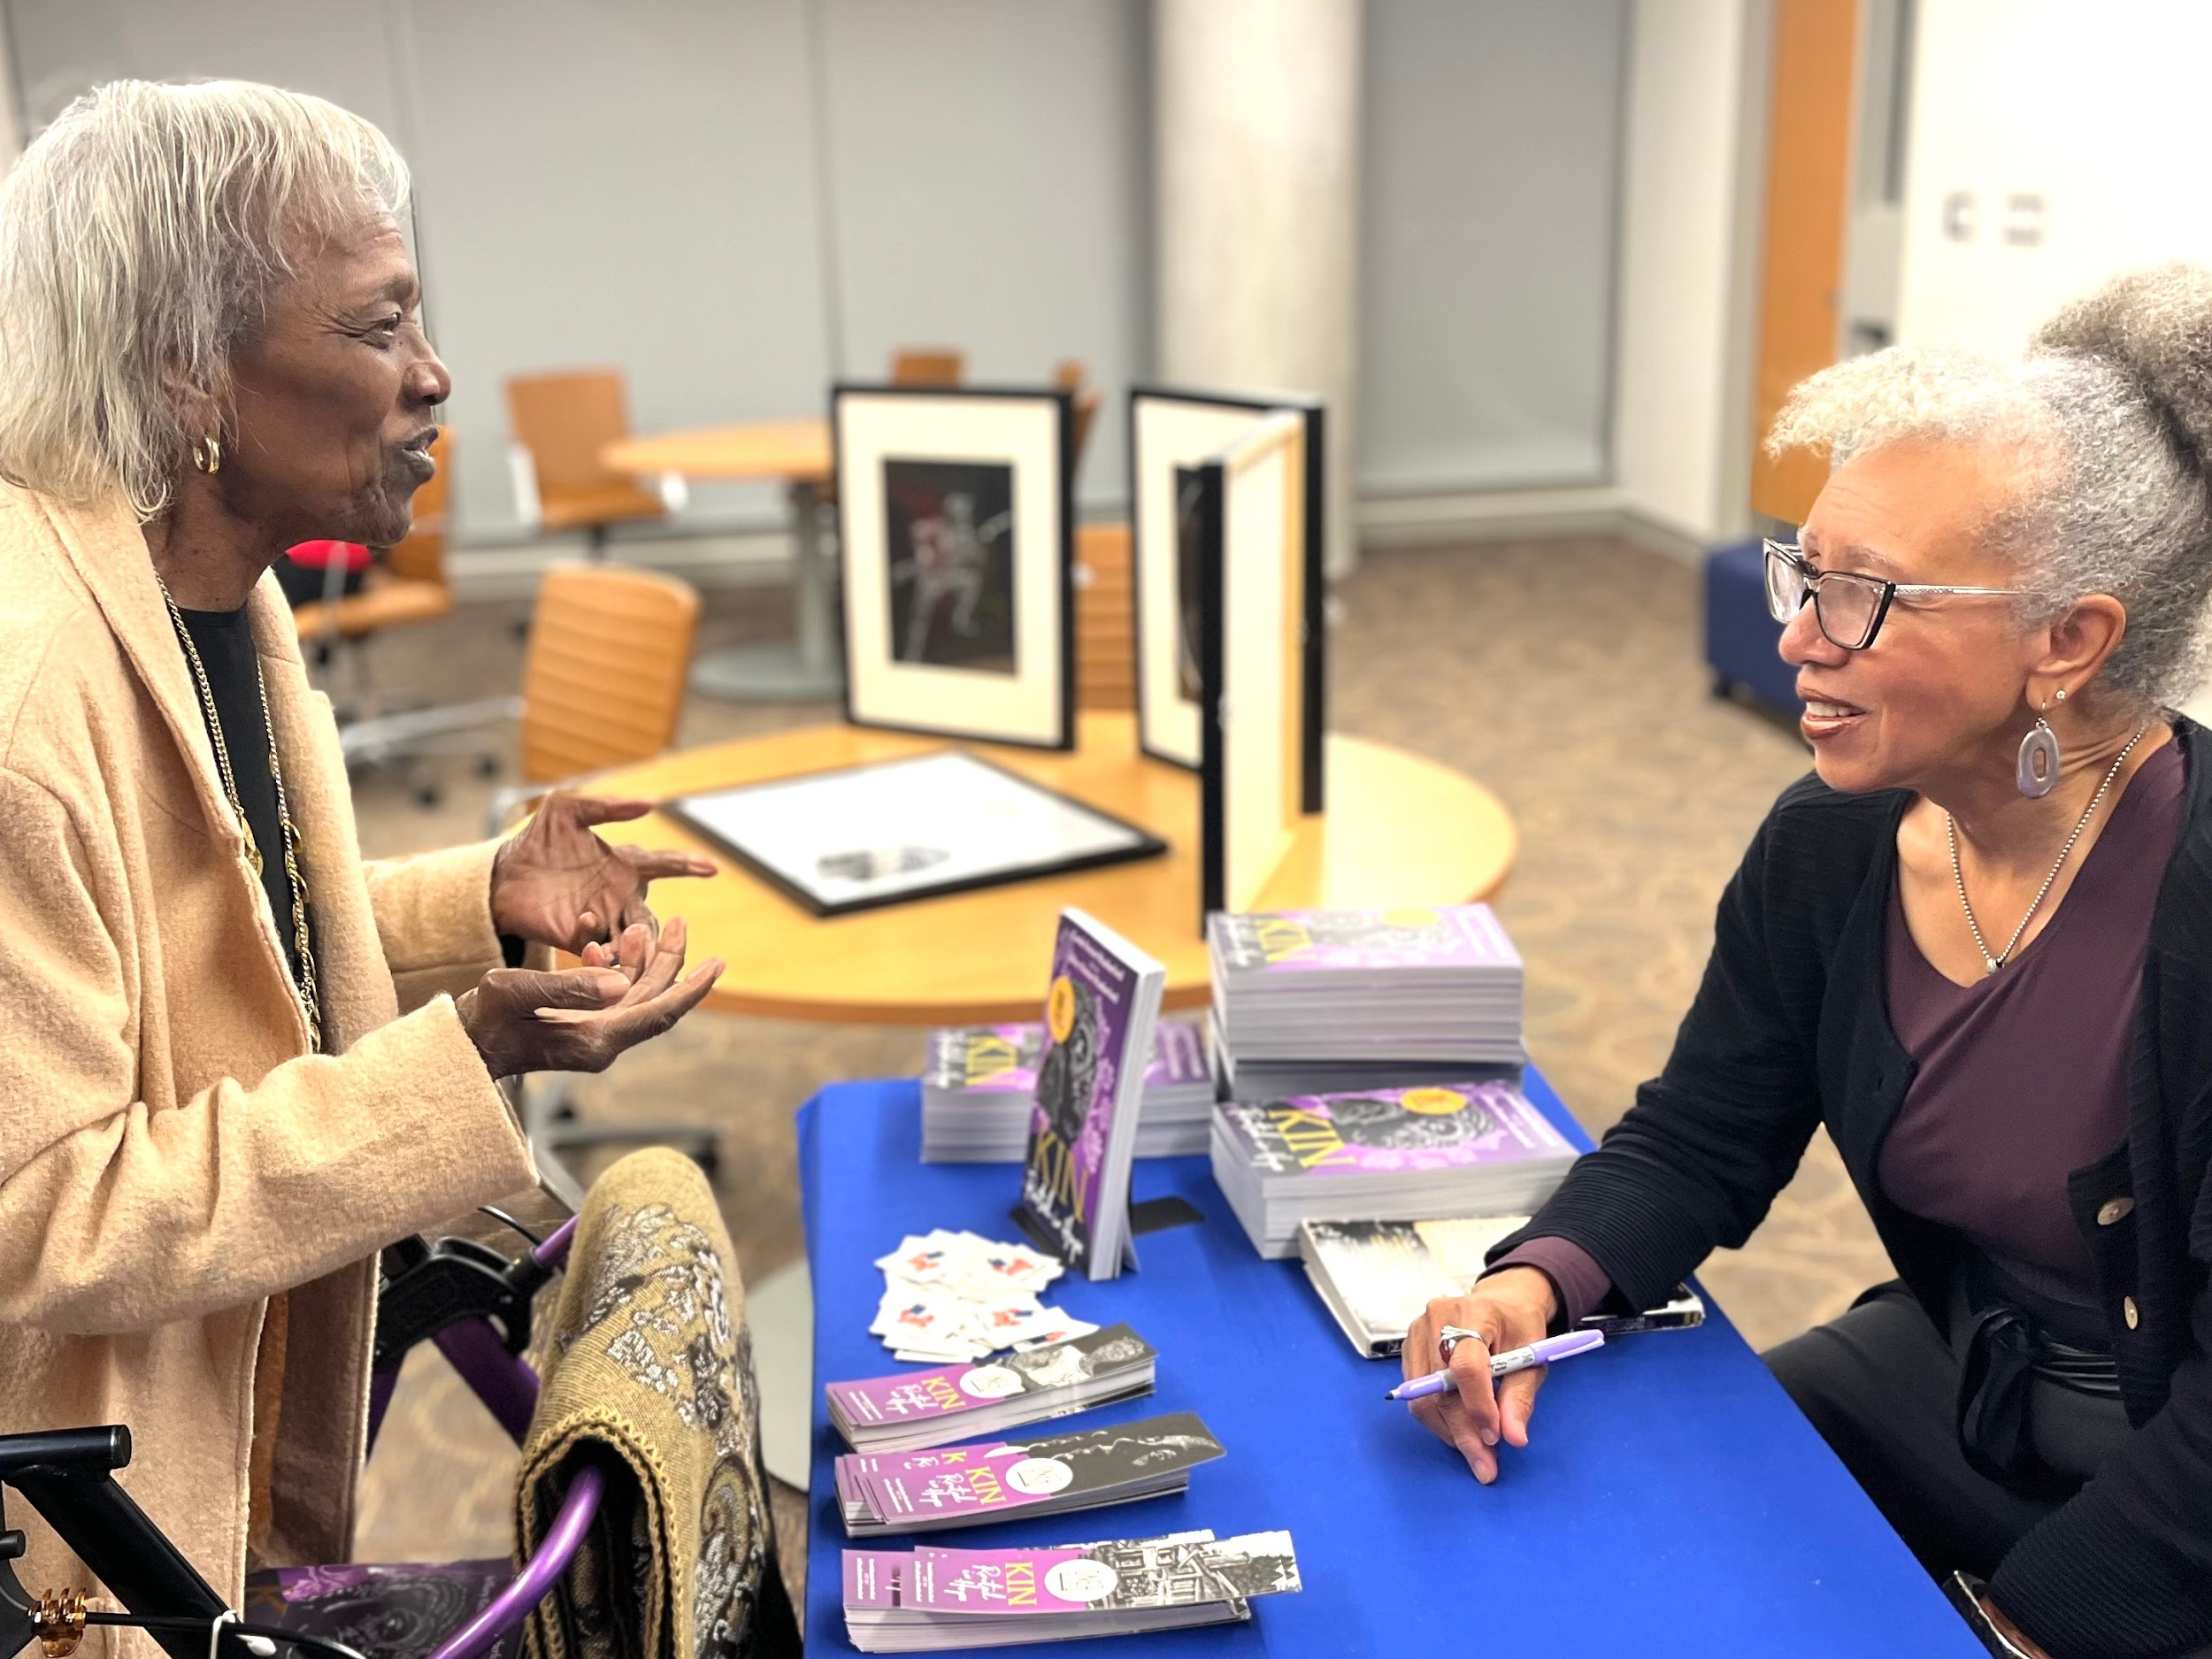
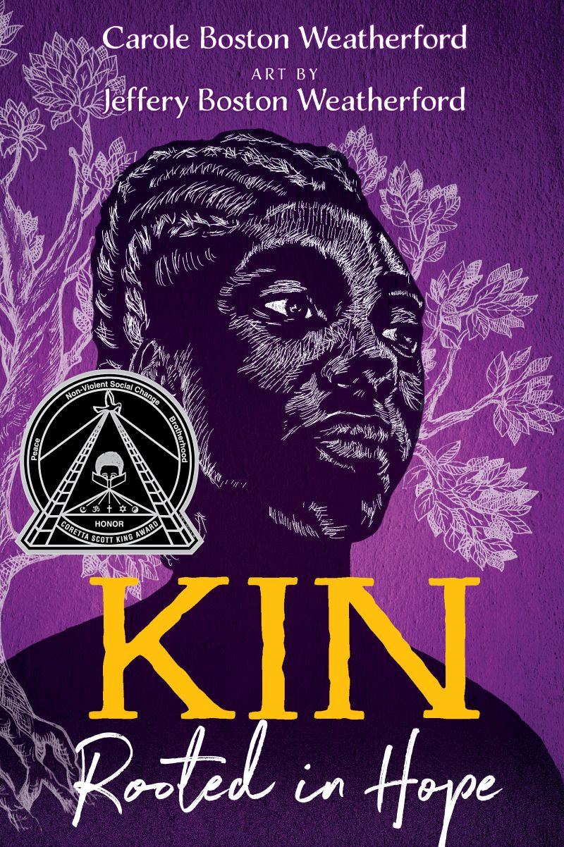
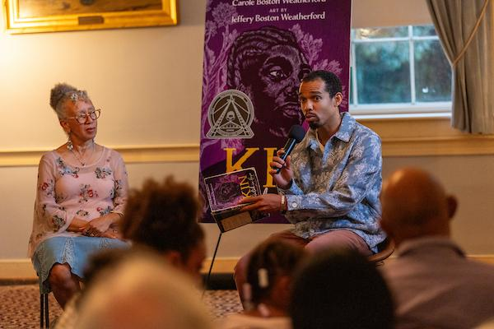
OMOB 2025
Theme: “What We Collect, What We Tell”
Book: Kin: Rooted in Hope by Carole Boston Weatherford with art by Jeffery Boston Weatherford
Key Topics: African American History, slavery, Civil War & Reconstruction, genealogy, place-based heritage, art-making, archival work, storytelling

Slide 7
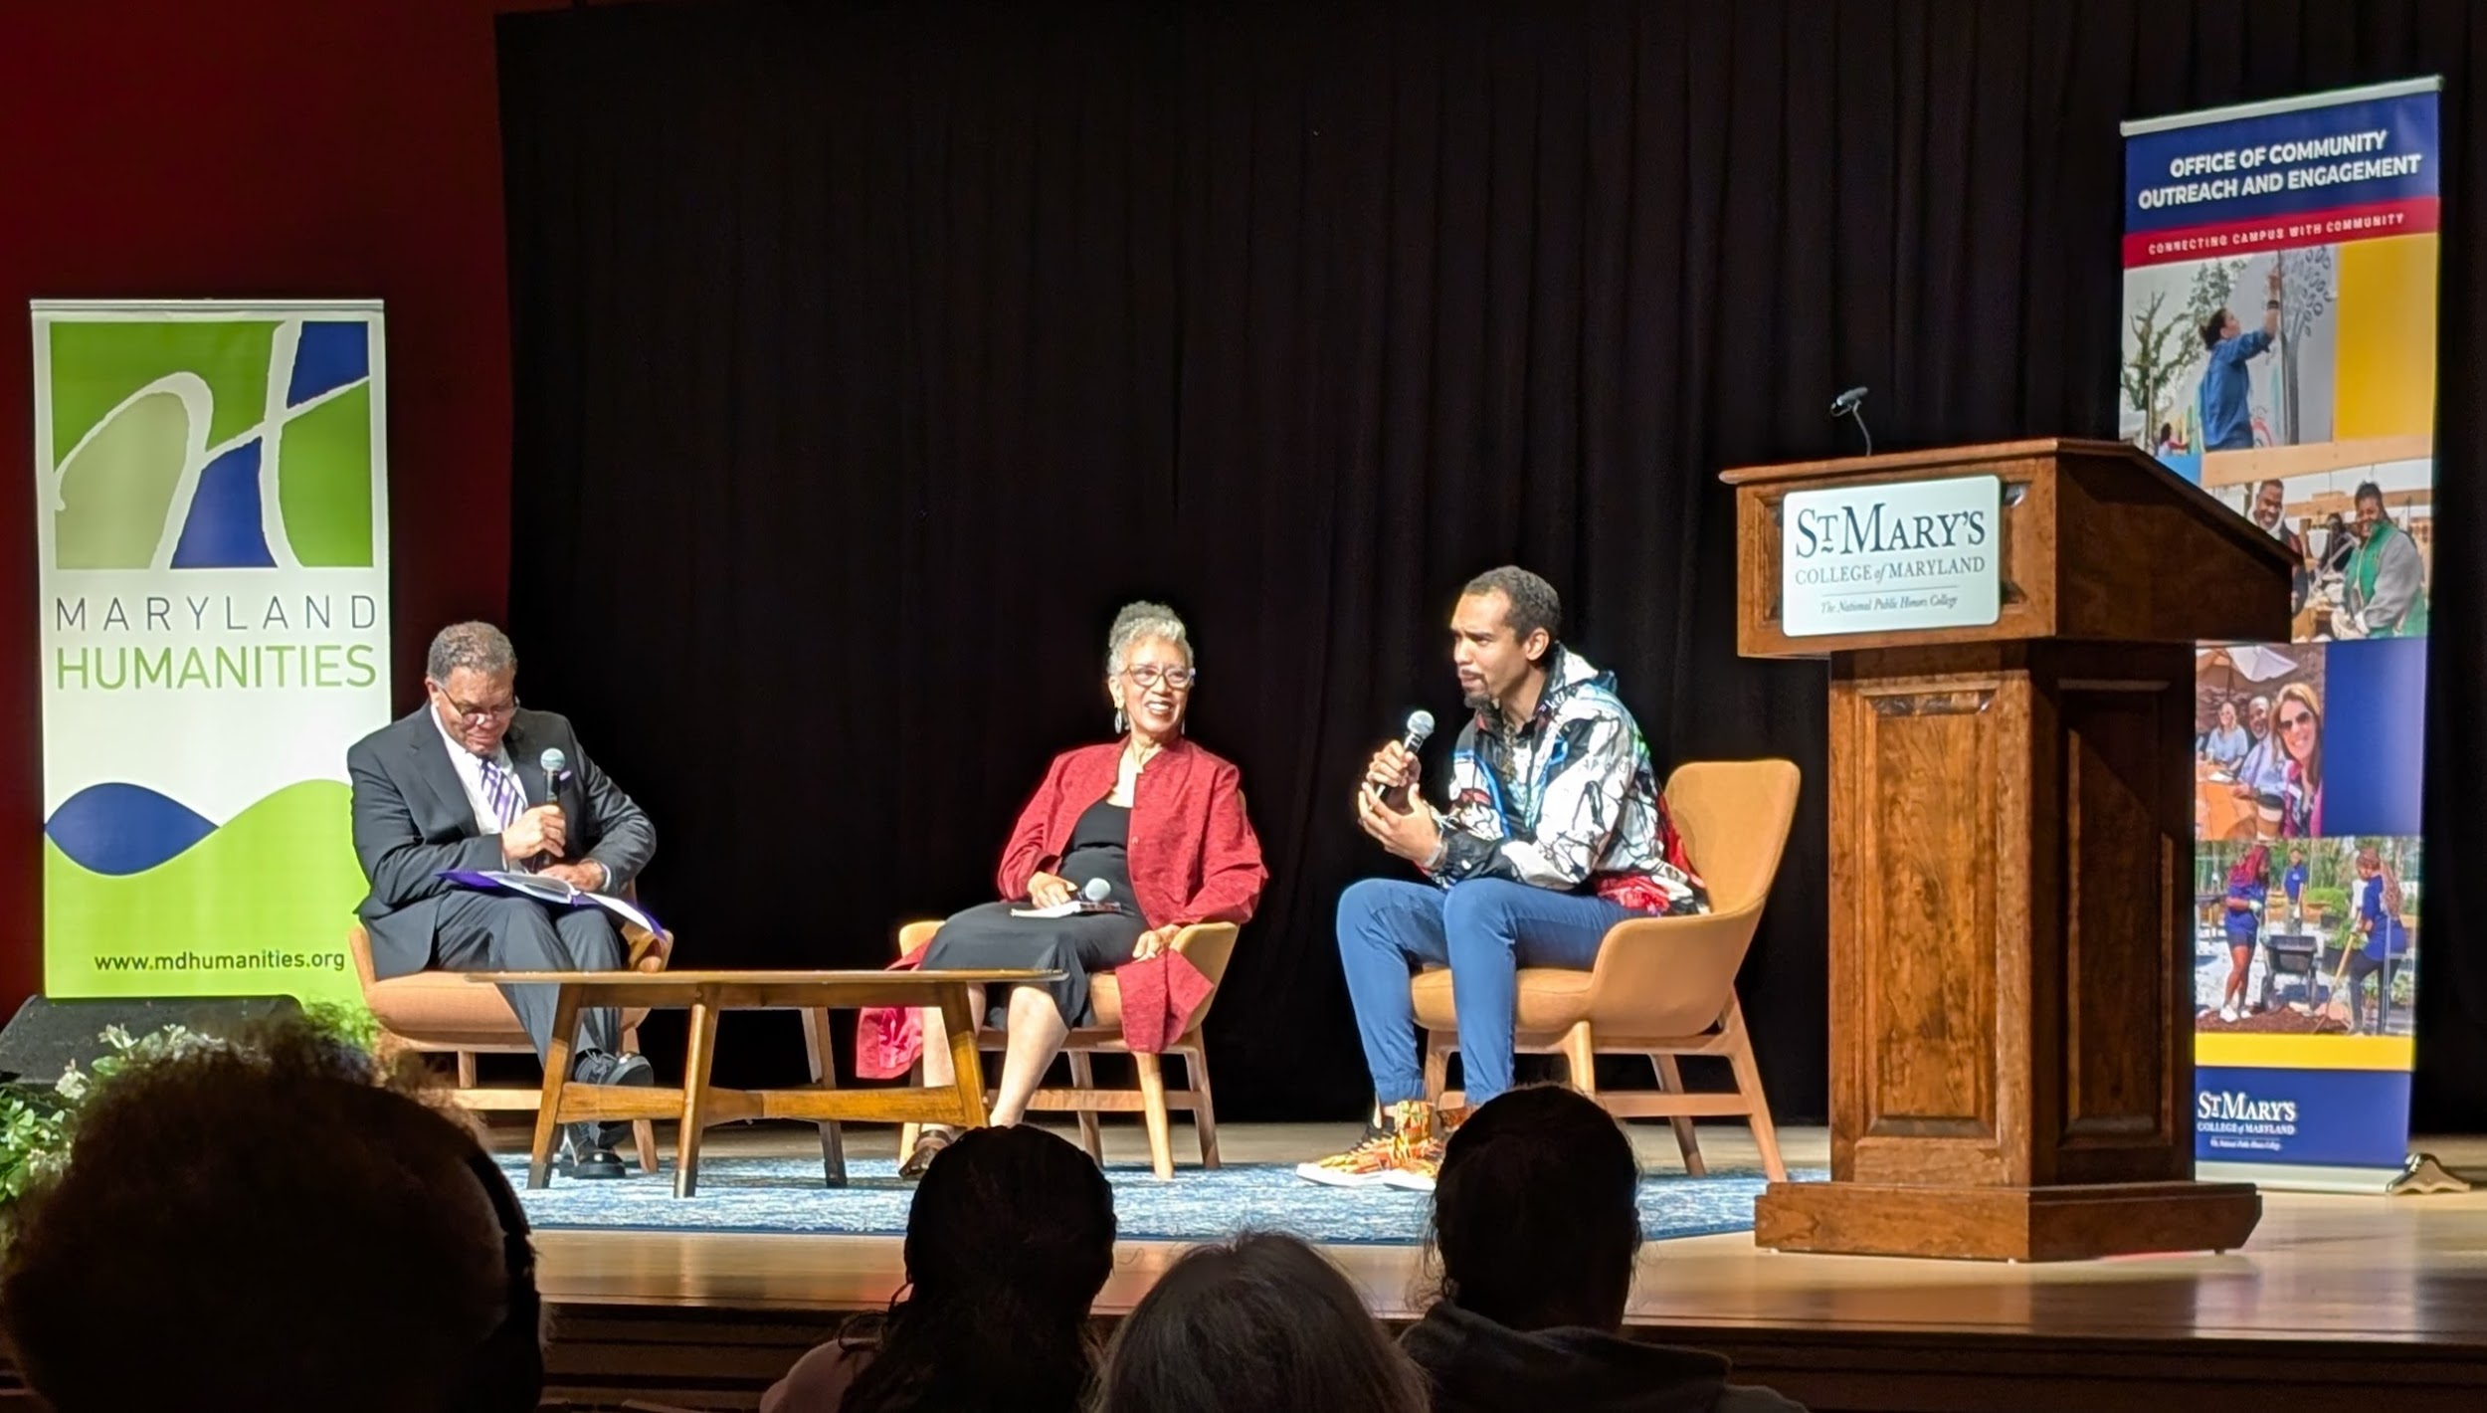
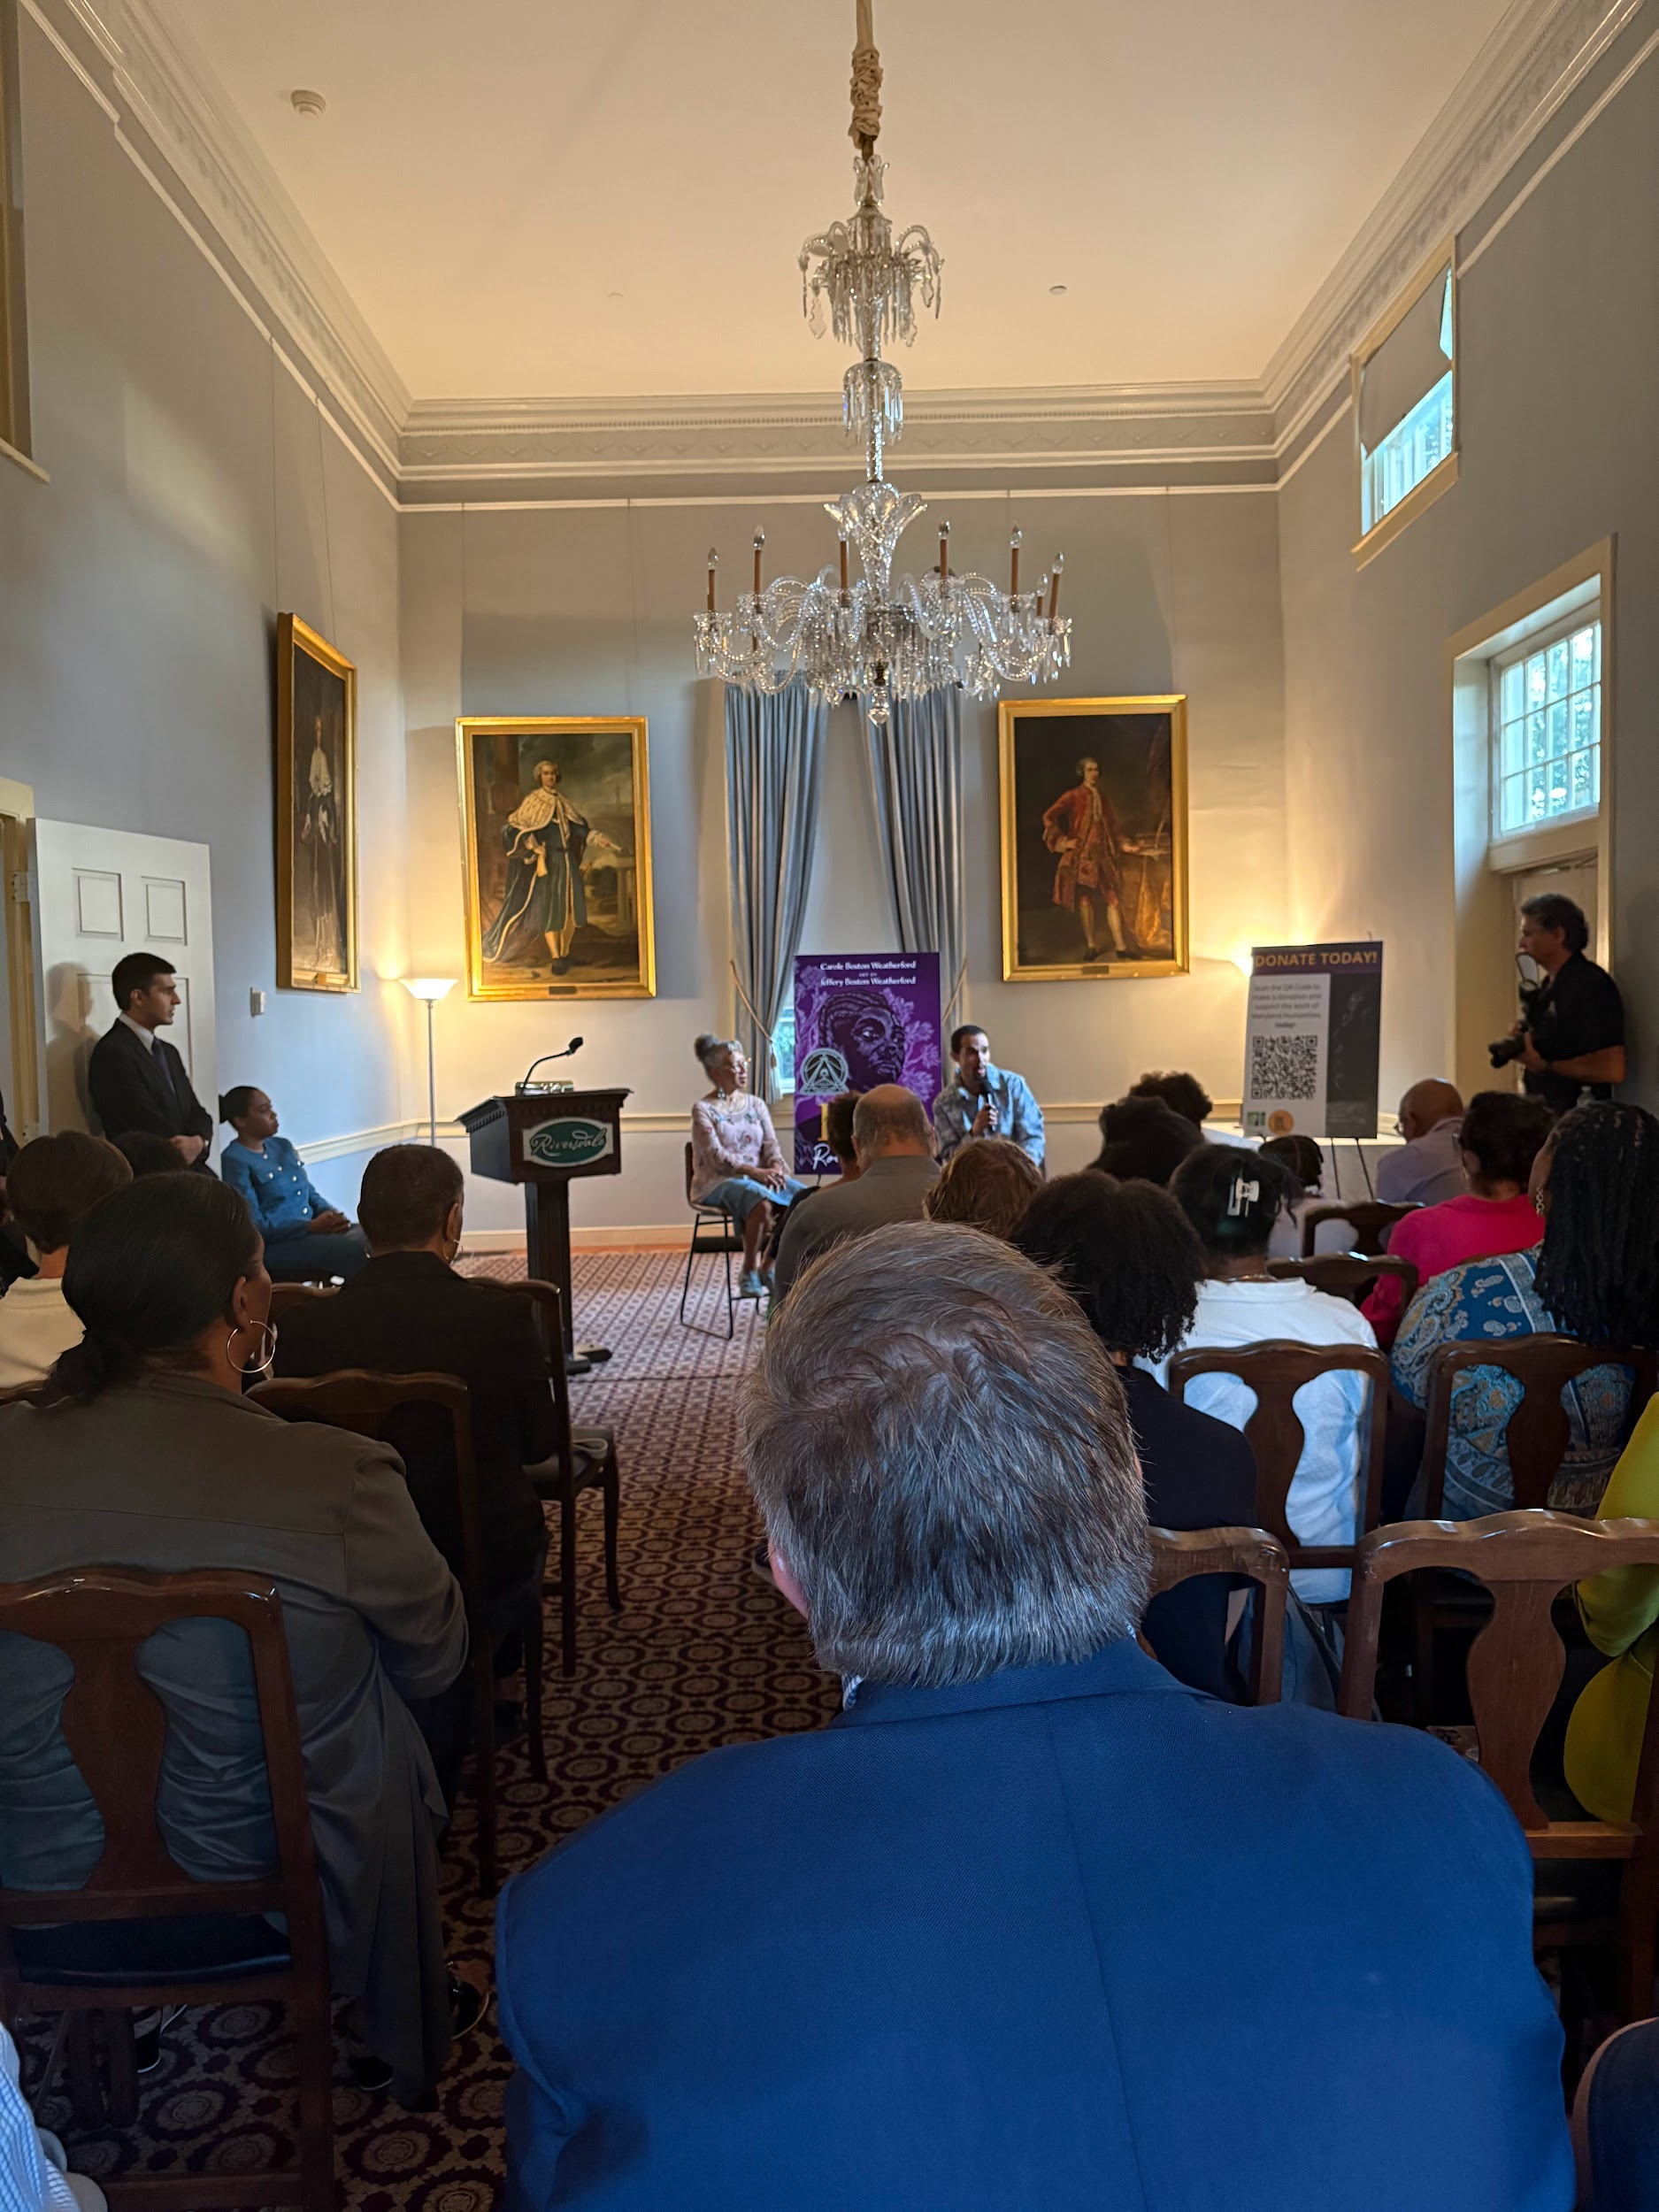
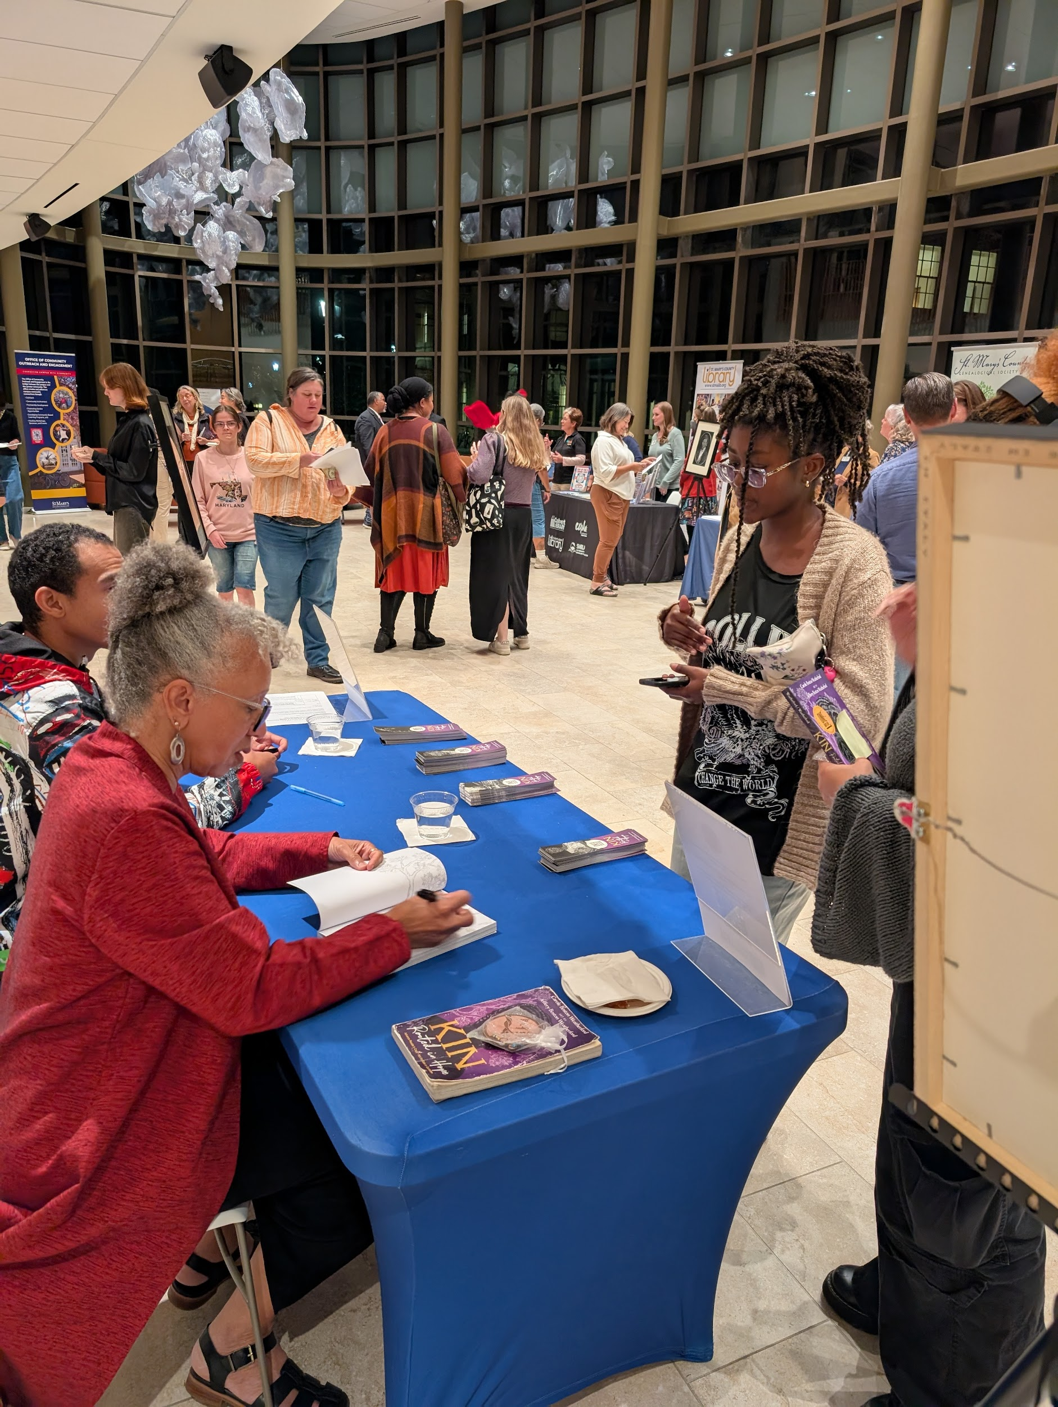
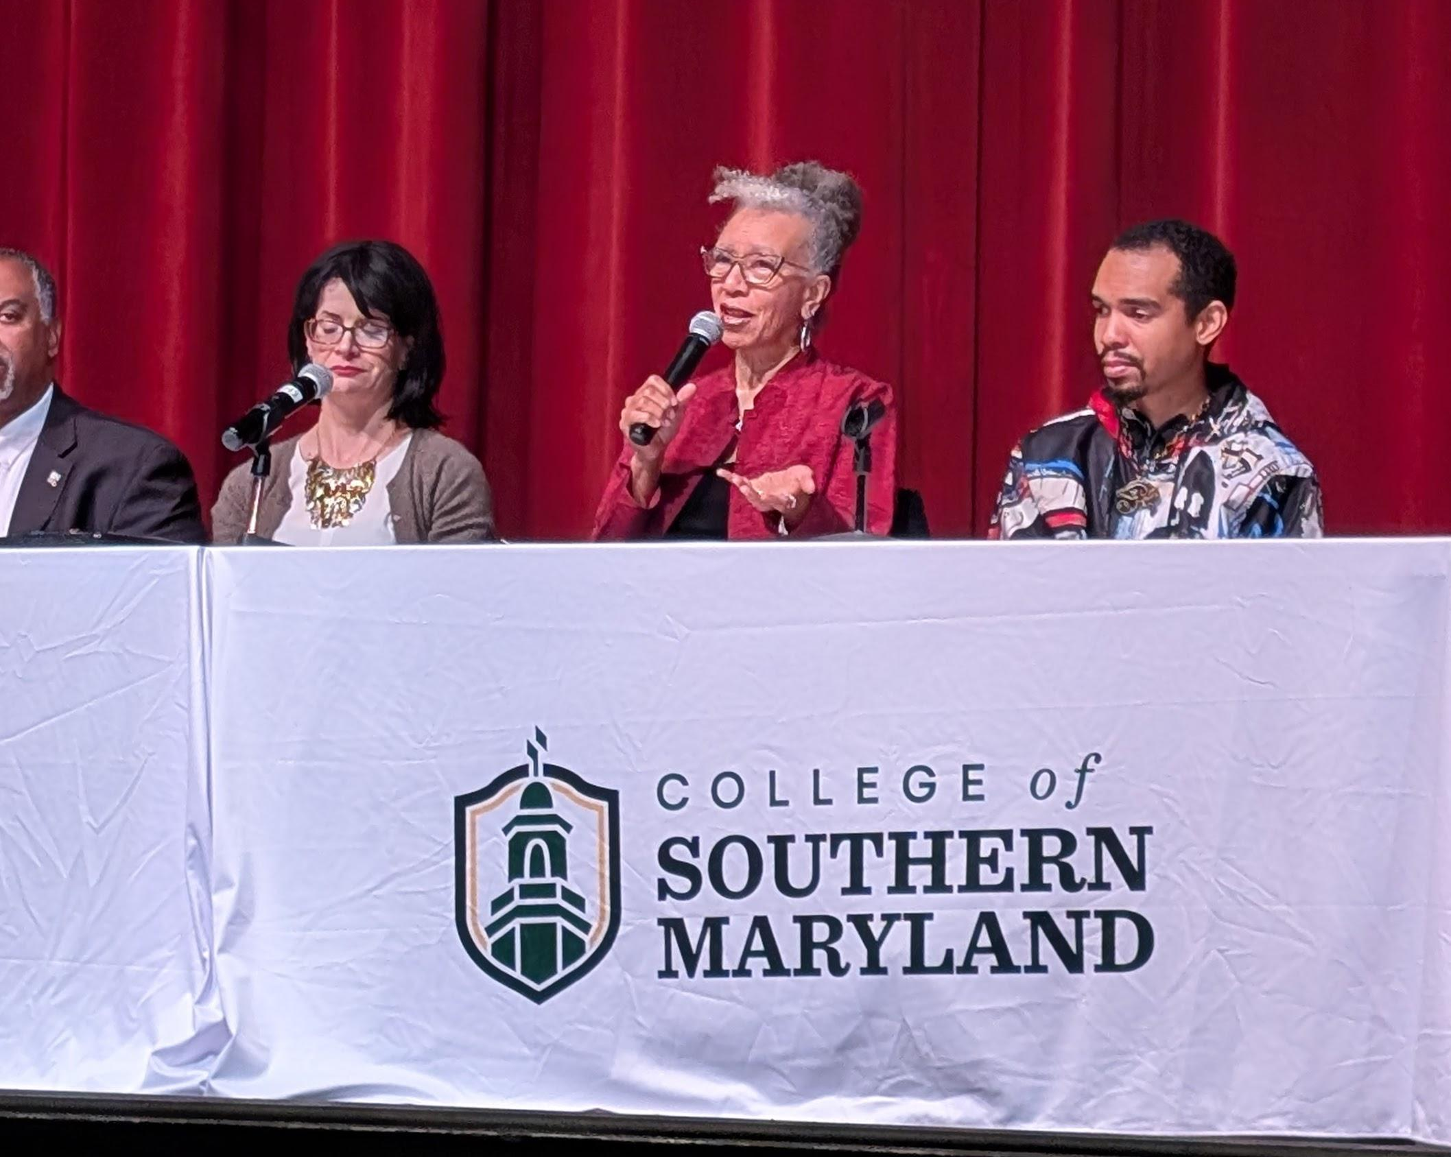

Slide 8
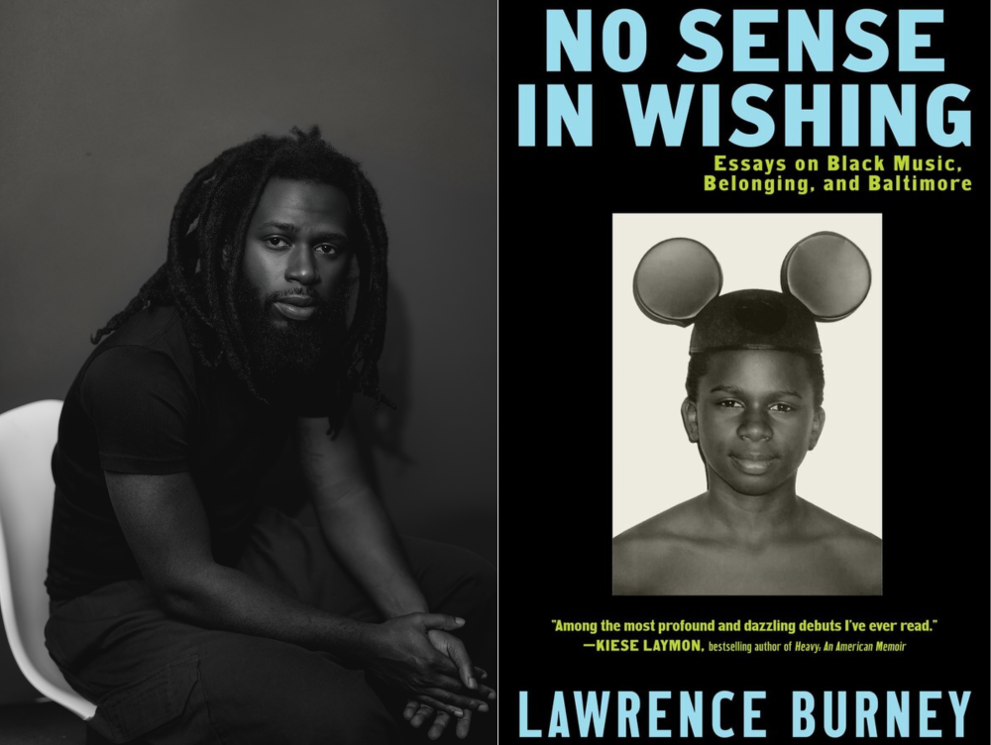
N
The 2026
One Maryland One Book Selection

Slide 9
“At its core, No Sense In Wishing's mission is to advocate spending ample time with what most captures your affection and curiosity…
This book tracks key moments in my life when I was transformed, often accompanied by the music, literature, film, or history that led me down that path. I'd like it to help folks connect the dots between the sociopolitical factors of their hometowns — or any town—and how music from that place's most oppressed communities emerged.”
Lawrence Burney

Slide 10
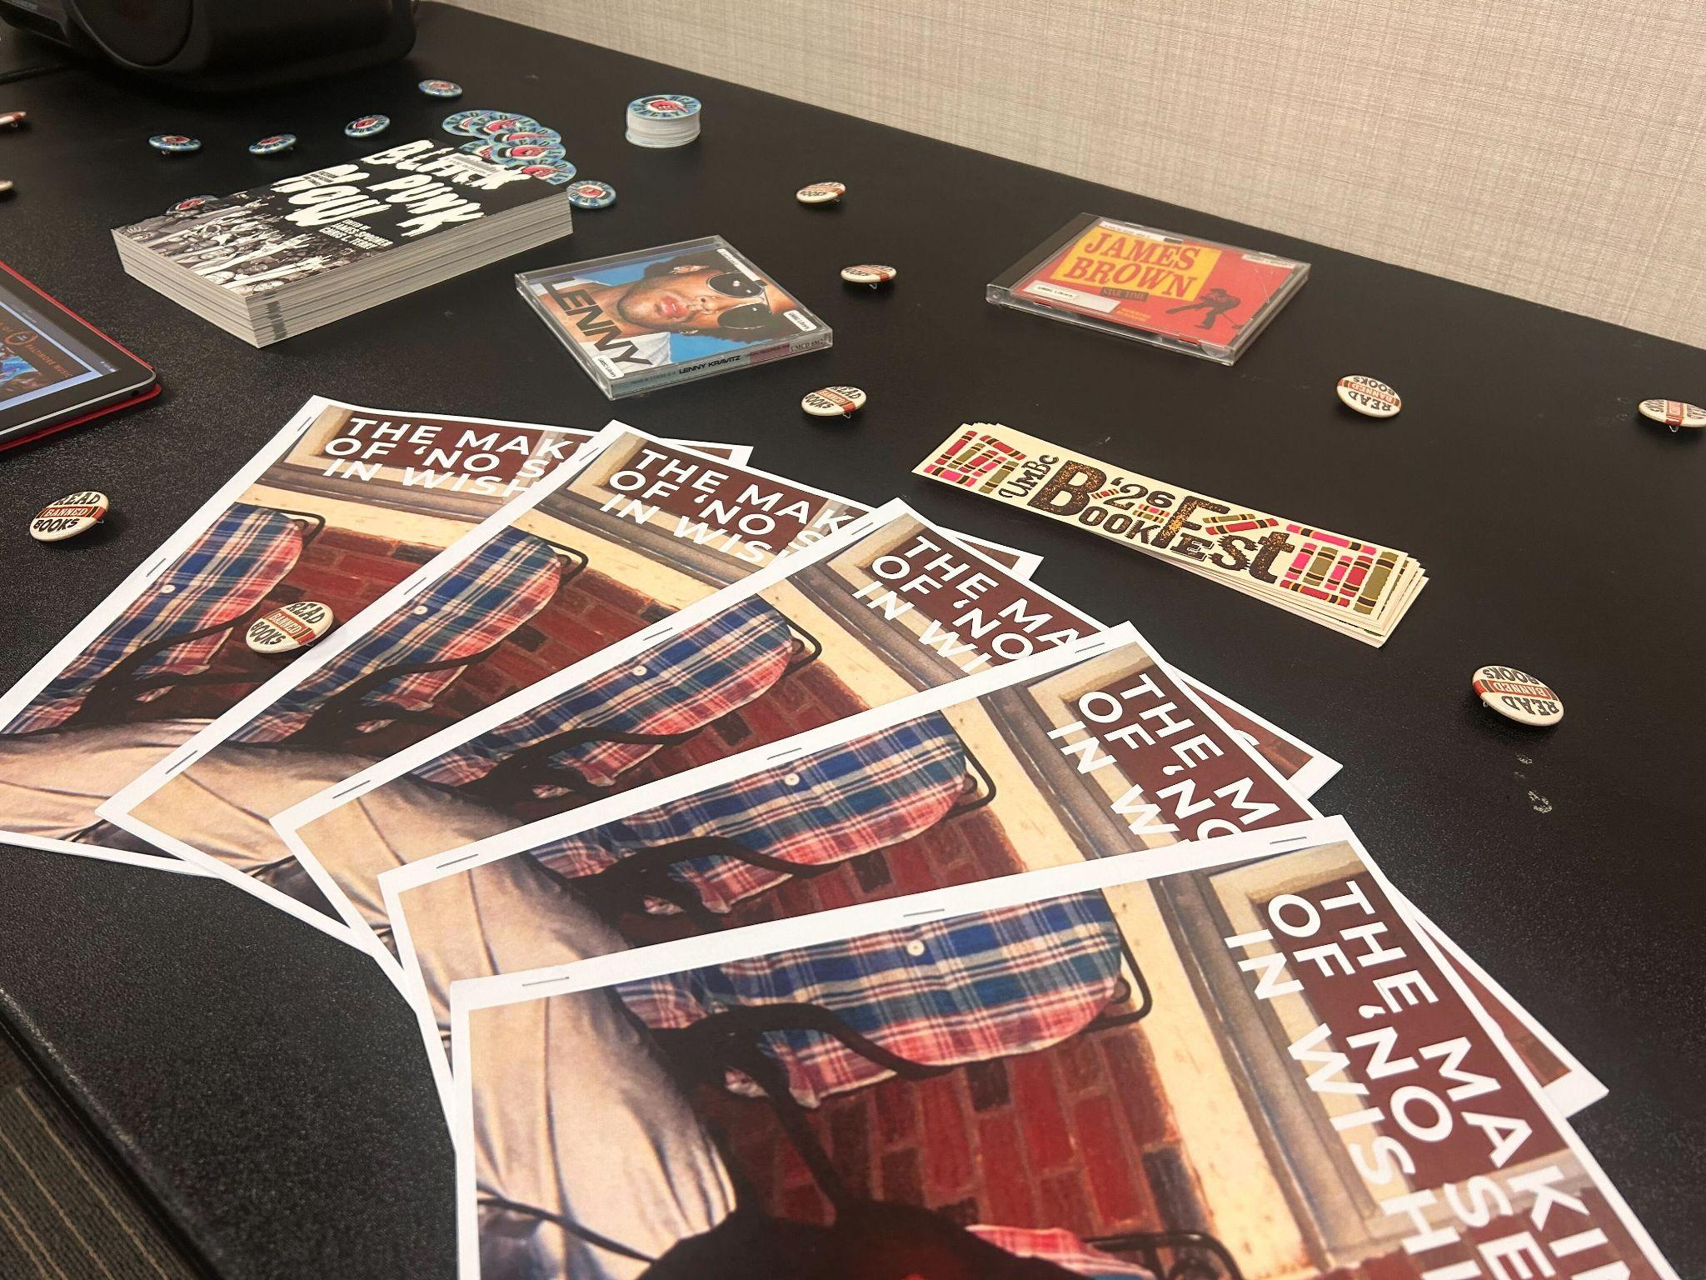
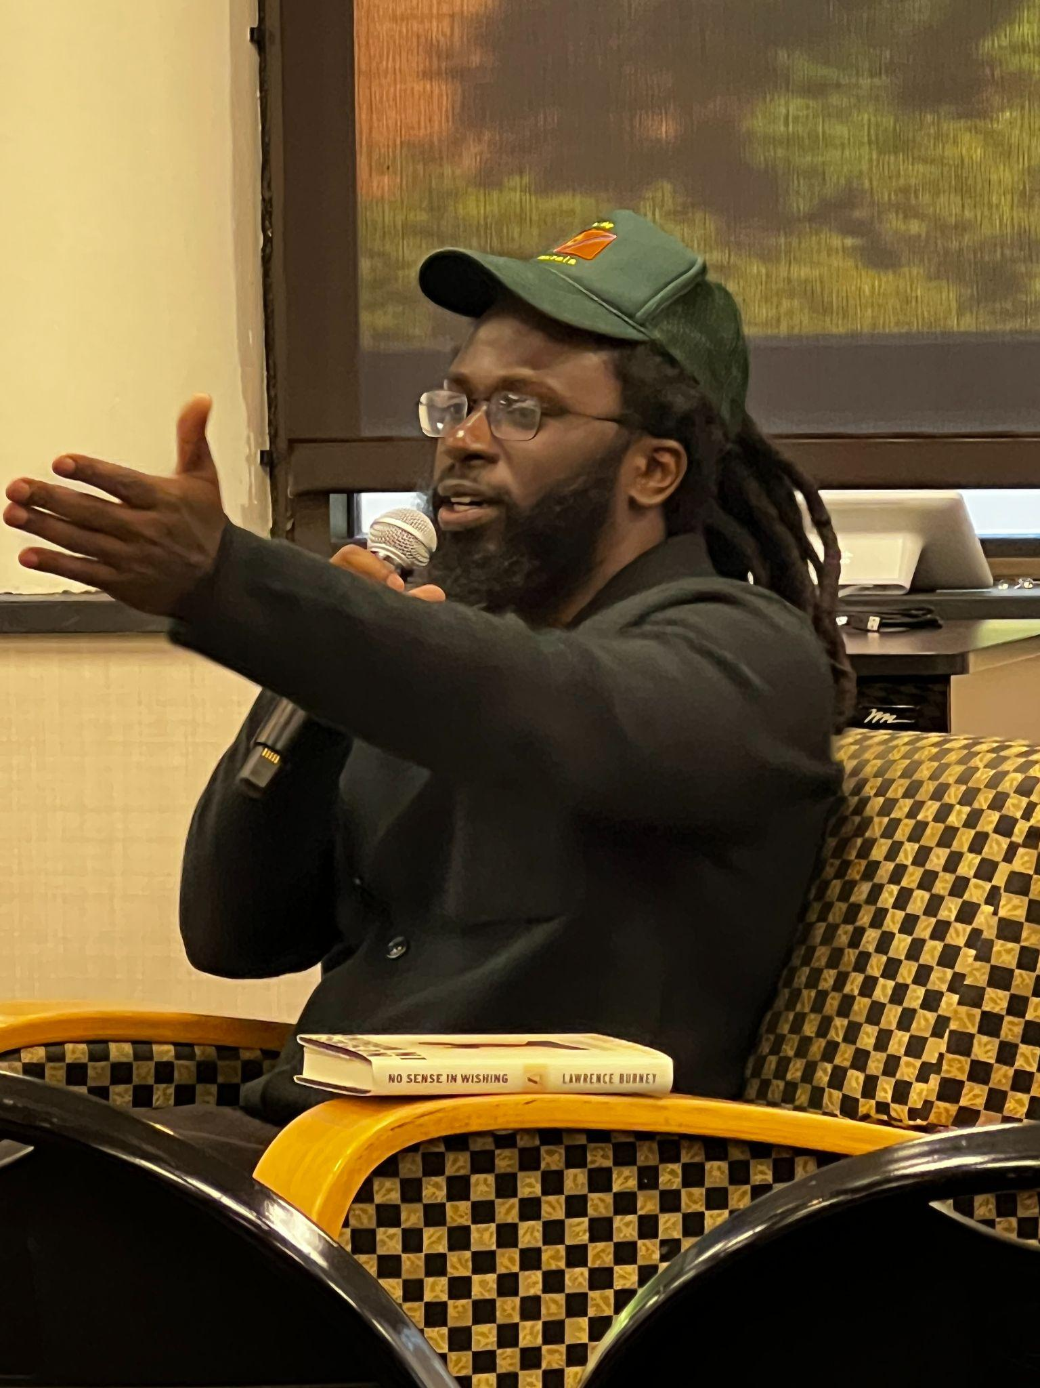
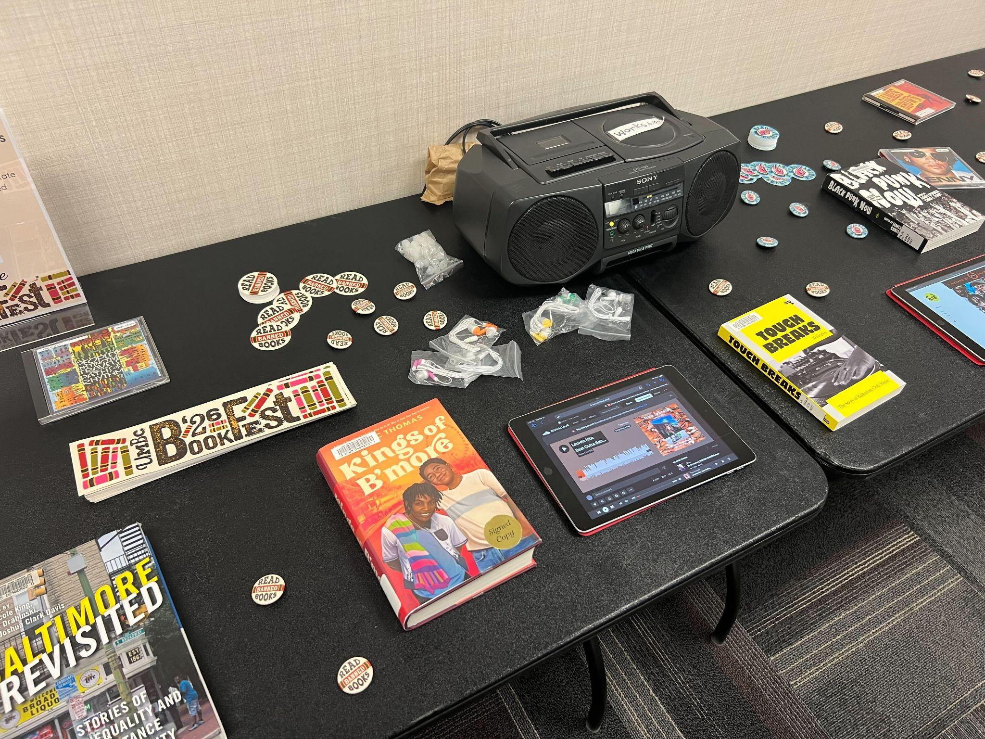
OMOB 2026
Theme: “Revolution, Reaction, Reform”
Key Topics:
Music criticism
Antebellum society in the dmv/chesapeake region
cultural products acting as tools of transformation
history of Black Baltimore music, specifically from the 80s-present
creative nonfiction as craft

Slide 11
How you can partner with One Maryland One Book:
Recieve FREE Books:
Sign up on MH Website
Books shipped over the summer
Bookmarks and posters also provided
Distribute to your patrons and communities
Host and/or Partner on a Local Program
While supplies last!
2. Host a Local Program:
Book Discussions
Writing Workshops
Guest Speakers or Panels
Performances or Visual Art Exhibitions
Film Screenings
Historical or Heritage Tours
Collaborative creative
Productions - podcasts, zines, digital humanities projects
3. Join an Author Tour Event:
MH will produce Author Tour events throughout the state.
Including one live virtual discussion with the Author.
Author will appear at local book festivals.

Slide 12
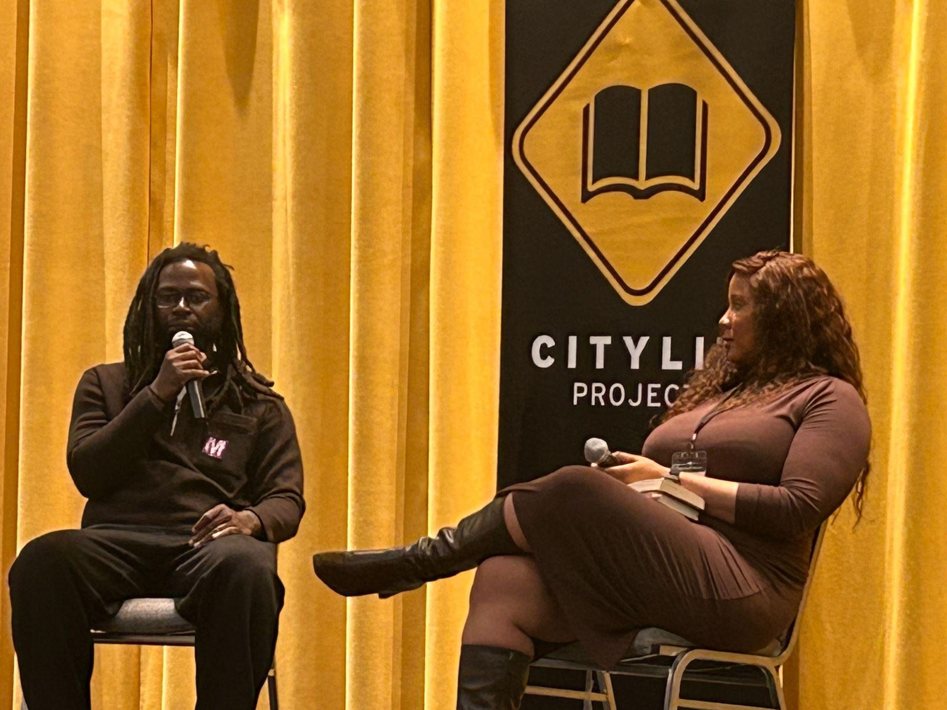
How do I Partner on an Author Tour Event?
Previous Format:
  One Week in September or October
  5-6 Book discussions between Author and Moderator
  Locations Across the State
New Format:
  Expanded Calendar
  Bringing Author to Festivals
  Regional Partnerships
  Going “beyond the book”

Slide 13
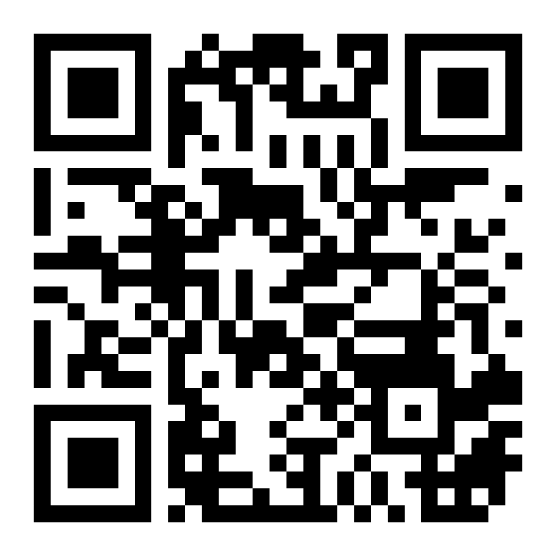
Discussion Time!
Join the Mentimeter!
Go to Menti.com and use the ID: 3696 3522
Or use the QR code on the right.

Slide 14
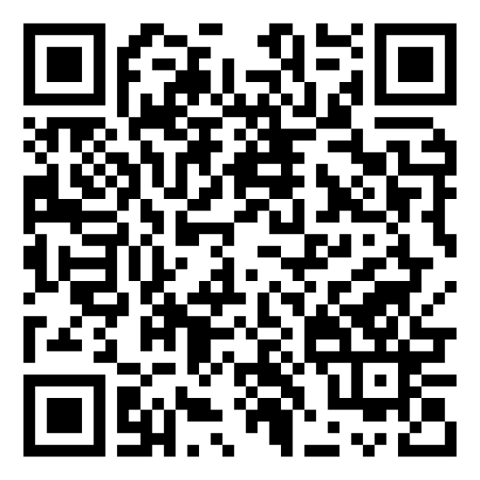
Thank you!
Aditya Desai
adesai@mdhumanities.org
Register for
Virtual Partner Sessions
(May-August)
Sign Up For our Newsletter!

Slide 15
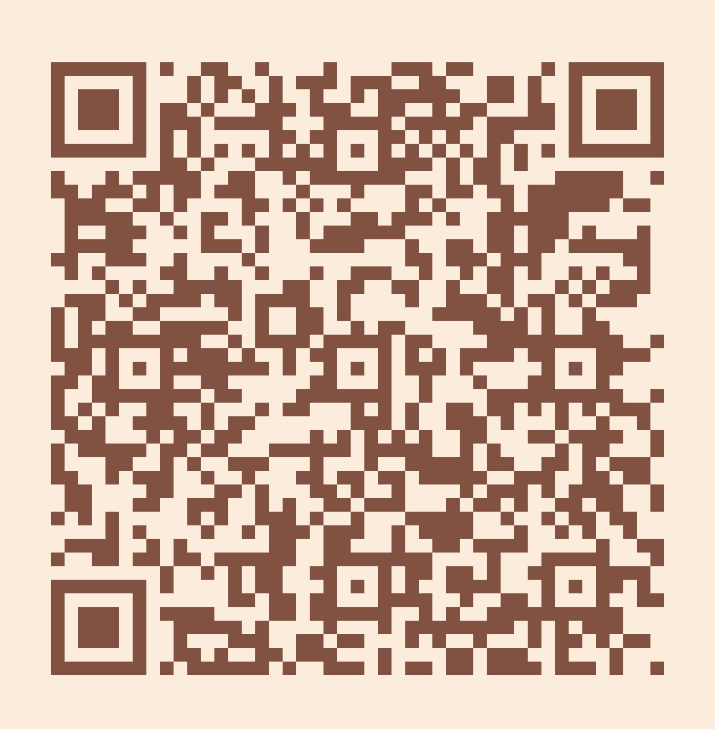
Please take a moment to complete the program survey.
SCAN ME!

