Slide 2




Don’t Miss!
50/50 RAFFLE
Tickets are $1 each and can be purchased from Conni Strittmatter or David Dahl! The winner takes home half the pot.
SILENT AUCTION
Visit the Silent Auction in the exhibitor hall to place your bids before 10 a.m. on Friday, May 8.
PUB QUIZ
Thursday, May 7 8:00 – 10:00 p.m. Choptank Ballroom
KARAOKE
Thursday, May 7 6:00 – 10:00 p.m. Windjammer

Slide 3







My first
Art
class
Library Art Programs for Toddlers & Preschoolers

Slide 4

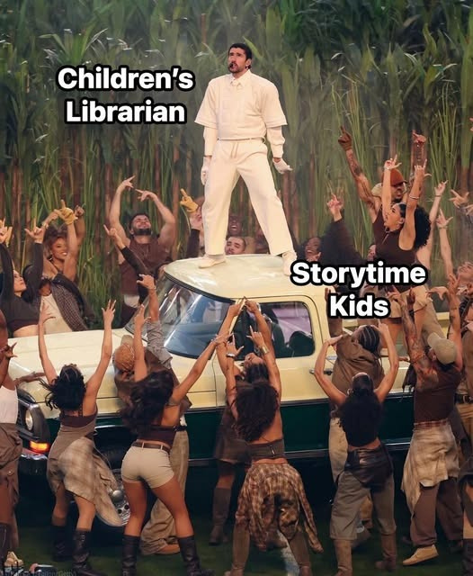


Slide 5
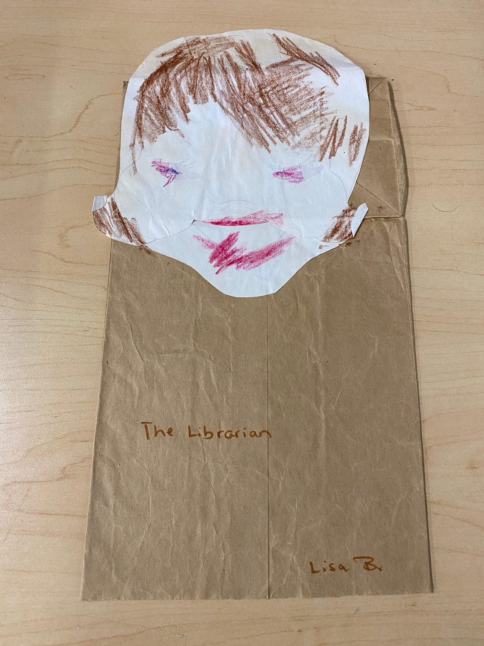

Slide 6




Overview
Benefits of Arts Programs for Young Children
My First Art Class: The Basics
Art Time!
Questions

Slide 7



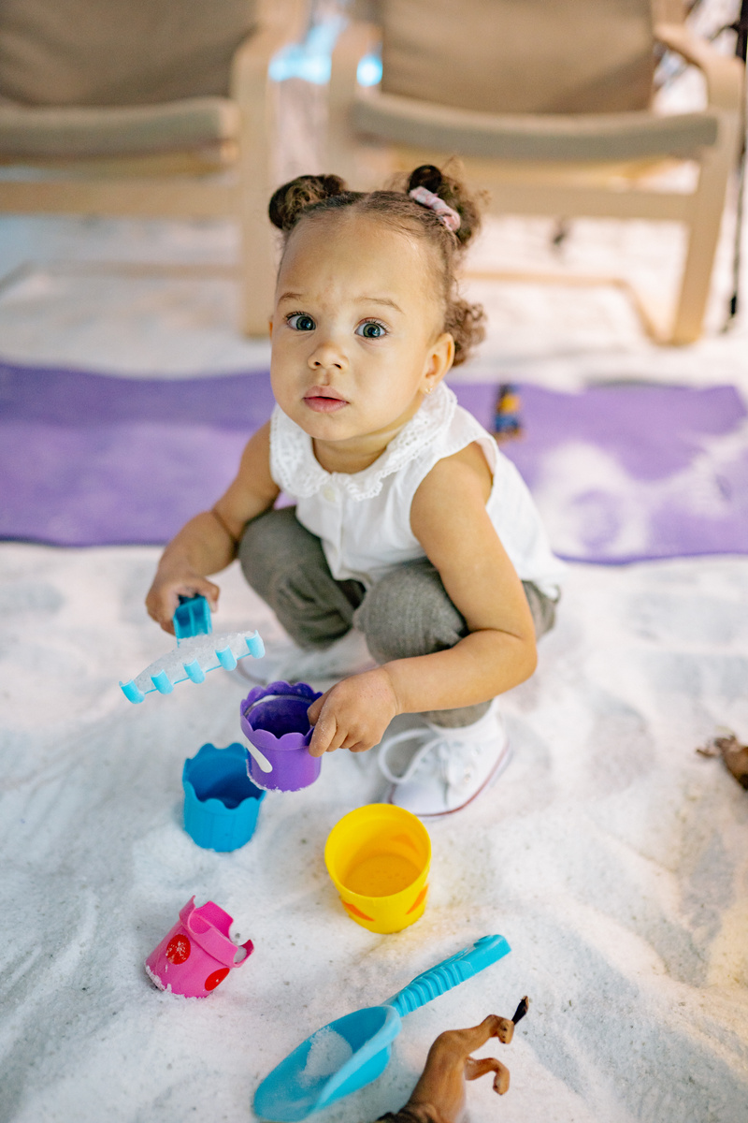
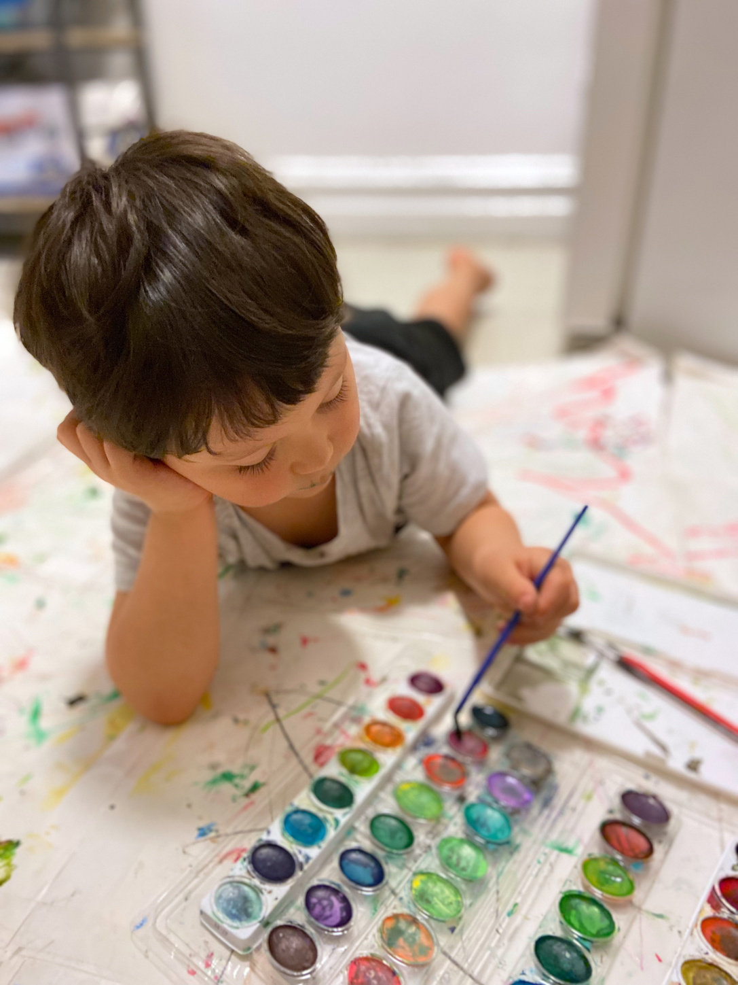

Why offer arts programs
for toddlers and preschoolers?

Slide 8

Why offer arts programs
for toddlers and preschoolers?

Slide 9
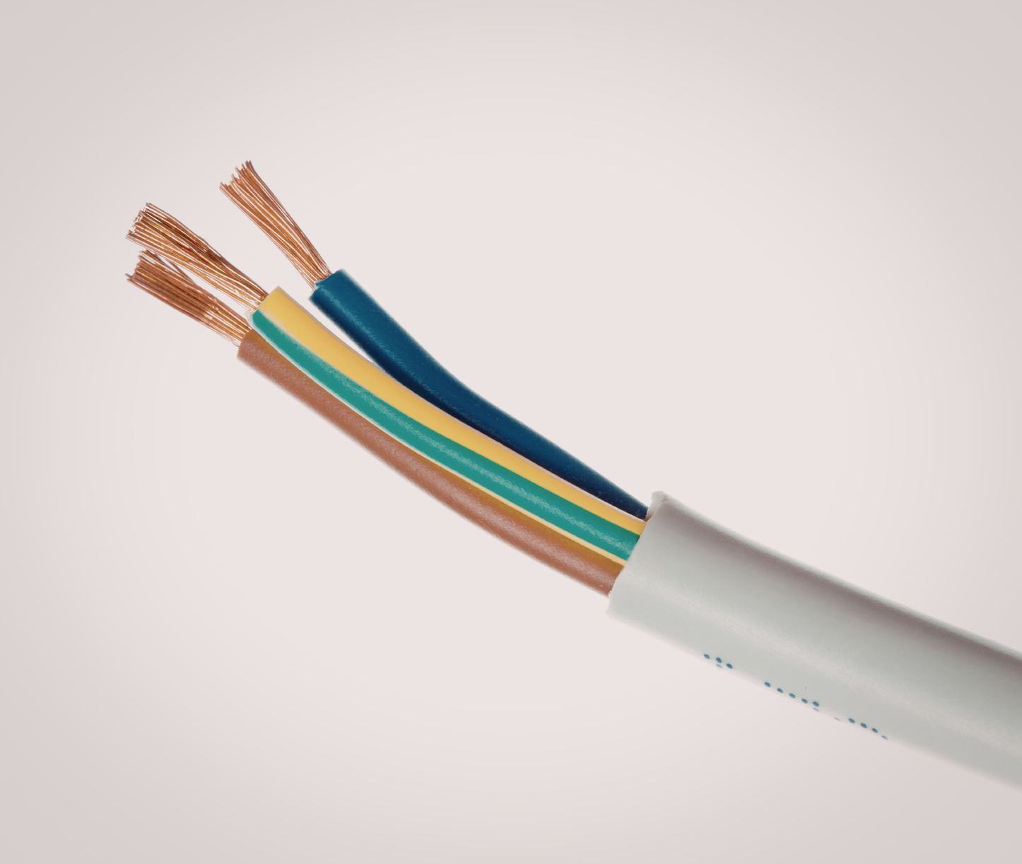
Myelination

Slide 10

Concepts
Colors
Shapes
Numbers
Textures
Patterns
Direction/Position

Slide 11
Skills
Counting
Grouping/Matching
Comparing/Contrasting
Ordering
Predicting

Slide 12
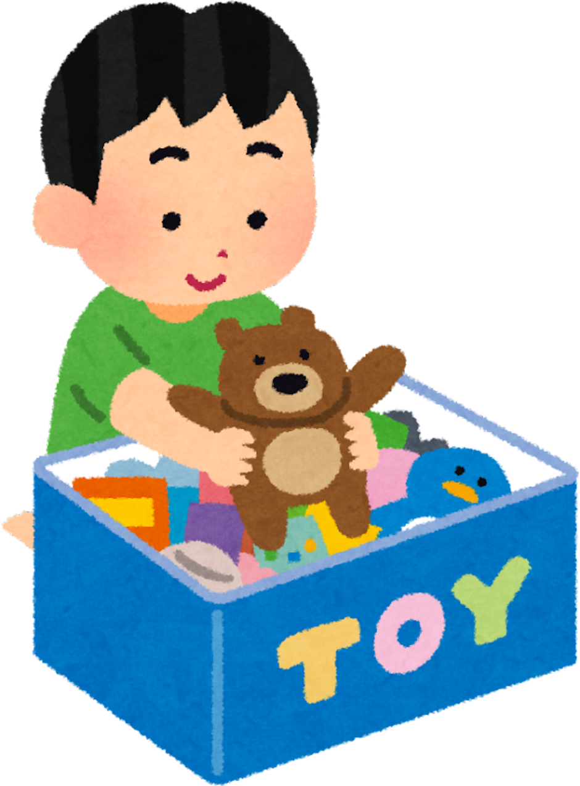
Spatial Skills
the ability to mentally manipulate information about objects in the environment and the spaces we inhabit

Slide 13
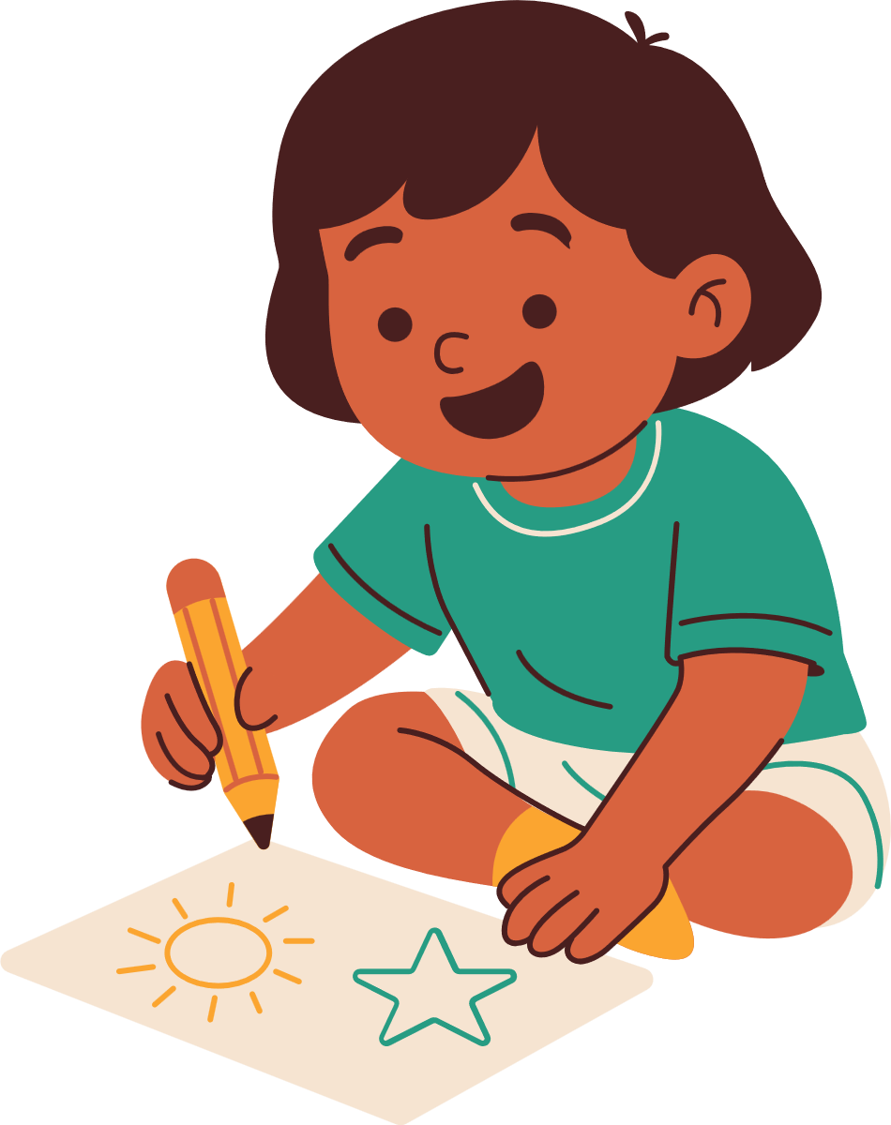
Early Literacy
Fine Motor Skills
Hand-Eye Coordination
Vocabulary
Oral Language
Narrative Structure
Background Knowledge

Slide 14

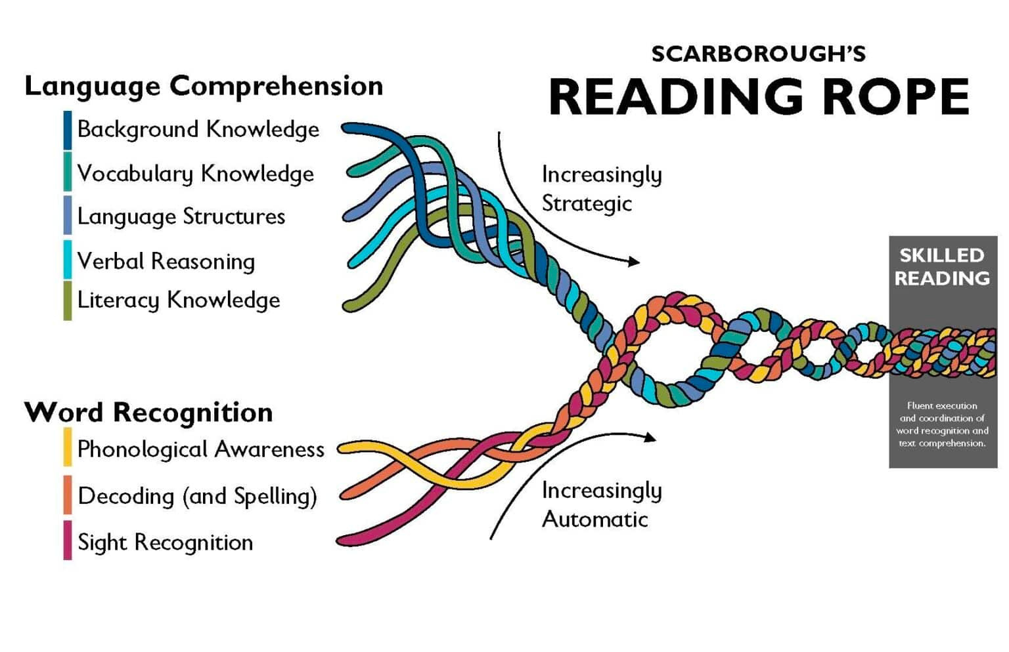
Science of Reading

Slide 15

Executive Function
Planning
Predicting
Sequencing
Decision-Making
Focusing

Slide 16

Social-Emotional Development
Building Self-Confidence
Managing Emotions
Sharing
Respecting Others’ Space
Cooperating
Communicating
Adapting
Decreasing Stress

Slide 17



THE BASICS
Developmental Level
Space
Time
Safety
Budget

Slide 18

Developmental Level: Toddler
Exploring with All of Their Senses
Still Developing Large Motor Skills
Short Attention Spans
Want to Repeat Actions
Establishing Autonomy

Slide 19
Developmental Level: Preschool
Slightly Longer Attention Span
Can Use More Fine Motor Skills
Want Independence and Control
More Deliberate and Goal-Oriented

Slide 20

Space
Shared or Dedicated?
Flooring & Furniture
Clean up
the space and the kids!
Access to other parts of the library
Outdoor spaces
Assume whatever materials you use will get everywhere!

Slide 21
Time
Prep
Set Up
Program
Clean Up
Everything will take longer than you think it will.

Slide 22
Safety
Toxic Materials
Food Allergies
Power Tools & Heat Sources
Sharp Objects
Choking Hazards
If it can be used to poke or cut something that you don’t want it to, it will.

Slide 23
Budget
Recyclables
Dollar Store / Thrift Stores
Creative Reuse Centers
Fabric / Furniture / Flooring Stores
You can do a lot with cardboard tubes, thin cardboard boxes, and paper shopping bags.

Slide 24


Art vs. Craft
Process vs. Product
Objectives & Experience
(or why anarchy is always an option!)

Slide 25
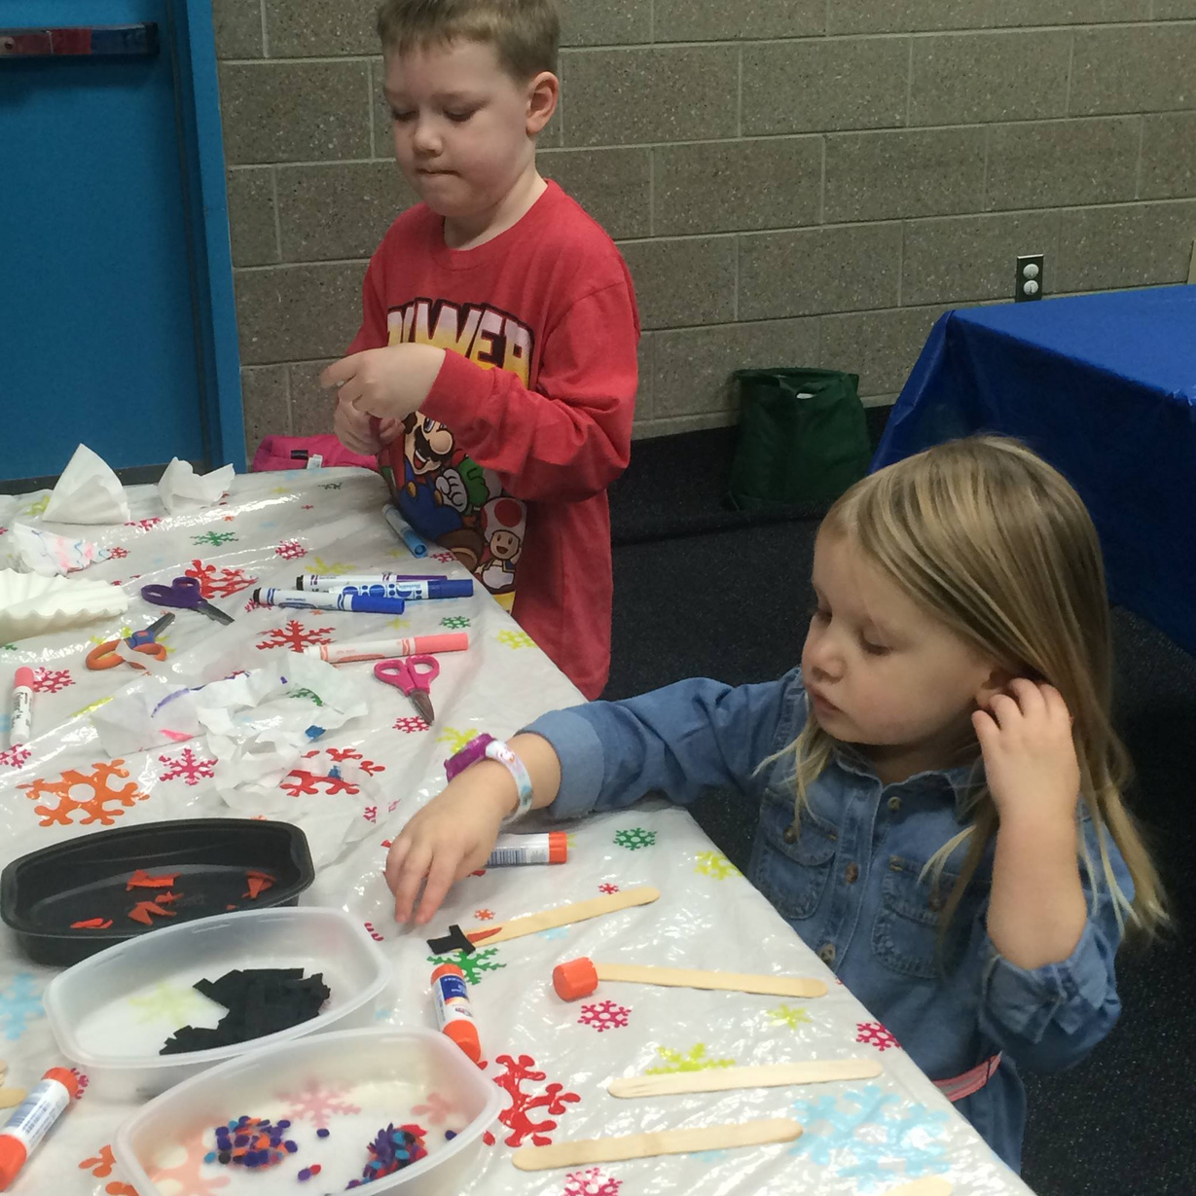

Slide 26

Play Preferences
Conceptual
Procedural
Creative
Social

Slide 27
Where to Get Ideas
Notion webpage for this presentation
Facebook: Storytime Solidarity, Programming Librarian Interest Group
Reverse engineering craft kits
Etsy (for design-your-own templates)

Slide 28
Other Concerns
“Ethnic” Art
Sustainability

Slide 29




Break
Time

Slide 30





it’s time to
PRACTICE!

Slide 31
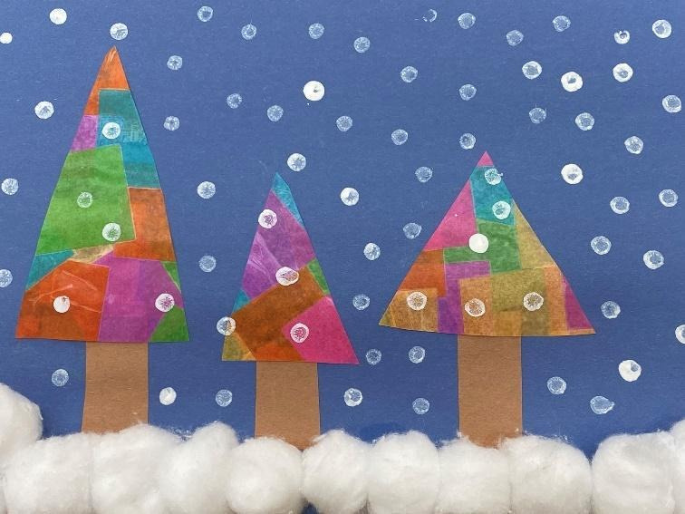

Slide 32
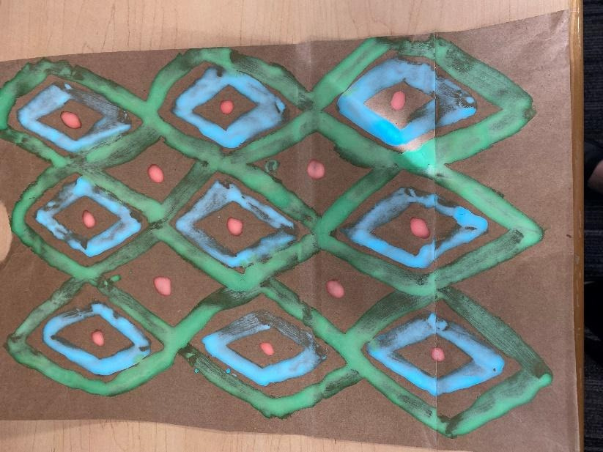

Slide 33

As you play . . .
What senses are being engaged in this project? Are there ways that you could add sensory elements to it?
What concepts or skills are included in this project? How could you model making those more explicit?
How could this project be simplified or made more complex to adapt it to different ages or abilities?
How might kids with the various play preferences engage with this project? How could you make it more inclusive?
What is open-ended about this project? Are there ways that you could make it more open-ended?

Slide 34



Questions?

Slide 35
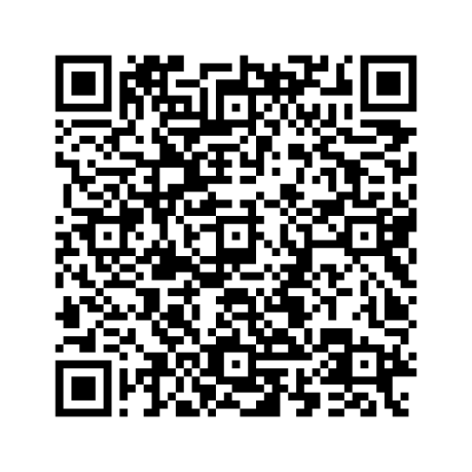


RESOURCES

Slide 36
Thank
You!
elizabeth.bintrim@montgomerycountymd.gov

Slide 37
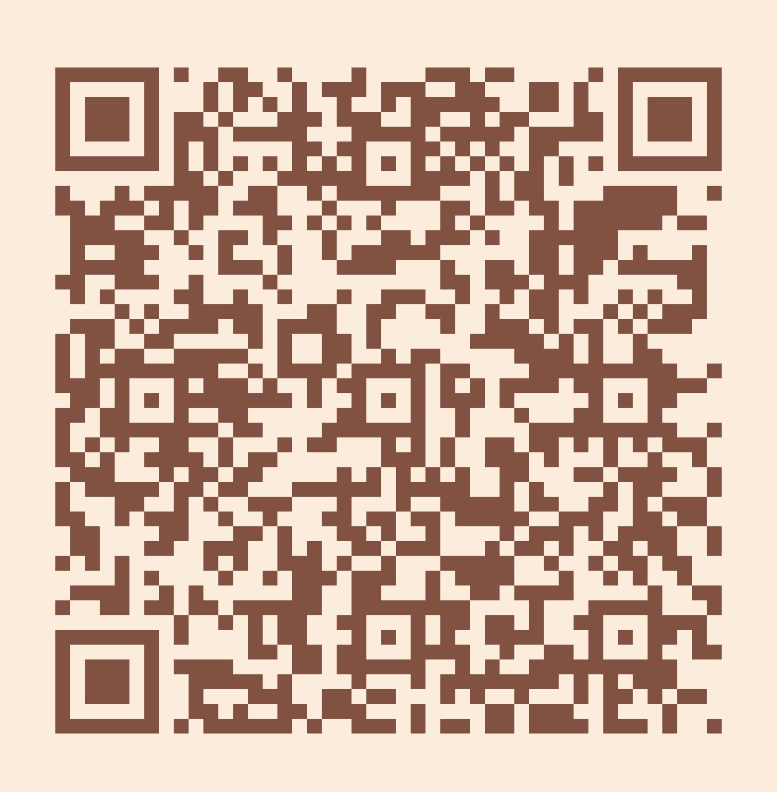
Please take a moment to complete the program survey.
SCAN ME!

