Slide 2




Don’t Miss!
50/50 RAFFLE
Tickets are $1 each and can be purchased from Conni Strittmatter or David Dahl! The winner takes home half the pot.
SILENT AUCTION
Visit the Silent Auction in the exhibitor hall to place your bids before 10 a.m. on Friday, May 8th.
PUB QUIZ
Thursday, May 7 8:00 – 10:00 p.m. Choptank Ballroom
KARAOKE
Thursday, May 7 6:00 – 10:00 p.m. Windjammer

Slide 3
Tsunagaru: Building Bridges in Japanese Language Learning Through Library-Faculty Collaboration
PRESENTERS:
Fusako Ito, MLIS,
Head of Cataloging/Technical Service
Bowie State University
Thurgood Marshall Library
Mina Seat
Instructor ​
Bowie State University​
Department of Language, Literature,
and Cultural studies

Slide 4
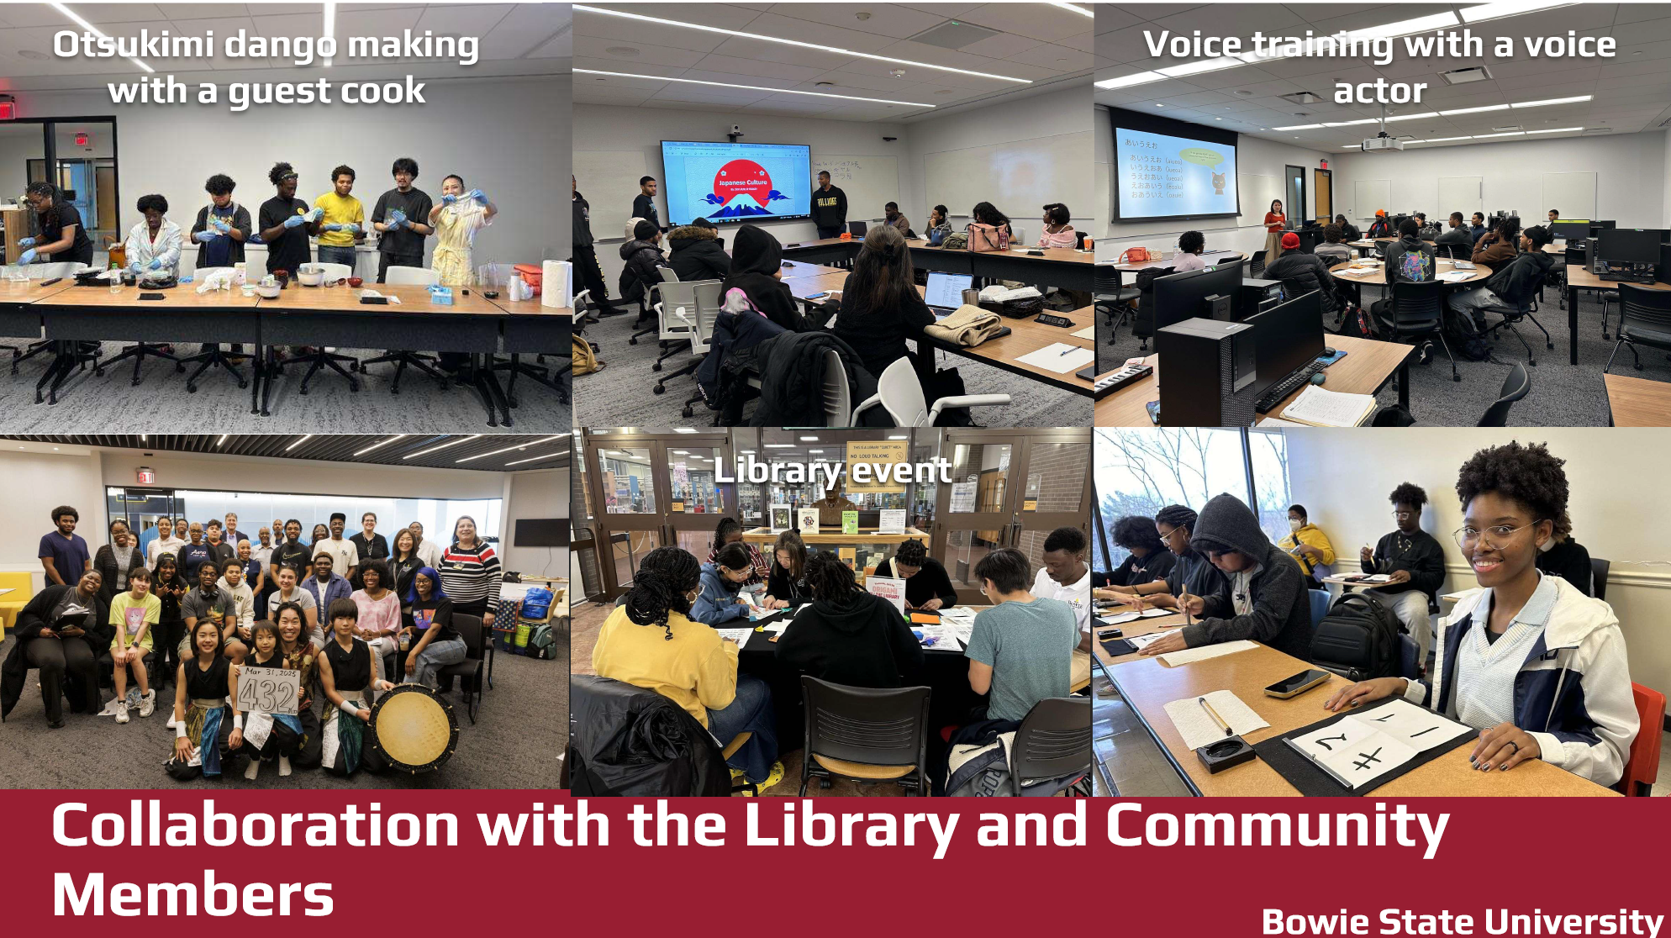

Slide 5
What does the instructor expect?
Librarians' expertise plays a vital role in enhancing students' cultural literacy and overall learning outcomes.
For linguistic development, librarians can support supplementary work and extended learning through in-class and out-of-class activities.
The librarian will play a key role in supporting advanced academic expectations by assisting with independent study opportunities and contributing to the potential development of a minor in Japanese cultural studies.
The librarian will continue to initiate and assist with cultural events, including those held in the library, across campus, and within the broader community.

Slide 6
Enhancing Students' Cutlual Liteary and Overall Learning Outcomes
Librarians' expertise plays a vital role in enhancing students' cultural literacy and overall learning outcomes.
Information literacy
Collection development
Methods: In-Class (requested by the instructor
Follow-ups (in-person/online)
Tools:
LibGuides (JAPN 101/102, Pop-Culture)
Research Guides: Search Strategy
Citations (MLA)
Existing library collection including EBSCO EBOOKs Collection
Find OA, OER for teaching/learning
Purchase Request to ACQ (budget)
Local Japanese Communities (flea market, moving sale, etc.)
Notes:
Information Literacy (+ AI Literacy)
Collection Development
Tools, Methods
Student talk each other – ask a student to spread the words

Slide 7
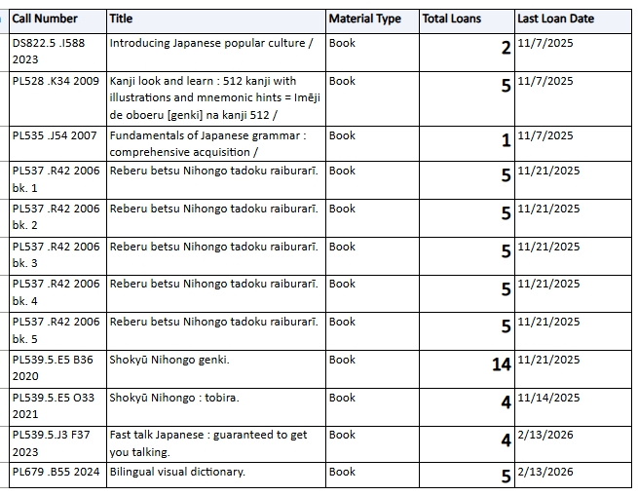
Challenge: Library Collection
Course Reserve Print Books Usage since 2023
Where do they go to find information?
Course Reserve Died?
What is the best media for students to continue learning language and culture?
What are the best devices for studying and learning?
Smart phones?

Slide 8
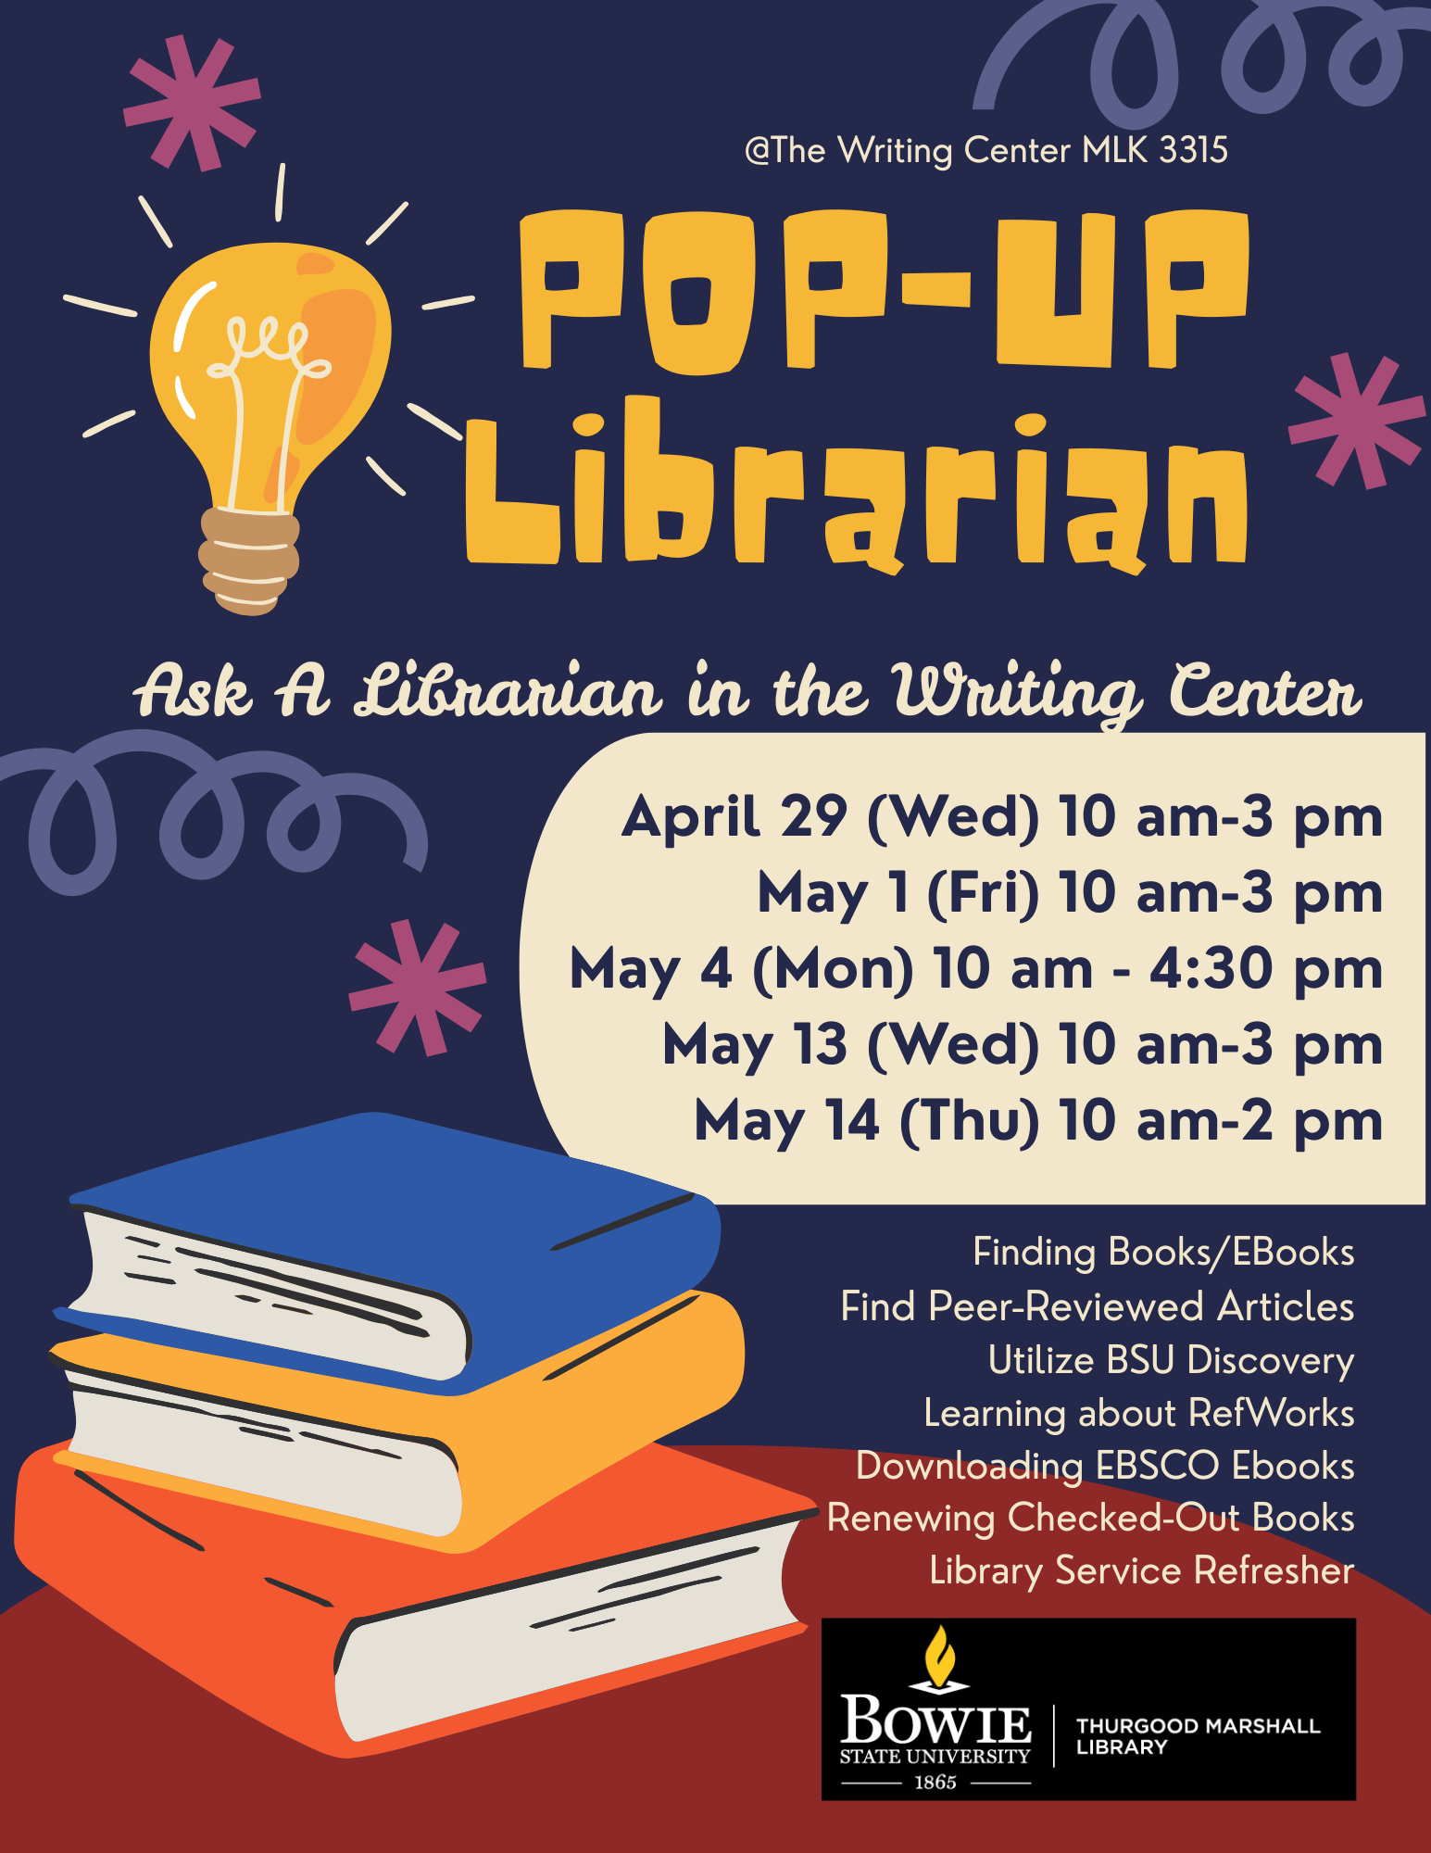
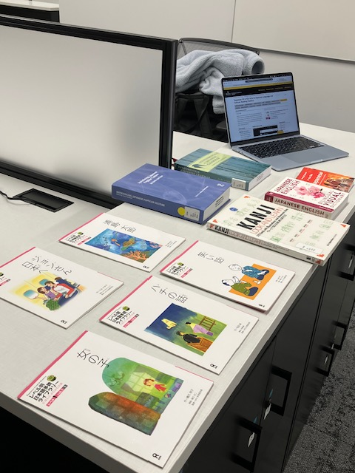
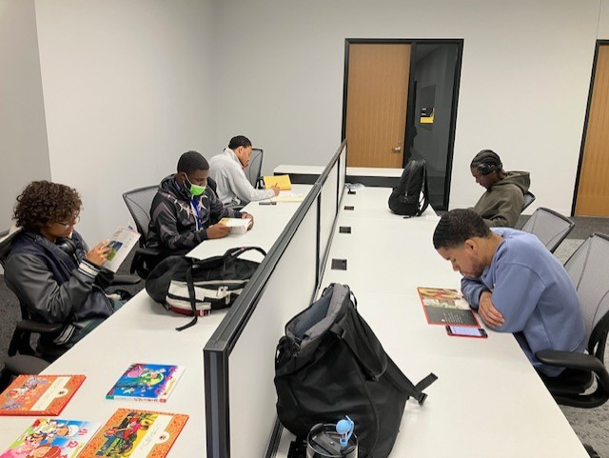
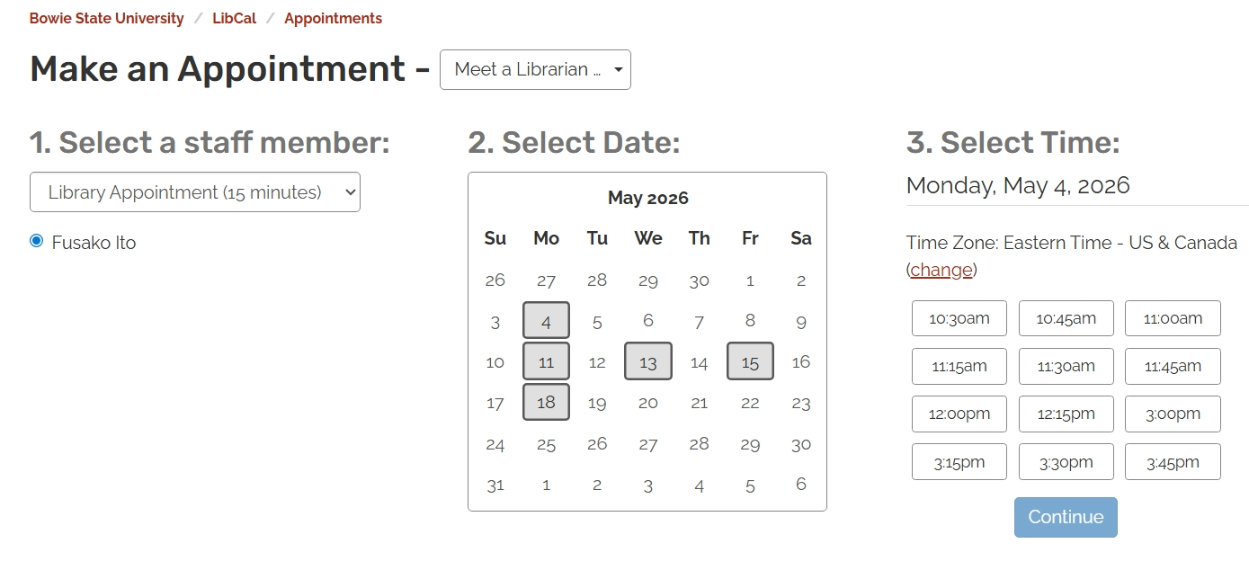
Support Students' Learning In-Class and Out-of-Class Activities
2) For linguistic development, librarians can support supplementary work and extended learning through in-class and out-of-class activities.
Visibility of Librarians
Class visit
Office Hours (LibCal)
Pop-up Librarian in Writing Center
Mentoring student organization
Conversation Practice
Notes:
Increase visibility of the librarian (in-person, outside of the library space)
Methods: How/Location
Conversation Practice (as a native speaker)
Office hours (LibCal)
Pop-Up Librarian in Writing Center
Menter student org
Class visit

Slide 9
Team Teaching Opportunities
3) The librarian will play a key role in supporting advanced academic expectations by assisting with independent study opportunities and contributing to the potential development of a minor in Japanese cultural studies.
Research support for students and faculty
Collection development
Independent Study Assignment:
Find OA, OER for teaching and learning Japanese language & Culture
Select and evaluate resources by non-native, students' view
List on-demand learning resources (OA, streaming videos)
Update LibGuides (JAPN 101/102/201/202)

Slide 10
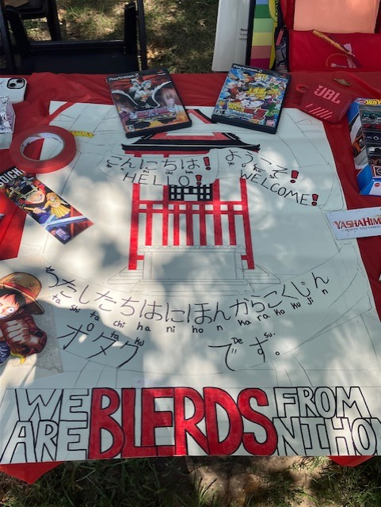
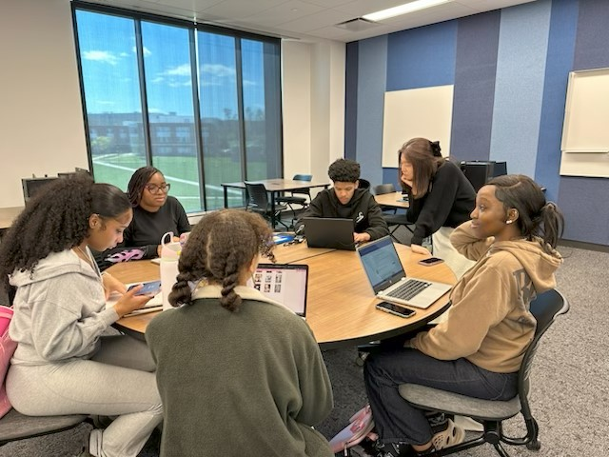
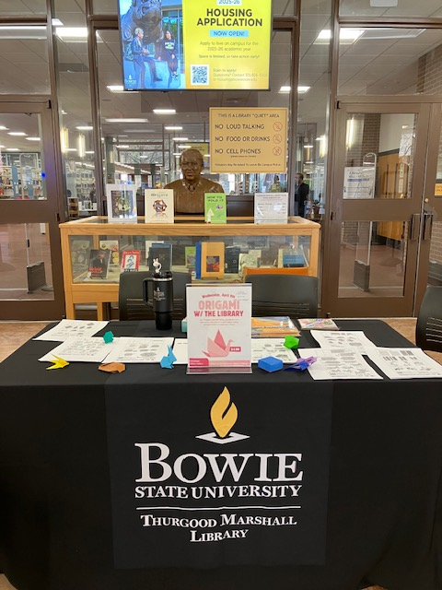
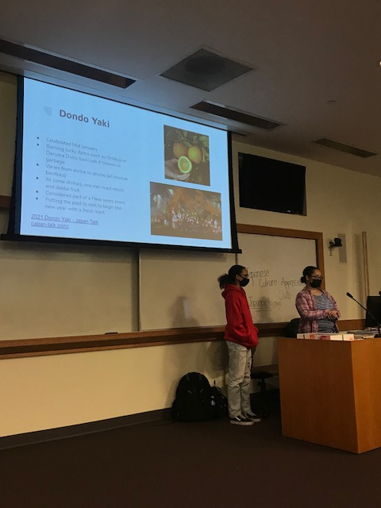

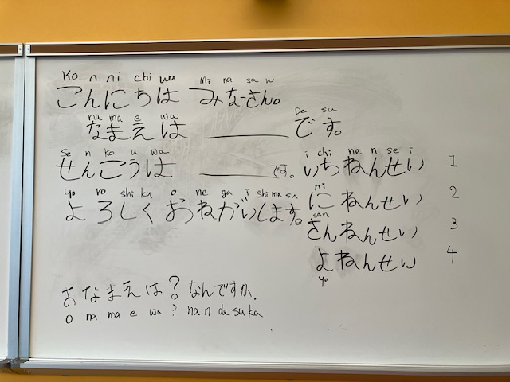
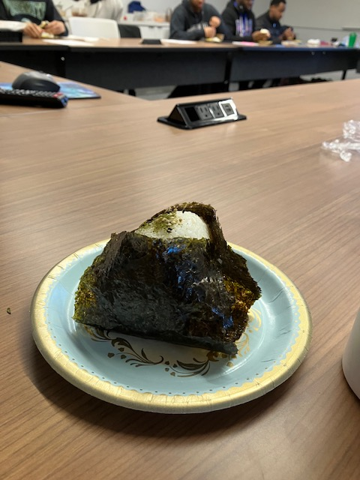
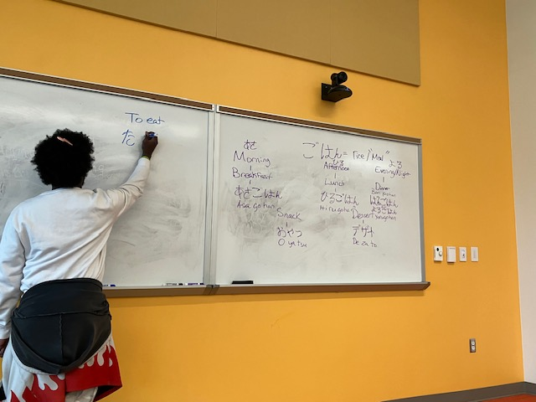
Cultural Event Support
4) The librarian will continue to initiate and assist with cultural events, including those held in the library, across campus, and within the broader community.

Slide 11
Tsunagaru:
Classroom and Library
Students and Library resources
Physical and Virtual
Instruction, Resources, Services, Meeting
Human Interaction
Students, faculty, staff, community and beyond
Cross-functional, Inter-Department Connection
Library, Academic Department, Academic Support Services (Tutorial Center, Writing Center, Student Success Center, Disability Support), International Education and Student Services, Student Organizations
Interconnection of Time: Past and Future

Slide 12
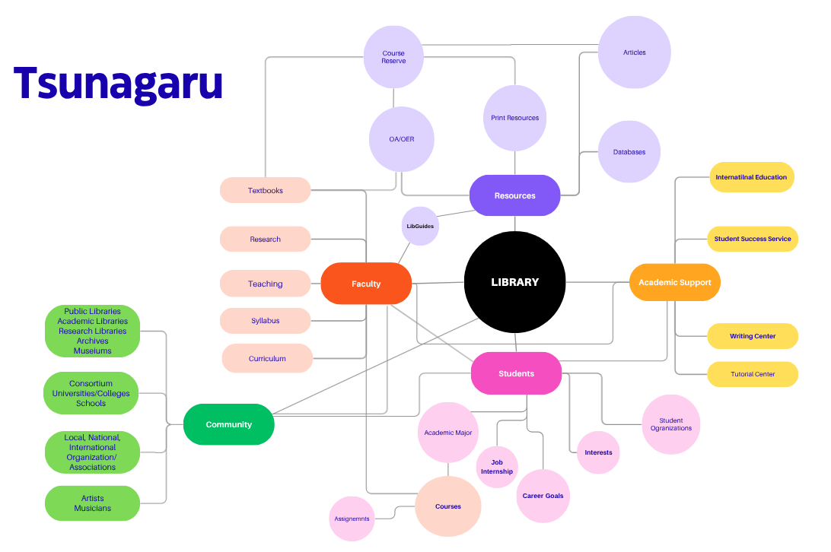

Slide 13
References
Consalvo, A., Doepker, G. M., Dubre, V., & Neel, J. (2022) Librarian-faculty collaboration for literacy
courses: promoting better leaning for preservice teachers. Language & Literacy (Kingston, Ont.),
107-130. 1020360/langandlit29605.
Reznowski, G. (2008). The librarian's role in motivating language learners: tales from an
Eastern Washington college town. Reference Services Review, 36(4), 414-423.
10.1108/00907320810920379
Vorobel, O., Voorhees, T. T., & Gokcora, D. (2021). Language learners' digital literacies: focus on students'
information literacy and reading practices online. Journal of Computer Assisted Learning, 37(4), 1127-
1140. 10.1111/jcal.12550
Notes:
Consalvo, A., Doepker, G. M., Dubre, V., & Neel, J. (2022). Librarian-Faculty Collaboration for Literacy Courses: Promoting Better Learning for Preservice Teachers. Language & Literacy (Kingston, Ont.), 24(3), 107–130. 10.20360/langandlit29605
Reznowski, G. (2008). The librarian's role in motivating language learners: tales from an Eastern Washington college town. Reference Services Review, 36(4), 414–423. 10.1108/00907320810920379
Vorobel, O., Voorhees, T. T., & Gokcora, D. (2021). Language learners' digital literacies: Focus on students' information literacy and reading practices online. Journal of Computer Assisted Learning, 37(4), 1127–1140. 10.1111/jcal.12550

Slide 14
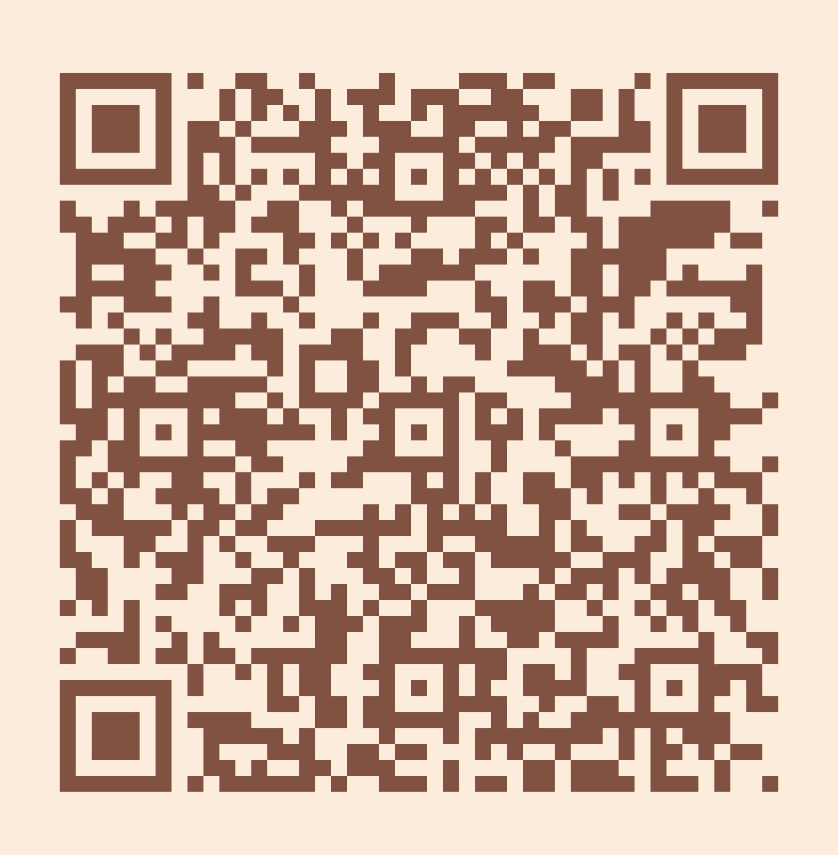
Please take a moment to complete the program survey.
SCAN ME!

Slide 15
Thank you!
CONTACT INFO

