Slide 2




Don’t Miss!
50/50 RAFFLE
Tickets are $1 each and can be purchased from Conni Strittmatter or David Dahl! The winner takes home half the pot.
SILENT AUCTION
Visit the Silent Auction in the exhibitor hall to place your bids before 10 a.m. on Friday, May 8th.
PUB QUIZ
Thursday, May 7 8:00 – 10:00 p.m. Choptank Ballroom
KARAOKE
Thursday, May 7 6:00 – 10:00 p.m. Windjammer

Slide 3
Maintaining Our Virtual Shelves: Database Descriptions for Better Patron Engagement
PRESENTERS: Katie Delezenski, Research and Instructional Librarian
Nicole Kulp, Serials and Electronic Resources Librarian Salisbury University, Salisbury, Maryland

Slide 4
Learning Objectives
By the end of this session, participants should be able to:
Understand how the intended audience of a database should change the approach to description
Develop a consistent methodology for writing database descriptions
Rewrite database descriptions for better clarity based on specific intended audience

Slide 5
History of SU Database Descriptions
Prior to 2024
Database descriptions were the sole purview of the S&ER Librarian
Some feedback from liaisons incorporated into the "best bets" and other subject tags
There was no clear process for review or what exactly constituted a well-written description
New databases were often described using vendor language with not much additional detail
Feedback from liaisons was incorporated by request
As a new librarian, and not an expert on all databases, I often struggled to find the appropriate words that
Captured the databases' best use
Were short enough to keep the researcher's attention
Did not sound like a sales pitch
I had neither the time, nor the expertise, to update old descriptions proactively.

Slide 6
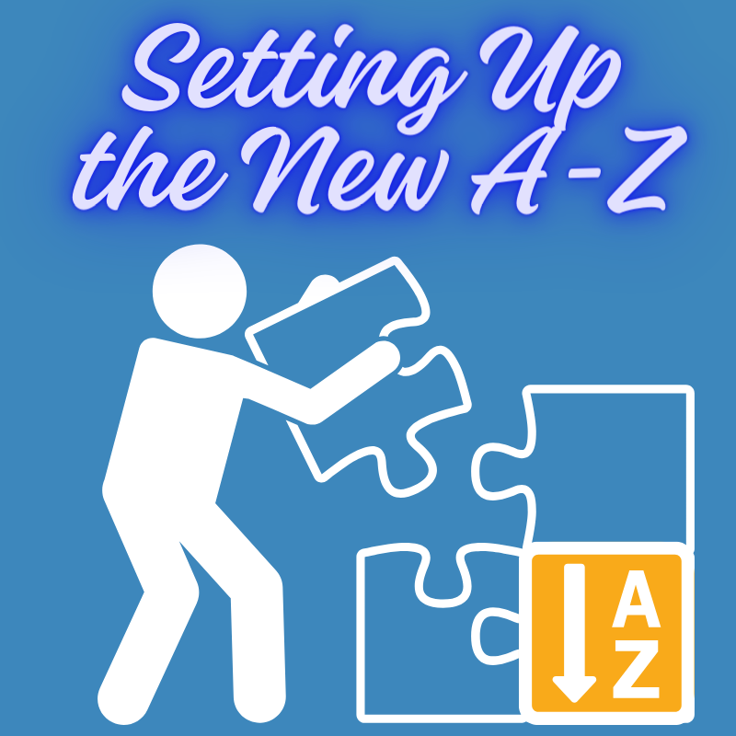
Springshare’s New A-Z Database List
As Springshare prepared to release a new A-Z List, I realized that maintenance needed to be done on all the descriptions but, more importantly, that I didn't need to do it alone!
I started to put together a working/learning session aimed to alter descriptions for ease of use and ease of migration.
From Springshare

Slide 7
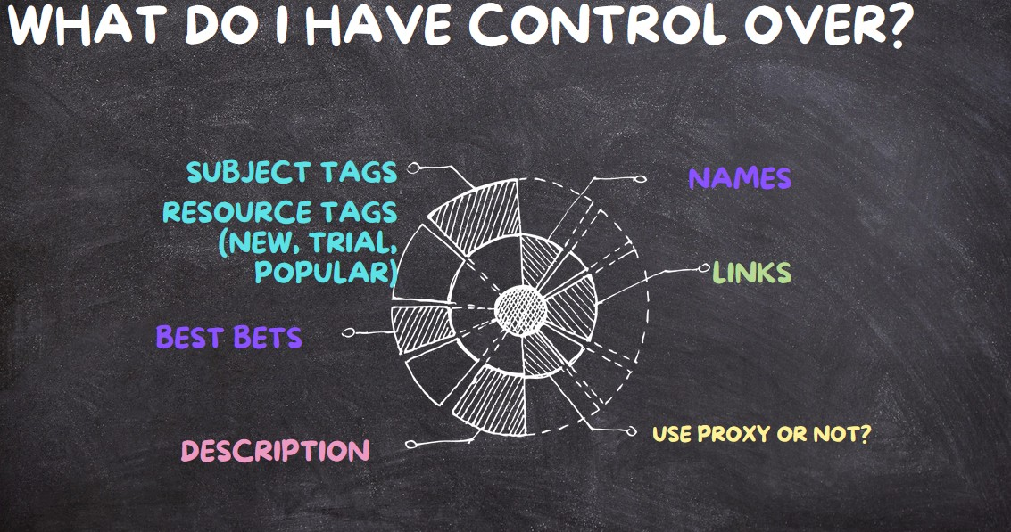
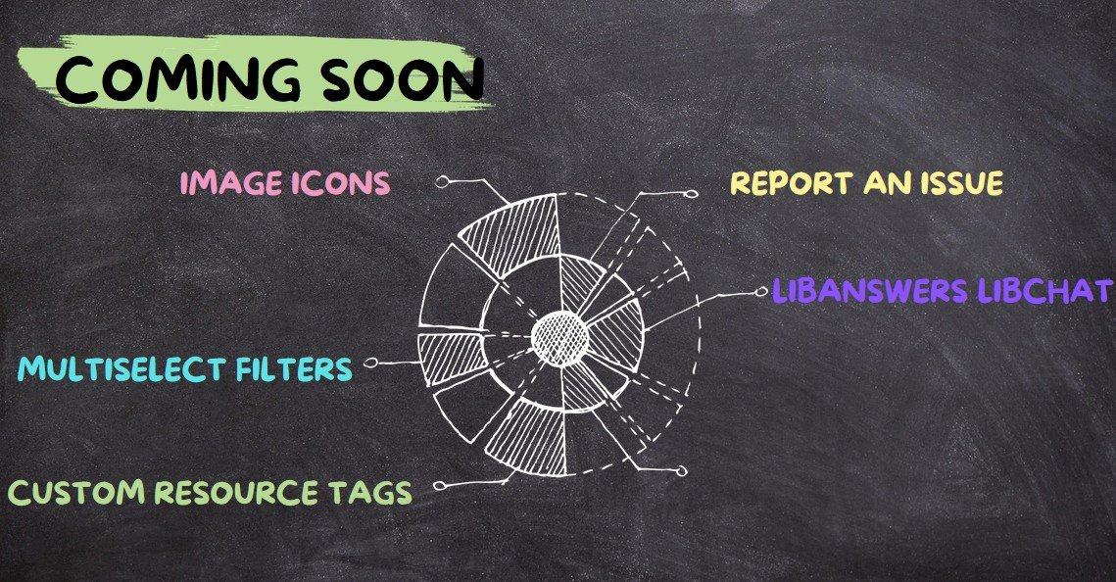
A Summer of Learning Discussion
So, What did we do?
Each summer, the library staff get together to learn from each other and work on special projects. In June of 2024,Nicole called the departments together to discuss the possibilities for A-Z database management and start the call for action.
Started with an explanation of what is within the current realm of possibility
Outlined the upcoming tools to frame description around what would be possible rather than only what is.
Guided entire staff in a group discussion via Padlet on what makes a good database description
Sample slide from SOL session detailing aspects of description and access that the S&ER Librarian has control over
Sample slide from SOL session detailing new aspects of description and access that the S&ER Librarian will have control over in new Springshare A-Z Database List

Slide 8
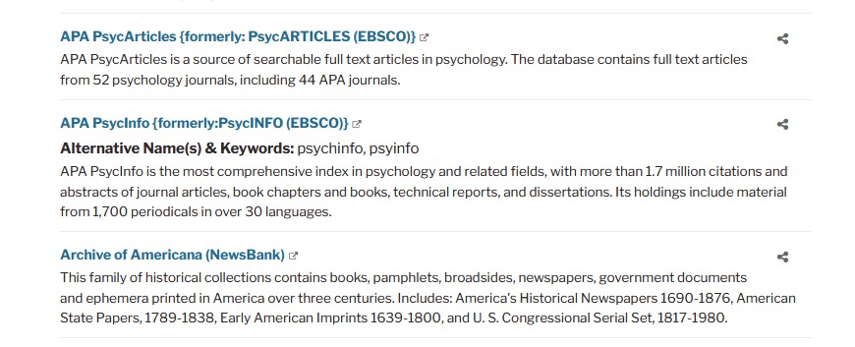
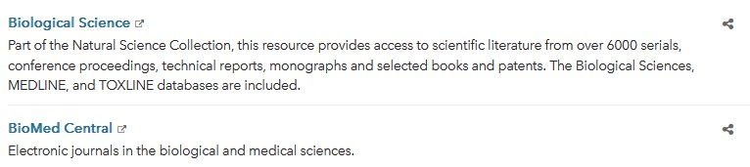


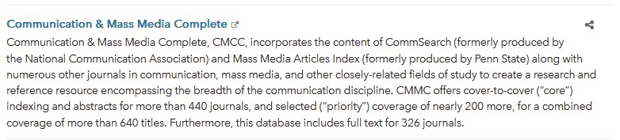
Examples of SU descriptions prior to Summer 2024
What do these descriptions tell you?
What don't these descriptions tell you?
Would you want to use the databases?
Would you feel comfortable knowing which one would contain the resources you need?

Slide 9
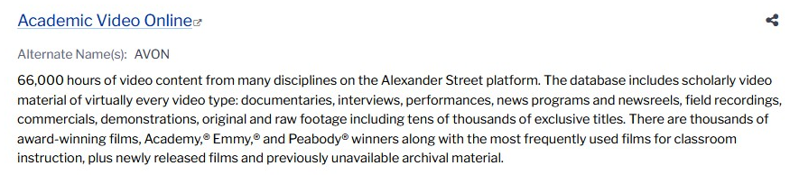
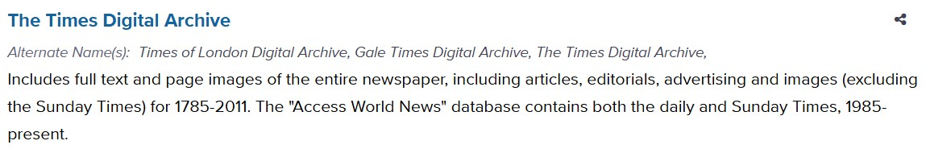
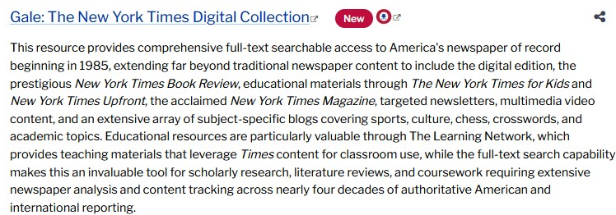
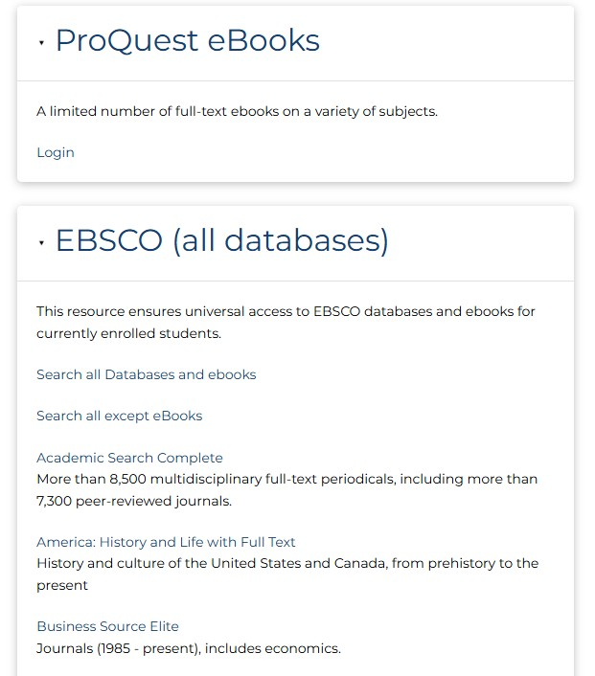
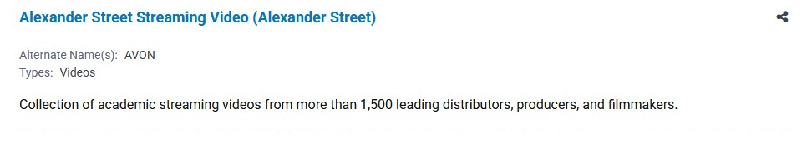
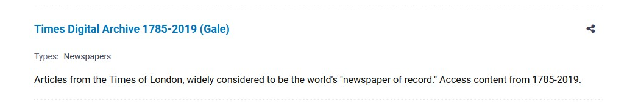
Examples of Other Academic Database Descriptions- Current
CUNY
UC Davis, California
Yuba College, California
University of Colorado, Boulder

Slide 10
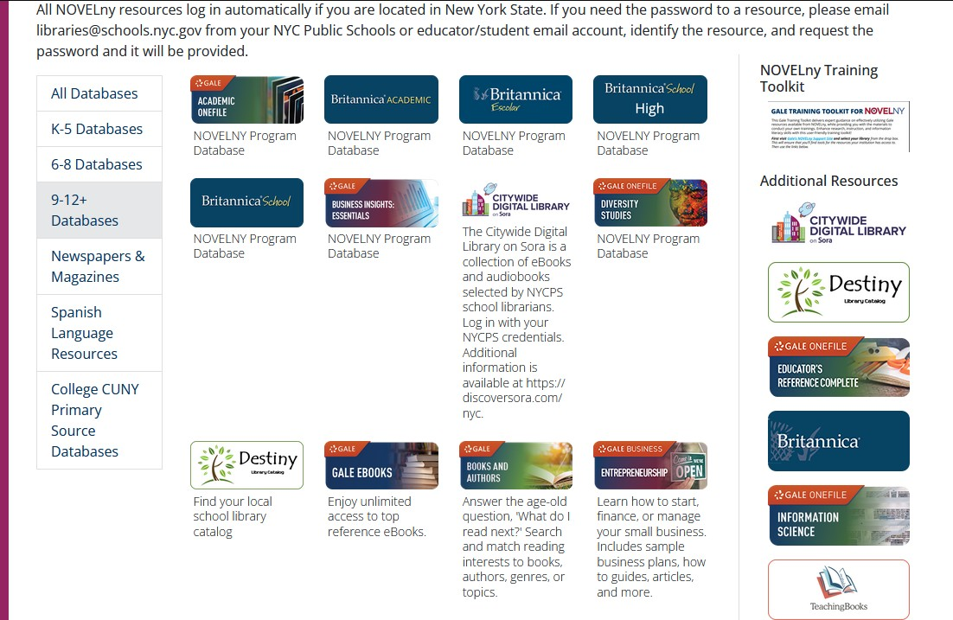
Examples of K12 Database Descriptions
Some things to consider:
From NY State School Library Database Page
What do you notice about the different versions of database listings?
Is any example we've provided helpful for high school students?
What control do School Librarians have over database description?

Slide 11
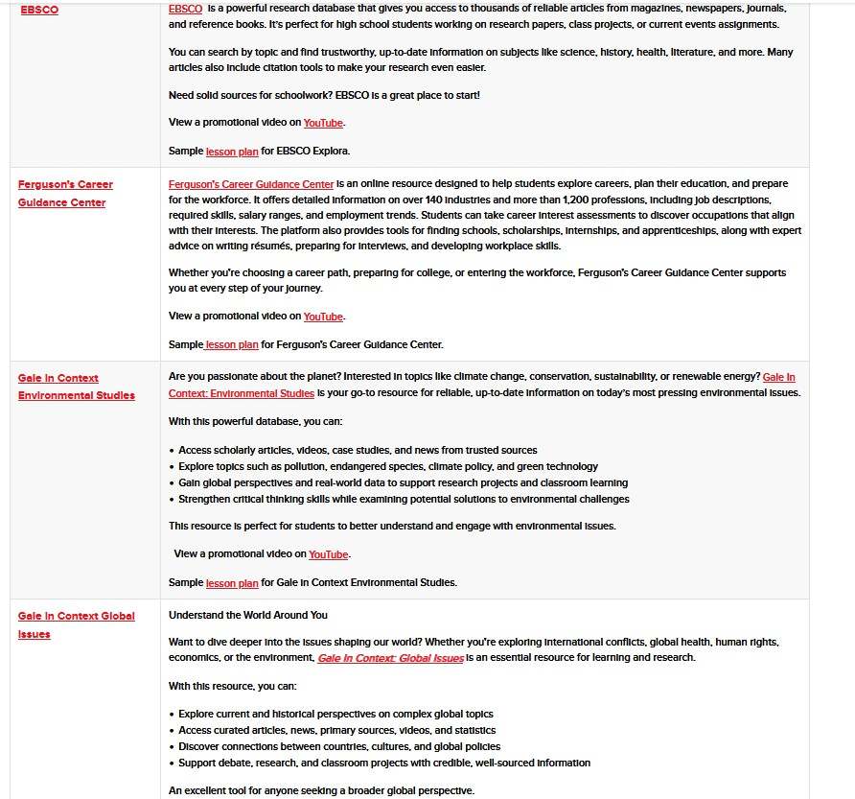
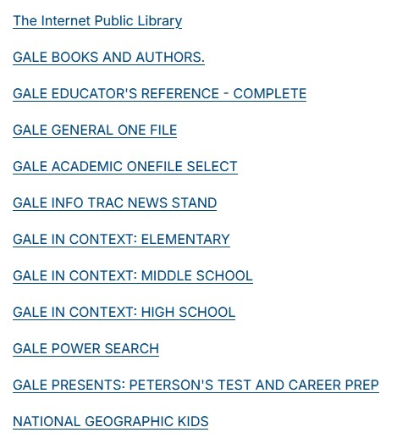
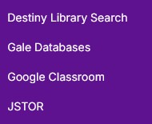
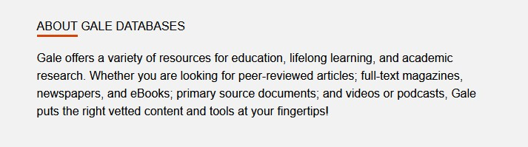
More Examples of K12 Database Descriptions
From an AZ High School library website
From a MD High School Board website
From a MD high school website resource list
After Clicking "Gale Databases"

Slide 12
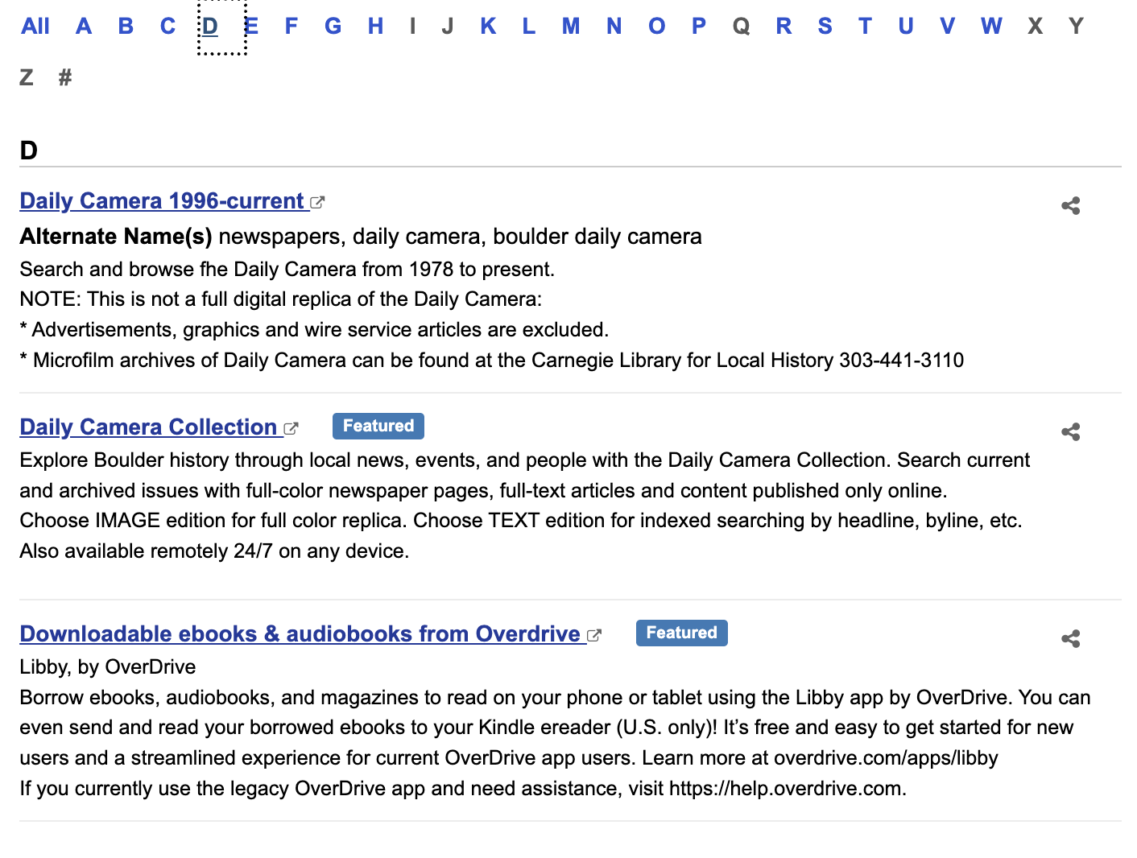
Example of a Public Library Database Description
Some things to consider:
What control do public librarians have over descriptions?
Would you look for Libby or Overdrive under "D"?
Are non-clickable URLS in the description useful?
How do URLs affect ADA compliance?
From Boulder Public Library's A-Z Database List

Slide 13
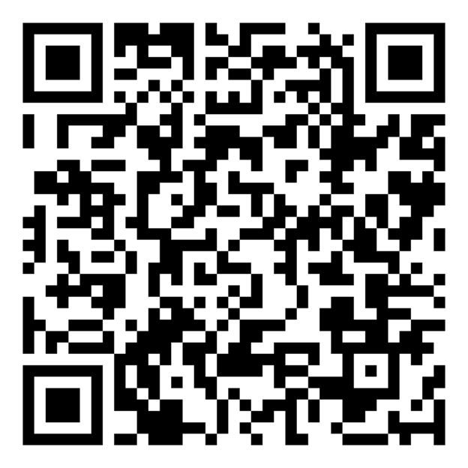

Let's Dig In!
Now that you know our process, it's your turn!
What should you consider for a database description rewrite project?
Follow the QR code to access our Padlet!
Feel free to discuss amongst yourselves!

Slide 14
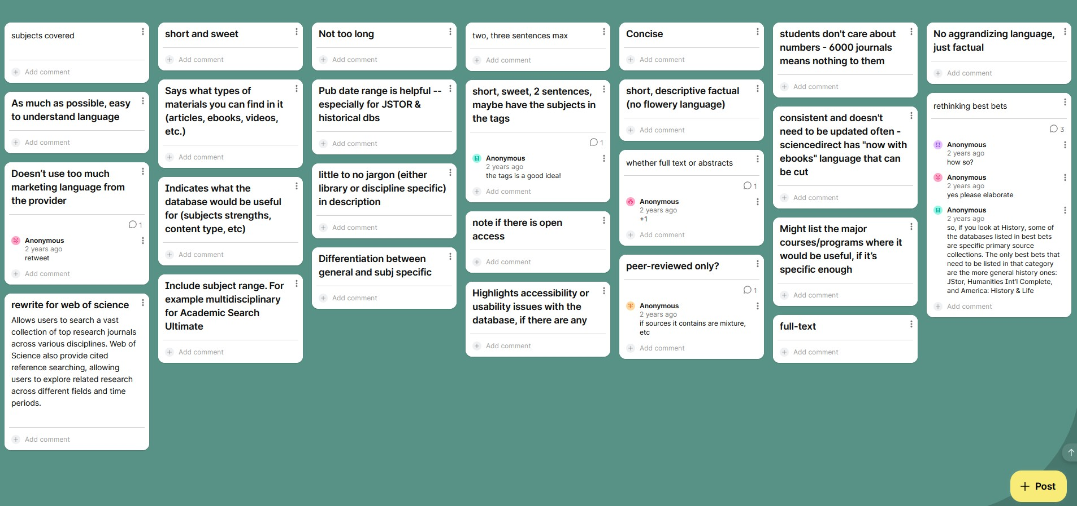
SU's Original Brainstorm!

Slide 15
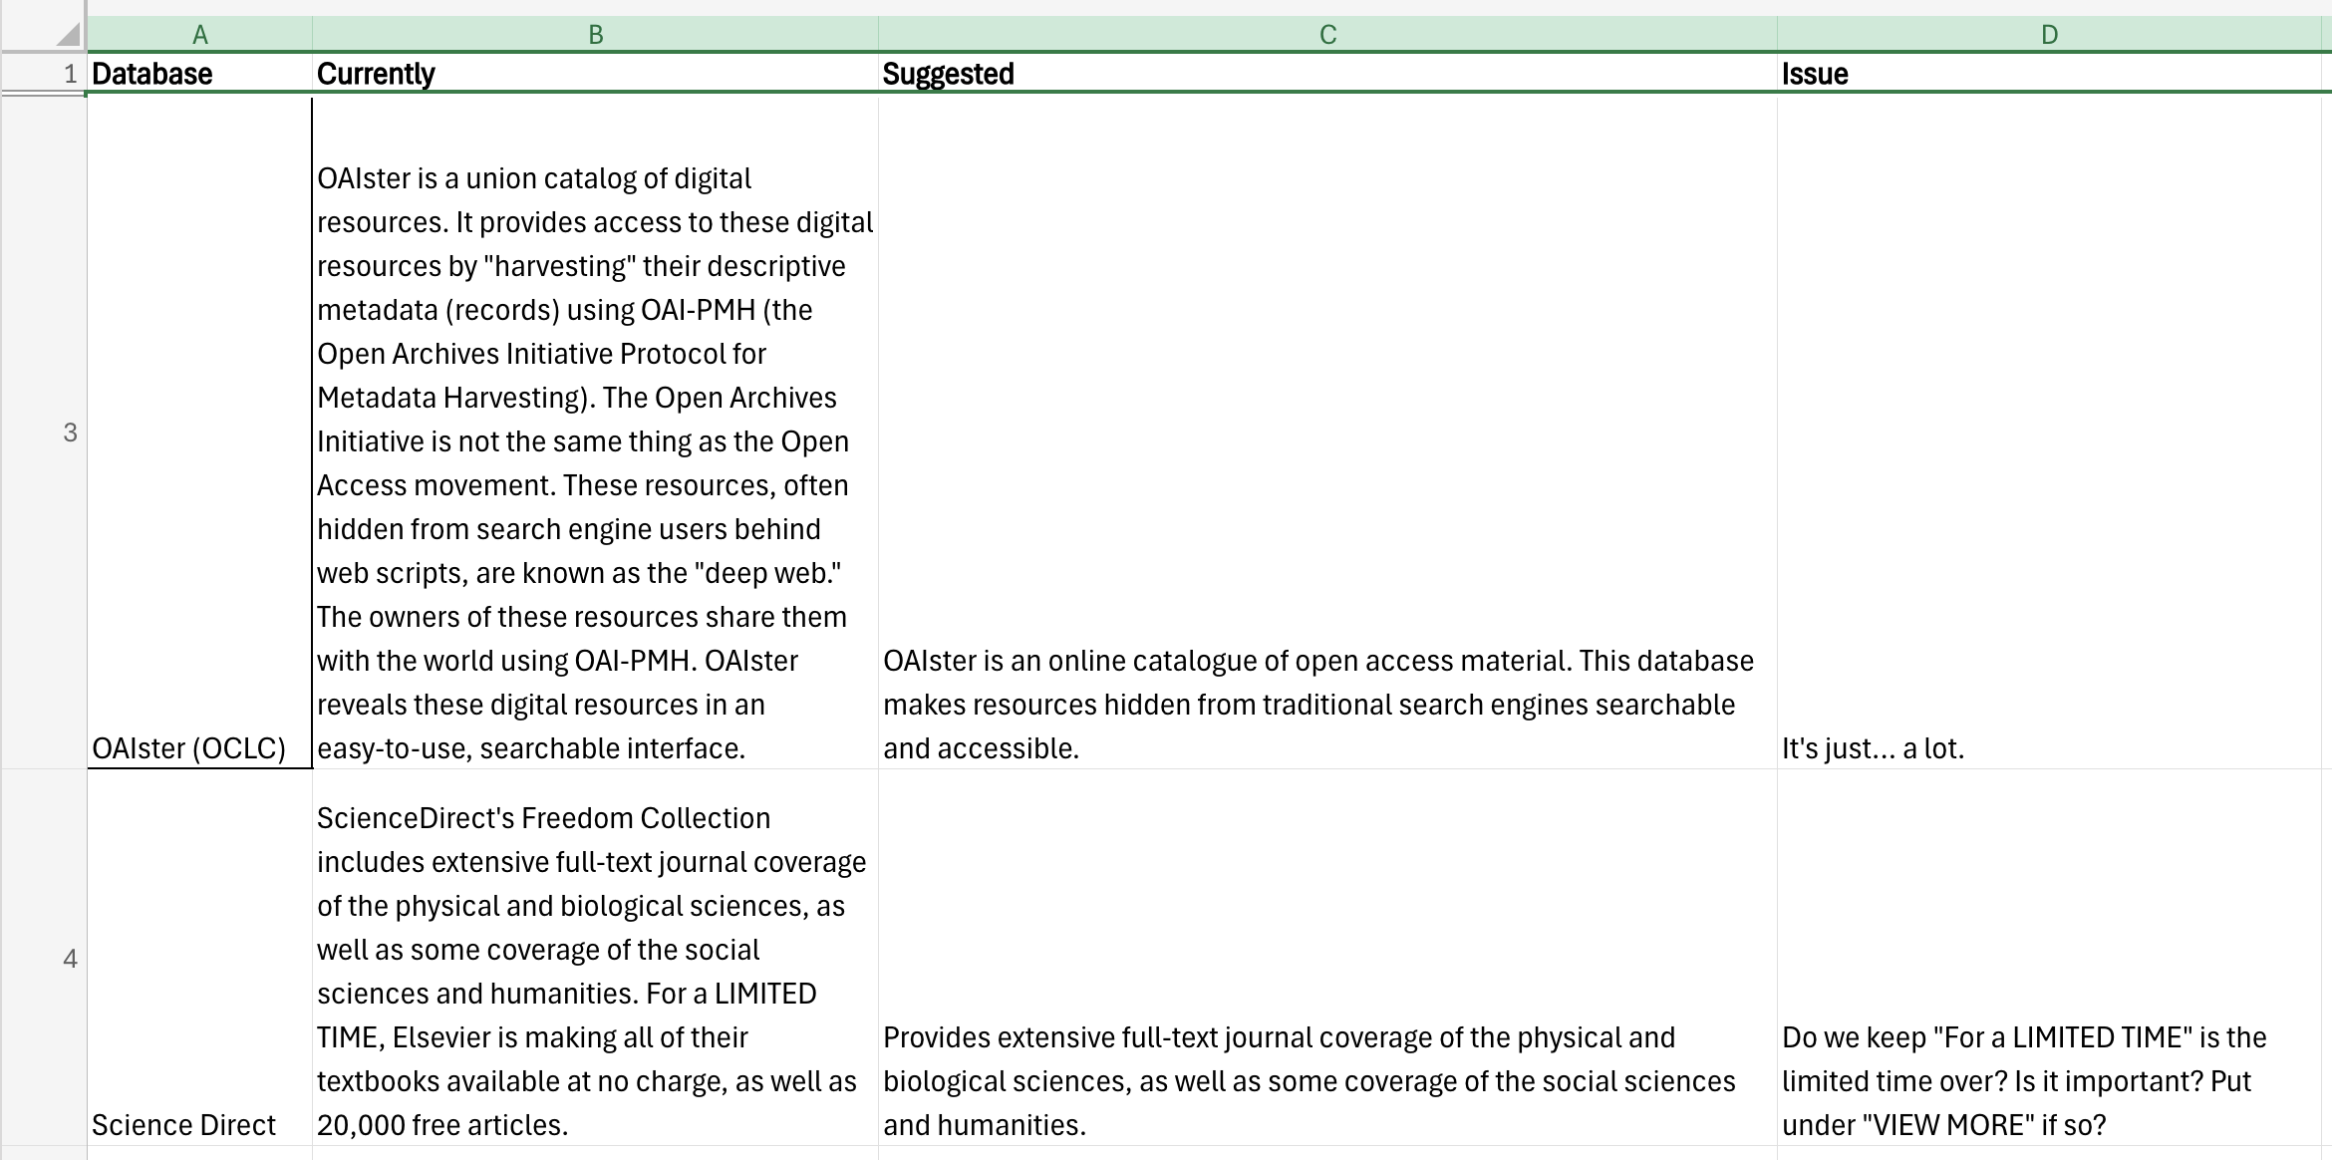
A Collaborative Process: Planning the Rewrite
A-Z Database List
Assigned rewrites to liaison by area of discipline and divided multidisciplinary databases
Adjusted for overlap
Tab for questionable descriptions to collaborate
Style guide informed by padlet and written by RIS Librarian Katie with oversite from S&ER Librarian Nicole

Slide 16
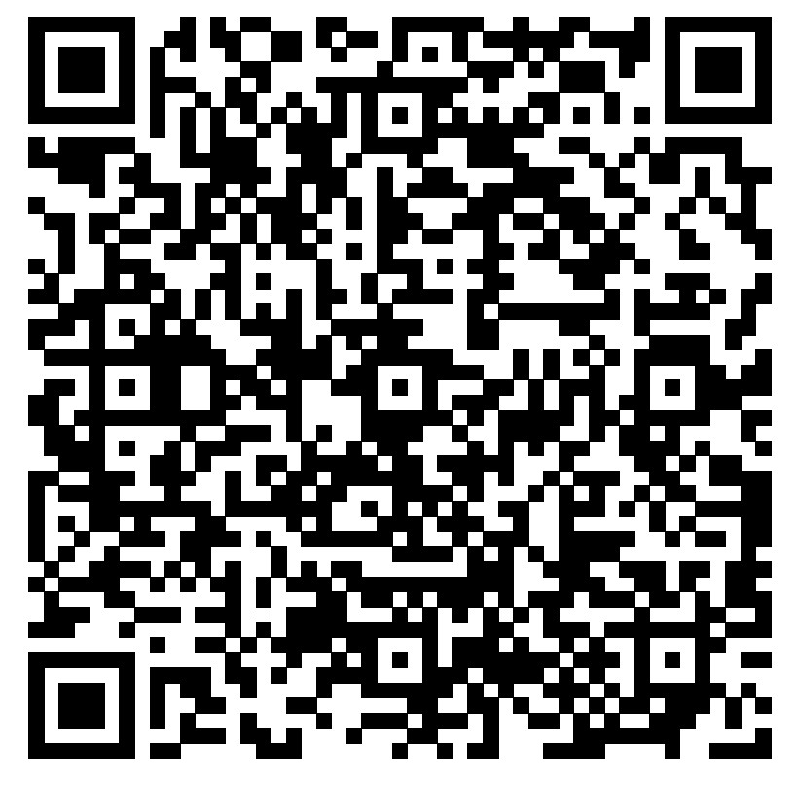
Put It Together: Style Guide Development and Division of Labor
Questions to ask yourself:
Who is your audience?​
Do you need to consider a word count limit?​
Is any jargon acceptable?​
Do you have thoughts on tone or active v. passive voice?​
Tags? Is there anything unique to your organization that may require tagging?​
How do you want to notate things unique to the vendor (such as log in requirement)​?
Do you care about avoiding repetitiveness?
Grammar points (such as oxford comma), is there an institution-specific writing guide to be aware of?
Who has responsibility for the initial descriptive work and who is responsible for the maintenance?
What is a reasonable review cycle?
Anything you need to plan for in the future?
Salisbury's Style Guide:

Slide 17
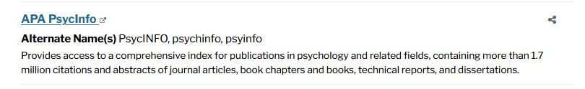
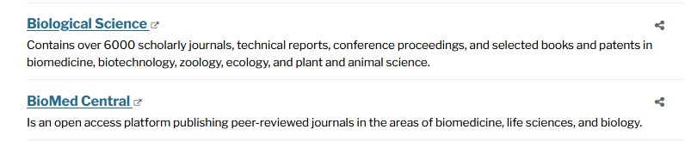

Examples of SU descriptions
Then
Now
What is different?
How would you have done it differently? ​
Would you feel comfortable knowing which database to use now?

Slide 18
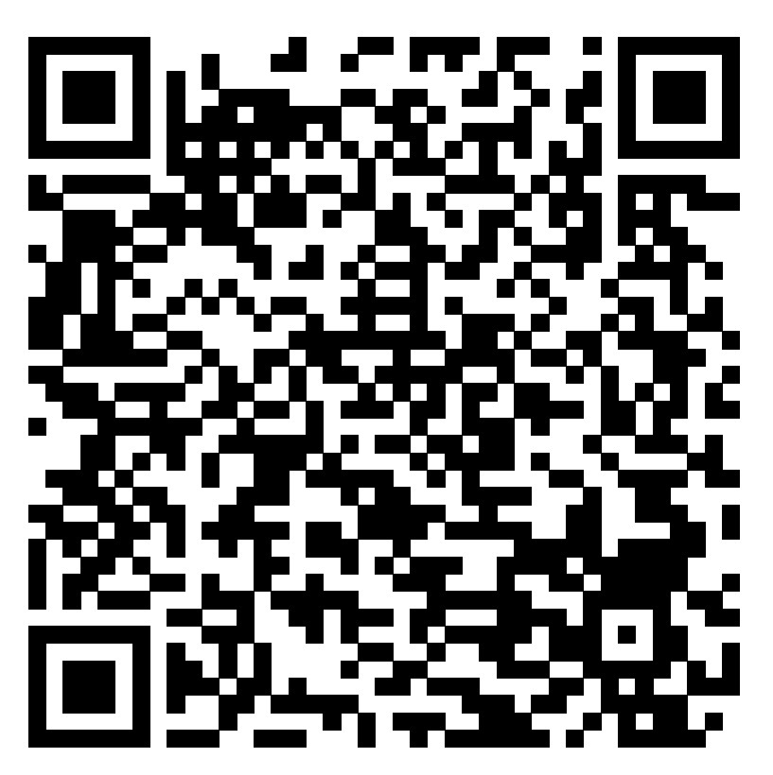
Now you try!
Try your skills at rewriting some examples found online, or jot down some thoughts about your own descriptions
Follow the QR code to access the worksheet!
Is it making sense now?
Are there ways to make things clearer when you don't necessarily have control over what appears on the website?
What would you like to remember for later?

Slide 19
Discussion
How did you find the exercise?
What decisions did you make stylistically?
Would you audience understand the original description?
What was difficult to rewrite?
If you don't have content control, how would you approach database descriptions for your patrons?

Slide 20
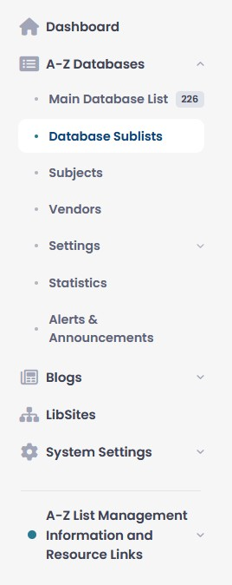
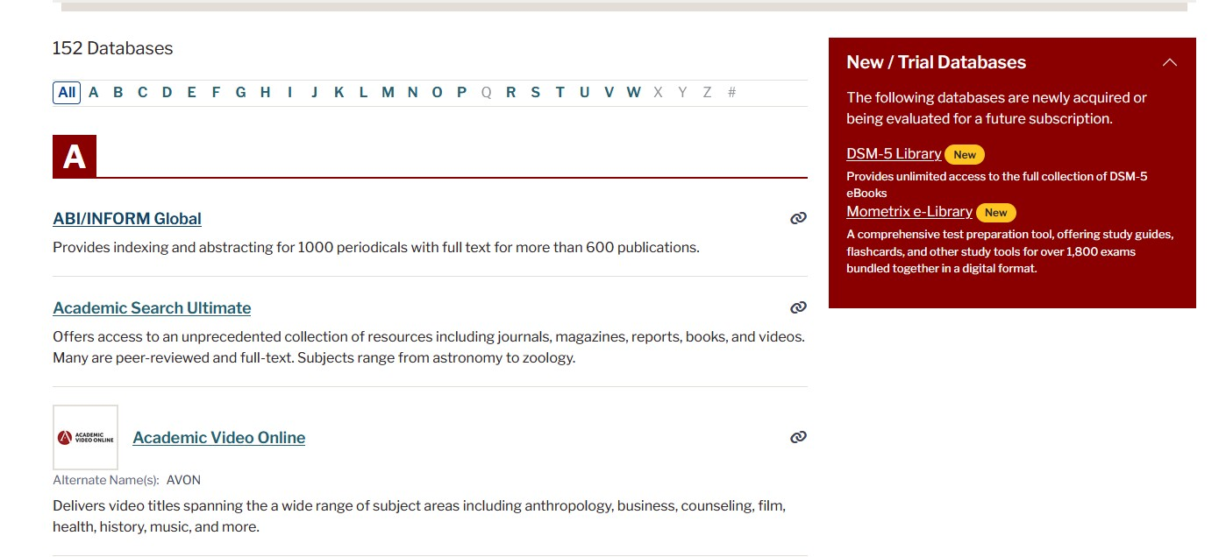
Looking toward the future- Summer 2026
Review descriptions again
Review “best bets”
Review subject tags
Review options for custom flags
Decide whether to include image icons
Talk about curated sub-lists of databases to celebrate different library objectives such as observance months
Consider which widgets to add to the A-Z list

Slide 21
Thank you!
CONTACT INFO
kadelezenski@salisbury.edu
nlkulp@salisbury.edu

Slide 22
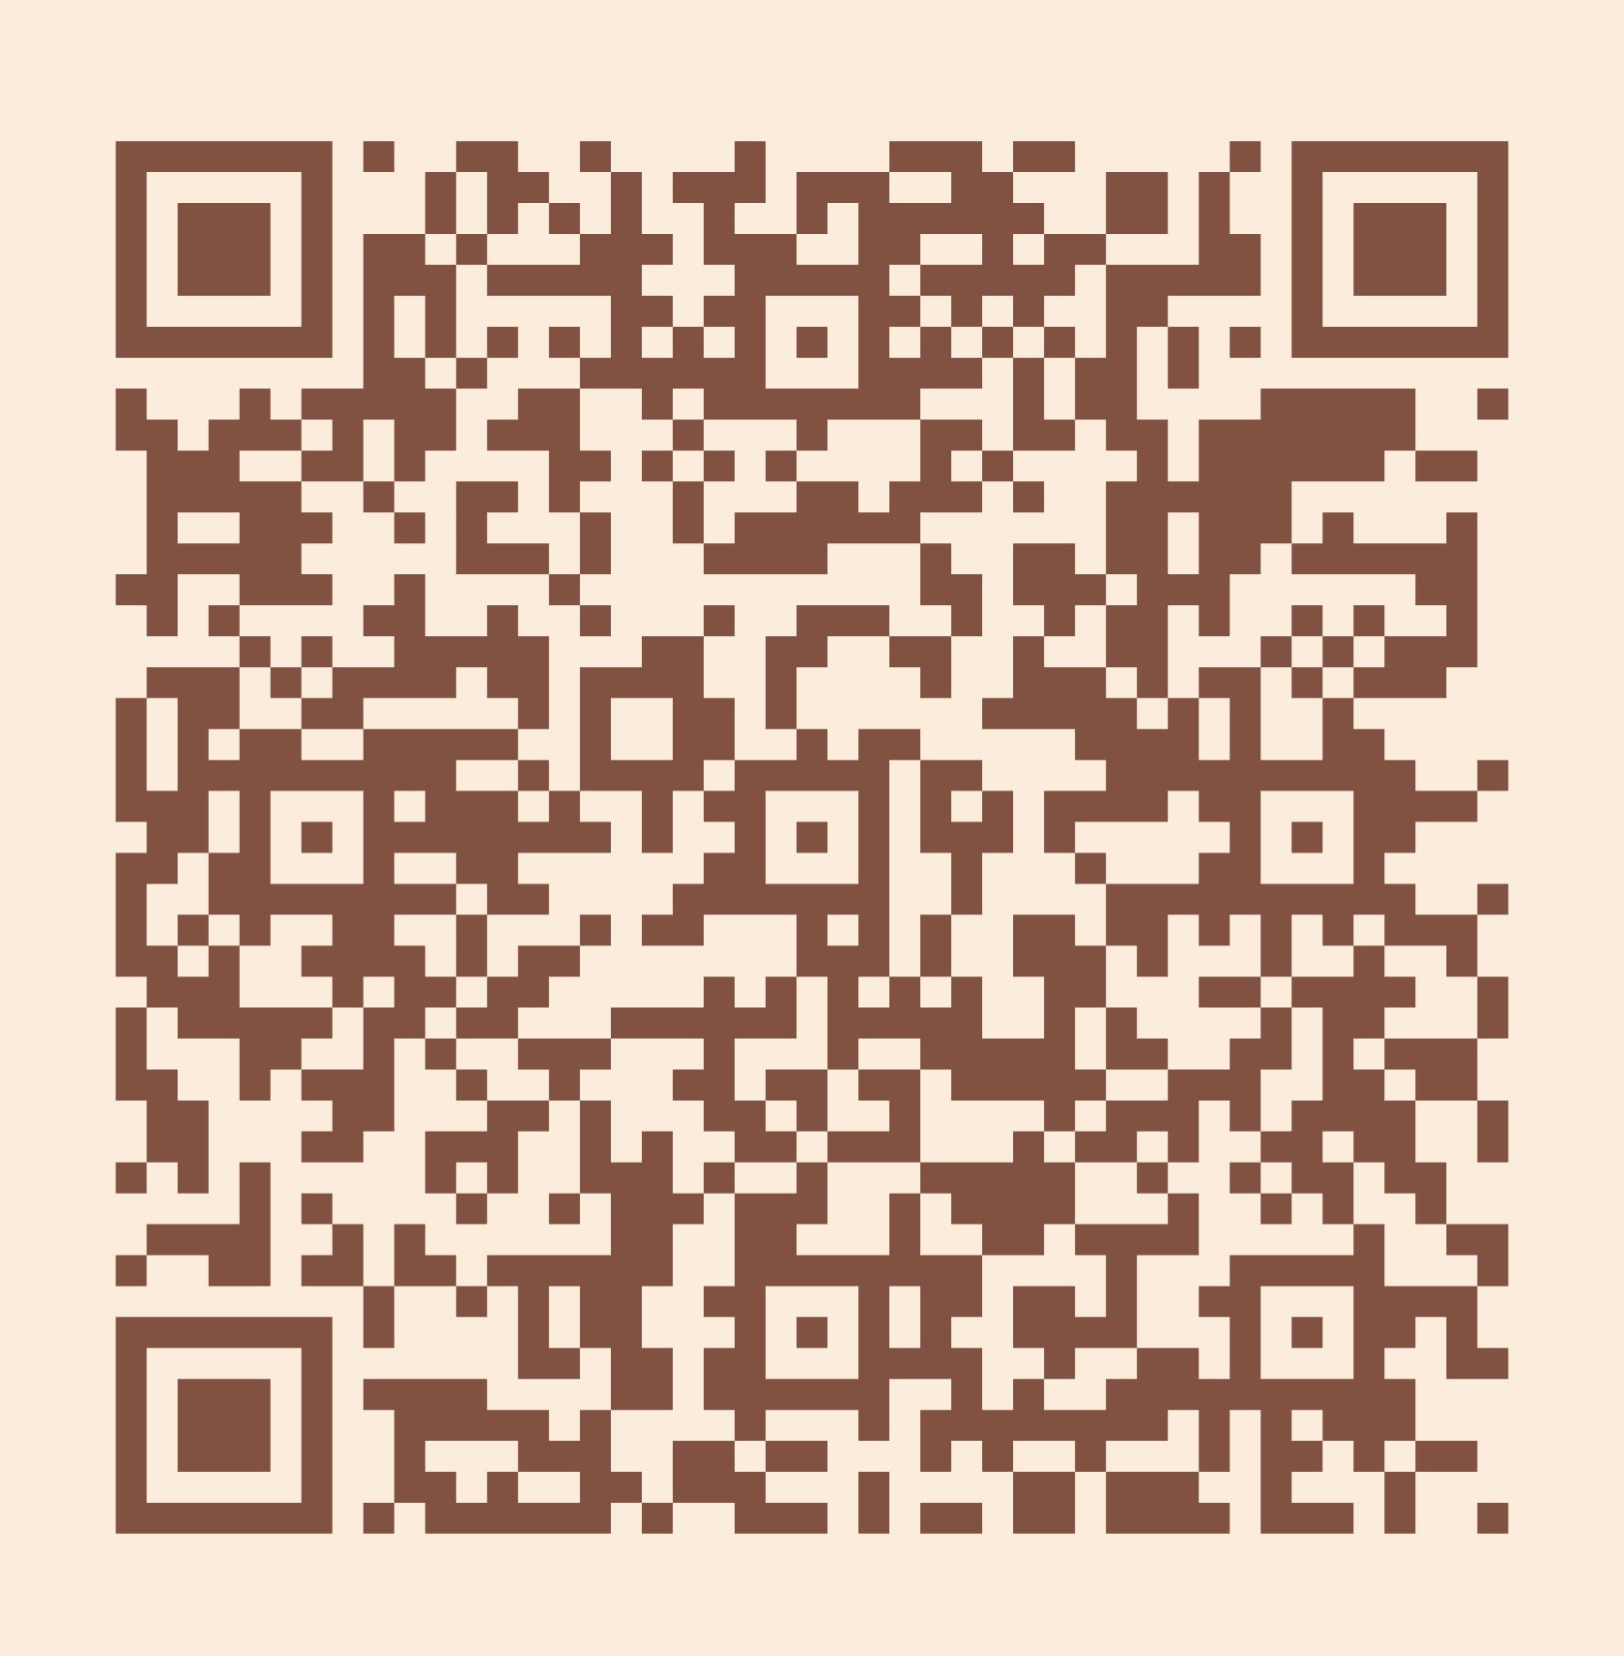
Please take a moment to complete the program survey.
SCAN ME!

