Slide 2




Don’t Miss!
50/50 RAFFLE
Tickets are $1 each and can be purchased from Conni Strittmatter or David Dahl! The winner takes home half the pot.
SILENT AUCTION
Visit the Silent Auction in the exhibitor hall to place your bids before 10 a.m. on Friday, May 8th.
PUB QUIZ
Thursday, May 7
8:00 – 10:00 p.m.
Choptank Ballroom
KARAOKE
Thursday, May 7
6:00 – 10:00 p.m.
Windjammer

Slide 3
School’s Out!
Building Local Partnerships with Schools
Using *Their* Calendars
Bernadette Davis * Youth Services Librarian * Brandywine Hundred Library * Wilmington, Delaware

Slide 4
School’s Out! Building Local Partnerships with Schools Using *Their* Calendars
Definition
Background
Samples
How To
Group Work: Create sample plan that can be implemented

Slide 5
School’s Out! Building Local Partnerships with Schools Using *Their* Calendars
School’s Out S.T.R.E.A.M is
an all-day, drop-in program
of hands-on, mostly self-guided activities
for school aged children and their adults
scheduled on days during the school year that students have off

Slide 6
Background
Notes:
Seeing kids in the building and not having any particular activity, hook for them to encourage them to come back. Also: importance of regular routines for parents. Don’t need to think about what to do when the kids are off school: They already know that the library will have something to do.

Slide 7
Background
Spinoff of Winter Break Reading Challenge
Parent / guardian requests
January 1, 2022 - May 1, 2026
89 separate events
Total attendance: 4898

Slide 8
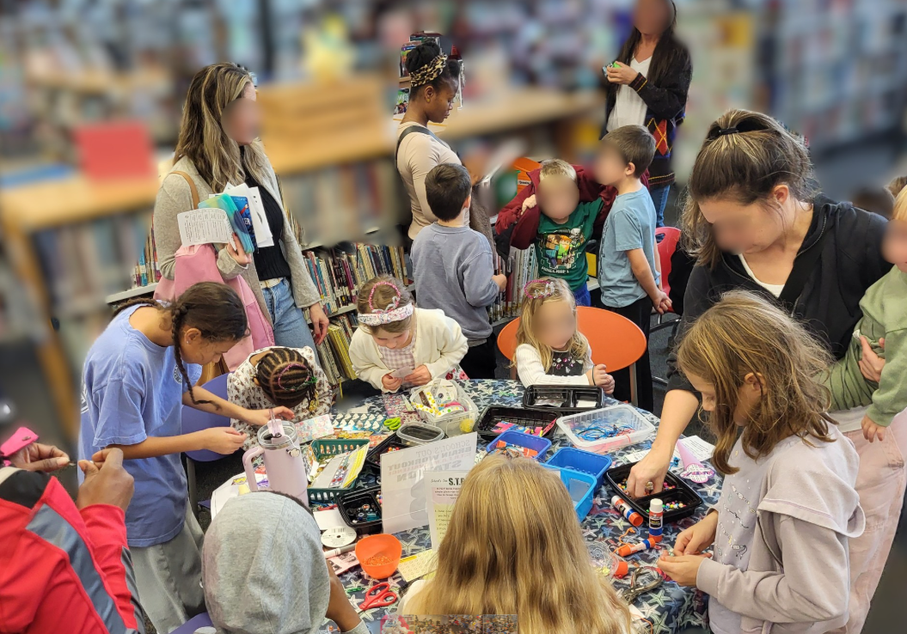
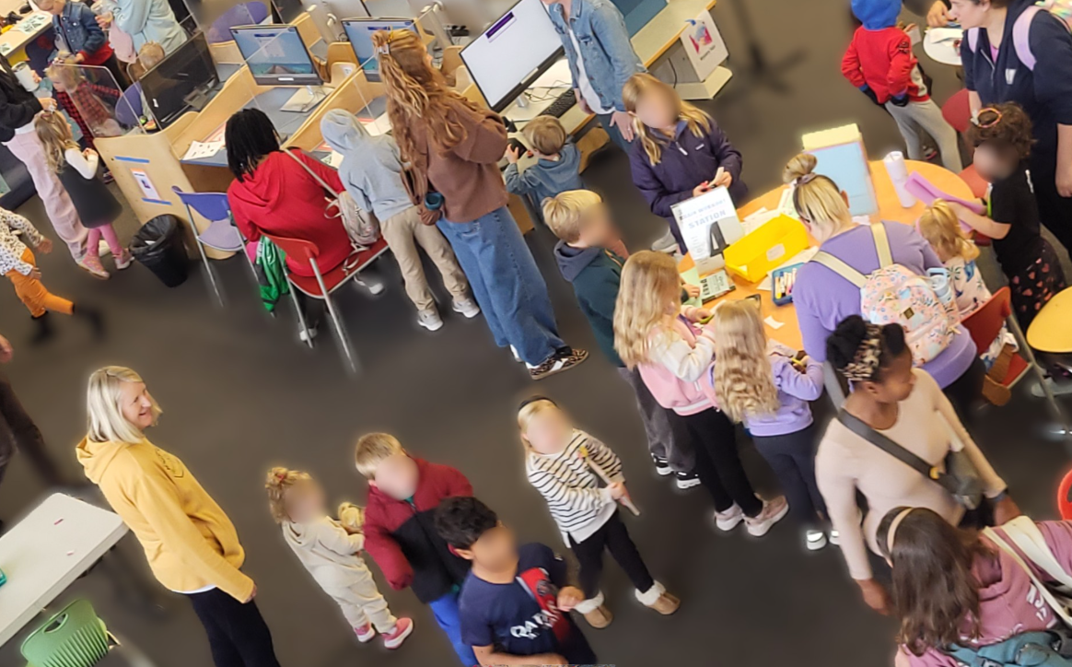
School’s Out! S.T.R.E.A.M.
The Brandywine Hundred Library successfully leveraged the current K-POP Demon Hunter trend by hosting a multi-day celebration highlighting science, technology, reading, engineering, art, math, language, and culture. With many schools closed for the Thanksgiving break, more than 450 patrons participated in the event on November 24, 25, and 26. Activities included self-guided STREAM stations, photo opportunities, scavenger hunts, and karaoke.
Social media posts related to this event were viewed and/or shared by patrons more than 967 times in 48 hours.
Brandywine Hundred Library saw record numbers of library attendance with door counts on Monday-667, Tuesday-719, and Wednesday-787.

Slide 9
SETTING UP the calendar
PLANNING & PREPPING content
MARKETING the event

Slide 10
SETTING UP THE CALENDAR
SELECTING THE DATES
Access School Calendars
Identify School Holidays
Match Dates to Library Schedule

Slide 11
Selecting the Dates: Access School Calendars
State’s Department of Education
Delaware
https://delaware.gov/guides/school-k-12/
Maryland https://marylandpublicschools.org/about/pages/school-systems/index.aspx
District Websites
Appoquinimink School District
Brandywine School District
Seaford School District
District Websites
Dorchester County
Montgomery County
Wicomico County

Slide 12
Selecting the Dates: Access School Calendars
Remember Private and Parochial Schools
Catholic Diocese of Wilmington
Delaware Charter Schools
Sussex County Non-Public Schools
Archdiocese of Baltimore
Maryland Approved Non-Public Schools

Slide 13
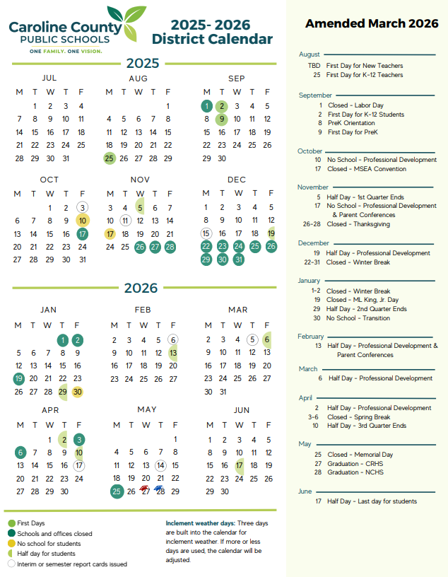
Identify School Holidays

Slide 14
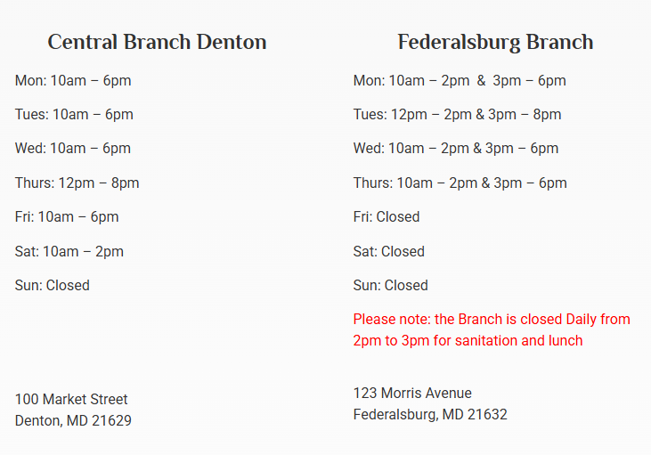
Compare & Match to Library Schedule

Slide 15
Compare & Match to Library Schedule

Slide 16
Compare & Match to Library Schedule

Slide 17
BRAINSTORMING BREAK
Any days / dates schools usually have off that libraries are open?
Rosh Hashanah / Yom Kippur
Indigenous People / Columbus Day
Day(s) before Thanksgiving
Day(s) before Christmas
Days after Christmas
Days before / after Easter
Conference Days
Professional Development Days

Slide 18
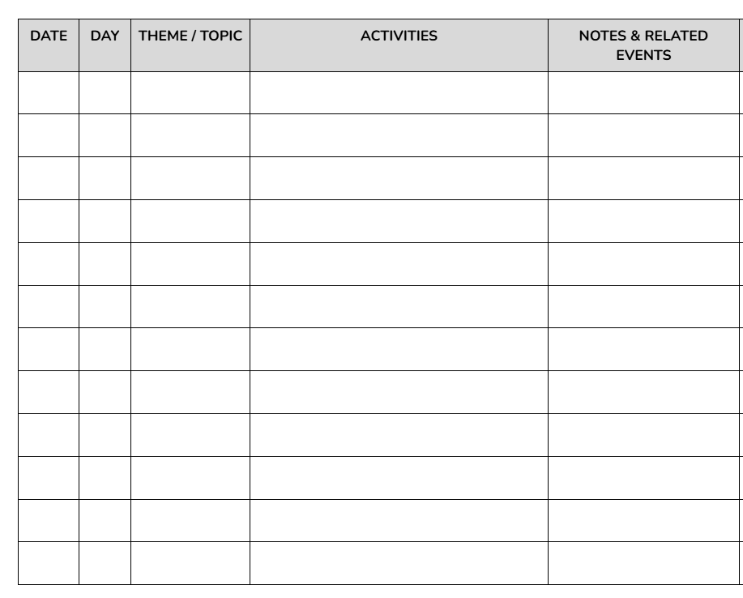
Choose the dates and start planning
SAMPLE PLANNING DOC
11/3 Mon
11/24 Mon

Slide 19
PLANNING & PREPPING the content

Slide 20
Planning & Prepping Content
CONSIDER:
National Day Calendar
Days of the Year
Time and Date
National Press Club Special Months
United Nations Days / Weeks
Build Your Library Literary Days
Teaching Books Calendar
WHAT ELSE?
Is there a national / international observance?

Slide 21
Planning & Prepping Content
CONSIDER:
Trending Now Google
The Today Show
Epidemic Sounds
Spotify Charts
Rotten Tomatoes
Nielsen Ratings
Movie Releases
What else?
Is there a national / international observance?
Is there a popular trend?

Slide 22
Planning & Prepping Content
CONSIDER:
Is there a national / international observance?
3D Printing
New collection
Upcoming festival or event
Museum Passes
Is there a popular trend?
Is there a library resource to highlight?

Slide 23
Planning & Prepping Content
CONSIDER:
Is there a national / international observance?
Is there a popular trend?
Recurring program
Special Guest
Demonstration
School District Event
Is there a library resource to highlight?
Can the program piggyback on another event?

Slide 24
BRAINSTORMING BREAK
Any annual / traditional / local observances that can be used for inspiration?
WHAT ELSE?
Sea Witch festival
Fire & Ice Festival
Superbowl
Kite Festival
Preakness

Slide 25
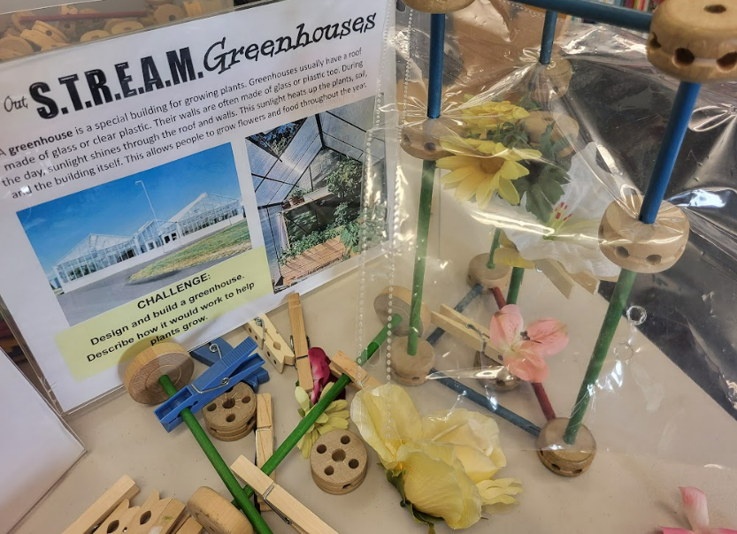
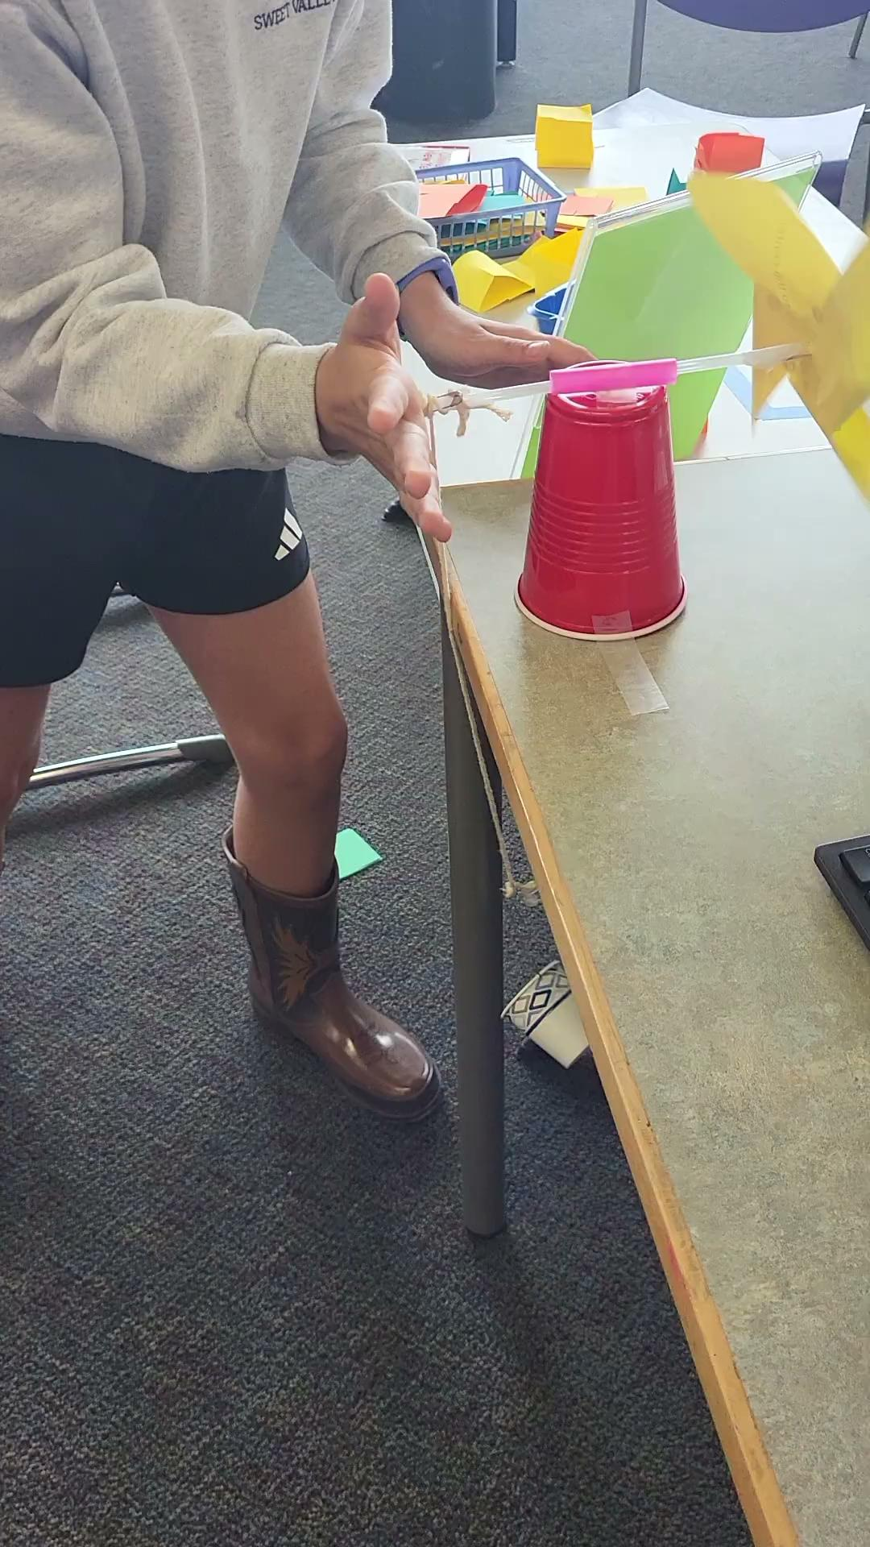
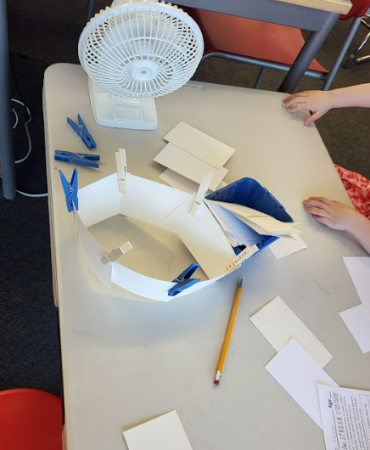
Earth Day & Energy

Slide 26
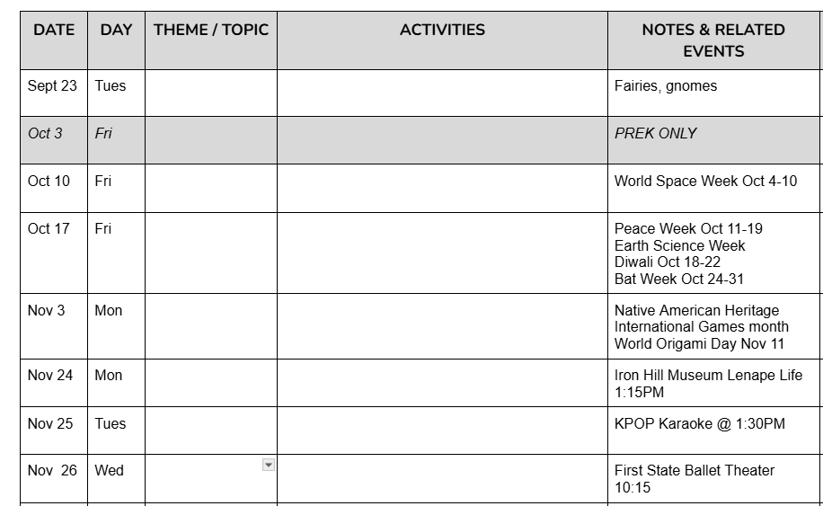
Determine Themes / Goals
SAMPLE PLANNING DOC

Slide 27
Planning & Prepping Content
CONSIDER:
Ages & Age Range
Development Appropriateness
Scalable for age & quantity

Slide 28
Planning & Prepping Content
CONSIDER:
Space
Materials
Staff

Slide 29
Planning & Prepping Content
CONSIDER:
Space
  How many tables?
  How many outlets?
  Line of sight?
WHAT ELSE?

Slide 30
Planning & Prepping Content
CONSIDER:
Materials
  What do you already have?
  What can be used without supervision?
  Consumable vs non-consumable?
  Is there a budget for purchasing materials?
WHAT ELSE?

Slide 31
BRAINSTORMING BREAK
School’s Out Starter Kit Materials
crayons
pencils
markers
glue sticks
scissors
tape
stapler & staples
paper
construction paper
popsicle sticks
paper clips
brass fasteners
binder clips
rubber bands
toothpicks
cotton swabs
yarn / string
paper plates
paper cups
clothespins

Slide 32
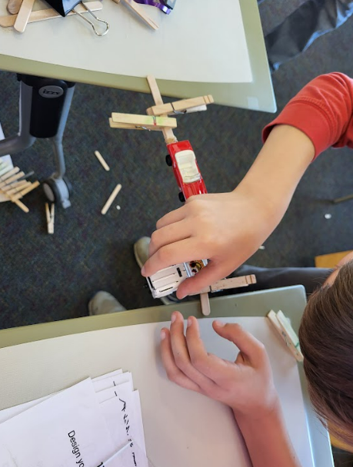
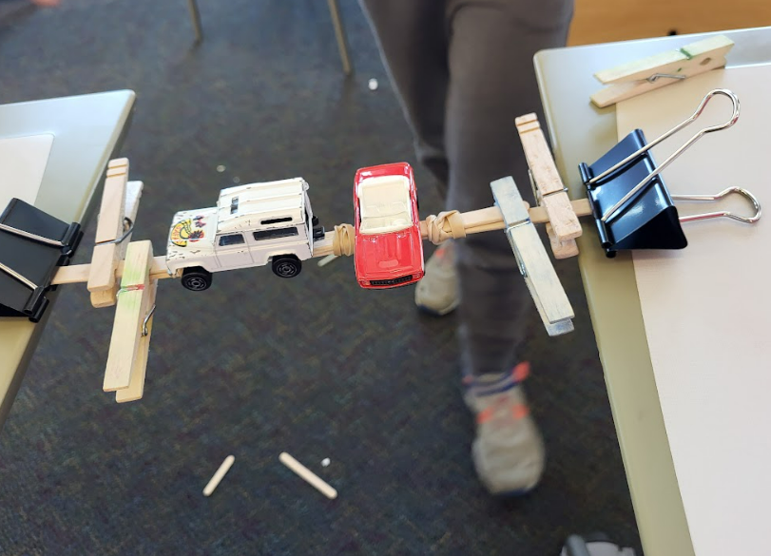
Bridge Building

Slide 33
Planning & Prepping Content
CONSIDER:
Staff
  What staff is available to prep and set up materials / activities?
  During the program how much supervision will be needed? Is available?
  Can volunteers (teens?) be engaged?
WHAT ELSE?

Slide 34

Planning & Prepping Content
RESOURCES:
NASA
Science Buddies
National Inventors Hall of Fame
STEAM Powered Family
Science Journal for Kids
WHAT ELSE?

Slide 35
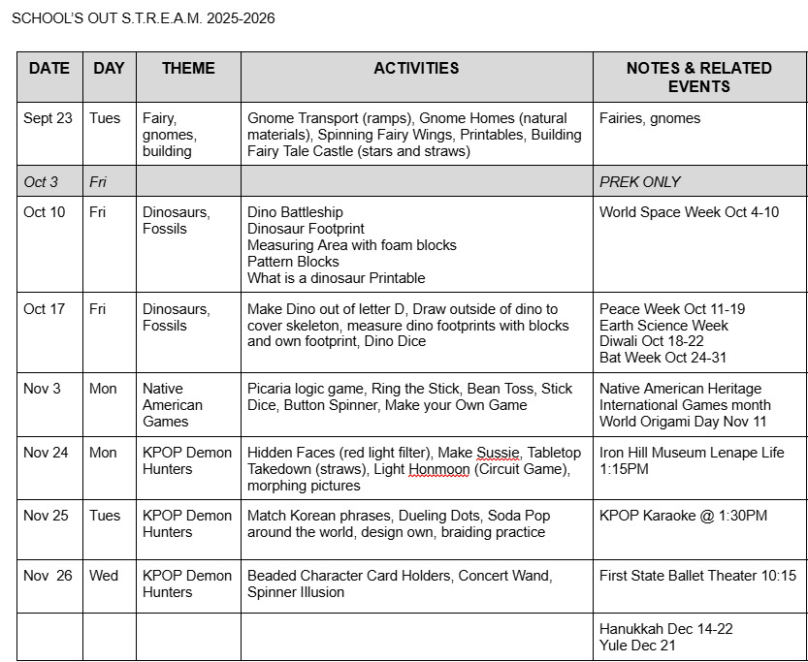
Determine Themes / Goals
SAMPLE PLANNING DOC

Slide 36
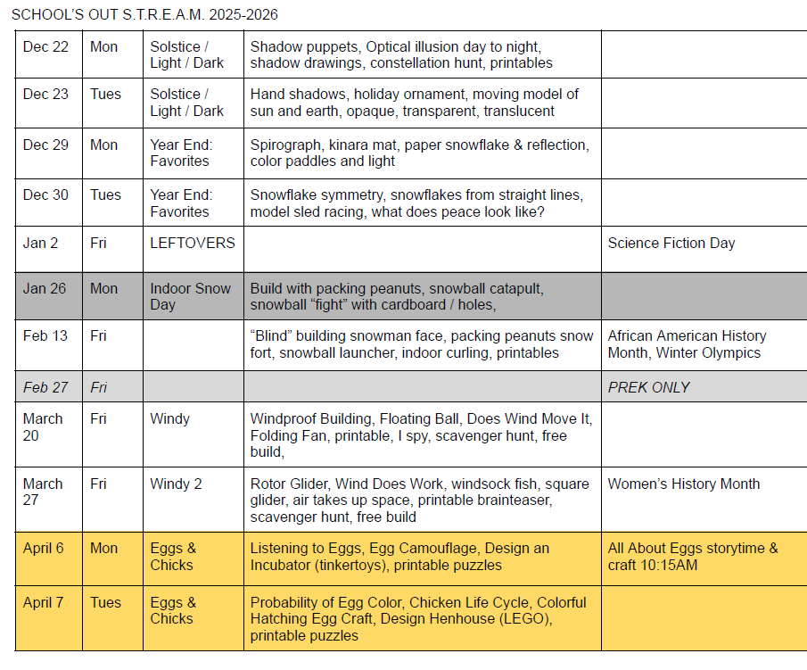
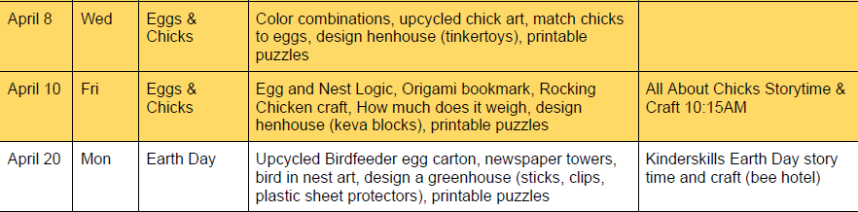
Sample Year Plan

Slide 37
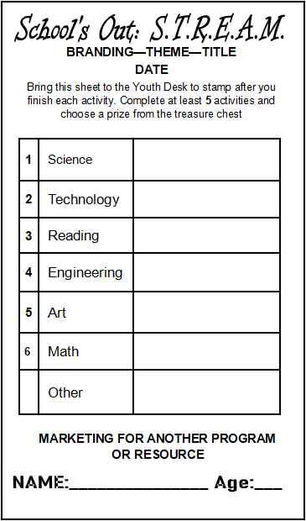
Planning Content
Branding
DRAFTING STAMP SHEET
Instructions
SIDE 1
Content Areas
Content Preview
Promotion

Slide 38
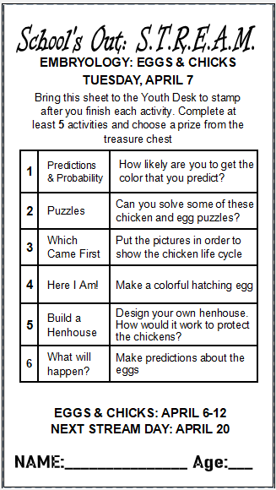
Planning Content
Branding
DRAFTING STAMP SHEET
Instructions
SIDE 1
Content Areas
Content Preview
Promotion

Slide 39
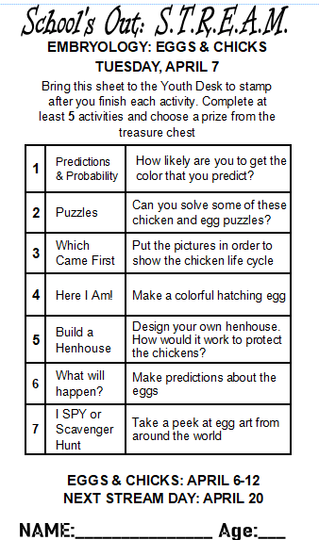
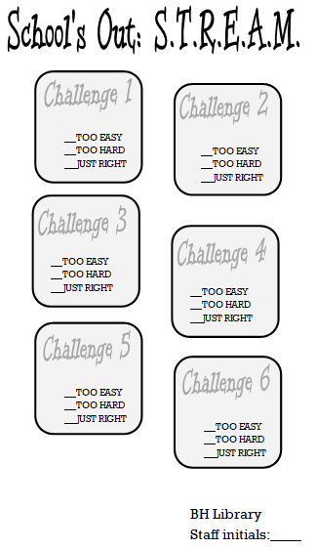
Planning Content
SIDE 2 = FEEDBACK
What other information would be useful to gather?

Slide 40
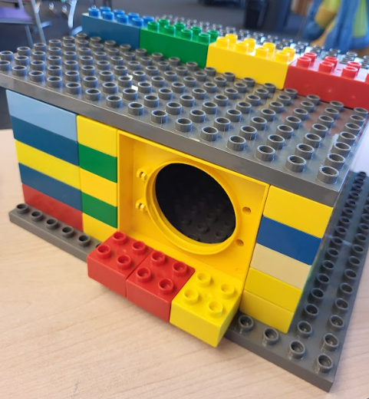
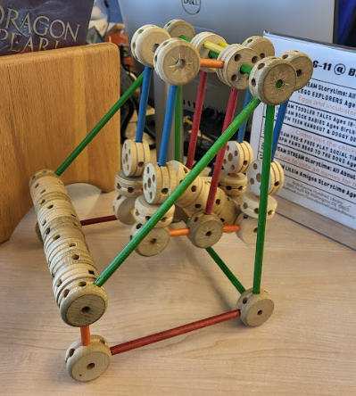
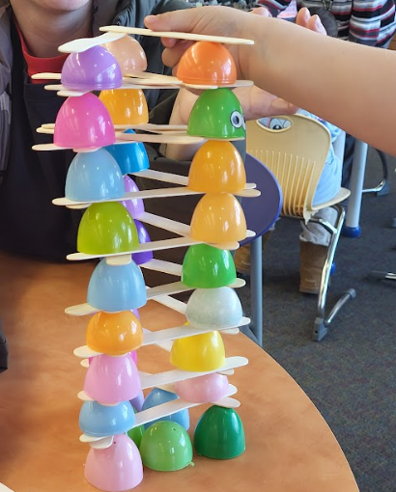
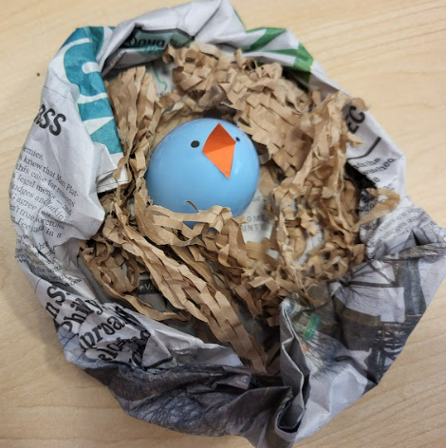
Eggs & Chicks

Slide 41
Marketing & Promoting
Notes:
Seeing kids in the building and not having any particular activity, hook for them to encourage them to come back. Also: importance of regular routines for parents. Don’t need to think about what to do when the kids are off school: They already know that the library will have something to do.

Slide 42
Marketing & Promoting
CONSIDER:
Permissions
  Can you create your own marketing?
  Are any elements mandatory on marketing material?
  Does anyone need to approve your marketing before it goes live?
WHAT ELSE?

Slide 43
Marketing & Promoting
CONSIDER:
Outlets
  What outlets do you already have?
    Branch Social Media
    Library website
    Foot Traffic
  What outlets can you explore?
    Community sites
    (MacaroniKid, MetroKids, Baltimore’s Child)
    System level social media
    System level site
WHAT ELSE?

Slide 44
Marketing & Promoting
CONSIDER:
Audience
  Whom are you trying to attract to this event?
    Public school students, private school students, homeschool students
    Existing patrons vs new patrons
  What age group are you trying to attract?
WHAT ELSE?

Slide 45
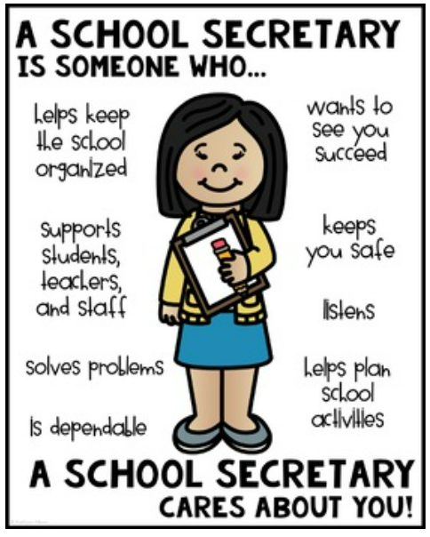
Marketing & Promoting
Making Connections
Contact school directly
Who is the most important staff person in the school?
Sample script:
Hi, my name is [name] from the [library]. We are hosting a free day of events for families on [DATE] when the kids are out of school, and I want to know the best way to share this information with your families.
Have social media flyer ready to share

Slide 46
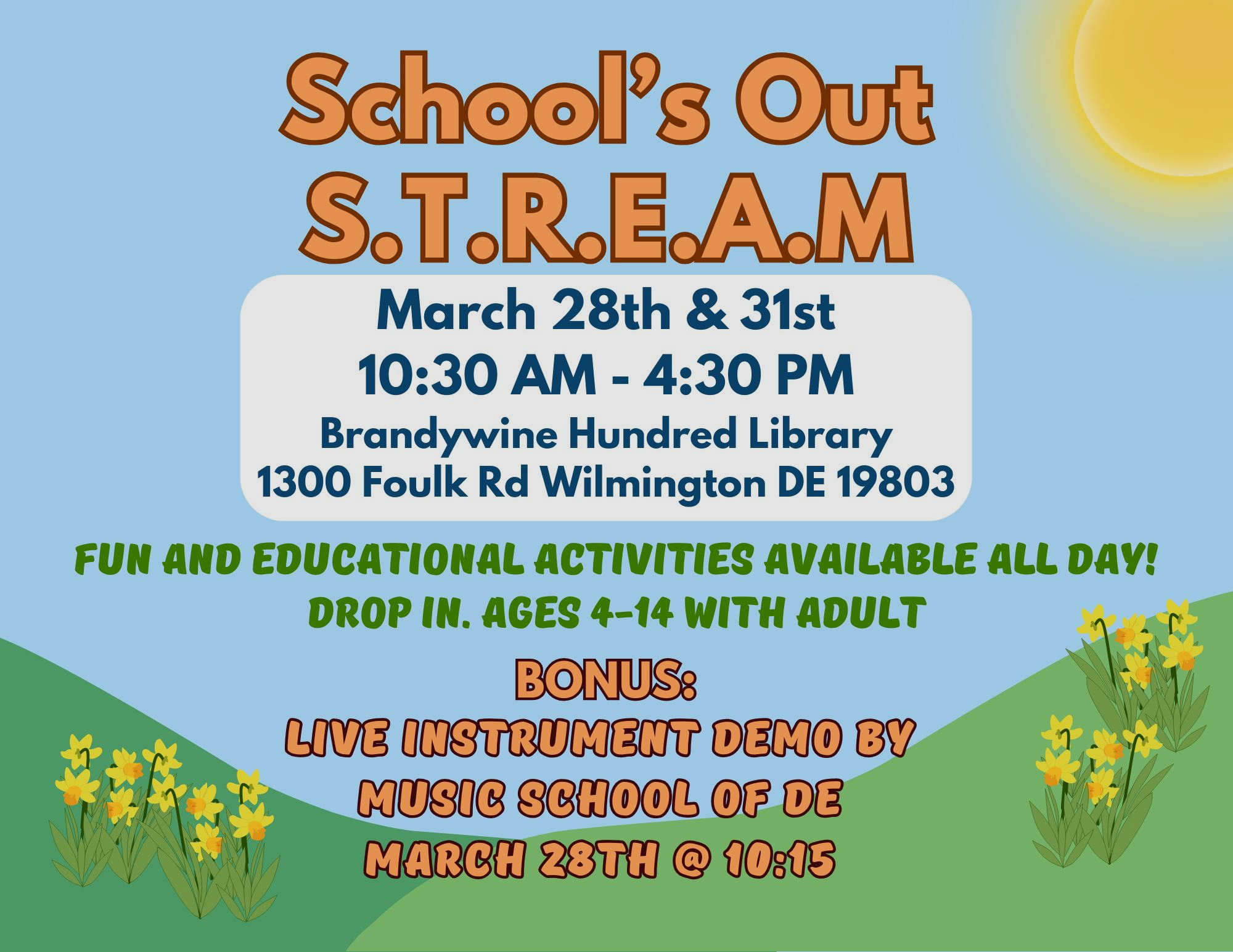
Tag the district or schools in your social media
Does your @brandywineschooldistrict student have the day off school on March 28th? Visit the Brandywine Hundred Library for hands-on learning and fun! Ages 4-14 with adult. 10:30AM-4:30PM. Drop in. No registration.

Slide 47
Marketing & Promoting
Making Connections
Connect with the PTA / PTO / Family Associations
Do you know the school library / media specialist?
Do any regular library patrons go to the schools?
WHAT ELSE?

Slide 48
GROUP WORK: GIVE IT A TRY

Slide 49
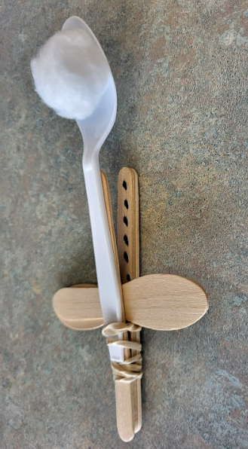
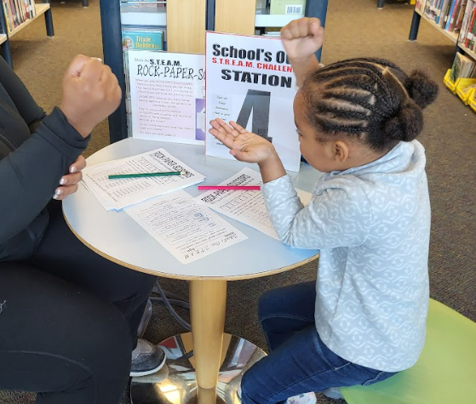
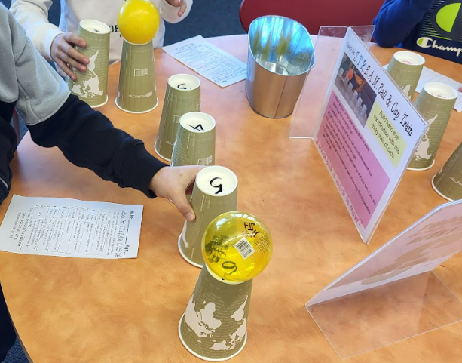
etc

Slide 50
Thank you!
Bernadette.caruso.davis@gmail.com
Bernadette.davis@newcastlede.gov
@missblibrarylady

Slide 51
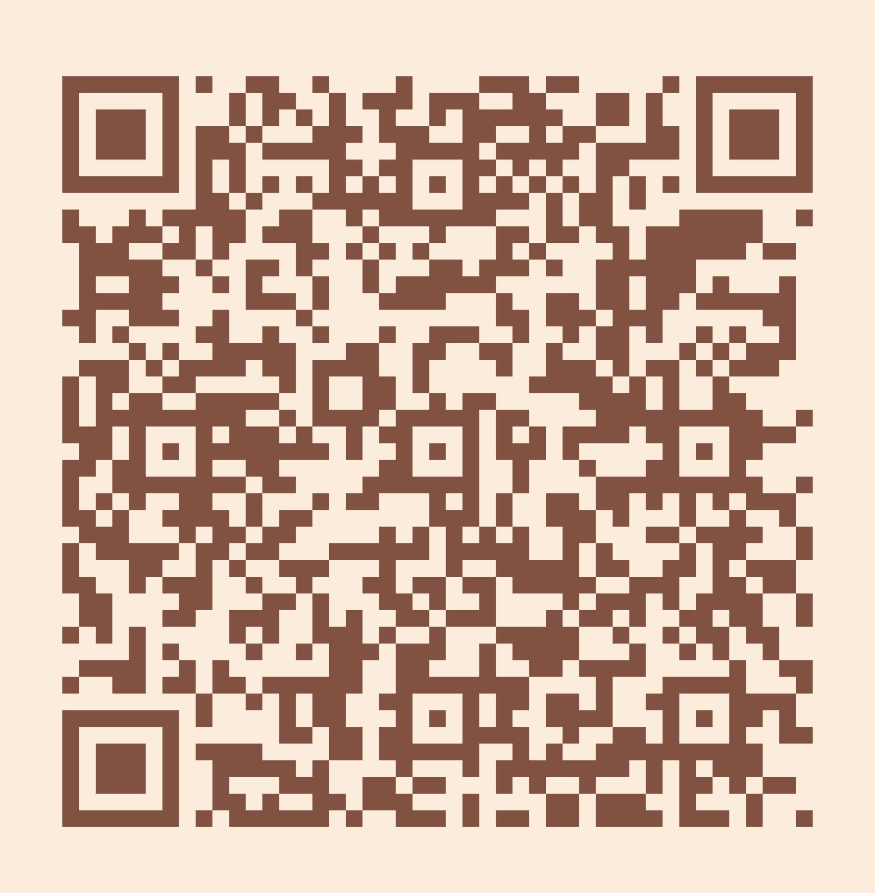
Please take a moment to complete the program survey.
SCAN ME!

