Slide 2




Don’t Miss!
50/50 RAFFLE
Tickets are $1 each and can be purchased from Conni Strittmatter or David Dahl! The winner takes home half the pot.
SILENT AUCTION
Visit the Silent Auction in the exhibitor hall to place your bids before 10:45 a.m. on Friday, May 8th.
PUB QUIZ
Thursday, May 7 8:00 – 10:00 p.m. Choptank Ballroom
KARAOKE
Thursday, May 7 8:00 – 11:00 p.m. Windjammer

Slide 3
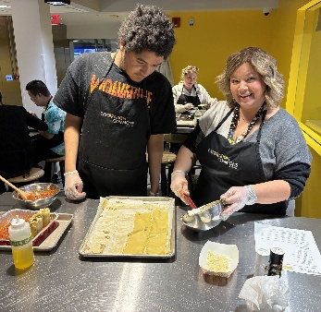
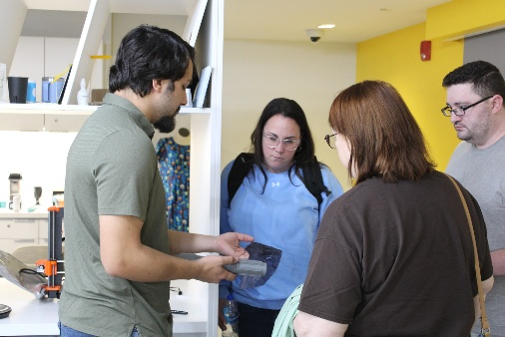
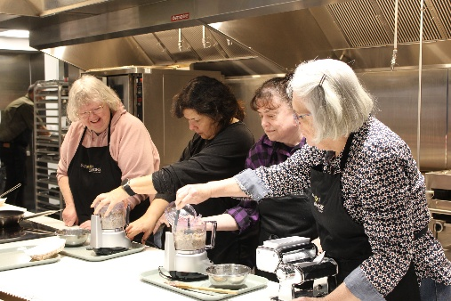
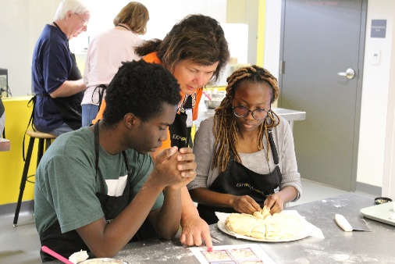
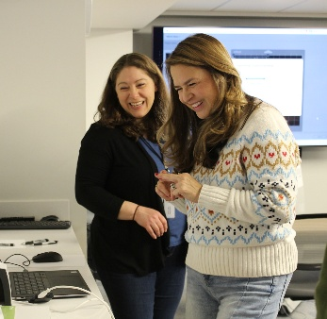
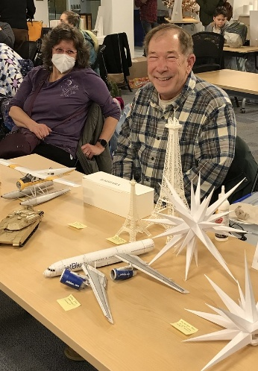
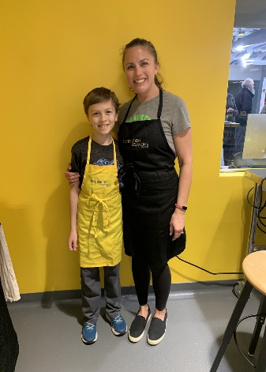
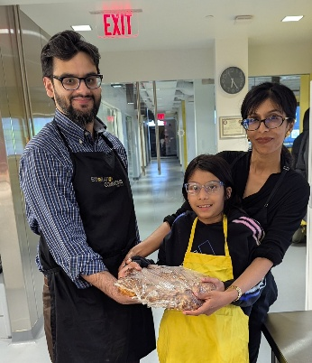
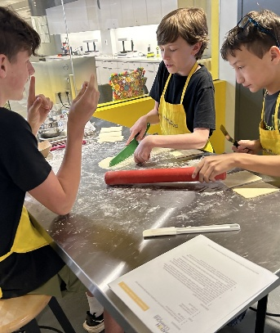
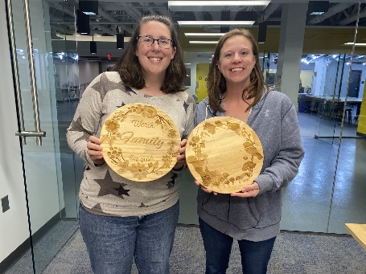
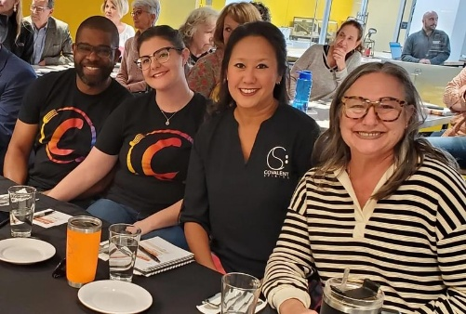
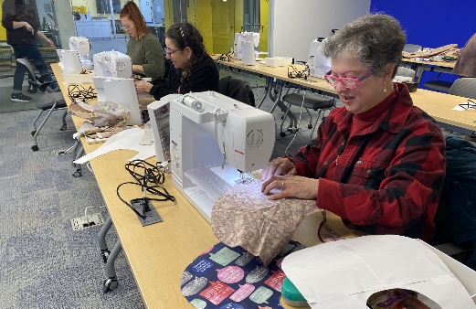
Recipes for Connection:
Food and Making as Pathways
to Community
Katie Haines & Joe DiMaggio III
Carroll County Public Library
Notes:
Joe & Katie introduce selves / titles

Slide 4

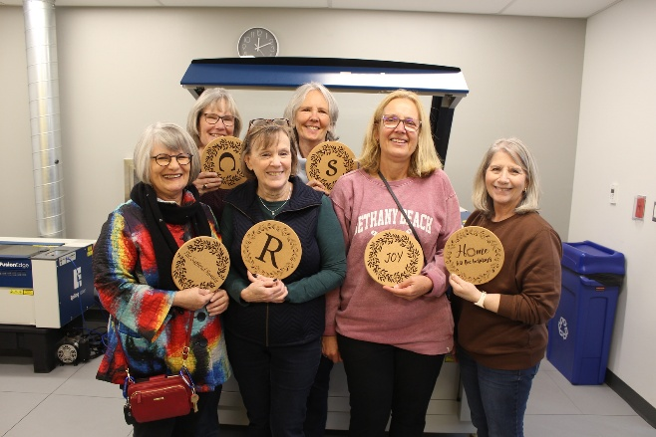
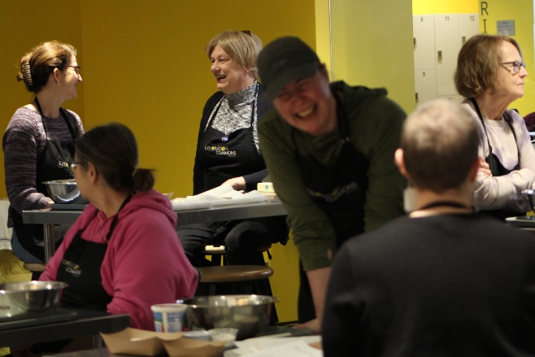
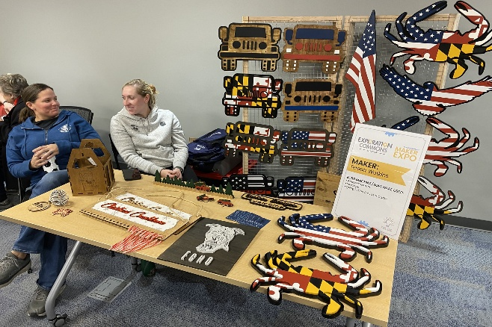
Learning Objectives
Create or adjust programs to increase accessibility
Identify opportunities for partnerships with community groups and local businesses
Name three ways to foster connection
Notes:
Joe Slide
Our learning objectives today are for you to be able to name 3 ways to foster connection, create or adjust programs to increase accessibility and identify opportunities for partnerships with community groups and local businesses.

Slide 5
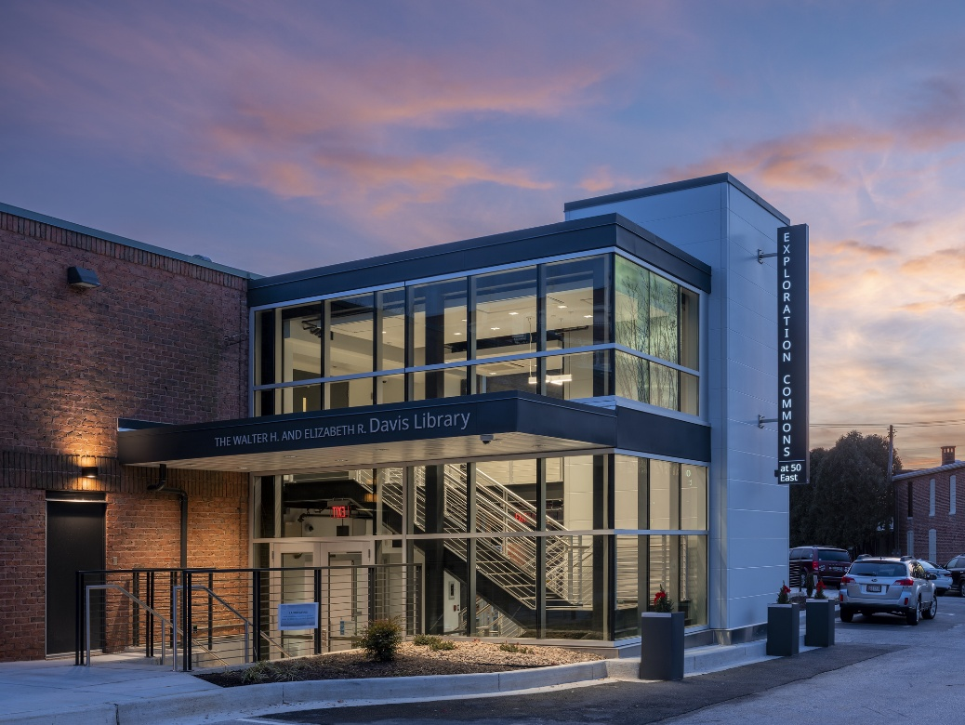
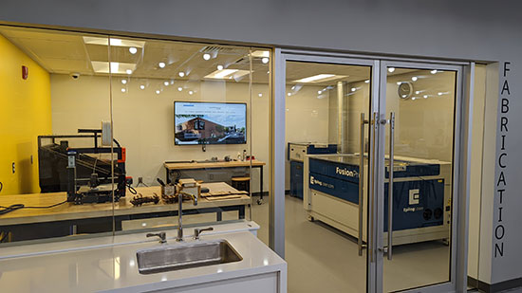
Exploration Commons @ 50 East
Exploration Commons was completed in December 2021 and provides the region with a collaborative and experiential learning space.
Notes:
Katie
Exploration Commons was completed in December 2021 and provides the region with a collaborative and experiential learning space that integrates a Makerspace, Teaching Kitchen, and Meeting Spaces.

Slide 6
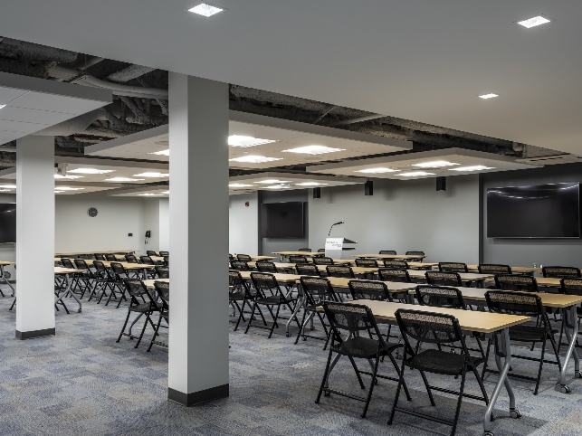
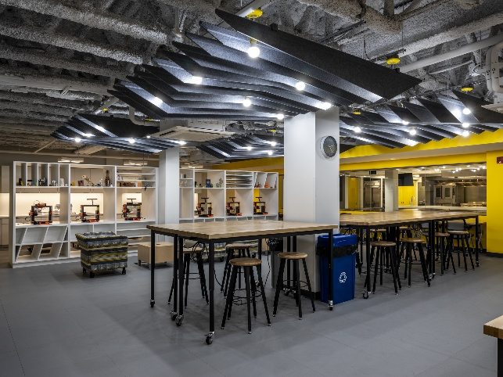
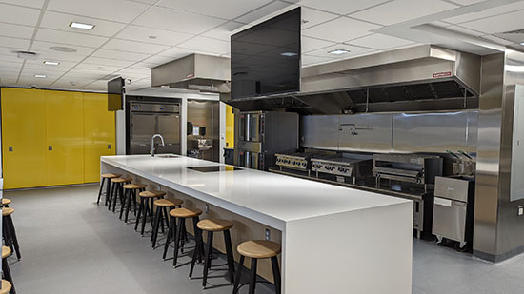

Exploration Commons @ 50 East
Meeting Rooms
Flexible spaces for group gatherings, workshops, and community events.
Makerspace
A fully equipped fabrication and digital design lab open to all skill levels.
Teaching Kitchen
A hands-on culinary classroom where community cooks and connects.
Notes:
Katie
There are four meeting room spaces for community use. The Makerspace is a 3000 square foot open floor space that is available for walk-in customers during all hours of operation, and is equipped with various resources and labs related to digital fabrication. The teaching kitchen is a 1500 square foot commercial kitchen where community cooks and connects.

Slide 7

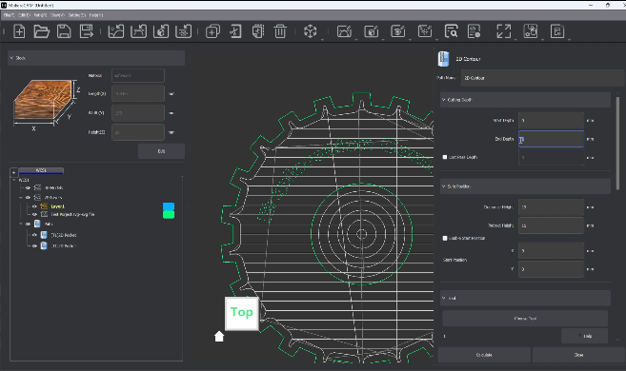
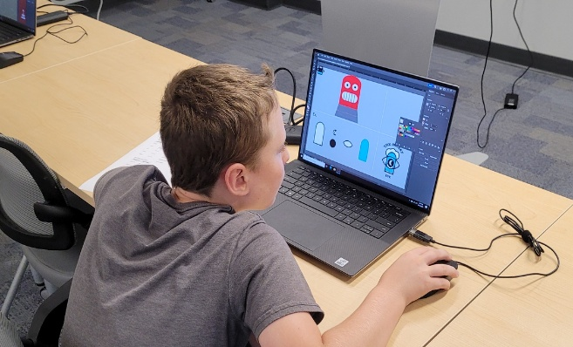
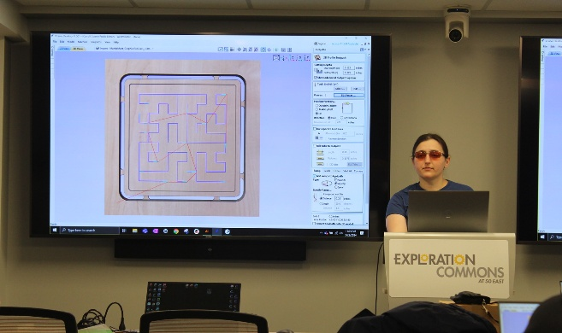
Makerspace Tools & Technology
Digital Tools
All listed software are available on public laptops and
desktops in the Makerspace!
Full Adobe Suite
Fusion 360
AutoCAD
Blender
CorelDraw
Inventor
Unity
Unreal Engine 5
MakeraCAM
FL Studio
Notes:
Joe Slide
Available laptops and desktops with various design software: Full Adobe Suite, Fusion360, AutoCAD, Blender, CorelDraw, Inventor, Unity, Unreal Engine 5, and FL Studio
Fabrication equipment: laser engravers, CNC, 3D printers, sewing machines, embroidery, serger, Cricut vinyl cutters, vaquformers, and 3D scanner.
Fabrication Lab, AR/VR Lab, & Audio/Video Lab available
Fabrication tools: calipers, rulers, cutting mats, x-acto knives, cutting guards, t-squares, etc.
Available materials for purchase: wood, slate stone, acrylic

Slide 8
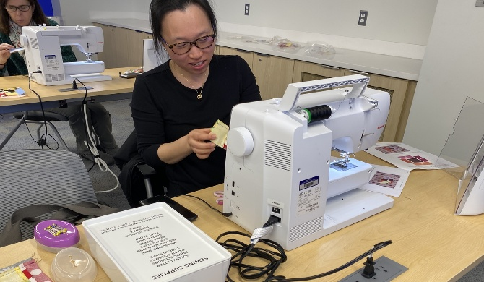
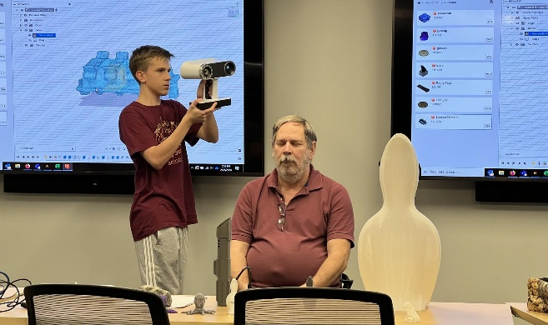
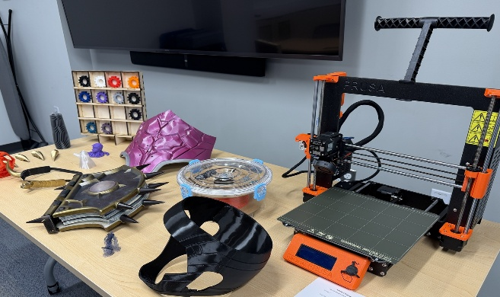
Makerspace Tools & Technology
Fabrication Equipment
All listed equipment we have available in the
Makerspace for classes and individual use!
Laser Engravers
CNC
3D Printers
Sewing Machines
Embroidery
Serger
Cricut Vinyl Cutters
Vaquformers
3D Scanner
Notes:
Joe Slide
Available laptops and desktops with various design software: Full Adobe Suite, Fusion360, AutoCAD, Blender, CorelDraw, Inventor, Unity, Unreal Engine 5, and FL Studio
Fabrication equipment: laser engravers, CNC, 3D printers, sewing machines, embroidery, serger, Cricut vinyl cutters, vaquformers, and 3D scanner.
Fabrication Lab, AR/VR Lab, & Audio/Video Lab available
Fabrication tools: calipers, rulers, cutting mats, x-acto knives, cutting guards, t-squares, etc.
Available materials for purchase: wood, slate stone, acrylic

Slide 9
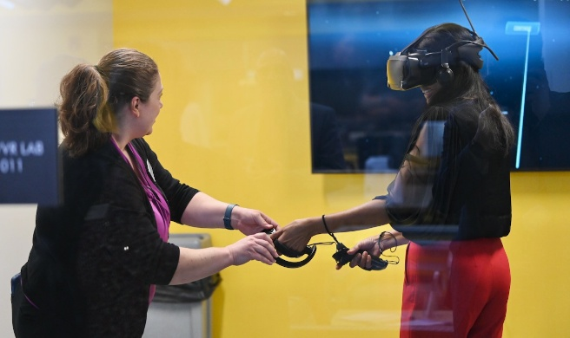
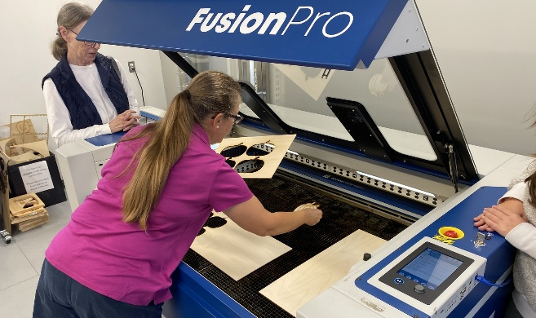
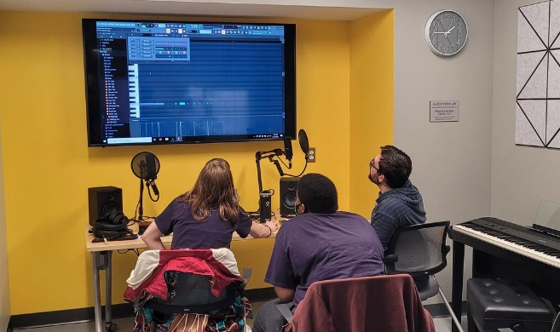
Makerspace Tools & Technology
Labs & Materials
All listed labs are available workspaces for patrons to
use and reserve at Exploration Commons!
Fabrication Lab
Augmented Reality/Virtual Reality Lab
Audio/Video Lab
Notes:
Joe Slide
Available laptops and desktops with various design software: Full Adobe Suite, Fusion360, AutoCAD, Blender, CorelDraw, Inventor, Unity, Unreal Engine 5, and FL Studio
Fabrication equipment: laser engravers, CNC, 3D printers, sewing machines, embroidery, serger, Cricut vinyl cutters, vaquformers, and 3D scanner.
Fabrication Lab, AR/VR Lab, & Audio/Video Lab available
Fabrication tools: calipers, rulers, cutting mats, x-acto knives, cutting guards, t-squares, etc.
Available materials for purchase: wood, slate stone, acrylic

Slide 10
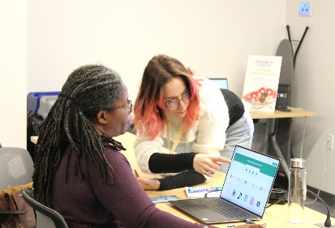
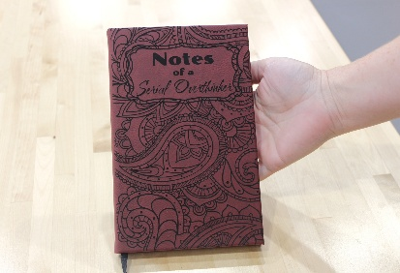
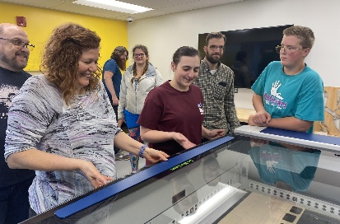
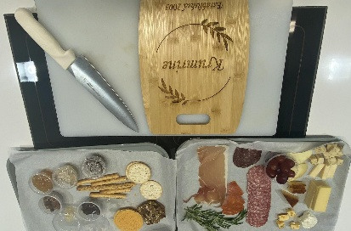
Makerspace Classes
Software Classes
Project-Based Classes
Certification Classes
Kitchen Crossover
Free instructional classes on various design software.
Hands on projects using combination of software and on-site equipment.
Free training for independent use of Makerspace machinery.
Combined makerspace + cooking class.
Notes:
Joe Slide
Software instructional classes, these are free classes
Project based classes that incorporate our on-site equipment, usually cost between $5-$20 depending on the project, but we do occasionally offer free project classes
Certification classes for patrons looking to gain independent use of our machinery, these classes are free
Certification classes for patrons looking to gain independent use of our machinery, these classes are free
Kitchen cross-over classes, project classes that incorporate the makerspace equipment and cooking food from the Teaching Kitchen, these classes typically have a charge ranging from $10-$25 depending on the project and recipe.

Slide 11

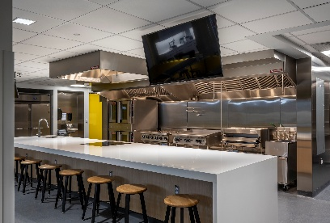
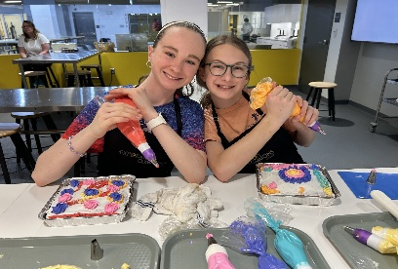
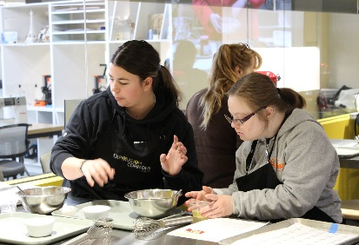
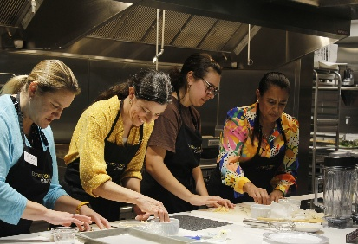
Teaching Kitchen Classes
Teaching
Kitchen
Cooking Classes
Partner Programs
Guest Instructors
A commercial kitchen space with room for 20 participants.
We teach 4-5 classes each week for children ages 6 and up, teens, and adults.
We host 4 partner classes each month for local non-profit organizations.
We host 2 guest instructors per quarter.
Notes:
Katie
We teach 5-6 classes each week for children ages 6 and up, teens, and adults
About 4 partner classes each month, for local non-profits
We host 1-2 guest instructors a quarter. These are typically local restaurant owners. Using guest instructors is a key way we add diversity to the classes we offer.
Registration is required for classes. Most of the classes in the kitchen have a fee to cover ingredients and supplies, anywhere from $5-$20. We do also have free classes every month, like our foundational knife skills class, and all of our partner classes are free.
Space fills quickly! At almost 5 years open, most classes are still filling in under 5 minutes.
Community prefers hands-on classes, but we do offer demonstration classes as well.

Slide 12

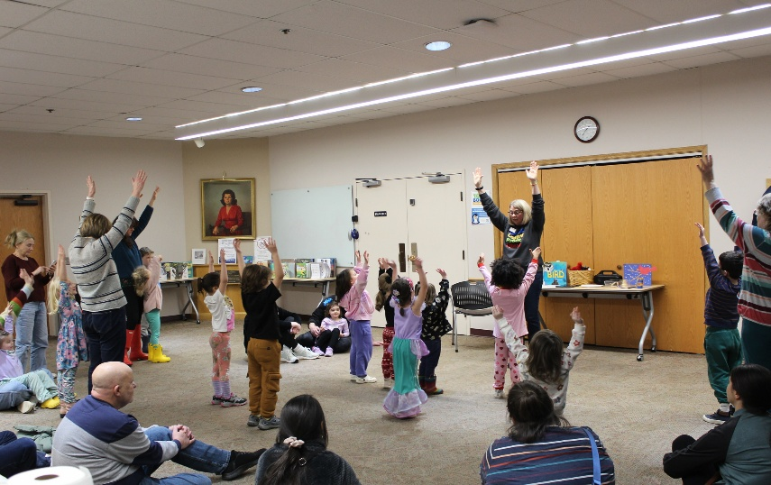
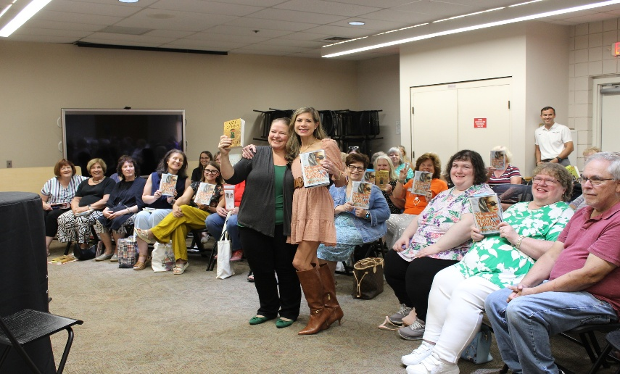
Libraries as Spaces
for Connection
What we know:
Connection supports well-being
People seek places where they feel they belong
What libraries already do:
Create welcoming, shared spaces
Foster interaction
Serve as a community anchor
Notes:
What we know:
Many of us are familiar with the 2023 Surgeon General’s report on the Epidemic of Lonliness and Isolation.
Connection supports well-being, both for the individual and the community
People seek places where they feel they belong and everyone knows their name
What libraries already do:
Create welcoming, shared spaces
Foster interaction—formal and informal
Serve as community anchors

Slide 13
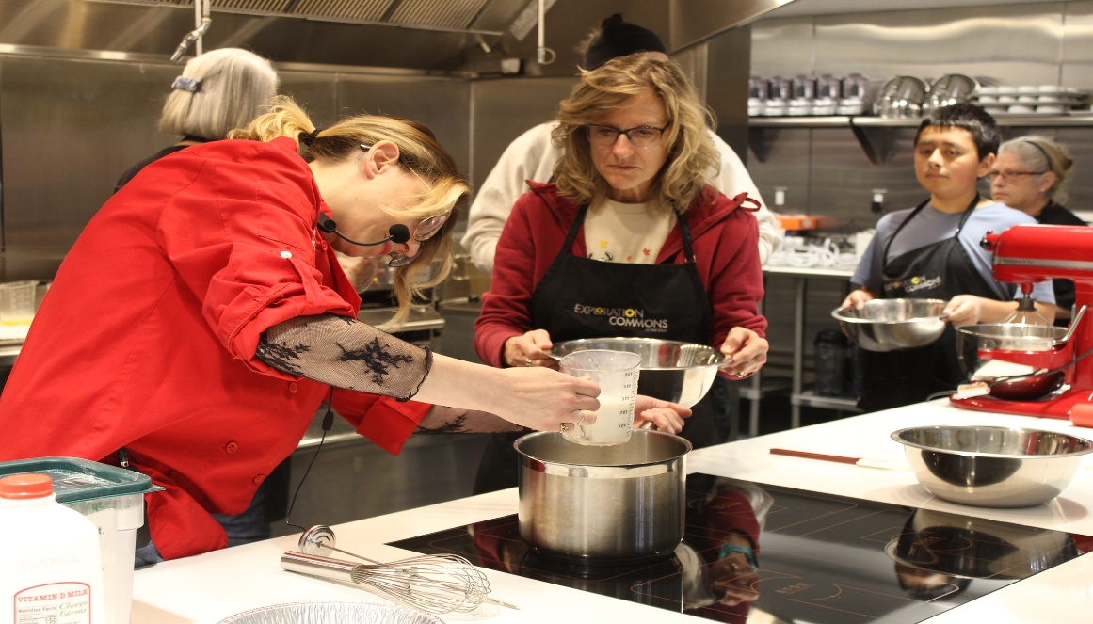
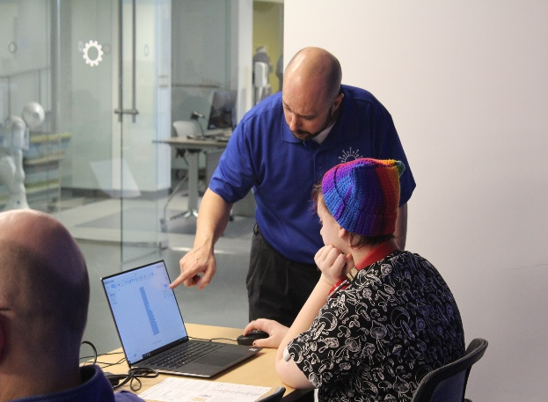
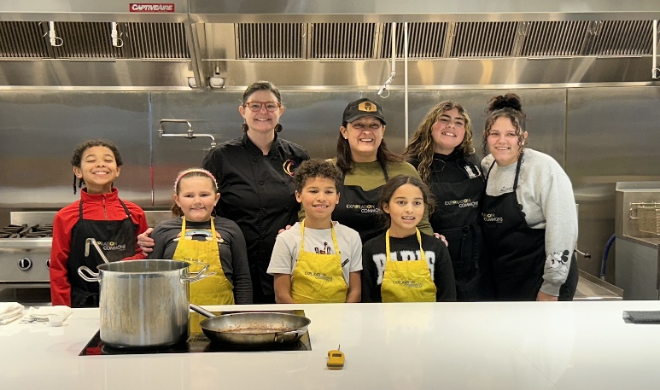
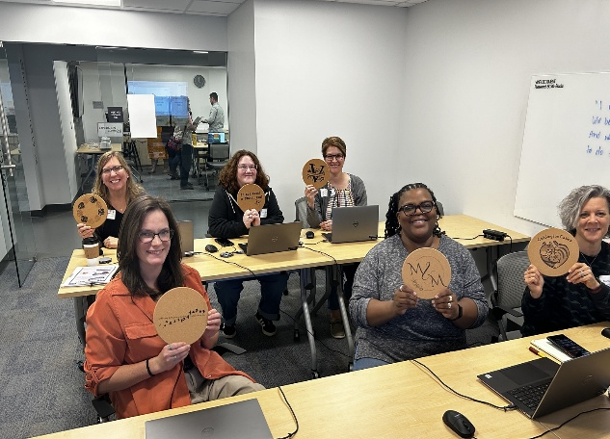
Our Approach
We create interactive, shared experiences where people learn by doing—building skills, confidence, and community along the way.
Notes:
Katie
We create interactive, shared experiences where people learn by doing—building skills, confidence, and community along the way.

Slide 14

Fostering Connection in the Makerspace
Notes:
Available laptops and desktops with various design software: Full Adobe Suite, Fusion360, AutoCAD, Blender, CorelDraw, Inventor, Unity, Unreal Engine 5, and FL Studio
Fabrication equipment: laser engravers, CNC, 3D printers, sewing machines, embroidery, serger, Cricut vinyl cutters, vaquformers, and 3D scanner.
Fabrication Lab, AR/VR Lab, & Audio/Video Lab available
Fabrication tools: calipers, rulers, cutting mats, x-acto knives, cutting guards, t-squares, etc.
Available materials for purchase: wood, slate stone, acrylic

Slide 15
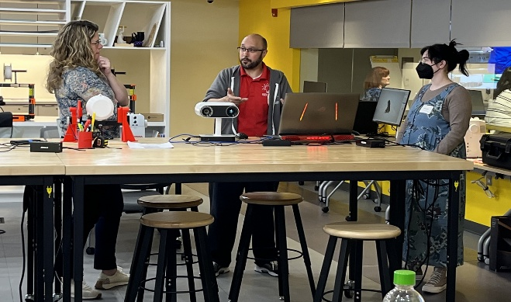
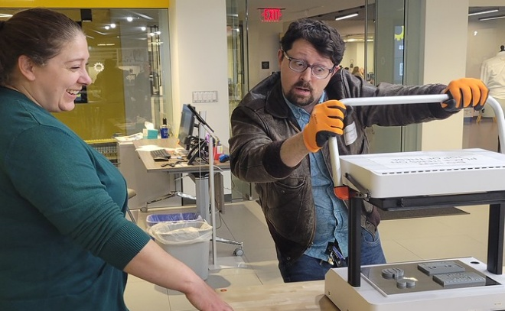
How We Foster Connection in
the Makerspace
Large open tables to encourage group work and large projects
Experienced staff available for questions and troubleshooting
Rotating slidedeck in the Makerspace to showcase customer projects
Notes:
Most classes require attendees to actively follow instruction on their own devices in order to successfully create their project
In classes that incorporate our fabrication equipment, patrons have the opportunity to view other participant’s projects being made along with their own
We label programs that require a higher-level of skill in certain subjects in order to not fragment the class between those who are confident in their skill set and those who are new to the techniques and concepts we teach on
Our makerspace features large open tables and workspaces to both encourage and accommodate group work and large projects
The main screen in the makerspace has an rotating slidedeck that showcases class photos or project photos submitted by our patrons

Slide 16
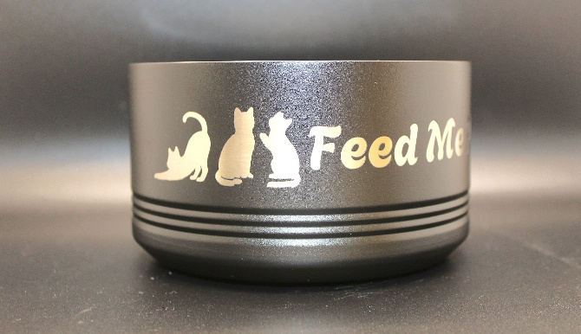
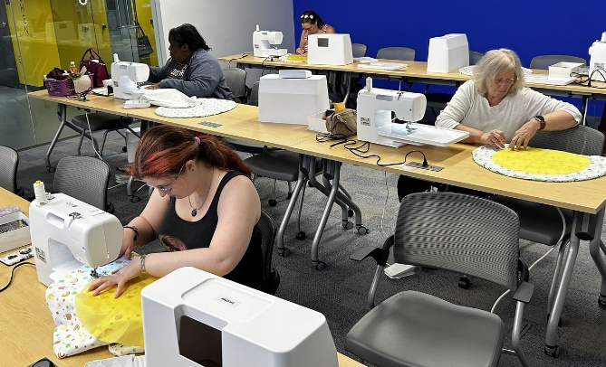
How We Foster Connection in Maker Classes
Classes catered to targeted groups (ex. Making for Seniors, Adults with Developmental Disabilities, Intro Level Classes, Intermediate Level Classes)
Project Interest Overlap
Time for casual discussion and group observation during fabrication
Making for Good classes allow patrons to create projects that will support the community
Notes:
Most classes require attendees to actively follow instruction on their own devices in order to successfully create their project
In classes that incorporate our fabrication equipment, patrons have the opportunity to view other participant’s projects being made along with their own
We label programs that require a higher-level of skill in certain subjects in order to not fragment the class between those who are confident in their skill set and those who are new to the techniques and concepts we teach on
Our makerspace features large open tables and workspaces to both encourage and accommodate group work and large projects
The main screen in the makerspace has an rotating slidedeck that showcases class photos or project photos submitted by our patrons

Slide 17

Fostering Connection in the Teaching Kitchen
Notes:
We teach 5-6 classes each week for children ages 6 and up, teens, and adults
About 4 partner classes each month, for local non-profits
We host 1-2 guest instructors a quarter. These are typically local restaurant owners. Using guest instructors is a key way we add diversity to the classes we offer.
Registration is required for classes. Most of the classes in the kitchen have a fee to cover ingredients and supplies, anywhere from $5-$20. We do also have free classes every month, like our foundational knife skills class, and all of our partner classes are free.
Space fills quickly! At almost 5 years open, most classes are still filling in under 5 minutes.
Community prefers hands-on classes, but we do offer demonstration classes as well.

Slide 18
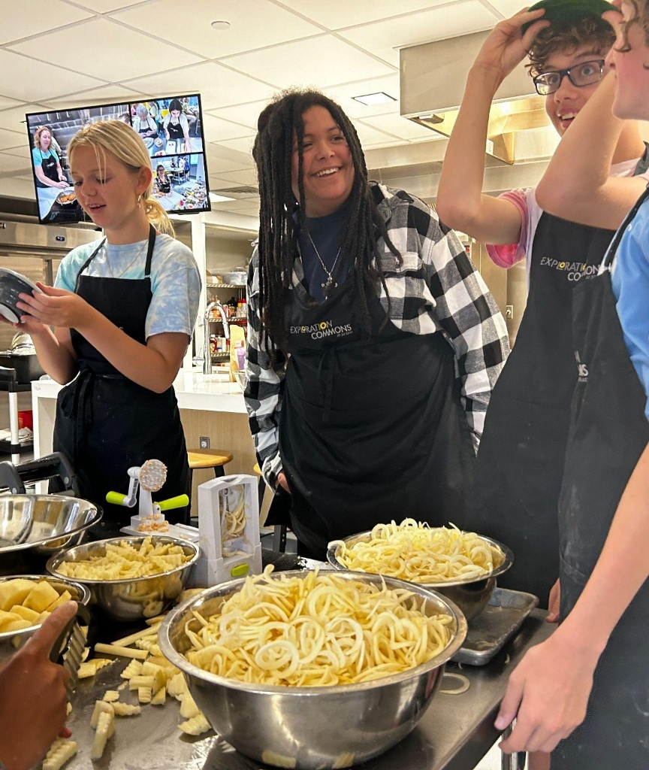
How We Foster Connection in the Teaching Kitchen
Room Design
Participants work around tables facing one another
Rolling slide deck before class
Class Design
Work in groups of 2, 3 or 4
Hands-on, active
Teamwork is required to get a finished product
Downtime provides space for interaction
Notes:
Room Design
Participants work around tables facing one another. It’s easier to talk to people when you’re facing them.
Tables are at different heights and the island is ADA accessible to allow everyone to find a good spot to work.
There’s a rolling slide deck that runs before class. It’s a passive talking point. It gives people something to look at, people love seeing themselves, family, teachers, other people in the community.
In Our Classes
Work in a group of 2, 3 or 4
Move around--in classes you are sitting around one table working together. But, there are other times when might be standing next to someone else a the prep sink, or using a wok next to someone else at the gas range. There’s lots of opportunity to connect with other people in the class (not just your table mates)
There are some classes where you’re working on your own, but a majority of the time, teamwork is usually required to get a finished product. There’s very few opportunities we have as adults, no longer in school, to have to work with a stranger. It’s truly a unique situation.
Fair amount of downtime. When I started designing classes I thought I’d have to fill every minute. But, now I know the downtime is such an important part of the class and it’s an important tool for connection. People start to chat and exchange stories about classes. They offer to send one another recipes. Or, they as questions of the instructor (salt question).

Slide 19
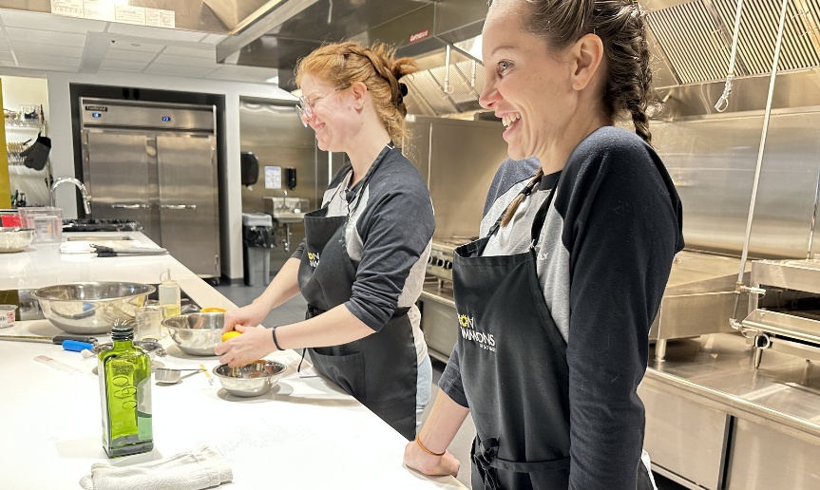
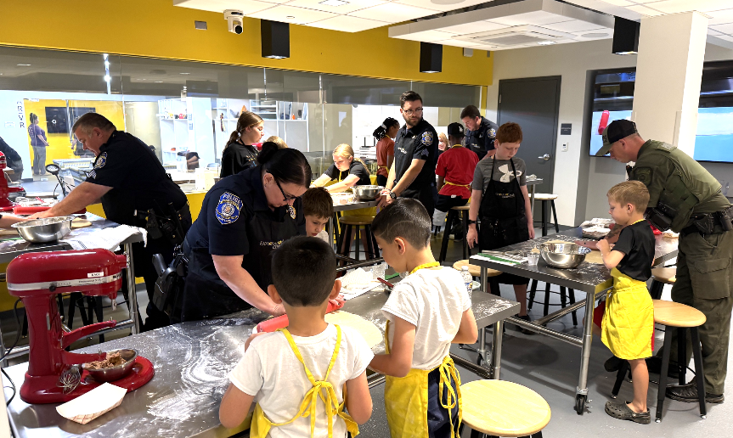
How We Foster Connection in the Teaching Kitchen
Common Interest Classes
Vegetarian
Cooking for 1
Gluten-Free classes
Cooking Basics
Nutrition and wellness classes taught by hospital dietitian
Notes:
Classes
Sometimes the classes are based around a common interest like Vegetarian, Cooking for 1, or Gluten-Free
Cooking Basics designed for a beginner cook. These classes move more slowly and everyone knows the content will be broken down and easy to follow.
We have a monthly nutrition and wellness class taught by hospital dietitian. She and the participants make the dish and while they eat she presents on a health-related topic like diabetes, anemia, or heart disease.
Inclusive cooks is a class that came about because we had community members ask for it. There are several organizations for adults with disabilites in the county who we work with, but there are many individuals who aren’t associated with the groups who want to come in for classes. While they are welcome to come to all of our classes, and many do, one staff member decided to flip the script. These classes are created for and centered on those with intellectual and developmental disabilities and they’re also open to all.
In our making for good classes, participants prepare a meal or treat that will be donated to a local organization. This is possible because our kitchen is licenced the same as a restaurant. We’ve made Turkey Noodle Soup and donated it to a soup kitchen. We had a local cupcake bakery owner, Em ___, teach how to make icing, how to ice a cupcake, make a fondant decoration. Each participant kept a couple and then the remainder were donated to staff at Boys and Girls Club.
What we see:
Many repeat participants have formed a community
Many friendships have formed
Birthday story
Cooking together is a form of teamwork that is unique.
Sharing a meal is a communal experience that is also unique.
There’s definitely a feeling of we’re all in this together. There’s camaraderie in cooking.

Slide 20

How We Foster Connection in the Teaching Kitchen
Inclusive Cooks
Slower-paced hands-on cooking series for people with intellectual and developmental disabilities, and people without.
Notes:
Classes
Sometimes the classes are based around a common interest like Vegetarian, Cooking for 1, or Gluten-Free
Cooking Basics designed for a beginner cook. These classes move more slowly and everyone knows the content will be broken down and easy to follow.
We have a monthly nutrition and wellness class taught by hospital dietitian. She and the participants make the dish and while they eat she presents on a health-related topic like diabetes, anemia, or heart disease.
Inclusive cooks is a class that came about because we had community members ask for it. There are several organizations for adults with disabilites in the county who we work with, but there are many individuals who aren’t associated with the groups who want to come in for classes. While they are welcome to come to all of our classes, and many do, one staff member decided to flip the script. These classes are created for and centered on those with intellectual and developmental disabilities and they’re also open to all.
In our making for good classes, participants prepare a meal or treat that will be donated to a local organization. This is possible because our kitchen is licenced the same as a restaurant. We’ve made Turkey Noodle Soup and donated it to a soup kitchen. We had a local cupcake bakery owner, Em ___, teach how to make icing, how to ice a cupcake, make a fondant decoration. Each participant kept a couple and then the remainder were donated to staff at Boys and Girls Club.
What we see:
Many repeat participants have formed a community
Many friendships have formed
Birthday story
Cooking together is a form of teamwork that is unique.
Sharing a meal is a communal experience that is also unique.
There’s definitely a feeling of we’re all in this together. There’s camaraderie in cooking.

Slide 21


How We Foster Connection in the Teaching Kitchen
Making for Good
Turkey Soup: Participants make a meal that will be shared with a local soup kitchen.
ButterWorks Bakery: Taught class how to make buttercream & fondant decorations, then donated them to Boys & Girls Club.
Notes:
Classes
Sometimes the classes are based around a common interest like Vegetarian, Cooking for 1, or Gluten-Free
Cooking Basics designed for a beginner cook. These classes move more slowly and everyone knows the content will be broken down and easy to follow.
We have a monthly nutrition and wellness class taught by hospital dietitian. She and the participants make the dish and while they eat she presents on a health-related topic like diabetes, anemia, or heart disease.
Inclusive cooks is a class that came about because we had community members ask for it. There are several organizations for adults with disabilites in the county who we work with, but there are many individuals who aren’t associated with the groups who want to come in for classes. While they are welcome to come to all of our classes, and many do, one staff member decided to flip the script. These classes are created for and centered on those with intellectual and developmental disabilities and they’re also open to all.
In our making for good classes, participants prepare a meal or treat that will be donated to a local organization. This is possible because our kitchen is licenced the same as a restaurant. We’ve made Turkey Noodle Soup and donated it to a soup kitchen. We had a local cupcake bakery owner, Em ___, teach how to make icing, how to ice a cupcake, make a fondant decoration. Each participant kept a couple and then the remainder were donated to staff at Boys and Girls Club.
What we see:
Many repeat participants have formed a community
Many friendships have formed
Birthday story
Cooking together is a form of teamwork that is unique.
Sharing a meal is a communal experience that is also unique.
There’s definitely a feeling of we’re all in this together. There’s camaraderie in cooking.

Slide 22


How We Foster Connection in the Teaching Kitchen
What we see:
Many repeat participants
Many friendships have formed
People even celebrate birthdays with us! 🎉
Notes:
Classes
Sometimes the classes are based around a common interest like Vegetarian, Cooking for 1, or Gluten-Free
Cooking Basics designed for a beginner cook. These classes move more slowly and everyone knows the content will be broken down and easy to follow.
We have a monthly nutrition and wellness class taught by hospital dietitian. She and the participants make the dish and while they eat she presents on a health-related topic like diabetes, anemia, or heart disease.
Inclusive cooks is a class that came about because we had community members ask for it. There are several organizations for adults with disabilites in the county who we work with, but there are many individuals who aren’t associated with the groups who want to come in for classes. While they are welcome to come to all of our classes, and many do, one staff member decided to flip the script. These classes are created for and centered on those with intellectual and developmental disabilities and they’re also open to all.
In our making for good classes, participants prepare a meal or treat that will be donated to a local organization. This is possible because our kitchen is licenced the same as a restaurant. We’ve made Turkey Noodle Soup and donated it to a soup kitchen. We had a local cupcake bakery owner, Em ___, teach how to make icing, how to ice a cupcake, make a fondant decoration. Each participant kept a couple and then the remainder were donated to staff at Boys and Girls Club.
What we see:
Many repeat participants have formed a community
Many friendships have formed
Birthday story
Cooking together is a form of teamwork that is unique.
Sharing a meal is a communal experience that is also unique.
There’s definitely a feeling of we’re all in this together. There’s camaraderie in cooking.

Slide 23
Designing for Inclusion & Accessibility in the Makerspace
Notes:
Available laptops and desktops with various design software: Full Adobe Suite, Fusion360, AutoCAD, Blender, CorelDraw, Inventor, Unity, Unreal Engine 5, and FL Studio
Fabrication equipment: laser engravers, CNC, 3D printers, sewing machines, embroidery, serger, Cricut vinyl cutters, vaquformers, and 3D scanner.
Fabrication Lab, AR/VR Lab, & Audio/Video Lab available
Fabrication tools: calipers, rulers, cutting mats, x-acto knives, cutting guards, t-squares, etc.
Available materials for purchase: wood, slate stone, acrylic

Slide 24


Designing for Inclusion & Accessibility:
Physical Access
ADA Compliant Laser Engraver & CNC
Varied Table Heights & Workstations in the Makerspace
Remote 3D Print Service & Internal Shipping to any In-County Branches
Notes:
Most classes require attendees to actively follow instruction on their own devices in order to successfully create their project
In classes that incorporate our fabrication equipment, patrons have the opportunity to view other participant’s projects being made along with their own
We label programs that require a higher-level of skill in certain subjects in order to not fragment the class between those who are confident in their skill set and those who are new to the techniques and concepts we teach on
Our makerspace features large open tables and workspaces to both encourage and accommodate group work and large projects
The main screen in the makerspace has an rotating slidedeck that showcases class photos or project photos submitted by our patrons

Slide 25


Designing for Inclusion & Accessibility:
Teaching Strategies
Large Screens for Easy Follow-Along Instruction
Series Programs for Continued Learning & Skill Building
Descriptive Language
Notes:
Most classes require attendees to actively follow instruction on their own devices in order to successfully create their project
In classes that incorporate our fabrication equipment, patrons have the opportunity to view other participant’s projects being made along with their own
We label programs that require a higher-level of skill in certain subjects in order to not fragment the class between those who are confident in their skill set and those who are new to the techniques and concepts we teach on
Our makerspace features large open tables and workspaces to both encourage and accommodate group work and large projects
The main screen in the makerspace has an rotating slidedeck that showcases class photos or project photos submitted by our patrons

Slide 26


Designing for Inclusion & Accessibility:
Teaching Strategies Cont.
iPads Available for Easier Design Accessibility
Project Handouts & Software Navigation Guides
Pre-Made Design Templates for Entry-Level Classes
Notes:
Most classes require attendees to actively follow instruction on their own devices in order to successfully create their project
In classes that incorporate our fabrication equipment, patrons have the opportunity to view other participant’s projects being made along with their own
We label programs that require a higher-level of skill in certain subjects in order to not fragment the class between those who are confident in their skill set and those who are new to the techniques and concepts we teach on
Our makerspace features large open tables and workspaces to both encourage and accommodate group work and large projects
The main screen in the makerspace has an rotating slidedeck that showcases class photos or project photos submitted by our patrons

Slide 27
Designing for Inclusion & Accessibility in the
Teaching Kitchen
Notes:
We teach 5-6 classes each week for children ages 6 and up, teens, and adults
About 4 partner classes each month, for local non-profits
We host 1-2 guest instructors a quarter. These are typically local restaurant owners. Using guest instructors is a key way we add diversity to the classes we offer.
Registration is required for classes. Most of the classes in the kitchen have a fee to cover ingredients and supplies, anywhere from $5-$20. We do also have free classes every month, like our foundational knife skills class, and all of our partner classes are free.
Space fills quickly! At almost 5 years open, most classes are still filling in under 5 minutes.
Community prefers hands-on classes, but we do offer demonstration classes as well.

Slide 28


Designing for Inclusion & Accessibility:
Physical Access
ADA Compliant Island
Varied table heights
Microphones, camera, and large video monitors so everyone can see and hear
Notes:
Physical access
Different table heights and ADA compliant island
Microphones
Cameras and video monitors to help everyone see
Adaptive tools
Expanded our small wares to include more accessible tools like:
Nylon knives (aka salad knives)
Rocker blades
Mats that keep bowls from sliding and keep pots in place on a burner
Color coded measuring tools
Beginner-First Instruction
We teach as though everyone is a beginner. We get out from behind the island and walk around to offer assistance and allow people to ask questions they may not have wanted the room to hear.
We ask what would be helpful!
Participants are invited to tell us what they need — inclusion is an ongoing conversation.

Slide 29

Designing for Inclusion & Accessibility:
Adaptive Tools
Adaptive Tools
Nylon knives
Rocker blades
Non-slip mats
Color coded tools
Notes:
Physical access
Different table heights and ADA compliant island
Microphones
Cameras and video monitors to help everyone see
Adaptive tools
Expanded our small wares to include more accessible tools like:
Nylon knives (aka salad knives)
Rocker blades
Mats that keep bowls from sliding and keep pots in place on a burner
Color coded measuring tools
Beginner-First Instruction
We teach as though everyone is a beginner. We get out from behind the island and walk around to offer assistance and allow people to ask questions they may not have wanted the room to hear.
We ask what would be helpful!
Participants are invited to tell us what they need — inclusion is an ongoing conversation.

Slide 30


Designing for Inclusion & Accessibility:
“Beginner First” Teaching
“Beginner First” Teaching
We teach as though everyone is a beginner
We step out from behind the island and circulate to answer questions.
Notes:
Physical access
Different table heights and ADA compliant island
Microphones
Cameras and video monitors to help everyone see
Adaptive tools
Expanded our small wares to include more accessible tools like:
Nylon knives (aka salad knives)
Rocker blades
Mats that keep bowls from sliding and keep pots in place on a burner
Color coded measuring tools
Beginner-First Instruction
We teach as though everyone is a beginner. We get out from behind the island and walk around to offer assistance and allow people to ask questions they may not have wanted the room to hear.
We ask what would be helpful!
Participants are invited to tell us what they need — inclusion is an ongoing conversation.

Slide 31

Community Collaborations
Notes:
What happens in our space is only part of the story.
By partnering with local organizations, individuals, and businesses, we’re able to bring in new voices, new points of view, and strengthen the connections that already exist in our community.

Slide 32



Partnering with Organizations for Adults with Disabilities
Who we currently work with:
The Arc
Penn Mar
Bello Machre
Target Community Sevices
Class rotation:
Each quarter, the groups have one maker class and one kitchen class
Notes:
In both maker classes and in the kitchen, we partner with local organizations and non-profits.
Currently, we work with 4 organizations for adults with developmental and intellectual disabilities:
The Arc
Penn Mar
Bello Machre
Target Community Services
When we opened, we had an existing relationship with The Arc and began with classes for them. Other groups used the meeting rooms and would see the classes happening in the kitchen or with the laser engraver and ask if they could have classes for their organization as well.
Each quarter, the groups have 1 maker and 1 kitchen class each.
As instructors, we have learned so much from them in terms of making classes more accessible.
As we’ve worked with these groups, additional partnerships have grown organically. For example, we’ve partnered with The Arc to support a summer internship program in both the makerspace and the kitchen.

Slide 33


Partnering with local organizations
Who we currently work with:
Boys & Girls Club
Find Your Purpose
Westminster Youth Project
Mid-Atlantic Gigabit Innovation Collaboratory (MAGIC)
Local Robotics group
Local food bank
McDaniel College
Notes:
BOTH These programs give participants hands-on experience—whether they’re preparing food, learning new skills on the laser engraver, or exploring technology in a supportive environment. At the same time, these partnerships strengthen our connection to the community and help us reach individuals who may not have otherwise found their way into our space. (Billy and the music studio)

Slide 34







Partnering with Individuals & Businesses
Imane Houmam, Westminster Royal Cakes
CC Beer Week
Mission Beelieve
Jen Yang, Covalent Spirits
Letitia Nortley, Expanding Boundaries
Annual Maker Expo
Notes:
BOTH In addition, we partner with individuals and restaurants to bring authentic foods, flavors and stories to the kitchen.
(These community members help us meet our goal of fostering respect of others and all food cultures by providing diverse and inclusive instruction).
Leticia
Covalent
Indian
Puerto Rican
Middle Eastern
Thai
Indonesian
Smokin Roches
Collision Course
Mission Beelieve
Em from Butterworks /Baking for Good
Maker expo
Beer week

Slide 35



Facilitating Connections
Local restaurant owners, Ashley & Tony Gerald, of Collision Course
Volunteered their time to teach a cooking class
For a local non-profit, Find Your Purpose

Slide 36
How did we develop these partnerships?
We reached out to newly established restaurants
We made connections early on with local food and tech-related organizations
Many of our partnerships grew organically from groups that were already using our meeting rooms
Notes:
BOTH
We say “yes” to a lot

Slide 37



Fostering Connection: Tim & Spike
Since starting his journey in our space, Spike has vended booths at several in-state shows!
Spike has sold his custom frames to local businesses and has even opened an online shop!
Notes:
Tim & Spike (Comfort & Confidence)
Developmental Disability, Limited Tech Experience, Prior Woodowokring Fabrication Experience, No Digital Fabrication Experience
What brought Tim in? What got Tim/Spike interested in the laser engravers? When did Spike’s business idea start? Were there other options for the business?
Where they are now. Learned, started a business, feeling welcomed to the point of expanding those Tim brings with him.
Spike has had segments on Channel 13 news and a dedicated role in the documentary “Thriving Together” which was recently debuted at a local film festival

Slide 38
Simple strategies for building community & connection
Feedback and photos after every class
Slideshow of previous classes and projects
Tables arranged facing one another
Interest-overlap and built in time downtime
Series classes allow for recurring patron interactions
Open studio classes encourage skill sharing
Making for Good classes create direct impacts
Notes:
BOTH

Slide 39

Thank you!
Katie Haines
Joe Dimaggio III
khaines@carr.org
Jdimaggio@carr.org

Slide 40

Please take a moment to complete the program survey.
SCAN ME!

