Slide 2
Balancing the Books: Intellectual Freedom in Technical Services and Collection Development
PRESENTERS:
Kristina J. Alayan, Associate Dean for Library & Technology (and Associate Law School Professor University of Maryland, Baltimore, Thurgood Marshall Law Library)
Laura Bandoch, Materials Assistant Director (Harford County Public Library)
Maggie Saponaro, Director, Collection Development Strategies (University of Maryland Libraries)

Slide 3
Resources
https://go.umd.edu/MLA_Balance
Selected Policies and Statements
Selected Publications
Cataloging Resources Tools
Censorship and Challenges Tools
DEI Tools
Ethics and Bias Tools

Slide 4
Thank you!
CONTACT INFO
Kristina J. Alayan: kalayan@law.umaryland.edu
Laura Bandoch:
bandoch@hcplonline.org
Maggie Saponaro:
msaponar@umd.edu

Slide 5
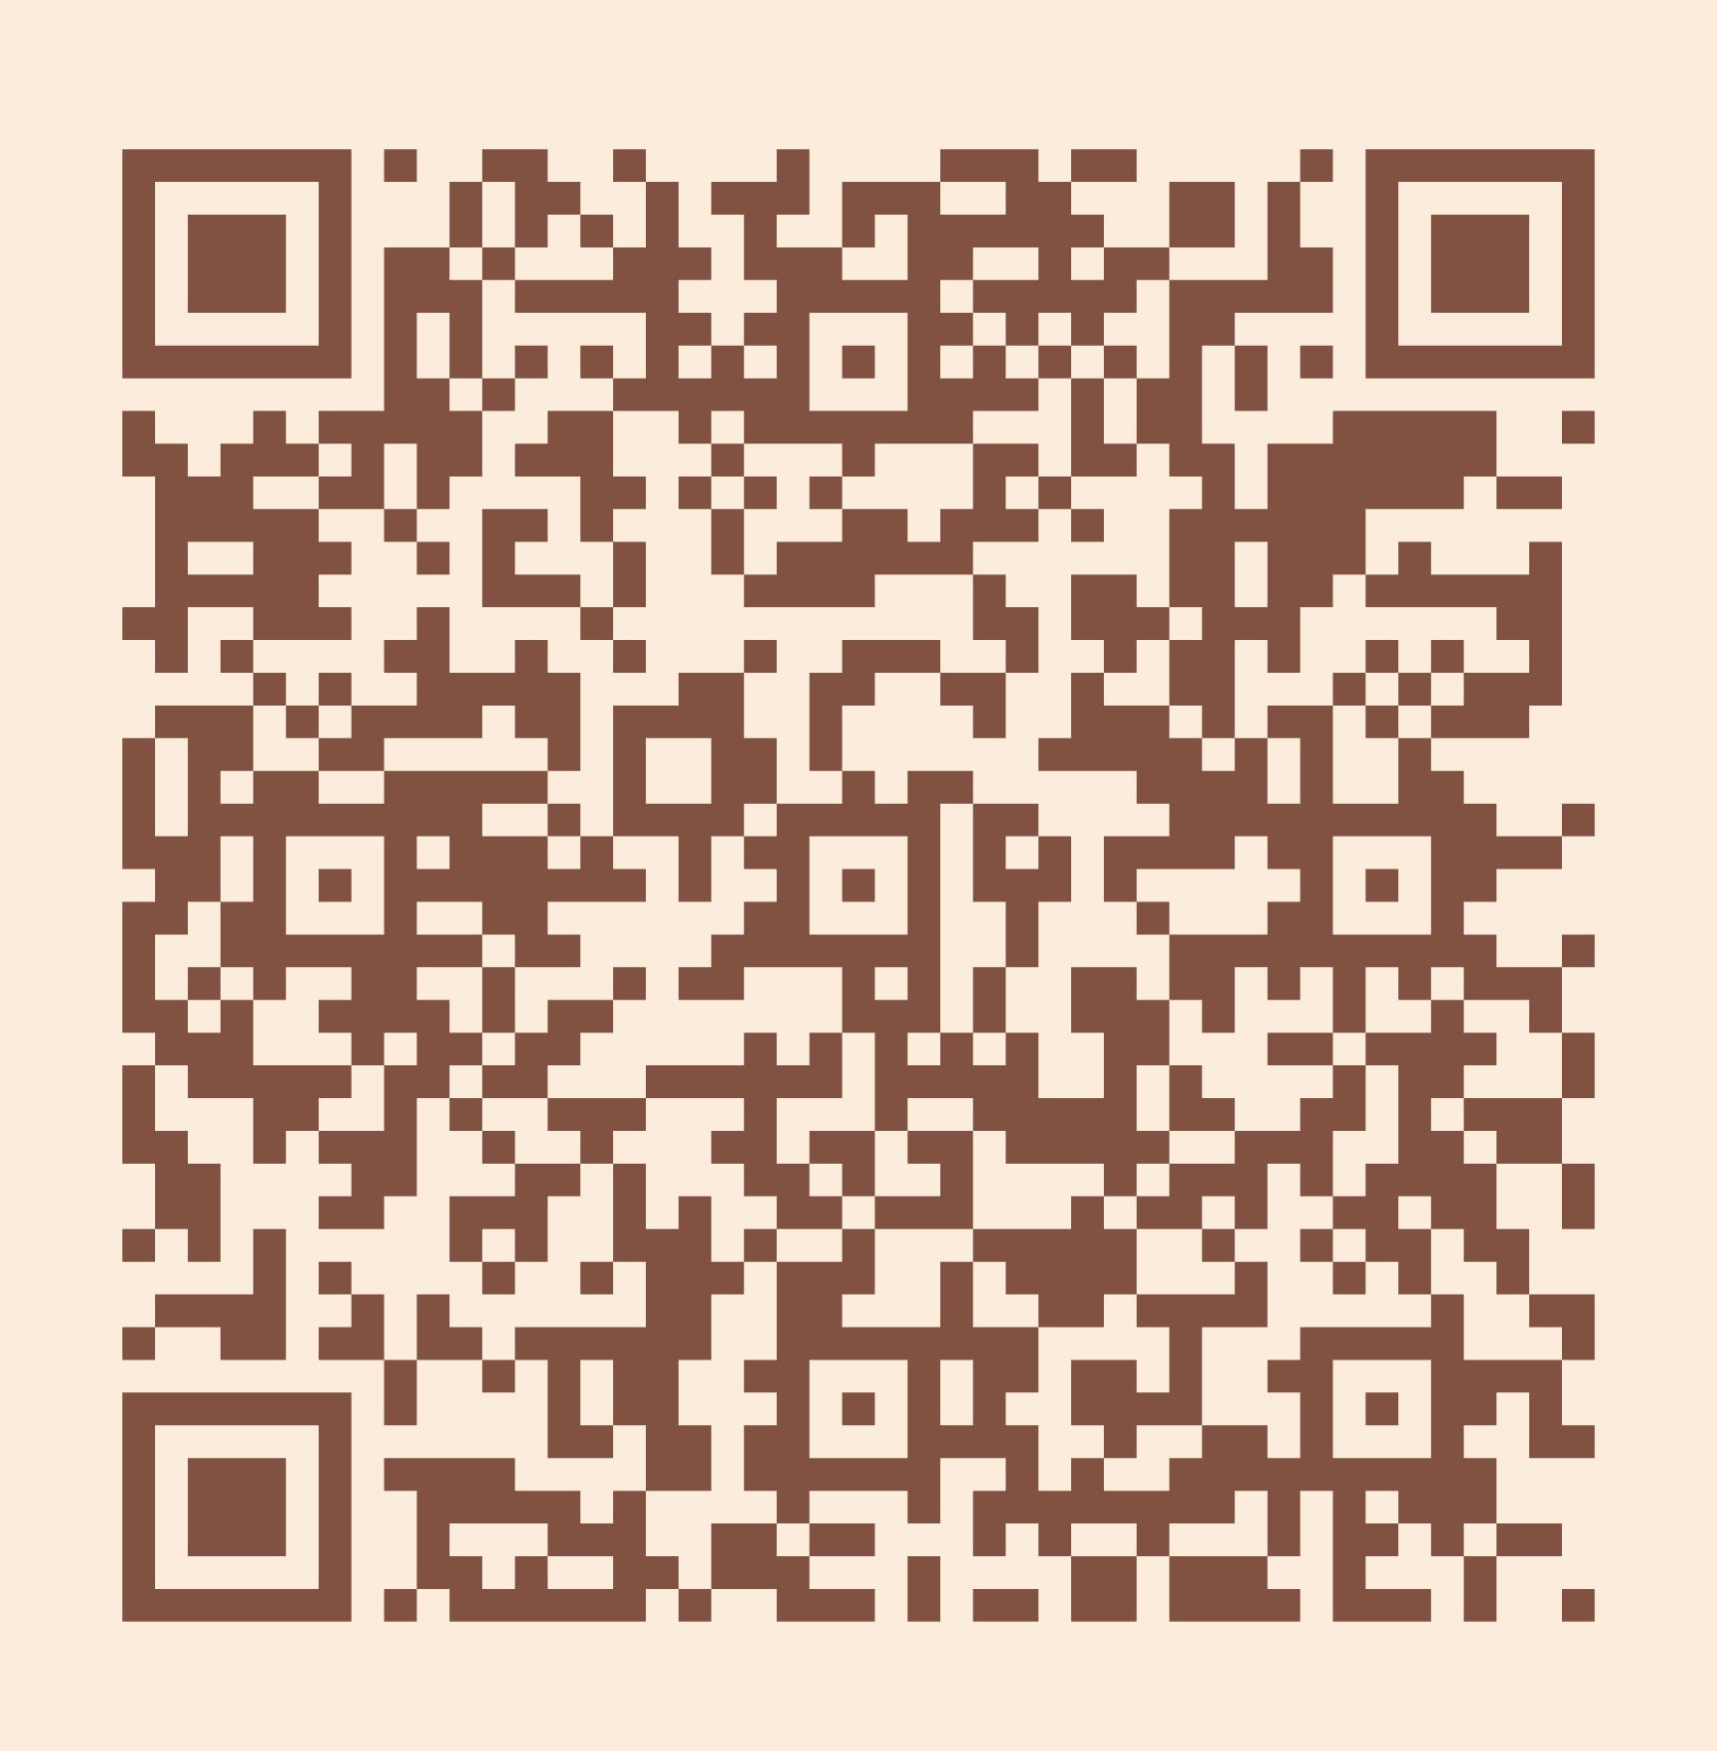
Please take a moment to complete the program survey.
SCAN ME!

