Slide 2




Don’t Miss!
50/50 RAFFLE
Tickets are $1 each and can be purchased from Conni Strittmatter or David Dahl! The winner takes home half the pot.
SILENT AUCTION
Visit the Silent Auction in the exhibitor hall to place your bids before 10:45 a.m. on Friday, May 8th.
PUB QUIZ
Thursday, May 7 8:00 – 10:00 p.m. Choptank Ballroom
KARAOKE
Thursday, May 7 8:00 – 11:00 p.m. Windjammer

Slide 3
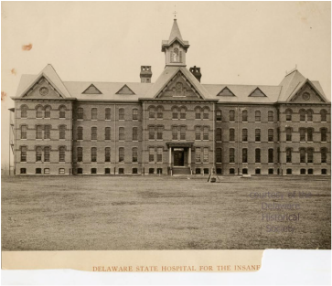


Historical Walking Tours
How to Make Your Story Interactive
Michelle Wynne-Feigin
Kent County Public Library
Library Technician
Notes:
Hello everyone! My name is Michelle Wynne-Feigin, and I am a library technician with Kent County Public Library.
Today, I am going to be guiding you through how to create your own walking tour! It is super fun and a great way to bring people to your library or to your local community, by making your story come to life!
Before working for Kent County, I was the senior librarian at the Delaware Department of Health and Social Services (DHSS) Library for seven years. While I worked on campus in New Castle, the library served all DHSS employees across the state of Delaware. Working there afforded me many opportunities to explore special and unique to engage with patrons. We wanted to implement programs that were accessible for users who weren’t physically able to visit us but keep them engaged to keep coming back again and again.
One of the most unique projects I have ever been involved in are these historical self-guided walking tours based off multidivisional campuses for DHSS across the state of Delaware. There is so much history all around us, from where we run our errands to where we work and it is endlessly fascinating how the past, present, and future often intersect.

Slide 4
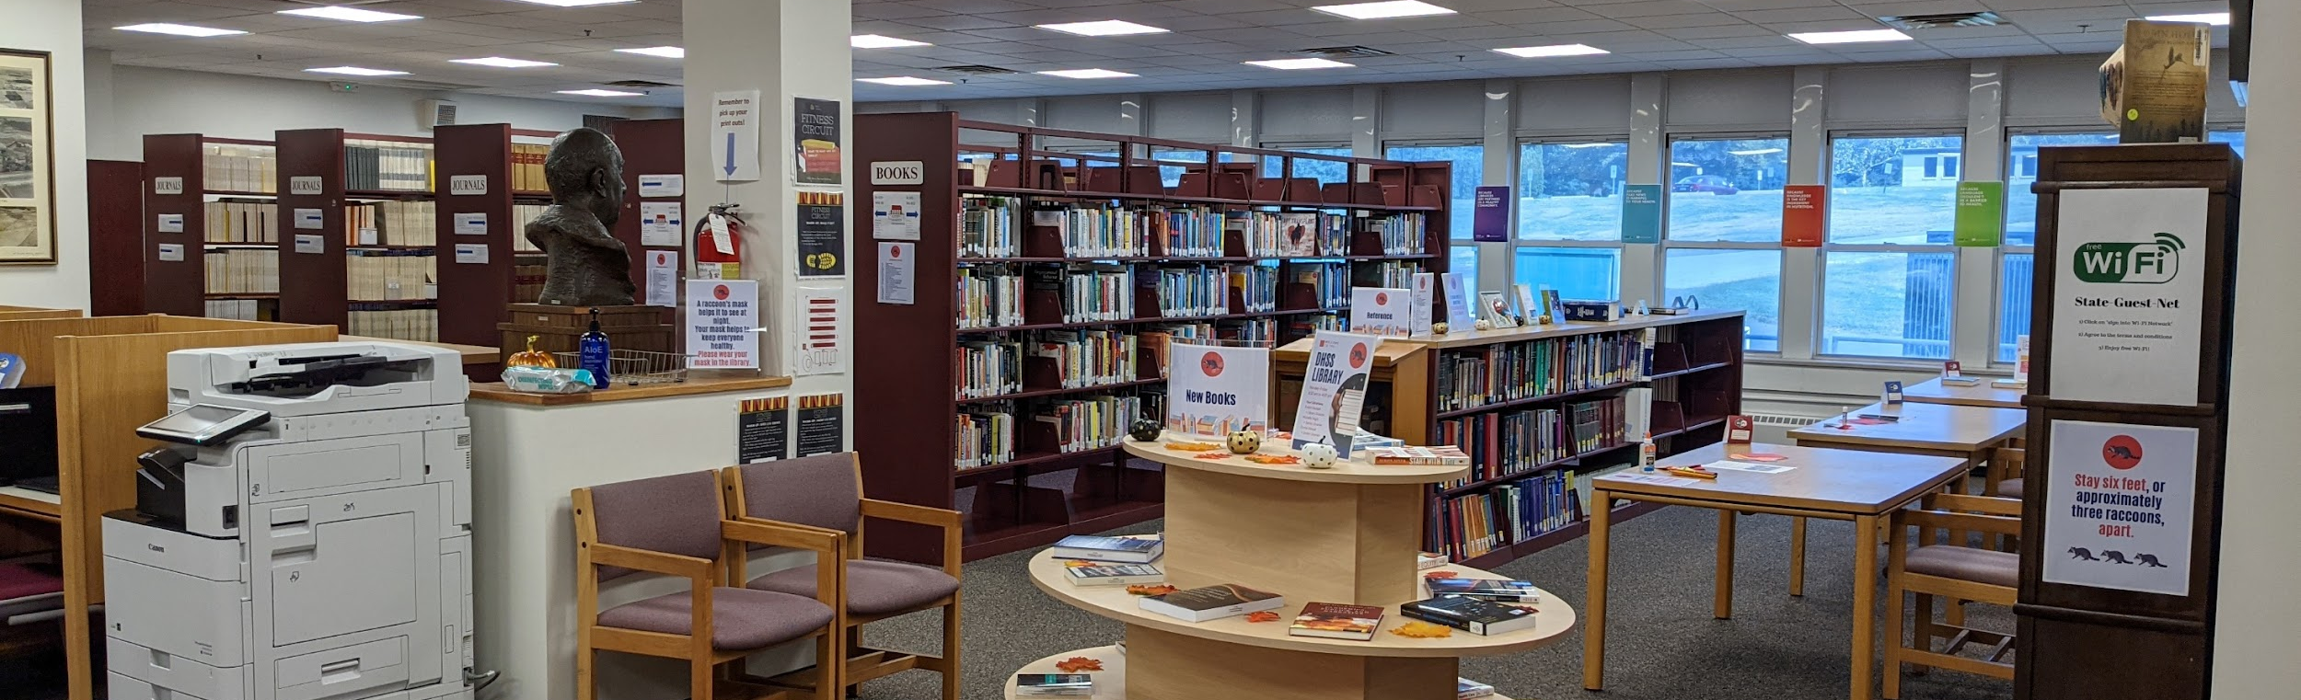
DHSS Library 101
Located in the Springer building on the Herman Holloway campus in New Castle, Delaware
Open Monday through Thursday, 8:30 am to 12:30 pm
Virtual Services only: Afternoons and Fridays
Research databases available for DHSS employees
Website available to public, including blog, newsletters, consumer health and open access health resources
Print book collection available for employees and public with DE library card
Notes:
This is the inside of the DHSS Library.. The library is located in the Springer Building of the Herman Holloway Campus in New Castle, Delaware. The library space is currently open in-person Mondays through Thursdays during the day with virtual services throughout the work week. The library is overseen by library director, Evelyn Hudson.
The DHSS Library primarily serves DHSS employees from all 11 divisions of health and social services. Electronic research databases are available for DHSS employees while the print book and DVD collections are available for any employees and members of the public with a DE library card. Their book collection includes specialized heath textbooks as well as scholarly texts on social issues, from aging and elder care to trauma awareness to health equity and diversity. They are also the only library in the state to house a Graphic Medicine collection, which features graphic novels about health topics.
Their website is available to the public, along with a weekly blog, monthly newsletter, and numerous free consumer health and open access resources.

Slide 5
THE PLAN
Introduction
Overview of our tours
Create a script
Utilizing Clio
How to go the extra mile!
Notes:
OK! Here’s the plan for today. I will be giving a little introduction on how we got started on this creative endeavor and provide you some overviews of the campuses we covered and their respective tour routes.
Next, I will guide you through the process that is needed to create a tour, from areas for research and creating a script to demonstrating utilizing Clio, a free website and app to upload and organize your tour.
Then I will tell you a couple of ways you can go that…extra mile…to make your walking tour a stand out!

Slide 6
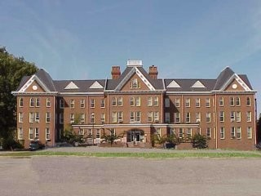
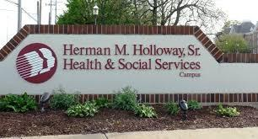
Herman Holloway Campus
Located in New Castle, Delaware
Multidivisional campus, including the Office of the Secretary
Delaware Psychiatric Center
August 1, 1889 – Hospital opened with 99 patients
There is an active apiary (bees!) on campus – honey and honeycomb available for sale
Cemetery and potter’s fields – over 5000 graves and counting!
Notes:
The DHSS Library is located on the Herman Holloway campus, in New Castle, Delaware and the focus of our first tour. It is a multidivisional campus with offices from many of the 11 divisions of DHSS, including the Office of the Secretary. It is also the home of the Delaware Psychiatric Center, which is the only state-operated psychiatric facility for mentally ill adults.
Just a little history about the Herman Holloway Campus. It is the site of the Farnhurst Hospital, which was the first hospital in the state of Delaware to consolidate their mental health care across all three counties. Before it was regulated to local almshouses, which were basically glorified homeless shelters but couldn’t provide individualized care. In August 1889, the hospital opened with 99 patients and it is still standing today as the Main Administration building and where the Office of the Secretary is located. Pictured above on the left is the Main Admin Building today and on the right is what it looked like when it was the original hospital back in the 1890s.
Some fun facts we learned and highlighted in our tour is that there is an active apiary on campus – or bees!! The apiary was part of a Veteran Beekeeper Program to treat symptoms of PTSD in veterans by giving them a practical trade with mindful tasks to help them stay present and focused. The honey and honeycomb from the apiary is available for sale!
There are also THREE different cemeteries/potter’s fields on campus with over 5000 grave sites and counting! I say counting because one of the potter’s fields serves as the New Castle County Potter’s Field and indigent burial area for individuals whose bodies aren’t claimed or for families unable to afford a private service.

Slide 7
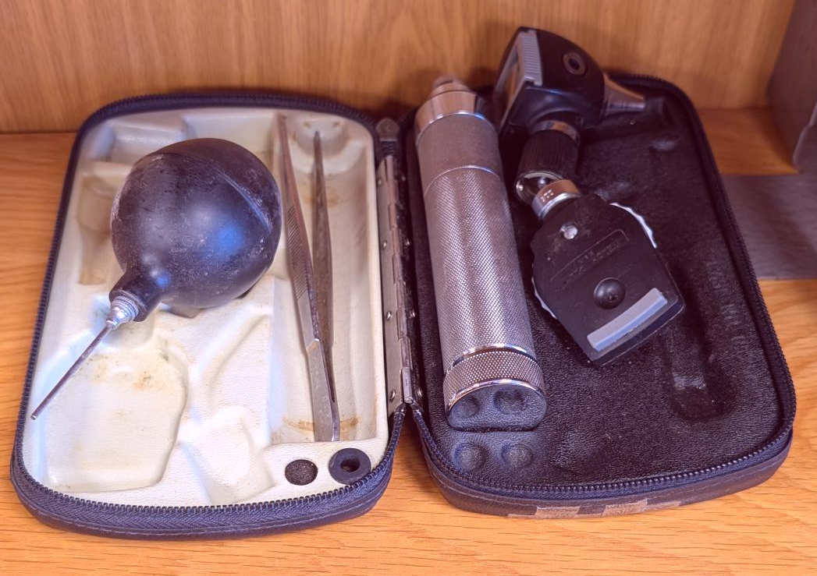
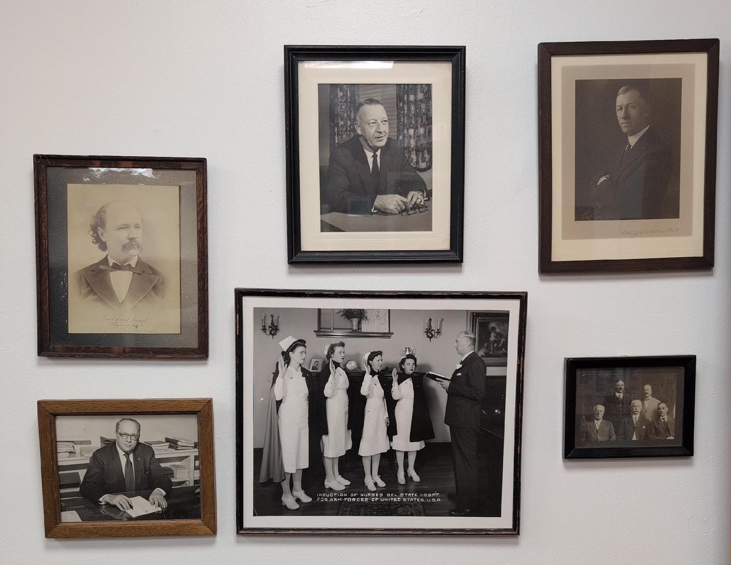
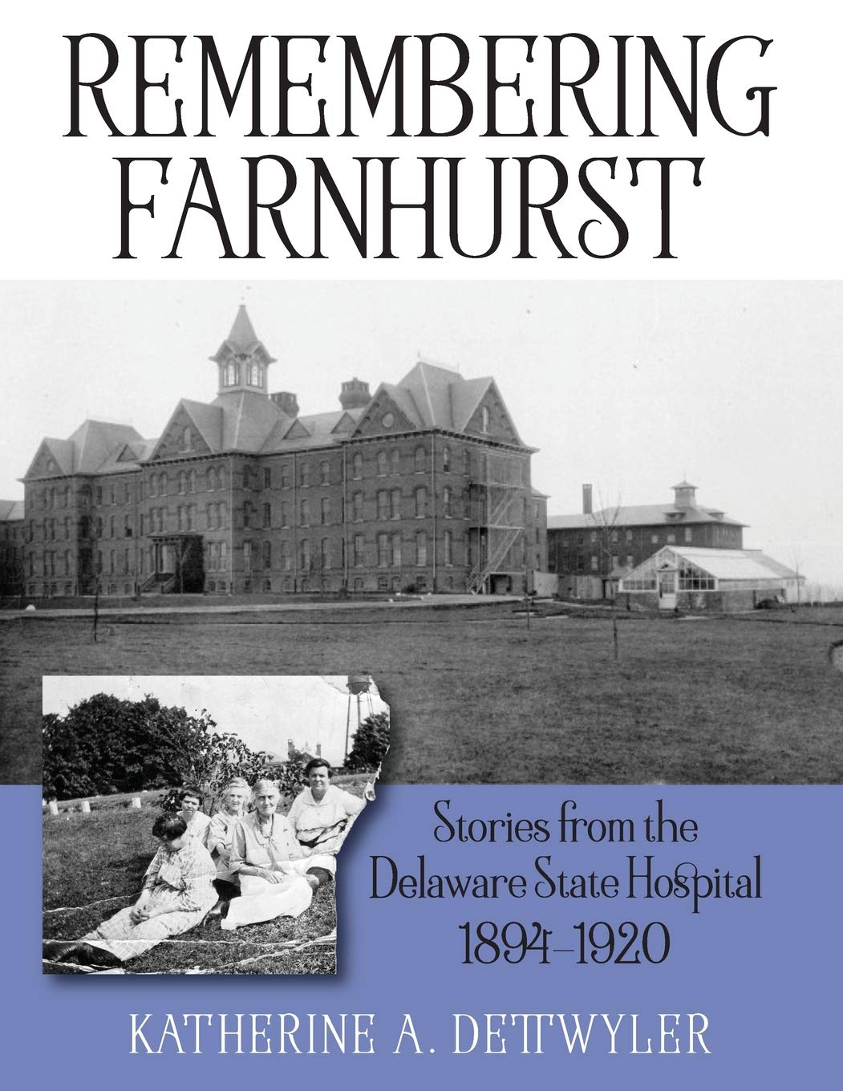
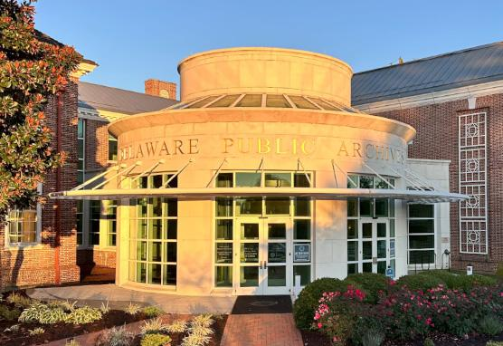
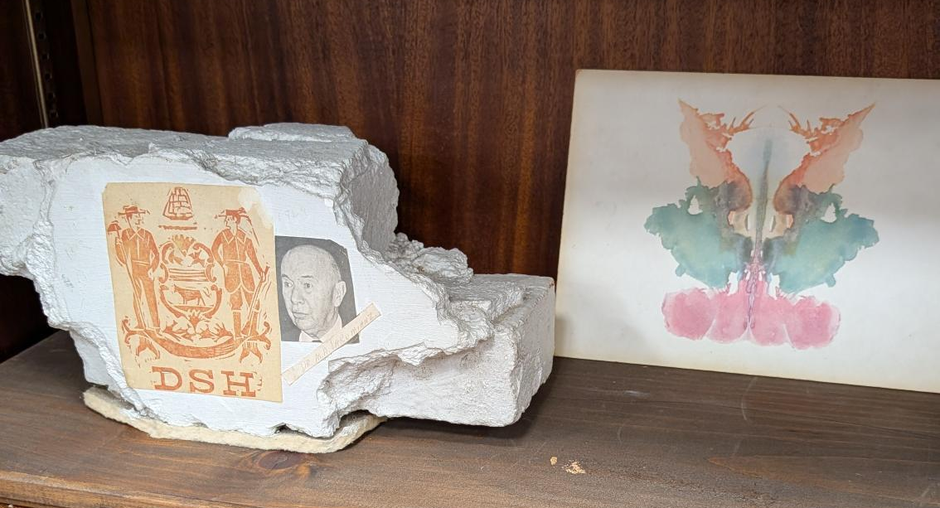
Background
Notes:
The DHSS Library has become an unofficial archive and storehouse of various objects, books, pictures, ledgers, etc. If anyone had any questions about the history of the campus, it would fall to the librarians to try to answer them. Here are just some of the pictures available in the DHSS library from including portraits of past superintendents, a picture from a graduating class from the nursing school that was at the hospital (all of those pictured on the upper left), and various aerial photos of the campus throughout the decades. The library has been gifted with many found items from old doctors' tools (pictured upper right) to patient ledgers to a set of 100-year-old Rorschach tests (bottom left)!
The library was very fortunate to have Katherine Dettwyler donate copies of her book, Remembering Farnhurst, as well as her research notes on the campus. Dettwyler’s book focuses on the history of the hospital from the purchase of 100 acres of land in 1894 through the terms of the first three superintendents of the hospital to patient histories up to 1920. Her book and notes had been a great jumping off point where to start while utilizing the Delaware Public Archives to help fill any gaps in our research (pictured bottom right – isn’t it pretty!?).
The DHSS Library has taken part in many different historical research projects for DHSS, from outlining its departmental history to researching notable Delawareans who made significant contributions to healthcare. Did you know that Dr. Henry Heimlich of the Heimlich Manuever was born in Wilmington, Delaware?
Since we had the building blocks, and people already were asking us questions, it only seemed natural as librarians to research and share our knowledge! We wanted to share our knowledge in a way that would be readily available to visitors, continually engaging to existing patrons and state employees, and helped bring the library’s efforts into focus.

Slide 8
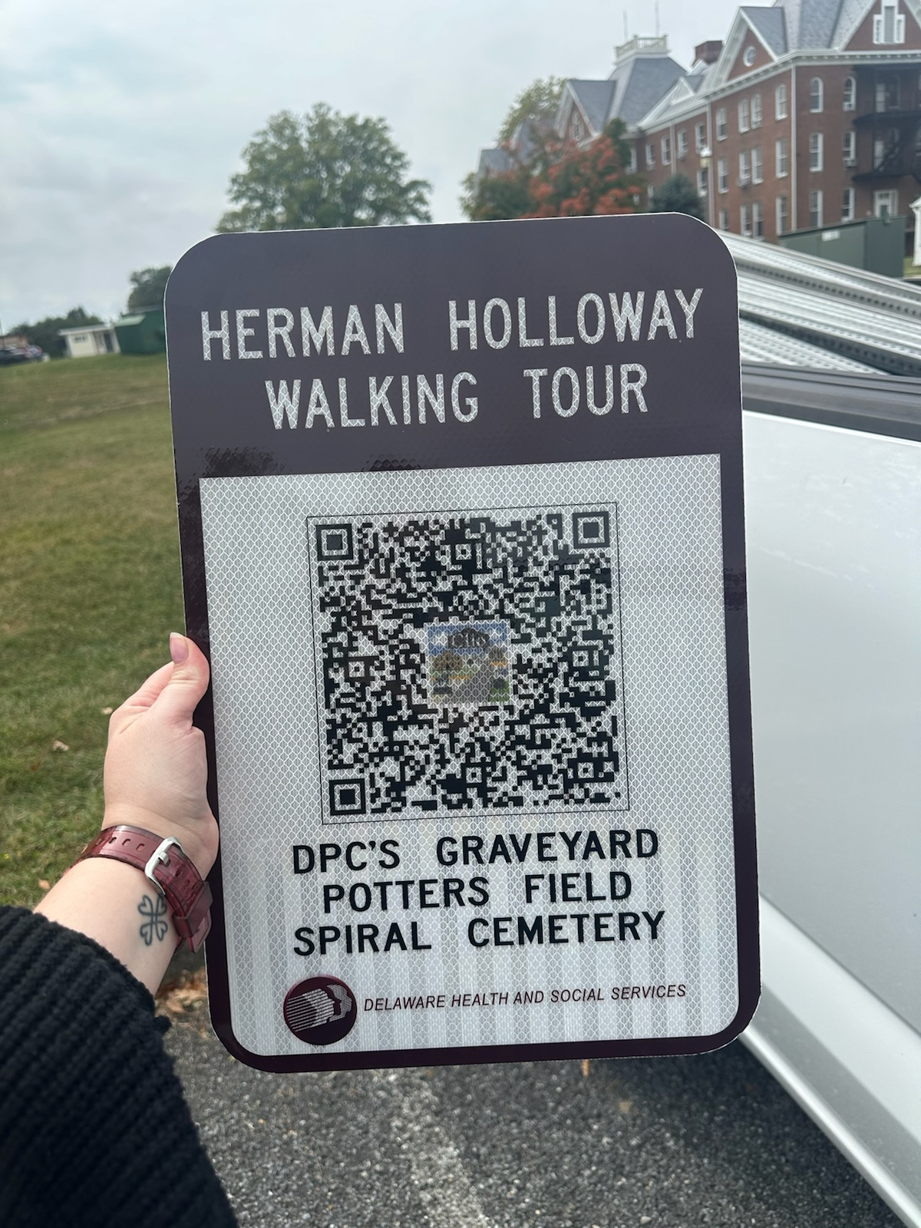
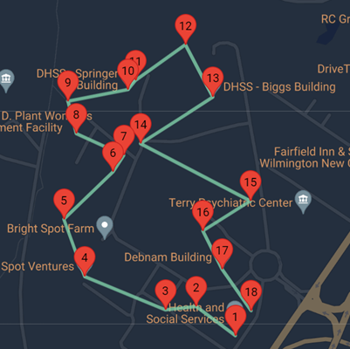
Herman Holloway Campus Historical Walking Tour
18 total stops across 2 miles
Focus on buildings with historical significance and names
QR codes can access whole tour or individual entries – signs posted
Can be accessed in person or on library website
Notes:
Here is a general overview of the tour for Herman Holloway. Each entry and site has been mapped out on Google Maps, thanks to Clio (more on them in a bit!). There are 18 total entries on our guided tour, measuring at around 2 miles to complete the tour in its entirety.
We chose to focus on buildings and sites on campus with historical significance, contribution to the campus, as well as researching who they are named after. For example, the DHSS Library is located in the Springer Building, but who was Springer? The tour has a total of 18 entries but the campus certainly has more buildings or stops that aren’t covered. As we were researching, it was easier to map out existing buildings and verify what was historically significant, what was cohesive for an overall route, and narrow down our tour from there.
And naturally we made the DHSS Library a stop on the tour! What better way to get more people into your library by literally leading them there? The individual entry provides a nice overview of the history of the library and what services and resources are available for employees and the public.
QR codes have been generated by Clio for each individual entry as well as the full tour. These QR codes bring you directly to the webpage for that entry with the option to access on the Clio app. We used these QR codes and, through DelDOT, created lovely signs posted at each individual tour site, seen pictured here.
Our tour is accessible for employees or visitors for in-person visits or can be accessed through the library’s website to visit the full tour through Clio. This has been a great way to introduce the campus to new visitors who are unfamiliar with the area.

Slide 9
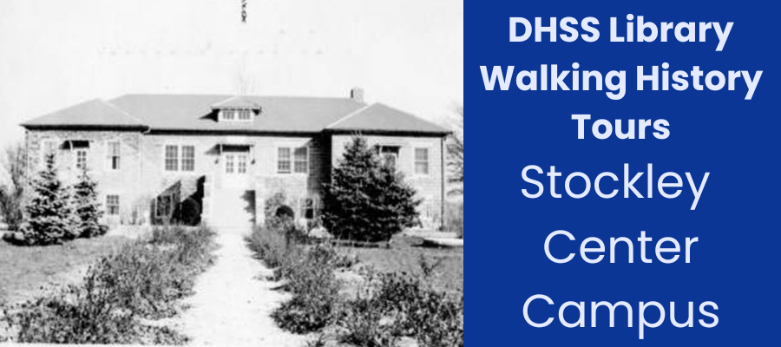
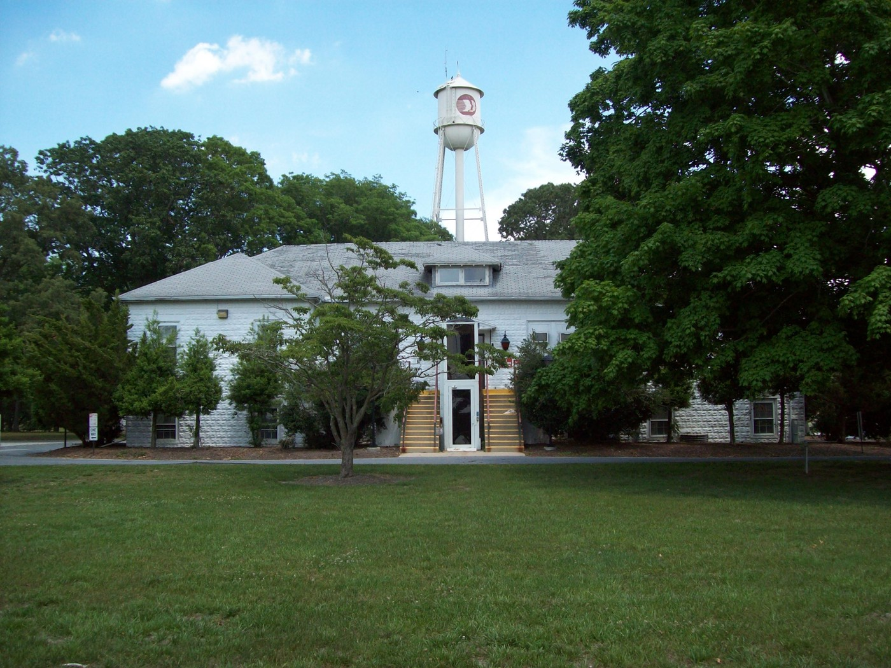
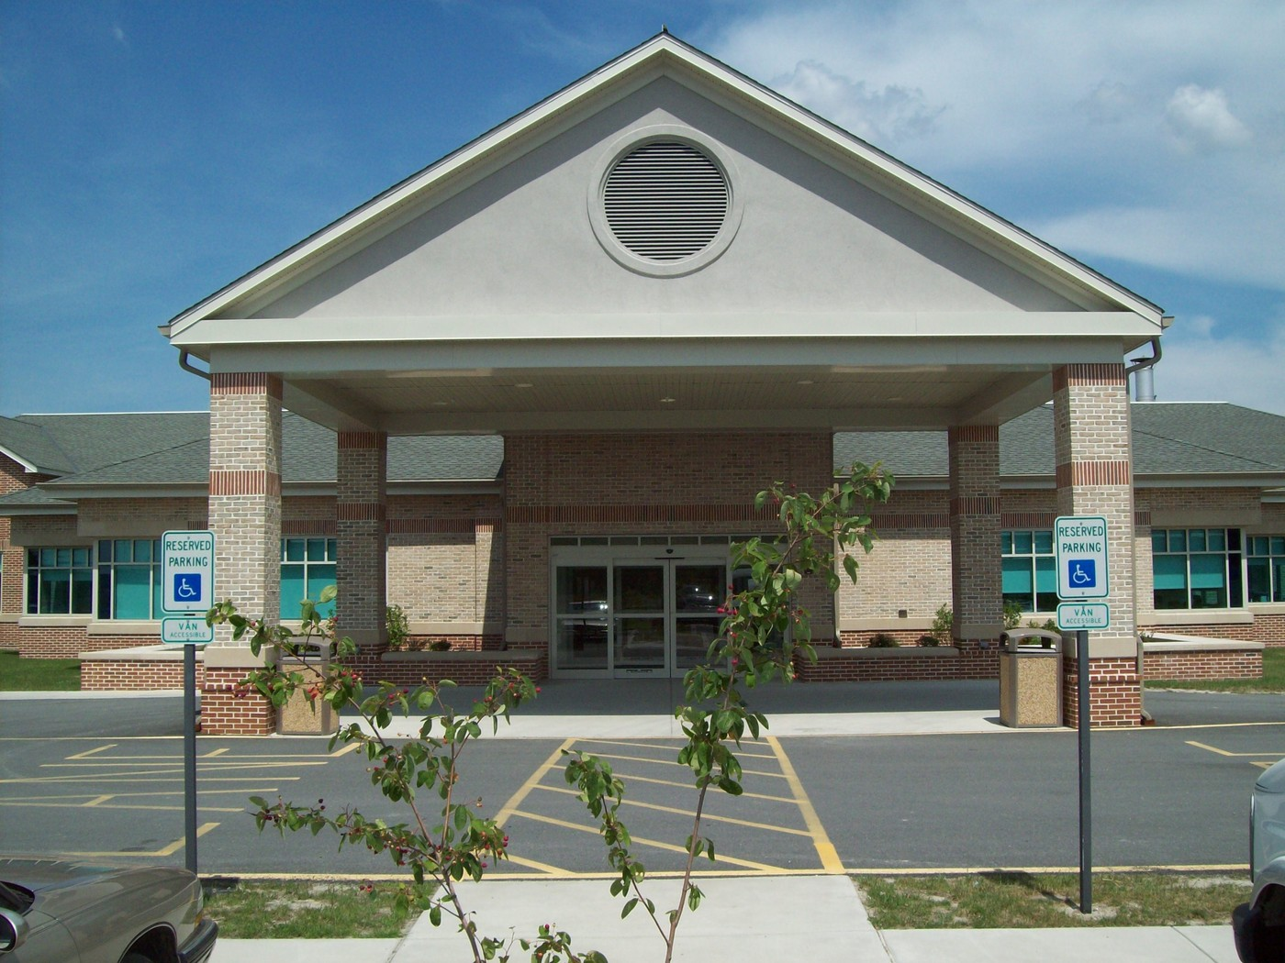
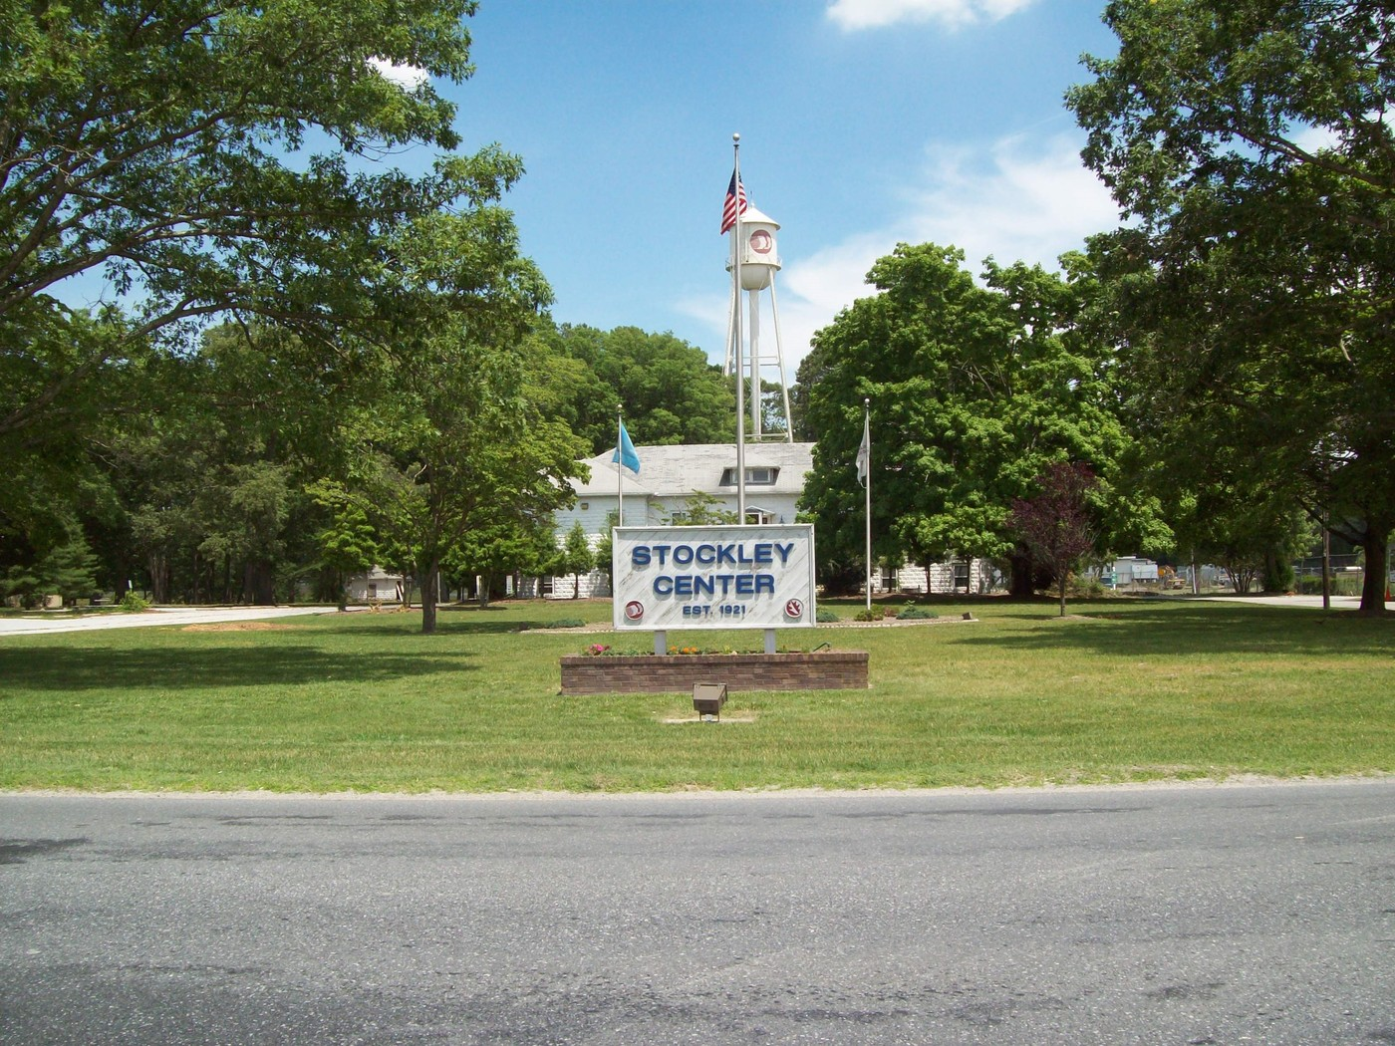
Stockley Center Campus
Located in Georgetown, Delaware
50-bed intermediate care facility for individuals with intellectual and developmental disabilties
May 1, 1921 – Opened with 6 young patients, director and his family
Completely self-sufficient with working farm, fire department, multi-faith chapel, hair salon, sewage disposal plant
Stockley Center Museum
Notes:
Our second walking tour covers the Stockley Center Campus, in Georgetown, Delaware. The Stockley Center is a Medicaid certified Intermediate Care Facility for individuals with Intellectual and Developmental Disabilities. The 50-bed facility provides esidential care for Stockley residents who need full-time medical treatment and provides temporary and respite care for dozens of other people with developmental disabilities. Some of the beds are for short-term, rehabilitative stays, and some provide medical care for individuals who live at home but whose families need brief periods of respite care. Today, the campus serves as a hub for diverse services, integrating state agencies, private entities, and community resources to enhance its multipurpose campus functions.
Just a little history about the Stockley Center Campus. Opened on May 1, 1921 as a residential cottage for six young residents, the Director of the facility, and his family. It was originally referred to as “The Colony” because, in a rural area like Georgetown, the facility was completely isolated and thus had to be self-sufficient. Residents got everything they needed at the Colony - education, medical care, job training - and many would spend their whole lives there. The colony also had a fire department, a multifaith chapel, hair salon, and sewage disposal plant, and a working farm working over 400 acres while maintaining livestock. By 1952, there was more than enough food produced that the Colony ended up supplying the rest of the institutions throughout the state of Delaware, including Farnhurst Hospital in New Castle!
The Stockley Center Museum was instrumental in helping with our research. The museum first opened in November 2014 and showcases an array of historical photographs, medical artifacts, clothing, equipment, and even original doors from the campus buildings. Linda Fleetwood, a dedicated volunteer coordinator and former special education teacher and administrator, oversees the museum and her stepson has been a patient at the facility.

Slide 10
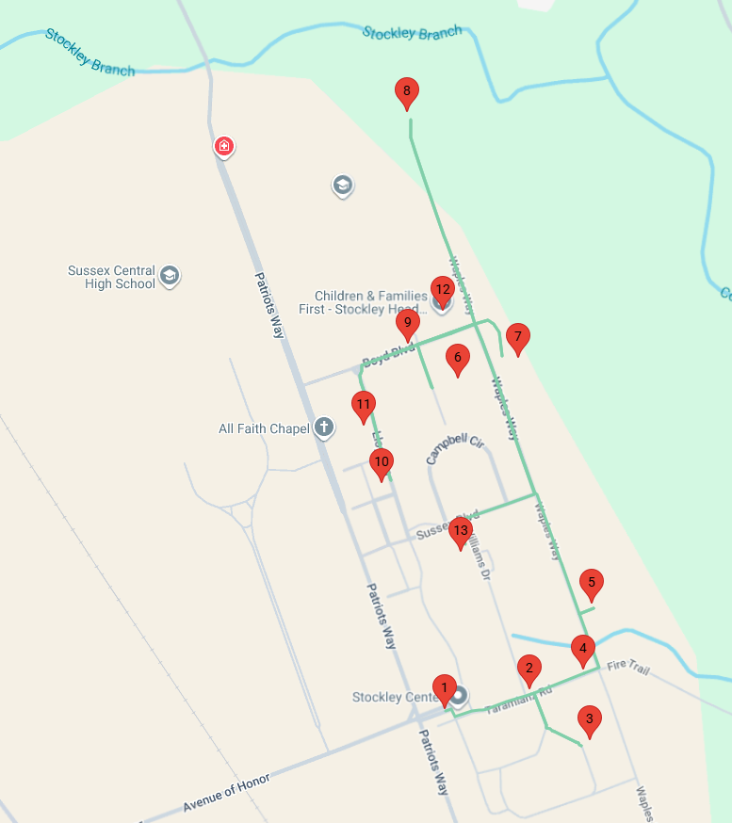
Stockley Center Campus Walking History Tour
13 total stops across 2 miles
Many of the original buildings no longer exist
Split up history of campus and patient life across different entries
Added disclaimer on outdated language and terminology of the time
Notes:
Here is a general overview of our tour for the Stockley Center. Each entry and site has been mapped out on Google Maps from Clio. We have 13 total entries on our guided tour, and covers two miles around the campus.
When it first opened, the facility had several “cottages” used for dormitories and medical offices. Many of those buildings no longer exist due to new upgraded facilities and growing resident populations, and we didn’t want to have a tour where visitors would visit an empty spot of land. As an alternative, we chose to highlight as many of the buildings on campus as possible, whether or not they had historical significance. We then interspersed our research on the history of the campus and patient life into different entries. We opted not to choose two of the buildings on campus because technically Stockley covers several acres of land and those buildings were too far away from the majority of the other buildings and wouldn’t be as readily accessible to members of the public.
This tour serves as an important reflection on the historical treatment of individuals with intellectual and developmental disabilities. The Stockley Center and government offices have taken on many different names over the last including some terminology and content that may reflect outdated attitudes or language no longer considered appropriate in society, the medical community, or government today. To address this concern, we included a written disclaimer on the tour’s home page as well as for individual entries that had that specific outdated language.
Like our first tour, our tour is accessible for employees or visitors for in-person visits or can be accessed through the library’s website to visit the full tour through Clio.
Signs with QR codes due to be set up later this year along with a soft launch event for specifically for Stockley/DHSS employees.

Slide 11
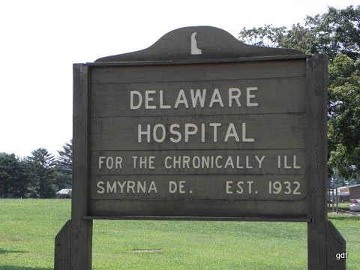
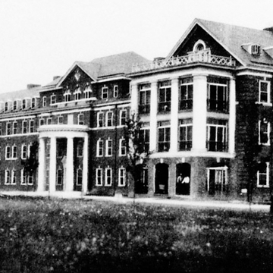

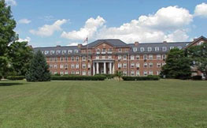
Delaware Hospital for the Chronically Ill
Located in Smyrna, Delaware
Originally the State Welfare Home
Opened September 25, 1933
Hospital being updated
Tour script finalized by end of this year
Notes:
The DHSS Library is in the process of creating its third history tour focusing on the Hospital for the Chronically Ill, located in Smyrna, Delaware.
Originally, this building was the State Welfare Home. The State Welfare Home was created to take the place of the almshouses, the institutions that acted similar to homeless shelters that I mentioned earlier. This facility was to provide a way for the impoverished and chronically ill citizens of Delaware to find a stable place of residential care. It opened in September 1933 and had over 350 patients its first year. At one point, the facility hosted up to 700 residents at a time.
The hospital is now currently being updated with the inclusion the Smyrna State Service Center on the first floor and a separate building housing the laboratory for the Delaware Department of Natural Resources and Environmental Control (DNREC).
The library aims to have their script finalized by the end of the year.

Slide 12
Creating a Script
Try to give an overview, general facts
Try to make entries 2-3 minutes MAX
After complete, read script out loud
Include directional information at the end of each entry
Save EVERYTHING!!
Prepare for multiple drafts and reviews
Remember your sources (cite on Clio)
Notes:
Now that we have gathered our research, mapped out our spots, let’s start writing!
With history, it is really easy to write out a detailed essay or include as much information available as possible but, for a walking tour, try to limit to a general overview or provide some significant highlights. Put yourself in the mind of someone who is visiting for the first time - think of fun things you learned about that you would want to hear. Bear in mind that you will be essentially standing in front of a building reading an entry or having it read to you. In fact, as you are writing you script, read each entry out loud and time yourself. This will allow you to edit the text upon reflection and possibly adjust for time and length. Aim for each tour entry to be two-to-three minutes MAX.
If you find that one entry is longer than others, try to divide it up among different entries so there is more equal time and attention. This was helpful with our Stockley tour inserting tidbits on the history of the overall campus or insights into resident life throughout the tour. It helped flesh out our tour entries that didn’t have a lot of historically significant information and balance the ones that were getting too long.
At the end of each tour entry, include brief directions on how they can get to the next stop. Visitors may not take the full tour but it is nice to include them so visitors don’t have to thumb through multiple pages to look at the map and then look up the next stop on the tour – you can literally guide them along.
It is very important to SAVE EVERYTHING. Create multiple draft files, track your changes in Microsoft Word, add dates to your files. Because likely it will be more than one person working on this tour. The scripts were reviewed by the library’s supervisor, that supervisor’s supervisor, the head of the Department, and the DHSS Communications team. This will mean answering different questions, getting various opinions, and going through lots of revisions so for your peace of mind, save everything, track your progress and have copies available.
Lastly, remember your sources and the opportunity to cite your sources on Clio. This is important especially if you have so much information that can’t be summarized in a brief two-to-three minute overview and people want to learn more. Great way to shoutout local authors or establishments, like the Delaware Public Archives or the Stockley Center Museum, for their contributions and resources.

Slide 13
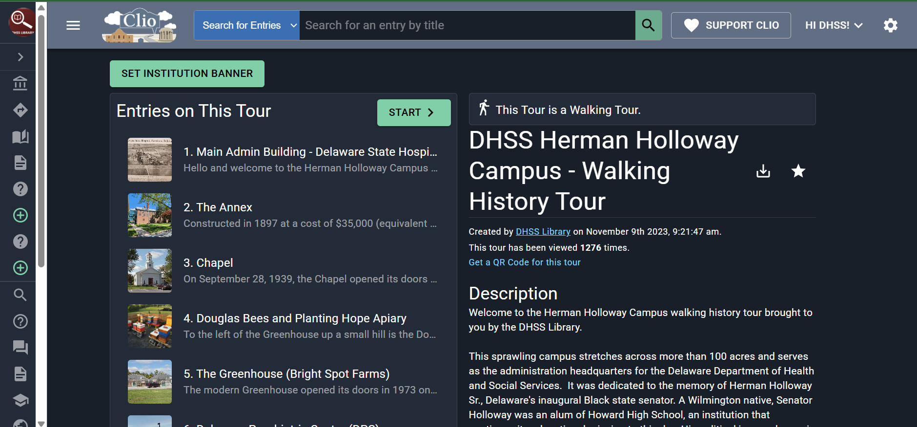
Clio
https://theclio.com/howToCreateTour
Notes:
After you have figured out your tour stops and created your script, you can now fully optimize Clio!
Clio is a free, non-profit educational website and mobile application that guides the public to thousands of historical and cultural sites throughout the United States along with nature trails, art walking tours, and virtual tours of museums and sites. You can create a free account as a contributor, whether working as an individual or through your library or institution.
Here is a screenshot of what the tour profile looks like on the website. You can create separate, standalone entries or create an entire tour route, like we have. Each entry is imputed by adding the physical address and Clio will use Google Maps to literally map out your tour with the information you provide. With each tour profile, you can edit the order of your stops, edit individual entries, and track the amount of views you get for the overall route.
Clio is super easy to use and they have lots of instructional guides and videos going over the website, the app, and step-by-step instructions. I have included the URL on the slide for their tutorial on how to create a tour.

Slide 14
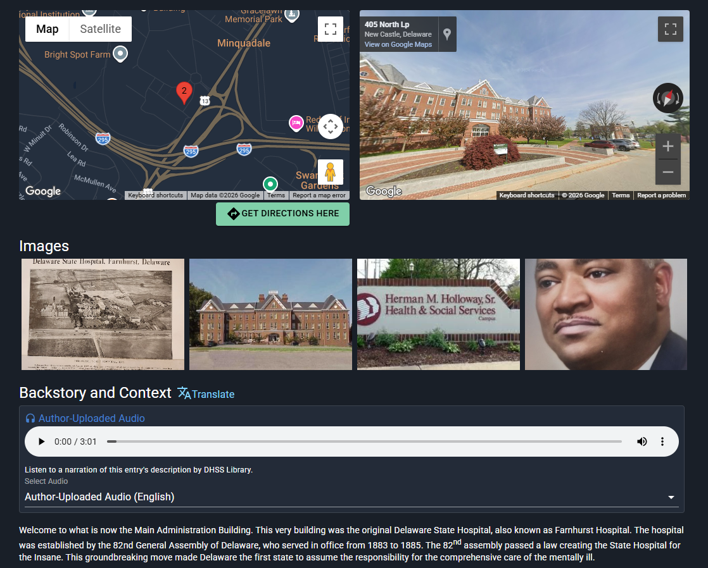
Clio Entries
Introduction (100 words)
Background and Context (300-500 words)
Location (Google Maps)
QR Code
Pictures
Sources
https://theclio.com/howToCreateTour
Notes:
Each entry includes an introduction, background and context, a map of the location of the entry (provided by Google Maps), a section for pictures, and a section for any sources included. This is also where you can get the individual QR code for the tour site and see how many times this particular entry was viewed or accessed.
The introduction and background and context sections have length requirements. The introduction needs to be at least 100 words and background and context sections need to be at least 300 words. The introduction should be a concise overview with the most essential information - this is what is going to draw in your visitors. Write this with the expectation that some of your visitors may only access this paragraph and the captions with your photos. If they are drawn in, they will stay for more. Then the Background and Context section for the bulk of your script. More details the better but make sure, especially if you have multiple entries, to keep it brief enough that visitors aren’t dwelling on one particular entry for long period of time.
If you wanted to add relevant links, photos, documents or videos, they would be added into the individual entries. Adding these additional resources as well as updating with reputable sources can flesh out a stop on your tour. Since you need to be frugal with your words and time with the Introduction and Background and Context sections, adding these relevant links or multimedia resources can be your chance to provide the patron or virtual visitor a chance to expand and learn more for themselves.
Here is the screenshot of the standalone entry for the Main Administration Building, or the site of the original hospital on the Herman Holloway Campus.

Slide 15
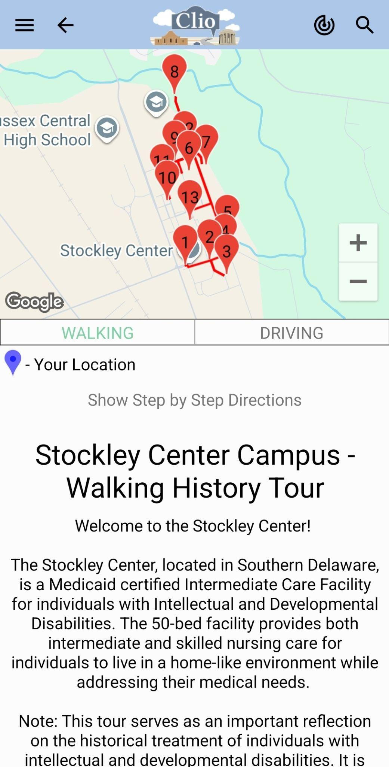
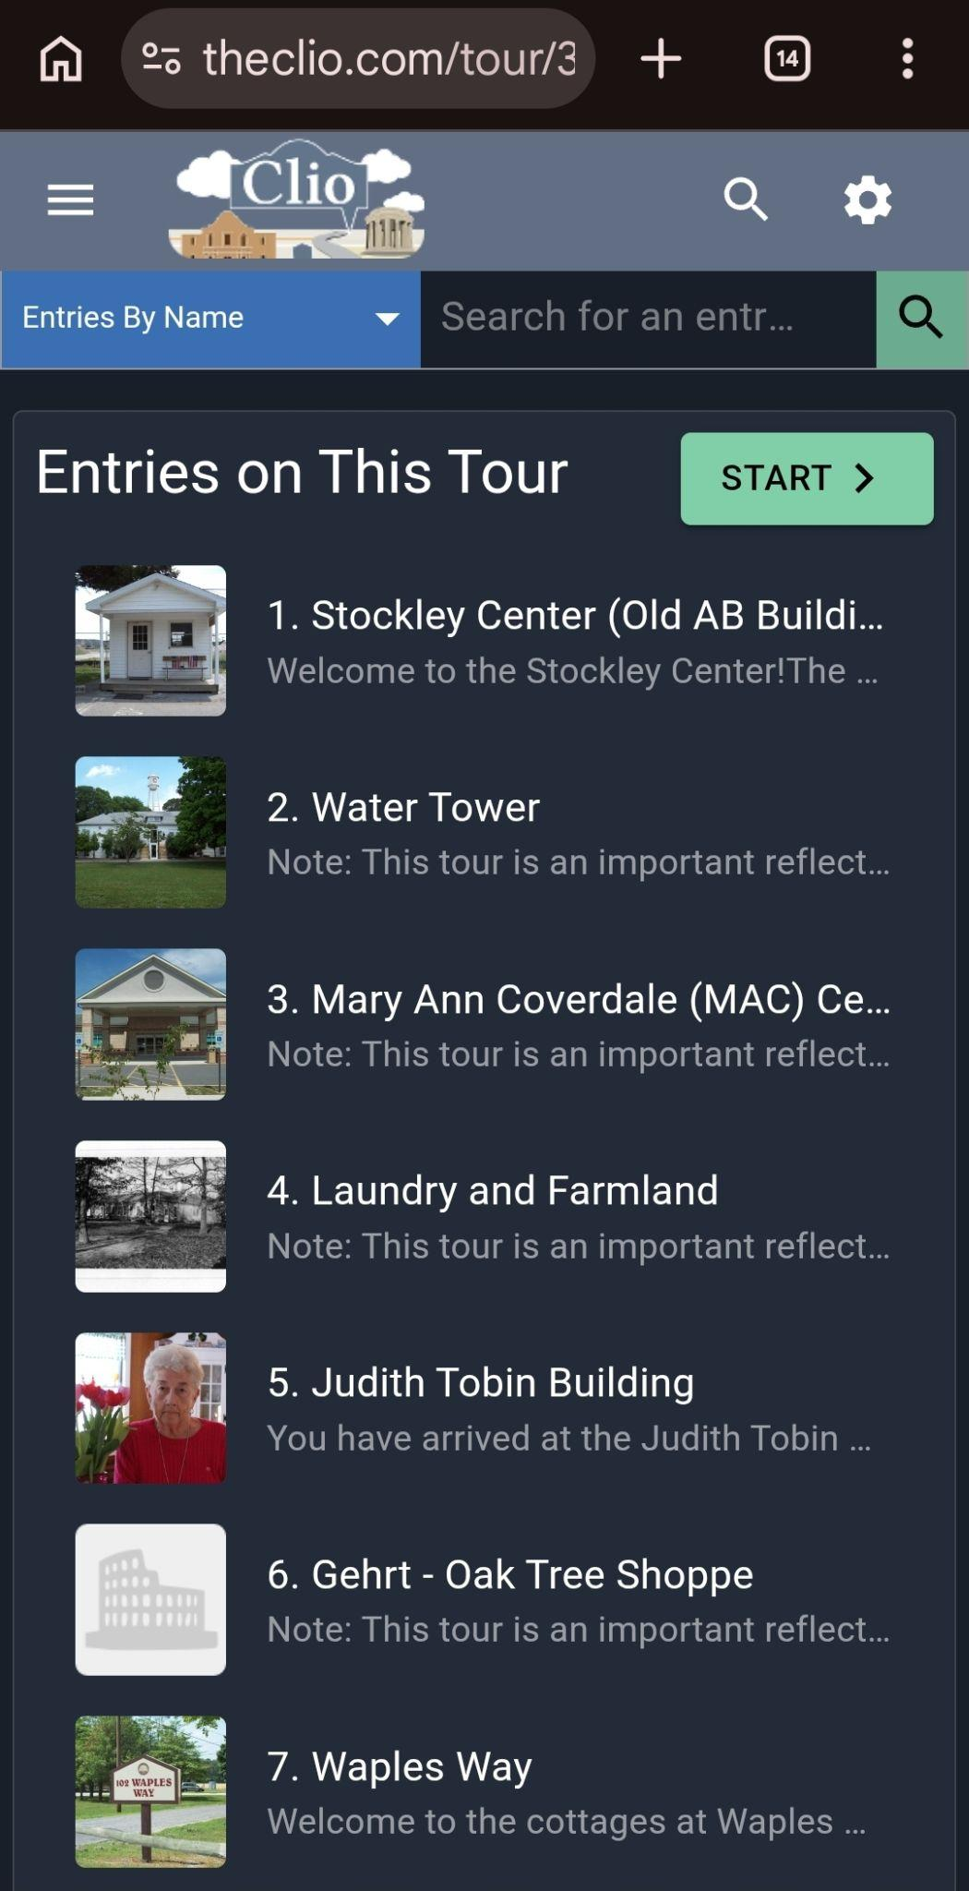
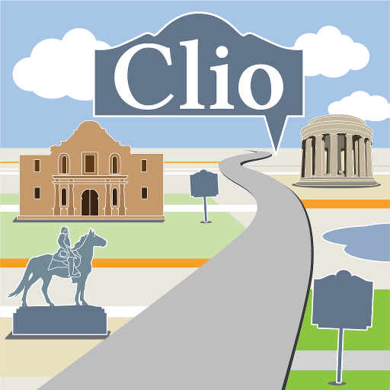
Clio App
Available in Google Play and Apple Stores
Listed as “Clio - Discover Nearby History”
Great for browsing and searching in the area
NOT recommended with scanning QR codes
Notes:
Clio is also available as a mobile app, available both in Google Play and Apple Stores. Search by individual entry or whole tours, by name or location, nearby history is now just a click away! Take a tour at your own pace with available walking and driving instructions, provided by Google Maps. The tour route is laid out in order so all the user needs to do is click on “Start Tour” and they can start accessing all of the entries in order! Pictured on the left is the Stockley Tour being viewed on the Clio app and on the right is the Stockley Tour viewed on the Clio website using a mobile device.
I advise recommending the app for patrons who are big history buffs or for library staff regularly working on the tours as it really is a cool app that can allow for a lot of fun opportunities with local history and geocaching.

Slide 16
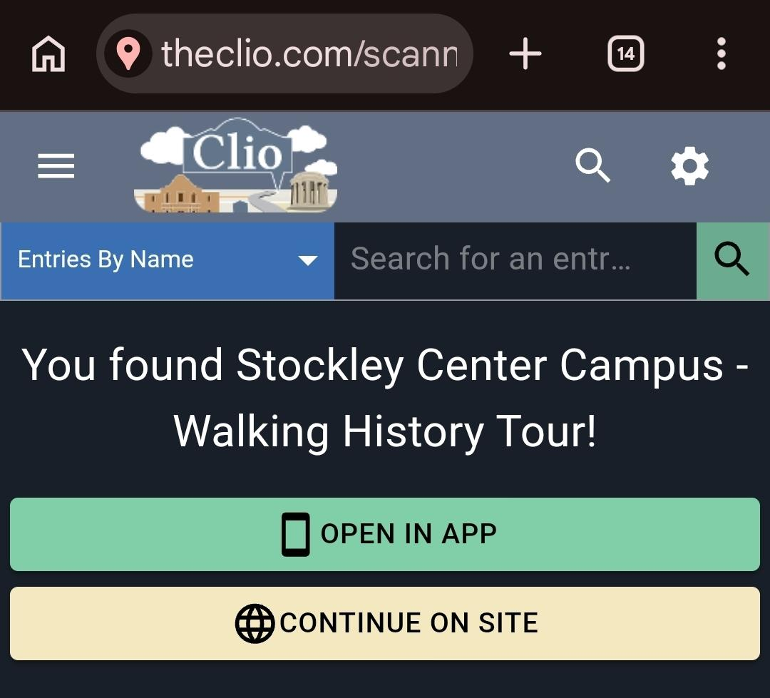
Scanning QR Codes
Notes:
I want to preface this by saying, in my own personal experience using the Clio app, I do NOT recommend using it when scanning QR codes. We found it was easier, especially for first-time visitors, to have them scan the QR code and access the website from their phones. That way, the QR codes take you directly to the tour’s page and the specific entry scanned. If you were to scan it to open with the app, it just opens the Clio app itself. It doesn’t open the specific entry or tour that is being accessed.

Slide 17

Going the extra mile – Audio narration
Entirely optional but if you have the means, go for it!
Create an enunciation guide
Use a quiet study room or office
Plug in microphone via USB to laptop or computer
Audacity – free audio editing program
Notes:
Now that we are familiar with Clio and have started putting the tour physically together, you can start to go the extra mile!
Entirely optional but if you have the means and skills to provide audio narration for your tour, go for it! It adds a great personalized touch to your walking tour. There is computer-generated audio available with each entry for visitors who do want the option to listen or for visitors who are vision impaired. But it is nice to add a “Voice” to your tour that is associated with your library or your community that can be more familiar and inviting.
I have a degree in Radio Broadcasting, so I definitely jumped on this bandwagon! I HIGHLY recommend if you are planning on making your own audio narration, is to make an enunciation guide. It is always good to double check, TRIPLE check, the enunciation of specific names or terms or locations. As someone who lives close to New-ARK, Delaware but has gone to school close to New-ERK, New Jersey, that is a very important distinction!! A big example is that our second tour is about “STOKE-lee” Center and not “STOCK-lee” Center.
You don’t need a big fancy set-up to record. In fact, you can use a quiet office space or even reserve a study room at the library! There are many affordable microphones available online that can easily be plugged into a laptop through a USB connection. For recording and editing your audio files, I recommend Audacity. It is a free, open-source digital audio editor that makes it easy to record and touch up your audio clips. These clips are saved into mp3 files that can be easily uploaded to the entry on Clio and saved as “Author-Narrated Audio.”

Slide 18
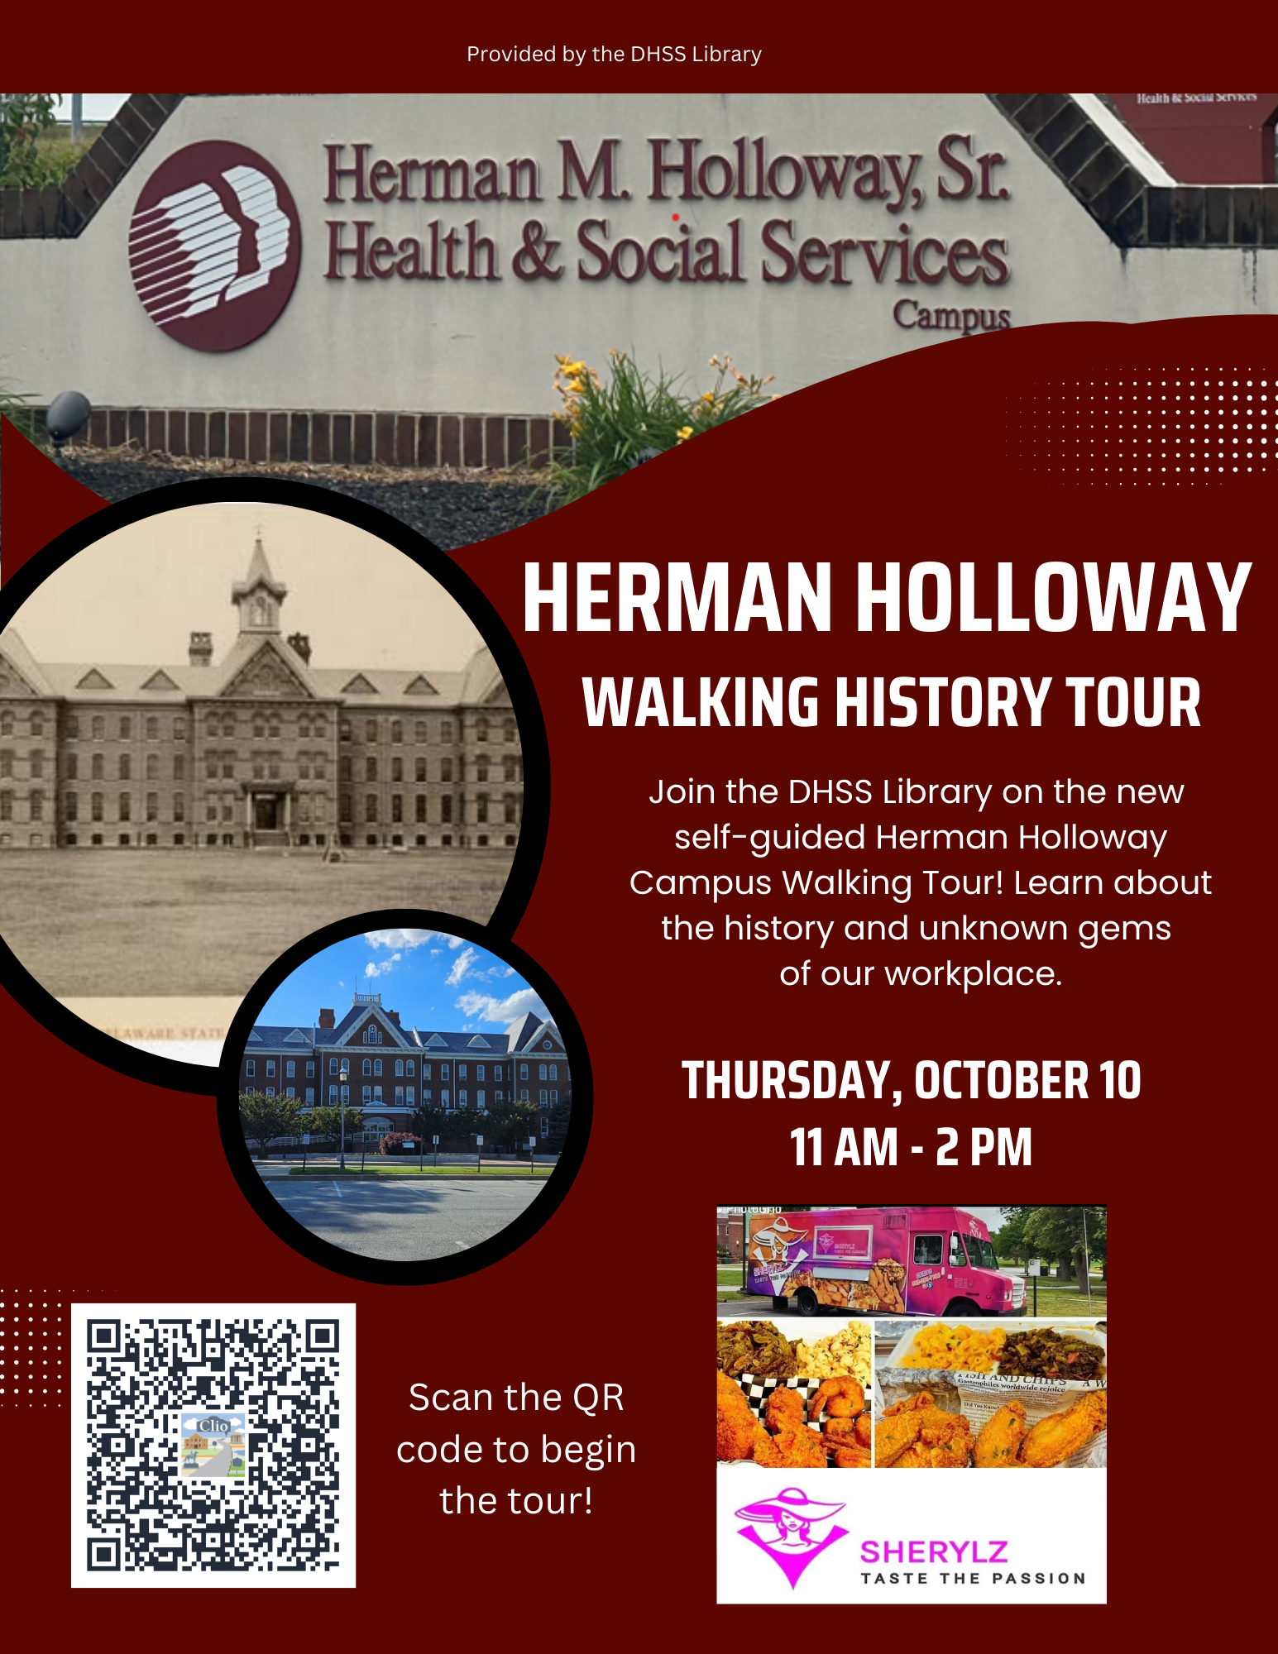
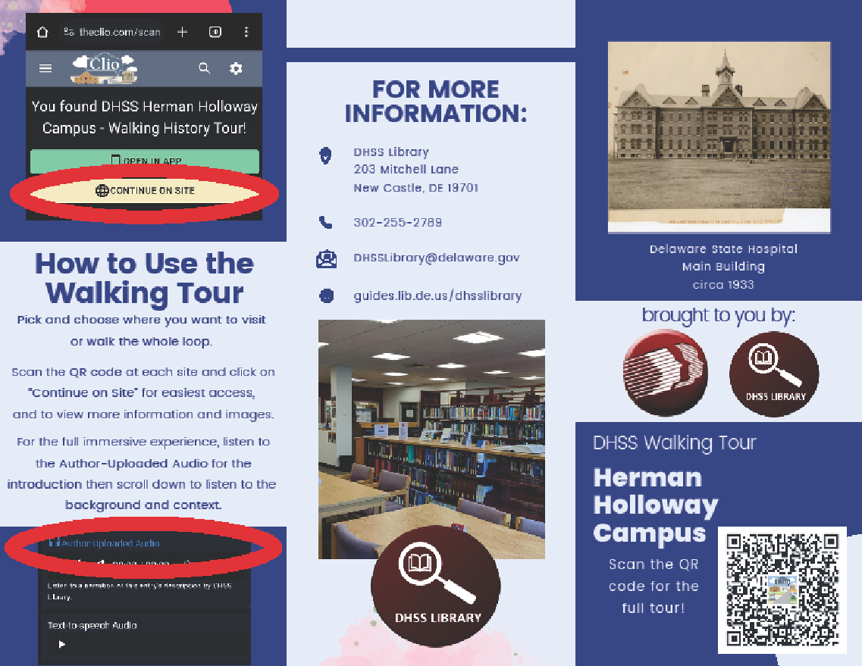
Going the extra mile – Marketing / promotions
Notes:
You just completed making your tour? Now what? PROMOTE IT!
Here is an example of one of the brochures were created to hand out year-round for new and returning visitors. They give a nice overview of each tour, with a map and list of entries on the inside, and QR code for the full tour on the front. We included instructions on how to access the tour using your mobile device’s internet as well how to access the Author-Narrated Audio for the full, immersive experience. We created our brochure and flyer via Canva (which is available for free), but if you have Microsoft Office available, Microsoft Publisher is also a good program to use for making brochures and flyers.
To kick off the completion of our first walking tour, in October 2024, we hosted a soft launch of the tour exclusively for DHSS employees who worked on the Herman Holloway Campus. We created and posted this flyer all over campus and sent them and copies of our brochure through campus-wide email blasts. We set up tables with library and DHSS merch along the route, and we had a food truck placed at one of the last few stops of the tour. It was wonderful to receive people’s feedback regarding the information relayed in the tour, the walkability of the route, and what could be improved. It was so surreal to walk past people listening to MY voice as they were going through the tour. Overall, everyone was super impressed with the expansive history and enjoyed being outside on a work day as they got to be re-introduced to their workplace and all the hidden treasures around them.

Slide 19

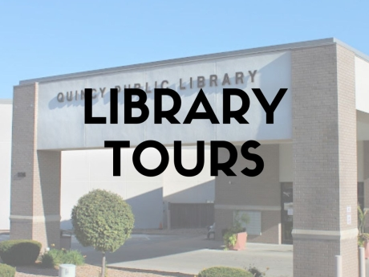
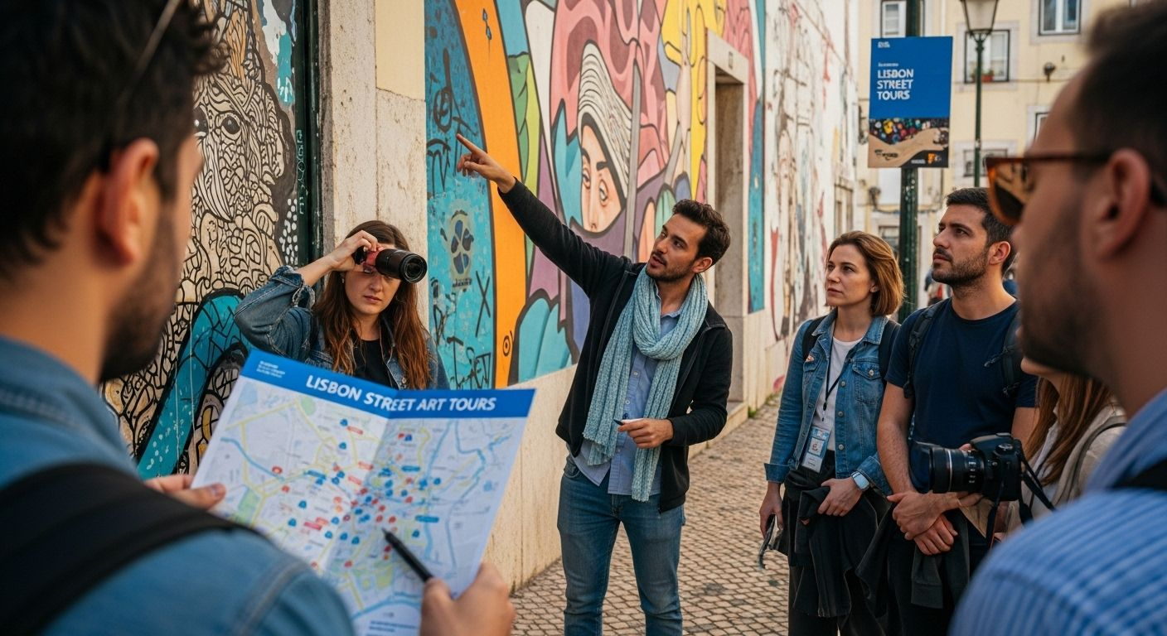
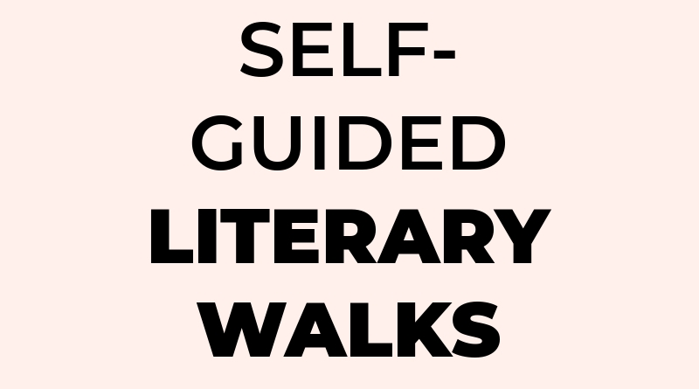


Ideas for Tours
Notes:
I hope that this inspires you to creating your own self-guided tour. Making history tours was the logical step for the DHSS Library but what will work for your library? Make a tour about! Guide your visitors to where the children’s desk is, who to reserve a study space, what kind of programs you host in your makerspace…whether you want to make the whole library one standalone entry or create an entire tour of the facility. This is a great way to showcase everything your library has to offer, some fun library stories, and the patron can take it at their pace. Collaborate with other county libraries or other consortium members to create a passport program! Create QR codes for each library in a specific county or even make a consortium-wide tour inviting patrons to visit every single member library. Not able to visit libraries further away? Scan their QR code to learn more about that library and have them virtually visit it.
Collaborate with local artists to host a self-guided art show hosted by your library or even during the warmer months, create a tour highlighting local street art. That way you can highlight sites of historical significance and pay tribute to local artists.
Explore your community through literary works! Map out specific literary locations found in books, see where authors were born and lived in your state. Visit the Dover Air Force Base in Delaware after reading “Port Mortuary” by Patricia Cornwell or look at Wilmington through a different lens with “Fight Club” by Chuck Palahniuk. Explore the world of Jack Ryan through Tom Clancy as many of his books also take place in Maryland!
Haunted tours are super popular - we just had one last night! These tours are a great way to synthesize local history with fantastical tales and local legends. One thing I ask you to consider is that many of these local stories are based on real people, real names, so these stories involving those dearly departed need to be told with an air of respect and dignity. For example, it may be considered inappropriate to convert the Herman Holloway or Stockley Campus tours into haunted tours because they are based in in a real hospital settings and dealt with real patients with chronic health and mental health conditions. While mental hospitals or patients with mental health conditions have been the subject of many horror books and movies, they are usually portrayed in a way that doesn’t invite inclusion and doesn’t accurately reflect local history or point of care. Since your tours would be available to the public, that is something to keep in mind as you are brainstorming.

Slide 20
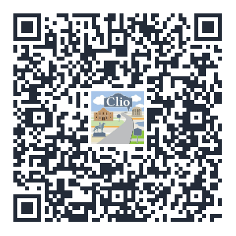
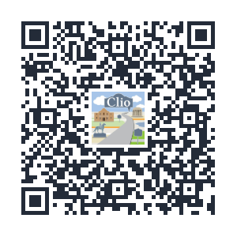
(…oh yeah! And check out our tours!!)
https://guides.lib.de.us/dhsslibrary/hhcwalkingtour
https://guides.lib.de.us/dhsslibrary/stockleycenterwalkingtour
Herman Holloway Campus (New Castle, DE)
Stockley Center Campus (Georgetown, DE)
Notes:
Oh yeah! And finally…make sure you check out our tours! I definitely talked a lot about them so make sure you explore them! Remember that you don’t even need to physically visit - just scan the QR codes for the full tours on the screen. The one on the left is for the full tour for the Herman Holloway Campus in New Castle and on the right is the full tour for the Stockley Center Campus in Georgetown.

Slide 21
Thank you!
MICHELLE WYNNE-FEIGIN
Kent County Public Library
michelle.wynne-feigin@kentcountyde.gov
Notes:
Thank you so much for letting me talk about stuff with you today! I know I gave you a lot of information all at once – does anyone have any questions?
Thank you again for having me and my slides are also available through Sched.
if you have any more questions or if you want to build your own walking history tour.

Slide 22
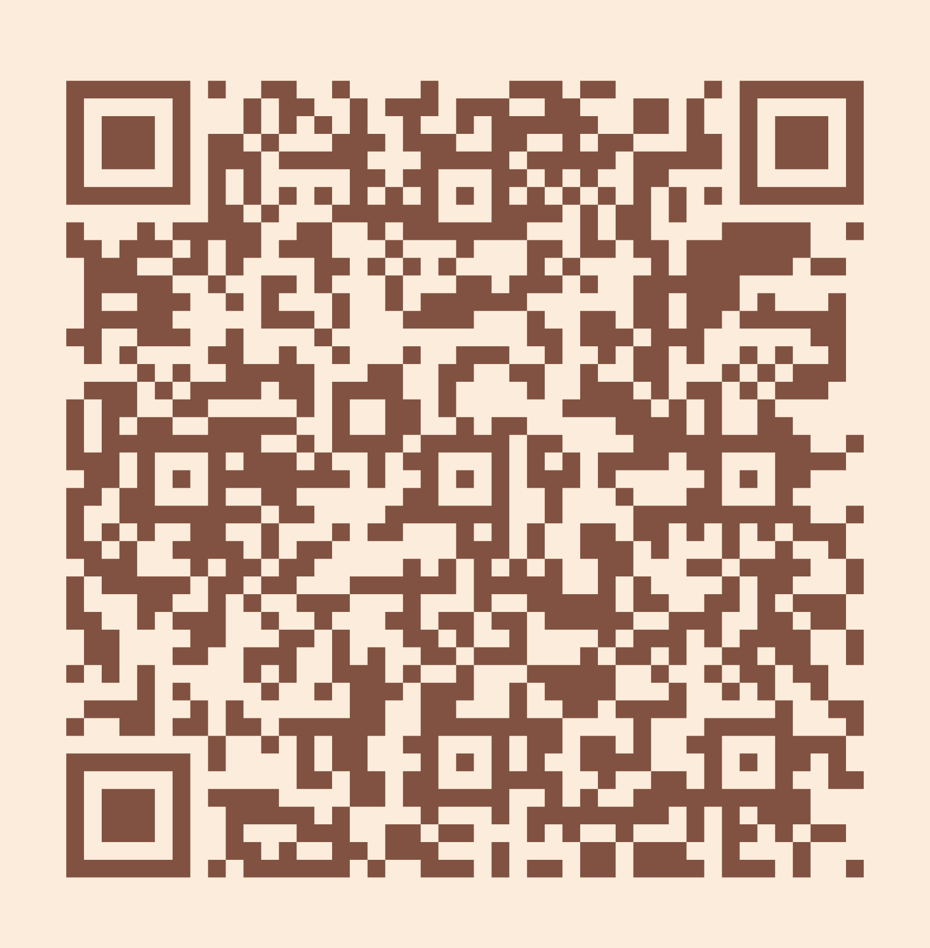
Please take a moment to complete the program survey.
SCAN ME!

