Slide 1
Cover slide

Slide 2




Don’t Miss!
50/50 RAFFLE
Tickets are $1 each and can be purchased from Conni Strittmatter or David Dahl! The winner takes home half the pot.
SILENT AUCTION
Visit the Silent Auction in the exhibitor hall to place your bids before 10:45 a.m. on Friday, May 8th.
PUB QUIZ
Thursday, May 7 8:00 – 10:00 p.m. Choptank Ballroom
KARAOKE
Thursday, May 7 8:00 – 11:00 p.m. Windjammer

Slide 3
Beyond the Ramp
Creating Truly Inclusive Library Experiences
MLA - DLA Conference 2026
AM Dillon
Grants and Development Coordinator, Certified ADA Coordinator
St. Mary’s County Library
240-587-7206
adillon@stmalib.org
Physical accessibility is just the beginning.

Slide 4
Session Overview: What We'll Explore Today
This 2-hour session covers five core areas of library inclusion:
1
• Foundations: Beyond Physical Access: Why ramps are the floor, not the ceiling, of inclusion
2
• Disability Etiquette: Respectful language, interaction skills, and person-first vs. identity-first language
3
• Inclusive Communication: Formats, signage, and staff communication that works for everyone
4
• Accessible Programs and Collections: Designing events and curating materials that honor disability experience
5
• Your Action Plan: Practical next steps you can take Monday morning

Slide 5
Why This Matters
Disability is America's largest minority group — and your community's most underserved patron population.
1 in 4
61 Million
U.S. adults lives with a disability
Americans have a disability of some kind
Source: CDC.gov
Source: CDC.gov
71%
36%
of web users with a disability leave a site that isn't accessible
of people with disabilities report feeling unwelcome in public spaces
Source: Section508.gov
Source: ADA National Network

Slide 6
The Inclusion Spectrum
Moving from legal compliance to genuine welcome — four levels of inclusion
Level 4: Disability Justice
Level 3: Inclusive Practice
Level 2: Accessible Services
Community co-design, centering disability voices, and addressing systemic barriers
Level 1: Legal Compliance
Disability etiquette, welcoming culture, and proactive design for all patrons
Assistive technology, alternative formats, and trained staff
ADA requirements, physical access, and basic accommodations
← Where most libraries start Where this session leads →

Slide 7
Disability Etiquette: Language That Respects
Two Accepted Language Models
Interaction Essentials — What to DO:
Person-First Language
"Person with a disability" — places the person before the condition. Common in medical and social service settings.
Speak directly to the patron, not their companion
Ask before helping — never assume assistance is needed
Get to eye level when speaking with wheelchair users
Allow extra time without drawing attention to it
Identity-First Language
"Disabled person" — embraced by many Deaf and autistic communities as part of identity, not separate from self.
Ask, Don't Assume
What NOT to Do:
Preferences vary by individual and community. Always follow the patron's lead.
Speak loudly or slowly unless asked to
Finish someone's sentences for them
Ask personal medical or diagnostic questions
Make disability the center of the interaction
Avoid Euphemisms
Skip "special needs" and "differently-abled." Plain, direct language is more respectful.
When in doubt: be warm, be patient, and follow the patron's lead.

Slide 8
Understanding Disability: A Broad View
Most disabilities are invisible. Every patron deserves a presumption of competence.
Physical and Mobility
Sensory
Cognitive and Learning
Wheelchair users, chronic pain, limb differences, muscular dystrophy
Blind and low-vision, Deaf and hard of hearing, deafblind patrons
Dyslexia, ADHD, intellectual disabilities, traumatic brain injury
Psychiatric and Mental Health
Chronic Illness and Invisible
Neurodivergent
Anxiety, depression, PTSD, schizophrenia, OCD
Autism, Tourette syndrome, sensory processing differences
Fibromyalgia, lupus, diabetes, cancer, ME/CFS — often not visible to others
Disability is not a monolith. Designing for one type often helps everyone.

Slide 9
Inclusive Communication
Spoken Communication
Written and Visual Materials
Digital and Online
Face the person directly when speaking
Use a natural pace — don't slow down unless asked
Use plain language; avoid library jargon
Rephrase if asked, without showing frustration
Offer alternatives: paper, text, AAC device support
Ensure sign language interpreters available on request
Minimum 14pt font; 16pt or larger preferred
Use sans-serif fonts: Calibri, Arial, or Verdana
Maintain high contrast — 4.5:1 ratio minimum
Left-align text; avoid justified alignment
Write in plain language at a 6th–8th grade reading level
Proactively offer large print and alternate formats
Meet WCAG 2.1 AA compliance for your website
Add alt text to all images on website and social media
Caption all video content — auto-captions alone are insufficient
Ensure PDFs are tagged for screen reader access
Support full keyboard navigation without a mouse
Test your site with a screen reader regularly
Ask patrons how they prefer to receive information — then honor that preference.

Slide 10
Sensory and Environmental Design
The library environment itself communicates welcome — or its absence.
Lighting
Sound and Noise
Scent and Air Quality
Offer both bright and dimmed areas
Avoid fluorescent-only environments
Provide reading lamps as alternatives
Minimize glare on screens
Designate clearly marked quiet zones
Offer noise-canceling headphones to borrow
Manage HVAC and equipment noise
Use visual alerts alongside auditory ones
Adopt a fragrance-free policy in enclosed spaces
Ensure good ventilation
Use unscented cleaning products
Post the policy visibly

Slide 11
Sensory and Environmental Design
The library environment itself communicates welcome — or its absence.
Wayfinding and Signage
Sensory Spaces
High-contrast, large-print directional signs
Braille on room IDs and elevator panels
Signs at multiple heights (standing and seated)
Accessible route map near entrance
Furniture and Layout
Variety of seating heights and styles
Clear floor paths — 36 inches minimum
Adjustable-height tables available
Power outlets in accessible locations
Designate a low-stimulation reading room
Offer sensory kits: fidgets, earplugs, sunglasses
Create a calming corner with adjustable features
Welcome service animals in all areas

Slide 12
Accessible and Inclusive Programming
Universal Design for Learning (UDL)
Program Ideas That Work
A framework for designing programs that work for everyone from the start:
Sensory-Friendly Story Times
Modified for noise sensitivity, movement, and flexible seating
Multiple Means of Representation
Assistive Technology Demos
Provide content in visual, auditory, and hands-on formats
Hands-on exploration of assistive tech available in the library
Disability History Month Events
Multiple Means of Engagement
Celebrating disability culture, history, and contributions
Offer different entry points and levels of participation
Caregiver Support Groups
Multiple Means of Expression
Space for family caregivers; consider offering respite childcare
Allow varied ways for participants to demonstrate learning
Job Access Workshops
Resume help, requesting workplace accommodations, vocational resources
Flexible Participation
In-person, virtual, and recorded options where possible
Seated Exercise and Yoga
Chair-based programs accessible to all mobility levels
Design programs WITH people who have disabilities — not just FOR them.

Slide 13
Collection Development and Disability Representation
Your collection is a mirror — it tells patrons whose stories matter.
Accessible Formats
Representation in Content
Fiction with disabled characters as protagonists, not sidekicks
Own-voices disability narratives by authors with disabilities
Disability memoirs and biographies from diverse perspectives
Disability studies academic and research resources
Resources for caregivers and family members
Employment and independent living guides
Children's books showing disability as part of ordinary life
Large print — adequate stock, not token titles
Audiobooks and e-audiobooks via OverDrive and Libby
E-books with adjustable text and screen reader support
BARD enrollment (Braille and Audio Reading Download from NLS)
Braille and tactile materials in children's collections
Easy-read and plain language materials for adult readers
Graphic novels and visual narratives for varied readers
Audit your collection: Are disabled characters secondary? Who wrote it? Is disability shown as tragedy?

Slide 14
Building a Culture of Inclusion: Staff Training
A Four-Stage Training Model — progressing from awareness through culture change:
1
2
3
4
Stage 1: Awareness
Stage 2: Knowledge
Stage 3: Skills
Stage 4: Culture
Disability models (medical vs. social), history, and the lived experience of patrons
Disability etiquette, legal obligations, specific disability types and their library implications
Communication tools, assistive technology, emergency evacuation procedures for mobility device users
Embedding inclusion into policies, hiring practices, programming decisions, and everyday interactions
Implementation Tips:
Annual refresher training for ALL staff, including pages
Disability-led training whenever possible
Role-playing scenarios for realistic practice
Safe space to ask questions without judgment
Patron feedback mechanism — and act on what you hear
Inclusion is everyone's job — from the director to the page shelving books.

Slide 15
Real Scenarios: Let's Practice
Discuss with a partner (8 minutes), then share with the full group.
A patron with a speech impediment is asking for help. You are having difficulty understanding them. Another patron is waiting.
A
A caregiver asks you to speak only to them, not the adult with a developmental disability they are with.
B
Discussion question: How do you handle this respectfully without making the patron feel embarrassed?
Discussion question: What is the most respectful approach for both the patron and the caregiver?
A patron with a service animal is at a computer. The dog is in the aisle and another patron complains.
A patron with anxiety asks for a quiet space to complete their library card application. No private room is available.
C
D
Discussion question: How do you navigate ADA requirements while maintaining community relations?
Discussion question: What immediate accommodations and long-term solutions can you offer?

Slide 16
Quick Wins: What You Can Do This Week
Free or Low Cost
Moderate Investment
Strategic and Long-Term
Add image descriptions to all social media posts
Train front-desk staff on person-first language
Create a designated quiet hour each week
Add fragrance-free reminder to programming spaces
Post accessible parking information on your website
Stock fidget tools and earplugs at the service desk
Review all signage for font size and color contrast
Purchase 2–3 assistive technology items to lend
Add large-print labels to shelf sections
Host a disability-led community conversation
Develop an accessibility statement for your website
Subscribe to a disability-focused database or periodical
Schedule annual all-staff disability etiquette training
Form a Disability Advisory Council with community members
Conduct a full accessibility audit — physical, digital, and programmatic
Revise collection development policy to include disability criteria
Apply for grants focused on accessibility technology
Build partnerships with local disability services organizations
Add accessibility coordinator responsibilities to a staff role
Start somewhere. Progress matters more than perfection.

Slide 17
My Library Action Plan
Take 10 minutes to complete this before you leave today.
One thing I will do THIS WEEK:
One thing I will propose to my team or director:
One policy or practice I will advocate to change:
A community partner I will contact:
Share your number-one action with a colleague today for accountability and support

Slide 18
Resources and Further Learning
Organizations
Library-Specific Resources
Reading and Media
ADA National Network — adata.org
National Center on Disability and Journalism — ncdj.org
American Foundation for the Blind — afb.org
Autism Society of America — autismsociety.org
ASAN — autisticadvocacy.org
NAMI (mental health) — nami.org
Disability Rights Advocates — dralegal.org
Haben Girma — Haben (memoir)
Alice Wong (ed.) — Disability Visibility anthology
Harriet McBryde Johnson — Too Late to Die Young
Crip Camp (2020, Netflix documentary)
Disability After Dark podcast — Andrew Gurza
The Accessible Stall podcast
DREDF — Disability Rights Education and Defense Fund
ALA Accessibility — ala.org/accessibility
ALA Libraries Serving Special Populations Section
COSLA State Library Accessibility Resources
WebAIM Accessibility Evaluator — webaim.org
NLS BARD (National Library Service) — loc.gov/nls
PLA Equity, Diversity, Inclusion, and Social Justice Initiative — ala.org/pla/initiatives/edi

Slide 19
conclusion
The library is the last truly public space — a place that belongs to everyone.
Let's make sure that's true for everyone.
Thank you for your commitment to building truly inclusive libraries.
Questions and Discussion

Slide 20
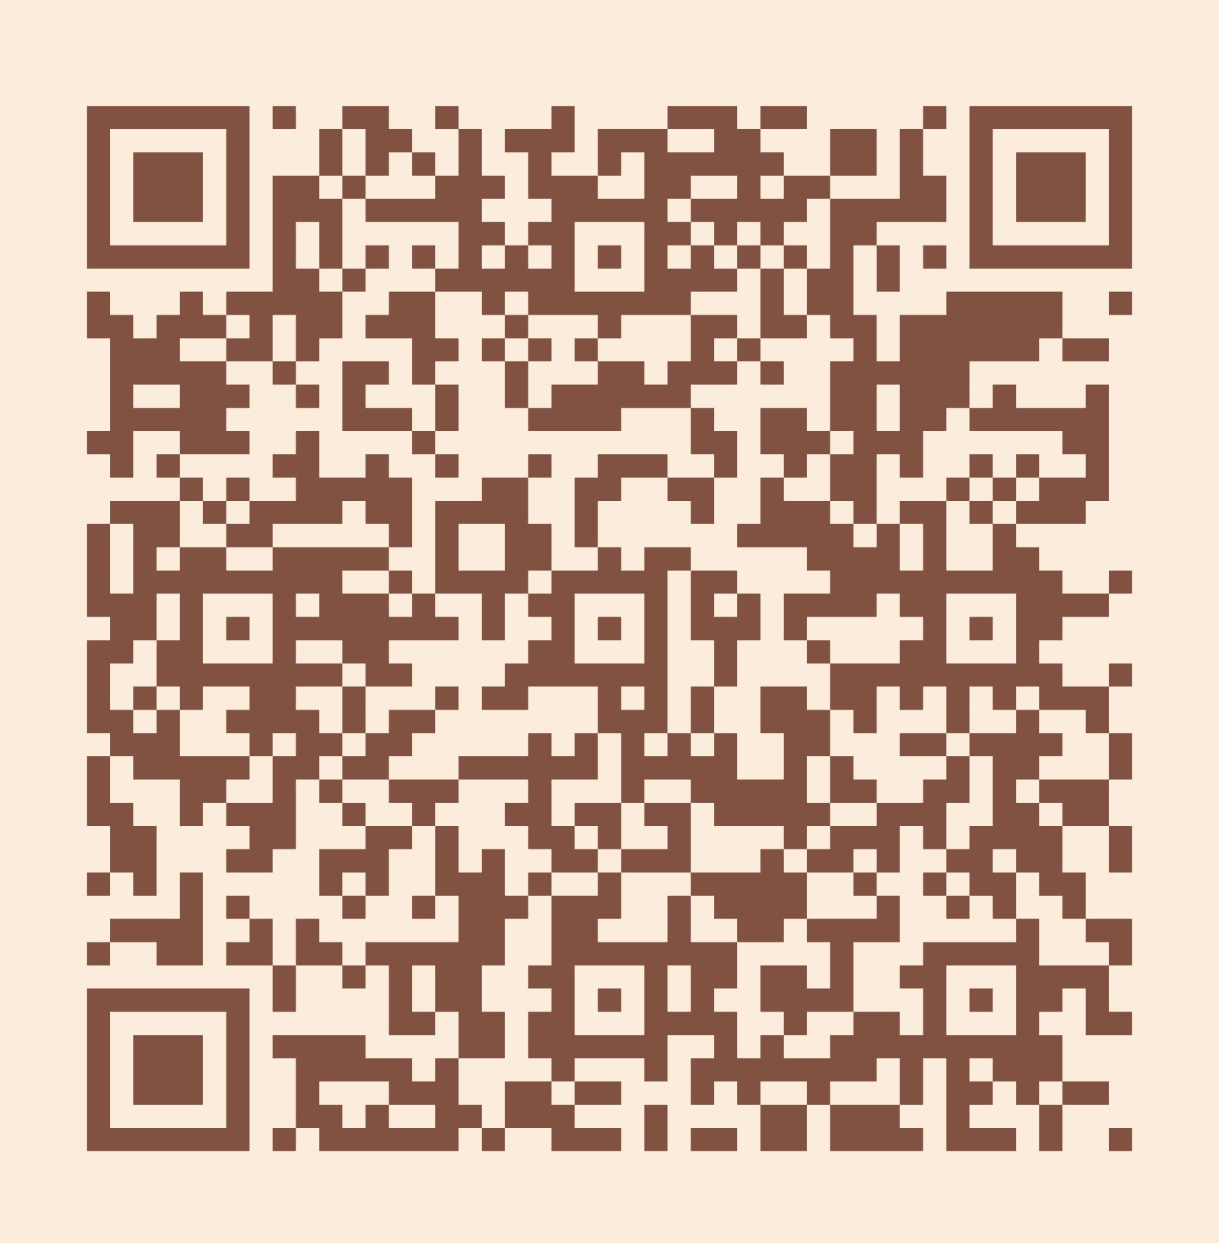
Please take a moment to complete the program survey.
SCAN ME!

