Slide 2




Don’t Miss!
50/50 RAFFLE
Tickets are $1 each and can be purchased from Conni Strittmatter or David Dahl! The winner takes home half the pot.
SILENT AUCTION
Visit the Silent Auction in the exhibitor hall to place your bids before 10:45 a.m. on Friday, May 8th.
PUB QUIZ
Thursday, May 7 8:00 – 10:00 p.m. Choptank Ballroom
KARAOKE
Thursday, May 7 8:00 – 11:00 p.m. Windjammer

Slide 3
Bringing Kindergarten to Libraries
How to Start a Kindergarten Readiness Program for Underserved Populations
Presenters
Danielle Navarro (She/Her)
Missy DeCesaris (She/Her)

Slide 4
Welcome to Class!
Find a seat.
Play with materials in your row
Clean up when the timer goes off.

Slide 5
Goodbye Grown Ups!
We wave goodbye like this,
We wave goodbye like this,
We clap our hands with all our friends,
We wave goodbye like this.

Slide 6
Hello, Class!
Bee, bee, bumblebee
Will you say your name for me?
(name)
Let’s clap it!
Let’s shout it!
Let’s whisper it!

Slide 7

Number of the Day…
Four
4
0
1
2
3
4
5
6
7
8

Slide 8
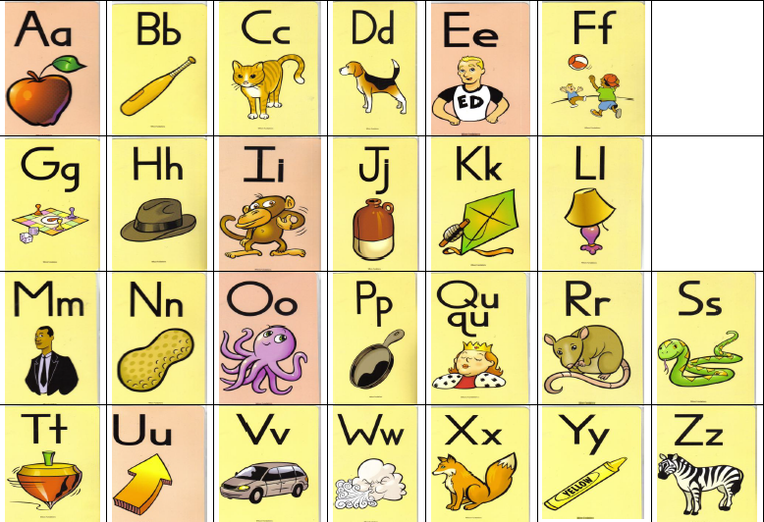
Fundations Alphabet

Slide 9

Letter of the Day
A

Slide 10
Word of the Day
Access

Slide 11
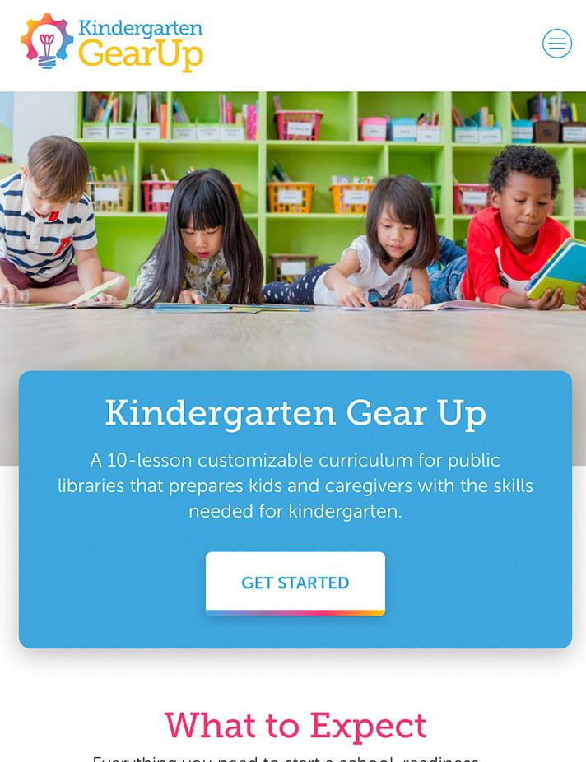
Why Kindergarten
Gear Up?
Part 2:

Slide 12
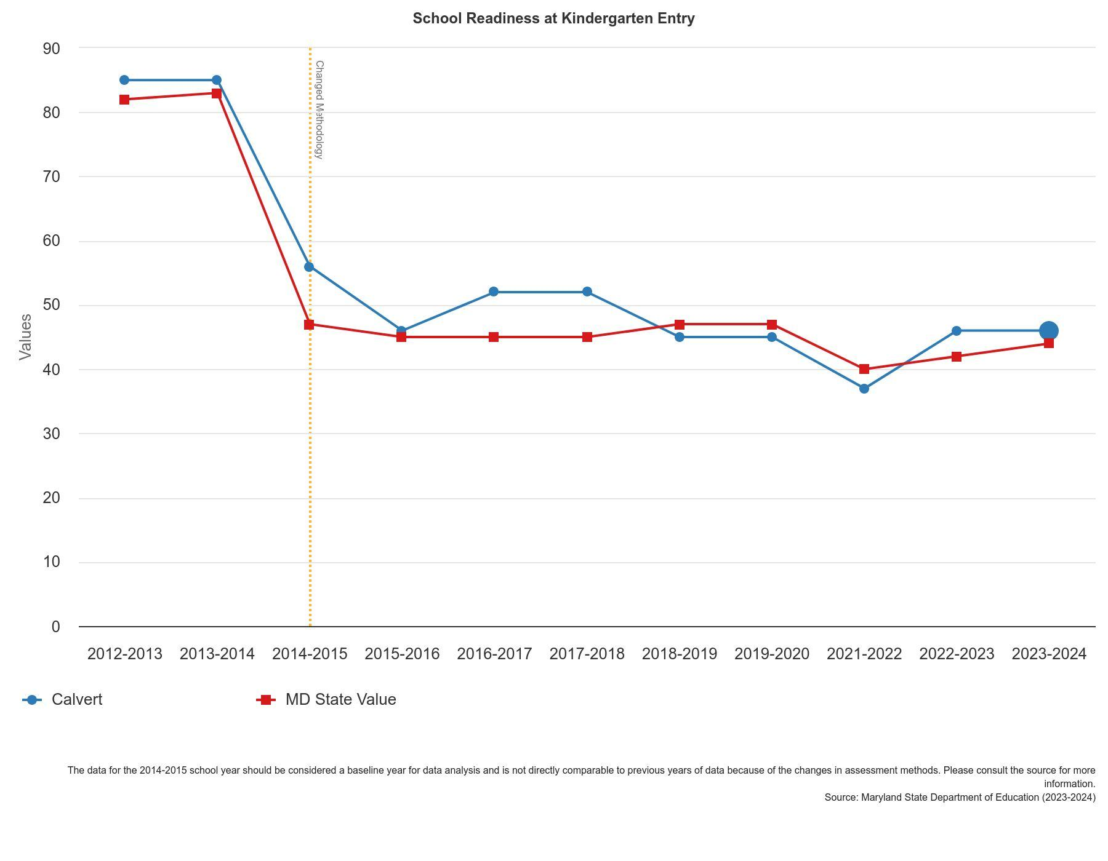
KRA Scores
Only 43% of kindergartners demonstrate school readiness for Calvert County
How can libraries support?
https://www.healthycalvert.org/indicators/index/view?indicatorId=399&localeId=1248

Slide 13
What is Kindergarten Gear Up?
Developed by:
Jodi odi del Pena - Librarian III & Youth Services Manager
San Diego County Library
Program Description:
This school-readiness initiative was developed by public librarians for public libraries and has been reviewed and approved by San Diego State University’s Department of Education.
Target audience:
Children entering Kindergarten who have had limited or no formal early childhood education or child care experience.
Program Structure
Duration 8-10 weeks
Session Length: 1 hour per session
Design: Sequential sessions that intentionally build upon previously introduced skills.

Slide 14
Early Learners Outcomes
Body & Spatial Awareness
Communication
Cooperation
Critical Thinking
Fine Motor Skills
Focus & Self-Control
Group Dynamics
Growth Mindset
Independence
Kindergarten Knowledge
Letter Recognition
Math skills
Print Awareness
Resilience
Sequencing
Sorting
Vocabulary
Word Awareness

Slide 15
Caregiver Outcomes
Advocacy
Community Building
Confidence
Connection
Peer-to-Peer Learning

Slide 16
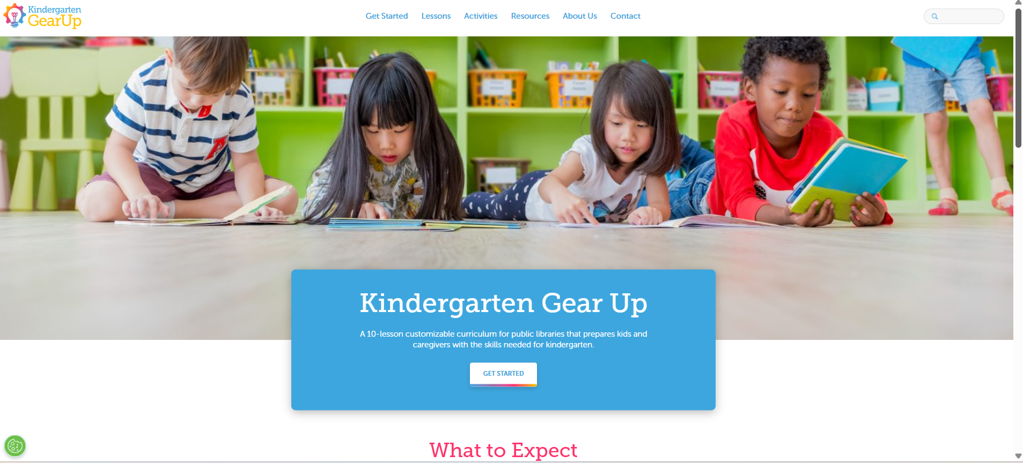
Website of KGU
Book Lists
17

Slide 17
Storytime vs KGU
KGU
Caregiver Gear Up
Independence
Independent Group Dynamics
Independent social, emotional, behavioral learning
Platform for directed adult peer-to-peer learning
Storytime
Early learning
Early literacy
Early numeracy
STEAM
Growth Mindset
Group Dynamics
Social Skills

Slide 18
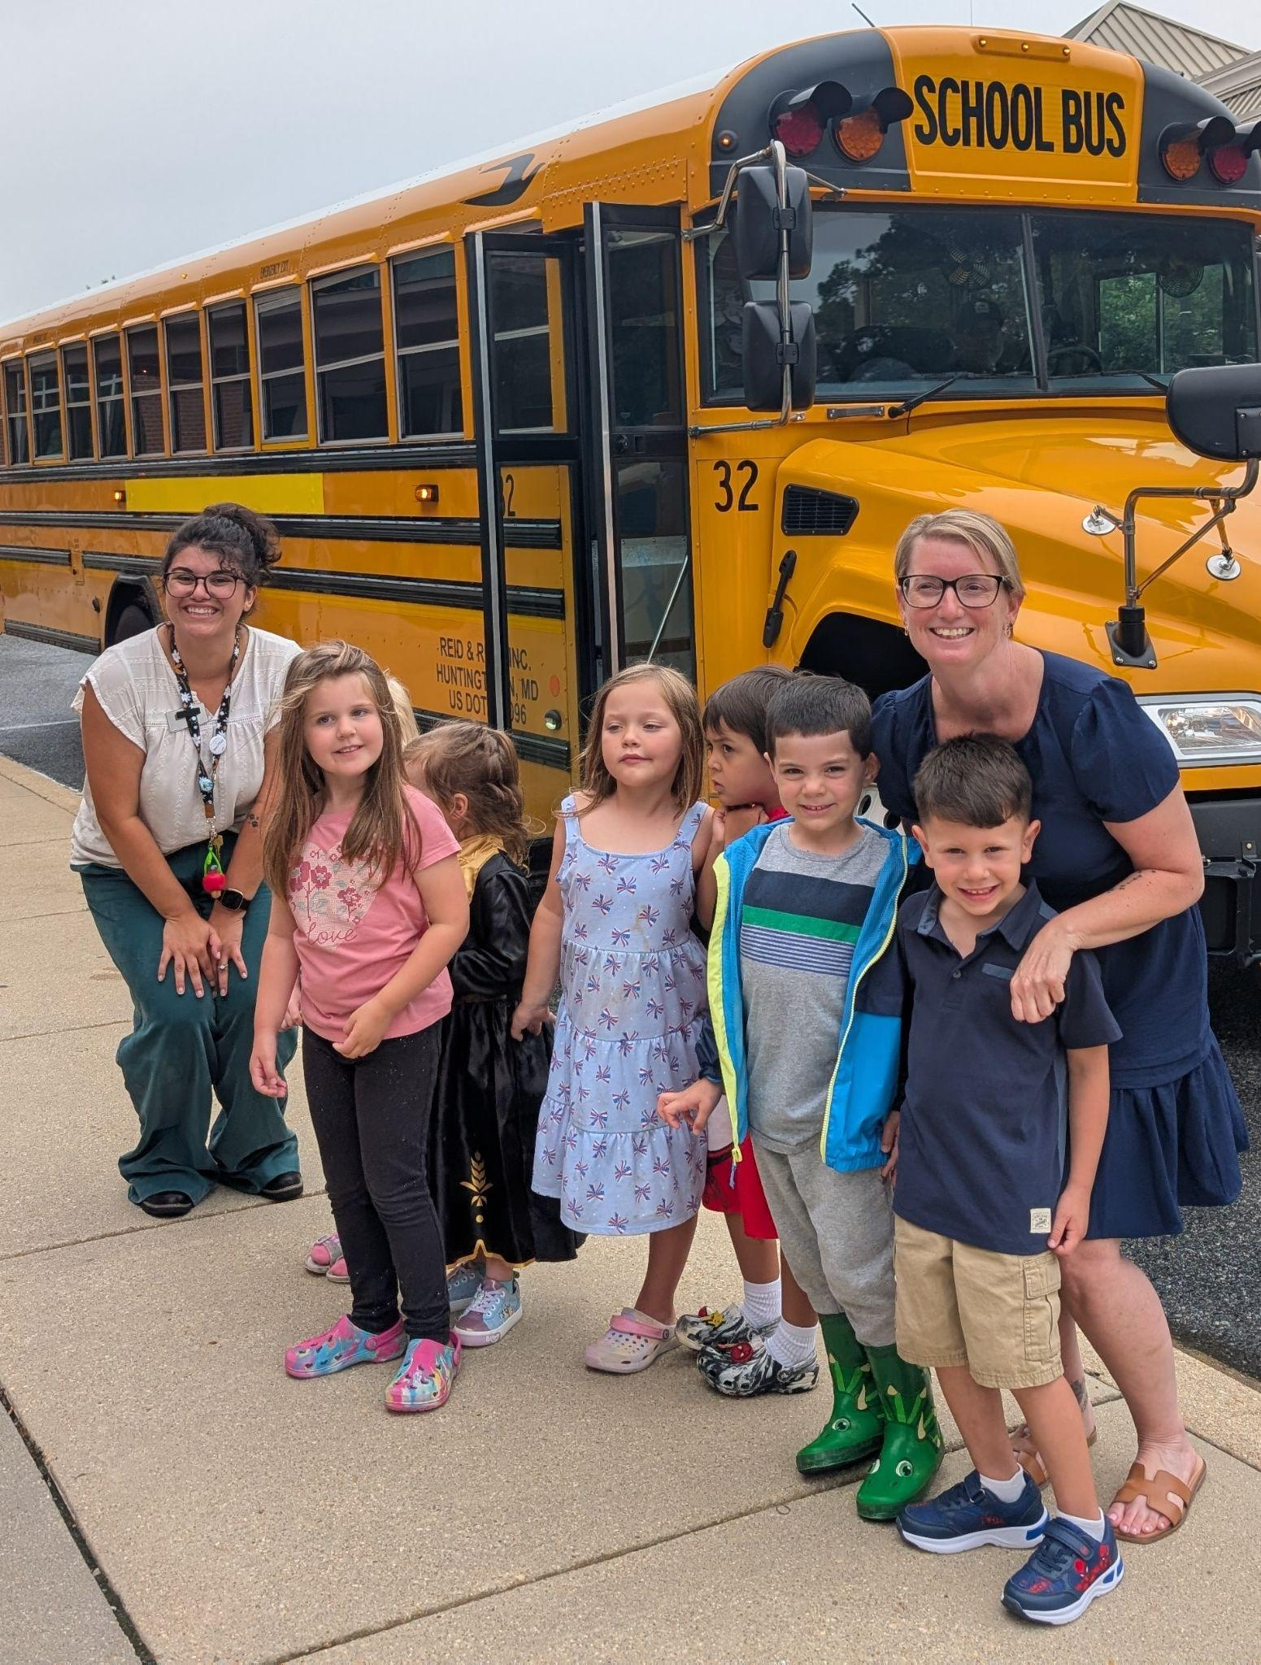

Kindergarten Gear Up at Calvert Library
Part 3:

Slide 19
Logistics of KGU Program
Year One
Year Two
Max Registration: 10 kids
x1 a week for 10 weeks
2pm - 3pm
Attendance:
Started with 10 kids attending
Ended with 8 kids attending
Max Registration: 10 kids*
x1 a week for 9 weeks
2pm - 3pm
Attendance:
Started with 11 kids registered (8 attending)
Currently have 8 kids attending

Slide 20
Community Partnership
We partner with our county school system and they cover the grown-up portion of Kindergarten Gear Up.
They have representatives from the school system talk about the following topics…
What to Expect in Kindergarten (with a Kindergarten Teacher)
Behavior Strategies (with a Behavior Therapist)
Fine Arts
STEM
Language Arts
Fine Motor (with an Occupational Therapist)

Slide 21
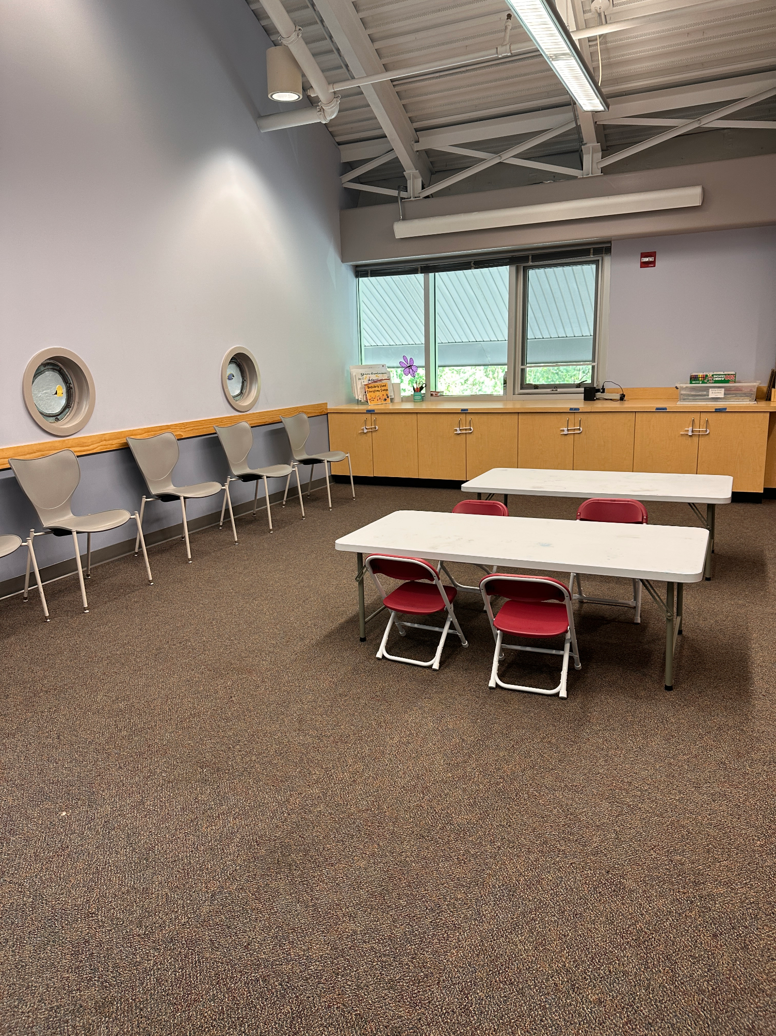
Materials We Use for KGU
Bought for KGU
Child Size Tables (x3)
Child Size Chairs (x15)
Clear Pocket Sleeves (x15)
Existing Materials
A Frame Easel
Smartboard
Manipulatives (puppets, gears, lincoln logs)
Carpet Squares
Calming Stuffies
Crafting Materials (crayons, scissors, pencils…)

Slide 22
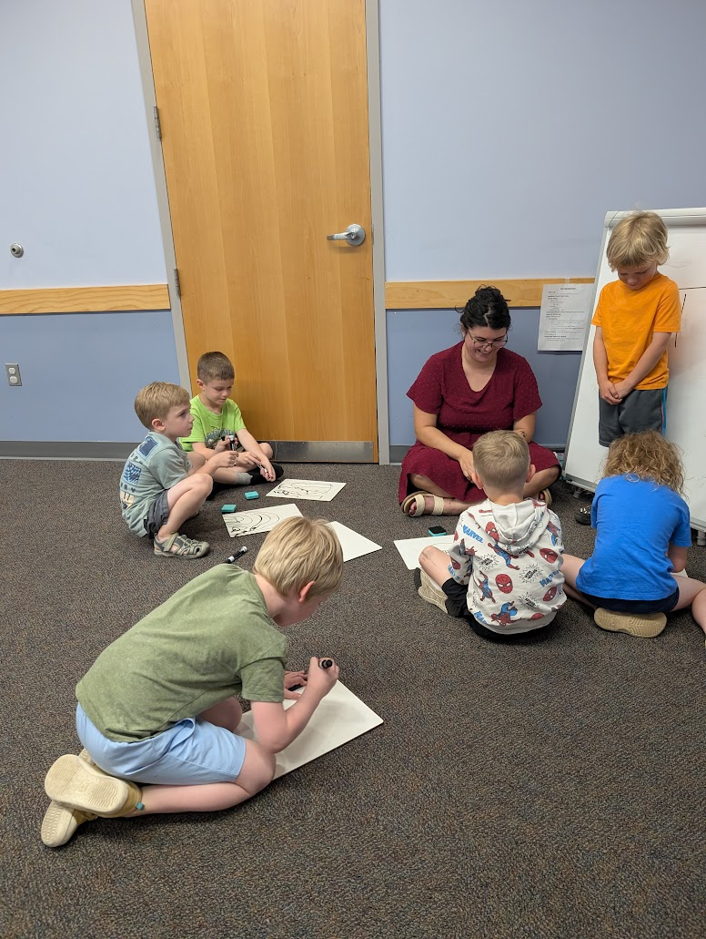
Lesson Plan Format
Warm Up
Goodbye Grownups
Whole Class At Tables
Name Song
Number of the Day
Alphabet & Phonemic Awareness
Letter of the Day
Word of the Day
Movement Break
Ready to Read Song (Eyes are Watching)
Book & Discussion
Lesson Activity
Practice Forming a Line (We are the Dinosaurs)
Grown Ups Return
Closing

Slide 23
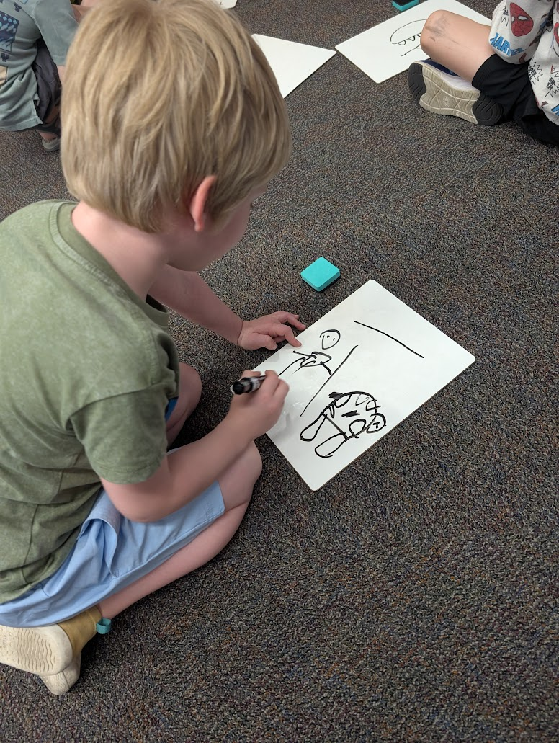
Lesson Themes
We met with the supervisor of early childhood education for CCPS, and decided the following themes from the kindergarten gear up website were most relevant to our community:
Be Yourself
Be Creative
Be Kind (Be a Friend)
Be Persistent
Be Polite
Be an Ally
Be Responsible
Be a Leader

Slide 24
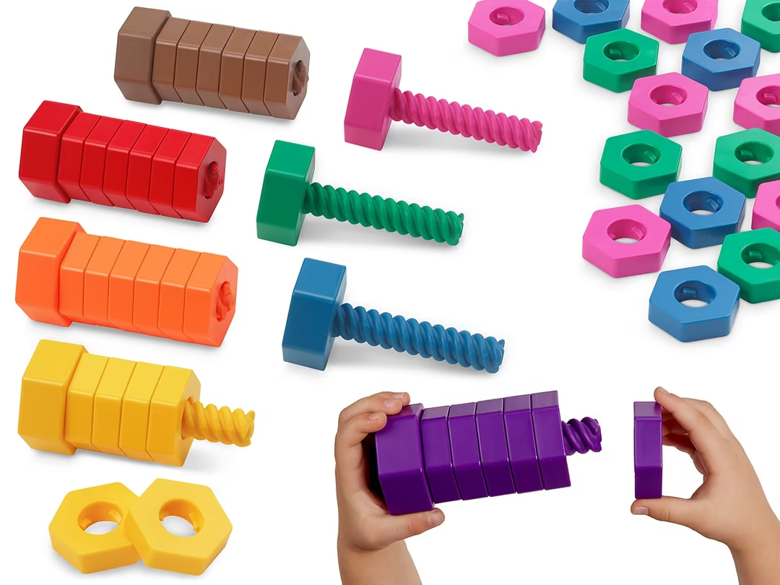
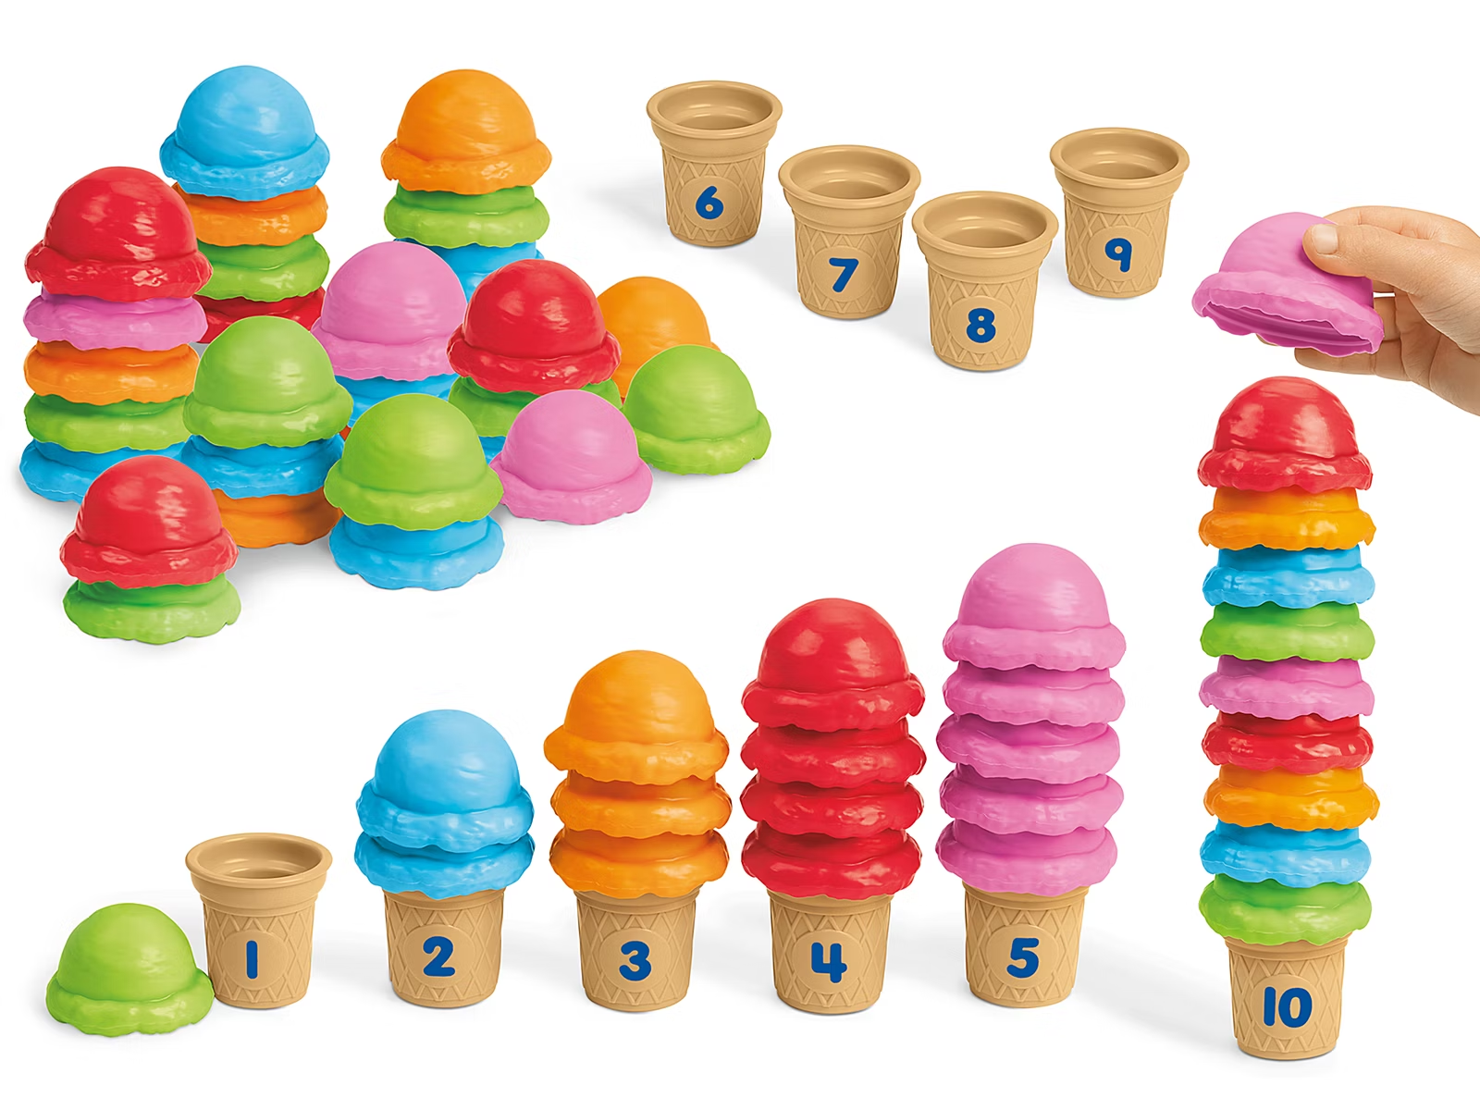
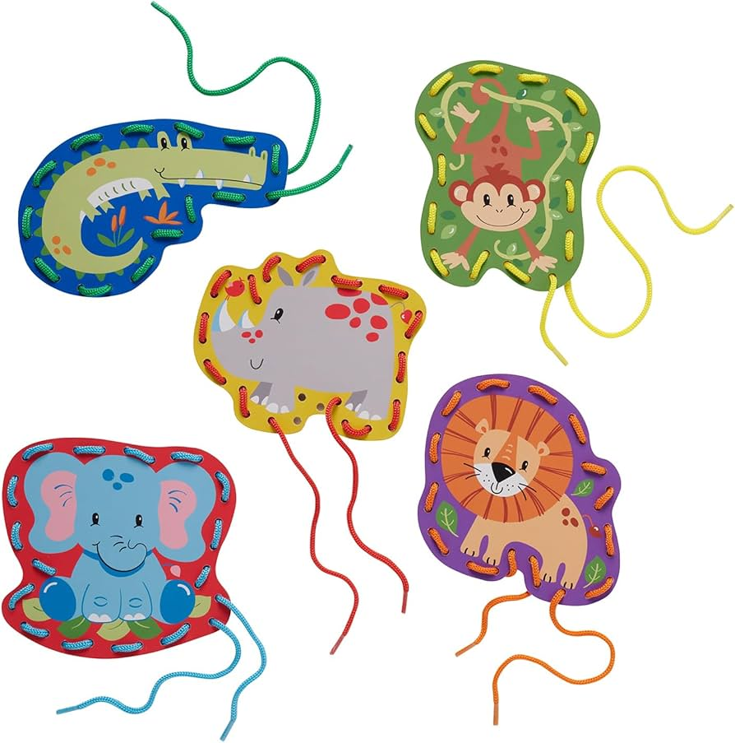
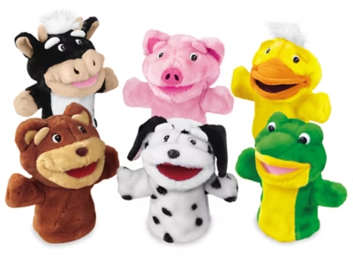
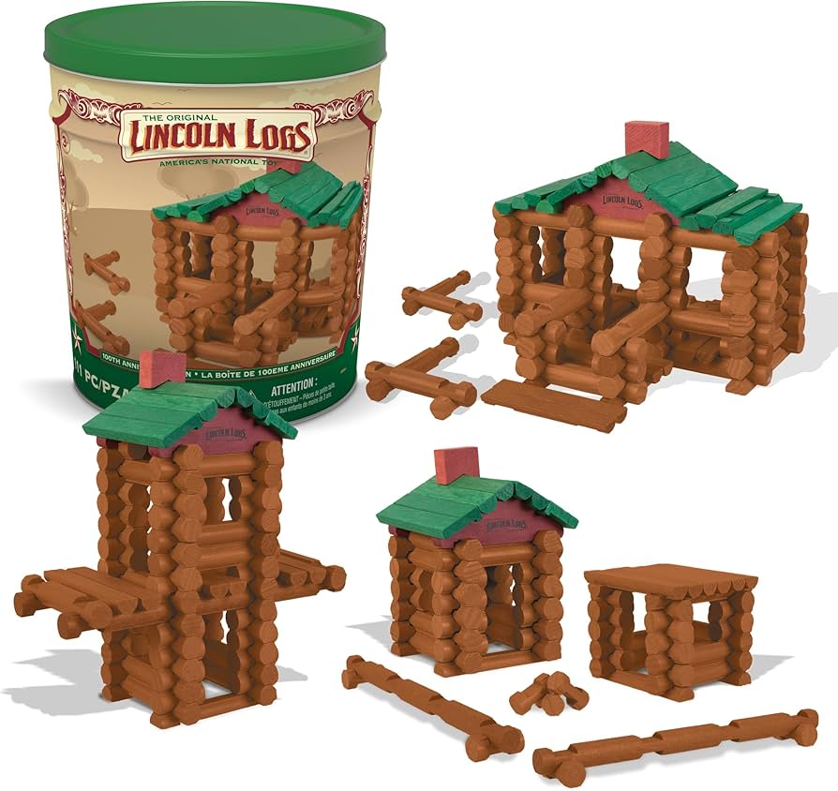
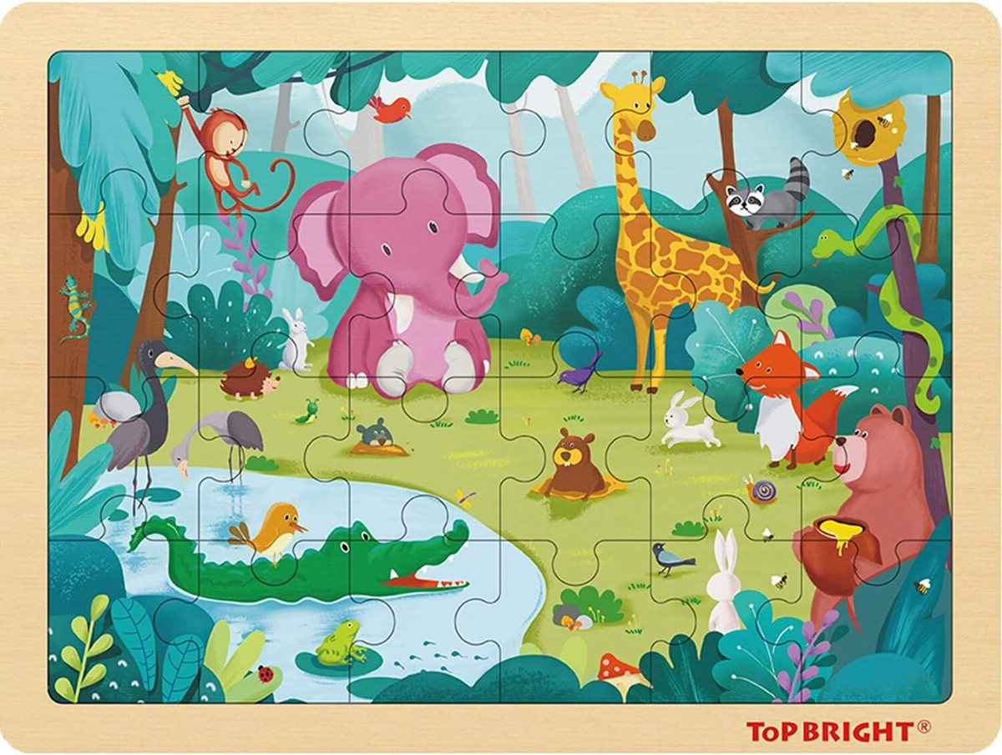
Warm Up Supplies

Slide 25
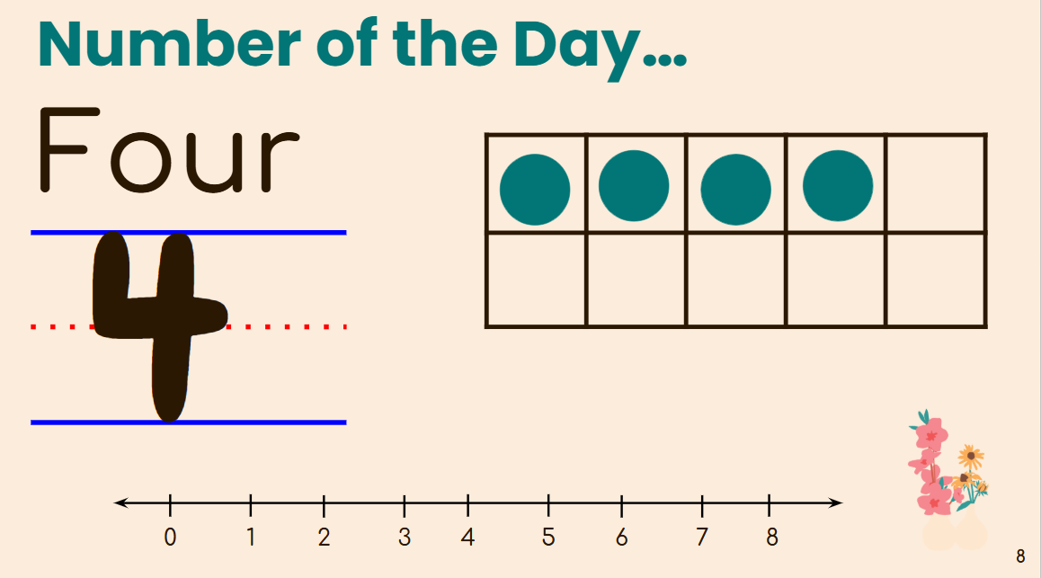
Number Routine & Alphabet
Fundations
Practice identifying numbers written in multiple ways and introduction to subitizing.
Literacy curriculum used in our school system to provide instruction on phonics and spelling.

Slide 26
How We Strayed from the Original Lesson Plans
What We Removed…
Grownups leave immediately after warm up
No transition activity with props to help ease the grownups leaving.*
Year one we did calendar and weather. Year two we did not.
Orientation session
What We Added
More opportunities for movement
More emphasis on phonemic awareness
More emphasis on technology exposure (KRA)
More emphasis on sharing and accepting what you get.
Bus ride and celebration

Slide 27

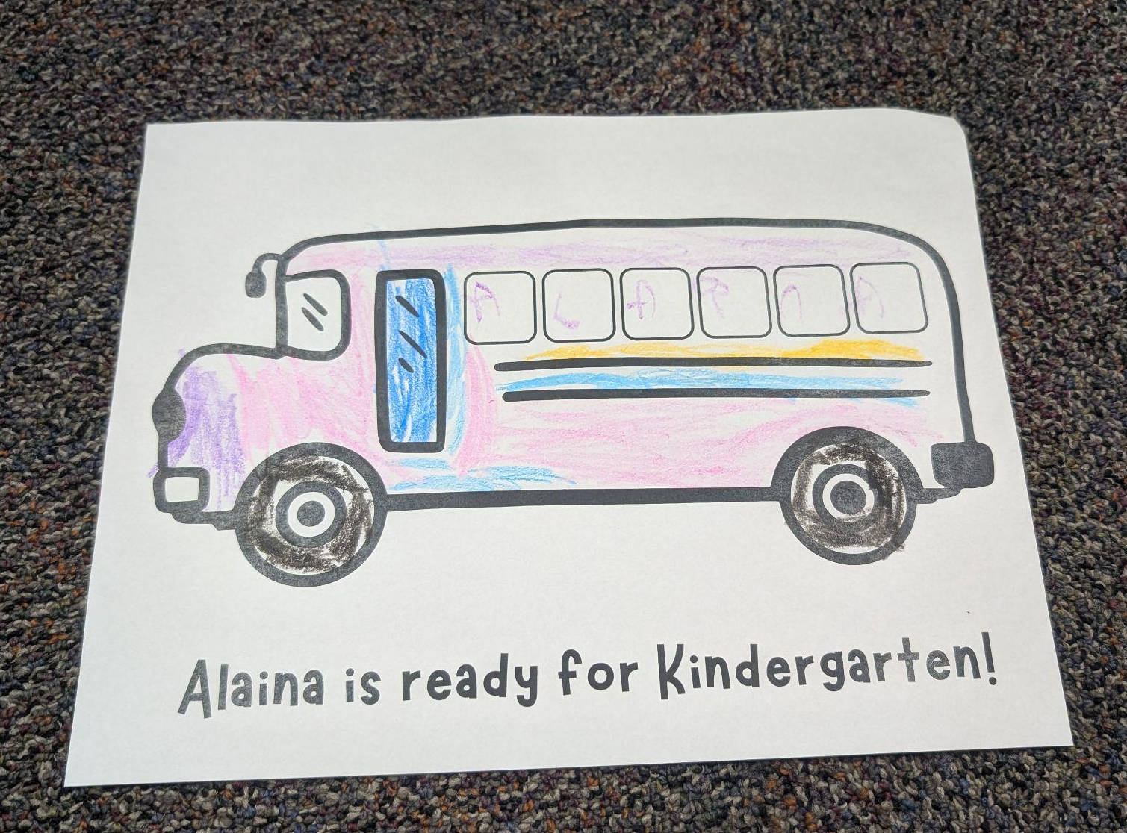
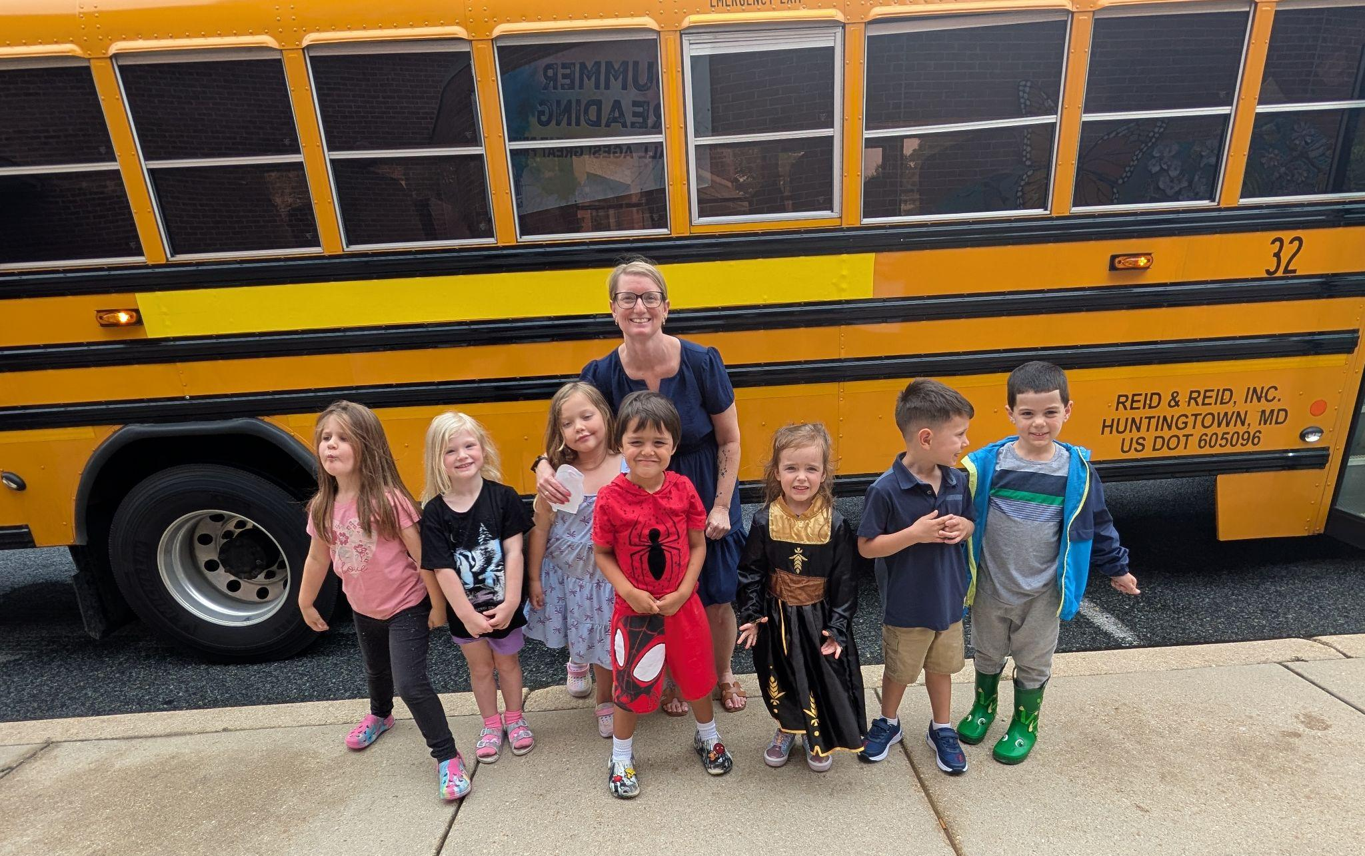
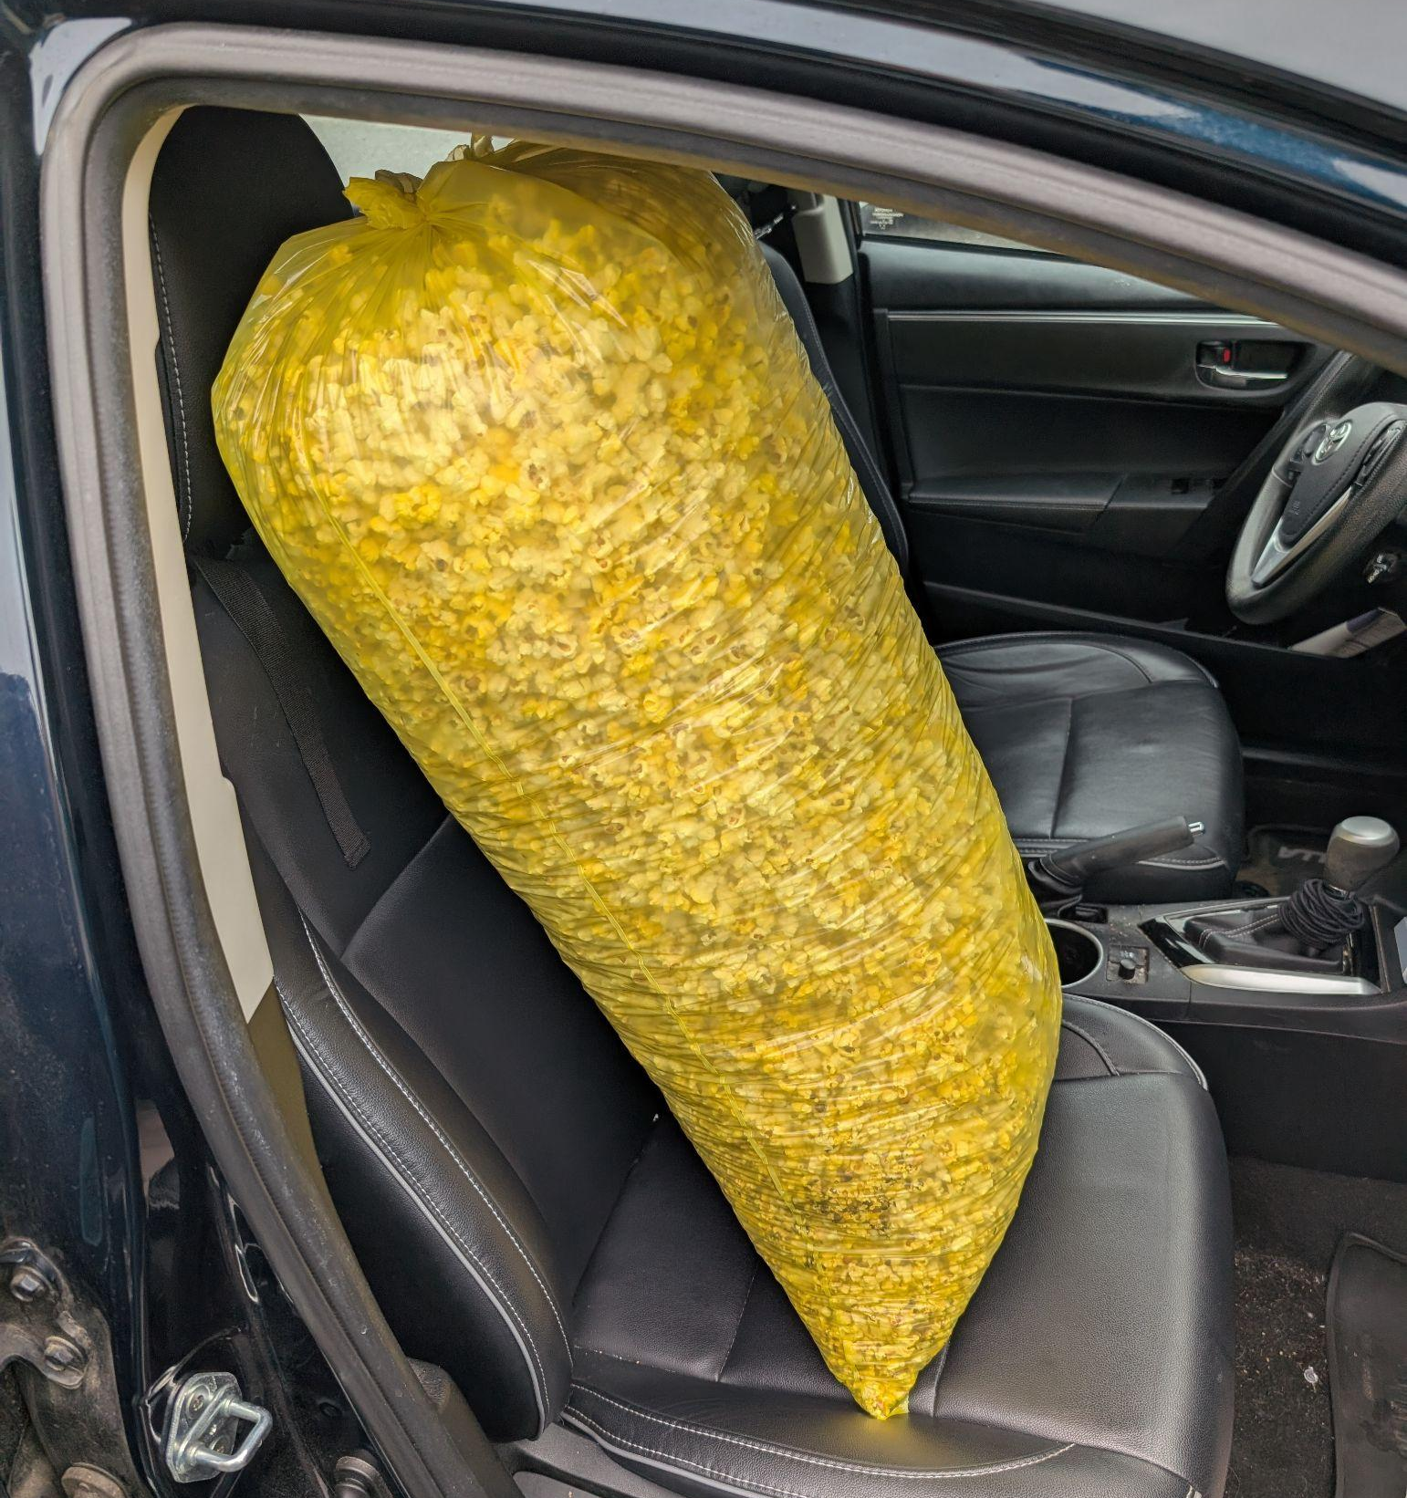
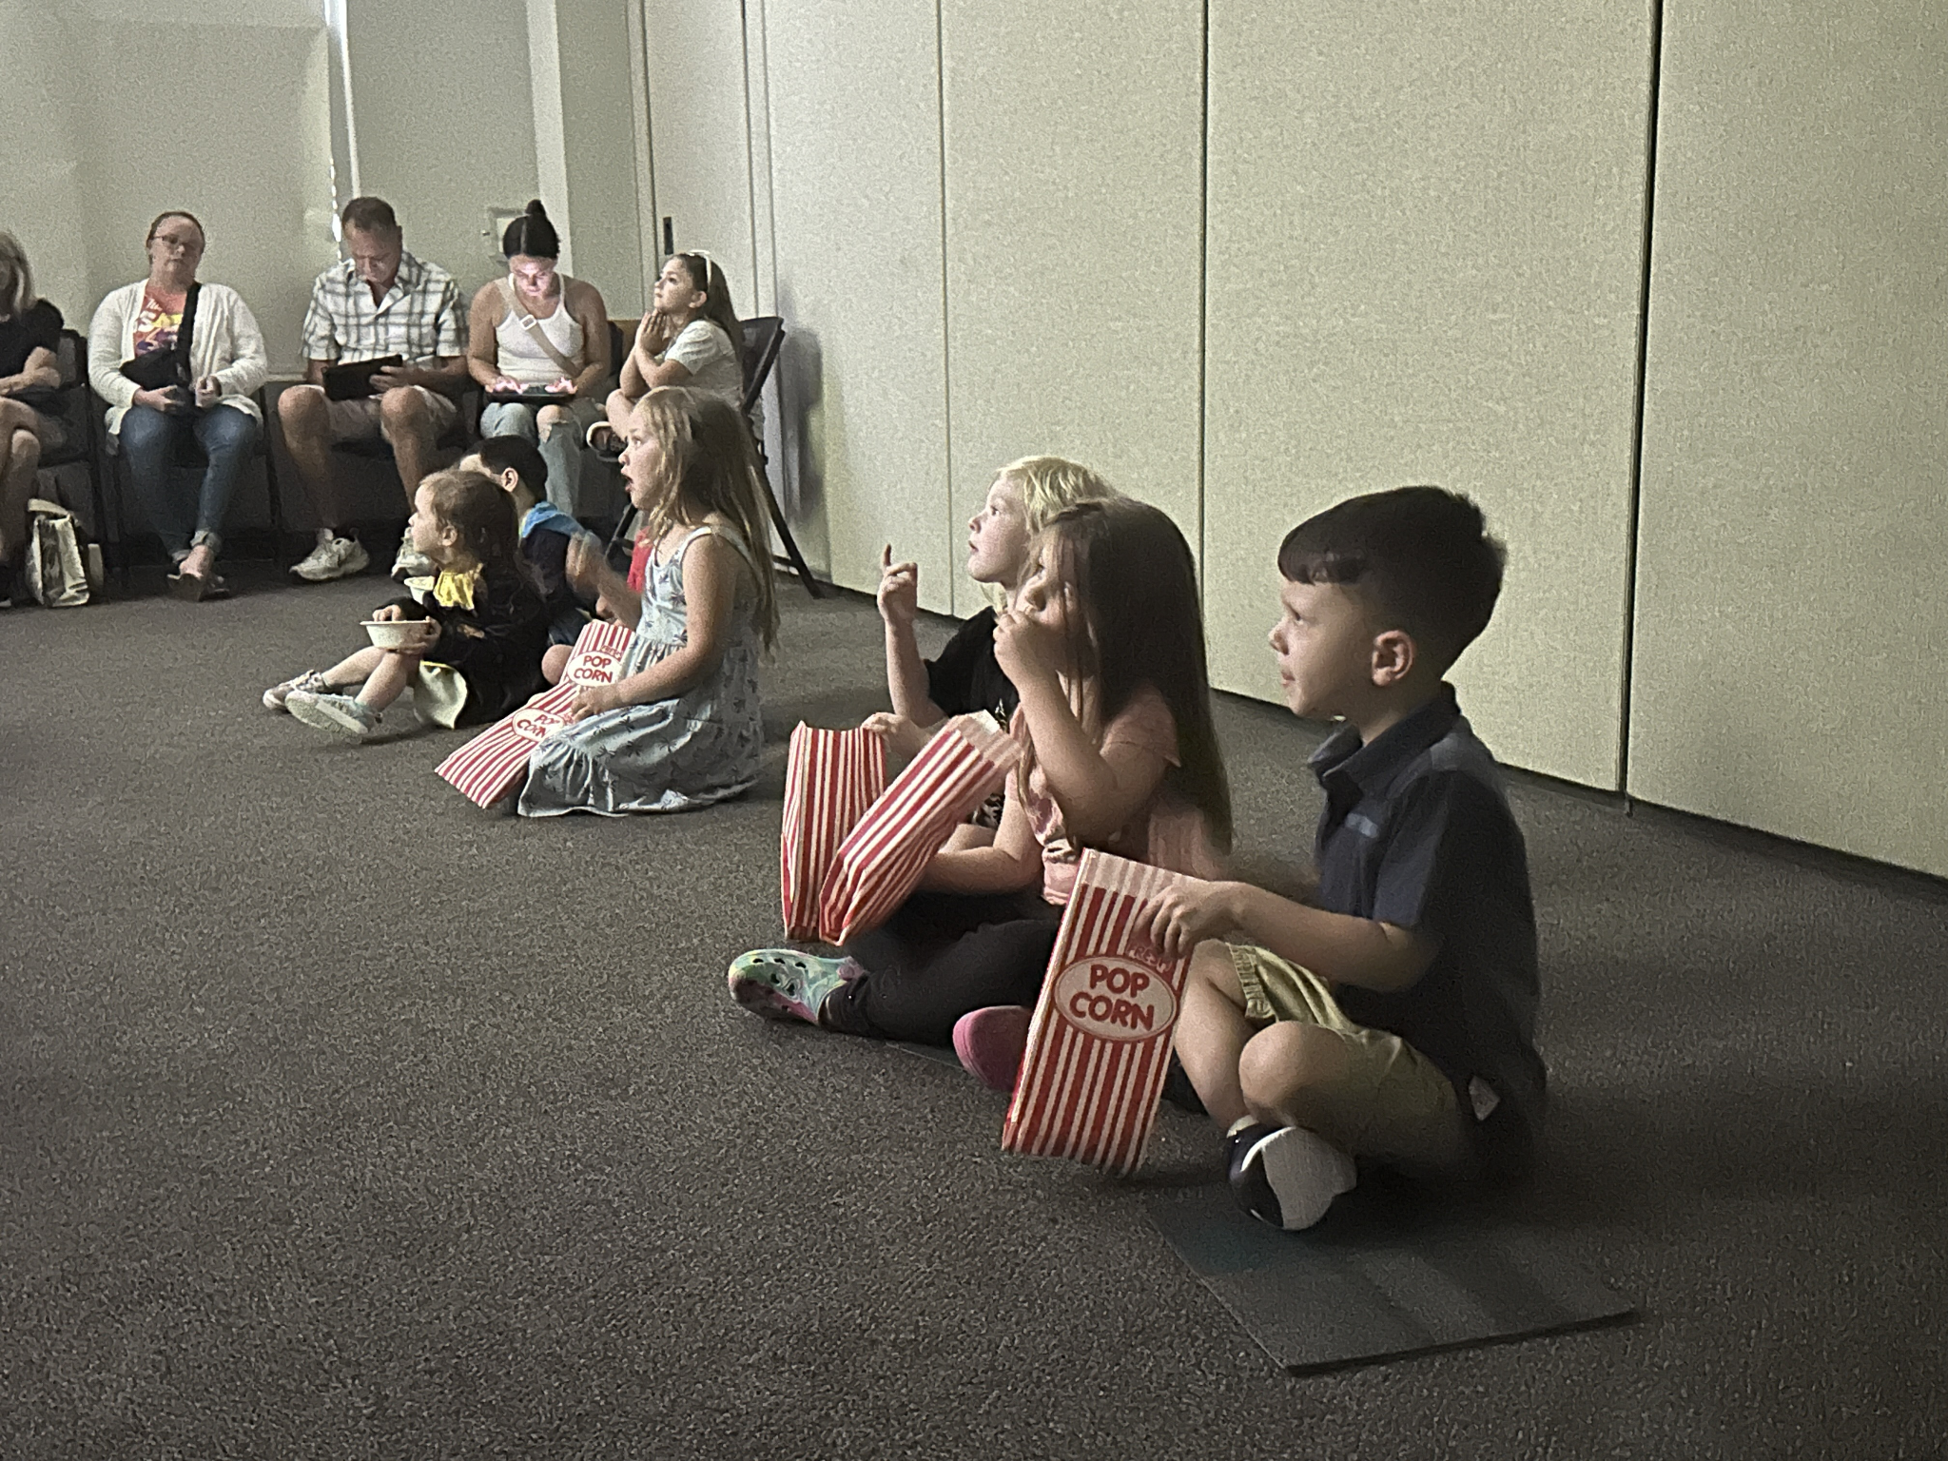
Celebration Session!
Bus Ride
Grown Up Surveys
Certificates
Practice the line OUTSIDE!

Slide 28
Successes!
What Caregivers Told Us in the End of Program Survey…
“i really appreciate (child’s) enthusiasm and he wanted to come every week”
“my child was so excited to come each week and she is so ready to start attending kindergarten. the program is really engaging to both kids and parents.”
“a great opportunity for children to interact with other kids their age before entering school”
“the teachers and guest speakers were amazing. very helpful in terms of what will be expected of my child when entering kindergarten. learned what i needed to work on with my child over the summer.”
What We Noticed
Walking in a Line
Waiting & Accepting No
Shy boy

Slide 29
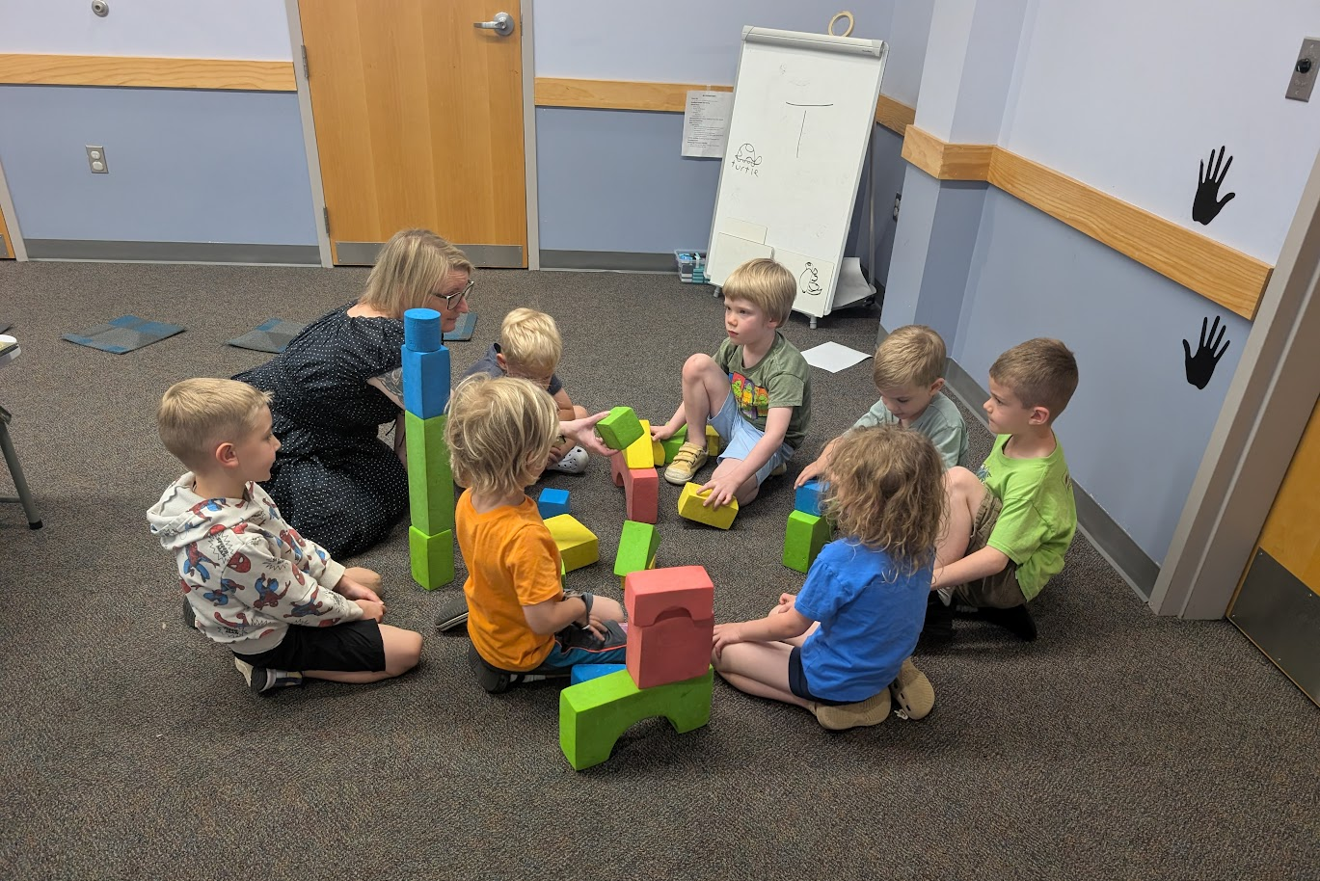
Expected Challenges
Group Dynamics
Kids who are too shy to participate
Kids who have to share every thought
Twin siblings
Disengagement
Sharing
Conflict Resolution
Raising hands and waiting to speak
The heavily desired position of LINE LEADER
Undoing existing bad habits (handwriting)

Slide 30
Unexpected Challenges
Limitations of 3rd party registration vendor (Communico)
Families not registering correctly
Families registering kids who are too young for the program
Coordinating with the school system for program dates
Consistent tardiness of families
Caregivers who want to stay the whole time with their little one
Kids who are heavily interested in screens

Slide 31
Best Practices We Recommend
This program needs 2 librarians in the room to run it.
Hold firm boundaries
Create moments for building and strengthening the classroom community
Correct behavior you know wouldn’t be accepted in school even if it seems like you’re nitpicking
If possible, 2 rooms is best
Be flexible and don’t be afraid to improvise in the moment
Tell the kids your name (and not just on the first day)
You need to be more intentional with redirection and expectations because there are no grown-ups to help you.

Slide 32
Questions?

Slide 33
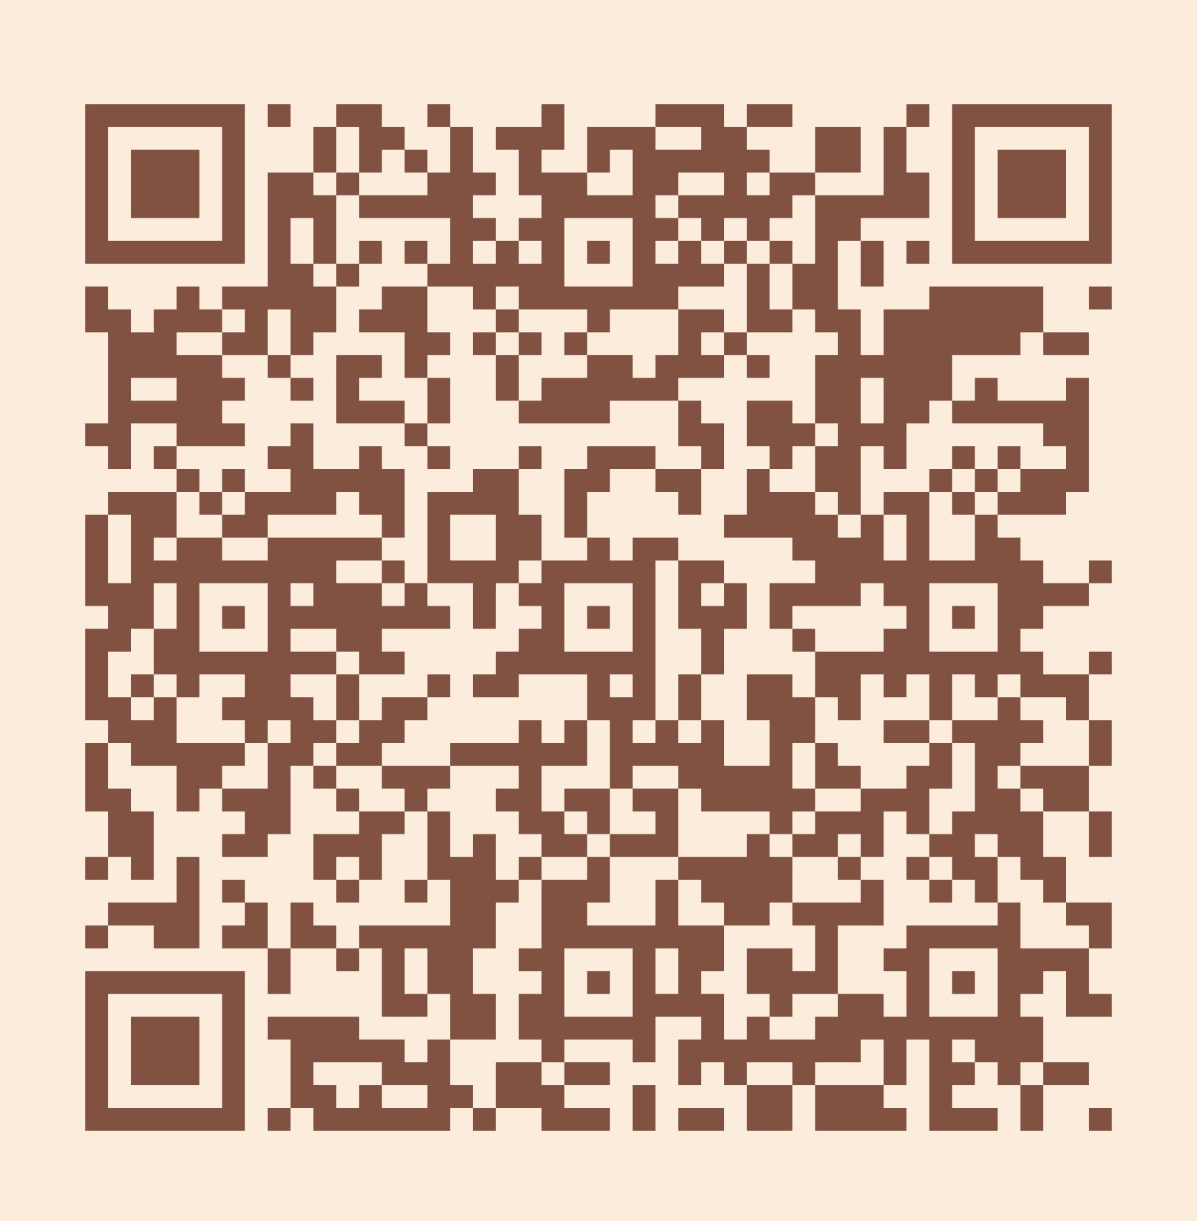
Please take a moment to complete the program survey.
SCAN ME!

Slide 34
Thank you!
Danielle Navarro
danielle.navarro@calvertlibrary.info
Missy DeCesaris
missy.decesaris@calvertlibrary.info

