Slide 1
The Will of Magic
Cultivating Willpower and Spiritual Fitness for Pagans and Magicians.

Slide 2
What is Spiritual fitness?
The contemporary idea that the “Spirit” may be made fitter, or atrophy; with consequences affecting all other forms of health and fitness.
Analogous with a stable and ancient understanding of spiritual health, capacity, and power:
    Something which needs to be maintained.
    Can be improved; facilitating both the practice of magical arts, and the soul’s expression into life.

Slide 3
USMC Spiritual Fitness
Founded on Clinical Research, actualized into a Spiritual Fitness system.
Defines spiritual fitness is broadly defined as ‘inner strength from higher purposes’ by the USMC.
Part of the ‘total health system of the USMC’, described as just as critical as physical, mental and social fitness
Has a direct influence on overall health, character, and fortitude.
Those engaged in spiritual practices are 60-80% less likely to take their own life.
(United States Marine Corps, 2024)

Slide 4

USMC Spiritual Fitness Includes:
Cultivation of good character
Integration and embodiment of core values
Time in nature
Rituals, rites, sacraments
Spiritual practices
Communication with Divinity and/or supernatural entities as befits one’s personal religion.
Spirit may be cultivated by ‘sets and reps’ of spiritual activities and practices.
USMC Spiritual Fitness
(United States Marine Corps, 2024)

Slide 5
Spiritual Health Impacts Overall Health
Current clinical research shows that regular spiritual practices and RSIs strongly correlate with positive mental and physical health outcomes through a wide—but not exhaustive—range of mechanisms (Gonçalves et al., 2015; Kruk & Aboul-Enein, 2024).
Much of the ‘how’ remains unknown – and may not be fully comprehensible within the scope of current clinical research.

Slide 6
The Magical Perspective
Manner of preparation
Spiritual cleanliness
Rarifying the spirit and mind
Cultivation of will, power and capacity
Removing obstacles for the soul, and the will.

Slide 7

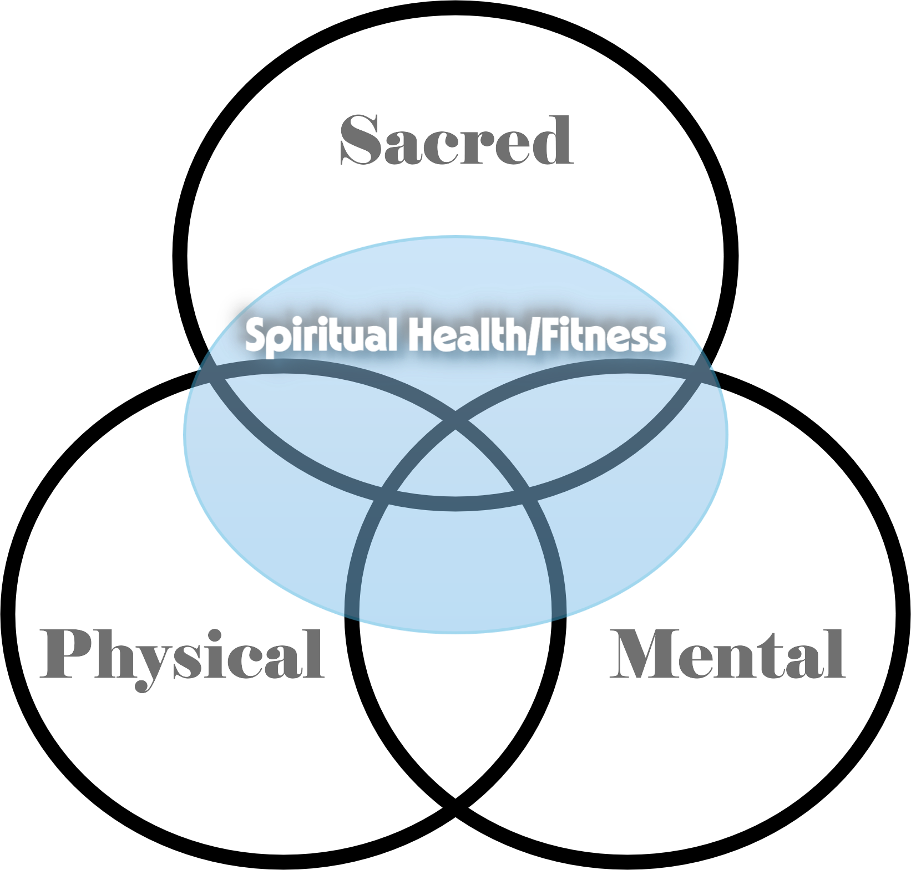
Where does Spiritual Health and Fitness…fit?

Slide 8
Magician = Spiritual Athlete
The Spirit Can...
Be Evaluated regarding its health and integration.
Exercised to improve its fitness.
Develop fortitude, magical capability, and spiritual health.
Better facilitate the aims of the soul through unification of the self.
Used to facilitate the development and exercising of will, and a rarefied mind.

Slide 9

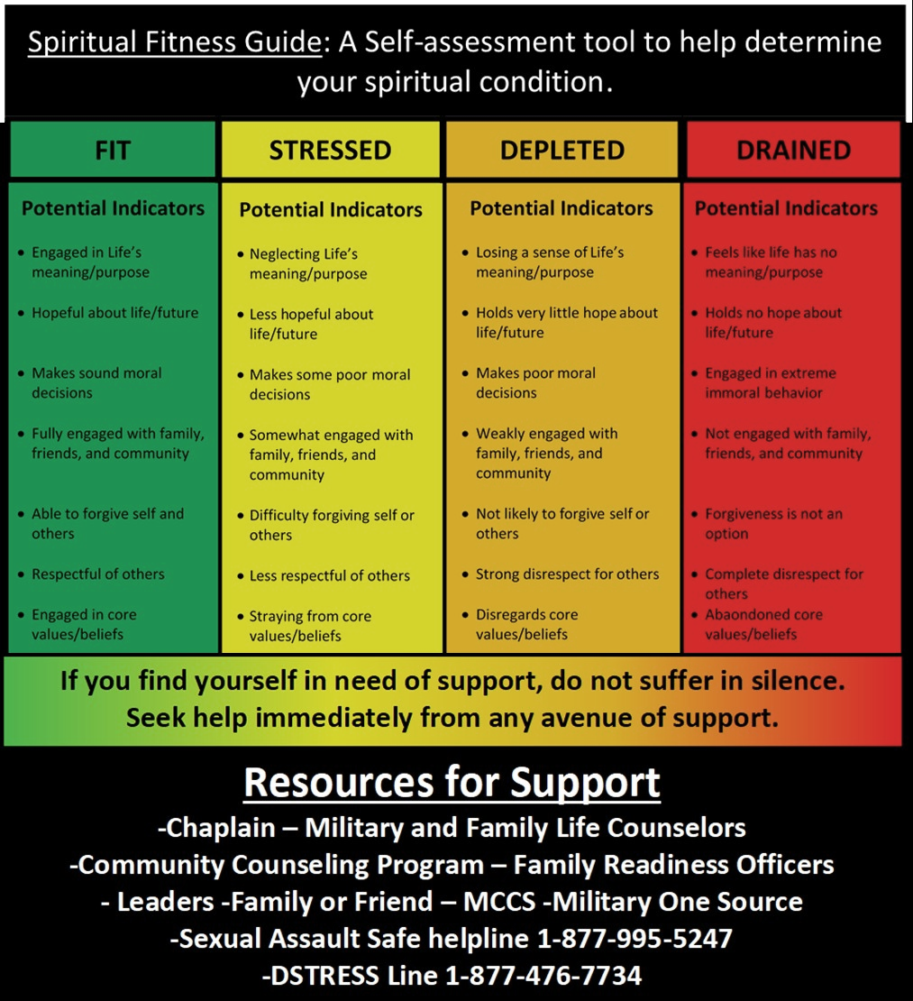

Slide 10
Magical Practices for Evaluating Spiritual Health
Sincere introspection
Divination
Clairvoyant, Tactile (psychometry) and Aueric evaluations
Katobasis
Utilizing correspondent items for sympathetic magical evaluations
And many more….

Slide 11
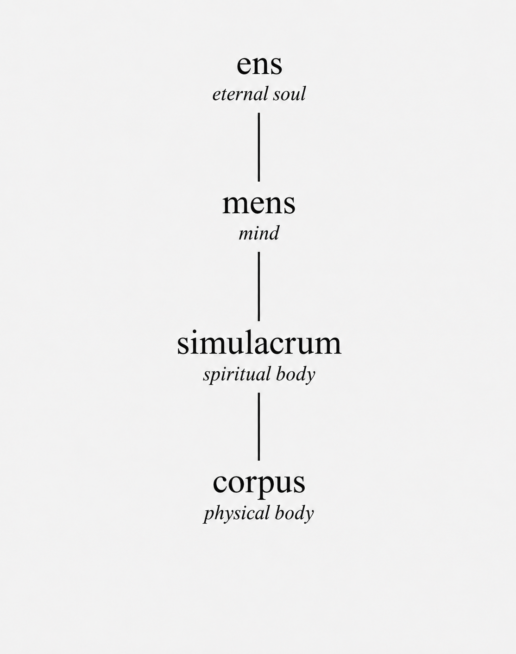
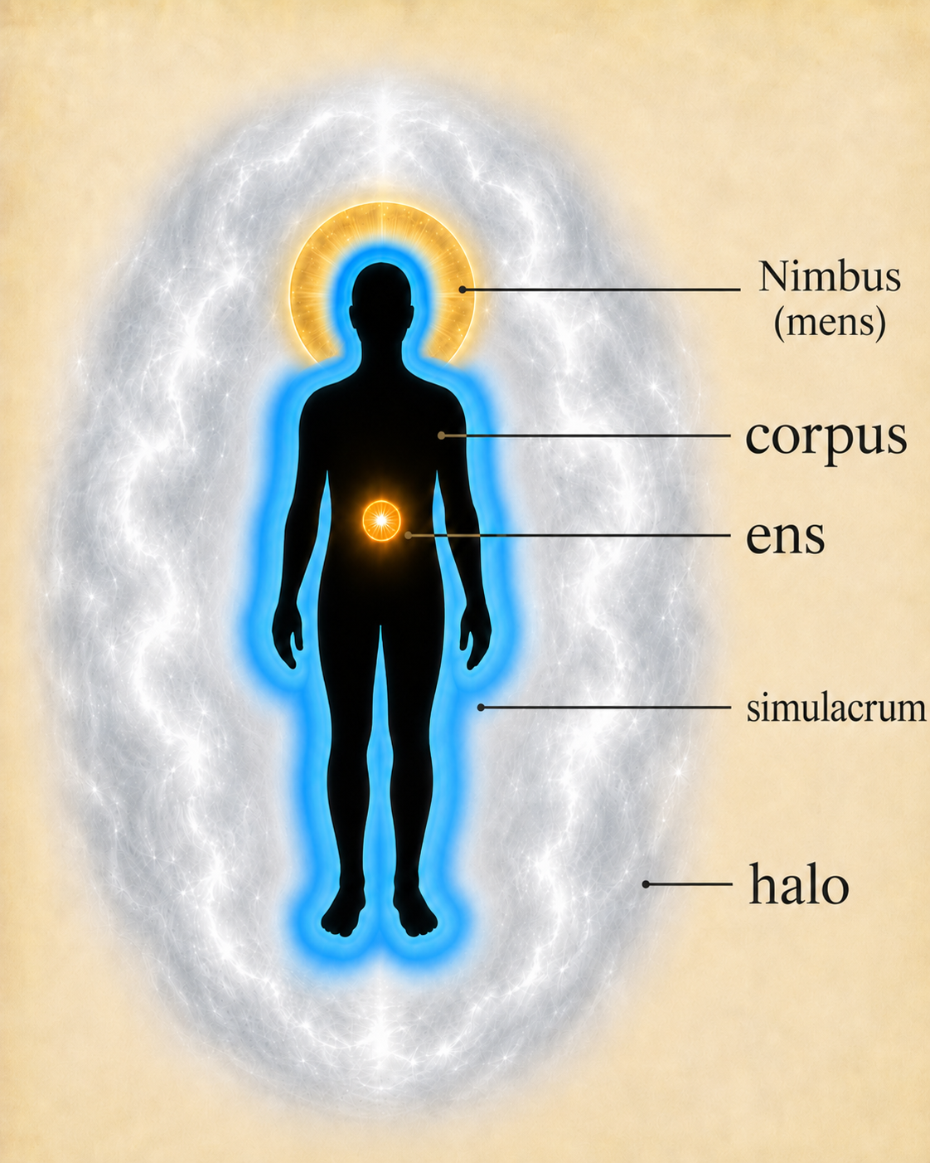

Slide 12




Slide 13
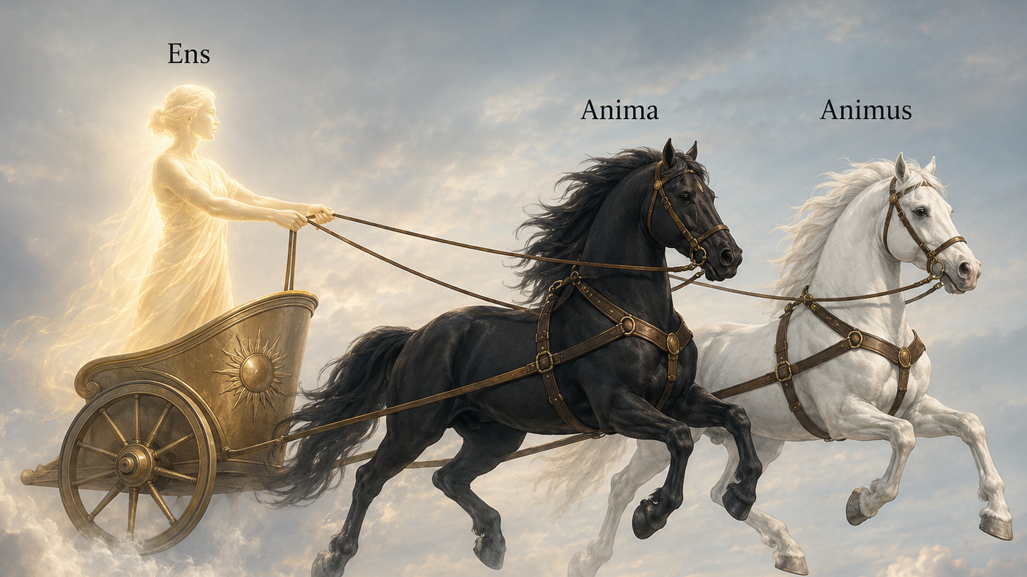
Tripartite Soul

Slide 14
Anima
Animus
Animal Spirit
Desires
Passions
Appetites
Emotions
Childlike
Power
Can be rebellious without structure and discipline; but can be trained through internalization via practice
Reason
Intellect
Rationality
Discerns
Limits
Delineate
Necessarily limits to discern; ought not bind that which needs to flow freely

Slide 15
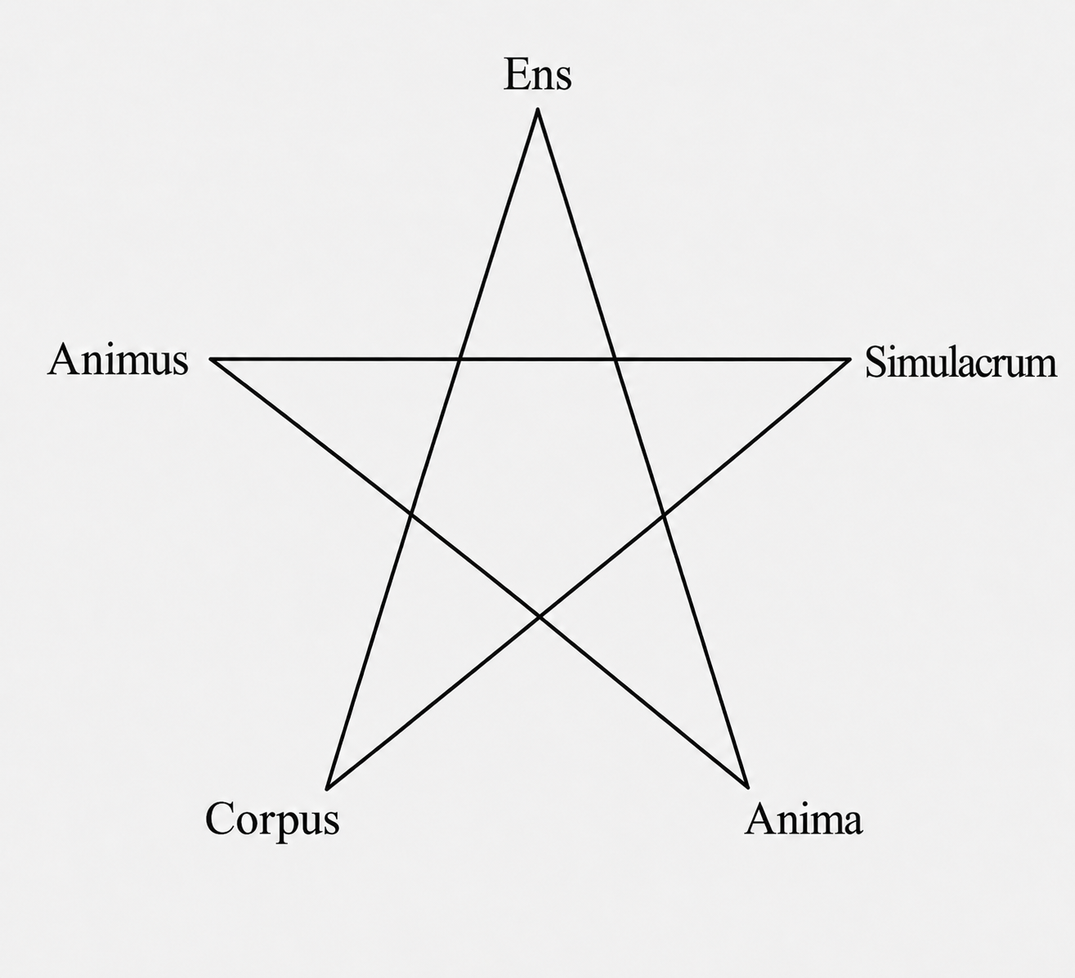
Unity
Unity of self: Will, core values, expression.
Unity of expression: Thought, word and deed.
This aligns the manifest self: Mind, Spirit, Body.
The more we are unified, the more our soul may freely express and act.
Just as the physical body is nourished by temporal sustenance, the mind is nourished by discovery, and the soul by the eternal.

Slide 16
Spiritual Cleansing
Water-cleansing (cleans spirit body).
Giving when overwhelmed (outpour when full to unburden the heart).
Art (When the mind is ill-balanced).
Spiritual orientation to sacred/gods (lightens/rarifies the mind and spirit).
Burdens of the Heart are Chains upon the Soul

Slide 17
Raising Power
We are sovereign beings naturally able to manipulate phasma (power).
Three essential considerations for drawing in power:
  Never draw from lifeforce.
  Ensure Power is clean from intelligences (intentions).
  Solar Plexus naturally both cleanses phasma, and acts as a storehouse.

Slide 18
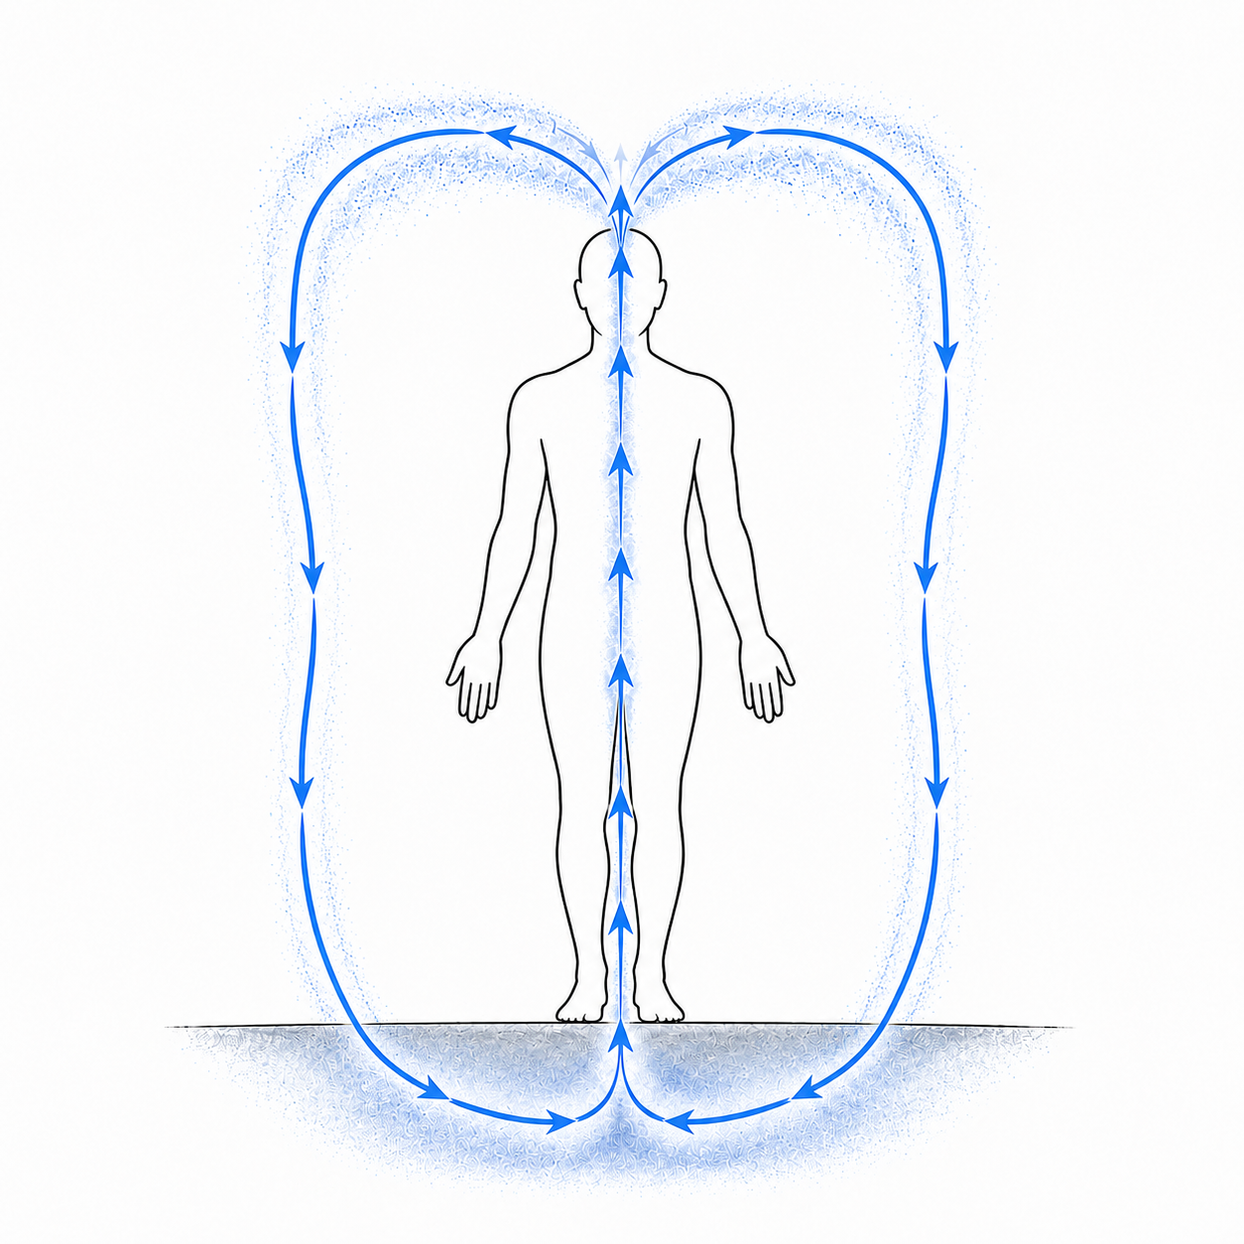
Multiplication
Builds power through repetitive movement of phasma.
METHOD:
  – Draw from under the earth into the soles of the feet.
  – Pull up the body, through the solar plexus, and up through the top of the head.
  – see it cascading down on like a fountain, back into the earth.
  – Use the power you have drawn to draw even more, repeating the process until you are sufficiently empowered for your purpose.
  – Let the fullness of that power reside in the solar plexus.
  – Circluate, or utilize as needed.

Slide 19
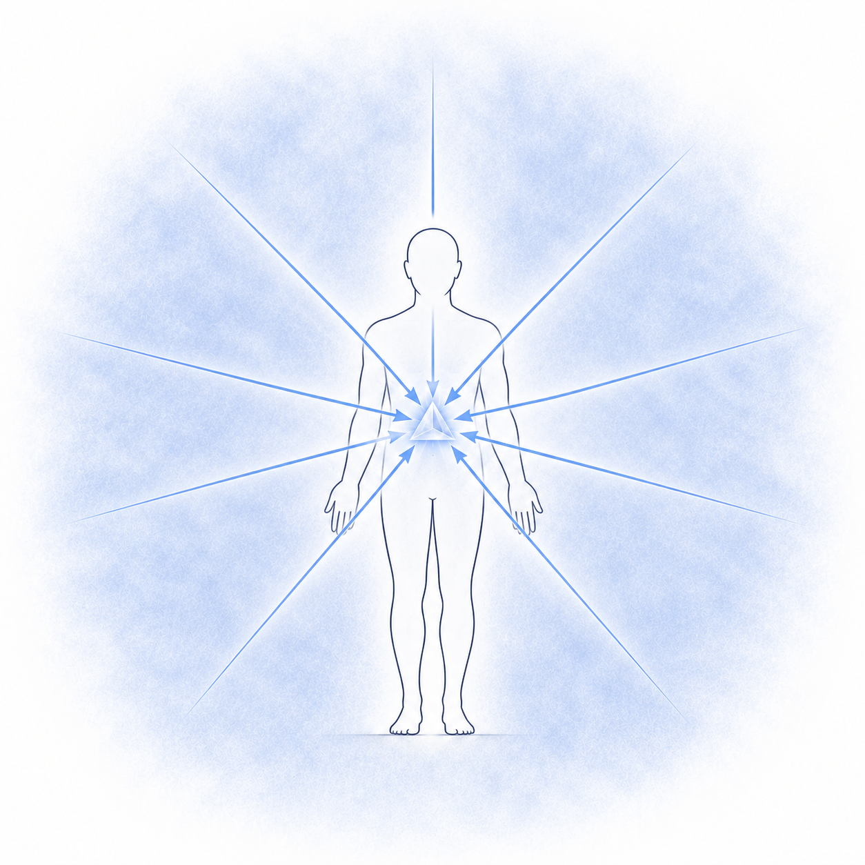
Coalescence
Draws from the ambient space around you.
METHOD:
  – Breath in phasma from the ambient space around you from all directions.
  – Draw directly into the solar plexus.
  – This will cleanse it of foreign intelligences
  – Repeat as needed.
  – Circulate, or utilize as needed.
–

Slide 20
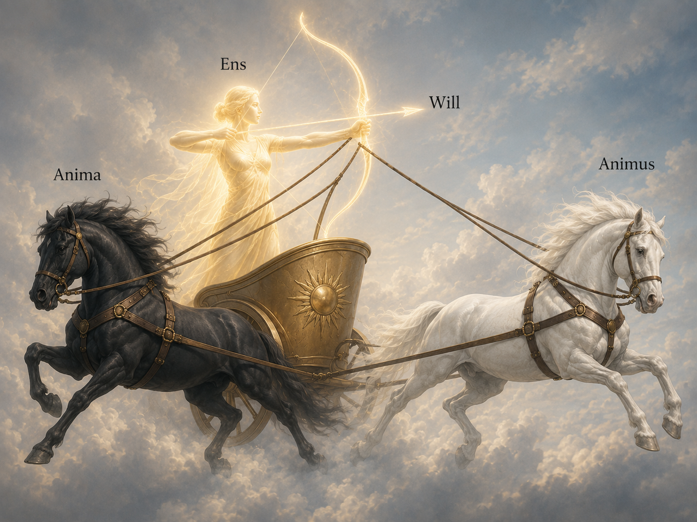
Tripartite Soul

Slide 21
Will
Will is natural.
Will power originates from the soul and exists on all levels of being.
Will is essential; it moves us, our spirits, our minds, our bodies.
Three essentials of cultivating and exercising Magical Will:
  Clearing obstacles through unity.
  Cultivating willpower through practice.
  Setting the ‘seat’ of willpower in the soul.

Slide 22
Cultivating Willpower
Because Willpower comes from the soul, spiritual fitness is critical:
In allowing the arrow of will to ‘shoot’ unobstructed through the mind and spirit.
Allowing the Will to be wielded from the soul, rather than co-opted by the Anima or Animus.
When Will proves difficult to grasp or maintain, exercise your will on any part of you or your life you can manage – this is like seizing the reins of the horse.

Slide 23
Cultivating Willpower
Exercising the Will makes it stronger. The more actively we exercise Will in our lives, the more honed it becomes.
The more we train, the more consistent it becomes.
Utilizing Will in magic is closer to the soul, naturally tempering a magical willpower which necessarily emanates throughout their being.
The goal is that when the ‘arrow’ of Will strikes, it does so with the full force of all our unified self and power; as devastatingly precise as the tip of an arrowhead.

Slide 24
Key Takeaways
The Spirit can be evaluated, and made healthier, fitter, and more capable.
Raising power has two considerations: never draw from your own life-force, and ensure power is ‘clean’ of intelligences.
Unity of self allows for a whole-souled approach to magic, and unobstructed wielding of Magical Will.
Will can be cultivated, honed, tempered, and wielded from the soul.
Animus is a tool; the Anima can be trained.
The Mind and Spirit can be rarefied, allowing the soul to shine through – and the mind more able to grasp deeper spiritual mysteries.

Slide 25
hunterdouglas1118@gmail.com

Slide 26
References
Gonçalves JPB, Lucchetti G, Menezes PR, Vallada H. Religious and spiritual interventions in mental health care: a systematic review and meta-analysis of randomized controlled clinical trials. Psychological Medicine. 2015;45(14):2937-2949. doi:10.1017/S0033291715001166
Kruk, J., & Aboul-Enein, B. H. (2024). Religion- and spirituality-based effects on health-related components with special reference to physical activity: A systematic review. Religions, 15(7), Article 835. https://doi.org/10.3390/rel15070835
United States Marine Corps. (2024). Spiritual fitness leader's guide (MCRP 6-10.1, Change 1). Department of the Navy. https://www.marines.mil/Portals/1/Publications/MCRP%206-10.1%20(SECURED).pdf?ver=AKnK0pS_K8q5Qq-isY2GVA%3d%3d

Slide 27
Any Questions?

