Slide 1
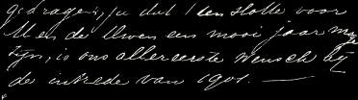



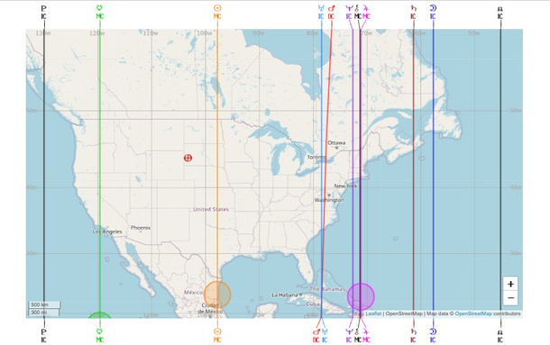
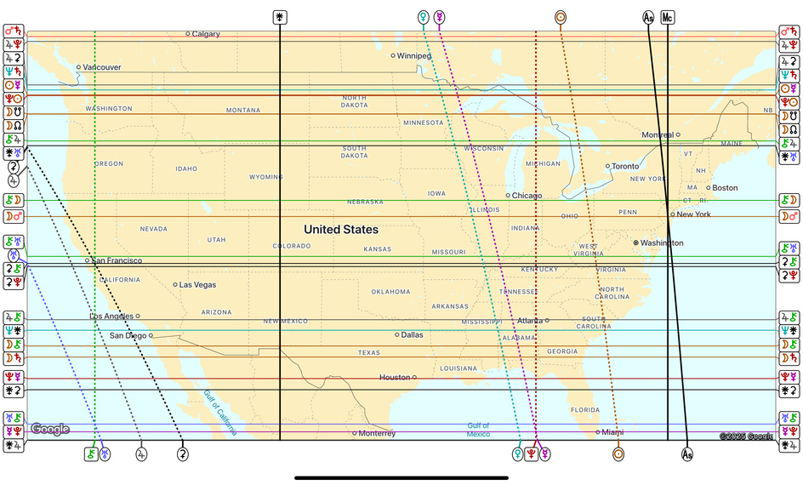






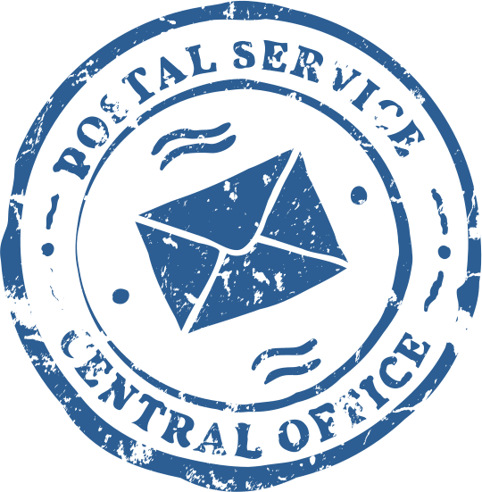
Astrocartography
101
Hosted By: Faith Grace

Slide 2
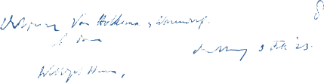
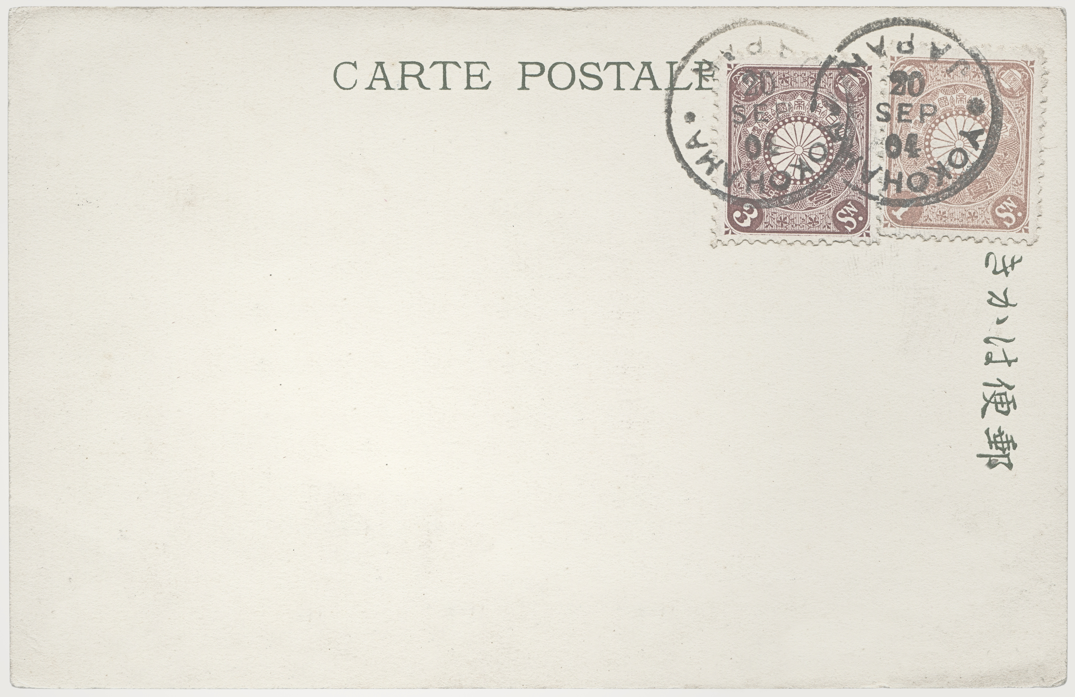

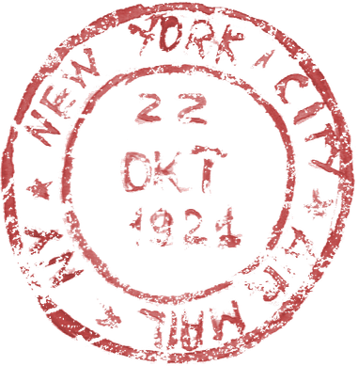
Faith Grace
The purpose of my work is to inspire women across the globe to empower themselves with love and confidence. My goal is to assist others with their emotional, spiritual, locational, and financial alignment. As we do the inner work, more doors are opened. New levels of life are unlocked. In turn, more and more people are inspired to live authentically and unapologetically.

Slide 3


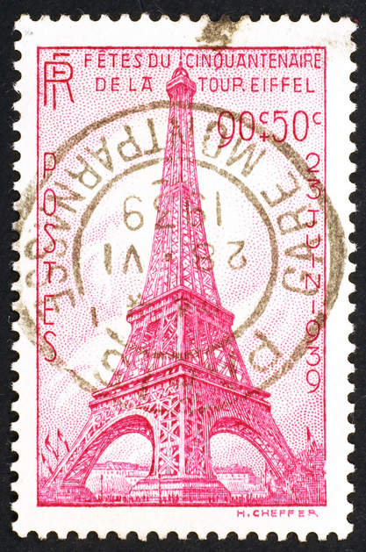
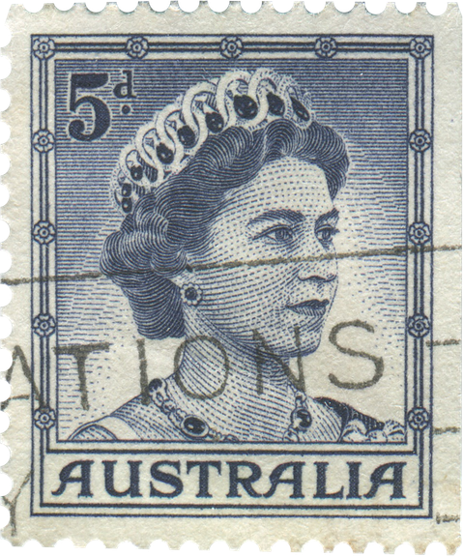
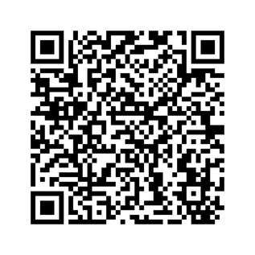
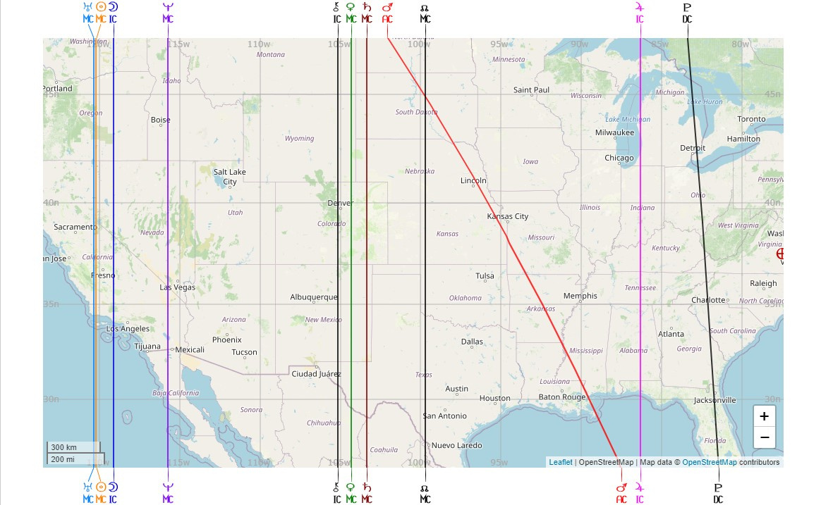
What is AstroCartoGraphy?
What is Astrocartography?
  A sector of locational astrology
  Locational astrology has existed for centuries, used by ancient civilizations
  Jim Lewis coined the term "Astrocartography," creating the map format we know today
  Takes birth chart and relocated chart data and translates it into a world map
  Shows lines marking where each planet was positioned on an angle across different locations

Slide 4






Ways To
Use It
CONNECTION AND PURPOSE
  Birth Chart Remediation
  Connecting with the land
  Remote Activation
  Business Marketing and Execution
  Retreats
TRAVEL & EXPERIENCE
  Relocation
  Intentional Travel
  Deeper connections
  For a Specific Goal: Career, Study, Projects, Business

Slide 5
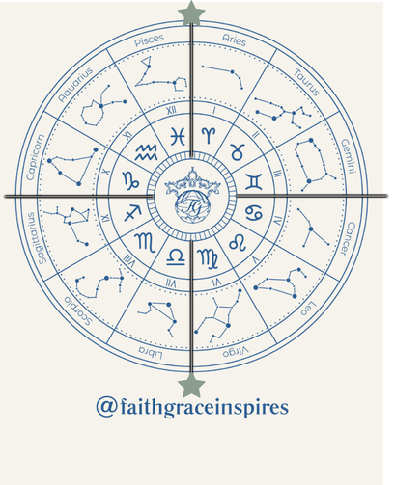
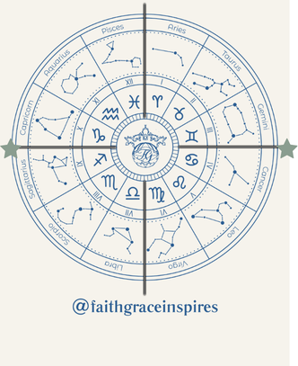

4 Angles
in a Chart
ASC- Your Rising Sign. This is you, your body, your self image, how others perceive you, etc.
DSC- How you relate to others, how you perceive the people in your relationships, themes around dynamics within your personal relationships.
IC- The root of your chart. Your background, matters of the home, matters related to family/parents/siblings, your subconscious
MC- The highest point in your chart. High visibility or feeling of being seen, the legacy you want to have, the way you conduct business, how you’re meant to show up in society on a high level.

Slide 6

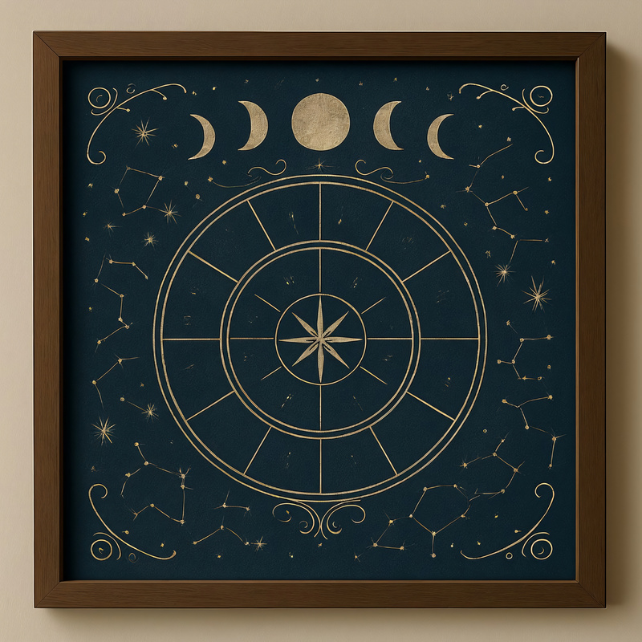


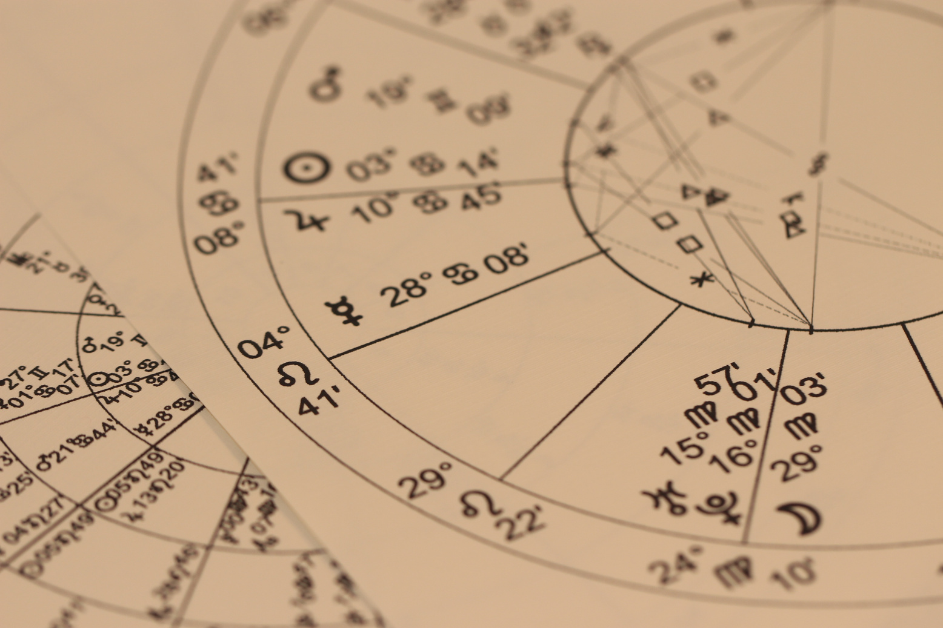
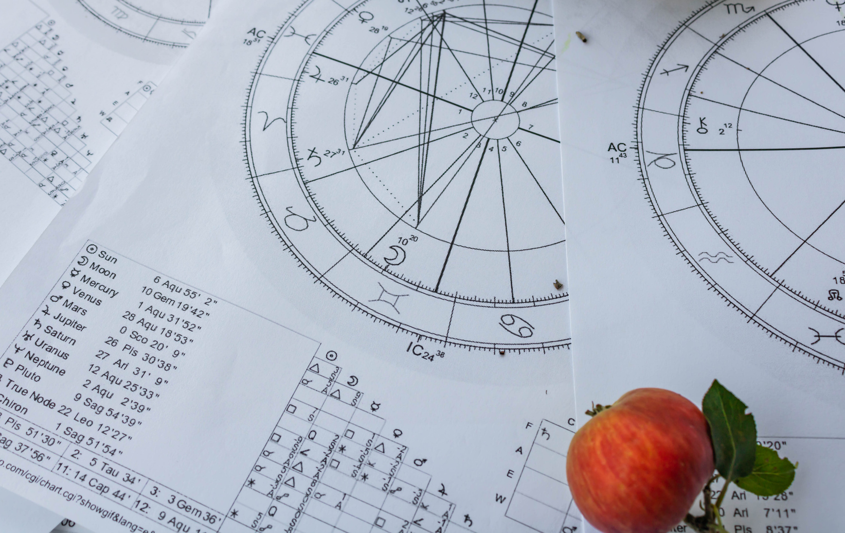


Generating
Relocated Charts
Relocated Charts
  A relocated chart re-adjusts your birth chart for the exact time and place you're relocating to
  Time zones differ around the world, so planetary positions look different depending on location (e.g., sun rising in one place, setting in another)
  Planet signs stay the same
  House positions can shift — your rising sign may change based on location

Slide 7


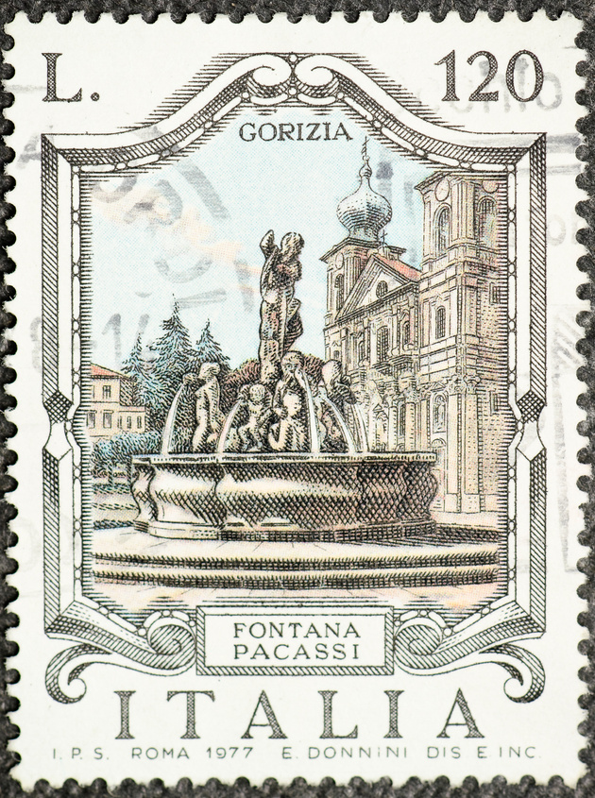
I am not guaranteeing that you’ll be an expert Astrocartographer after this but you will be much more informed and able to dissect your map with more clarity!
The Components of an AstrocartoGraphy Map
  48 Astrocartography Lines- 4 lines per planetary body
  Sun, Moon, Mercury, Venus, Mars, Jupiter, Saturn, Neptune, Uranus, Pluto, Chiron, North Node (not including other Asteroids)
  Parans
  Bonus: Local Space Lines

Slide 8
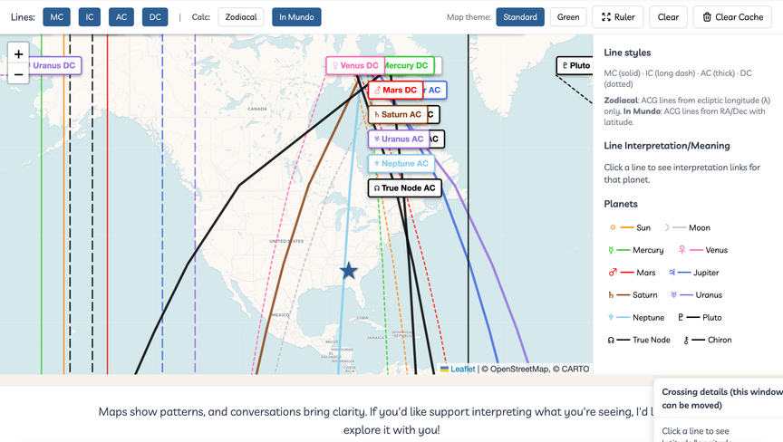
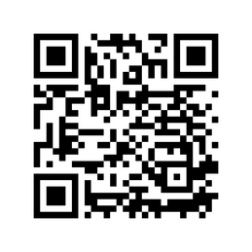
Generating Your AstroCartoGraphy
Map
Download the app! You can save this site as a web app by adding it to your homescreen :)
  Step 1: Go to my site and select the ‘Maps’ section
  Step 2: Gather Your Birth Information
  To generate your map, you’ll need:
  Your date of birth
  Your exact birth time (as close as possible)
  Your place of birth
  Accuracy matters, especially for angular lines (Ascendant, Descendant, Midheaven, and IC). If you’re unsure of your birth time, you can still explore the map, but some lines may shift slightly.

Slide 9
This will give you a better understanding of how each line may manifest for you and how to work with this energy!
Things to Keep in Mind When using AstroCartography
  The Sign that the Planetary Body is In (What is the Dignity of the Planet?)
  What House Does the Planet Relocate to in the Relocated Chart
  Your Aspects:
    Opposition
    Square
    Two “Malefics” are Conjunct

Slide 10






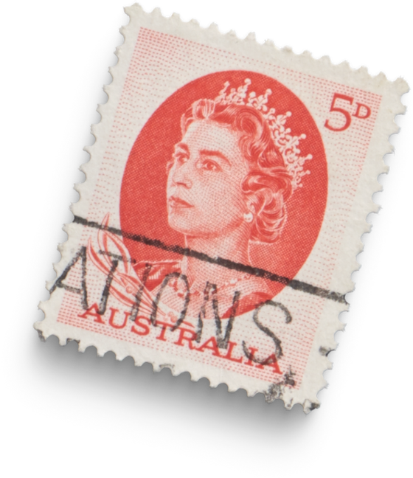
Sun Lines
Sun ASC:
Pros:
  Strong self-confidence and personal vitality
Cons:
  Pressure to perform or maintain an image
Sun DSC:
Pros:
  Energizing partnerships/Attracts confident or influential people
Cons:
  Power struggles in relationships + Over-identifying through others
Sun IC:
Pros:
  Deep self-understanding
  Centeredness and personal grounding
Sun MC:
Pros:
  Career recognition and clarity + Leadership opportunities
Cons:
  Public pressure or high expectations
Sun Line: Brings visibility, vitality, and purpose. You might feel more confident or “seen” here.

Slide 11


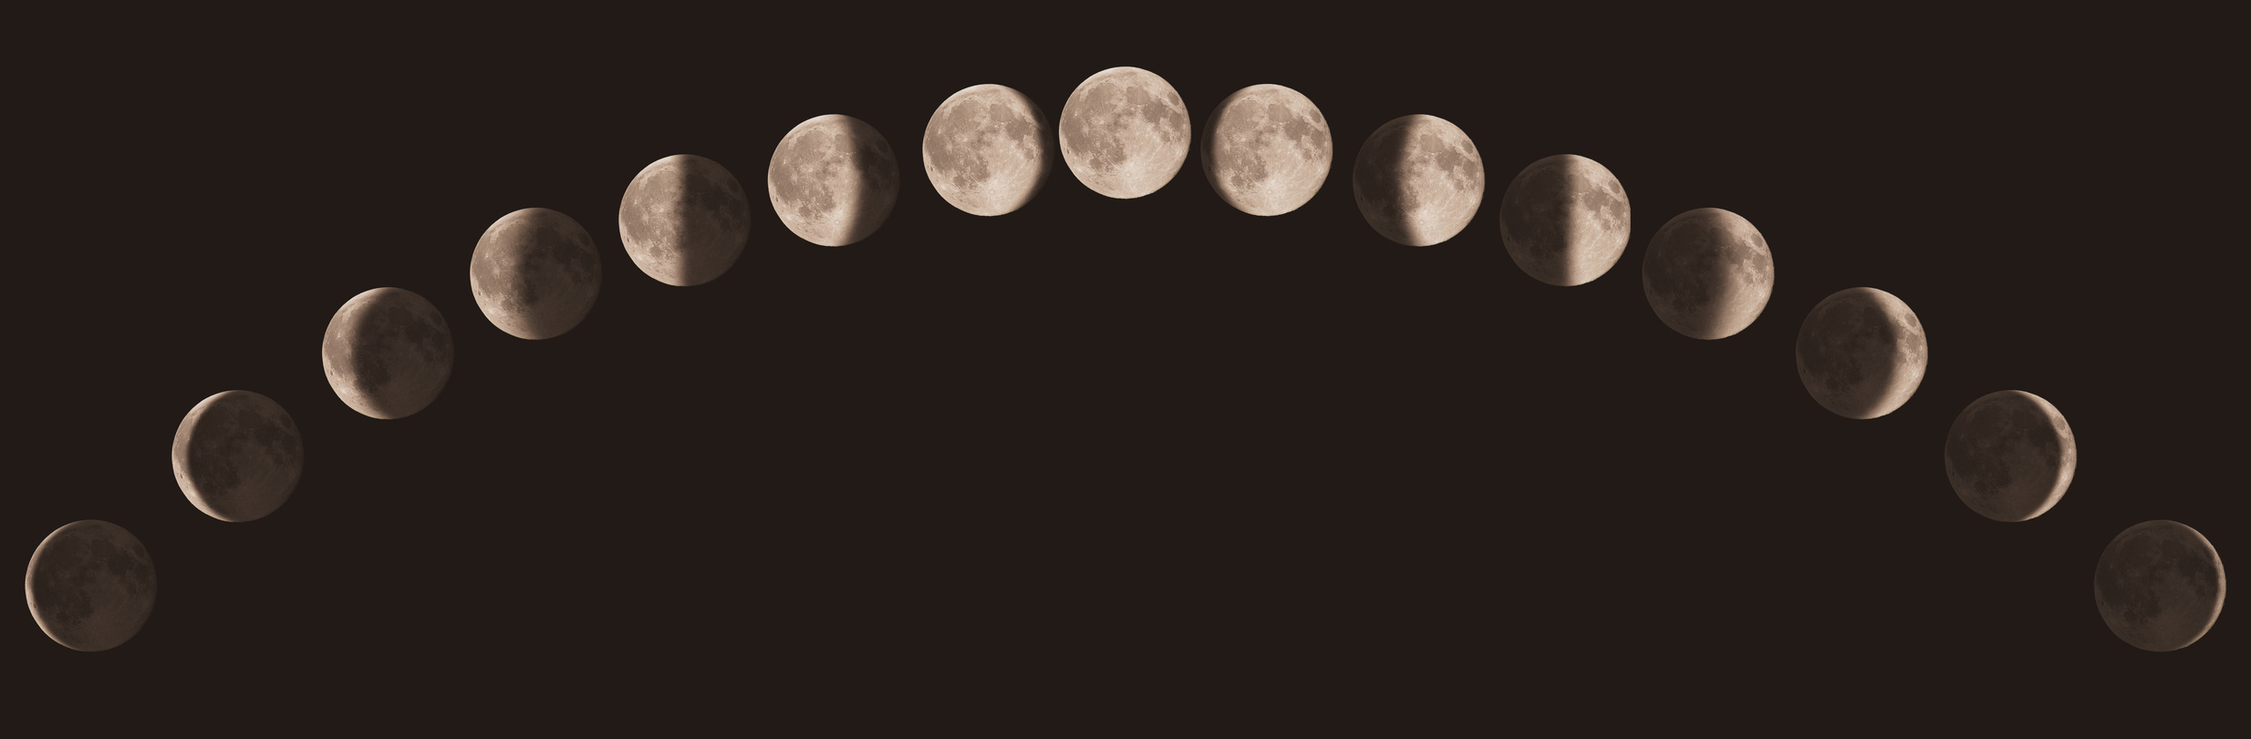


Moon Lines
Moon ASC:
Pros:
  Heightened intuition + Soft, magnetic presence
Cons:
  Moodiness or emotional overwhelm + Sensitivity to environment
Moon DSC:
Pros:
  Emotional intimacy with others + Nurturing partnerships
Cons:
  Emotional dependence + Taking on others’ feelings
Moon IC:
Pros:
  Strong sense of home and belonging + Nurturing domestic life
Cons:
  Childhood wounds surface + Difficulty detaching from the past
Moon MC:
Pros:
  Career involving care, intuition, or creativity
Cons:
  Emotional burnout
  Career direction fluctuates
Moon Line: Emotional, nurturing, and often deeply personal. Great for connecting with family or healing but can feel moody, too.

Slide 12
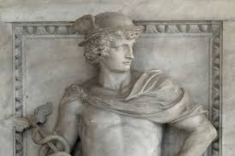
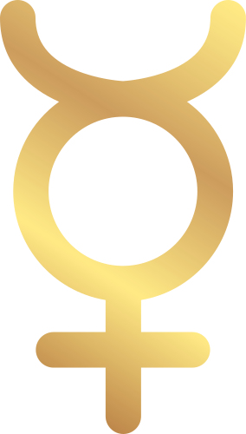

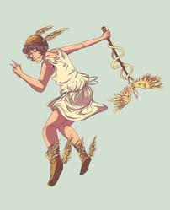

Mercury Lines
Mercury ASC:
Pros:
  Clear communication + Sharp thinking and adaptability
Cons:
  Restlessness or anxiety
Mercury DSC:
Pros:
  Stimulating relationships + Learning through others
Cons:
  Miscommunications + Mental rather than emotional intimacy
Mercury IC:
.Pros:
  Active inner life and imagination + Great place for writing or studying
  Cons:
  Hard to rest mentally + Nervous tension in the home
Mercury MC:
Pros:
  Great for writing, teaching, media
Cons:
  Scatter or lack of focus + Overanalyzing career decisions
Mercury Line: Mental stimulation, communication, tech, teaching, writing your mind is on here

Slide 13

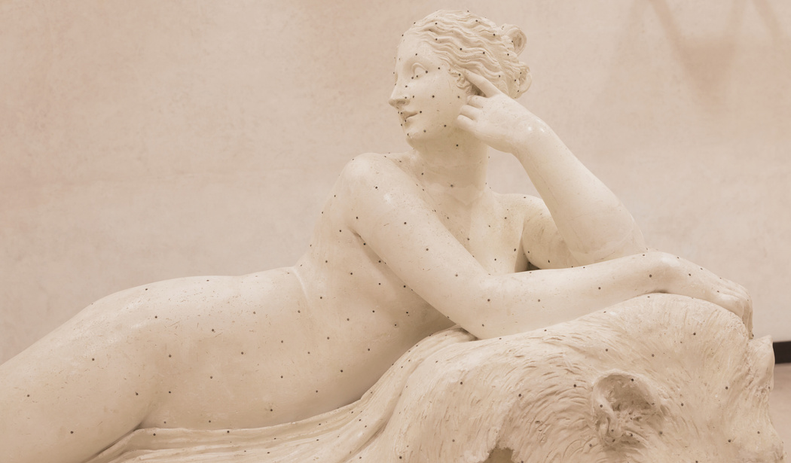

Venus Lines
Venus ASC:
Pros:
  Attractive, charming presence + Ease with social interactions
Cons:
  Over-focus on appearance + Seeking external validation
  Difficulty enforcing boundaries
Venus DSC:
Pros:
  Harmonious partnerships/Connections + Romance and connection
Cons:
  People-pleasing tendencies + Avoiding conflict
Venus IC:
Pros:
  Beautiful home environment + Inner Emotional nourishment
Cons:
  Overindulgence or laziness + Difficulty initiating change
Venus MC:
Pros:
  Public appeal and likability + Success in art, beauty, or marketing
Venus Line: Love, beauty, ease, money, romance. This line often gets hyped and it can be lovely but it’s not one-size-fits-all.

Slide 14
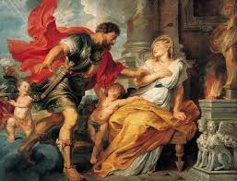


Mars Lines
Mars ASC:
Pros:
  Strong physical energy + High motivation/Assertiveness
Cons:
  Impatience or irritation + Conflict with others
Mars DSC:
Pros:
  Passionate relationships + Clear boundaries
Cons:
  Arguments or competitiveness + Attraction to intense or aggressive partners
Mars IC:
Pros:
  Productivity at home + Breaking patterns or stagnation
Mars MC:
Pros:
  Career drive and ambition +Ability to take decisive action
Mars Line: Energy, motivation, action. Can bring passion or conflict, depending on your chart

Slide 15
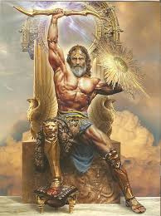
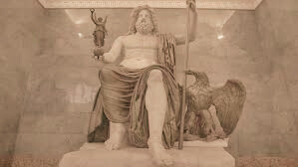
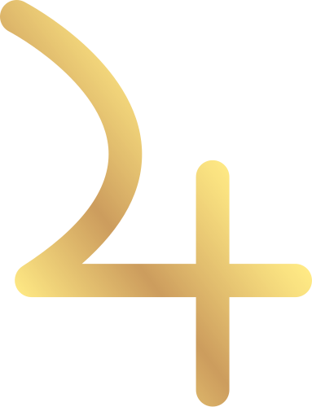
Jupiter Lines
\Jupiter ASC:
Pros:
  Optimism and confidence + Personal expansion
Cons:
  Overextending yourself + Difficulty with moderation
Jupiter DSC:
Pros:
  Growth-oriented relationships + Generous, supportive partners
Cons:
  Over-giving + Unrealistic expectations
Jupiter IC:
Pros:
  Joyful, big home life + Spiritual grounding
Cons:
  Avoidance of emotional work + Excess or overindulgence at home
Jupiter MC:
Pros:
  Career expansion and recognition + Leadership and education roles
Cons:
  Spreading yourself thin +Taking on too large of goals
Jupiter Line: Expansion, luck, abundance. Many feel “big blessings” here, but again context matters.

Slide 16
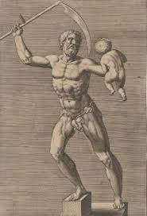
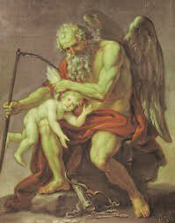

Saturn Lines
Saturn ASC:
Pros:
  Strong discipline + Personal maturity
Cons:
  Isolation or heaviness + Self-criticism
Saturn DSC:
Pros:
  Serious long-term partnerships + Learning boundaries
Cons:
  Emotional distance + Responsibility outweighing joy
Saturn IC:
Pros:
  Solid foundations +Emotional resilience
Cons:
  Heavy or restrictive home life + Old wounds or family karma surface
Saturn MC:
Pros:
  Career mastery/ Long-term stability + Respect and authority
Cons:
  Delayed success + Pressure and responsibility
Saturn Line: Lessons, discipline, structure. Feels like “work,” but also growth.

Slide 17
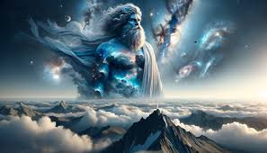
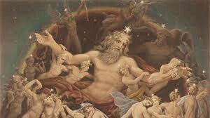

Uranus Lines
Uranus ASC:
Pros:
  Authentic self-expression + Freedom to reinvent
Cons:
  Instability in identity + Hard to commit to routines
Uranus DSC:
Pros:
  Exciting, unconventional relationships + Unique people enter your life
Cons:
  Unpredictable relationships + Emotional detachment
Uranus IC:
Pros:
  Breaks family cycles + Fresh start energetically
Cons:
  Disconnection from roots + Difficulty settling down
Uranus MC:
Pros:
  Innovation in career + Entrepreneurial energy
Cons:
  Inconsistent career trajectory/ Sudden job changes + Rebelling against structure
Uranus Line: Change, innovation, restlessness. Great for breakthroughs or new beginnings.

Slide 18
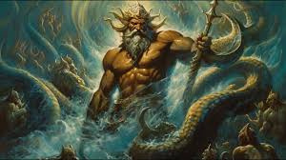
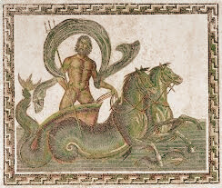
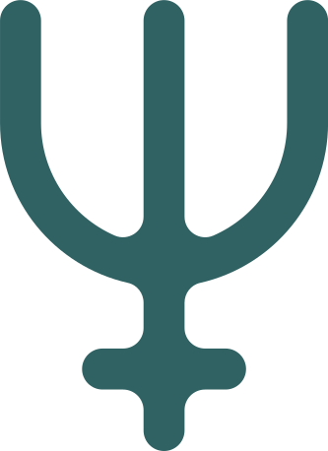
Neptune Lines
Neptune ASC:
Pros:
  Artistic or spiritual aura + Compassionate presence
Cons:
  Confusion around identity + Idealism leading to disappointment
Neptune DSC:
Pros:
  Soulful, dreamy connections + Deep emotional resonance
Cons:
  Easily Deceived +Lack of clarity in relationships
Neptune IC:
Pros:
  Deep inner connection + Spiritual insights
Cons:
  Emotional fog + Unclear family dynamics
Neptune MC:
Pros:
  Creative or spiritual career visibility + Magnetism in artistic fields
Cons:
  Confusing career direction + Misunderstood public image
Neptune Line: Dreamy, spiritual, sometimes unclear. Amazing for intuition or creativity; confusing if you're seeking structure.

Slide 19
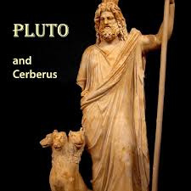
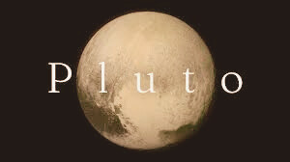

Pluto Lines
Pluto ASC:
Pros:
  Powerful personal transformation + Shifts in identity that feel deep and authentic
Cons:
  Feeling intense or misunderstood + Emotional heaviness
Pluto DSC:
Pros:
  Deep, life-changing relationships + Psychological insight into others
Cons:
  Obsessive or intense partners + Shadow patterns surfacing in relationships
Pluto IC:
Pros:
  Ancestral healing + Inner rebirth and emotional depth
Cons:
  Family power dynamics + Emotional intensity
Pluto MC:
Pros:
  Strong influence in career +Ability to lead and transform systems
Cons:
  Power struggles with authority +Pressure to reinvent
Pluto Line: Deep transformation. Not always light and fluffy but powerful.

Slide 20
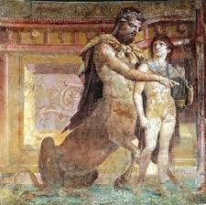
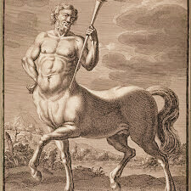

Chiron Lines
Chiron ASC:
Pros:
  Opportunity to heal identity wounds + Increased empathy and emotional intelligence
Cons:
  Can feel exposed or misunderstood + May struggle with self-worth or visibility
Chiron DSC:
Pros:
  Relationships serve as mirrors for healing + Meeting “wounded healer” figures
Cons:
  Attracting emotionally unavailable or wounded partners + Feel overly responsible for others’ healing
Chiron IC:
Pros:
  Strong potential for ancestral or generational clearing + Safe space for vulnerability and inner work
Cons:
  Emotional heaviness or grief may surface + Tendency to withdraw or isolate when healing is needed
Chiron MC:
Pros:
  Turn your wounds into purpose-driven work + Seen publicly as a mentor or guide
Cons:
  Fear of being judged or not “enough” professionally + Wounds around public recognition or leadership
Chiron Line: Healing, vulnerability, and emotional depth. Can stir old wounds, but offers powerful insight and inner transformation.

Slide 21
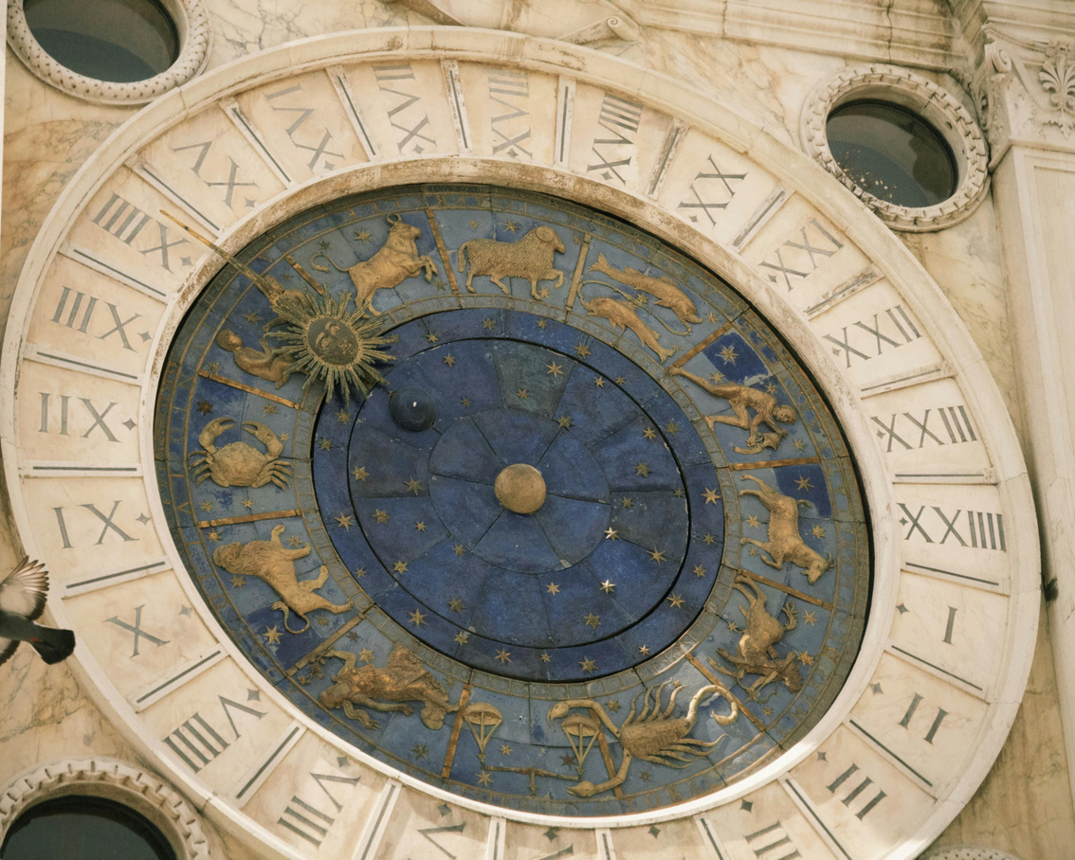
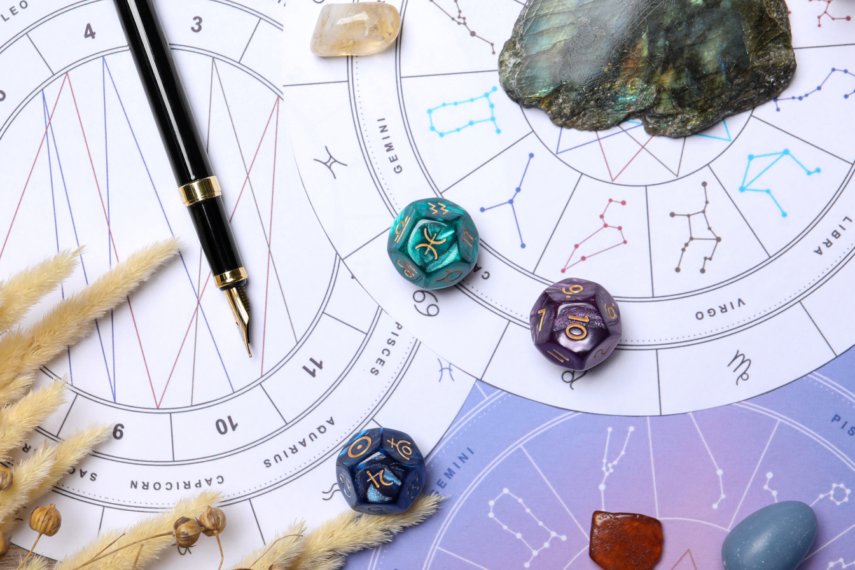

North Node Lines
North Node ASC:
Pros:
  Strong sense of personal evolution + Encouraged to step into new identity
Cons:
  Identity shifts can feel disorienting + Others may project expectations onto you
North Node DSC:
Pros:
  Fated relationships and connections + Deep karmic meetings
Cons:
  Partnerships may feel intense or “meant to be” before you’re ready + Hard to maintain independence while growing through others
North Node IC:
Pros:
  Strong inner alignment and spiritual grounding + Personal evolution that begins within
Cons:
  Old family patterns may resurface + Deep internal changes can feel isolating at times
North Node MC:
Pros:
  Career aligned with soul purpose +Encouragement to lead or share your gifts
Cons:
  Pressure to define your life purpose quickly + Fear of visibility or not being “ready”
North Node Line: Soul growth, aligned purpose, and future potential. Things may feel fated or unfamiliar but they’re meant to guide you forward.

Slide 22

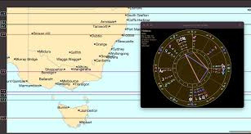
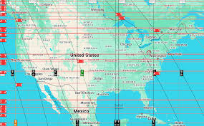
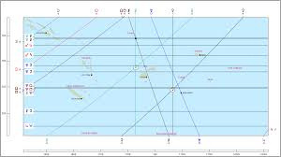
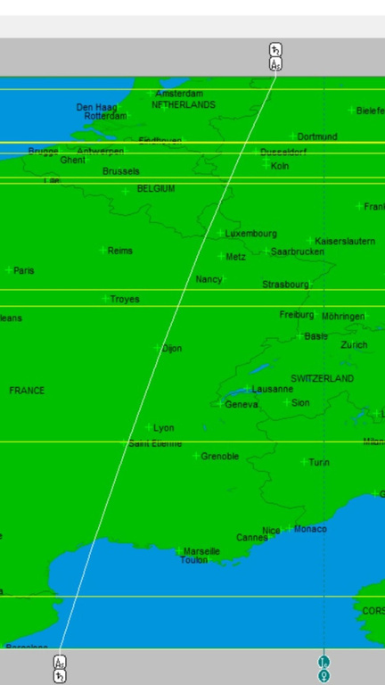
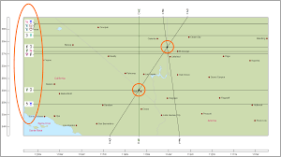

What are
Parans?
A horizontal line that is created when two Planetary Astrocartography lines cross. This horizontal line spans out across the globe and can be felt up to a 75 mile radius. These lines will combine the energies of the two planets and that combo is usually what you may feel.
Ex. Venus-Moon, Uranus-Sun, Saturn-North Node, Pluto-Jupiter
These are usually shown on professional Astrology Software such as AstroGold or Solar Fire. But, you can also see them on Astro.com (you have to click around) or Astro-seek.com (very clunky and hard to read sometimes).

Slide 23





Remote
Activation
  You can activate an astrocartography line's energy without physically traveling there
  Works by intentionally interacting with things connected to that location
Ways to do this (many happen unconsciously):
  Bring home a souvenir tied to the place
  Learn the language
  Eat the food
  Meet people who are from there
Key idea: focus your intention on the location's energy and let it manifest in daily life
  Also useful for collaborating with others — personally or in business

Slide 24

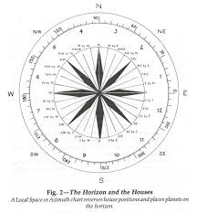
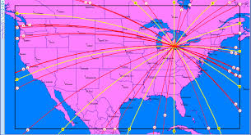
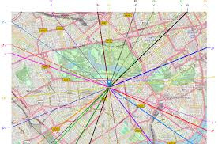



Local
Space Lines
Local Space
  A locational astrology technique often paired with Astrocartography
  Adds finer detail — maps planetary energy within your city, not just across the globe
  You become the compass: planetary lines radiate outward from your location
  Different neighborhoods/districts fall along different planetary lines
On the Map
  Starts with a pin at your birth city, showing lines projecting outward from there
  Relocate the pin to your current city — lines adjust accordingly
Example
  Your favorite coffee shop might sit near your Moon line
  Your gym or Pilates studio might sit near your Mars or Venus line

Slide 25

In Summary
I’d love to continue working with you! Here are a few ways to enter my world!
  What Astrocartography is and its roots in locational astrology
  Relocated charts and how they adjust your birth chart to a new location
  The angles in a chart (AC, DC, MC, IC) and what each represents
  How to generate your own astrocartography map
  Reading the planetary lines and what they mean
  Parans and how they add another layer of interpretation
  Local Space and mapping planetary energy within a city
  Remote activation and how to tap into a line's energy without traveling

Slide 26
Ways to Work with Me
I’d love to continue working with you! Here are a few ways to enter my world!
  Download the Free Astrocartography Guide & Save the Webapp!
  Subscribe to my YouTube Channel
  Enroll into the Foundations of Astro Mapping Course!
  Book a 1:1 Reading with Me
  Come to the Astrocartography Retreat in France!
COUPON(s): MYSTICSOUTH/MYSTICSOUTH-C/MYSTICSOUTH-G

Slide 27



Thank You!
www.faithgraceinspires.com
assistant@faithgraceinspires.com
@faithgraceinspires
Thank you for giving me the opportunity to instruct you today! i hope this class was helpful and that you feel more empowered when it comes to Astrocartography and locational astrology!

