Slide 1
Battlefield Magick: Operational enablement at the tactical edge
{ Making magick practical, situational, and mission-fit }

Slide 2
Disclaimer
The views expressed are our own and do not constitute endorsement by the Department of the Army, the Department of Defense, or the U.S. Government.

Slide 3
“ Do the Mundane…”

Slide 4
Introductions
WR Neumann
  32 years military service
  Army Chief Warrant Officer
  Theater Army to tactical SOF operational experience
  Multigenerational practical magical tradition
Temper
  23 years military service
  Army First Sergeant
  Combat Arms / TRADOC
  Longstanding Kemetic magical practice

Slide 5
Thesis (aka “Main Takeaway”)
Magick can function as an enabling capability.
  It serves the mission
  It is tailored to the threat
  It integrates with mundane action
  It reduces friction and creates advantage

Slide 6
What We’ll Cover
The “Tactical Edge”
“Operational Enablement”
Vignette (virtual “Staff Ride”)
Magical Techniques
  Divination (Various Methods)
  Mental Influence
  “Pushing probability” / Re-weaving the Tapestry
  Camouflage and Cloaking
  Shielding, Warding
  Enchantments
  Environmental Disruption
  Prep Time / Logoros Field

Slide 7
The Tactical Edge
  Military - Strategic Rear vs. Tactical Edge
  For Practicioners - Temple Practice vs. Field Practice
  Dynamic Environment
  Time Pressue
  Limited Tools
  Incomplete Information

Slide 8
Operational Enablement
  Operation - activity to accomplish a mission (a task + a purpose)
  Enablers - capabilities that make the mission more achievable
  What things support the work, which things are the work
  Windshield analogy
  Utility

Slide 9
What Enablers Do
  Increase decision space - more options, more time to choose
  Buy down risk - reduce the cost of being wrong
  Widen the aperture - more paths to success
  They create opportunities,not outcomes

Slide 10
Candidacy Test
  Suitable - does it actually address the mission and the real obstacle?
  Feasible - can we employ it with the time, people, training, and money you actually have?
  Acceptable - is the advantage worth the cost, risk, and what must shrink to run it?
  Distinguishable - does it add something our existing capabilities don't already do?
  Measurable - Did it run? Did it help?
  Serviceable - reliable, trainable, portable, concealable

Slide 11
Common Pitfalls
  Enamorment - adopted because it's impressive, not because it fits
  Unmeasurable - cannot assess whether it's working
  Untrained - the tool does not use itself
  Over-reliance - missing assessment of its limitations
  Over-investment - more of the thing isn’t better
  The rule: an enabler becomes mission-degrading when the burden it creates exceeds the advantage it provides

Slide 12
Summary & Practical Considerations
Warfighting
  Never Want to Fight an Even Match (create advantage)
  Seek Least Expensive Tactical Edge
  Tools should be mobile
  Becomes a Part of Everyday Life
    10,000 Hours
    Muscle Memory
    Train as You Fight, Fight as You Train

Slide 13
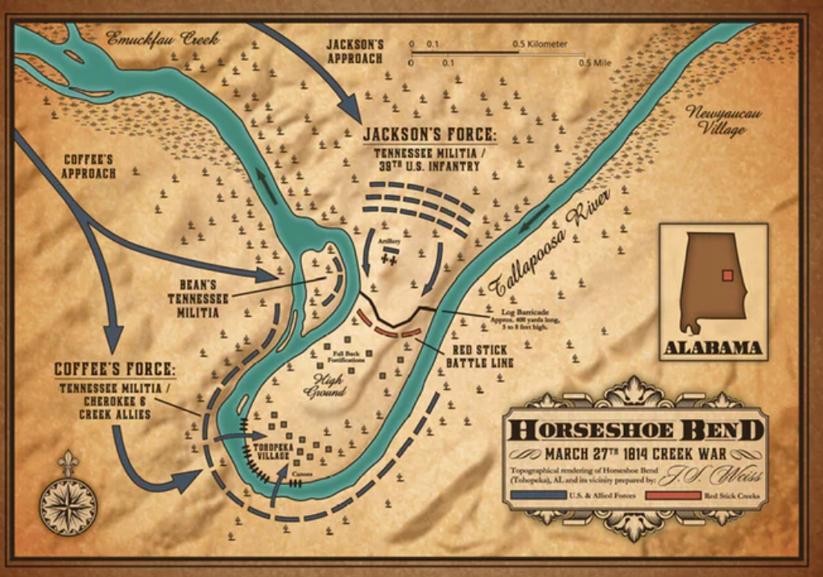
Staff Ride – Battle of Horseshoe Bend

Slide 14
Practical (Techniques)

Slide 15
Divination
Methods
  Spirits
  Signs and Portents
  Others
Vignettes

Slide 16

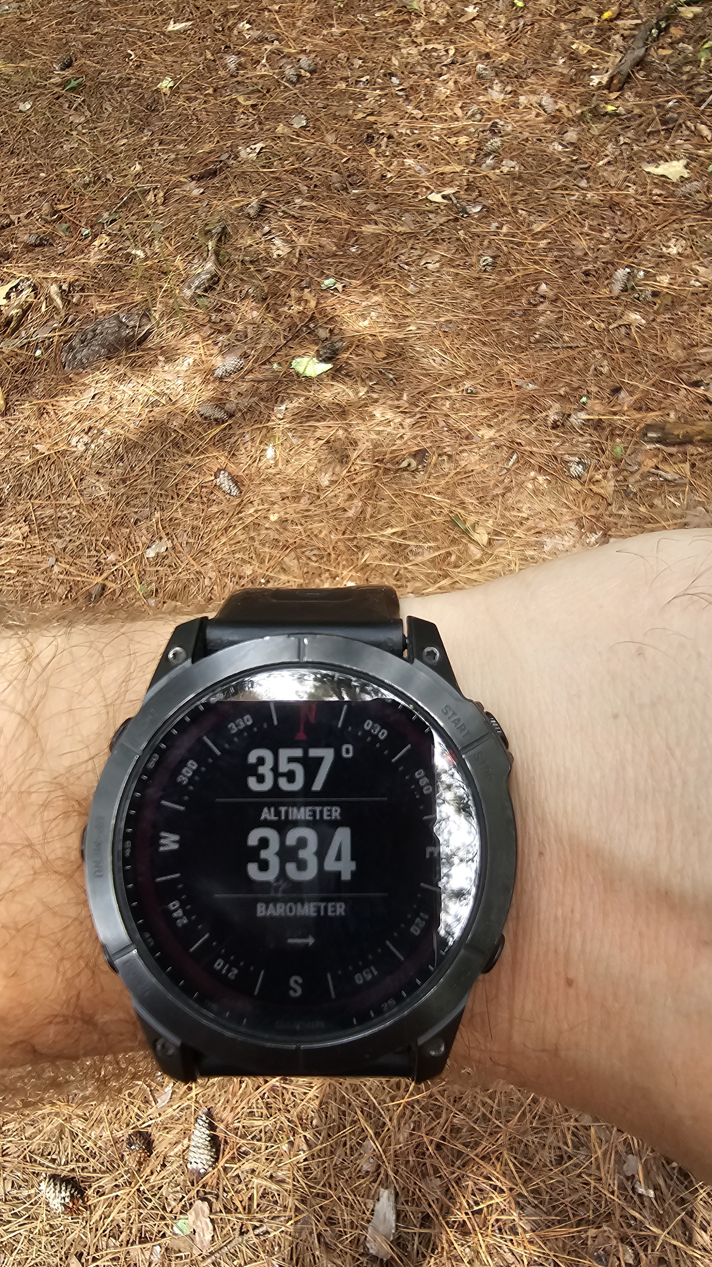

Slide 17
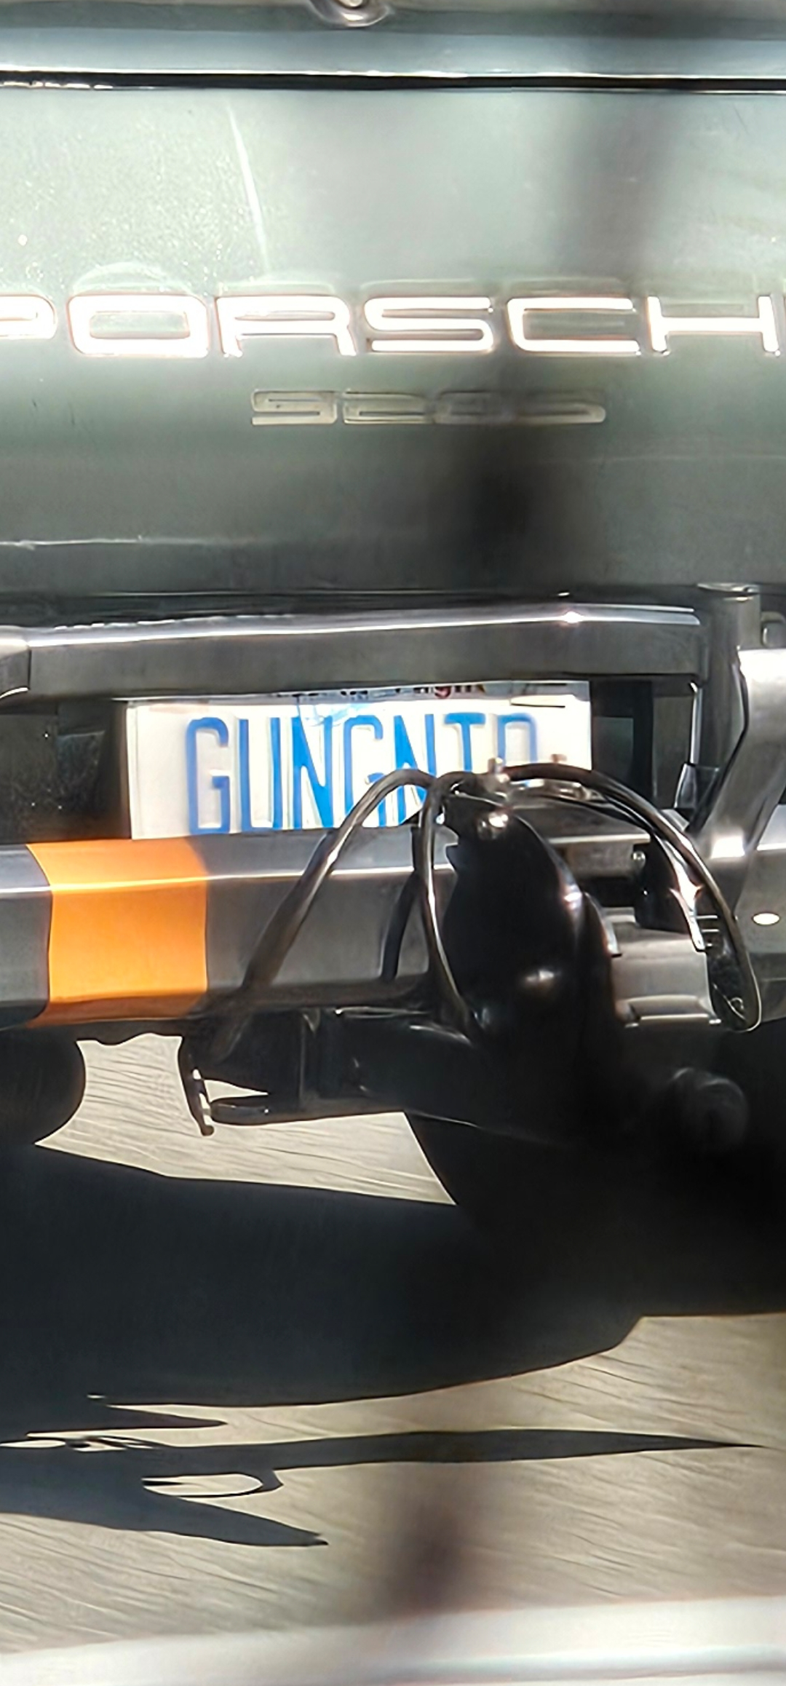
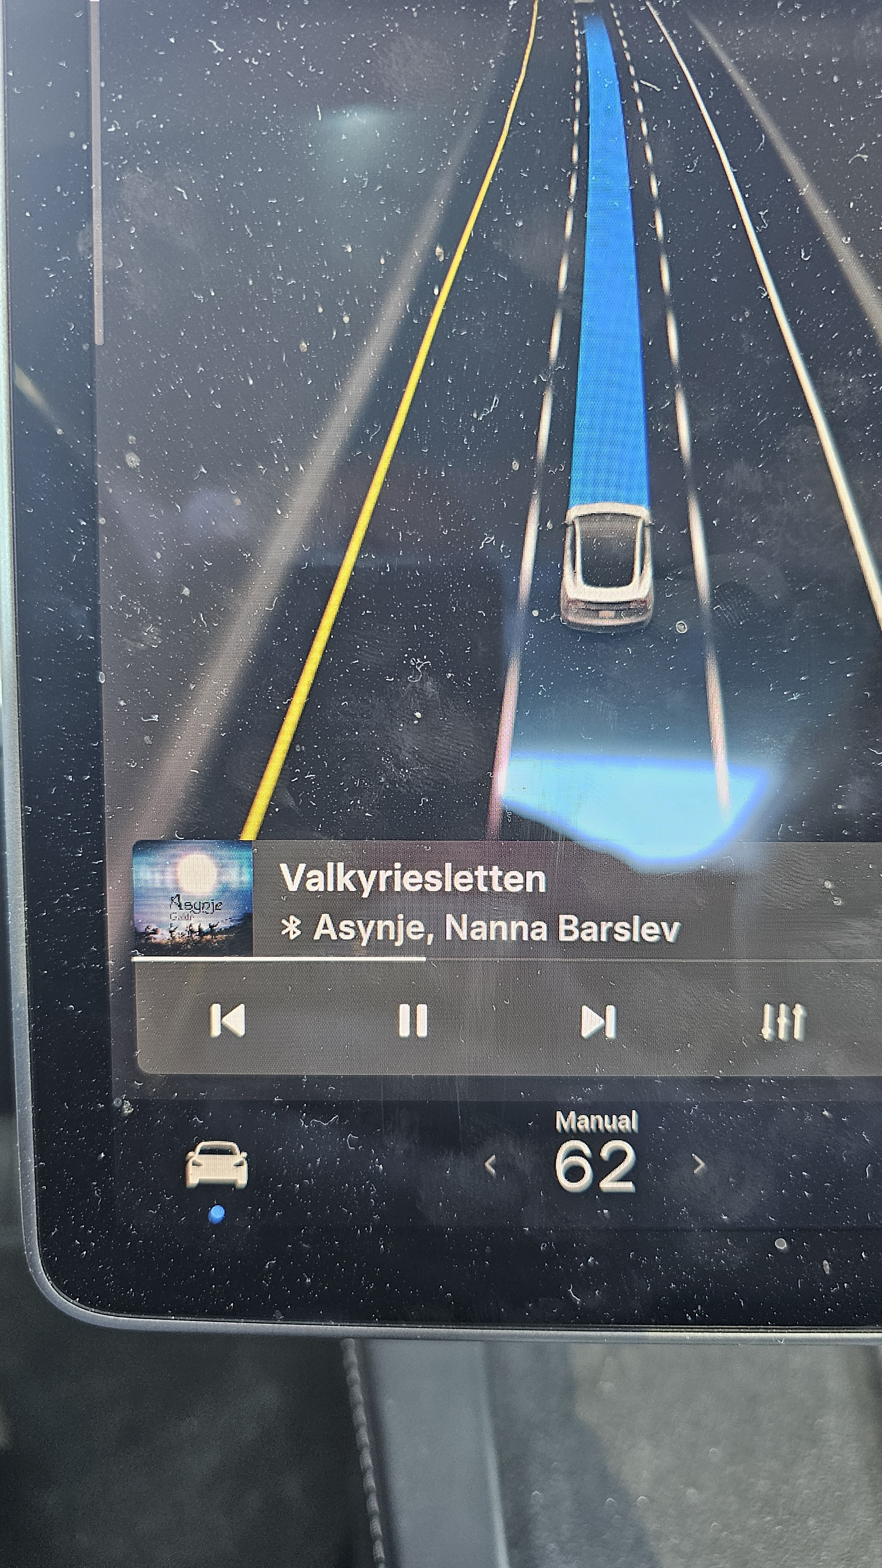
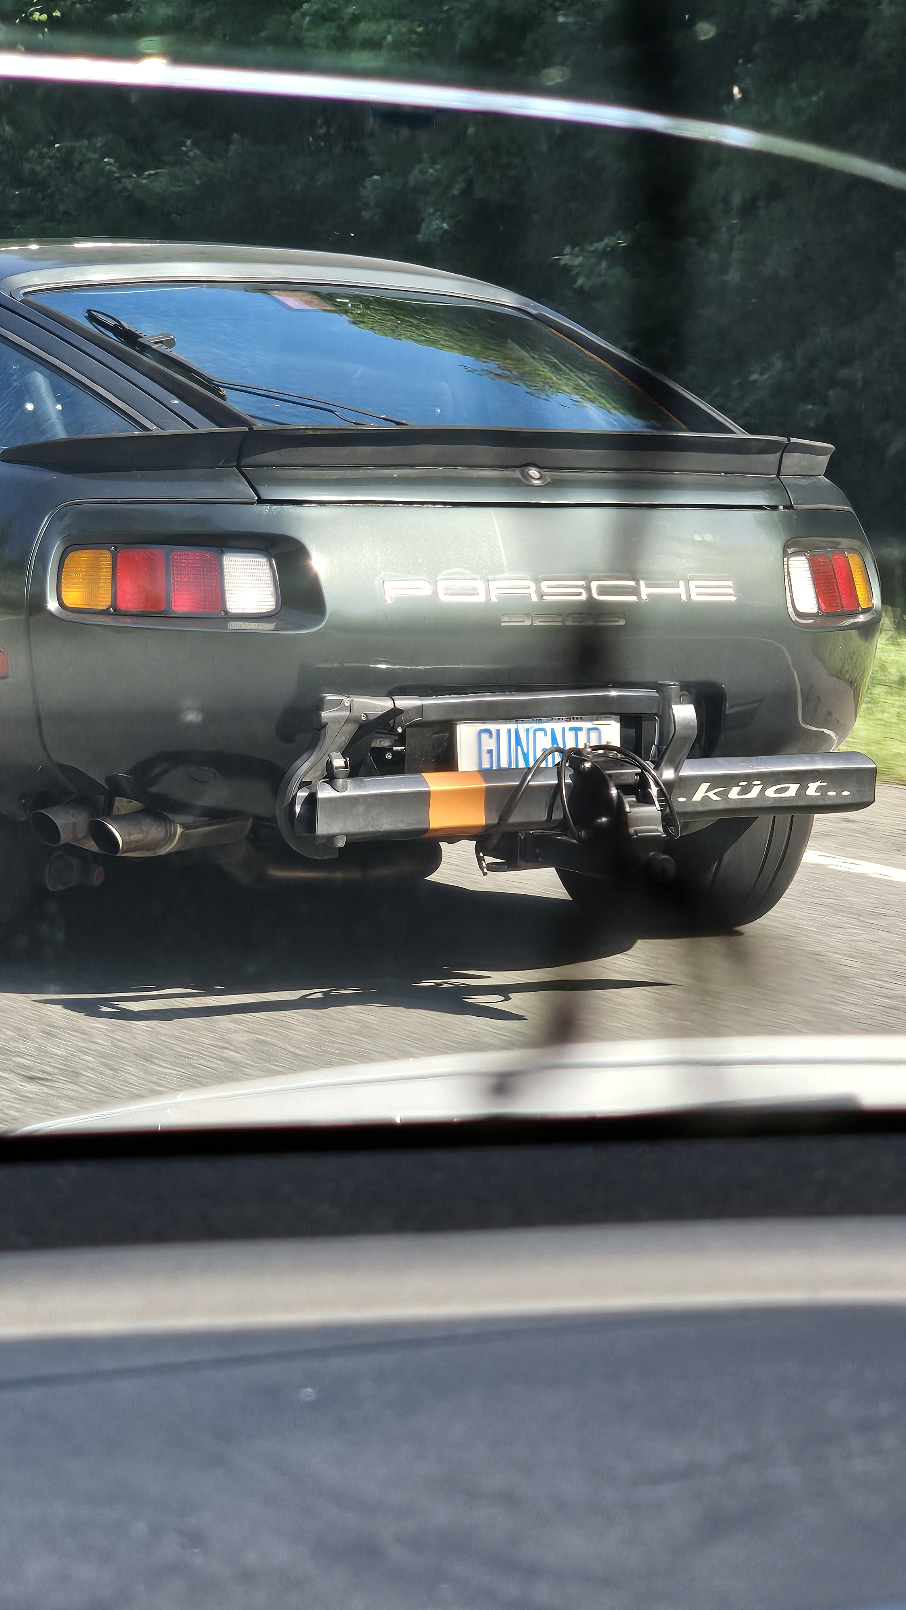

Slide 18
Mental Influence
How it Works
Vignettes

Slide 19
“Pushing Probabilitity” / Reweaving the Tapesty
How it Works
Vignettes

Slide 20
Camouflage
Methods
Vignettes

Slide 21
Preparation & Planning Ahead
Methods
  Mental Preparations
    Neutral & Ready Stance
    Severing and Binding
    Blood and Bone
    Half in Half out
  Internal Constructs
    Stronghold/Temple
    Storage
    Bandwidth Awareness
Vignettes

Slide 22
Prep-Time
Methods
  Sigils
  Logoros Field
    Passive Aggressive Defense
    Readied Activatable Offense
Vignettes

Slide 23
Shielding & Warding
Methods
  Shield Arrays
Vignettes

Slide 24
Closing the Distance
Methods
  Allied Alignment
    Group Sync & Shared Feed
  Enemy Alignment (Remember Kevin Bacon)
    Infinite reach
Vignettes

Slide 25
Enchantment
Methods
  Blades
  Bullets
  Witch Engines
  Weapons of last resort
Vignettes

Slide 26
Environmental Disruption
Methods
  Electromagnetic
  Thermal
Vignettes

