Slide 1
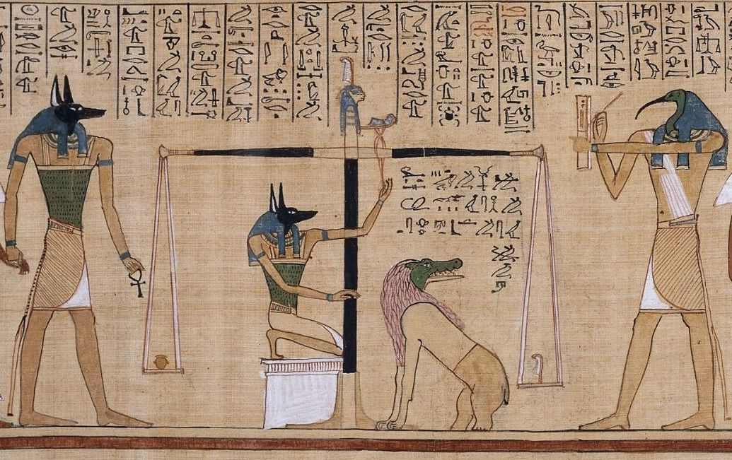
Prometheus with a Pen
Thoth and the Connection Between
Writing, Magic, and Divination
Photo credit: Book of the Dead, ca. 1275 BCE, papyrus, Thebes, Egypt (British Museum)
Notes:
Questions of clarification vs. questions of discussion

Slide 2

Notes:
I'm going to tell you my favorite divination story.

Slide 3
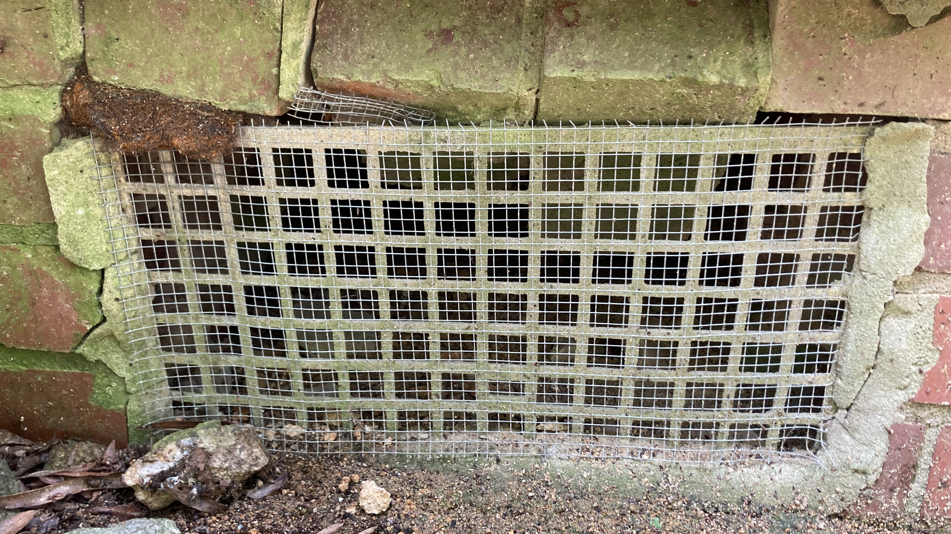

Slide 4
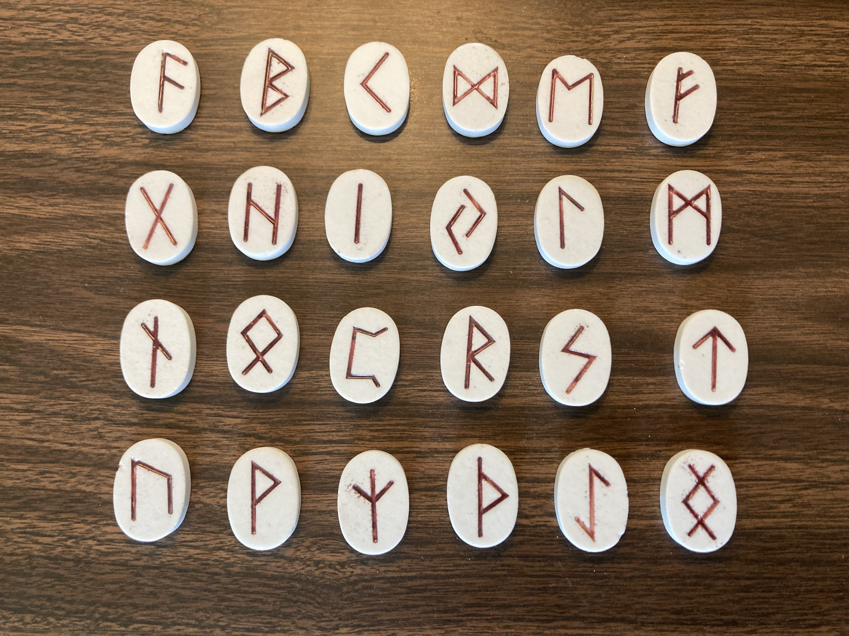

Slide 5
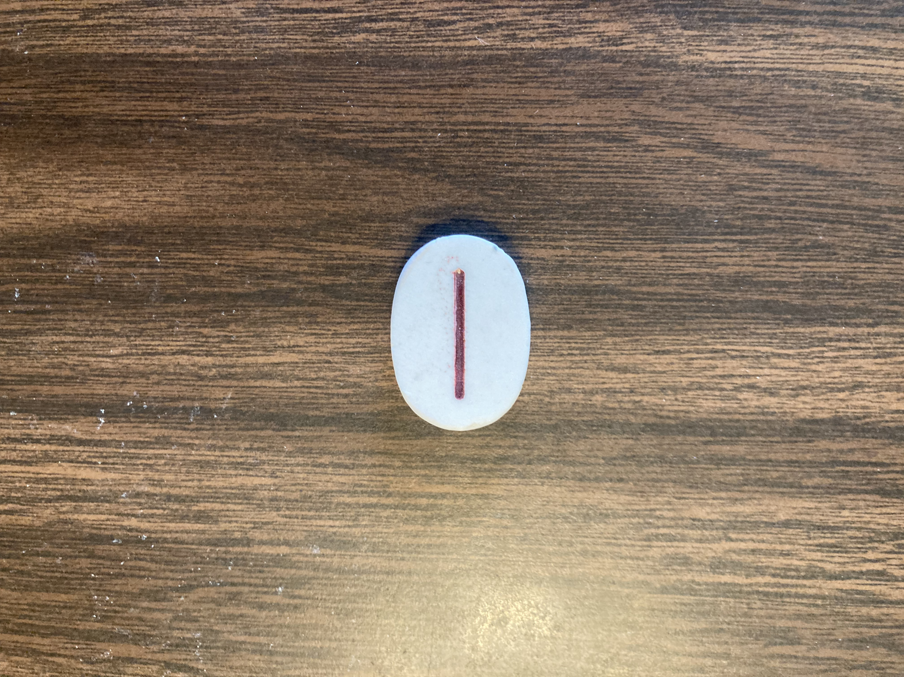

Slide 6


Slide 7

Notes:
I use the runes because they work. What I don’t necessarily understand is how they work.
Tarot = psychological and artistic richness conveyed by content in the images, history of the cards, etc. Runes = ???
I love tarot but my main tool is the runes, probably because I’m a writer and they’re a writing system. (Also they’re simpler.)
Got me thinking about divination tools and magical practices that use writing systems. When you’ve got all these other divination systems, why add writing to the mix? Is there a functional connection between magic, divination, and writing? That’s what we’ll investigate today. I’m going to start by discussing four examples of divinatory or magical tools that use writing systems as writing systems.

Slide 8
Notes:
1. Elder futhark was the alphabet of the Germanic peoples of NW Europe, 100-700 AD; other rune sets were used later, until the Latin alphabet took precedence
Mythical origins of the runes described in the Havamal, poem in the Codex Regius, a collection of Old Norse poems from the Viking age, ca. 900-1000 A.D. Havamal stanzas 139-140 tell how Odin obtained the runes:
I know that I hung on a windy tree
nine long nights,
wounded with a spear, dedicated to Odin,
myself to myself,
on that tree of which no man knows from where its roots run.
No bread did they give me nor a drink from a horn,
downwards I peered;
I took up the runes,
screaming I took them,
then I fell back from there.
Roman historian Tacitus in his work Germania in 98 AD mentions the Germans using pieces of wood marked by nota, “mark, sign, letter, word, writing”: “They pay as much attention as anyone else does to divination and lots. The method of drawing lots is uniform. A bough is cut from a nut-bearing tree and divided into slips. These are distinguished by certain signs and spread casually and at random over white cloth. Afterwards, if the inquiry be official, the community priest or, if private, the father of the family in person, after prayers to the gods and with eyes turned to heaven, takes up one slip at a time till he has done this on three separate occasions. After taking the three, he interprets them according to the signs which have been already stamped on them.”

Slide 9
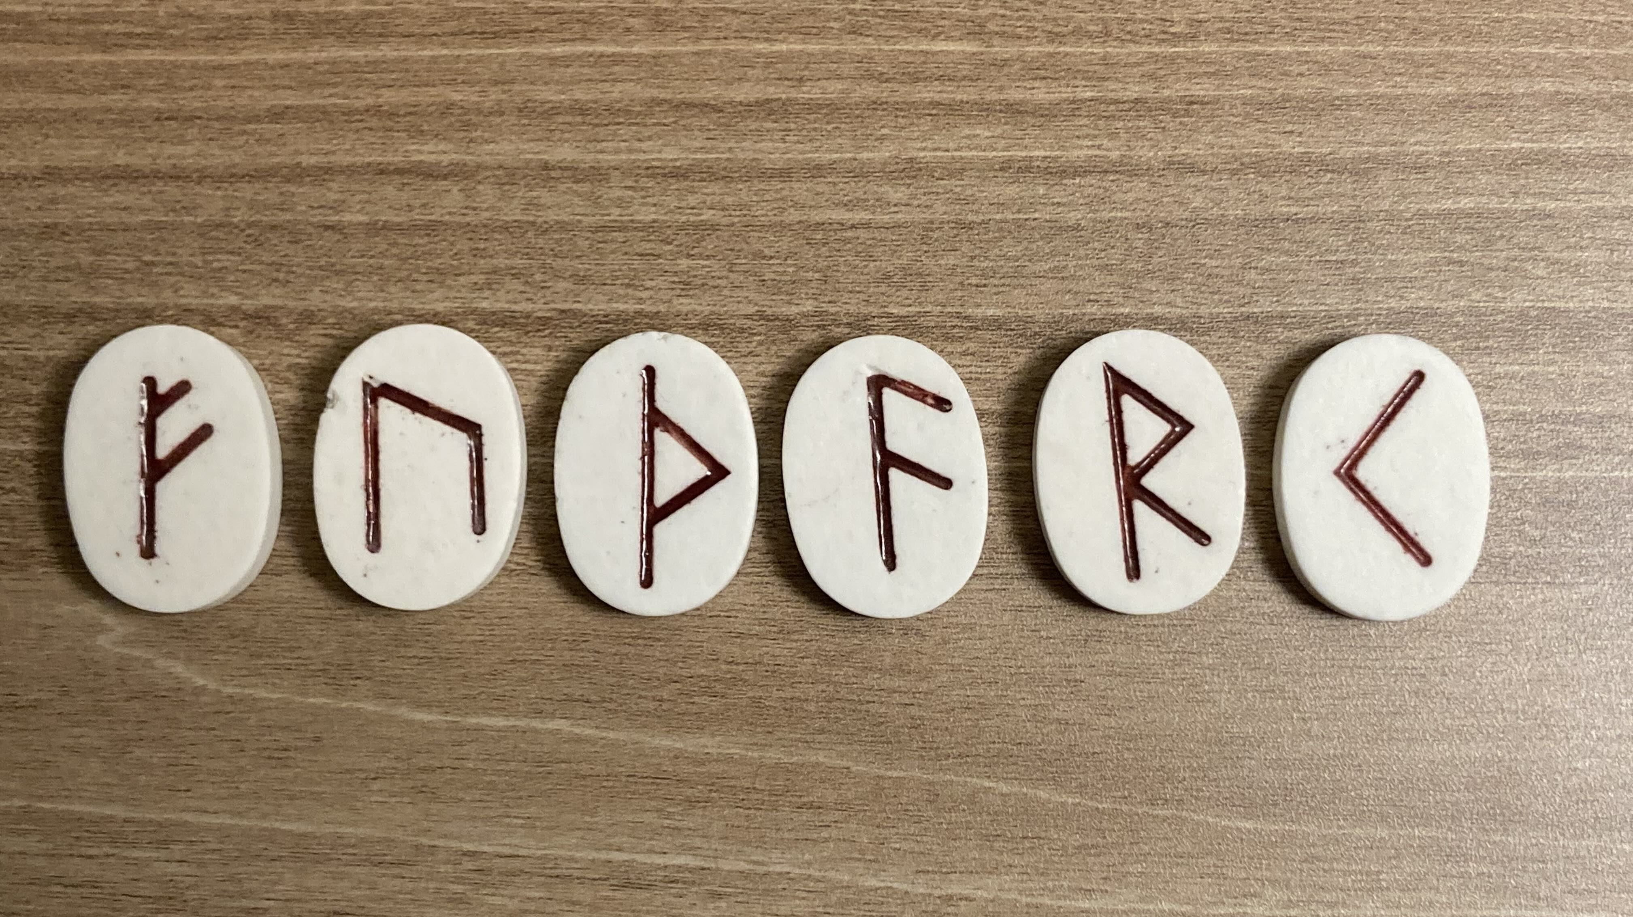

Slide 10
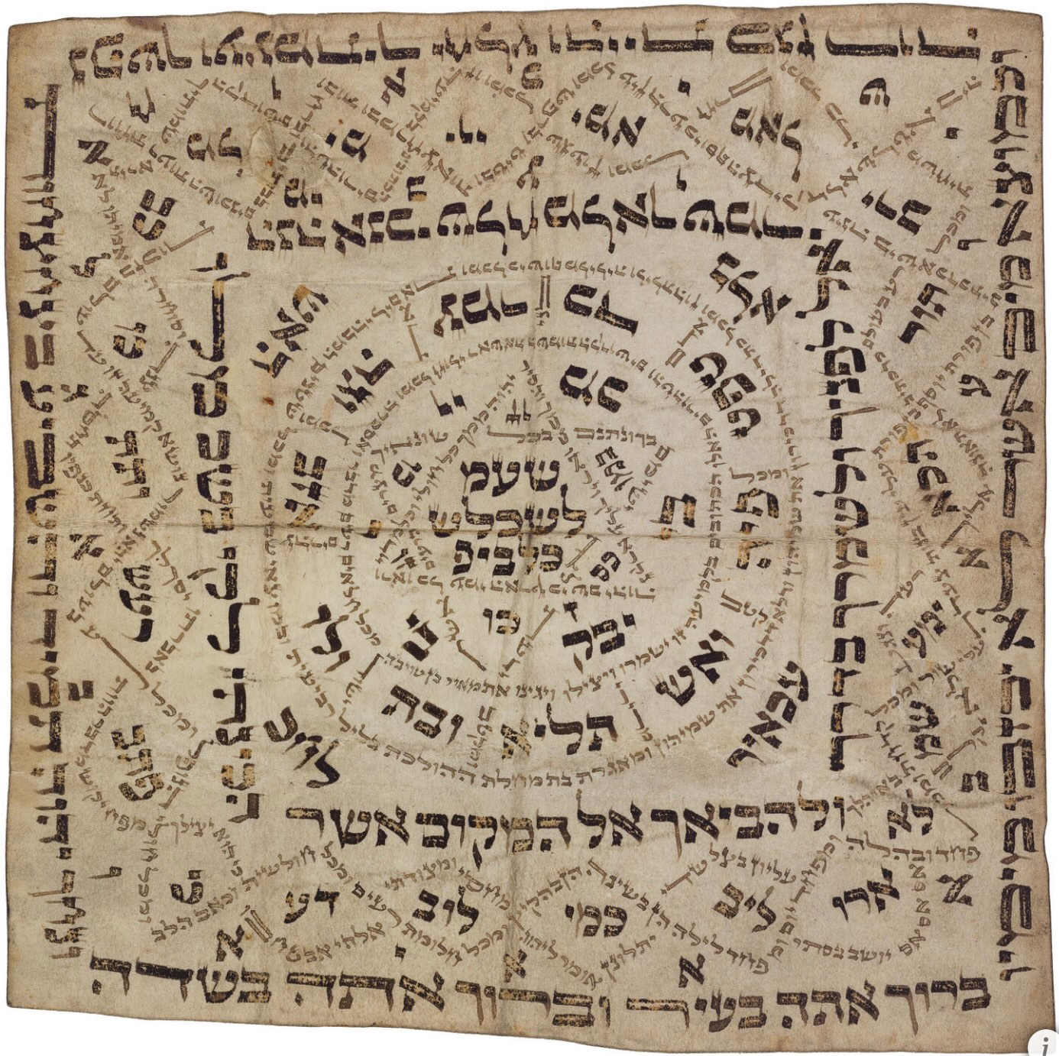
Kabbalistic Paper Amulets
Paper printed with Biblical quotations, prayers, blessings, or names of angels relevant to their specific purpose, such as protection in childbirth, protection against the evil eye, etc.
Meant to be worn or carried on the person
Part of the “practical Kabbalah” tradition, a form of Jewish mysticism
Use began during the Talmudic period, beginning after destruction of the second temple in Jerusalem in 70 AD
  Printed amulet (Germany), artist unknown, ca. 1750. Posen Library of Jewish Culture and Civilization.
Notes:
2. Kabbalistic paper amulets.
Tell about novel research leading to this
Amulets were inscribed with Biblical quotations, prayers, blessings, or names of angels relevant to their specific purpose, such as protection in childbirth, protection against the evil eye, etc. Permutations and combinations of the letters of the different names of God were frequently used. The efficacy of the amulet depended not only on the inscription but also on the person who wrote it; the more pious the author the more effective was the amulet.
They are meant to be bound or hung on the person.
Use began during the Talmudic period, beginning after the destruction of the second temple in Jerusalem in 70 AD, marking a shift from so-called Temple Judaism to Rabbinic Judaism -- the production and compilation of the texts that became the Talmud, one of the central texts of Judaism. Amulets are frequently mentioned in Talmudic literature.

Slide 11
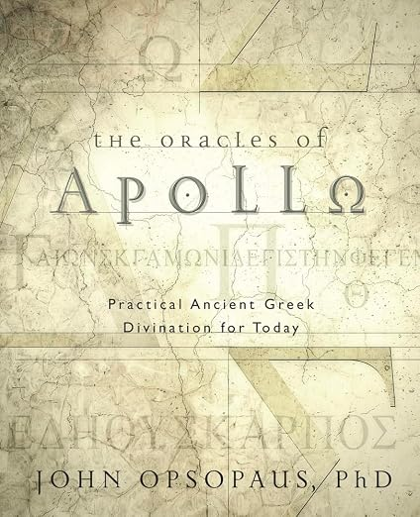
Greek Alphabet Oracle
Discovered in a stone inscription in modern-day Turkey in 1842; dated to second or third century CE
Consult the oracle by drawing from a set of 24 stones, each inscribed with a letter
Each letter has a corresponding oracular statement; the first word of the statement begins with that letter
“The God [Apollo] says you will do everything successfully.” Or: “Flee the very great storm, lest you be disabled in some way.”
Can also use dice or astragaloi
  Learn more at: opsopaus.com/OM/BA/GAO.html#keywords
Notes:
3. Ancient Greek alphabet oracle. Learned about this from John Opsopaus, one of our presenters this year, who presented on this topic at Mystic South 2023. This is the cover of his book.
Tell about novel research leading to this via following TAPA on FB, then seeing their Mystic South post, then asking the runes about submitting a proposal, then submitting and presenting, and attending the John Opsopaus talk
Greek alphabet oracle discovered in the form of an inscription in stone in ancient Lycia (modern-day Turkey) in 1842; first complete and accurate copy published in 1888
A dozen inscriptions presenting this oracle discovered in Turkey and Cyprus, all essentially the same; dating to second or third century CE
You draw from a bag of 24 potsherds, each one inscribed with a letter of the Greek alphabet. Each letter has a corresponding oracular statement, and the first word of the statement (in Greek) begins with that letter.
“The God [Apollo] says you will do everything successfully.” Or: “Flee the very great storm, lest you be disabled in some way.”
You could also roll dice or astragaloi, singular astragalus, inaccurately called “knucklebones”; the pastern bones, the lower leg bones of large animals, between the fetlock and the hoof. Each side of the bone is given a numerical value, and you roll them according to a set procedure until you get a number between 1 and 24, which gives you your Greek letter that corresponds to an oracular statement.
Kind of like a combination of the I Ching and the runes

Slide 12
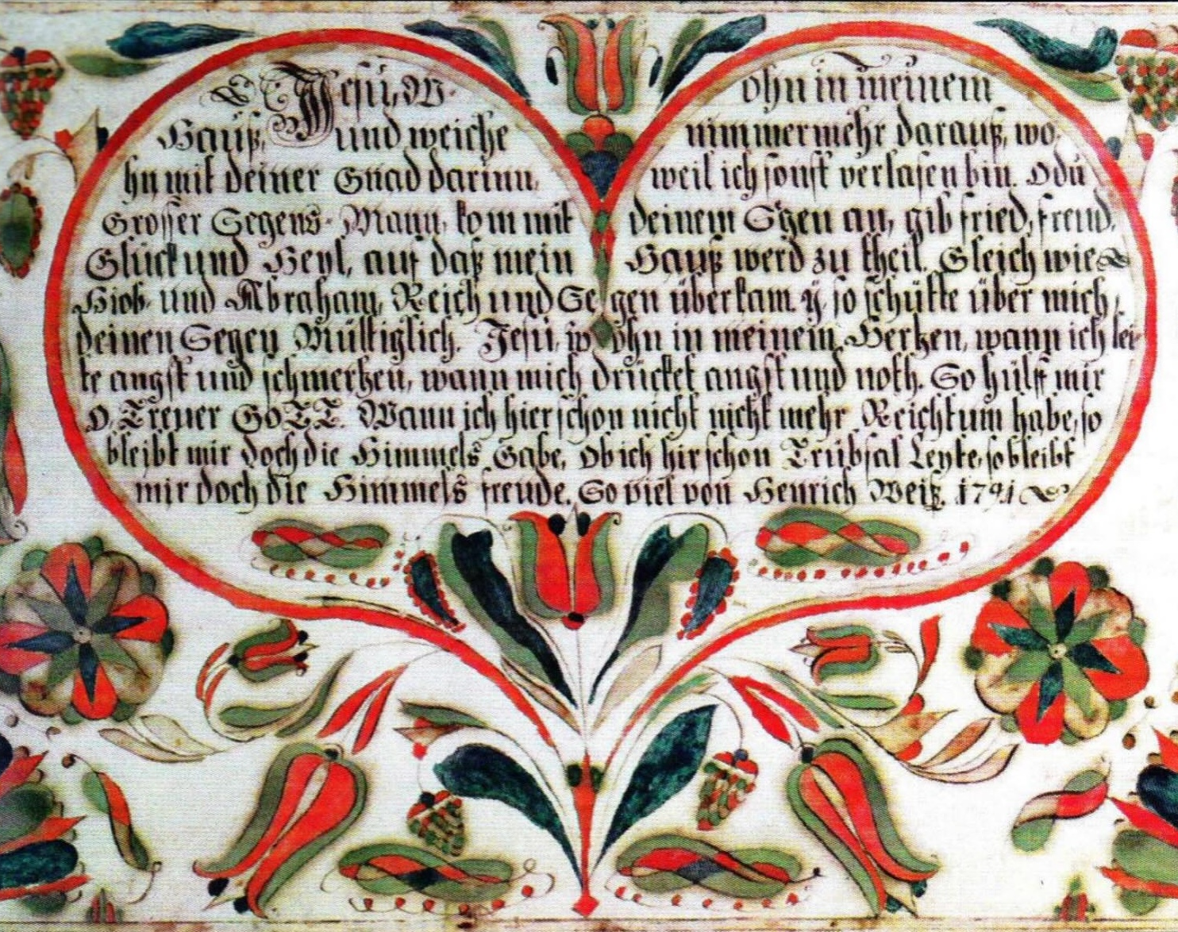
Himmelbrief (Heavenly Letter)
A written charm circulated in Western Europe since the fourth century AD
Based on a letter that Jesus Christ supposedly sent to King Abgar V of Edessa, to protect the king
Heavenly letters need to be worn or carried on the body
German immigrants brought this tradition to Pennsylvania with them in the 18th century
“Hexenmeisters” wrote them for homeowners and soldiers
  Photo credit: Haus-segen (house blessing), 1791, hand-drawn and lettered by Heinrich Weiss, Schwenkfelder Library and Heritage Center Collection. Powwowing in Pennsylvania, p. 37.
Notes:
4. Himmelbrief, or "heavenly letter"
No idea how this happened, but my purchase history shows that in 2010 I bought the e-book version of Hex and Spellwork, about folk magic practices in the Pennsylvania Dutch country (“Dutch” is an Americanization of Deutsch, referring to German immigrants)
The Heavenly Letter originally a written charm that circulated in Western Europe from the fourth century onwards. It was especially popular in the late Middle Ages. Standard text states that the recipient or bearer of the letter is under God’s protection from all kinds of misfortunes.
Ultimately derives from an apocryphal letter supposedly sent by Jesus Christ to King Abgar V of Edessa, an Arab Christian king who wrote Jesus a letter and Jesus supposedly wrote back. Jesus’s letter said it protected the king against medical and political problems. Any heavenly letter was supposed to have been physically transported from heaven to earth, often by an angel. The physical letter itself has the power to protect or heal the user of the charm. Most heavenly letters state that they need to be worn on the body.
A lot of these circulated throughout Europe in the Middle Ages and the tradition made its way to North America with German immigrants to Pennsylvania, the Pennsylvania Dutch.
Pennsylvania Dutch folk magic tradition is called Powwow (Narragansett powwaw or Massachusett pauwau), which is believed to be an Americanization of Braucherei. Hexenmeisters would write heavenly letters of protection or himmelbriefs that soldiers would carry with them into battle in WWI and WWII.
Mention phylactery from John Opsopaus’s talk today; in the Egyptian Magical Papyri, instructions for inscribing a piece of paper with a sequence of letters and symbols in a certain arrangement that will protect the bearer against many types of misfortune. The letters are the seven Greek vowels, each of which has a correspondence with one of the seven planets of astrology.
SUMMATION: These all have the integral use of writing in common, as opposed to forms of magic that don’t, like herbal charms or verbal charms, or forms of divination that don’t, like scapulomancy or lithomancy. So what’s so special about writing? Why use letters?

Slide 13
Where Writing Meets Magic in the Dictionary:
The Etymology of “Grammar”
Notes:
Humans have long suspected there is a fundamental interpenetration between magic and writing—that writing and magic participate with each other at a fundamental level—as revealed by the etymology of the word “grammar.”
Greek grammatike means “art of letters”
Latin grammatica means “grammar”
Old French grammaire means BOTH “Latin grammar” AND “magic spells, incantations” ca. 12th century
Became French grimoire, “book of sorcery”
Became English “gramary” ca. early 14th cent. meaning “grammar,” also “learning in general” which included “magic,” which begat the Scottish variant “glamor,” enchantment
Late 14th cent., the modern word “grammar” appears
A similar evolution took place from German giving us the two meanings of “spell,” literary and magical
From ancient Greece to the present day, writing and magic have been traveling together, intertwined.

Slide 14
Where Writing Meets Magic in the Dictionary:
The Etymology of “Grammar”
Ancient Greek grammatike, “art of letters”
Notes:
Humans have long suspected there is a fundamental interpenetration between magic and writing—that writing and magic participate with each other at a fundamental level—as revealed by the etymology of the word “grammar.”
Greek grammatike means “art of letters”
Latin grammatica means “grammar”
Old French grammaire means BOTH “Latin grammar” AND “magic spells, incantations” ca. 12th century
Became French grimoire, “book of sorcery”
Became English “gramary” ca. early 14th cent. meaning “grammar,” also “learning in general” which included “magic,” which begat the Scottish variant “glamor,” enchantment
Late 14th cent., the modern word “grammar” appears
A similar evolution took place from German giving us the two meanings of “spell,” literary and magical
From ancient Greece to the present day, writing and magic have been traveling together, intertwined.

Slide 15
Where Writing Meets Magic in the Dictionary:
The Etymology of “Grammar”
Ancient Greek grammatike, “art of letters”
Greek grammatike > Latin grammatica, “grammar”
Notes:
Humans have long suspected there is a fundamental interpenetration between magic and writing—that writing and magic participate with each other at a fundamental level—as revealed by the etymology of the word “grammar.”
Greek grammatike means “art of letters”
Latin grammatica means “grammar”
Old French grammaire means BOTH “Latin grammar” AND “magic spells, incantations” ca. 12th century
Became French grimoire, “book of sorcery”
Became English “gramary” ca. early 14th cent. meaning “grammar,” also “learning in general” which included “magic,” which begat the Scottish variant “glamor,” enchantment
Late 14th cent., the modern word “grammar” appears
A similar evolution took place from German giving us the two meanings of “spell,” literary and magical
From ancient Greece to the present day, writing and magic have been traveling together, intertwined.

Slide 16
Where Writing Meets Magic in the Dictionary:
The Etymology of “Grammar”
Ancient Greek grammatike, “art of letters”
Greek grammatike > Latin grammatica, “grammar”
Latin grammatica > Old French grammaire:
1. Latin grammar
2. magic spells, incantations
Notes:
Humans have long suspected there is a fundamental interpenetration between magic and writing—that writing and magic participate with each other at a fundamental level—as revealed by the etymology of the word “grammar.”
Greek grammatike means “art of letters”
Latin grammatica means “grammar”
Old French grammaire means BOTH “Latin grammar” AND “magic spells, incantations” ca. 12th century
Became French grimoire, “book of sorcery”
Became English “gramary” ca. early 14th cent. meaning “grammar,” also “learning in general” which included “magic,” which begat the Scottish variant “glamor,” enchantment
Late 14th cent., the modern word “grammar” appears
A similar evolution took place from German giving us the two meanings of “spell,” literary and magical
From ancient Greece to the present day, writing and magic have been traveling together, intertwined.

Slide 17
Where Writing Meets Magic in the Dictionary:
The Etymology of “Grammar”
Ancient Greek grammatike, “art of letters”
Greek grammatike > Latin grammatica, “grammar”
Latin grammatica > Old French grammaire:
1. Latin grammar
2. magic spells, incantations
Old French grammaire > French grimoire, “book of sorcery”
Notes:
Humans have long suspected there is a fundamental interpenetration between magic and writing—that writing and magic participate with each other at a fundamental level—as revealed by the etymology of the word “grammar.”
Greek grammatike means “art of letters”
Latin grammatica means “grammar”
Old French grammaire means BOTH “Latin grammar” AND “magic spells, incantations” ca. 12th century
Became French grimoire, “book of sorcery”
Became English “gramary” ca. early 14th cent. meaning “grammar,” also “learning in general” which included “magic,” which begat the Scottish variant “glamor,” enchantment
Late 14th cent., the modern word “grammar” appears
A similar evolution took place from German giving us the two meanings of “spell,” literary and magical
From ancient Greece to the present day, writing and magic have been traveling together, intertwined.

Slide 18
Where Writing Meets Magic in the Dictionary:
The Etymology of “Grammar”
Ancient Greek grammatike, “art of letters”
Greek grammatike > Latin grammatica, “grammar”
Latin grammatica > Old French grammaire:
1. Latin grammar
2. magic spells, incantations
Old French grammaire > French grimoire, “book of sorcery”
French grimoire > English gramary, meaning “grammar” and “learning in general,” which included “magic”; this sense of gramary > the Scottish variant glamor, “enchantment”
Notes:
Humans have long suspected there is a fundamental interpenetration between magic and writing—that writing and magic participate with each other at a fundamental level—as revealed by the etymology of the word “grammar.”
Greek grammatike means “art of letters”
Latin grammatica means “grammar”
Old French grammaire means BOTH “Latin grammar” AND “magic spells, incantations” ca. 12th century
Became French grimoire, “book of sorcery”
Became English “gramary” ca. early 14th cent. meaning “grammar,” also “learning in general” which included “magic,” which begat the Scottish variant “glamor,” enchantment
Late 14th cent., the modern word “grammar” appears
A similar evolution took place from German giving us the two meanings of “spell,” literary and magical
From ancient Greece to the present day, writing and magic have been traveling together, intertwined.

Slide 19
Where Writing Meets Magic in the Dictionary:
The Etymology of “Grammar”
Ancient Greek grammatike, “art of letters”
Greek grammatike > Latin grammatica, “grammar”
Latin grammatica > Old French grammaire:
1. Latin grammar
2. magic spells, incantations
Old French grammaire > French grimoire, “book of sorcery”
French grimoire > English gramary, meaning “grammar” and “learning in general,” which included “magic”; this sense of gramary > the Scottish variant glamor, “enchantment”
Gramary > grammar, late 14th century
Notes:
Humans have long suspected there is a fundamental interpenetration between magic and writing—that writing and magic participate with each other at a fundamental level—as revealed by the etymology of the word “grammar.”
Greek grammatike means “art of letters”
Latin grammatica means “grammar”
Old French grammaire means BOTH “Latin grammar” AND “magic spells, incantations” ca. 12th century
Became French grimoire, “book of sorcery”
Became English “gramary” ca. early 14th cent. meaning “grammar,” also “learning in general” which included “magic,” which begat the Scottish variant “glamor,” enchantment
Late 14th cent., the modern word “grammar” appears
A similar evolution took place from German giving us the two meanings of “spell,” literary and magical
From ancient Greece to the present day, writing and magic have been traveling together, intertwined.

Slide 20
Where Writing Meets Magic in the Dictionary:
The Etymology of “Grammar”
Ancient Greek grammatike, “art of letters”
Greek grammatike > Latin grammatica, “grammar”
Latin grammatica > Old French grammaire:
1. Latin grammar
2. magic spells, incantations
Old French grammaire > French grimoire,
“book of sorcery”
French grimoire > English gramary, meaning “grammar” and “learning in general,” which included “magic”; this sense of gramary > the Scottish variant glamor, “enchantment”
Gramary > grammar, late 14th century
A similar evolution took place in German, giving us the two meanings of spell—linguistic and magical
Notes:
Humans have long suspected there is a fundamental interpenetration between magic and writing—that writing and magic participate with each other at a fundamental level—as revealed by the etymology of the word “grammar.”
Greek grammatike means “art of letters”
Latin grammatica means “grammar”
Old French grammaire means BOTH “Latin grammar” AND “magic spells, incantations” ca. 12th century
Became French grimoire, “book of sorcery”
Became English “gramary” ca. early 14th cent. meaning “grammar,” also “learning in general” which included “magic,” which begat the Scottish variant “glamor,” enchantment
Late 14th cent., the modern word “grammar” appears
A similar evolution took place in German giving us the two meanings of “spell,” literary and magical
From ancient Greece to the present day, writing and magic have been traveling together, intertwined throughout history.

Slide 21
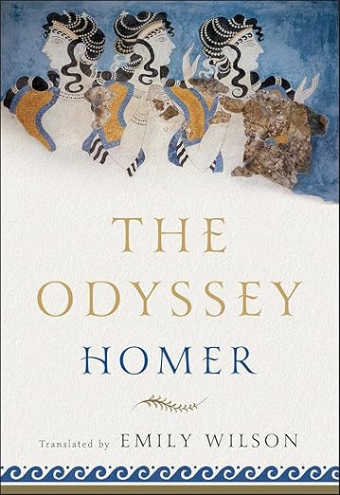
Notes:
Before writing, people were speaking language. Anatomically modern humans appeared about 300,000 years ago, and based on genetic data it’s believed we had spoken language for at least 200,000 years.
In some of the earliest narratives we have, we believe we have evidence of what oral narrative was like, because the earliest written narratives were likely transcriptions of narratives that were orally composed. A good example of this is the Homeric poems, like the Odyssey, which were composed to be memorable so bards could perform them from memory: rhythm, rhyme, either lots of speeches or lots of big actions, standardized turns of phrase, all of which allowed for extemporaneous variation so the poet could keep the narrative going without having to memorize it all.
This speech of memorialization is concerned with happenings, doings, behaviors, actions, graphic images of concrete situations, not with abstract ideas. Primary oral thinking is imagistic thinking because it uses concrete images to convey information. This means that as far as we can tell, the spoken language of pre-literate cultures did not facilitate the development of abstract thinking.

Slide 22
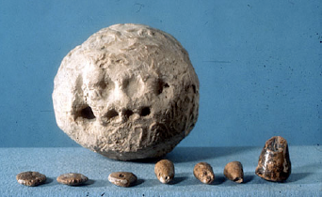
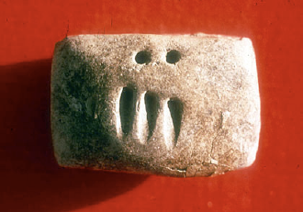
The Invention of Writing:
A Process of Abstraction
  Envelope, tokens and corresponding markings, from Susa, Iran (Courtesy Musée du Louvre, Département des Antiquités Orientales)
  Impressed tablet featuring an account of grain, from Godin Tepe, Iran (Courtesy Dr. T. Cuyler Young, Royal Ontario Museum, Toronto)
Notes:
So people just lived in this imagistic, immediate world until writing was invented. And as we’ll see, the process of inventing writing was a process of greater and greater conceptual abstraction. Writing was invented in AT LEAST three places and times: Mesopotamia 3200 BCE, China 1250 BCE, Mesoamerica 650 BCE. The Mesopotamian variant, which we call cuneiform, is the writing system with the earliest origins known to us, and it has survived unbroken down to the present day. Cuneiform started out as a way to do accounting of items stored in warehouses. Clay tokens for counting ca. 8000 BC. The marks became numbers. More and more abstract.

Slide 23
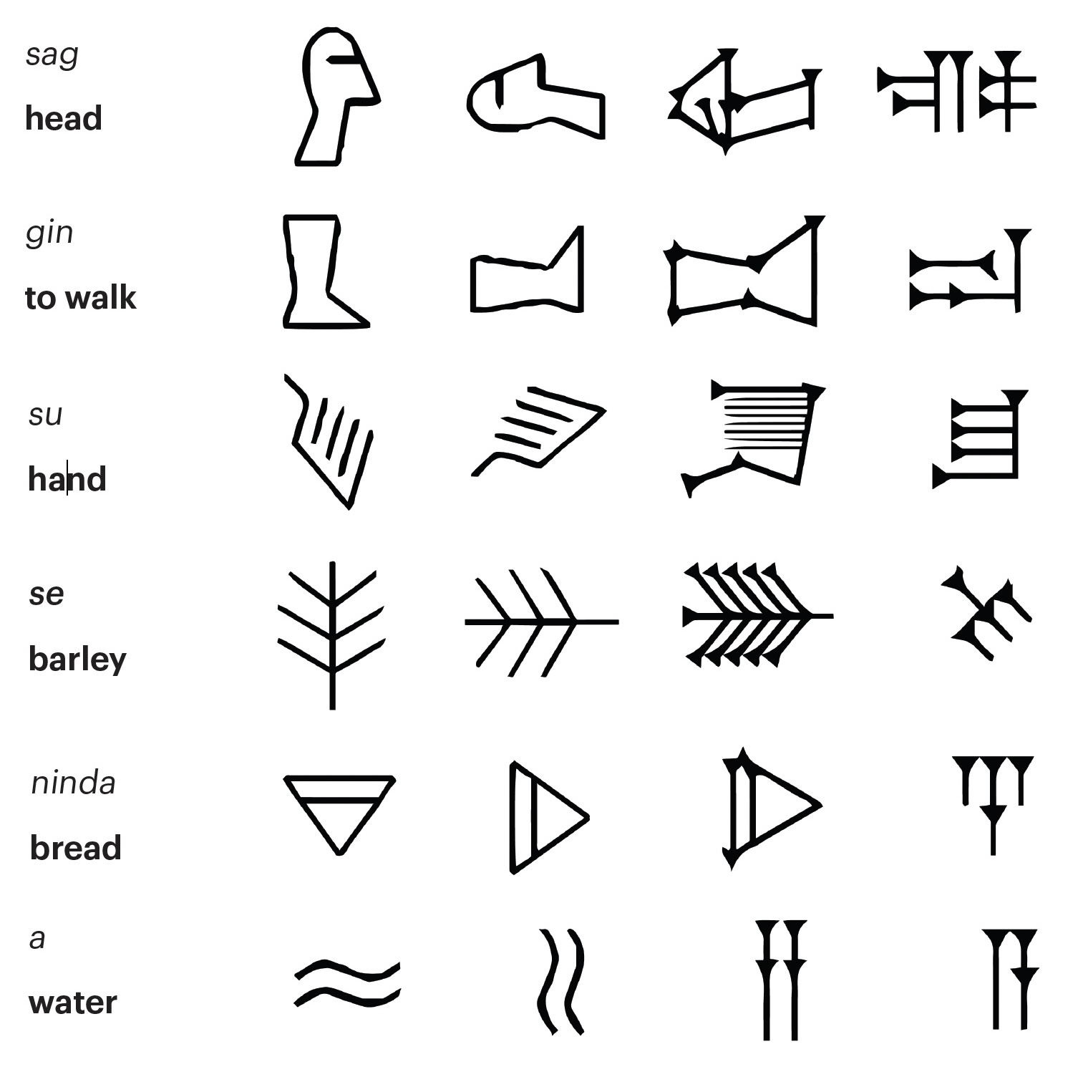
The Invention of Writing:
A Process of Abstraction
  Source: “Evolution of Pictographs into Cuneiform,” Getty Museum
Notes:
Impressions on clay for numbers turned into pictographic signs, of the things being counted, and then of other things, i.e., a drawing of a head, a drawing of a foot, drawing of a jar, ca. 3100 BC. Then around 3000 BC the pictographs began to be approximated in the form of true cuneiform symbols that were logographic, i.e., representing entire words, with each word understood as the spoken word. Using writing as phonetic signs that represented sounds rather than objects. This is what allowed writing to move away from accounting and to become much more versatile in terms of what it could be used for. Greater abstraction. According to Russian psychologist Lev Vygotsky, the act of putting spoken words and unspoken thoughts into written words releases and, in the process, changes the thoughts themselves. As humans learned to use written language more and more precisely to convey their thoughts, their capacity for abstract thought and novel ideas accelerated.

Slide 24
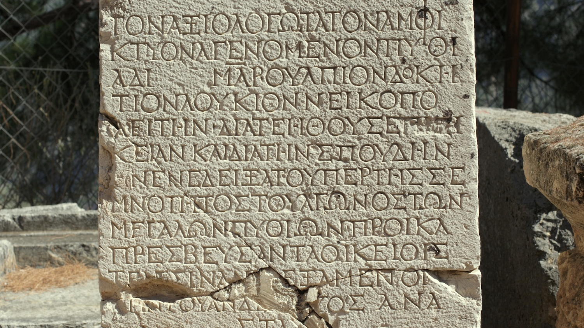
Notes:
Next leap forward was development of the alphabet. Per Maryanne Wolf, the alphabet was invented as the end result of three epiphanies:
1. Symbolic representation (one level of abstraction more than drawings): You can create symbols that represent concrete objects as well as abstract concepts.
2. Durational representation: symbols can be used to communicate across space and time because they endure beyond the instance of utterance. This makes preservation and transmission of information far easier.
3. Sound-to-symbol representation: The most linguistically abstract epiphany, which did not happen everywhere, was sound-symbol correspondence, “the stunning realization that all words are actually composed of tiny individual sounds and that symbols can physically signify each of these sounds for every word.” The innovation of the Greeks.
The first alphabet was invented by a Semitic people or peoples around the year 1500 BC. This one didn’t have symbols for vowel sounds; only consonants. We didn’t get vowels, we couldn’t buy a vowel, until between 800 and 750 BCE when the Greeks designed their alphabet—the first alphabet complete with vowels, which could represent every sound in every word in the language. Classicists believe this total transformation of the word from sound to sight gave ancient Greek culture the intellectual tools that enabled it to undergo such a dramatic flourishing in philosophy and the arts. Here are the reasons why:
People in an oral culture, like preliterate Greece, could not see or hear or taste categories, classes, relationships, principles, or axioms. Greater abstraction facilitated analysis and more elaborate reasoning.
Formal logic—the foundation of scientific reasoning—is the invention of Greek culture after it had interiorized the technology of alphabetic writing.
The ability to analyze the self fosters greater self-awareness and personal development.
Wolf: “Within such a broadened context, there can be no surprise that one of the most profound and prolific periods of writing, art, philosophy, theater, and science in all of previously recorded history accompanied the spread of the Greek alphabet.”

Slide 25
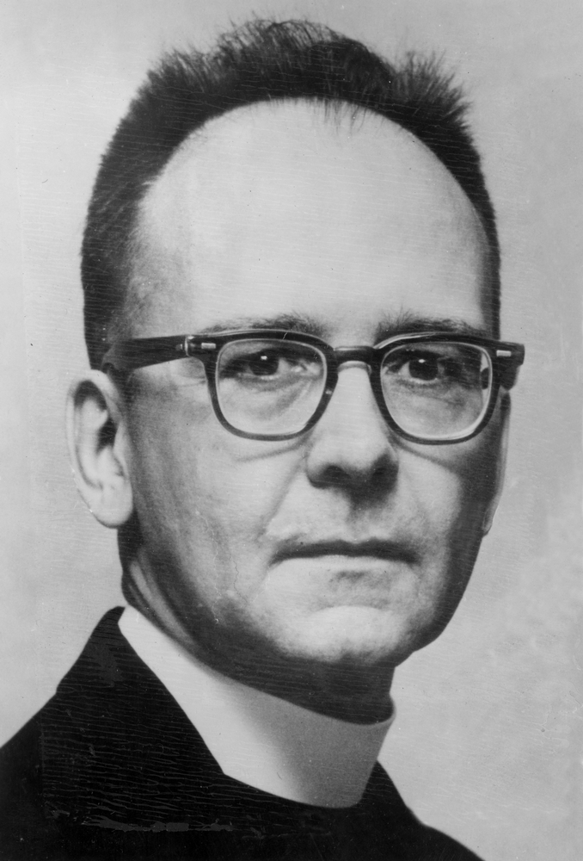
“More than any other single invention, writing has transformed human consciousness.”
—Walter Ong, Orality and Literacy (1982)
  Photo credit: University of Chicago Photographic Archive
Notes:
Walter Ong was an American Jesuit priest, professor of English literature, cultural and religious historian, and philosopher. His major interest was in exploring how the transition from orality to literacy influenced culture and changed human consciousness. In 1978 he served as elected president of the Modern Language Association. Orality and Literacy is about how human cultures made the transition from an oral culture that did not have writing to a literate culture that did.

Slide 26
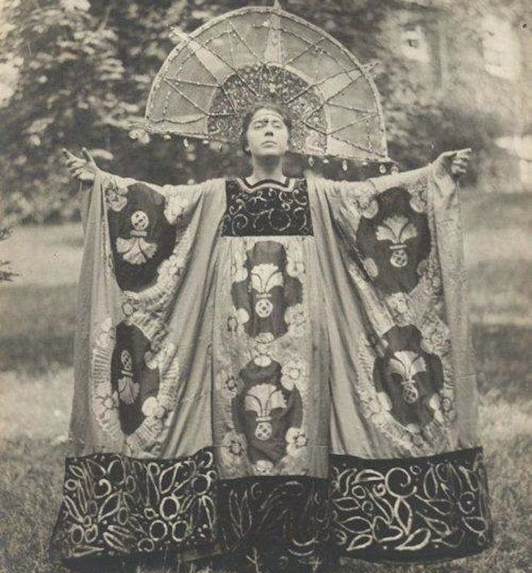
“More than any other single invention, writing has transformed human consciousness.”
—Walter Ong, Orality and Literacy (1982)
“Magic is the art of causing changes in consciousness to occur in accordance with the will.”
—Dion Fortune, “The Rationale of Magic” (1934)
  Photo credit: University of Chicago Photographic Archive
  Photo credit: Theosophy Wiki
Notes:
Dion Fortune was a British occultist, ceremonial magician, and writer. In her 1934 essay “The Rationale of Magic” Fortune says “Aleister Crowley has defined magic as the art of causing changes to occur in accordance with will. This is a perfectly correct definition only it is too comprehensive.” Fortune proposes her definition of magic as “the art of causing changes to take place in consciousness in accordance with will.” She states that ceremonial magic works on the subconscious mind and on nothing else. That’s consonant with her stance as a practitioner of Western cereomonial magic.
My practice of magic goes beyond that; it starts with changes in consciousness in accordance with the will, but the change is consciousness is only a means to an end, and the end is some sort of change in the external world, beyond my consciousness.
Although really I should say beyond *just* my consciousness, because I believe my consciousness participates in the entire world, which is how changes in my consciousness *can* change things besides my consciousness. But regardless of how you define magic, I think it’s clear that any form of magic worthy of the name involves a change in consciousness, and that’s why writing is so useful in magic and divination: because it has a transformative effect on consciousness.

Slide 27
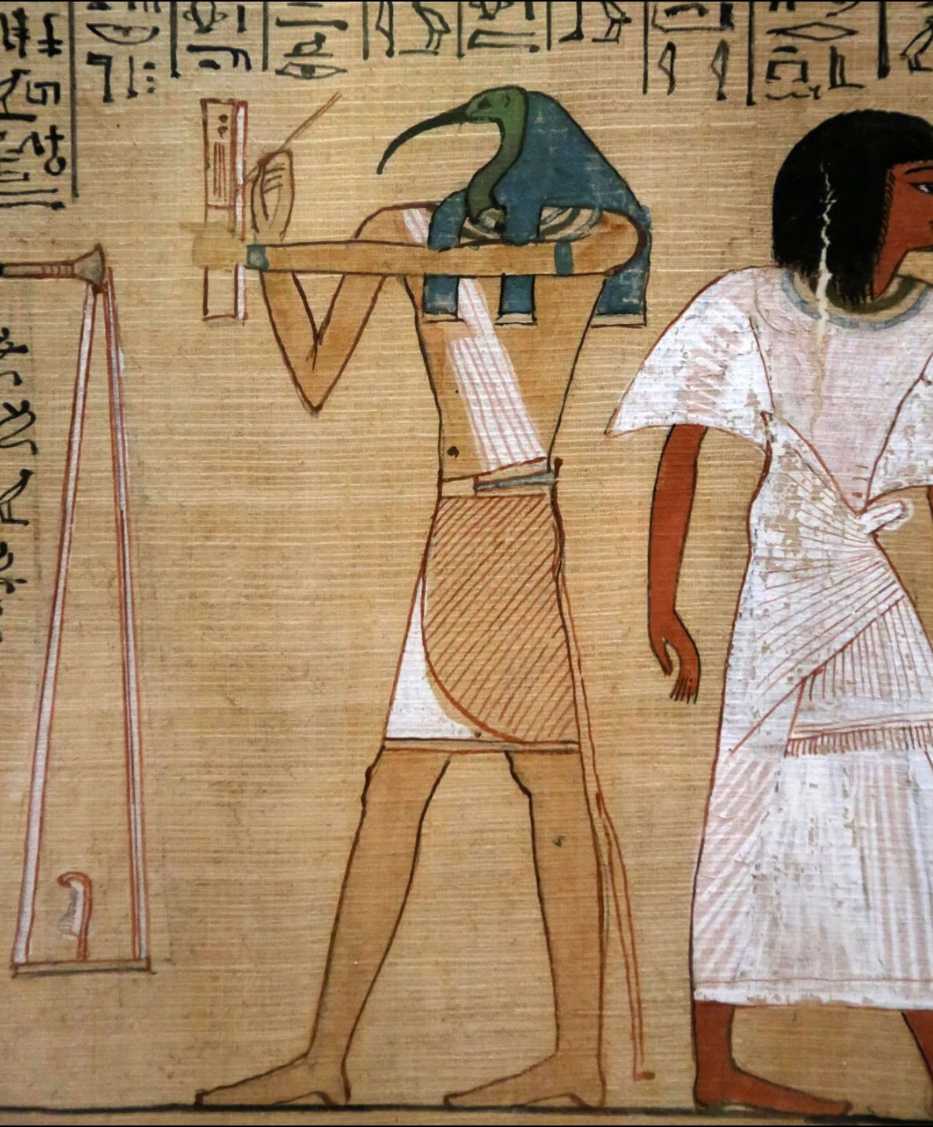
Thoth: Divine Scribe
Created writing as a memory aid
Egyptians called writing medu netjer, “words of the gods”; this is what we refer to as hieroglyphics, after Greek hieros “holy” and glyphein “to carve”
Patron deity of scribes
Scribes worked in the House of Life: school, library, and workplace, attached to a temple
House of Life is where texts that provide knowledge for passing into eternal paradise are written and kept
If Thoth approved a scribe’s writing, his consort, Seshat, would store it in her immortal library for eternity
  Photo credit: Book of the Dead, ca. 1275 BCE, papyrus, Thebes, Egypt (British Museum)
Notes:
Third and final example of writing as a divine gift is ancient Egyptian god Thoth.
Egypt has long been thought to be the repository of truly primeval wisdom. Even in ancient Greece, Plato and Socrates and Aristotle already repeated stories about legendary Egyptian wisdom. Plato’s dialogue Phaedrus includes a passage where Socrates tells his interlocutor, Phaedrus, the story of how Thoth created writing as a memory aid.
In the dialogue, an ancient king tells Thoth he hasn’t created an aid to memory; he’s a technology for reminding people of things, which will actually make memory weaker. Socrates was against writing for this very reason, which is probably the main reason why he never wrote anything. Everything we have of Socrates’s sayings is contained in dialogues written by Plato, his pupil.
Thoth, usually termed “god of wisdom” “divine scribe,” or “scribe of the gods,” created writing or, as the Egyptians called it, medu netjer, “the words of the gods” (this is what we refer to as hieroglyphics, after the Greek hieros “holy” and glyphos “to carve”).
Patron deity of scribes, who, at the beginning of their work day, would pour out one drop of ink in his honor. Scribes wrote with a pen made from a single reed.
They trained for their trade and then practiced it in a place called the House of Life. Combination school, library, and workplace, attached to a temple. Called House of Life because this is where the texts that provide knowledge for passing into eternal paradise are written and kept.

Slide 28
Thoth: God of Wisdom, Creation, and Magic
Thoth possessed 42 books containing
all wisdom
Bore the title “Author of Every Work on Every Branch of Knowledge, Both Human and Divine”
In some myths, Thoth is self-created at the beginning of time and, as an ibis, lays the cosmic egg that holds all of creation
Known as “great in heka,” “lord of heka,” Egyptian word for “magic”: a supernatural force that can repel demonic attack and prevent or heal physical sickness or injury
  Photo credit: Book of the Dead, ca. 1275 BCE, papyrus, Thebes, Egypt (British Museum)
Notes:
Thoth was said to possess 42 books containing all wisdom, and he was given the title the “Author of Every Work on Every Branch of Knowledge, Both Human and Divine.” This is why he is called the god of wisdom as well as the god of writing.
In some myths, Thoth is created by Ra; in others, Thoth is self-created at the beginning of time and, as an ibis, lays the cosmic egg which holds all of creation. Thus he is a creator deity as well.

Slide 29
Thoth: Psychopomp
Worship of Thoth began in Pre-Dynastic Period, 6000–3150 BCE
Thoth appears prominently in Egypt’s oldest religious texts, the Pyramid Texts, dated to 2350-2150 BCE
Thoth venerated through the Ptolemaic Period (323-30 BCE), the last dynastic era of Egyptian history
Thoth then synthesized with Greek god Hermes to become Hermes Trismegistus, purported author of the Hermetica
Hermes and Thoth were both psychopomps
Thoth alone survived classical Egyptian theology and entered Western philosophy
  Photo credit: Book of the Dead, ca. 1275 BCE, papyrus, Thebes, Egypt (British Museum)
Notes:
Thoth may be one of the oldest deities within the Egyptian pantheon. Worship of Thoth began in Lower Egypt most likely in the Pre-Dynastic Period (c. 6000-3150 BCE), which predates the invention of writing, ca. 2600-2800 BCE. Thoth already plays a prominent role in the oldest religious texts of Egypt, the Pyramid Texts, dated to 2350-2150 BCE, and continues to appear almost everywhere in Egypt up through the Ptolemaic Period (323-30 BCE), the last dynastic era of Egyptian history, marking Thoth's veneration as among the longest of the Egyptian gods or any deity from any civilization.
Thoth then became synthesized with the Greek god Hermes to become the syncretized Hermes Trismegistus, the thrice-great Hermes, who was the purported author of the works known collectively as the Hermetica, which formed the core of all of the philosophical tradition known as hermeticism.
The syncretization between Hermes and Thoth makes sense because they were both psychopomps: the pyramid texts have Thoth actually bearing the soul of the deceased into the underworld, and in Greek mythology Hermes would guide deceased souls into the afterlife.
Thus in a very important sense Thoth alone survived the decline and eventual oblivion of classical Egyptian theology and was smuggled, within Hermes Trismegistus, into the very heart of Western philosophy through Hermeticism.

Slide 30
Thoth: Prometheus with a Pen
Prometheus gave rise to human civilization by giving us fire; Thoth plays a similar role by giving us writing
Thoth straddles and orchestrates humanity’s transition from orality to literacy
Writing and reading defeat time and space, allowing consciousness to participate in the eternal realm of the gods
His gift transforms our consciousness, allowing us to use it for magic and divination
  Photo credit: Book of the Dead, ca. 1275 BCE, papyrus, Thebes, Egypt (British Museum)
Notes:
I call Thoth “Prometheus with a pen” because Prometheus is said to have given fire to the human race, which gave rise to the development of human civilization. Thoth plays the same role by creating writing and giving it to us.
Thoth straddles the transition of humanity from orality to literacy, and he is the one who ushers human consciousness across the threshold.
His gift transforms our consciousness in way that’s nothing short of magical, which is why writing is such an apt tool for magic and divination.
Writing and reading are ultimately ways to defeat time and space, and to allow our consciousness to participate in the eternal realm of the gods, where all spaces can be here and all times can be now.
From the ancient Egyptian Book of Thoth, composed between 1st c. BCE and 2nd c. CE: When “he-who-loves-knowledge” asks Thoth “What is writing?” Thoth replies, “Writing is a sea. Its reeds are a shore. Hasten therein, little one, little one!”

Slide 31
Brent Winter
winterbrent1@gmail.com
Photo credit: Book of the Dead, ca. 1275 BCE, papyrus, Thebes, Egypt (British Museum)

Slide 32
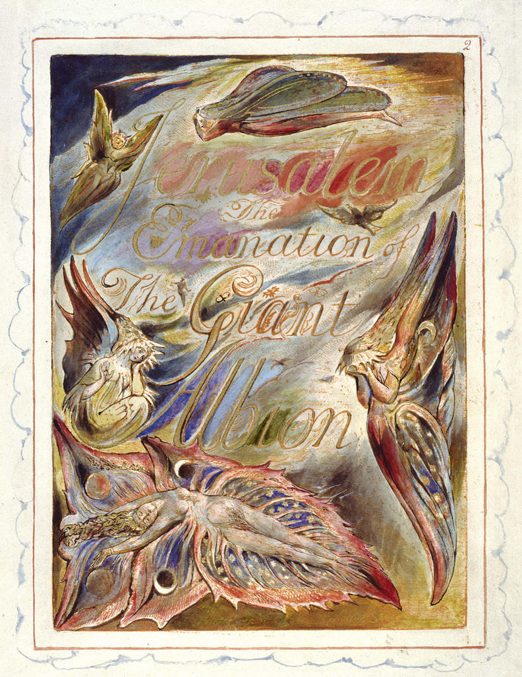
Jerusalem: Emanation of the Giant Albion
Reader! lover of books! lover of heaven
And of that God from whom all books are given
Who in mysterious Sinai’s awful cave
To Man the wondrous art of writing gave,
Again he speaks in thunder and in fire!
—William Blake
  Source: The William Blake Archive (blakearchive.org)
Notes:
Perhaps this is why writing has so often been seen as a divine tool or even a divine gift: For example, Odin gave us the runes as described in Havamal. And here is 17th-18th century British poet William Blake from his preface to his long poem Jerusalem: Emanation of the Giant Albion:
Reader! lover of books! lover of heaven
And of that God from whom all books are given
Who in mysterious Sinai’s awful cave
To Man the wondrous art of writing gave,
Again he speaks in thunder and in fire!

